Slide 1
SSE3 Hypertext concepts
Jens Bjarke Pedersen

Slide 2
Agenda
Pioneers and evolution
Hypermedia
Modern hypermedia technology
Structure domains
Architectural evolution
The project

Slide 3
Pioneers and history
Vannevar Bush – Memex
Hypertext as memory extender
Douglas C. Engelbart
Cooperative view: Hypertext as problem solver
NLS=Online system, traveling through working files
Theodor Holm Nelson
Communication view: Hypertext as linked text base
Text was never to be deleted
Adapted to WWW
Notes:
Made a machine that could make associations between information and navigate through these. This was inspired by how people were thinking
Engelbart thought hypertext as as a problem solver tool with the ability to scroll through files and find the solution
Nelson though of hypertext as linked text base which iss adpted to the WWW. Everything should be kept and versioned – no 404 missing page.

Slide 4
Hypermedia
What is hypertext/media
WWW
Documents
Links and anchors
Associate structures
Tendency to Navigational only
People structure knowledge in many ways
Spatial, classification, issue, annotation

Slide 5
Hypermedia
Modern Hypermedia technology
Multiple structuring mechanism in one system
Provided for one document
Provide structure in existing applications
If not possible the app wont be used
State of the art software technology
Open systems
Flexible architecture
Well defined interfaces
Development tools

Slide 6
Hypermedia
Separation of documents and structure unlike the WWW
Structure can be add to all types of documents and stored elsewhere
Allows for multiple structures
Associations
Classification
Argumentation support
Spatial organization
Metadata
Annotations

Slide 7
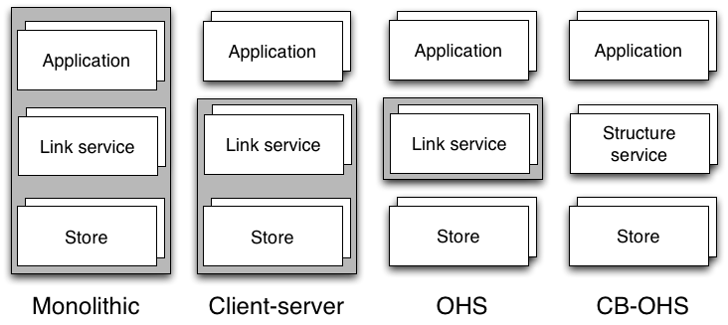
Architectural evolution

Slide 8
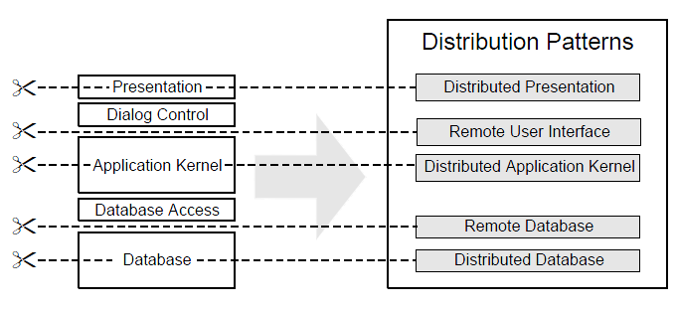
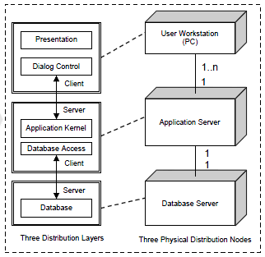
Architectural evolution
Client-Server system

Slide 9
Architectural evolution
Open hypermedia systems
OHS offer open link services
Link server system (LSS): provides hypertext structuring facilities to an open set of applications
Hyperbase management system (HBMS): like LSS, but also includes hypertext storages facilities

Slide 10
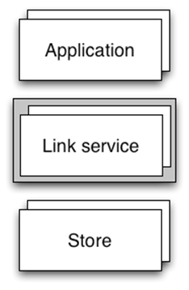
Architectural evolution
Advantages
Well-defined open interfaces
Open client layer: 3rd party applications are able to access the link service
Separate backend and middleware layer: different contexts can be implemented easily
Disadvantages
Increased system complexity
Standardized communication protocols?
Problems
Different hypermedia services
Different data models (e.g. different link types)
Different hypermedia architectures
Results
Applications can only use certain OHS
Hypermedia structure only useable for certain storage architectures
Hypermedia structures cannot be extended beyond the system (island problem)

Slide 11
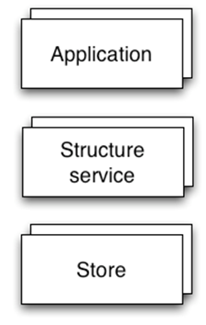
Architectural evolution
Component based OHS
Client layer
Client interface
Structure service layer
Structure service API
Backend API
Backend layer

Slide 12
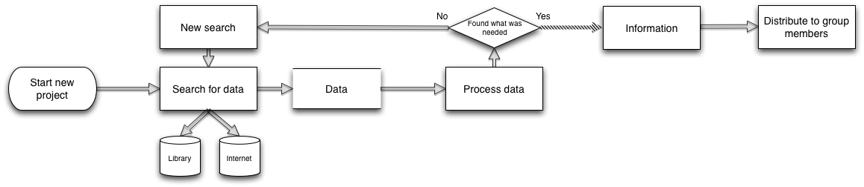
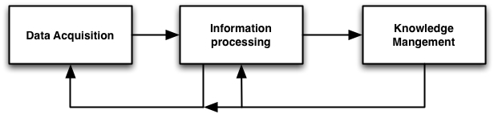
The project
Motivation:
Current work flow(Field study of ourselves)
Split into three phases
12

Slide 13
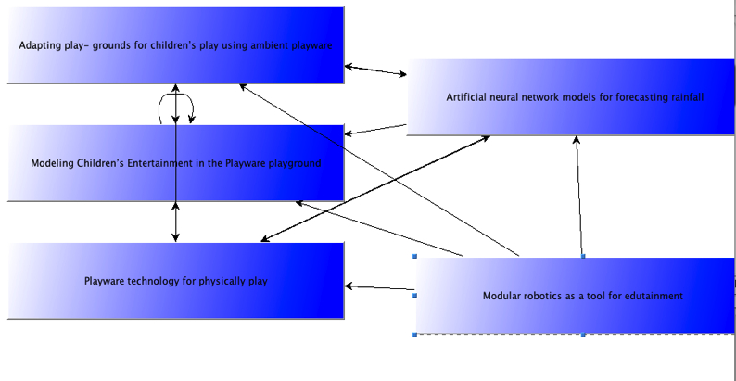
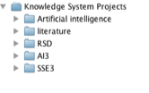
The project
Overview:
Knowledge management system
Reusing existing knowledge, Organize knowledge in projects, sharing knowledge

Slide 14
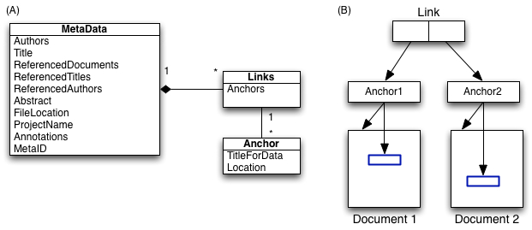
The project
Overview:
Hypertext concepts
Links, anchors, different structures of information

Slide 15
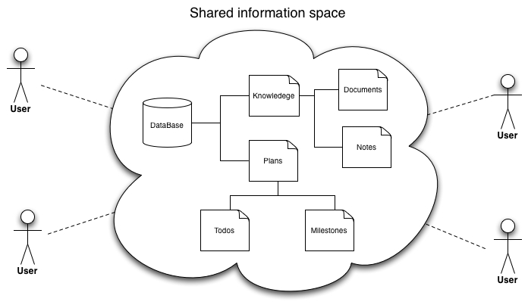
The project
Overview
Computer supported cooperative work
Planning, Shared information space, asynchronous cooperation on documents

Slide 16
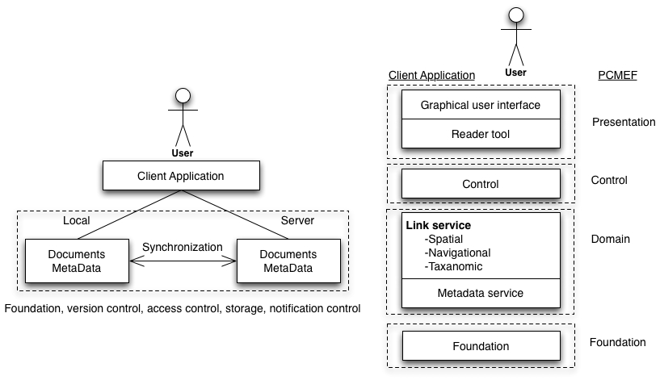
The project
Architecture
Notes:
Structual service burde være link service har skrevet forkert I rapporten

Slide 17
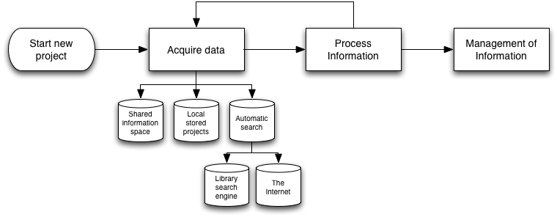
The project
New work flow With the use of the system

