Slide 1
Computer supported cooperative work -Basic concepts
Jens Bjarke Pedersen

Slide 2
Agenda
Computer supported cooperative work
CSCW concepts
CSCW perspective
Grove
How CSCW could be used
Construct
AwareMedia
The project

Slide 3
Computer supported cooperative work
Computer supported cooperative work
Electronic workplace
Develop software for groups to increase cooperative work
From other software failures
Qualities of co-operative work process
How to develop computer software to help this process
How process could be organized
Notes:
CSCW
Increase working together with others, offspring of other failures automation offices
Concepts build from older stuff
It’s not a tool or technology but how to use the qualities of co-Op work processes
On design: how to create comp tech to fir into and support these work process
How we can organize the work process

Slide 4
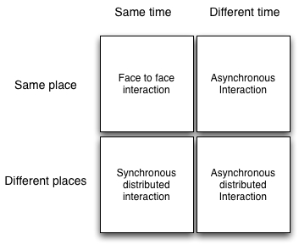
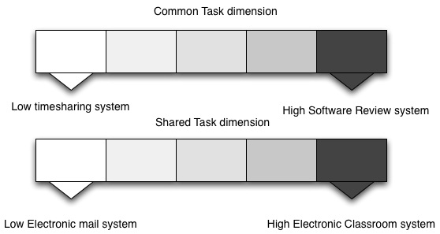
Computer supported cooperative work
Shared environment
Notes:
Simultaneous activities. Real time or non-real time
Help face-to-face group or a group distribution
Real time interaction or non realtime asynchronous
Comprehensive groupware might best use them all (pic 1)
Real time editing with a group
Alone at the office typing

Slide 5
CSCW concepts
Concepts for group interaction
Communication
Real-time
Phone conference
Computer
Collaboration
Sharing information
Coordination
Notes:
Goal is to improve the productivity of decision making meetings either by speeding up the decision making process or improving the quality of the resulting decisions
Communication types
Computer serves as a comm medium
Real timer computer conferencing, group distributed electronic meetings interact sync, use of existing apps or build from the ground
Phone conf: Tends to be awkward, you can’t see what the others are doing, lots of issues with that
Computer: Use comp to show stuff (GoToMetting)

Slide 6
CSCW perspective
Perspectives for success
Distributed systems
Communications
Human-Computer interaction
Artificial Intelligence
Social Theory
Notes:
5 key perspectives for successful groupware
Distributed: User distributed over time an space, multi user
Communications: common problem how to communicate, choose the appropriate tech for interaction
Human-Comp: How shall computers and humans interact in a multi user system
AI: develop techniques to use AI in groupware
Social: Social aspects

Slide 7
Grove
Real time concepts
Real-Time Groupware
Design and purpose
Shared environment
Group window
Tele pointer – multiple cursors
View
Synchronous and asynchronous interactions
Session
Role
Notes:
Important features in the app Grove, which stands for Group Outline Viewing Editor, help authors write stuff
Shared context: Context visible and changeble for all users
Group window: Collection of windows everybody can see and interact with, a circle drawn in one will be displayed in another
TelePointer:Curser show on more than one display and can be controled by different users
View:<Multimedia presnteation of the shared context
Sync or Asnyc: Real time or non real time
Seesion: Period of sync interaction supported by the group ware
Role: privileges and responsibilities a user has

Slide 8
Grove
User experience
Face-to-face in meeting room
Distributed
Mixed mode of both
Interface
WYSIWIS
Distraction issue
Group Dynamics
Visual Space Management
Notes:
GROUPWARE dev conscious of the potential effect of tech on people and their way work
Session type: face-to-face: electronic meeting room
Distributed: where participants work from machines in their office and talk via phones etc
Group interfaces differ from singleuser interaface and are controlled by multiple users not one
Design problems, more than one can controlle higher complexity
WYSIWIS: denotes interface with shared context, everything is the same on all views, smart when working on the same, can be inflexible
A good group interface should dpict overall group activity but not be distracting
Must match a groups work prcoess
Limited on single user, but more on multi user

Slide 9
Grove
Group Processes
Protocols
Operations
Concurrency Control
Responsiveness
Group Interface
Wide-Area
Data Replication
Robustness
Locking
Notification
Notes:
Some well defined task required the participation of a set of user are called group processes.
Protocols are mutually agreed upon ways of interacting, maybe in hard/soft techproto or left to the social aspects socialprotocls
May help and may not
Should be able to work both as single and multi
Groupware need concurency control to resolve conlix
Most have fast response time and notifcation time
Group interface in WYSIWIS
Time in distribution over network must be considered
Data replication have local copy to ensure faster response time
Robustness. Recover from fail states
Lock: data before it is written, but how to get the lock, and when and when to real
Notification is vital, since user must now when events occur in mulit user app

Slide 10
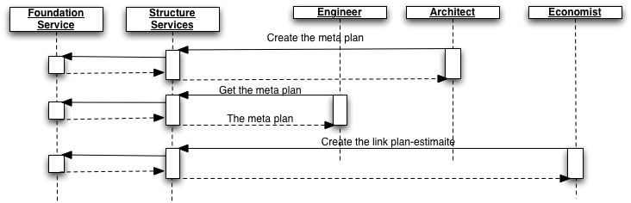
How CSCW could be used
Construct
Hypermedia
The workflow (Session)
Awareness and Session service
Notes:
The construct system is a good eaxemple of how an cscw system cloud be applied

Slide 11
How CSCW could be used
Field Study
Awareness
Public and shared social
Temporal
Spatial
Communication
Notes:
System developed for hospital with the use of field study
Public and shared social: social awareness is not personal, we all know what we all are doing
Temporal: Temporal coordination helps align their own actions to a log of past activities , and anticipate future work flow
Spatial: Helping users to understand and be aware of activities taking place in a room
Communication supporting written or spoken communication which can be shared among collaborating colleagues

Slide 12

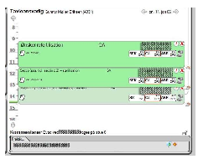
How CSCW could be used
AwareMedia
The System
Spatial
Operation scheduling
Context-awareness
Instant messaging
Notes:
System has been designed as large publicly accessible interactive surface which allows clinicians to maintain a shared, temporal, spatial peripheral awareness of the unfolding of work at an operation ward
Combined overview of people place and time
Distributed system using services and clients
Using video streaming techs
Spatial view of where doctors are
Operation scheduling giving info of who should do what and when
Context provides info about activities social awerness
IM to provide communication

Slide 13
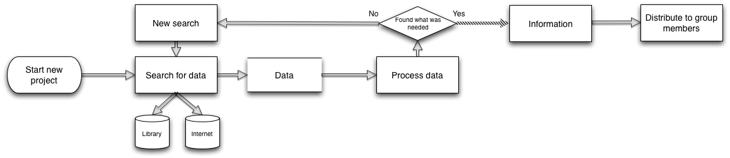
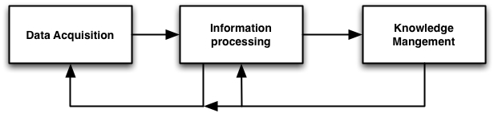
The project
Motivation:
Current work flow(Field study of ourselves)
Split into three phases
13

Slide 14
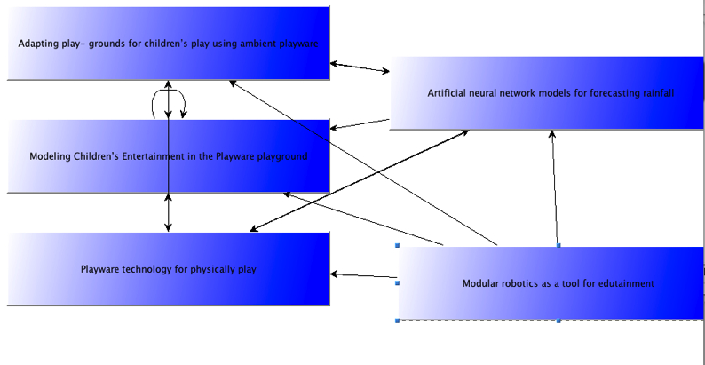
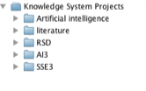
The project
Overview:
Knowledge management system
Reusing existing knowledge, Organize knowledge in projects, sharing knowledge

Slide 15
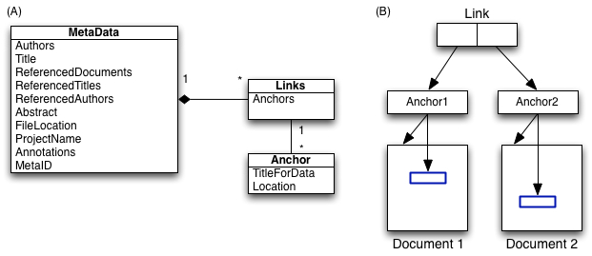
The project
Overview:
Hypertext concepts
Links, anchors, different structures of information

Slide 16
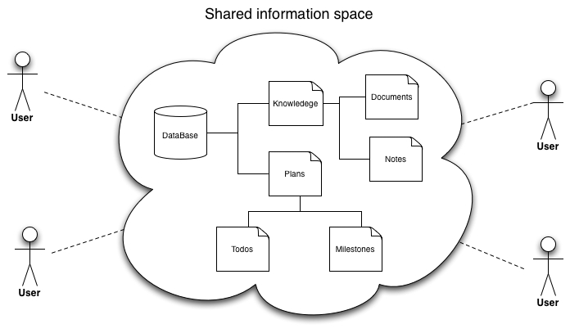
The project
Overview
Computer supported cooperative work
Planning, Shared information space, asynchronous cooperation on documents, notifications

Slide 17
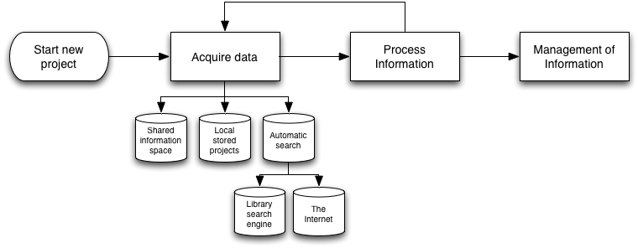
The project
New work flow With the use of the system

