Slide 1
Computer supported cooperative work -Advanced concepts
Jens Bjarke Pedersen

Slide 2
Agenda
CSCW
CSCW applications
Concepts in CSCW
Common/shared information space
Field studies
The project

Slide 3
CSCW
Computer supported cooperative work
Develop software for groups to increase cooperative work
From other software failures
Qualities of co-operative work process
How to develop computer software to help this process
How process could be organized
Notes:
CSCW
Increase working together with others, offspring of other failures automation offices
Concepts build from older stuff
It’s not a tool or technology but how to use the qualities of co-Op work processes
On design: how to create comp tech to fir into and support these work process
How we can organize the work process

Slide 4
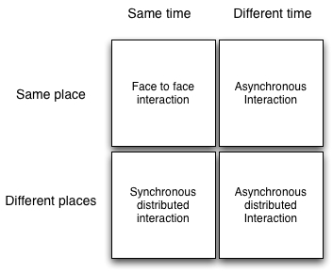
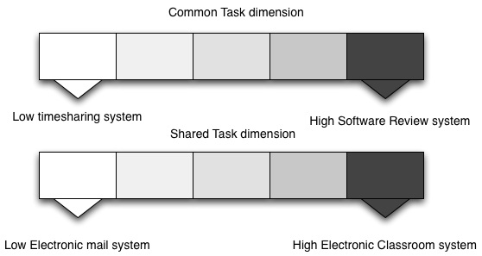
Computer supported cooperative work
Shared environment
Notes:
Simultaneous activities. Real time or non-real time
Help face-to-face group or a group distribution
Real time interaction or non realtime asynchronous
Comprehensive groupware might best use them all (pic 1)
Real time editing with a group
Alone at the office typing

Slide 5
CSCW Applications
GROVE
Calendar Management
The Co-ordinator
CRUISER
Notes:
Some examples of application developed with the use of CSCSW
GROVE
Outliner software for writers
Workstation
Distributed meetings
Free hands and able to talk
See what others were doing
Private window
Users liked it
Calendar Management
High and low cost
Those who will benefit and those who must do the work
How to plan a meeting
Automatically plan a meeting
Free time is not free time, need to talk to secretary anyway
How to make it work (everybody must use it)
Not electronic versions of paper calendars
The Co-ordinator
Email application
Reminds you of when an action occur
Workflow
Failure was not able to incorporate into the normal workflow, restricted to how user should talk, no conversation
Violated CSCW princps
The Floernce Project
A nursing ward
How do they work, complexity, passing information to next shift, arranging meetings, uses note for information
Not using other systems do to “lack of overview” and their belief of the ward
Cannot force them
Created a Worksheet for the nurses
The proposed solution and how it works
CRUISER
The idea
Collaboration between colleagues, different place at work, hallways, office kitchen etc.
Communication to others via camera and video/mics, virtual world
Why it probably wont work, video of people working all the time

Slide 6
Concepts in CSCW
Articulation work
Situated action
Mutual Influence
Shared Information Space
Shared Material
Double Level Language
Equality
Notes:
Concepts of CSCW, not a checklist, but apparently if they are not in the system the likelihood of success is decreased
Articulation work -Articulation work: cooperating individuals must somehow be able to partition work into units, divide it amongst themselves and, after the work is performed, reintegrate it
Representation of information
Gap between requirements and the actual work process
Distribution of work
Calendar Management
Situated action
Relationship between plan, action and context
Knowledge about the process is not the same as know how to do it
Do not anticipate to much
The nursing wards
Mutual Influence
Social context
Conversation
Retract, restate, change or take different position
Should not hinder variety of ways
What I do affects other, and their actions effect mine
Wage Bargainer exercise mutual influence
Shared Information Space
Contains articulated work, situated action, and mutual influence
Shared Material
Situated action, mutual influence etc. need shared material
Participants needs to share the “world” and the “space”
Double Level Language
Divided into to parts
Forma
Common reference point
Cultural
Equality
Balance between those who does the job and those who benefit

Slide 7
Common/shared information space
Describes the cooperative work done within the organization
Floats across time and place
Contains artifacts for coordination of work and sharing of information
Could be physical
Creates awareness for the cooperation
Several parameters characterize a CIS
The degree of distribution
The multiplicity of webs of significance
The level of required articulation work
Notes:
(i) the degree of distribution: collaborative work implies
almost always a physical distribution of persons. Physical
proximity offers the advantages of visual, oral and auditory
communication without augmentation between actors,
provided that this is possible. E.g. a noisy engine room or
an office full of dividers would not offer these advantages.
While these advantages are not immediately at hand
whenever work is distributed over large physical areas,
they may be achieved by the use of various means of
communication (written documents, phone, e-mail, on-line
video etc).
(ii) the multiplicity of webs of significance: we are all spun
into nets of significance. We grew up with some of these;
whereas others have been learned during education, work
experience etc. The more different webs of significance are
part of a CIS, the more work is required to achieve
sufficient mutual understanding. The more different
cultures, languages, and professions are present, the less
can cooperation depend on already shared contexts of
meaning and the more hermeneutical effort is required.
(iii) the level of required articulation work: cooperative
work varies with the degree to which coordination is
necessary and therefore the level of required articulation
work to achieve sufficient coordination varies. At the
wastewater plant a talk during the coffee breaks is
sufficient to coordinate the workers’ different tasks,
whereas work at the hospital ward is dependent on a much
higher need for continuous coordination.
(iv) the multiplicity and intensity of means

Slide 8
Common/shared information space
A hospital work process
Central artifacts
Care-journal
Patient’s record
Work-calendar and schedule
The Hospitals CIS
Accumulation, documents and transmission
Collaboration
Notes:
An example for a CSCW
Over the years lot of artifacts, care-record etc
Whitebords and work schedules, routines, procedural etc.
The central artifacst are: journals,records,workcaleder
The CIS of the ward
Has accumulation docs and trans of infor over time, and then req collaboration betweem staf, incl, coordination articulation work
All in all hospital ward is characterized ´by multiple networks of communication and distributions

Slide 9
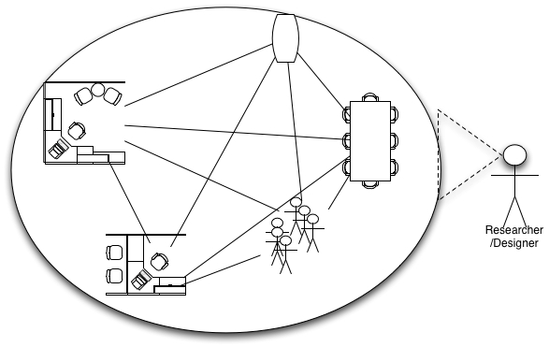
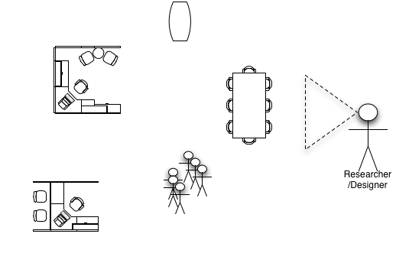
Field studies
Why should this be conducted
Natural settings
Holism
Descriptive
Members point-of-view
Notes:
To find failures in what you’re doing, you might now how it should work but does the users. Or to recognize a current workflow you want to optimze
Natural settings
Study the subjects activities in their everyday setting
Holism
Stuff can only be understood in the natural setting
Descriptive
Nonjudgmental description of what the subjects are doing
Members point of view
See if from the subjects view

Slide 10
Field studies
Observation
Why
Role
Focus of observation
Note taking
Video recording
Analysis
Why use video and why not
Interview
How, who and where
Notes:
Why observe:
Activities part of the daily life so it can’t be explained
Role:
Fly on the wall, observer participants, participant observer (not good hard, no overview), move back and forth
Decide what to observe, when , and where and how long
When you’re not surprised of what you see, it’s enough

Slide 11
Field studies
Traditional approaches
Customer surveys
Operability assessments
Focus Groups
Field trips
Field visits
Field test
Example from other projects
Notes:
You now da shi

Slide 12
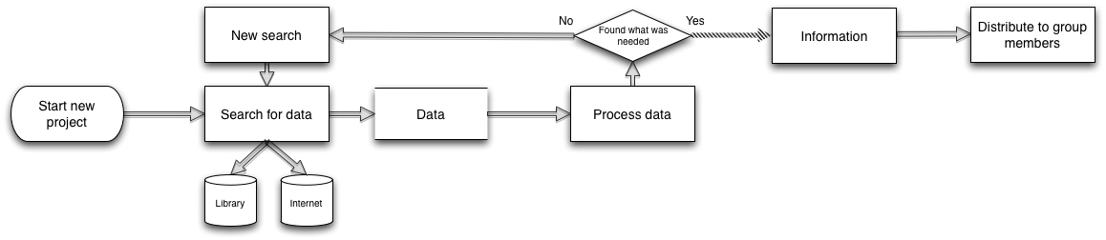
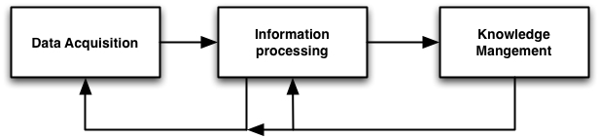
The project
Motivation:
Current work flow(Field study of ourselves)
Split into three phases
12

Slide 13
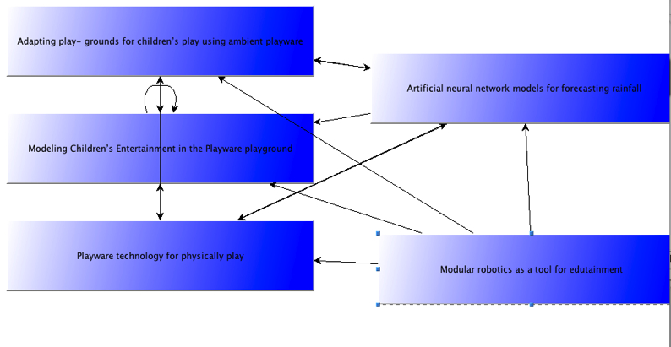
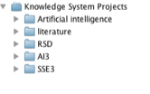
The project
Overview:
Knowledge management system
Reusing existing knowledge, Organize knowledge in projects, sharing knowledge

Slide 14
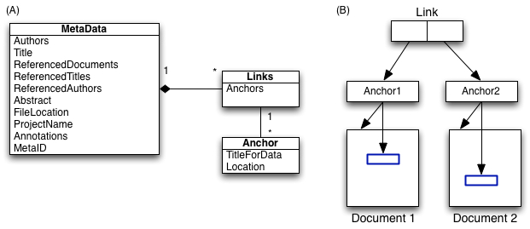
The project
Overview:
Hypertext concepts
Links, anchors, different structures of information

Slide 15
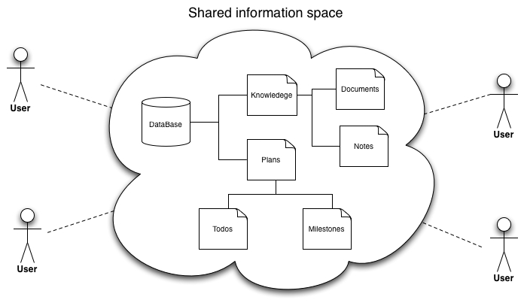
The project
Overview
Computer supported cooperative work
Planning, Shared information space, asynchronous cooperation on documents

Slide 16
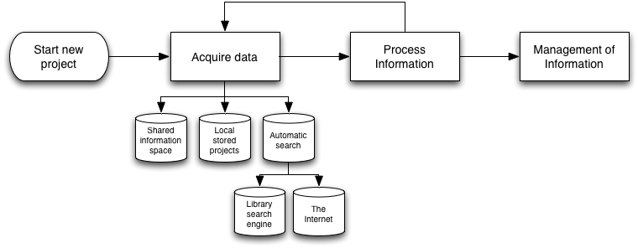
The project
New work flow With the use of the system

