Slide 1
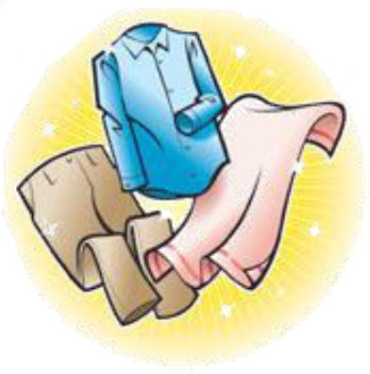
Sorting Criteria
Subtask 5 – RSD Robot System Design

Slide 2
Introduction
Task description
Everybody knows that washing black and white together is a bad idea, but there are a lot more criteria to consider, to prepare a wash
Appropriate colors for joint was
Washing conditions –e.g. temperature, centrifugation, spinning speed, drying
The appropriate amount of laundry should be prepared in piles or containers, which correspond to the load size of a washing machine
When elders move in their clothes will be tagged (subtask 6), but the washing recipes of each item should also be registered
That task should be simple for the staff
Challenges
Together with group of subtask 6 create an easy an appropriate interface for registering clothes and washing recipes
Control criteria for the robot arm in subtask 4
Close collaboration with subtask 4 and 6
Perhaps some “untagged” clothes should be put in washing bags?
Technologies available
Investigate possible technologies

Slide 3
Collaboration

Slide 4
Possible Technologies

Slide 5
System Design

Slide 6
Sorting Criteria

Slide 7
MySQL Library

Slide 8
Transfer Socket Server

Slide 9
Conclusion

