Slide 1
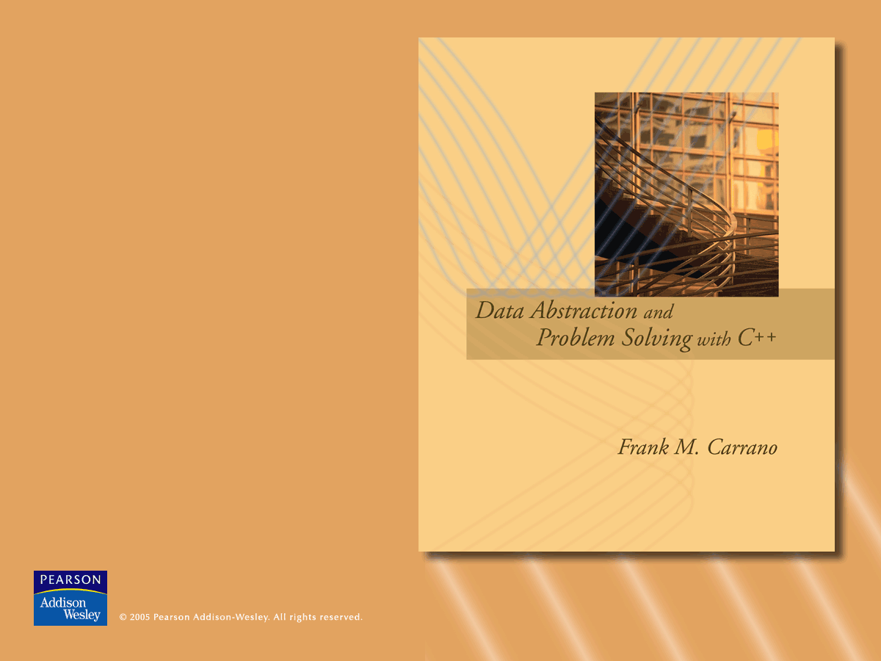
Sections 13.1, 13.2, 13.4, and 14.1
Queues

Slide 2
The Abstract Data Type Queue
A queue
  New items enter at the back, or rear, of the queue
  Items leave from the front of the queue
  First-in, first-out (FIFO) property
    The first item inserted into a queue is the first item to leave
© 2005 Pearson Addison-Wesley. All rights reserved
7-<number>

Slide 3
The Abstract Data Type Queue
Queues
  Are appropriate for many real-world situations
    Example: A line to buy a movie ticket
  Have applications in computer science
    Example: A request to print a document
A simulation
  A study to see how to reduce the wait involved in an application
© 2005 Pearson Addison-Wesley. All rights reserved
7-<number>

Slide 4
The Abstract Data Type Queue
ADT queue operations
  Create an empty queue
  Destroy a queue
  Determine whether a queue is empty
  Add a new item to the queue
  Remove the item that was added earliest
  Retrieve the item that was added earliest
© 2005 Pearson Addison-Wesley. All rights reserved
7-<number>

Slide 5
The Abstract Data Type Queue
bool isEmpty() const;
// Determines whether the queue is empty.
// Precondition: None.
// Postcondition: Returns true if the queue
// is empty; otherwise returns false.
© 2005 Pearson Addison-Wesley. All rights reserved
7-<number>

Slide 6
The Abstract Data Type Queue
bool enqueue(QueueItemType newItem);
// Inserts an item at the back of a queue.
// Precondition: newItem is the item to be
// inserted.
// Postcondition: If the insertion is
// successful, newItem is at the back of the
// queue.
© 2005 Pearson Addison-Wesley. All rights reserved
7-<number>

Slide 7
The Abstract Data Type Queue
bool dequeue();
// Dequeues the front of a queue.
// Precondition: None.
// Postcondition: If the queue is not empty,
// the item that was added to the queue
// earliest is deleted.
© 2005 Pearson Addison-Wesley. All rights reserved
7-<number>

Slide 8
The Abstract Data Type Queue
bool dequeue(QueueItemType& queueFront);
// Retrieves and deletes the front of a queue
// Precondition: None.
// Postcondition: If the queue is not empty,
// queueFront contains the item that was
// added to the queue earliest, and the item
// is deleted.
© 2005 Pearson Addison-Wesley. All rights reserved
7-<number>

Slide 9
The Abstract Data Type Queue
bool getFront(QueueItemType& queueFront)const;
// Retrieves the item at the front of a queue
// Precondition: None.
// Postcondition: If the queue is not empty,
// queueFront contains the item that was
// added to the queue earliest.
© 2005 Pearson Addison-Wesley. All rights reserved
7-<number>

Slide 10
Implementations of the ADT Queue
An array-based implementation
Possible implementations of a pointer-based queue
  A linear linked list with two external references
    A reference to the front
    A reference to the back
  A circular linked list with one external reference
    A reference to the back
© 2005 Pearson Addison-Wesley. All rights reserved
7-<number>

Slide 11
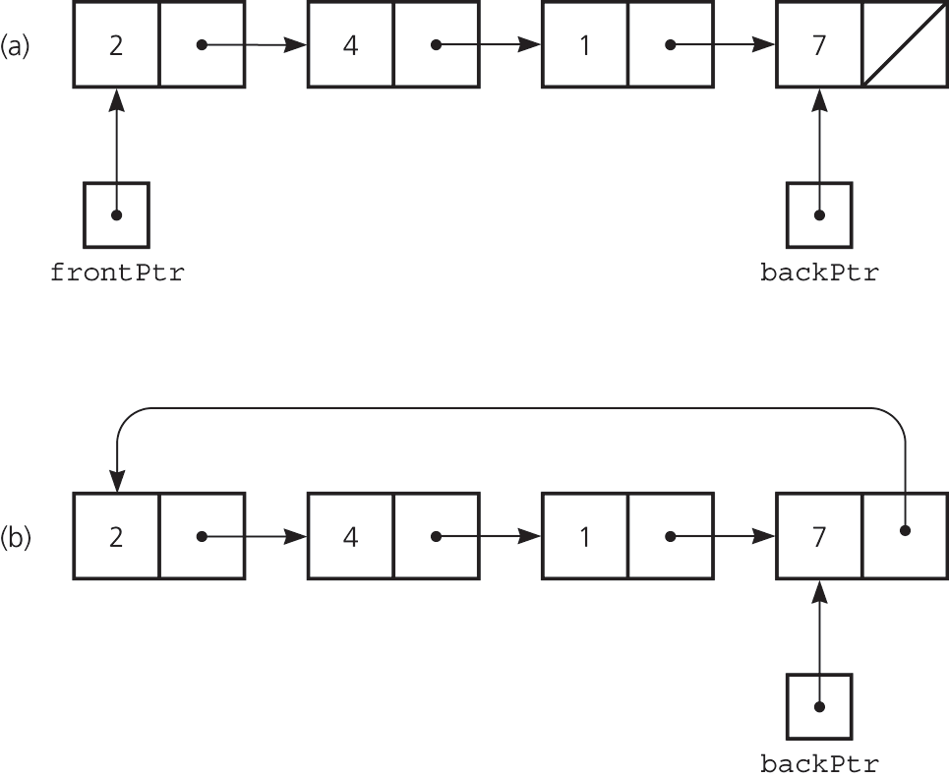
A Pointer-Based Implementation
Figure 7.4 A pointer-based implementation of a queue: (a) a linear linked list with two external pointers b) a circular linear linked list with one external pointer
© 2005 Pearson Addison-Wesley. All rights reserved
7-<number>

Slide 12
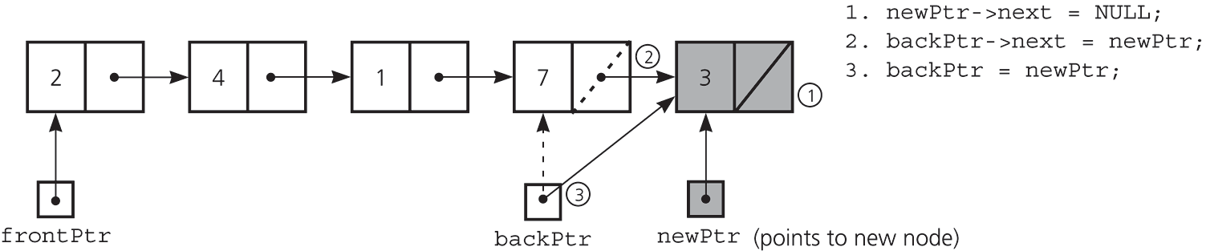
A Pointer-Based Implementation
Figure 7.5 Inserting an item into a nonempty queue
© 2005 Pearson Addison-Wesley. All rights reserved
7-<number>

Slide 13
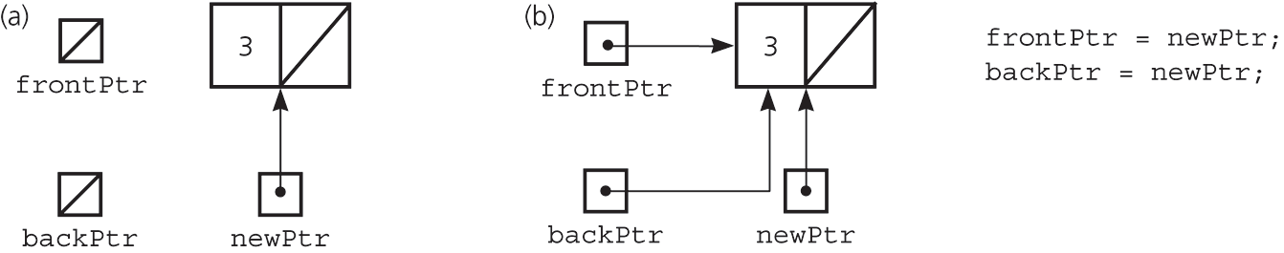
A Pointer-Based Implementation
Figure 7.6 Inserting an item into an empty queue: a) before insertion; b) after insertion
© 2005 Pearson Addison-Wesley. All rights reserved
7-<number>

Slide 14
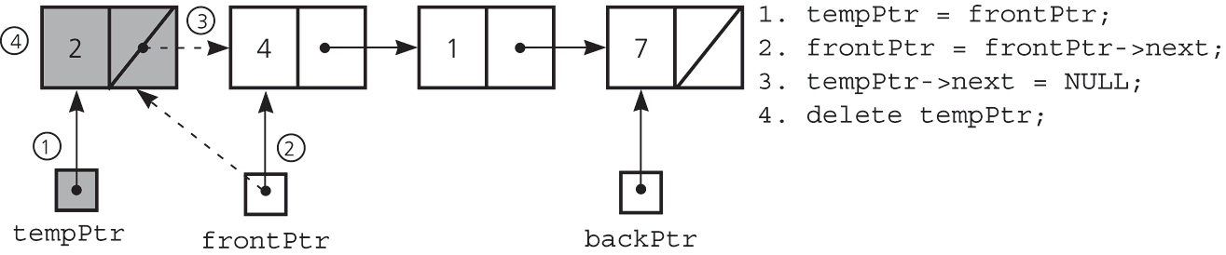
A Pointer-Based Implementation
Figure 7.7 Deleting an item from a queue of more than one item
© 2005 Pearson Addison-Wesley. All rights reserved
7-<number>

Slide 15
A Pointer-Based Implementation
typedef desired-type-of-queue-item QueueItemType;
class Queue{
public:
Queue(); // default constructor
Queue(const Queue& Q); // copy constructor
~Queue(); // destructor
// Queue operations:
bool isEmpty() const;
bool enqueue(QueueItemType newItem);
bool dequeue();
bool dequeue(QueueItemType& queueFront);
bool getFront(QueueItemType& queueFront) const;
private:
// The queue is implemented as a linked list with one external
// pointer to the front of the queue and a second external
// pointer to the back of the queue.
struct QueueNode{
QueueItemType item;
QueueNode *next;
};
QueueNode *backPtr;
QueueNode *frontPtr;
};
© 2005 Pearson Addison-Wesley. All rights reserved
7-<number>

Slide 16
A Pointer-Based Implementation
// default constructor
Queue::Queue() : backPtr(NULL), frontPtr(NULL){
}
// copy constructor
Queue::Queue(const Queue& Q){
// Implementation left as an exercise (Exercise 4)
}
© 2005 Pearson Addison-Wesley. All rights reserved
7-<number>

Slide 17
A Pointer-Based Implementation
// destructor
Queue::~Queue(){
while (!isEmpty())
dequeue();
}
© 2005 Pearson Addison-Wesley. All rights reserved
7-<number>

Slide 18
A Pointer-Based Implementation
bool Queue::isEmpty() const {
return backPtr == NULL;
}
© 2005 Pearson Addison-Wesley. All rights reserved
7-<number>

Slide 19
A Pointer-Based Implementation
bool Queue::enqueue(QueueItemType newItem){
// create a new node
QueueNode *newPtr = new QueueNode;
// set data portion of new node
newPtr->item = newItem;
newPtr->next = NULL;
// insert the new node
if (isEmpty()) // insertion into empty queue
frontPtr = newPtr;
else // insertion into nonempty queue
backPtr->next = newPtr;
backPtr = newPtr; // new node is at back
return true;
}
© 2005 Pearson Addison-Wesley. All rights reserved
7-<number>

Slide 20
A Pointer-Based Implementation
bool Queue::dequeue(){
if (isEmpty())
return false;
else{
// queue is not empty; remove front
QueueNode *tempPtr = frontPtr;
if (frontPtr == backPtr){ // special case
frontPtr = NULL;
backPtr = NULL;
}
else
frontPtr = frontPtr->next;
tempPtr->next = NULL; // defensive strategy
delete tempPtr;
return true;
}
}
© 2005 Pearson Addison-Wesley. All rights reserved
7-<number>

Slide 21
A Pointer-Based Implementation
bool Queue::dequeue(QueueItemType& queueFront){
if (isEmpty())
return false;
else{
// queue is not empty; retrieve front
queueFront = frontPtr->item;
dequeue(); // delete front
return true;
}
}
© 2005 Pearson Addison-Wesley. All rights reserved
7-<number>

Slide 22
A Pointer-Based Implementation
bool Queue::getFront(QueueItemType& queueFront)const {
if (isEmpty())
return false;
else {
// queue is not empty; retrieve front
queueFront = frontPtr->item;
return true;
}
}
© 2005 Pearson Addison-Wesley. All rights reserved
7-<number>

Slide 23
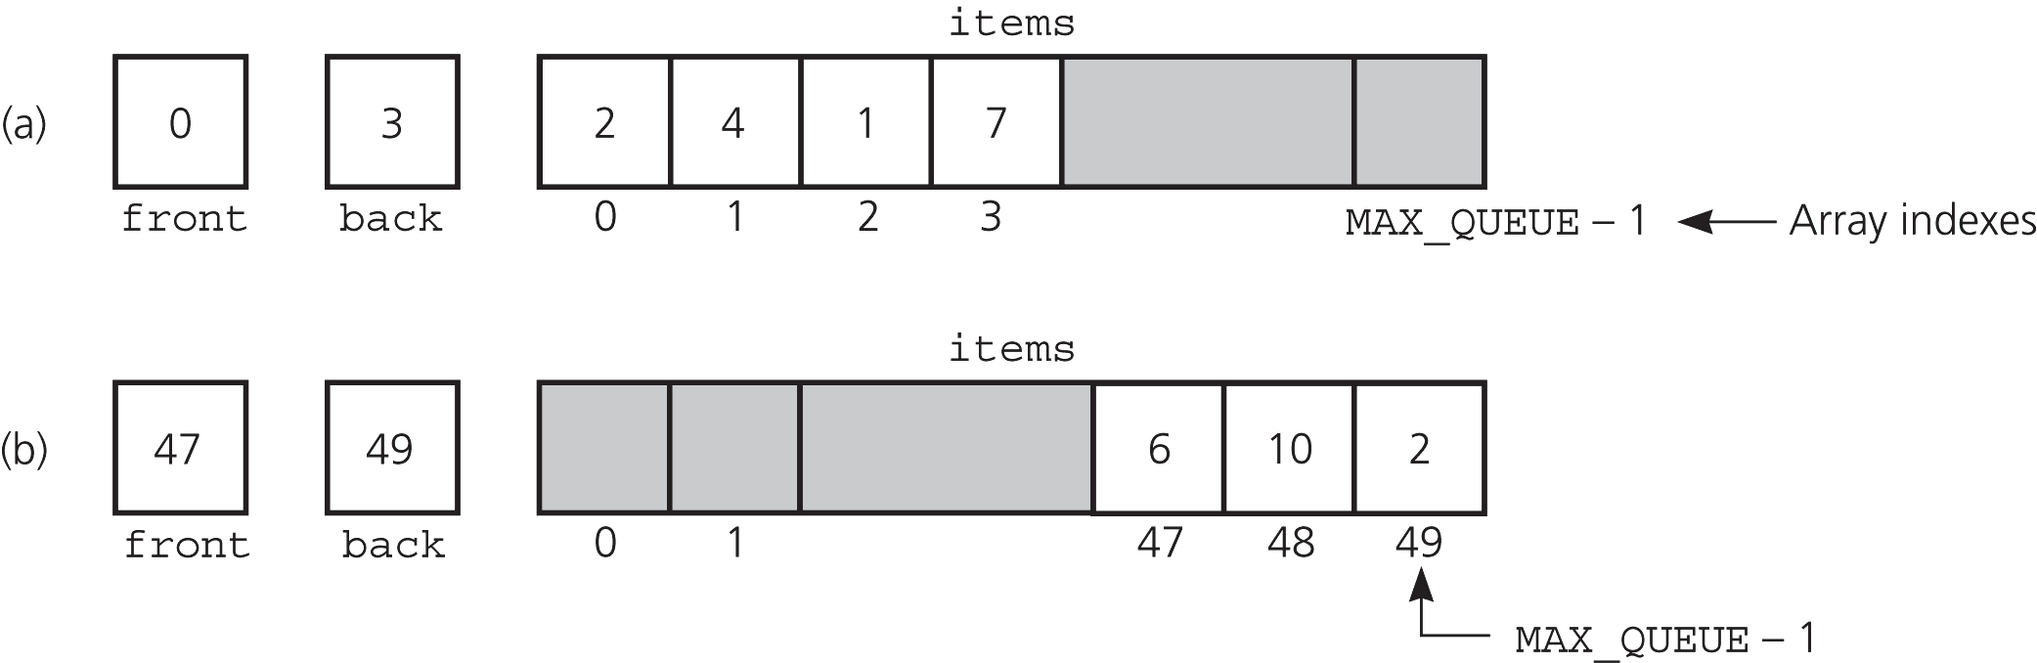
An Array-Based Implementation
Figure 7.8
a) A naive array-based implementation of a queue; b) rightward drift can cause the queue to appear full
© 2005 Pearson Addison-Wesley. All rights reserved
7-<number>

Slide 24
An Array-Based Implementation
A circular array eliminates the problem of rightward drift
A problem with the circular array implementation
  front and back cannot be used to distinguish between queue-full and queue-empty conditions
© 2005 Pearson Addison-Wesley. All rights reserved
7-<number>

Slide 25
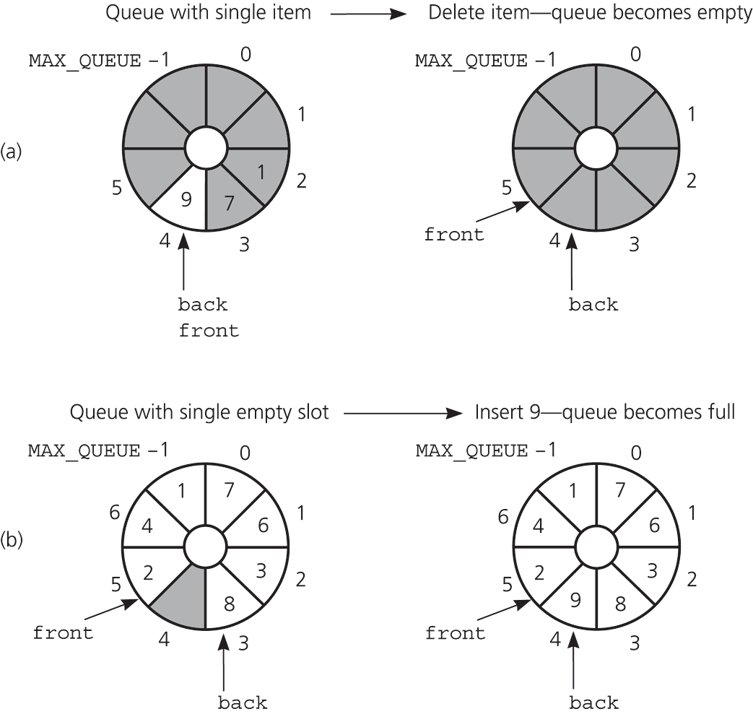
An Array-Based Implementation
Figure 7.11b
(a) front passes back when the queue becomes empty; (b) back catches up to front when the queue becomes full
© 2005 Pearson Addison-Wesley. All rights reserved
7-<number>

Slide 26
An Array-Based Implementation
To detect queue-full and queue-empty conditions
  Keep a count of the queue items
To initialize the queue, set
  front to 0
  back to MAX_QUEUE – 1
  count to 0
© 2005 Pearson Addison-Wesley. All rights reserved
7-<number>

Slide 27
An Array-Based Implementation
Inserting into a queue
  back = (back+1) % MAX_QUEUE;
  items[back] = newItem;
  ++count;
Deleting from a queue
  front = (front+1) % MAX_QUEUE;
  --count;
© 2005 Pearson Addison-Wesley. All rights reserved
7-<number>

Slide 28
An Array-Based Implementation
const int MAX_QUEUE = maximum-size-of-queue;
typedef desired-type-of-queue-item QueueItemType;
class Queue{
public:
Queue(); // default constructor
// copy constructor and destructor are
// supplied by the compiler
// Queue operations:
bool isEmpty() const;
bool enqueue(QueueItemType newItem);
bool dequeue();
bool dequeue(QueueItemType& queueFront);
bool getFront(QueueItemType& queueFront) const;
private:
QueueItemType items[MAX_QUEUE];
int front;
int back;
int count;
};
© 2005 Pearson Addison-Wesley. All rights reserved
7-<number>

Slide 29
An Array-Based Implementation
// default constructor
Queue::Queue():front(0), back(MAX_QUEUE-1), count(0){
}
© 2005 Pearson Addison-Wesley. All rights reserved
7-<number>

Slide 30
An Array-Based Implementation
bool Queue::isEmpty() const {
return (count == 0);
}
© 2005 Pearson Addison-Wesley. All rights reserved
7-<number>

Slide 31
An Array-Based Implementation
bool Queue::enqueue(QueueItemType newItem) {
if (count == MAX_QUEUE)
return false;
else{
// queue is not full; insert item
back = (back+1) % MAX_QUEUE;
items[back] = newItem;
++count;
return true;
}
}
© 2005 Pearson Addison-Wesley. All rights reserved
7-<number>

Slide 32
An Array-Based Implementation
bool Queue::dequeue(){
if (isEmpty())
return false;
else {
// queue is not empty; remove front
front = (front+1) % MAX_QUEUE;
--count;
return true;
}
}
© 2005 Pearson Addison-Wesley. All rights reserved
7-<number>

Slide 33
An Array-Based Implementation
bool Queue::dequeue(QueueItemType& queueFront) {
if (isEmpty())
return false;
else{
// queue is not empty;
// retrieve and remove front
queueFront = items[front];
front = (front+1) % MAX_QUEUE;
--count;
return true;
}
}
© 2005 Pearson Addison-Wesley. All rights reserved
7-<number>

Slide 34
An Array-Based Implementation
bool Queue::getFront(QueueItemType& queueFront)const {
if (isEmpty())
return false;
else{
// queue is not empty; retrieve front
queueFront = items[front];
return true;
}
}
© 2005 Pearson Addison-Wesley. All rights reserved
7-<number>

Slide 35
An Array-Based Implementation
Variations of the array-based implementation
  Use a flag isFull to distinguish between the full and empty conditions
  Declare MAX_QUEUE + 1 locations for the array items, but use only MAX_QUEUE of them for queue items
© 2005 Pearson Addison-Wesley. All rights reserved
7-<number>

Slide 36
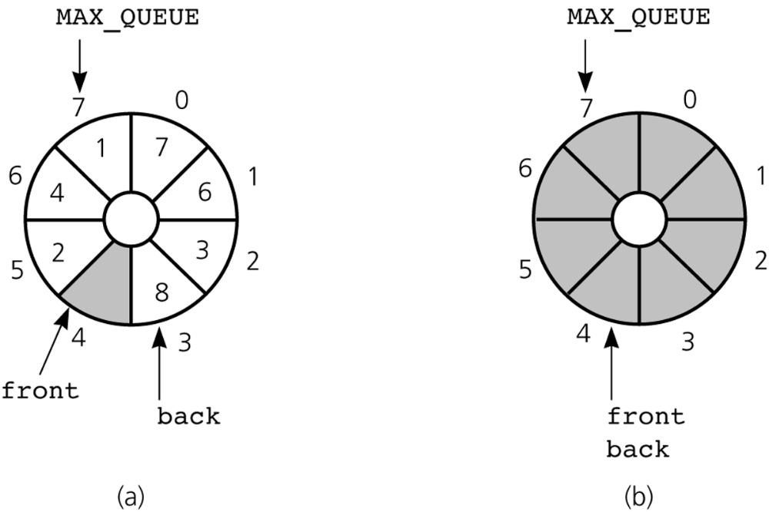
An Array-Based Implementation
Figure 7.12
A more efficient circular implementation: a) a full queue; b) an empty queue
© 2005 Pearson Addison-Wesley. All rights reserved
7-<number>

Slide 37
An Implementation That Uses the ADT List
If the item in position 1 of a list aList represents the front of the queue, the following implementations can be used
  dequeue()
    aList.remove(1)
  getFront(queueFront)
    aList.retrieve(1, queueFront)
© 2005 Pearson Addison-Wesley. All rights reserved
7-<number>

Slide 38
An Implementation That Uses the ADT List
If the item at the end of the list represents the back of the queue, the following implementations can be used
  enqueue(newItem)
    aList.insert(getLength() + 1, newItem)
© 2005 Pearson Addison-Wesley. All rights reserved
7-<number>

Slide 39
An Implementation That Uses the ADT List
#include "ListP.h" // ADT list operations
typedef ListItemType QueueItemType;
class Queue {
public:
Queue(); // default constructor
Queue(const Queue& Q); // copy constructor
~Queue(); // destructor
// Queue operations:
bool isEmpty() const;
bool enqueue(QueueItemType newItem);
bool dequeue();
bool dequeue(QueueItemType& queueFront);
bool getFront(QueueItemType& queueFront) const;
private:
List aList;
};
© 2005 Pearson Addison-Wesley. All rights reserved
7-<number>

Slide 40
An Implementation That Uses the ADT List
// default constructor
Queue::Queue() {
}
// copy constructor
Queue::Queue(const Queue& Q): aList(Q.aList){
}
© 2005 Pearson Addison-Wesley. All rights reserved
7-<number>

Slide 41
An Implementation That Uses the ADT List
// destructor
Queue::~Queue() {
}
© 2005 Pearson Addison-Wesley. All rights reserved
7-<number>

Slide 42
An Implementation That Uses the ADT List
bool Queue::isEmpty() const {
return (aList.getLength() == 0);
}
© 2005 Pearson Addison-Wesley. All rights reserved
7-<number>

Slide 43
An Implementation That Uses the ADT List
bool Queue::enqueue(QueueItemType newItem) {
return aList.insert(aList.getLength()+1, newItem);
}
© 2005 Pearson Addison-Wesley. All rights reserved
7-<number>

Slide 44
An Implementation That Uses the ADT List
bool Queue::dequeue() {
return aList.remove(1);
}
© 2005 Pearson Addison-Wesley. All rights reserved
7-<number>

Slide 45
An Implementation That Uses the ADT List
bool Queue::dequeue(QueueItemType& queueFront) {
if (aList.retrieve(1, queueFront))
return aList.remove(1);
else
return false;
}
© 2005 Pearson Addison-Wesley. All rights reserved
7-<number>

Slide 46
An Implementation That Uses the ADT List
bool Queue::getFront(QueueItemType& queueFront) const{
return aList.retrieve(1, queueFront);
}
© 2005 Pearson Addison-Wesley. All rights reserved
7-<number>

Slide 47
Example: Recognizing Palindromes
A palindrome
  A string of characters that reads the same from left to right as its does from right to left
To recognize a palindrome, a queue can be used in conjunction with a stack
  A stack reverses the order of occurrences
  A queue preserves the order of occurrences
© 2005 Pearson Addison-Wesley. All rights reserved
7-<number>

Slide 48
Example: Recognizing Palindromes
A nonrecursive recognition algorithm for palindromes
  As you traverse the character string from left to right, insert each character into both a queue and a stack
  Compare the characters at the front of the queue and the top of the stack
© 2005 Pearson Addison-Wesley. All rights reserved
7-<number>

Slide 49
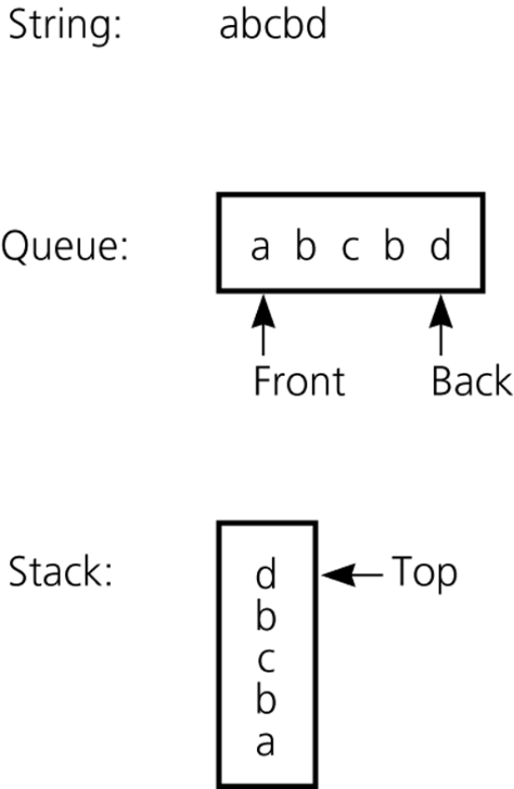
Example: Recognizing Palindromes
Figure 7.3
The results of inserting a string into both a queue and a stack
© 2005 Pearson Addison-Wesley. All rights reserved
7-<number>

Slide 50
Application: Simulation
Simulation
  A technique for modeling the behavior of both natural and human-made systems
  Goal
    Generate statistics that summarize the performance of an existing system
    Predict the performance of a proposed system
  Example
    A simulation of the behavior of a bank
© 2005 Pearson Addison-Wesley. All rights reserved
7-<number>

Slide 51
Application: Bank Simulation
As customers arrive, they go to the back of the line
We will use a queue to represent the line of customers in the bank
  The current customer, who is at the front of the line, is being served
  You remove this customer from the system next
© 2005 Pearson Addison-Wesley. All rights reserved
7-<number>

Slide 52
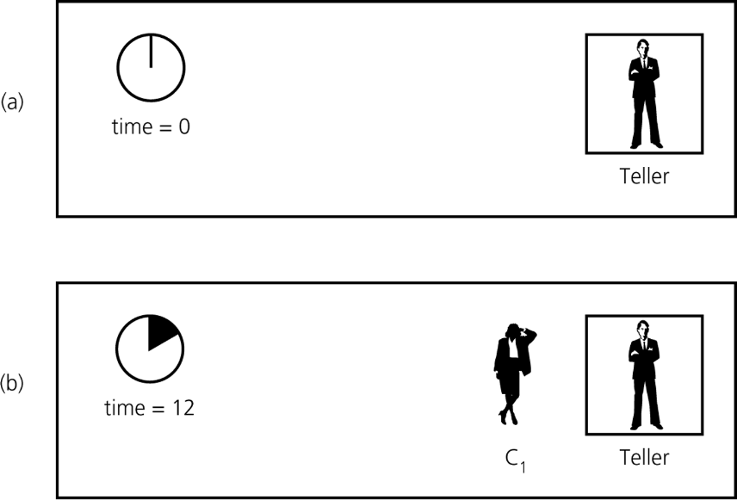
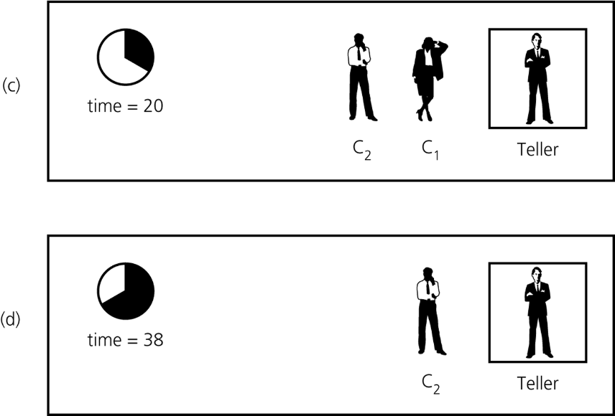
Application: Bank Simulation
Figure 7.14 A bank line at time a) 0; b) 12 c) 20; d) 38
© 2005 Pearson Addison-Wesley. All rights reserved
7-<number>

Slide 53
Summary
The definition of the queue operations gives the ADT queue first-in, first-out (FIFO) behavior
A pointer-based implementation of a queue uses either
  A circular linked list
  A linear linked list with a head reference and a tail reference
© 2005 Pearson Addison-Wesley. All rights reserved
7-<number>

Slide 54
Summary
A circular array eliminates the problem of rightward drift in an array-based implementation
Distinguishing between the queue-full and queue-empty conditions in a circular array
  Count the number of items in the queue
  Use a isFull flag
  Leave one array location empty
© 2005 Pearson Addison-Wesley. All rights reserved
7-<number>

Slide 55
Comparing Implementations
Automatic versus dynamic size
  An automatically allocated array
    Prevents the enqueue operation from adding an item to the queue if the array is full
  A dynamically allocated array or a pointer- implementation
    Does not impose this restriction on the enqueue operation
© 2005 Pearson Addison-Wesley. All rights reserved
7-<number>

Slide 56
Comparing Implementations
Pointer-based implementations
  A linked list implementation
    More efficient
  The ADT list implementation
    Simpler to write
© 2005 Pearson Addison-Wesley. All rights reserved
7-<number>

Slide 57
A Summary of Position-Oriented ADTs
Position-oriented ADTs
  List
  Stack
  Queue
Stacks and queues
  Only the end positions can be accessed
Lists
  All positions can be accessed
© 2005 Pearson Addison-Wesley. All rights reserved
7-<number>

Slide 58
A Summary of Position-Oriented ADTs
Stacks and queues are very similar
  Operations of stacks and queues can be paired off as
    createStack and createQueue
    Stack isEmpty and queue isEmpty
    push and enqueue
    pop and dequeue
    Stack getTop and queue getFront
© 2005 Pearson Addison-Wesley. All rights reserved
7-<number>

Slide 59
A Summary of Position-Oriented ADTs
ADT list operations generalize stack and queue operations
  getLength
  insert
  remove
  retrieve
© 2005 Pearson Addison-Wesley. All rights reserved
7-<number>

