Slide 1
Analysis of Algorithms
Initially prepared by Dr. İlyas Çiçekli; improved by various Bilkent CS202 instructors.

Slide 2
Algorithm
An algorithm is a set of instructions to be followed to solve a problem.
There can be more than one solution (more than one algorithm) to solve a given problem.
An algorithm can be implemented using different prog. languages on different platforms.
Once we have a correct algorithm for the problem, we have to determine the efficiency of that algorithm.
How much time that algorithm requires.
How much space that algorithm requires.
We will focus on
How to estimate the time required for an algorithm
How to reduce the time required

Slide 3
Analysis of Algorithms
How do we compare the time efficiency of two algorithms that solve the same problem?
We should employ mathematical techniques that analyze algorithms independently of specific implementations, computers, or data.
To analyze algorithms:
First, we start counting the number of significant operations in a particular solution to assess its efficiency.
Then, we will express the efficiency of algorithms using growth functions.

Slide 4
Analysis of Algorithms
Simple instructions (+,-,*,/,=,if,call) take 1 step
Loops and subroutine calls are not simple operations
They depend on size of data and the subroutine
“sort” is not a single step operation
Complex Operations (matrix addition, array resizing) are not single step
We assume infinite memory
We do not include the time required to read the input

Slide 5
The Execution Time of Algorithms
Consecutive statements
count = count + 1;
sum = sum + count;
Total cost = 1 + 1
➔ The time required for this algorithm is constant
Times
1
1
Don’t forget: We assume that each simple operation takes one unit of time

Slide 6
The Execution Time of Algorithms
If-else statements
if (n < 0){
absval = -n
cout << absval;
}
else
absval = n;
Total Cost <= 1 + max(2,1)
Times
1
1
1
1

Slide 7
The Execution Time of Algorithms
Single loop statements
i = 1;
sum = 0;
while (i <= n) {
i = i + 1;
sum = sum + i;
}
Times
1
1
n+1
n
n
Total cost = 1 + 1 + (n + 1) + n + n
➔ The time required for this algorithm is proportional to n

Slide 8
The Execution Time of Algorithms
Nested loop statements
i = 1;
sum = 0;
while (i <= n) {
j=1;
while (j <= n) {
sum = sum + i;
j = j + 1;
}
i = i +1;
}
Times
1
1
n+1
n
n * (n+1)
n * n
n * n
n
Total cost = 1 + 1 + (n + 1) + n + n * (n + 1) + n * n + n * n + n
➔ The time required for this algorithm is proportional to n²

Slide 9
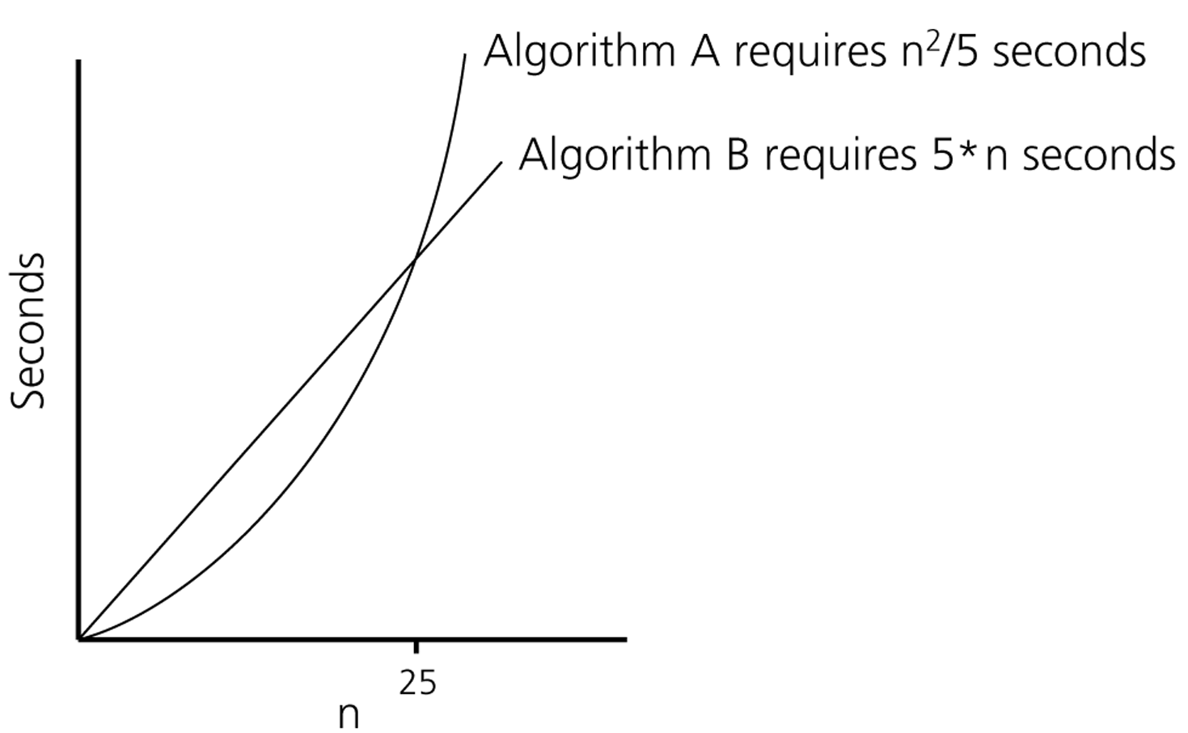
Algorithm Growth Rates
We measure the time requirement of an algorithm as a function of the problem size.
The most important thing is to learn how quickly the time requirement of an algorithm grows as a function of the problem size.
An algorithm’s proportional time requirement is known as growth rate.
We can compare the efficiency of two algorithms by comparing
their growth rates.
The time requirement as a function of the problem size n

Slide 10
Order-of-Magnitude Analysis and Big-O Notation
If Algorithm A requires time at most proportional to f(n), it is said to be order f(n), and it is denoted as O(f(n))
f(n) is called the algorithm’s growth-rate function
Since the capital O is used in the notation, this notation is called the Big-O notation

Slide 11
Big-O Notation
Definition:
Algorithm A is order of if it requires no more than time units to solve a problem of size
There may exist many values of c and n₀
More informally, is an upper bound on

Slide 12
O-notation: Asymptotic upper bound
T(n) = O(f(n)) if ∃ positive constants c, n₀ such that
0 ≤ T(n) ≤ cf(n), ∀n ≥ n₀
cf(n)
Asymptotic running times of algorithms are usually defined by functions whose domain are N={0, 1, 2, …} (natural numbers)
T(n) = O(f(n))
T(n)

Slide 13
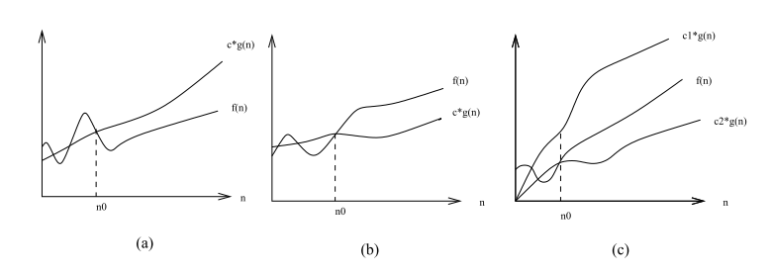
Big-O Notation
c*f(n)
c₁*f(n)
T(n)
T(n)
T(n)
c*f(n)
c₂*f(n)
O(f(n)) Ω(f(n)) Θ(f(n))
Big-O definition implies: constant n₀ beyond which it is satisfied
We do not care about small values of n

Slide 14
Example
Show that 2n² = O(n³)
We need to find two positive constants: c and n₀ such that:
0 ≤ 2n² ≤ cn³ for all n ≥ n₀
Choose c = 2 and n₀ = 1
➔ 2n² ≤ 2n³ for all n ≥ 1
Or, choose c = 1 and n₀ = 2
➔ 2n² ≤ n³ for all n ≥ 2

Slide 15
Example
Show that 2n² + n = O(n²)
We need to find two positive constants: c and n₀ such that:
0 ≤ 2n² + n ≤ cn² for all n ≥ n₀
2 + (1/n) ≤ c for all n ≥ n₀
Choose c = 3 and n₀ = 1
➔ 2n² + n ≤ 3n² for all n ≥ 1

Slide 16
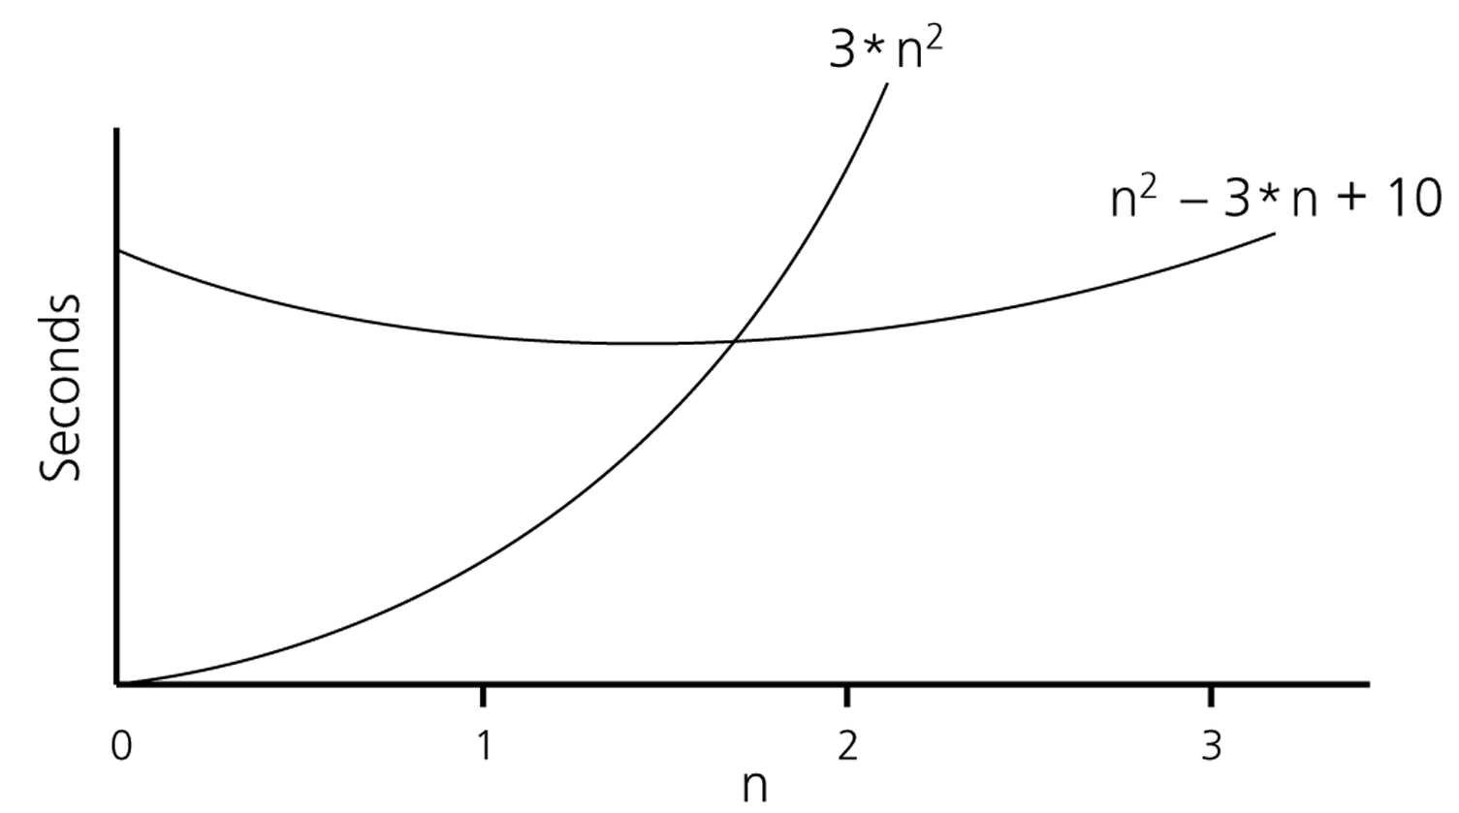
Example
Show that is order of
Show that there exist constants c and n₀ that satisfy the condition
Try c = 3 and n₀ = 2

Slide 17
True or False?
True
Choose c = 10⁹ and n₀ = 1
10⁹n² = O (n²)
0 ≤ 10⁹n² ≤ 10⁹n² for n ≥1
Choose c = 100 and n₀ = 1
100n^{1.9999} = O (n²)
True
0 ≤ 100n^{1.9999} ≤ 100n² for n≥1
10⁻⁹n^{2.0001} ≤ cn² for n ≥ n₀
False
10⁻⁹n^{2.0001} = O (n²)
10⁻⁹ n^{0.0001} ≤ c for n ≥ n₀
Contradiction

Slide 18
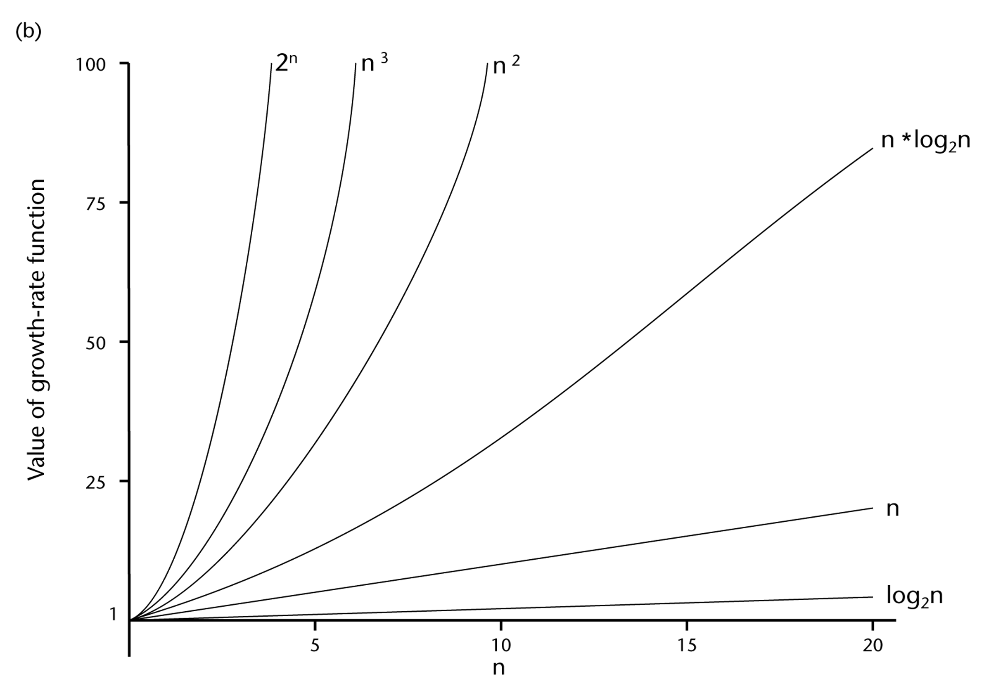
A Comparison of Growth-Rate Functions

Slide 19
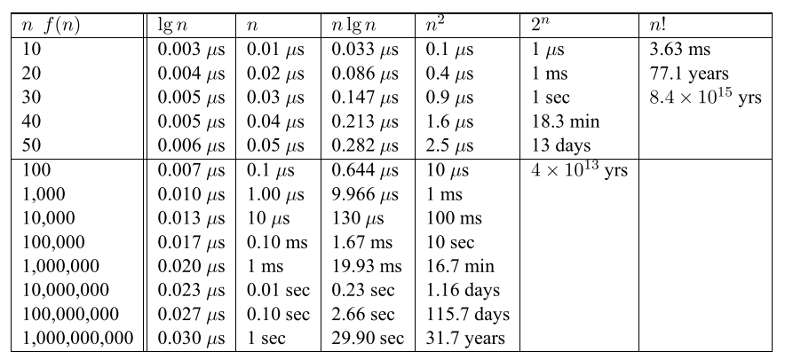
A Comparison of Growth-Rate Functions

Slide 20
A Comparison of Growth-Rate Functions
Any algorithm with n! complexity is useless for n>=20
Algorithms with 2^{n} running time is impractical for n>=40
Algorithms with n² running time is usable up to n=10,000
But not useful for n>1,000,000
Linear time (n) and n log n algorithms remain practical even for one billion items
Algorithms with log n complexity is practical for any value of n

Slide 21
Properties of Growth-Rate Functions
We can ignore the low-order terms
If an algorithm is O(n³+4n²+3n), it is also O(n³)
Use only the highest-order term to determine its grow rate
We can ignore a multiplicative constant in the highest-order term
If an algorithm is O(5n³), it is also O(n³)
O( f(n) ) + O( g(n) ) = O( f(n) + g(n) )
If an algorithm is O(n³) + O(4n²), it is also O(n³ +4n²) ➔ So, it is O(n³)
Similar rules hold for multiplication

Slide 22
Some Useful Mathematical Equalities

Slide 23
Growth-Rate Functions
Remember our previous examples
Times
i = 1; 1
sum = 0; 1
while (i <= n) { n + 1
i = i + 1; n
sum = sum + i; n
}
Total cost = 1 + 1 + (n + 1) + n + n = 3 * n + 3
➔ The time required for this algorithm is proportional to n
➔ The growth-rate of this algorithm is proportional to O(n)

Slide 24
Growth-Rate Functions
Times
i = 1; 1
sum = 0; 1
while (i <= n) { n + 1
j=1; n
while (j <= n) { n * (n + 1)
sum = sum + i; n * n
j = j + 1; n * n
}
i = i +1; n
}
Total cost = 1 + 1 + (n + 1) + n + n * (n + 1) + n * n + n * n + n
Total cost = 3 * n² + 4 * n + 3
➔ The time required for this algorithm is proportional to n²
➔ The growth-rate of this algorithm is proportional to O(n²)

Slide 25
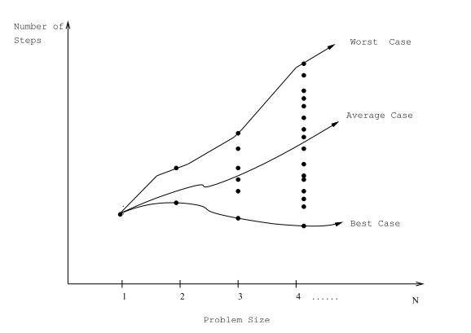
What to Analyze
Worst-case performance
It is an upper bound for any input
Its use is more common than the others
Best-case performance
This is useless! Why?
Average-case performance
It is valid if you can figure out what the “average” input is
It is computed considering all possible inputs and their distribution
It is usually difficult to compute

Slide 26
Consider the sequential search algorithm
int sequentialSearch(const int a[], int item, int n){
for (int i = 0; i < n; i++)
if (a[i] == item)
return i;
return -1;
}
Worst-case:
If the item is in the last location of the array or
If it is not found in the array
Best-case:
If the item is in the first location of the array
Average-case:
How can we compute it?

Slide 27
How to find the growth-rate of C++ codes?

Slide 28
Some Examples
Solved on the Board.

Slide 29
What about recursive functions?

Slide 30
Consider the problem of Hanoi towers
void hanoi(int n, char source, char dest, char spare) {
if (n > 0) {
hanoi(n - 1, source, spare, dest);
move from source to dest
hanoi(n - 1, spare, dest, source);
}
}
How do we find the growth-rate of the recursive hanoi function?
First write a recurrence equation for the hanoi function
Then solve the recurrence equation
There are many methods to solve recurrence equations
We will learn a simple one known as repeated substitutions
http://www.cut-the-knot.org/recurrence/hanoi.shtml

Slide 31
Let’s first write a recurrence equation for the hanoi function
We will then solve it by using repeated substitutions

Slide 32
More examples
Factorial function
Binary search
Merge sort – later

