Slide 1
Sorting and Searching
Initially prepared by Dr. İlyas Çiçekli; improved by various Bilkent CS202 instructors.

Slide 2
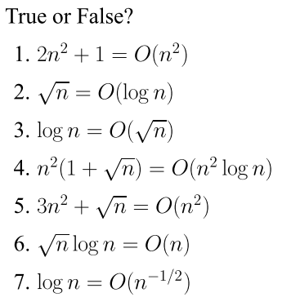
Problem of the Day

Slide 3
Sequential Search
int sequentialSearch( const int a[], int item, int n){
for (int i = 0; i < n && a[i]!= item; i++);
if (i == n)
return –1;
return i;
}
Unsuccessful Search: ➔ O(n)
Successful Search:
Best-Case: item is in the first location of the array ➔ O(1)
Worst-Case: item is in the last location of the array ➔ O(n)
Average-Case: The number of key comparisons 1, 2, ..., n
➔ O(n)

Slide 4
Binary Search
int binarySearch( int a[], int size, int x) {
int low =0;
int high = size –1;
int mid; // mid will be the index of
// target when it’s found.
while (low <= high) {
mid = (low + high)/2;
if (a[mid] < x)
low = mid + 1;
else if (a[mid] > x)
high = mid – 1;
else
return mid;
}
return –1;
}

Slide 5
Binary Search – Analysis
For an unsuccessful search:
The number of iterations in the loop is ⎣log₂n⎦ + 1 ➔ O(log₂n)
For a successful search:
Best-Case: The number of iterations is 1 ➔ O(1)
Worst-Case: The number of iterations is ⎣log₂n⎦ +1 ➔ O(log₂n)
Average-Case: The avg. # of iterations < log₂n ➔ O(log₂n)
0 1 2 3 4 5 6 7 ← an array with size 8
3 2 3 1 3 2 3 4 ← # of iterations
The average # of iterations = 21/8 < log₂8

Slide 6
How much better is O(log₂n)?
n O(log₂n)
16 4
64 6
256 8
1024 (1KB) 10
16,384 14
131,072 17
262,144 18
524,288 19
1,048,576 (1MB) 20
1,073,741,824 (1GB) 30

Slide 7
Sorting

Slide 8
Importance of Sorting
Why don’t CS profs ever stop talking about sorting?
Computers spend more time sorting than anything else, historically 25% on mainframes.
Sorting is the best studied problem in computer science, with a variety of different algorithms known.
Most of the interesting ideas we will encounter in the course can be taught in the context of sorting, such as divide-and-conquer, randomized algorithms, and lower bounds.
(slide by Steven Skiena)

Slide 9
Sorting
Organize data into ascending / descending order
Useful in many applications
Any examples can you think of?
Internal sort vs. external sort
We will analyze only internal sorting algorithms
Sorting also has other uses. It can make an algorithm faster.
e.g., find the intersection of two sets

Slide 10
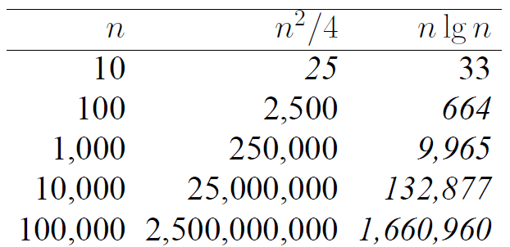
Efficiency of Sorting
Sorting is important because once a set of items is sorted, many other problems become easy.
Furthermore, using O(n log n) sorting algorithms leads naturally to sub-quadratic algorithms for these problems.
Large-scale data processing would be impossible if sorting took O(n²) time.
(slide by Steven Skiena)

Slide 11
Applications of Sorting
Closest Pair: Given n numbers, find the pair which are closest to each other.
Once the numbers are sorted, the closest pair will be next to each other in sorted order, so an O(n) linear scan completes the job. – Complexity of this process: O(??)
Element Uniqueness: Given a set of n items, are they all unique or are there any duplicates?
Sort them and do a linear scan to check all adjacent pairs.
This is a special case of closest pair above.
Complexity?
Mode: Given a set of n items, which element occurs the largest number of times? More generally, compute the frequency distribution.
How would you solve it?

Slide 12
Sorting Algorithms
There are many sorting algorithms, such as:
Selection Sort
Insertion Sort
Bubble Sort
Merge Sort
Quick Sort
First three sorting algorithms are not so efficient, but last two are efficient sorting algorithms.

Slide 13
Selection Sort

Slide 14
Selection Sort
List divided into two sublists, sorted and unsorted.
Find the biggest element from the unsorted sublist. Swap it with the element at the end of the unsorted data.
After each selection and swapping, imaginary wall between the two sublists move one element back.
Sort pass: Each time we move one element from the unsorted sublist to the sorted sublist, we say that we have completed a sort pass.
A list of n elements requires n-1 passes to completely sort data.

Slide 15
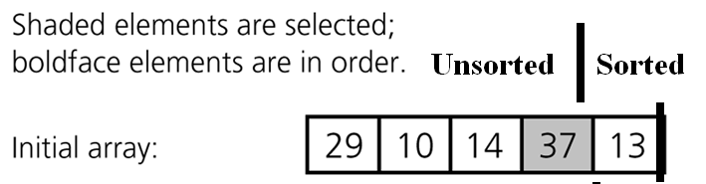




Selection Sort (cont.)

Slide 16
Selection Sort (cont.)
typedef type-of-array-item DataType;
void selectionSort( DataType theArray[], int n) {
for (int last = n-1; last >= 1; --last) {
int largest = indexOfLargest(theArray, last+1);
swap(theArray[largest], theArray[last]);
}
}

Slide 17
Selection Sort (cont.)
int indexOfLargest(const DataType theArray[], int size) {
int indexSoFar = 0;
for (int currentIndex=1; currentIndex<size;++currentIndex)
{
if (theArray[currentIndex] > theArray[indexSoFar])
indexSoFar = currentIndex;
}
return indexSoFar;
}
--------------------------------------------------------
void swap(DataType &x, DataType &y) {
DataType temp = x;
x = y;
y = temp;
}

Slide 18
Selection Sort -- Analysis
To analyze sorting, count simple operations
For sorting, important simple operations: key comparisons and number of moves
In selectionSort() function, the for loop executes n-1 times.
In selectionSort() function, we invoke swap() once at each iteration.
➔ Total Swaps: n-1
➔ Total Moves: 3*(n-1) (Each swap has three moves)

Slide 19
Selection Sort – Analysis (cont.)
In indexOfLargest() function, the for loop executes (from n-1 to 1), and each iteration we make one key comparison.
➔ # of key comparisons = 1+2+...+n-1 = n*(n-1)/2
➔ So, Selection sort is O(n²)
The best case, worst case, and average case are the same ➔ all O(n²)
Meaning: behavior of selection sort does not depend on initial organization of data.
Since O(n²) grows so rapidly, the selection sort algorithm is appropriate only for small n.
Although selection sort requires O(n²) key comparisons, it only requires O(n) moves.
Selection sort is good choice if data moves are costly but key comparisons are not costly (short keys, long records).

Slide 20
Insertion Sort

Slide 21
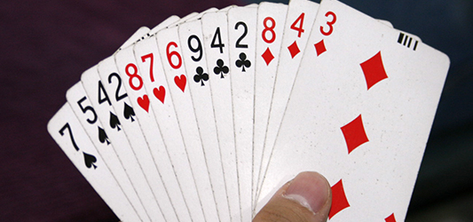
Insertion Sort
Insertion sort is a simple sorting algorithm appropriate for small inputs.
Most common sorting technique used by card players.
List divided into two parts: sorted and unsorted.
In each pass, the first element of the unsorted part is picked up, transferred to the sorted sublist, and inserted in place.
List of n elements will take at most n-1 passes to sort data.

Slide 22
Insertion Sort: Basic Idea
Assume input array: A[1..n]
Iterate j from 2 to n
already sorted
j
iter j
insert into sorted array
j
after
iter j
sorted subarray

Slide 23
Algorithm: Insertion Sort
Insertion-Sort (A)
1. for j ← 2 to n do
2. key ← A[j];
3. i ← j - 1;
4. while i > 0 and A[i] > key
do
5. A[i+1] ← A[i];
6. i ← i - 1;
endwhile
7. A[i+1] ← key;
endfor

Slide 24
Algorithm: Insertion Sort
Insertion-Sort (A)
1. for j ← 2 to n do
2. key ← A[j];
3. i ← j - 1;
4. while i > 0 and A[i] > key
do
5. A[i+1] ← A[i];
6. i ← i - 1;
endwhile
7. A[i+1] ← key;
endfor
Iterate over array elts j
Loop invariant:
The subarray A[1..j-1]
is always sorted
already sorted
j
key

Slide 25
Algorithm: Insertion Sort
Insertion-Sort (A)
1. for j ← 2 to n do
2. key ← A[j];
3. i ← j - 1;
4. while i > 0 and A[i] > key
do
5. A[i+1] ← A[i];
6. i ← i - 1;
endwhile
7. A[i+1] ← key;
endfor
Shift right the entries
in A[1..j-1] that are > key
already sorted
j
< key
> key
j
< key
> key

Slide 26
Algorithm: Insertion Sort
Insertion-Sort (A)
1. for j ← 2 to n do
2. key ← A[j];
3. i ← j - 1;
4. while i > 0 and A[i] > key
do
5. A[i+1] ← A[i];
6. i ← i - 1;
endwhile
7. A[i+1] ← key;
endfor
key
j
< key
> key
now sorted
Insert key to the correct location
End of iter j: A[1..j] is sorted

Slide 27
Insertion Sort - Example
Insertion-Sort (A)
1. for j ← 2 to n do
2. key ← A[j];
3. i ← j - 1;
4. while i > 0 and A[i] > key
do
5. A[i+1] ← A[i];
6. i ← i - 1;
endwhile
7. A[i+1] ← key;
endfor
5
2
4
6
1
3

Slide 28
Insertion Sort - Example: Iteration j=2
Insertion-Sort (A)
1. for j ← 2 to n do
2. key ← A[j];
3. i ← j - 1;
4. while i > 0 and A[i] > key
do
5. A[i+1] ← A[i];
6. i ← i - 1;
endwhile
7. A[i+1] ← key;
endfor
key=2
j
5
2
4
6
1
3
initial
sorted
> 2
j
5
2
4
6
1
3
shift
sorted
insert
key
2
5
4
6
1
3

Slide 29
Insertion Sort - Example: Iteration j=3
Insertion-Sort (A)
1. for j ← 2 to n do
2. key ← A[j];
3. i ← j - 1;
4. while i > 0 and A[i] > key
do
5. A[i+1] ← A[i];
6. i ← i - 1;
endwhile
7. A[i+1] ← key;
endfor
key=4
j
2
5
4
6
1
3
initial
sorted
What are the entries at the
end of iteration j=3?
?
?
?
?
?
?

Slide 30
Insertion Sort - Example: Iteration j=3
Insertion-Sort (A)
1. for j ← 2 to n do
2. key ← A[j];
3. i ← j - 1;
4. while i > 0 and A[i] > key
do
5. A[i+1] ← A[i];
6. i ← i - 1;
endwhile
7. A[i+1] ← key;
endfor
key=4
j
2
5
4
6
1
3
initial
sorted
j
< 4
> 4
2
5
4
6
1
3
shift
sorted
insert
key
2
4
5
6
1
3

Slide 31
Insertion Sort - Example: Iteration j=4
Insertion-Sort (A)
1. for j ← 2 to n do
2. key ← A[j];
3. i ← j - 1;
4. while i > 0 and A[i] > key
do
5. A[i+1] ← A[i];
6. i ← i - 1;
endwhile
7. A[i+1] ← key;
endfor
key=6
j
2
4
5
6
1
3
initial
sorted
j
< 6
2
4
5
6
1
3
shift
sorted
insert
key
2
4
5
6
1
3

Slide 32
Insertion Sort - Example: Iteration j=5
Insertion-Sort (A)
1. for j ← 2 to n do
2. key ← A[j];
3. i ← j - 1;
4. while i > 0 and A[i] > key
do
5. A[i+1] ← A[i];
6. i ← i - 1;
endwhile
7. A[i+1] ← key;
endfor
key=1
j
2
4
5
6
1
3
initial
sorted
What are the entries at the
end of iteration j=5?
?
?
?
?
?
?

Slide 33
Insertion Sort - Example: Iteration j=5
Insertion-Sort (A)
1. for j ← 2 to n do
2. key ← A[j];
3. i ← j - 1;
4. while i > 0 and A[i] > key
do
5. A[i+1] ← A[i];
6. i ← i - 1;
endwhile
7. A[i+1] ← key;
endfor
key=1
j
2
4
5
6
1
3
initial
sorted
j
>1
>1
>1
>1
2
4
5
6
1
3
shift
sorted
insert
key
1
2
4
5
6
3

Slide 34
Insertion Sort - Example: Iteration j=6
Insertion-Sort (A)
1. for j ← 2 to n do
2. key ← A[j];
3. i ← j - 1;
4. while i > 0 and A[i] > key
do
5. A[i+1] ← A[i];
6. i ← i - 1;
endwhile
7. A[i+1] ← key;
endfor
key=3
j
1
2
4
5
6
3
initial
sorted
j
<3
>3
>3
>3
1
2
4
5
6
3
shift
sorted
insert
key
1
2
3
4
5
6

Slide 35
Insertion Sort Algorithm - Notes
Items sorted in-place
Elements rearranged within array
At most constant number of items stored outside the array at any time (e.g. the variable key)
Input array A contains sorted output sequence when the algorithm ends
Incremental approach
Having sorted A[1..j-1], place A[j] correctly so that A[1..j] is sorted

Slide 36
Insertion Sort (in C++)
void insertionSort(DataType theArray[], int n) {
for (int unsorted = 1; unsorted < n; ++unsorted) {
DataType nextItem = theArray[unsorted];
int loc = unsorted;
for ( ;(loc > 0) && (theArray[loc-1] > nextItem); --loc)
theArray[loc] = theArray[loc-1];
theArray[loc] = nextItem;
}
}

Slide 37





Insertion Sort (cont.)
Sorted
Unsorted

Slide 38
Insertion Sort – Analysis
What is the complexity of insertion sort? ➔ Depends on array contents
Best-case: ➔ O(n)
Array is already sorted in ascending order.
Inner loop will not be executed.
The number of moves: 2*(n-1) ➔ O(n)
The number of key comparisons: (n-1) ➔ O(n)
Worst-case: ➔ O(n²)
Array is in reverse order:
Inner loop is executed p-1 times, for p = 2,3, …, n
The number of moves: 2*(n-1)+(1+2+...+n-1)= 2*(n-1)+ n*(n-1)/2 ➔ O(n²)
The number of key comparisons: (1+2+...+n-1)= n*(n-1)/2 ➔ O(n²)
Average-case: ➔ O(n²)
We have to look at all possible initial data organizations.
So, Insertion Sort is O(n²)

Slide 39
Insertion Sort – Analysis
Which running time will be used to characterize this algorithm?
Best, worst or average?
➔ Worst case:
Longest running time (this is the upper limit for the algorithm)
It is guaranteed that the algorithm will not be worse than this.
Sometimes we are interested in average case. But there are problems:
Difficult to figure out average case. i.e. what is the average input?
Are we going to assume all possible inputs are equally likely?
In fact, for most algorithms average case is the same as the worst case.

Slide 40
Bubble Sort

Slide 41
Bubble Sort
List divided into two sublists: sorted and unsorted.
The largest element is bubbled from the unsorted list and moved to the sorted sublist.
After that, the wall moves one element back, increasing the number of sorted elements and decreasing the number of unsorted ones.
One sort pass: each time an element moves from the unsorted part to the sorted part.
Given a list of n elements, bubble sort requires up to n-1 passes (maximum passes) to sort data.

Slide 42
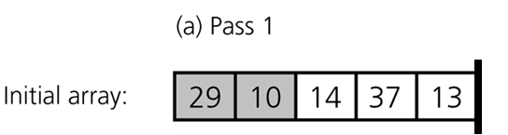
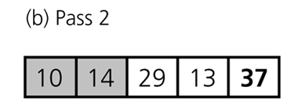







Bubble Sort (cont.)

Slide 43
Bubble Sort (cont.)
void bubbleSort( DataType theArray[], int n) {
bool sorted = false;
for (int pass = 1; (pass < n) && !sorted; ++pass) {
sorted = true;
for (int index = 0; index < n-pass; ++index) {
int nextIndex = index + 1;
if (theArray[index] > theArray[nextIndex]) {
swap(theArray[index], theArray[nextIndex]);
sorted = false; // signal exchange
}
}
}
}

Slide 44
Bubble Sort – Analysis
Worst-case: ➔ O(n²)
Array is in reverse order:
Inner loop is executed n-1 times,
The number of moves: 3*(1+2+...+n-1) = 3 * n*(n-1)/2 ➔ O(n²)
The number of key comparisons: (1+2+...+n-1)= n*(n-1)/2 ➔ O(n²)
Best-case: ➔ O(n)
Array is already sorted in ascending order.
The number of moves: 0 ➔ O(1)
The number of key comparisons: (n-1) ➔ O(n)
Average-case: ➔ O(n²)
We have to look at all possible initial data organizations.
So, Bubble Sort is O(n²)

Slide 45
Merge Sort

Slide 46
Mergesort
One of two important divide-and-conquer sorting algorithms
Other one is Quicksort
It is a recursive algorithm.
Divide the list into halves,
Sort each half separately, and
Then merge the sorted halves into one sorted array.

Slide 47
Merge Sort: Basic Idea
Input array A
Divide
sort this half
sort this half
Conquer
merge two sorted halves
Combine

Slide 48
Merge-Sort (A, p, r)
if p = r then return;
else
q ← ⎣ (p+r)/2⎦; (Divide)
Merge-Sort (A, p, q); (Conquer)
Merge-Sort (A, q+1, r); (Conquer)
Merge (A, p, q, r); (Combine)
endif
Call Merge-Sort(A,1,n) to sort A[1..n]
Recursion bottoms out when subsequences have length 1

Slide 49
Merge Sort: Example
Merge-Sort (A, p, r)
if p = r then
return
else
q ← ⎣ (p+r)/2⎦
Merge-Sort (A, p, q)
Merge-Sort (A, q+1, r)
Merge(A, p, q, r)
endif
p
q
r
5
2
4
6
1
3
p
q
r
2
4
5
1
3
6
1
2
3
4
5
6

Slide 50
How to merge 2 sorted subarrays?
A[p..q]
2
4
5
1
2
3
4
5
6
A[q+1..r]
1
3
6
What is the complexity of this step?
Θ(n)

Slide 51
Merge Sort: Correctness
Merge-Sort (A, p, r)
if p = r then
return
else
q ← ⎣ (p+r)/2⎦
Merge-Sort (A, p, q)
Merge-Sort (A, q+1, r)
Merge(A, p, q, r)
endif
Base case: p = r
→ Trivially correct
Inductive hypothesis: MERGE-SORT
is correct for any subarray that is a
strict (smaller) subset of A[p, q].
General Case: MERGE-SORT is
correct for A[p, q].
From inductive hypothesis and
correctness of Merge.

Slide 52
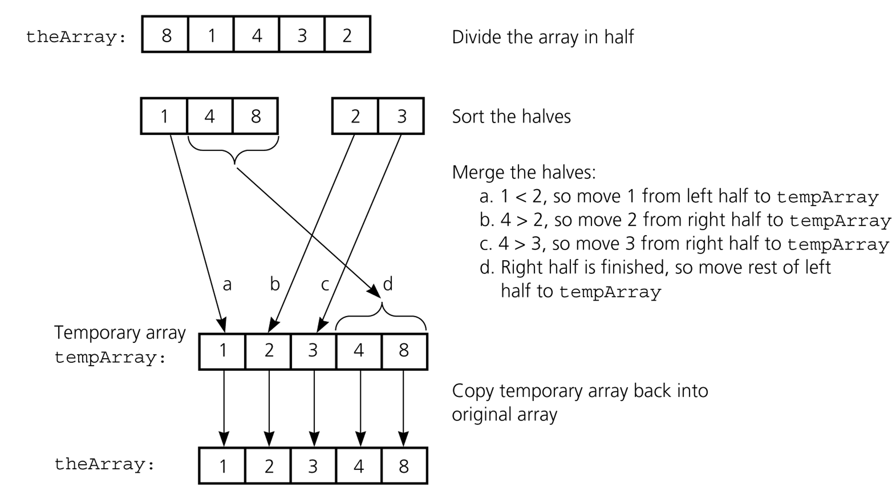
Mergesort – Another Example

Slide 53
Mergesort (in C++)
void mergesort( DataType theArray[], int first, int last) {
if (first < last) {
int mid = (first + last)/2; // index of midpoint
mergesort(theArray, first, mid);
mergesort(theArray, mid+1, last);
// merge the two halves
merge(theArray, first, mid, last);
}
} // end mergesort

Slide 54
Merge
const int MAX_SIZE = maximum-number-of-items-in-array;
void merge( DataType theArray[], int first, int mid, int last) {
DataType tempArray[MAX_SIZE]; // temporary array
int first1 = first; // beginning of first subarray
int last1 = mid; // end of first subarray
int first2 = mid + 1; // beginning of second subarray
int last2 = last; // end of second subarray
int index = first1; // next available location in tempArray
for ( ; (first1 <= last1) && (first2 <= last2); ++index) {
if (theArray[first1] < theArray[first2]) {
tempArray[index] = theArray[first1];
++first1;
}
else {
tempArray[index] = theArray[first2];
++first2;
}
} …

Slide 55
Merge (cont.)
…
// finish off the first subarray, if necessary
for (; first1 <= last1; ++first1, ++index)
tempArray[index] = theArray[first1];
// finish off the second subarray, if necessary
for (; first2 <= last2; ++first2, ++index)
tempArray[index] = theArray[first2];
// copy the result back into the original array
for (index = first; index <= last; ++index)
theArray[index] = tempArray[index];
} // end merge

Slide 56
Mergesort - Example
6 | 3 | 9 | 1 | 5 | 4 | 7 | 2
divide
6 | 3 | 9 | 1
5 | 4 | 7 | 2
divide
divide
6 | 3
9 | 1
5 | 4
7 | 2
divide
divide
divide
divide
6
3
9
1
5
4
7
2
merge
merge
merge
merge
3 | 6
1 | 9
4 | 5
2 | 7
merge
merge
1 | 3 | 6 | 9
2 | 4 | 5 | 7
merge
1 | 2 | 3 | 4 | 5 | 6 | 7 | 9

Slide 57
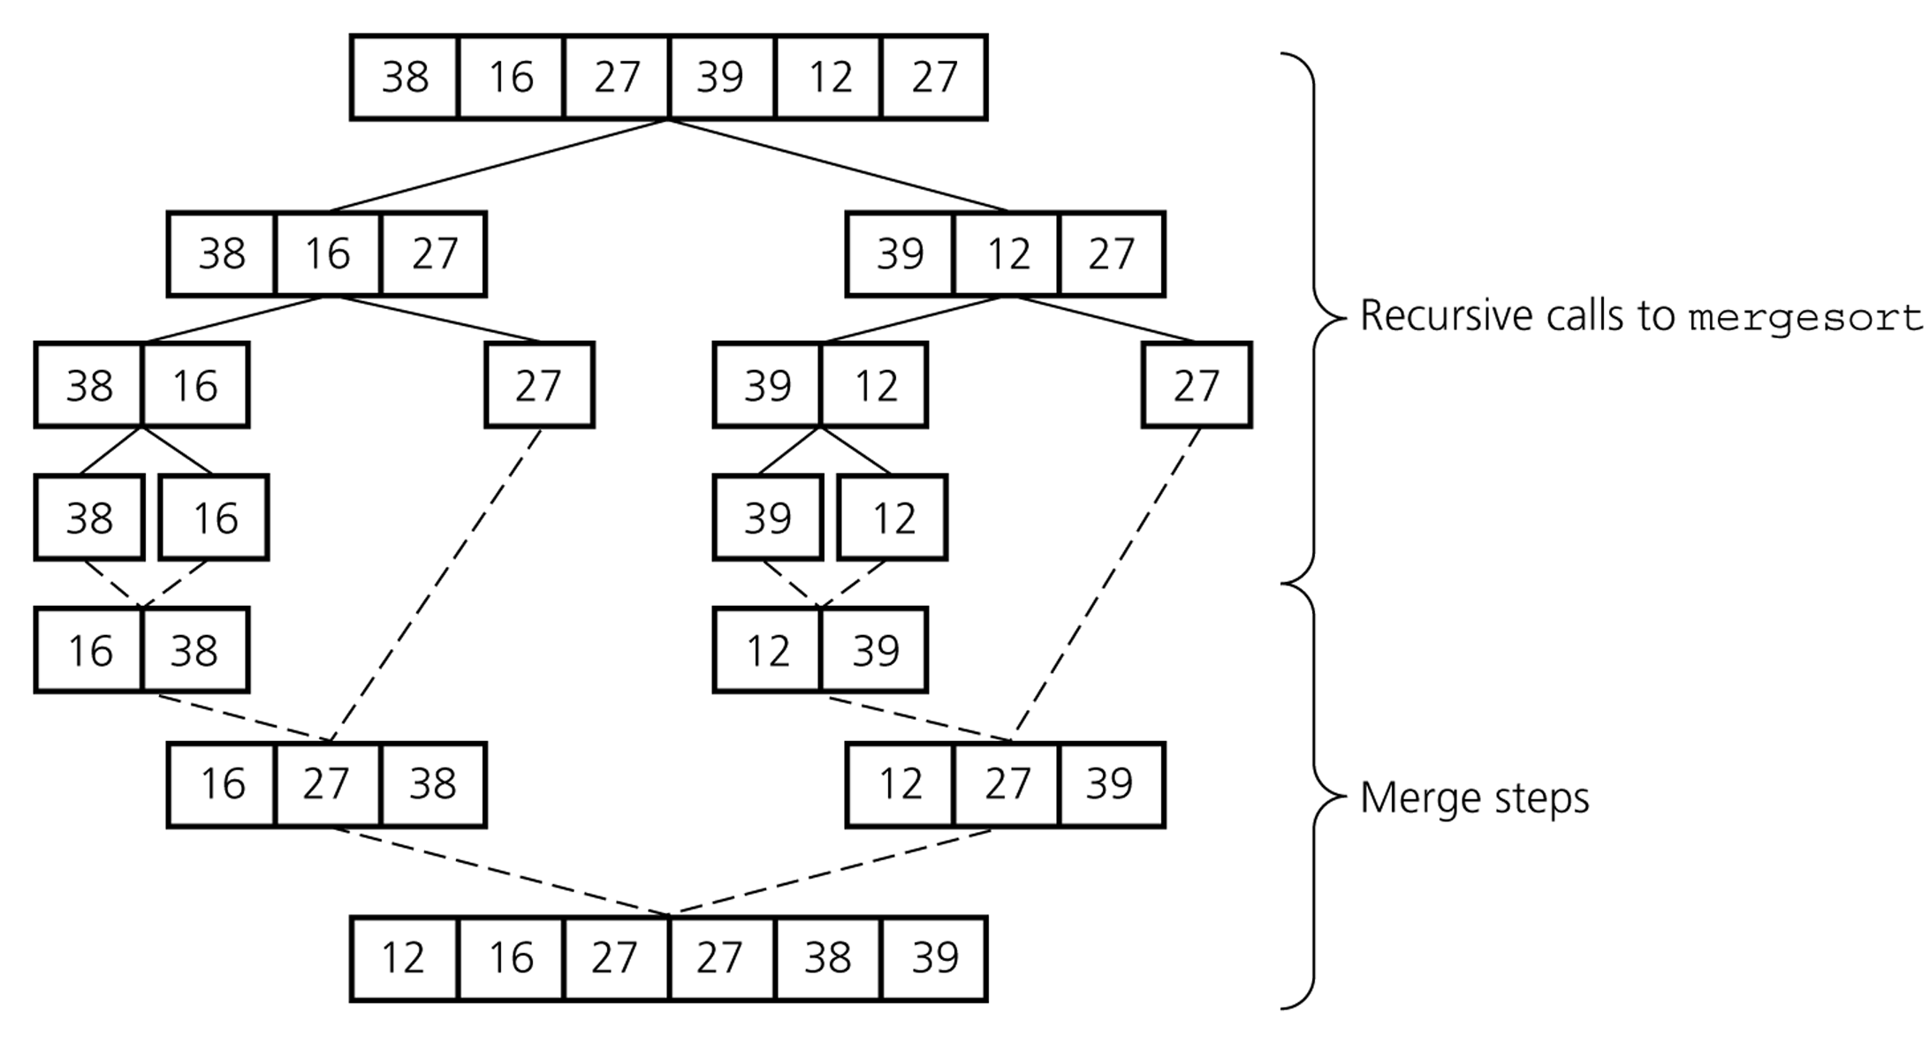
Mergesort – Example2

Slide 58
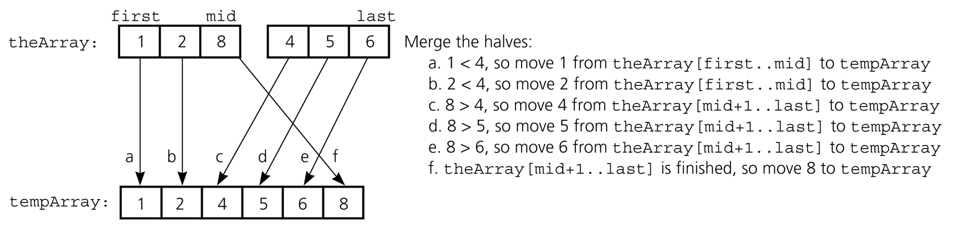
Mergesort – Analysis of Merge
A worst-case instance of the merge step in mergesort

Slide 59
Mergesort – Analysis of Merge (cont.)
0 k-1
0 k-1
Merging two sorted arrays of size k
Best-case:
All the elements in the first array are smaller (or larger) than all the elements in the second array.
The number of moves: 2k + 2k
The number of key comparisons: k
Worst-case:
The number of moves: 2k + 2k
The number of key comparisons: 2k-1
 | ..........
 | ..........
0 2k-1
 | ..........

Slide 60
Merge Sort: Complexity
Merge-Sort (A, p, r)
if p = r then
return
else
q ← ⎣ (p+r)/2⎦
Merge-Sort (A, p, q)
Merge-Sort (A, q+1, r)
Merge(A, p, q, r)
endif
T(n)
Θ(1)
Θ(1)
T(n/2)
T(n/2)
Θ(n)

Slide 61
Merge Sort – Recurrence
Describe a function recursively in terms of itself
To analyze the performance of recursive algorithms
For merge sort:
Θ(1) if n=1
2T(n/2) + Θ(n) otherwise
T(n) =

Slide 62
How to solve for T(n)?
Θ(1) if n=1
2T(n/2) + Θ(n) otherwise
T(n) =
Generally, we will assume T(n) = Θ(1) for sufficiently small n
The recurrence above can be rewritten as:
T(n) = 2 T(n/2) + Θ(n)
How to solve this recurrence?

Slide 63
Solve Recurrence: T(n) = 2T (n/2) + Θ(n)
Θ(n)
T(n/2)
T(n/2)

Slide 64
Solve Recurrence: T(n) = 2T (n/2) + Θ(n)
Θ(n)
Θ(n/2)
Θ(n/2)
T(n/2)
2x
subprobs
each size
halved
T(n/4)
T(n/4)
T(n/4)
T(n/4)

Slide 65
Solve Recurrence: T(n) = 2T (n/2) + Θ(n)
Θ(n)
Θ(n)
Θ(n/2)
Θ(n/2)
Θ(n)
Θ(lgn)
T(n/4)
T(n/4)
T(n/4)
T(n/4)
Θ(1)
Θ(1)
Θ(1)
Θ(1)
Θ(1)
Θ(1)
Θ(1)
Θ(1)
Θ(1)
Θ(n)
Θ(n)
Total: Θ(nlgn)

Slide 66
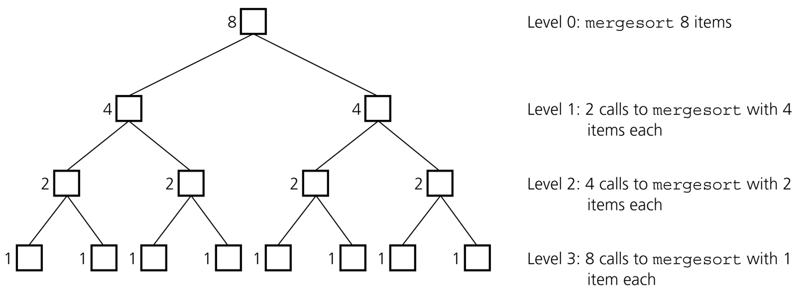
Mergesort - Analysis
Levels of recursive calls to mergesort, given an array of eight items

Slide 67
Mergesort - Analysis
2^{m}
level 0 : 1 merge (size 2^{m-1})
2^{m-1}
2^{m-1}
level 1 : 2 merges (size 2^{m-2})
level 2 : 4 merges (size 2^{m-3})
2^{m-2}
2^{m-2}
2^{m-2}
2^{m-2}
.
.
.
.
.
.
level m-1 : 2^{m-1} merges (size 2⁰)
2⁰
2⁰
. . . . . . . . . . . . . . . . .
level m

Slide 68
Mergesort - Analysis
Worst-case –
The number of key comparisons:
= 2⁰*(2*2^{m-1}-1) + 2¹*(2*2^{m-2}-1) + ... + 2^{m-1}*(2*2⁰-1)
= (2^{m} - 1) + (2^{m} - 2) + ... + (2^{m} – 2^{m-1}) ( m terms )
= m*2^{m} –
= m*2^{m} – (2^{m} – 1)
= n * log₂n – n + 1
➔ O (n * log₂n )

Slide 69
Mergesort – Average Case
There are possibilities when merging two sorted lists of size k.
k=2 ➔ = = 6 different cases
# of key comparisons = ((2*2)+(4*3)) / 6 = 16/6 = 2 + 2/3
Average # of key comparisons in mergesort is
n * log₂n – 1.25*n – O(1)
➔ O (n * log₂n )

Slide 70
Mergesort – Analysis
Mergesort is extremely efficient algorithm with respect to time.
Both worst case and average cases are O (n * log₂n )
But, mergesort requires an extra array whose size equals to the size of the original array.
If we use a linked list, we do not need an extra array
But, we need space for the links
And, it will be difficult to divide the list into half ( O(n) )

Slide 71
Quicksort

Slide 72
Quicksort
Like Mergesort, Quicksort is based on divide-and-conquer paradigm.
But somewhat opposite to Mergesort
Mergesort: Hard work done after recursive call
Quicksort: Hard work done before recursive call
Algorithm
First, partition an array into two parts,
Then, sort each part independently,
Finally, combine sorted parts by a simple concatenation.

Slide 73
Quicksort (cont.)
The quick-sort algorithm consists of the following three steps:
Divide: Partition the list.
1.1 Choose some element from list. Call this element the pivot.
- We hope about half the elements will come before and half after.
1.2 Then partition the elements so that all those with values less than the pivot come in one sublist and all those with values greater than or equal to come in another.
2. Recursion: Recursively sort the sublists separately.
3. Conquer: Put the sorted sublists together.

Slide 74
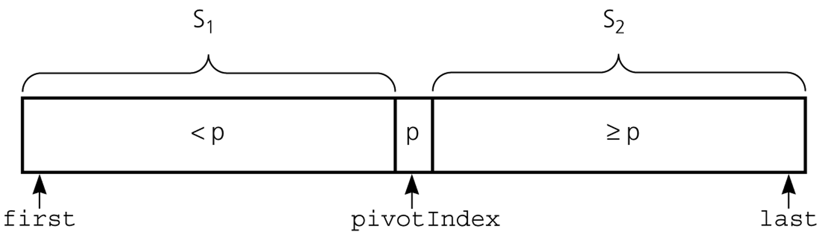
Partition
Partitioning places the pivot in its correct place position within the array.
Arranging elements around pivot p generates two smaller sorting problems.
sort left section of the array, and sort right section of the array.
when these two smaller sorting problems are solved recursively, our bigger sorting problem is solved.

Slide 75
Divide: Partition the array around a pivot element
Choose a pivot element x
Rearrange the array such that:
Left subarray: All elements < x
Right subarray: All elements ≥ x
Input:
5
3
2
7
4
1
3
6
e.g. x = 5
After partitioning:
3
3
2
1
4
5
7
6
< 5
≥ 5

Slide 76
Conquer: Recursively Sort the Subarrays
Note: Everything in the left subarray < everything in the right subarray
3
3
2
1
4
5
7
6
sort recursively
sort recursively
After conquer:
1
2
3
3
4
5
6
7
Note: Combine is trivial after conquer. Array already sorted.

Slide 77
Partition – Choosing the pivot
First, select a pivot element among the elements of the given array, and put pivot into first location of the array before partitioning.
Which array item should be selected as pivot?
Somehow we have to select a pivot, and we hope that we will get a good partitioning.
If the items in the array arranged randomly, we choose a pivot randomly.
We can choose the first or last element as a pivot (it may not give a good partitioning).
We can use different techniques to select the pivot.

Slide 78
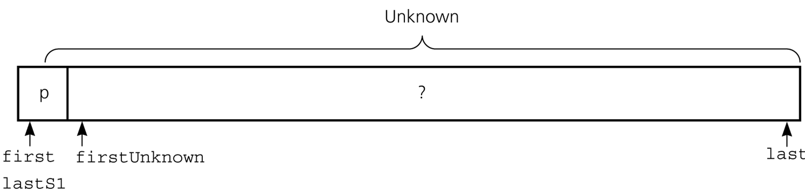
Partition Function (cont.)
Initial state of the array

Slide 79
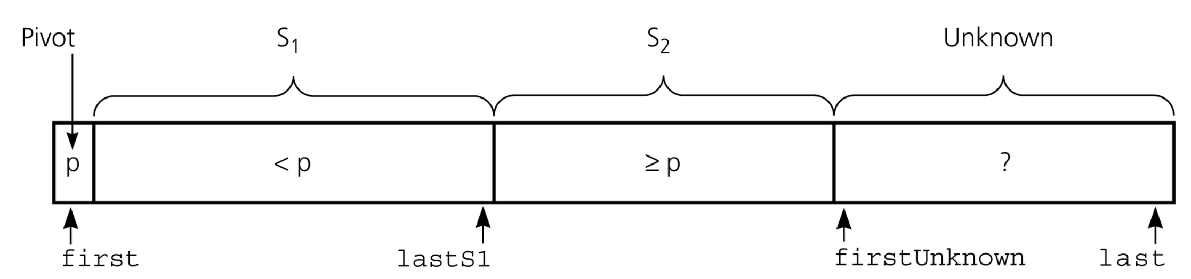
Partition Function (cont.)
Invariant for the partition algorithm

Slide 80
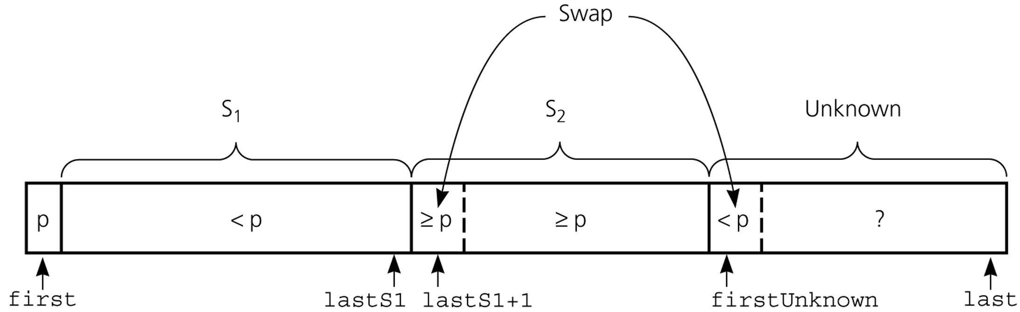
Partition Function (cont.)
Moving theArray[firstUnknown] into S₁ by swapping it with
theArray[lastS1+1] and by incrementing both lastS1 and firstUnknown.

Slide 81
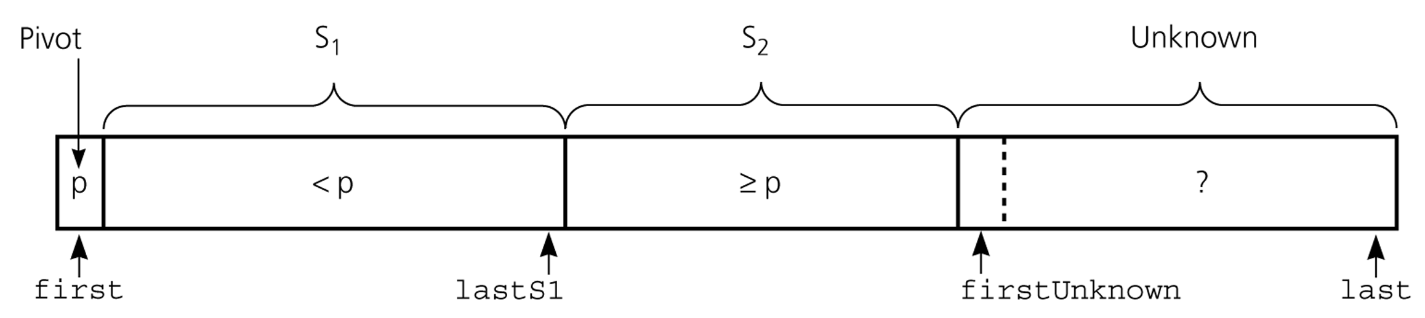
Partition Function (cont.)
Moving theArray[firstUnknown] into S₂ by incrementing firstUnknown.

Slide 82







Partition Function (cont.)
Developing the first
partition of an array
when the pivot is the
first item

Slide 83
Quicksort Function
void quicksort(DataType theArray[], int first, int last) {
// Precondition: theArray[first..last] is an array.
// Postcondition: theArray[first..last] is sorted.
int pivotIndex;
if (first < last) {
// create the partition: S1, pivot, S2
partition(theArray, first, last, pivotIndex);
// sort regions S1 and S2
quicksort(theArray, first, pivotIndex-1);
quicksort(theArray, pivotIndex+1, last);
}
}

Slide 84
Partition Function
void partition(DataType theArray[], int first, int last,
int &pivotIndex) {
// Precondition: theArray[first..last] is an array; first <= last.
// Postcondition: Partitions theArray[first..last] such that:
// S1 = theArray[first..pivotIndex-1] < pivot
// theArray[pivotIndex] == pivot
// S2 = theArray[pivotIndex+1..last] >= pivot
// place pivot in theArray[first]
choosePivot(theArray, first, last);
DataType pivot = theArray[first]; // copy pivot
…

Slide 85
Partition Function (cont.)
// initially, everything but pivot is in unknown
int lastS1 = first; // index of last item in S1
int firstUnknown = first + 1; // index of first item in unknown
// move one item at a time until unknown region is empty
for ( ; firstUnknown <= last; ++firstUnknown) {
// Invariant: theArray[first+1..lastS1] < pivot
// theArray[lastS1+1..firstUnknown-1] >= pivot
// move item from unknown to proper region
if (theArray[firstUnknown] < pivot) { // belongs to S1
++lastS1;
swap(theArray[firstUnknown], theArray[lastS1]);
} // else belongs to S2
}
// place pivot in proper position and mark its location
swap(theArray[first], theArray[lastS1]);
pivotIndex = lastS1;
}

Slide 86
Quicksort – Analysis
Worst Case: (assume that we are selecting the first element as pivot)
The pivot divides the list of size n into two sublists of sizes 0 and n-1.
The number of key comparisons
= n-1 + n-2 + ... + 1
= n²/2 – n/2 ➔ O(n²)
The number of swaps =
= n-1 + n-1 + n-2 + ... + 1
swaps outside of the for loop swaps inside of the for loop
= n²/2 + n/2 - 1 ➔ O(n²)
So, Quicksort is O(n²) in worst case

Slide 87
Quicksort – Analysis
Quicksort is O(n*log₂n) in the best case and average case.
Quicksort is slow when the array is already sorted and we choose the first element as the pivot.
Although the worst case behavior is not so good, and its average case behavior is much better than its worst case.
So, Quicksort is one of best sorting algorithms using key comparisons.

Slide 88
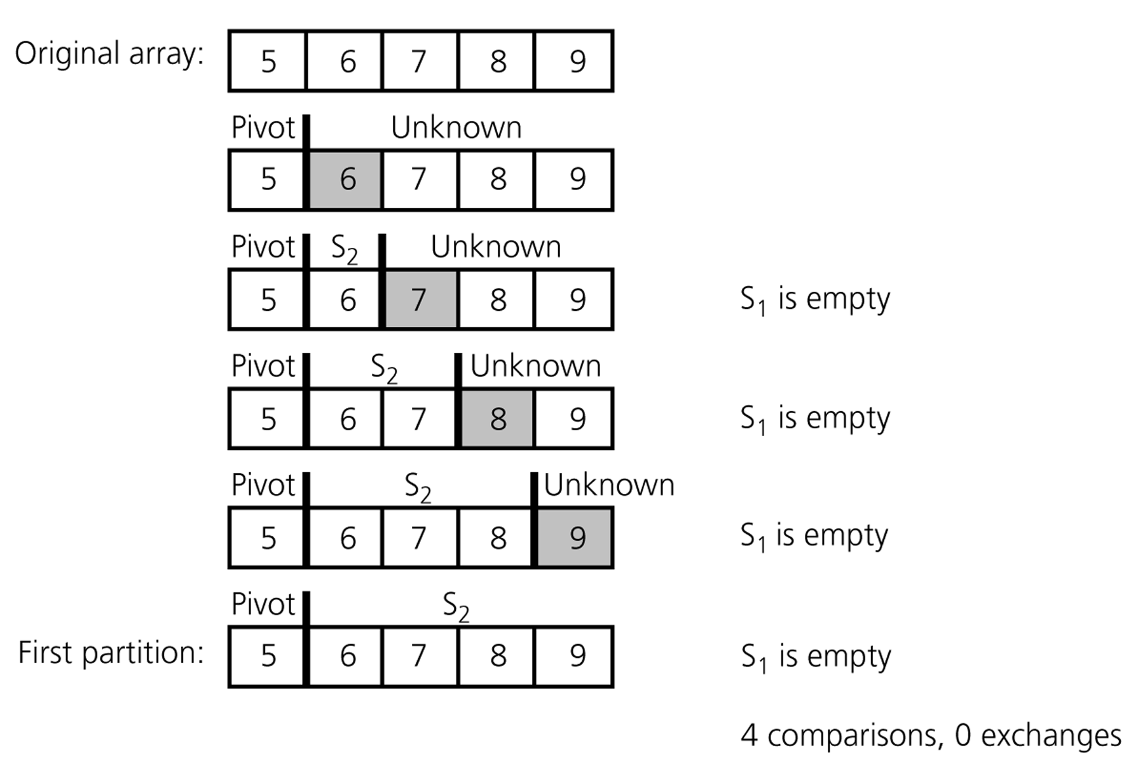
Quicksort – Analysis
A worst-case partitioning with quicksort

Slide 89
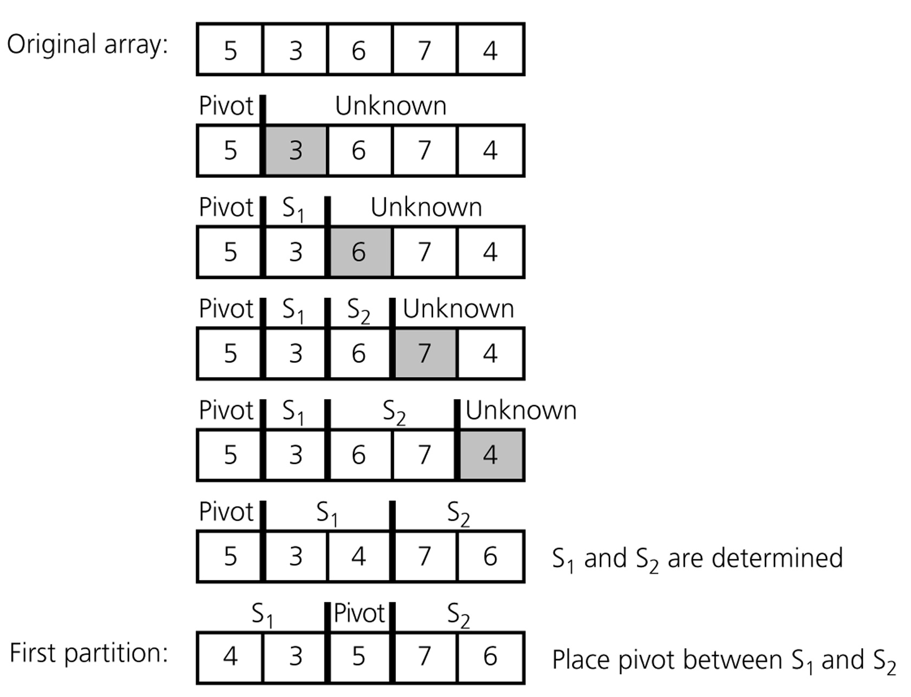
Quicksort – Analysis
An average-case partitioning with quicksort

Slide 90
Other Sorting Algorithms?

Slide 91
Other Sorting Algorithms?
Many! For example:
Shell sort
Comb sort
Heapsort
Counting sort
Bucket sort
Distribution sort
Timsort
e.g. Check http://en.wikipedia.org/wiki/Sorting_algorithm for a table comparing sorting algorithms.

Slide 92
Radix Sort
Radix sort algorithm different than other sorting algorithms that we talked.
It does not use key comparisons to sort an array.
The radix sort :
Treats each data item as a character string.
First group data items according to their rightmost character, and put these groups into order w.r.t. this rightmost character.
Then, combine these groups.
Repeat these grouping and combining operations for all other character positions in the data items from the rightmost to the leftmost character position.
At the end, the sort operation will be completed.

Slide 93
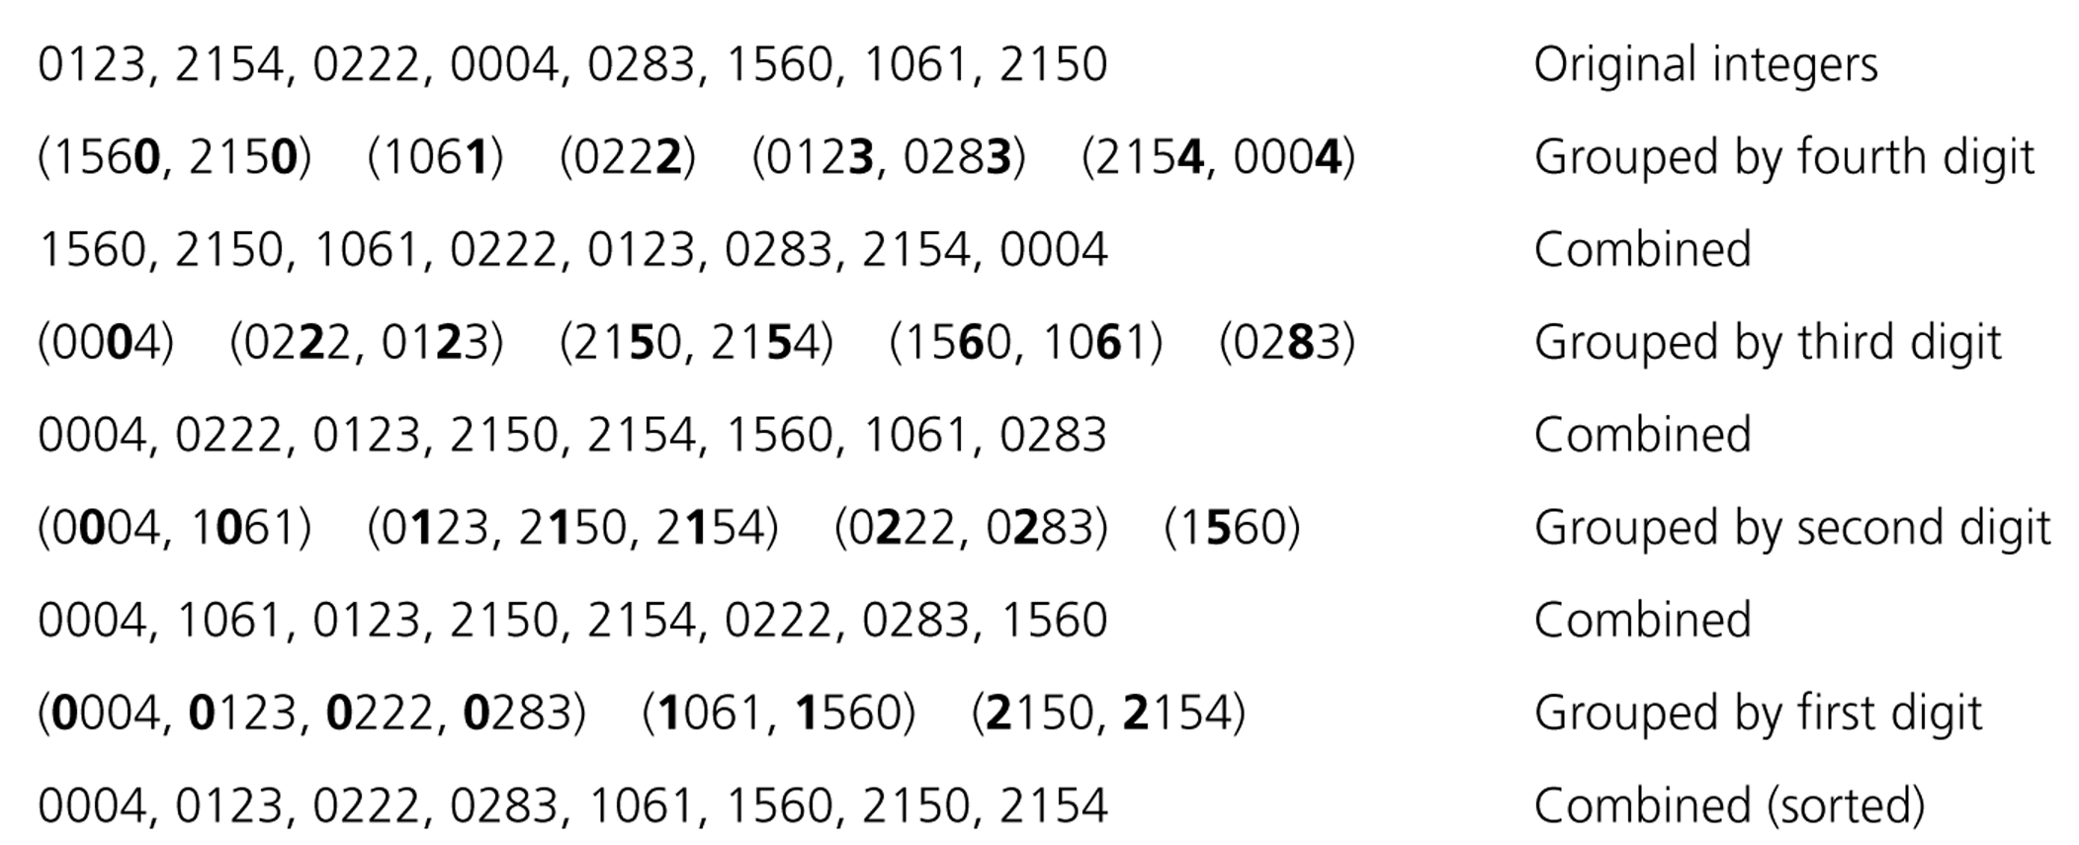
Radix Sort – Example

Slide 94
Radix Sort – Example
mom, dad, god, fat, bad, cat, mad, pat, bar, him original list
(dad,god,bad,mad) (mom,him) (bar) (fat,cat,pat) group strings by rightmost letter
dad,god,bad,mad,mom,him,bar,fat,cat,pat combine groups
(dad,bad,mad,bar,fat,cat,pat) (him) (god,mom) group strings by middle letter
dad,bad,mad,bar,fat,cat,pat,him,god,mom combine groups
(bad,bar) (cat) (dad) (fat) (god) (him) (mad,mom) (pat) group strings by middle letter
bad,bar,cat,dad,fat,god,him,mad,mom,par combine groups (SORTED)

Slide 95
Radix Sort - Algorithm
radixSort( int theArray[], in n:integer, in d:integer)
// sort n d-digit integers in the array theArray
for (j=d down to 1) {
Initialize 10 groups to empty
Initialize a counter for each group to 0
for (i=0 through n-1) {
k = jth digit of theArray[i]
Place theArray[i] at the end of group k
Increase kth counter by 1
}
Replace the items in theArray with all the items in
group 0, followed by all the items in group 1, and so on.
}

Slide 96
Radix Sort -- Analysis
The radix sort algorithm requires 2*n*d moves to sort n strings of d characters each.
➔ So, Radix Sort is O(n)
Although the radix sort is O(n), it is not appropriate as a general-purpose sorting algorithm.
Its memory requirement is d * original size of data (because each group should be big enough to hold the original data collection.)
For example, to sort string of uppercase letters. we need 27 groups.
The radix sort is more appropriate for a linked list than an array. (we will not need the huge memory in this case)

Slide 97
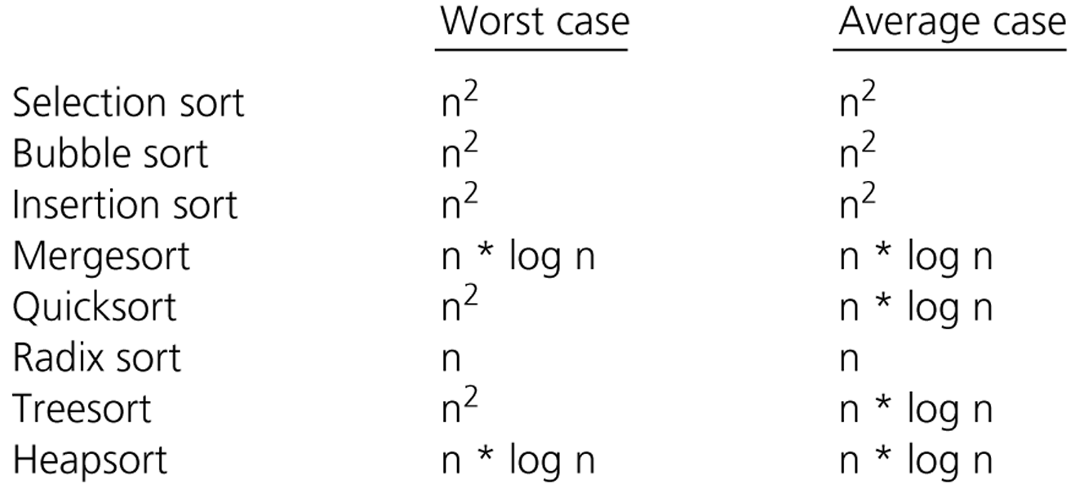
Comparison of Sorting Algorithms

