Slide 1
Trees
Initially prepared by Dr. İlyas Çiçekli; improved by various Bilkent CS202 instructors.

Slide 2
What is a Tree?
T is a tree if either
T has no nodes, or
T is of the form:
where r is a node and T₁, T₂, ..., T_{k} are trees.

Slide 3
Tree Terminology
Parent – The parent of node n is the node directly above in the tree.
Child – The child of node n is the node directly below in the tree.
If node m is the parent of node n, node n is the child of node m.
Root – The only node in the tree with no parent.
Leaf – A node with no children.
Siblings – Nodes with a common parent.
Ancestor – An ancestor of node n is a node on the path from the root to n.
Descendant – A descendant of node n is a node on the path from n to a leaf.
Subtree – A subtree of node n is a tree that consists of a child (if any) of n and the child’s descendants (a tree which is rooted by a child of node n)

Slide 4
A Tree – Example
Root
A
B
C
D
E
F
G
Leaf
H
I
J
K
L
M
N
Siblings
P
Q
Node A has 6 children: B, C, D, E, F, G.
B, C, H, I, P, Q, K, L, M, N are leaves in the tree above.
K, L, M are siblings since F is parent of all of them.

Slide 5
What is a Tree?
The root of each sub-tree is said to be child of r, and
r is the parent of each sub-tree’s root.
If a tree is a collection of N nodes, then it has N-1 edges. Why?
A path from node n₁ to n_{k} is defined as a sequence of nodes n₁,n₂, …,n_{k} such that n_{i} is parent of n_{i+1} (1 ≤ i < k)
There is a path from every node to itself.
There is exactly one path from the root to each node. Why?

Slide 6
Level of a node
Level – The level of node n is the number of nodes on the path from root to node n.
Definition: The level of node n in a tree T
If n is the root of T, the level of n is 1.
If n is not the root of T, its level is 1 greater than the level of its parent.

Slide 7
Height of A Tree
Height – number of nodes on longest path from the root to any leaf.
The height of a tree T in terms of the levels of its nodes is defined as:
If T is empty, its height is 0
If T is not empty, its height is equal to the maximum level of its nodes.
Or, the height of a tree T can be defined as recursively as:
If T is empty, its height is 0.
If T is non-empty tree, then since T is of the form:
height(T) = 1 + max{height(T₁),height(T₂),...,height(T_{k})}

Slide 8
Binary Tree
A binary tree T is a set of nodes with the following properties:
The set can be empty.
Otherwise, the set is partitioned into three disjoint subsets:
a tree consists of a distinguished node r, called root, and
two possibly empty sets are binary tree, called left and right subtrees of r.
T is a binary tree if either
T has no nodes, or
T is of the form:
where r is a node and T_{L} and T_{R} are binary trees.

Slide 9
Binary Tree Terminology
Left Child – The left child of node n is a node directly below and to the left of node n in a binary tree.
Right Child – The right child of node n is a node directly below and to the right of node n in a binary tree.
Left Subtree – In a binary tree, the left subtree of node n is the left child (if any) of node n plus its descendants.
Right Subtree – In a binary tree, the right subtree of node n is the right child (if any) of node n plus its descendants.

Slide 10
Binary Tree -- Example
A is the root.
B is left child of A,
C is right child of A.
D doesn’t have a right child.
H doesn’t have a left child.
B, F, G and I are leaves.
• A
• B
• C
• D
• E
• F
• G
• H
• I

Slide 11
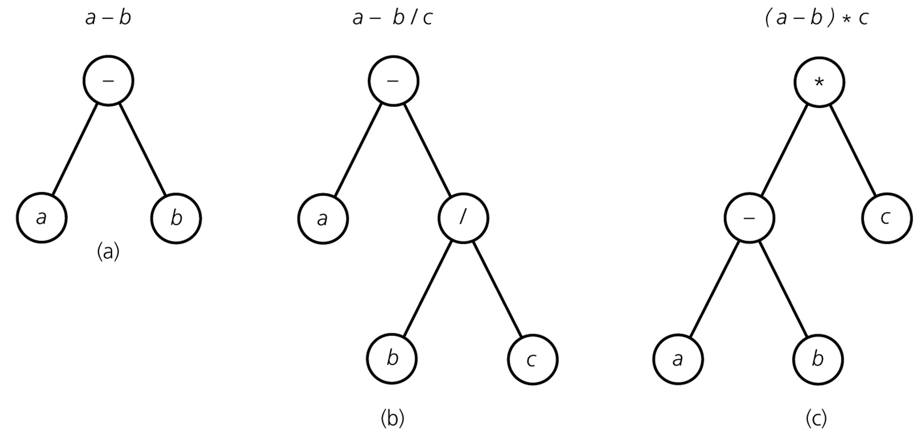
Binary Tree – Representing Algebraic Expressions

Slide 12
Height of Binary Tree
The height of a binary tree T can be defined as recursively as:
If T is empty, its height is 0.
If T is non-empty tree, then since T is of the form ...
... height of T is 1 greater than height of its root’s taller subtree; ie.
height(T) = 1 + max{height(T_{L}),height(T_{R})}

Slide 13
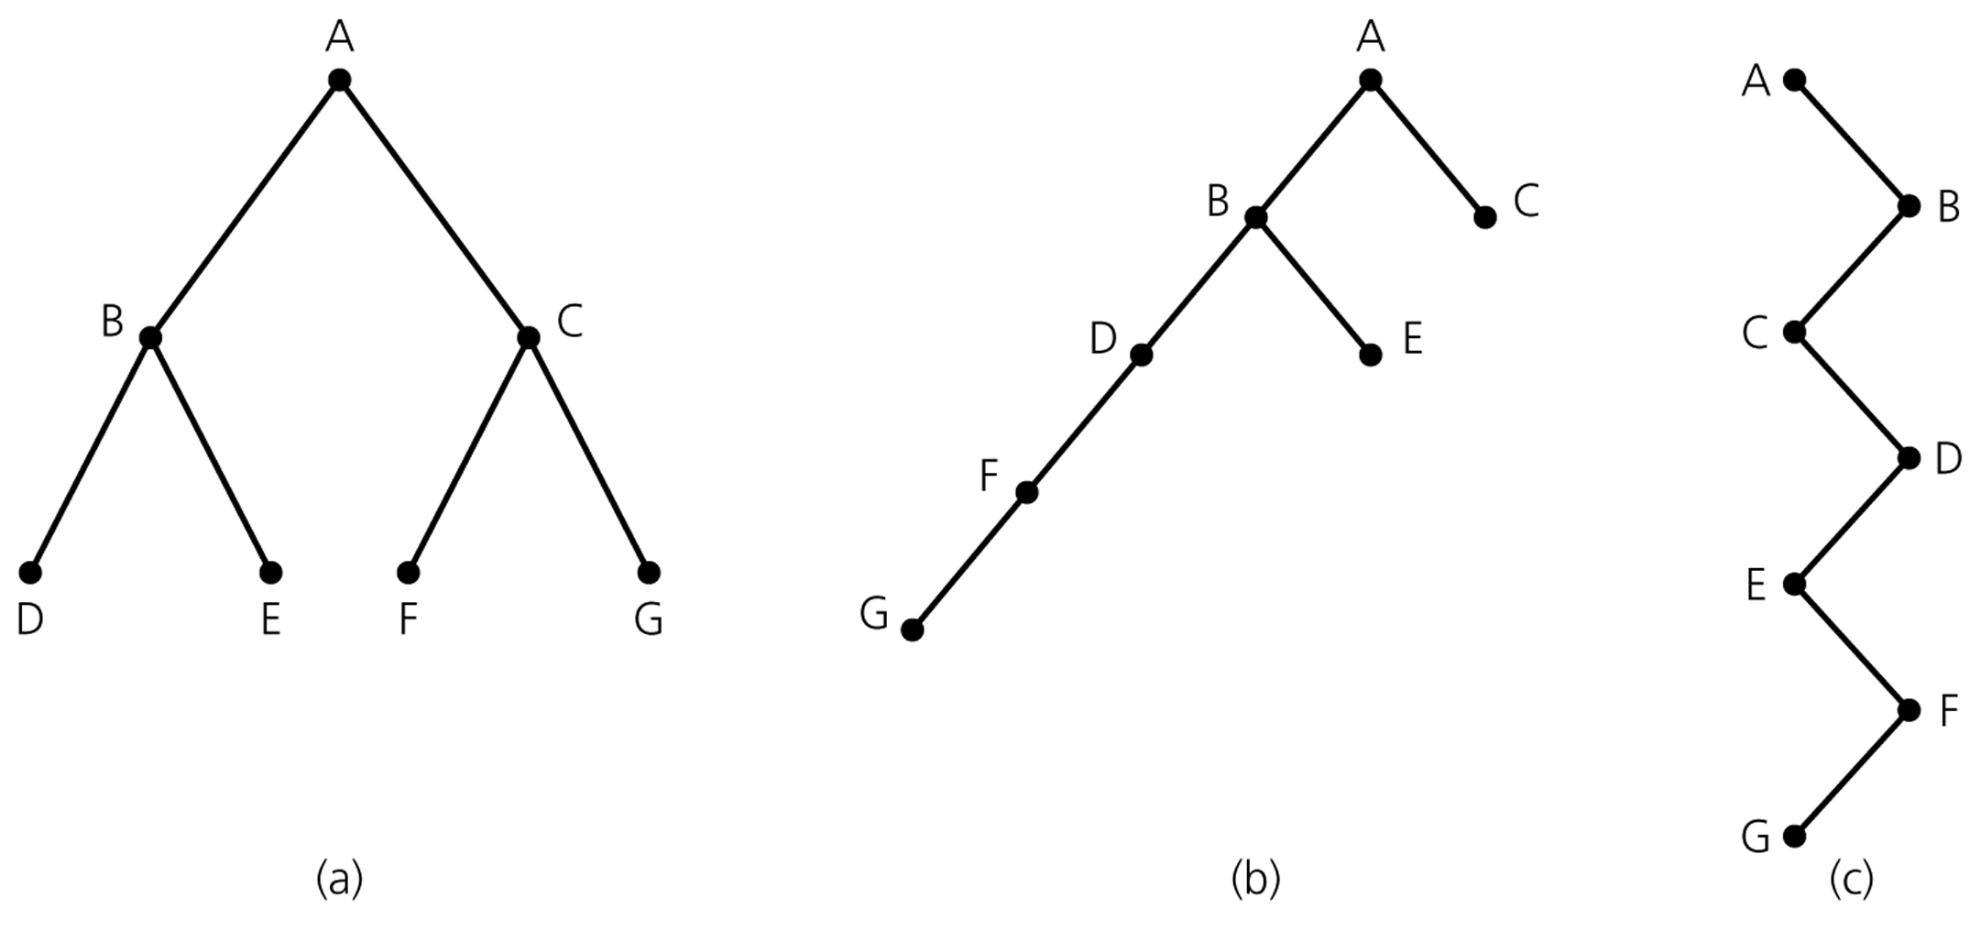
Height of Binary Tree (cont.)
Binary trees with the same nodes but different heights

Slide 14
Number of Binary trees with Same # of Nodes
n=0 ➔ empty tree
n=1 ➔
•
(1 tree)
•
•
n=2 ➔
(2 trees)
•
•
•
•
•
•
•
n=3 ➔
•
•
(5 trees)
•
•
•
•
•
•
•
•
n is even ➔
n is odd ➔

Slide 15
Full Binary Tree
In a full binary tree of height h, all nodes that are at a level less than h have two children each.
Each node in a full binary tree has left and right subtrees of the same height.
Among binary trees of height h, a full binary tree has as many leaves as possible, and leaves all are at level h.
A full binary tree has no missing nodes.
Recursive definition of full binary tree:
If T is empty, T is a full binary tree of height 0.
If T is not empty and has height h>0, T is a full binary tree if its root’s subtrees are both full binary trees of height h-1.

Slide 16

Full Binary Tree – Example
A full binary tree of height 3

Slide 17
Complete Binary Tree
A complete binary tree of height h is a binary tree that is full down to level h-1, with level h filled in from left to right.
A binary tree T of height h is complete if
All nodes at level h-2 and above have two children each, and
When a node at level h-1 has children, all nodes to its left at the same level have two children each, and
When a node at level h-1 has one child, it is a left child.
A full binary tree is a complete binary tree.

Slide 18
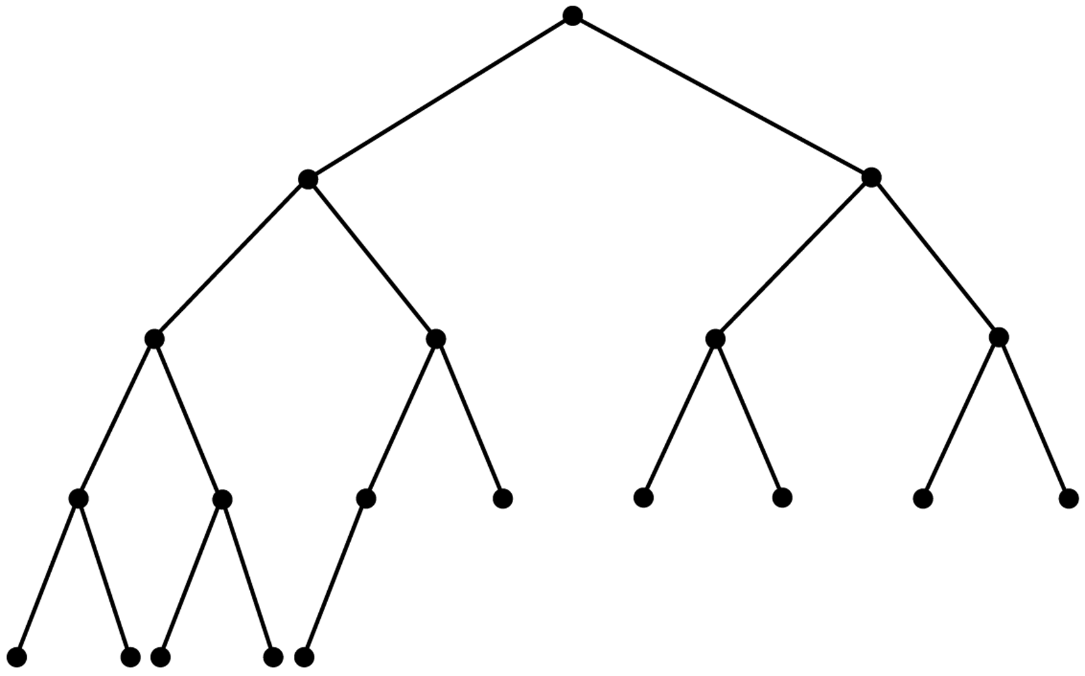
Complete Binary Tree – Example

Slide 19
Balanced Binary Tree
A binary tree is balanced (or height balanced), if the height of any node’s right subtree and left subtree differ no more than 1.
A complete binary tree is a balanced tree. Why?
Later, we look at other height balanced trees.
AVL trees
Red-Black trees, ....

Slide 20
Maximum and Minimum Heights of a Binary Tree
Efficiency of most binary tree operations depends on tree height.
E.g. maximum number of key comparisons for retrieval, deletion, and insertion operations for BSTs is the height of the tree.
The maximum of height of a binary tree with n nodes is n. How?
Each level of a minimum height tree, except the last level, must contain as many nodes as possible.
Should the tree be a Complete Binary Tree?

Slide 21
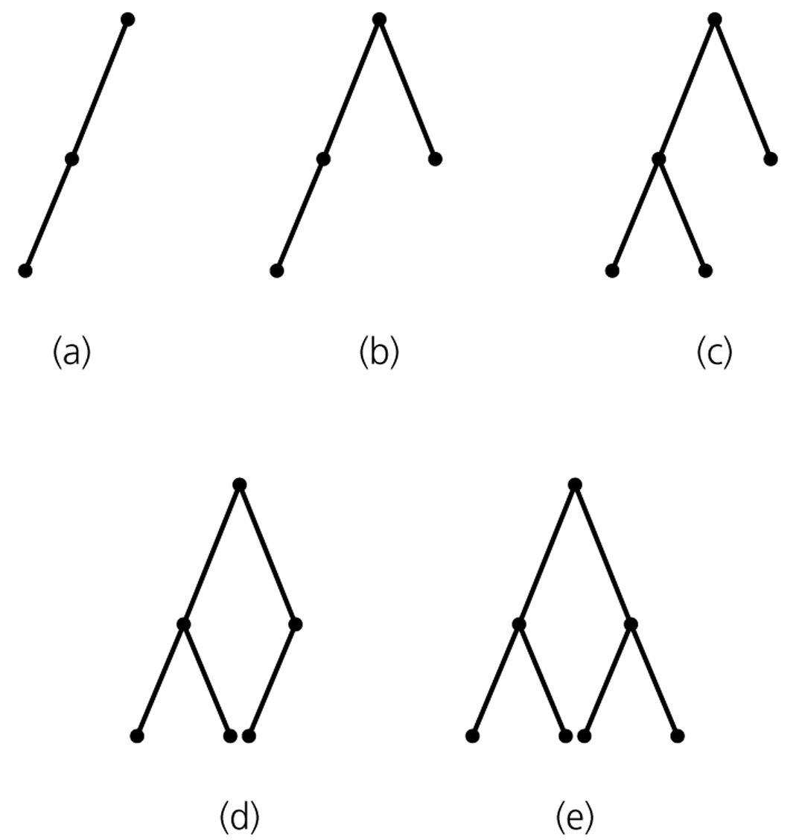
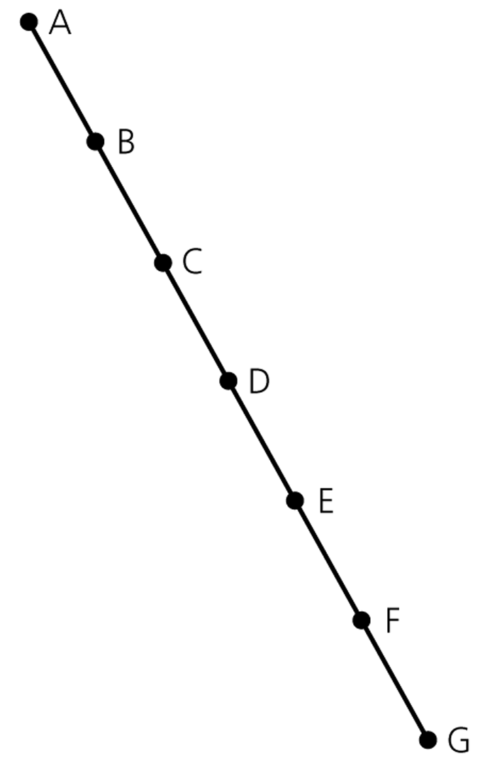
Maximum and Minimum Heights of a Binary Tree
A maximum-height binary tree
with seven nodes
Some binary trees of height 3

Slide 22
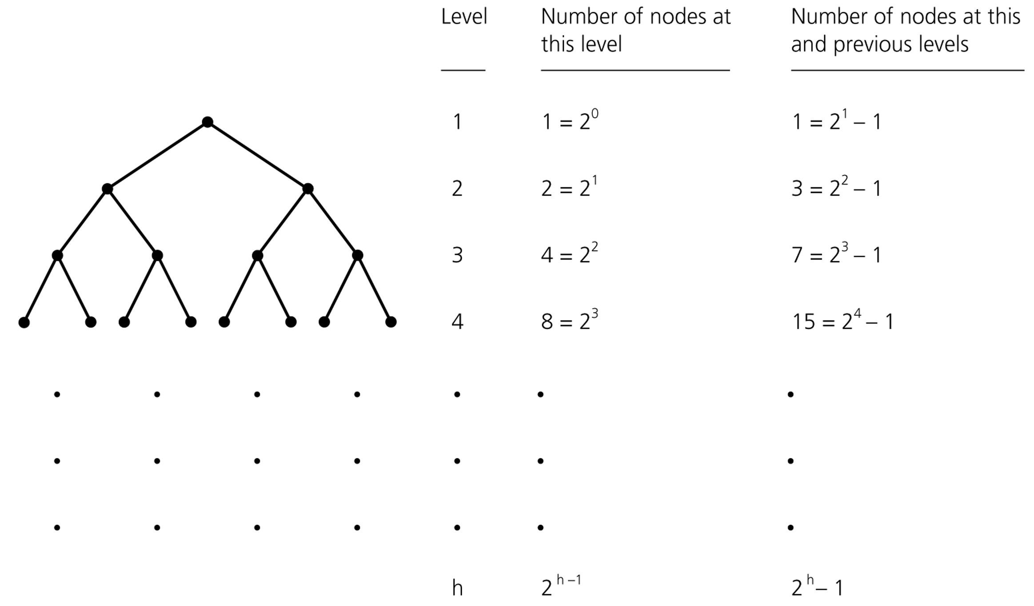
Counting the nodes in a full binary tree of height h

Slide 23
Some Height Theorems
Theorem: A full binary tree of height h≥0 has 2^{h}-1 nodes.
The maximum number of nodes that a binary tree of height h can have is 2^{h}-1.
We cannot insert a new node into a full binary tree without
increasing its height.

Slide 24
Some Height Theorems
Theorem 10-4: The minimum height of a binary tree with n nodes is ⎡log₂(n+1)⎤ .
Proof: Let h be the smallest integer such that n≤2^{h}-1. We can establish following facts:
Fact 1 – A binary tree whose height is ≤ h-1 has < n nodes.
Otherwise h cannot be smallest integer in our assumption.
Fact 2 – There exists a complete binary tree of height h that has exactly n nodes.
A full binary tree of height h-1 has 2^{h-1}-1 nodes.
Since a binary tree of height h cannot have more than 2^{h}-1 nodes.
At level h, we will reach n nodes.
Fact 3 – The minimum height of a binary tree with n nodes is the smallest integer h such that n ≤2^{h}-1.
So, ➔ 2^{h-1}-1 < n ≤ 2^{h}-1
➔ 2^{h-1} < n+1 ≤ 2^{h}
➔ h-1 < log₂(n+1) ≤ h
Thus, ➔ h = ⎡log₂(n+1)⎤ is the minimum height of a binary tree with n nodes.

Slide 25
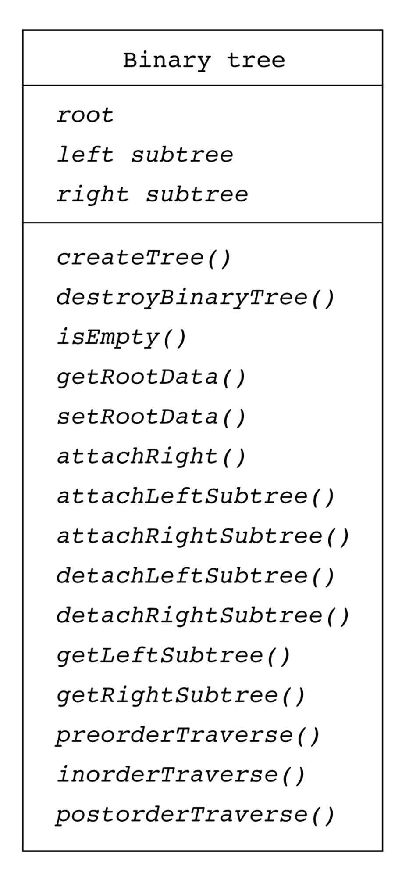
UML Diagram for BinaryTree ADT
What is an ADT?

Slide 26
An Array-Based Implementation of Binary Trees
const int MAX_NODES = 100; // maximum number of nodes
typedef string TreeItemType;
class TreeNode { // node in the tree
private:
TreeNode();
TreeNode(const TreeItemType& nodeItem, int left, int right);
TreeItemType item; // data portion
int leftChild; // index to left child
int rightChild; // index to right child
// friend class - can access private parts
friend class BinaryTree;
};
// An array of tree nodes
TreeNode[MAX_NODES] tree;
int root;
int free;

Slide 27
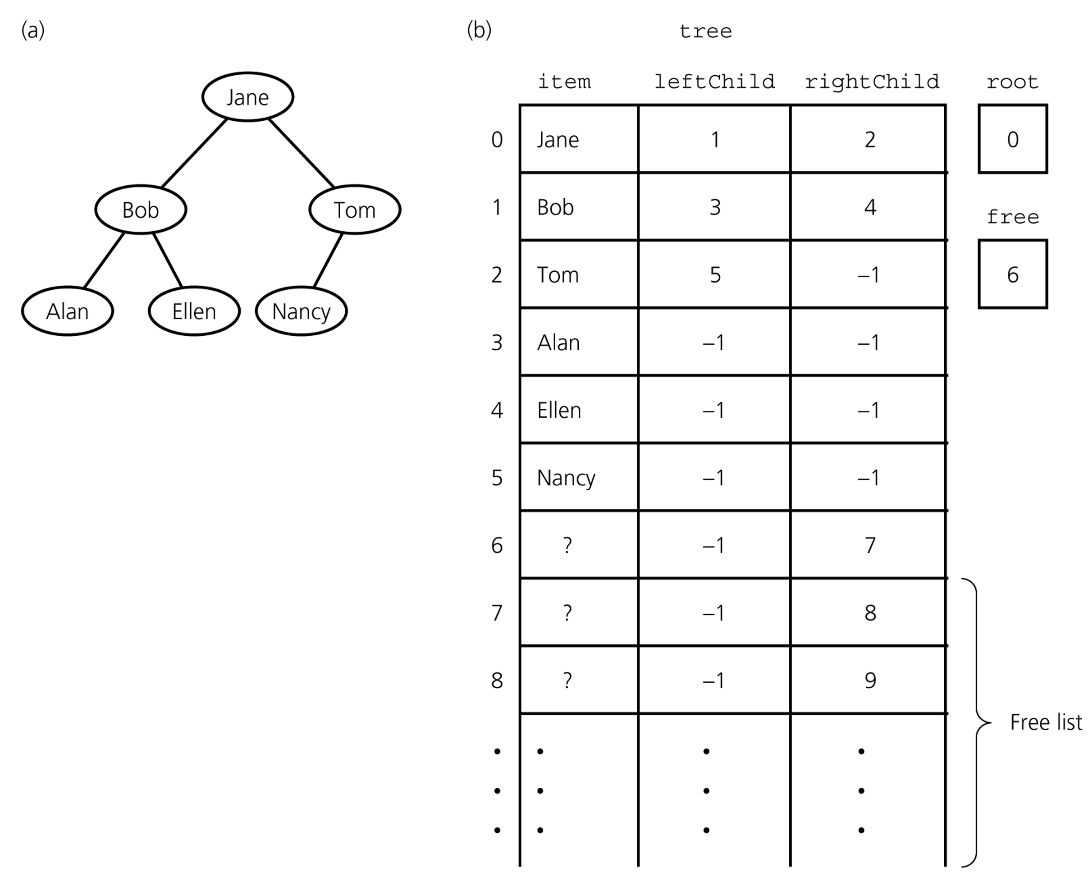
An Array-Based Implementation (cont.)
A free list keeps track of available nodes.
To insert a new node into the tree, we first
obtain an available node from the free list.
When we delete a node from the tree, we
have to place into the free list so that we
can use it later.

Slide 28
An Array-Based Representation of a Complete Binary Tree
If we know that our binary tree is a complete binary tree, we can use a simpler
array-based representation for complete binary trees
without using leftChild, rightChild links
We can number the nodes level by level, and left to right (starting from 0, the root
will be 0). If a node is numbered as i, in the ith location of the array, tree[i],
contains this node without links.
Using these numbers we can find leftChild, rightChild, and parent of a node i.
The left child (if it exists) of node i is tree[2*i+1]
The right child (if it exists) of node i is tree[2*i+2]
The parent (if it exists) of node i is tree[(i-1)/2]

Slide 29
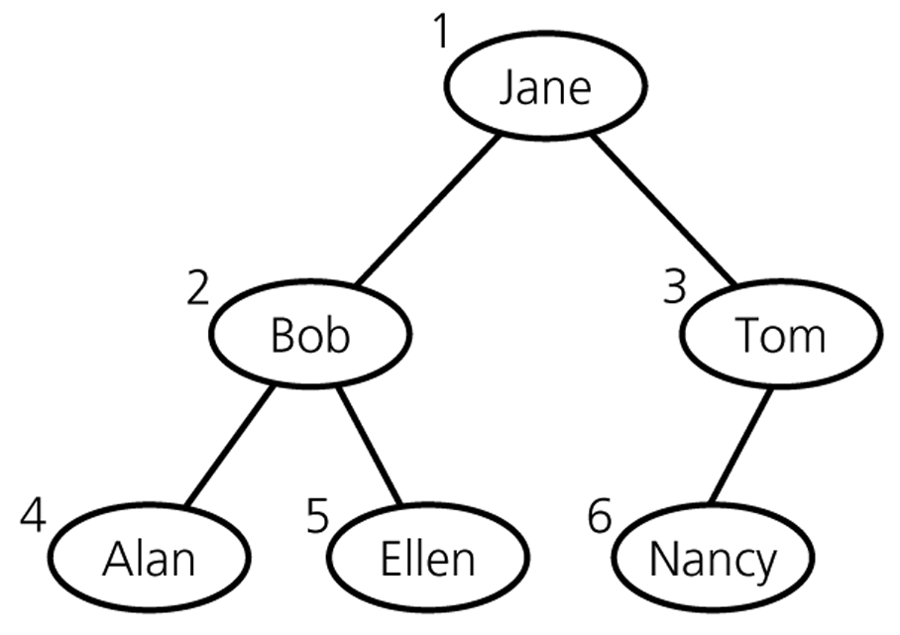
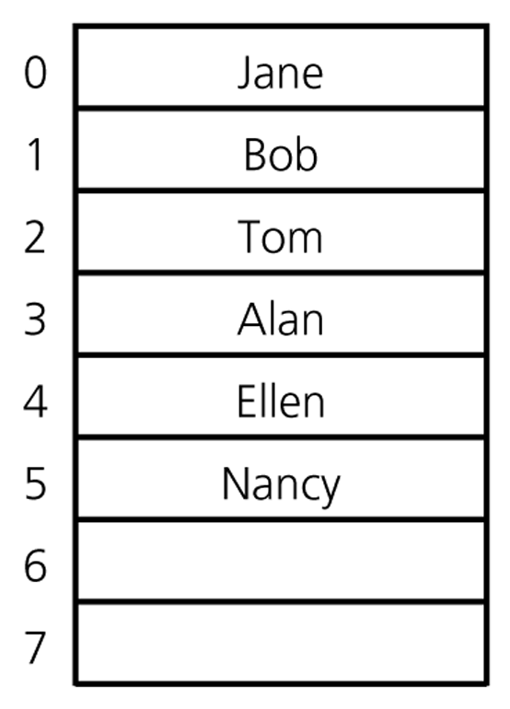
An Array-Based Representation of a Complete Binary Tree (cont.)
0
1
2
3
4
5

Slide 30
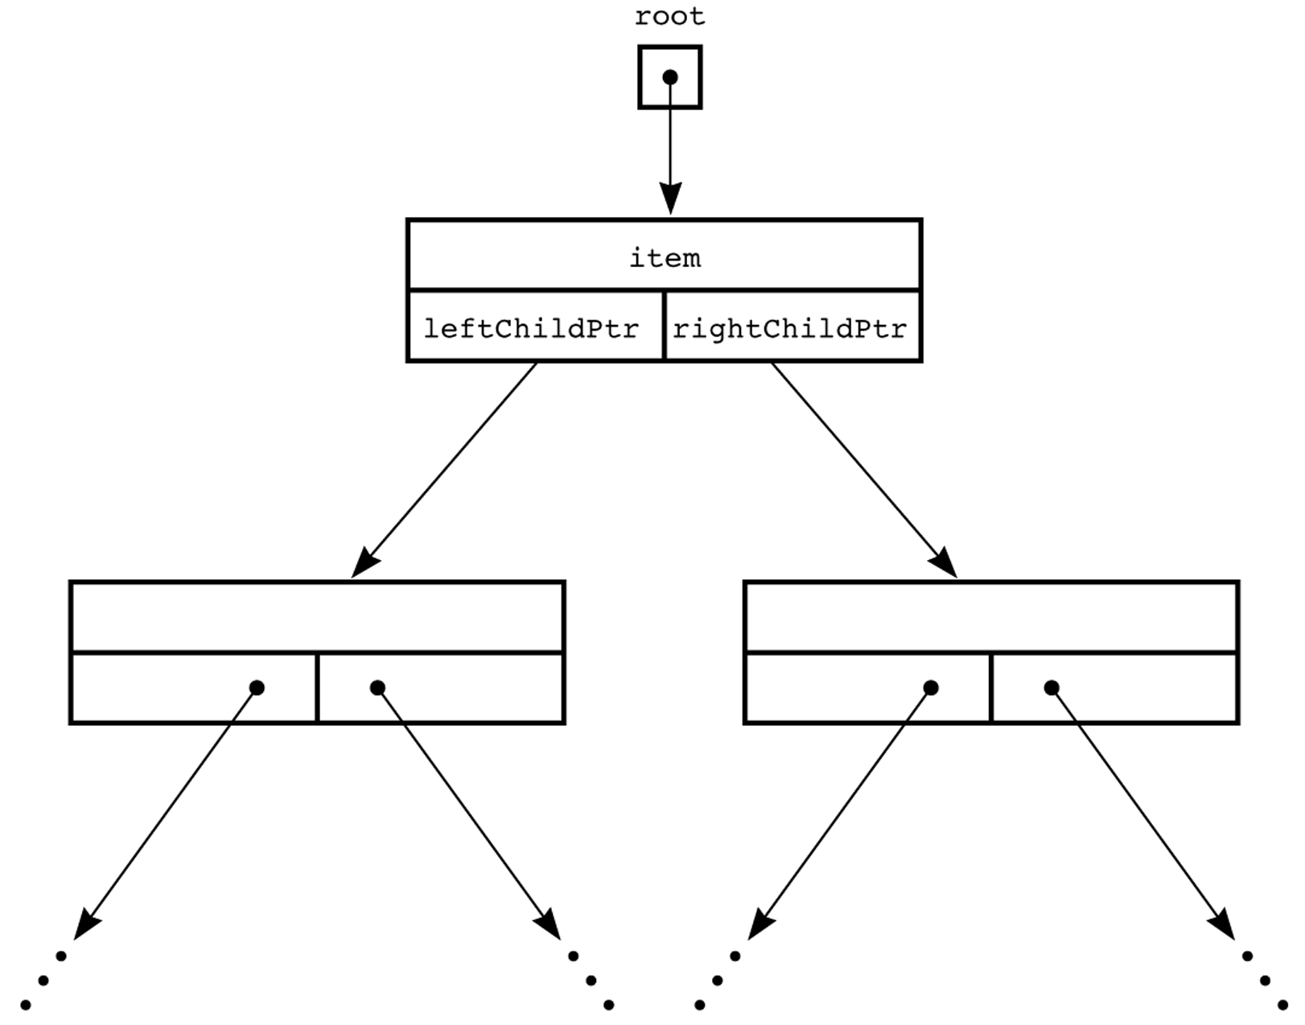
Pointer-Based Implementation of Binary Trees

Slide 31
A Pointer-Based Implementation of a Binary Tree Node
typedef string TreeItemType;
class TreeNode { // node in the tree
private:
TreeNode() {}
TreeNode(const TreeItemType& nodeItem,
TreeNode *left = NULL,
TreeNode *right = NULL)
:item(nodeItem),leftChildPtr(left),rightChildPtr(right) {}
TreeItemType item; // data portion
TreeNode *leftChildPtr; // pointer to left child
TreeNode *rightChildPtr; // pointer to right child
friend class BinaryTree;
};

Slide 32
Binary Tree – TreeException.h
class TreeException : public exception{
private:
string msg;
public:
virtual const char* what() const throw()
{
return msg.c_str();
}
TreeException(const string & message =""):
exception(), msg(message) {};
~TreeException() throw() {};
}; // end TreeException

Slide 34
The BinaryTree Class
Properties
TreeNode * root
Constructors
BinaryTree();
BinaryTree(const TreeItemType& rootItem);
BinaryTree(const TreeItemType& rootItem,
BinaryTree& leftTree, BinaryTree& rightTree);
BinaryTree(const BinaryTree& tree);
void copyTree(TreeNode *treePtr, TreeNode* & newTreePtr) const;
Destructor
~BinaryTree();
void destroyTree(TreeNode * &treePtr);

Slide 35
BinaryTree: Public Methods
bool isEmpty()
TreeItemType rootData() const throw(TreeException)
void setRootData(const TreeItemType& newItem)
void attachLeft(const TreeItemType& newItem)
void attachRight(const TreeItemType& newItem)
void attachLeftSubtree(BinaryTree& leftTree)
void attachRightSubtree(BinaryTree& rightTree)
void detachLeftSubtree(BinaryTree& leftTree)
void detachRightSubtree(BinaryTree& rightTree)
BinaryTree leftSubtree()
BinaryTree rightSubtree()
void preorderTraverse(FunctionType visit_fn)
void inorderTraverse(FunctionType visit_fn)
void postorderTraverse(FunctionType visit_fn)
FunctionType is a pointer to a function:
typedef void (*FunctionType)(TreeItemType& anItem);

Slide 36
BinaryTree: Implementation
The complete implementation is in your text book
In class, we will go through only some methods
Skipping straightforward methods
Such as isEmpty, rootData, and setRootData functions
Skipping some details
Such as throwing exceptions

Slide 37
// Default constructor
BinaryTree::BinaryTree() : root(NULL) {
}
// Protected constructor
BinaryTree::BinaryTree(TreeNode *nodePtr) : root(nodePtr) {
}
// Constructor
BinaryTree::BinaryTree(const TreeItemType& rootItem) {
root = new TreeNode(rootItem, NULL, NULL);
}

Slide 38
// Constructor
BinaryTree::BinaryTree(const TreeItemType& rootItem,
BinaryTree& leftTree, BinaryTree& rightTree) {
root = new TreeNode(rootItem, NULL, NULL);
attachLeftSubtree(leftTree);
attachRightSubtree(rightTree);
}
void BinaryTree::attachLeftSubtree(BinaryTree& leftTree) {
// Assertion: nonempty tree; no left child
if (!isEmpty() && (root->leftChildPtr == NULL)) {
root->leftChildPtr = leftTree.root;
leftTree.root = NULL
}
}
void BinaryTree::attachRightSubtree(BinaryTree& rightTree) {
// Left as an exercise
}

Slide 39
// Copy constructor
BinaryTree::BinaryTree(const BinaryTree& tree) {
copyTree(tree.root, root);
}
// Uses preorder traversal for the copy operation
// (Visits first the node and then the left and right children)
void BinaryTree::copyTree(TreeNode *treePtr, TreeNode *& newTreePtr) const {
if (treePtr != NULL) { // copy node
newTreePtr = new TreeNode(treePtr->item, NULL, NULL);
copyTree(treePtr->leftChildPtr, newTreePtr->leftChildPtr);
copyTree(treePtr->rightChildPtr, newTreePtr->rightChildPtr);
}
else
newTreePtr = NULL; // copy empty tree
}

Slide 40
// Destructor
BinaryTree::~BinaryTree() {
destroyTree(root);
}
// Uses postorder traversal for the destroy operation
// (Visits first the left and right children and then the node)
void BinaryTree::destroyTree(TreeNode *& treePtr) {
if (treePtr != NULL){
destroyTree(treePtr->leftChildPtr);
destroyTree(treePtr->rightChildPtr);
delete treePtr;
treePtr = NULL;
}
}

Slide 41
Binary Tree Traversals
Preorder Traversal
The node is visited before its left and right subtrees,
Postorder Traversal
The node is visited after both subtrees.
Inorder Traversal
The node is visited between the subtrees,
Visit left subtree, visit the node, and visit the right subtree.

Slide 42
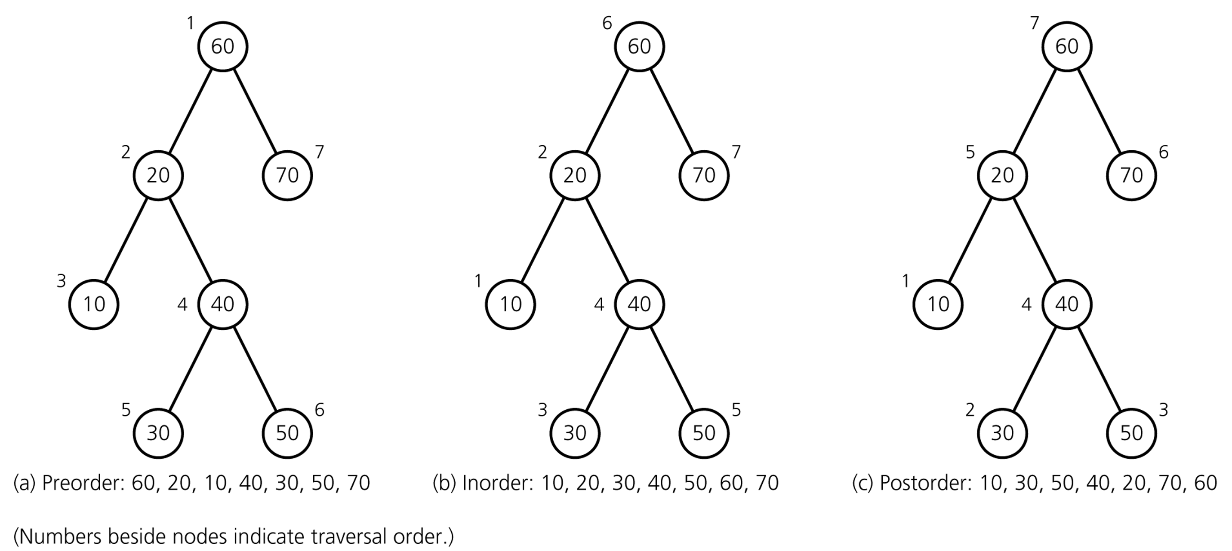
Binary Tree Traversals

Slide 43
void BinaryTree::preorderTraverse(FunctionType visit) {
preorder(root, visit);
}
void BinaryTree::inorderTraverse(FunctionType visit) {
inorder(root, visit);
}
void BinaryTree::postorderTraverse(FunctionType visit) {
postorder(root, visit);
}
---------------------------------------------------------------------------------------------------------
Remember that:
FunctionType is a pointer to a function
Variables that point to the address of a function
typedef void (*FunctionType)(TreeItemType& anItem);
Example of using inorderTraverse function:
void display(TreeItemType& anItem) { cout << anItem << endl; }
BinaryTree T1;
T1.inorderTraverse(display);

Slide 44
void BinaryTree::preorder(TreeNode *treePtr, FunctionType visit) {
if (treePtr != NULL) {
visit(treePtr->item);
preorder(treePtr->leftChildPtr, visit);
preorder(treePtr->rightChildPtr, visit);
}
}
void BinaryTree::inorder(TreeNode *treePtr, FunctionType visit) {
if (treePtr != NULL) {
inorder(treePtr->leftChildPtr, visit);
visit(treePtr->item);
inorder(treePtr->rightChildPtr, visit);
}
}
void BinaryTree::postorder(TreeNode *treePtr, FunctionType visit) {
if (treePtr != NULL) {
postorder(treePtr->leftChildPtr, visit);
postorder(treePtr->rightChildPtr, visit);
visit(treePtr->item);
}
}

Slide 45
Complexity of Traversals
What is the complexity of each traversal type?
Preorder traversal
Postorder traversal
Inorder traversal

Slide 46
Binary Search Tree
An important application of binary trees is their use in searching.
Binary search tree is a binary tree in which every node X contains a data value that satisfies the following:
all data values in its left subtree are smaller than data value in X
all data values in its right subtree are larger than data value in X
the left and right subtrees are also binary search trees

Slide 47
Binary Search Tree
6
6
2
8
2
8
1
4
1
4
3
3
7
A binary search tree
Not a binary search tree,
but a binary tree Why?

Slide 48
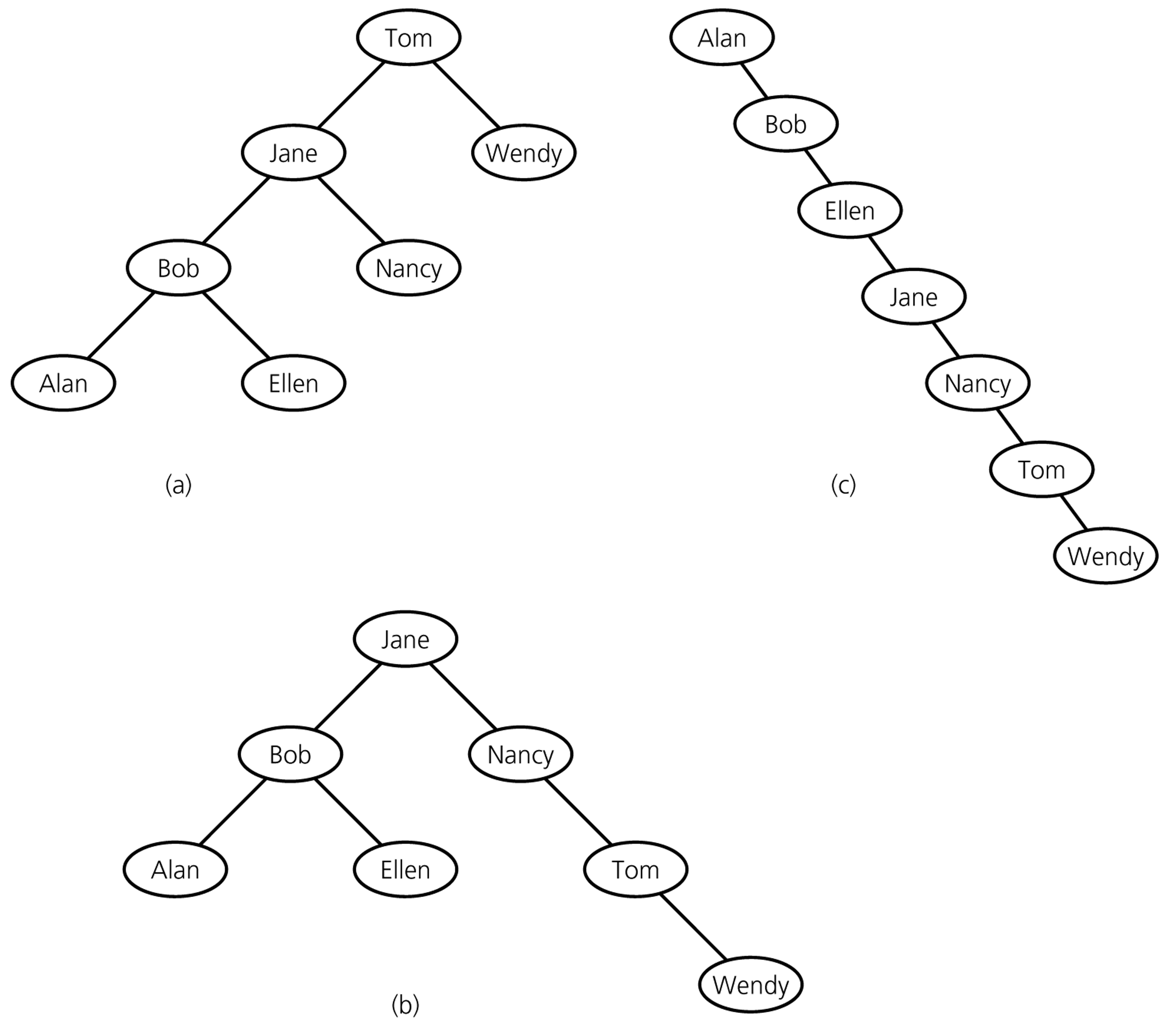
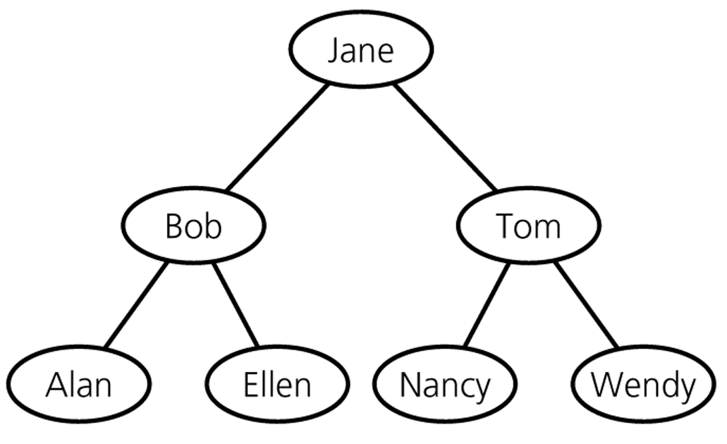
Binary Search Trees – containing same data

Slide 49
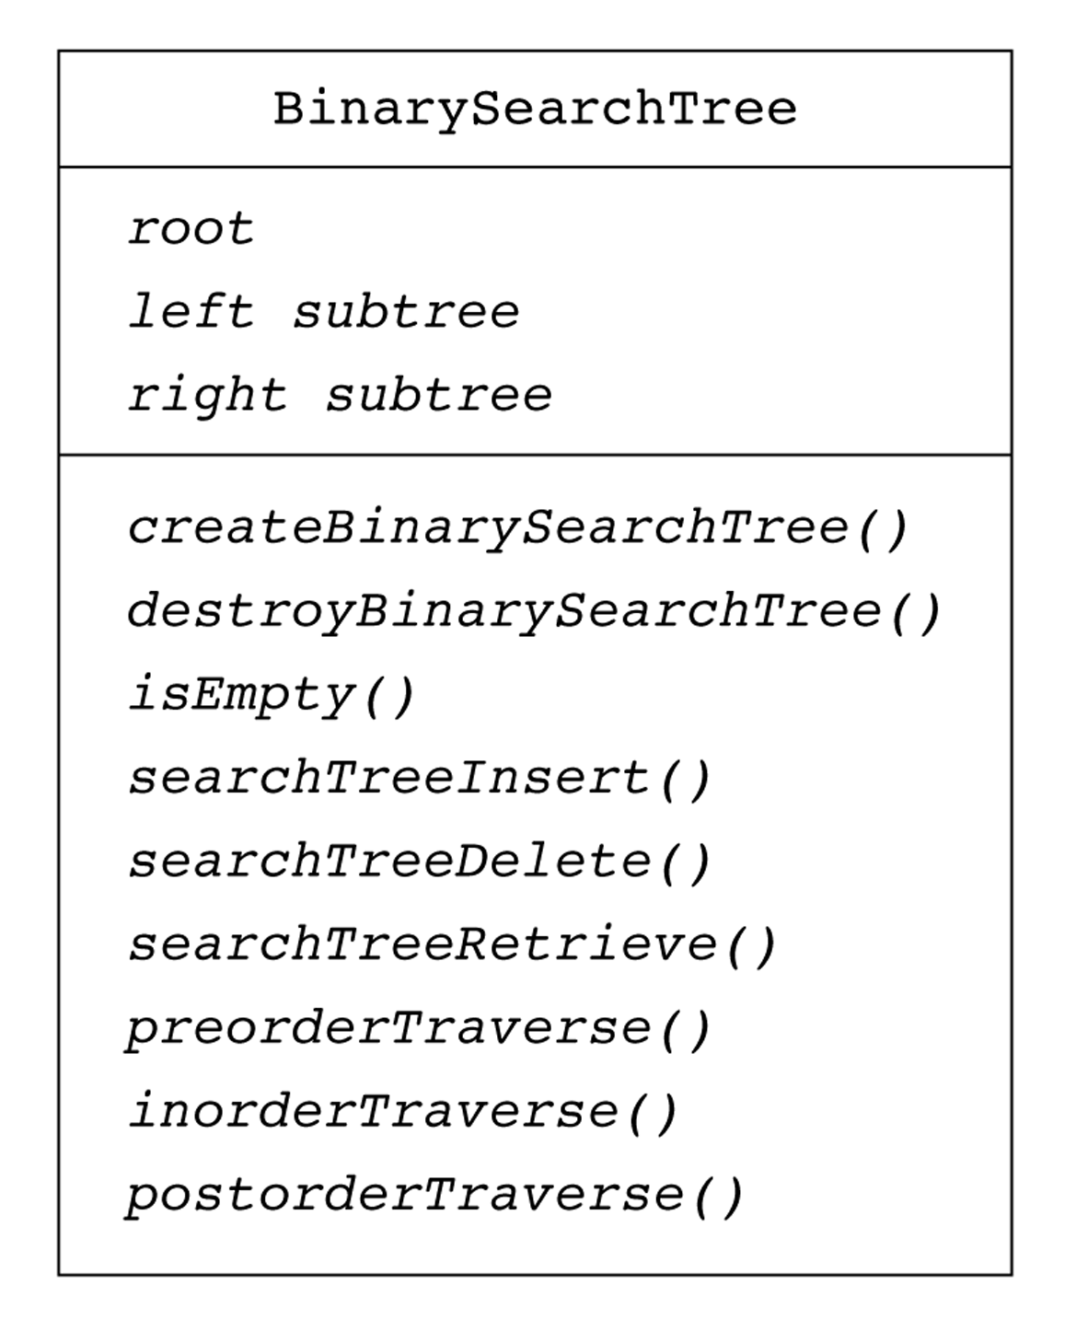
BinarySearchTree Class – UML Diagram

Slide 50
The KeyedItem Class
typedef desired-type-of-search-key KeyType;
class KeyedItem {
public:
KeyedItem() { }
KeyedItem(const KeyType& keyValue) : searchKey(keyValue) { }
KeyType getKey() const {
return searchKey;
}
private:
KeyType searchKey;
// ... and other data items
};

Slide 51
The TreeNode Class
typedef KeyedItem TreeItemType;
class TreeNode { // a node in the tree
private:
TreeNode() { }
TreeNode(const TreeItemType& nodeItem,TreeNode *left = NULL,
TreeNode *right = NULL)
: item(nodeItem), leftChildPtr(left), rightChildPtr(right){ }
TreeItemType item; // a data item in the tree
TreeNode *leftChildPtr; // pointers to children
TreeNode *rightChildPtr;
// friend class - can access private parts
friend class BinarySearchTree;
};

Slide 52
The BinarySearchTree Class
Properties
TreeNode * root
Constructors
BinarySearchTree();
BinarySearchTree(const BinarySearchTree& tree);
Destructor
~BinarySearchTree();

Slide 53
The BinarySearchTree Class
Public methods
bool isEmpty() const;
void searchTreeRetrieve(KeyType searchKey, TreeItemType& item);
void searchTreeInsert(const TreeItemType& newItem);
void searchTreeDelete(KeyType searchKey);
void preorderTraverse(FunctionType visit);
void inorderTraverse(FunctionType visit);
void postorderTraverse(FunctionType visit);
BinarySearchTree& operator=(const BinarySearchTree& rhs);

Slide 54
The BinarySearchTree Class
Protected methods
void retrieveItem(TreeNode *treePtr, KeyType searchKey,
TreeItemType& item);
void insertItem(TreeNode * &treePtr,const TreeItemType& item);
void deleteItem(TreeNode * &treePtr, KeyType searchKey);
void deleteNodeItem(TreeNode * &nodePtr);
void processLeftmost(TreeNode * &nodePtr, TreeItemType& item);

Slide 55
Searching (Retrieving) an Item in a BST
void BinarySearchTree::searchTreeRetrieve(KeyType searchKey,
TreeItemType& treeItem) const throw(TreeException) {
retrieveItem(root, searchKey, treeItem);
}
void BinarySearchTree::retrieveItem(TreeNode *treePtr, KeyType searchKey,
TreeItemType& treeItem) const throw(TreeException) {
if (treePtr == NULL)
throw TreeException("TreeException: searchKey not found");
else if (searchKey == treePtr->item.getKey())
treeItem = treePtr->item;
else if (searchKey < treePtr->item.getKey())
retrieveItem(treePtr->leftChildPtr, searchKey, treeItem);
else
retrieveItem(treePtr->rightChildPtr, searchKey, treeItem);
}

Slide 56
Inserting an Item into a BST
Insert 5
Search determines the insertion point.
6
2
8
1
4
3
5

Slide 57
Inserting an Item into a BST
void BinarySearchTree::searchTreeInsert(const TreeItemType& newItem) {
insertItem(root, newItem);
}
void BinarySearchTree::insertItem(TreeNode *& treePtr,
const TreeItemType& newItem) throw(TreeException) {
// Position of insertion found; insert after leaf
if (treePtr == NULL) {
treePtr = new TreeNode(newItem, NULL, NULL);
if (treePtr == NULL)
throw TreeException("TreeException: insert failed");
}
// Else search for the insertion position
else if (newItem.getKey() < treePtr->item.getKey())
insertItem(treePtr->leftChildPtr, newItem);
else
insertItem(treePtr->rightChildPtr, newItem);
}

Slide 58
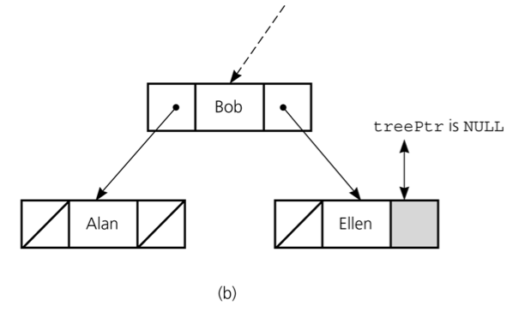
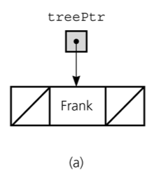
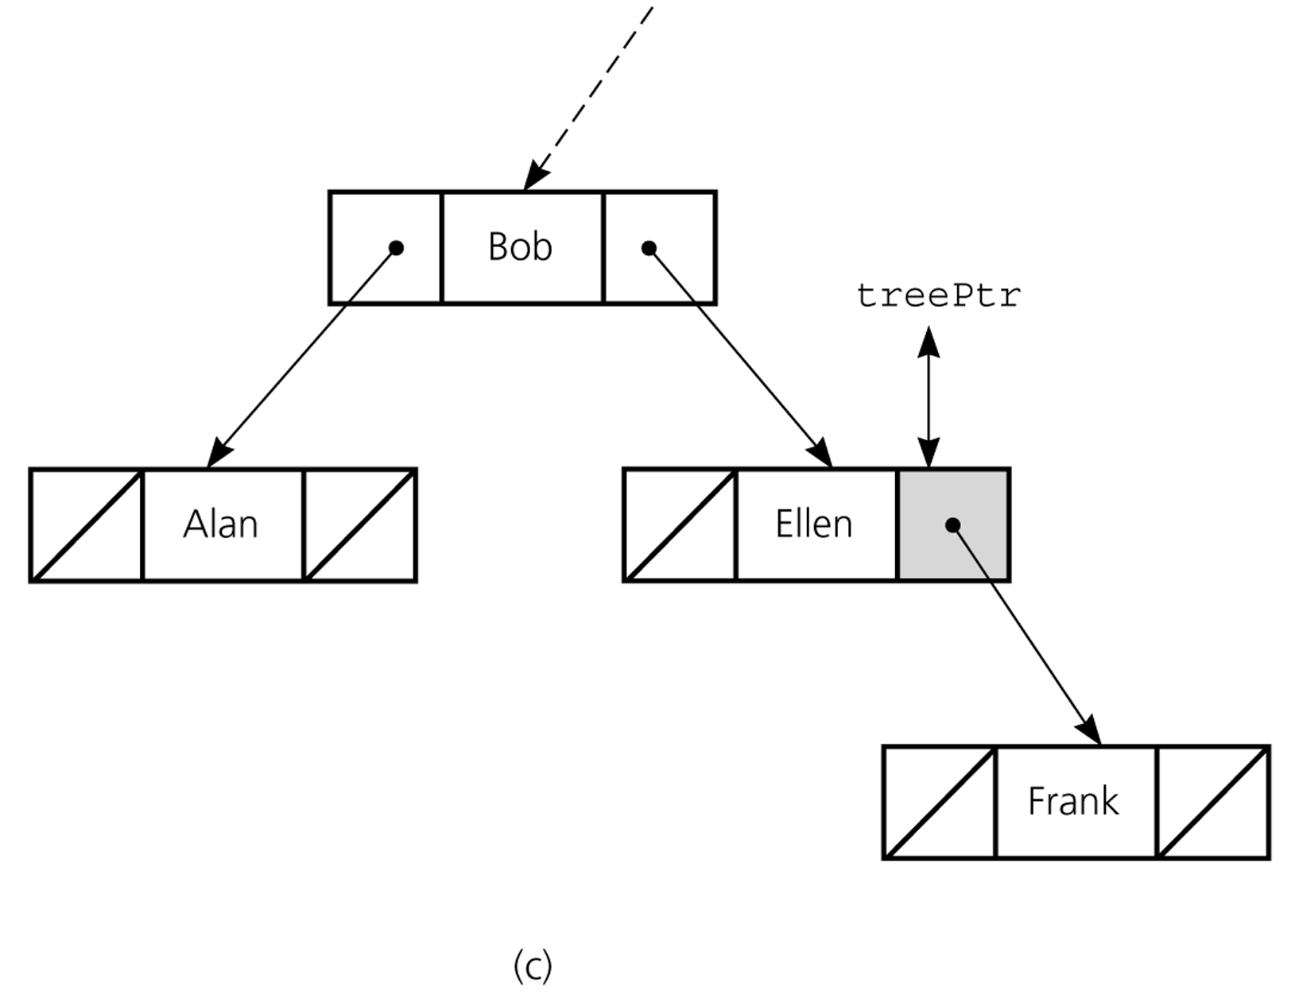
Inserting an Item into a BST

Slide 59
Deleting An Item from a BST
To delete an item from a BST, we have to locate that item in that BST.
The deleted node can be:
Case 1 – A leaf node.
Case 2 – A node with only with child
(with left child or with right child).
Case 3 – A node with two children.

Slide 60
Deletion – Case 1: A Leaf Node
To remove the leaf containing the item, we have to set the pointer in its parent to NULL.
50
50
➔
40
60
40
60
30
45
70
30
45
42
42
Delete 70 (A leaf node)

Slide 61
Deletion – Case 2: A Node with only a left child
50
50
➔
40
60
40
60
30
42
70
30
45
70
42
Delete 45 (A node with only a left child)

Slide 62
Deletion – Case 2: A Node with only a right child
50
50
➔
40
70
40
60
30
45
30
45
70
42
42
Delete 60 (A node with only a right child)

Slide 63
Deletion – Case 3: A Node with two children
Locate the inorder successor of the node.
Copy the item in this node into the node which contains the item which will be deleted.
Delete the node of the inorder successor.
50
50
➔
42
60
40
60
70
30
45
70
30
45
42
Delete 40 (A node with two children)

Slide 64
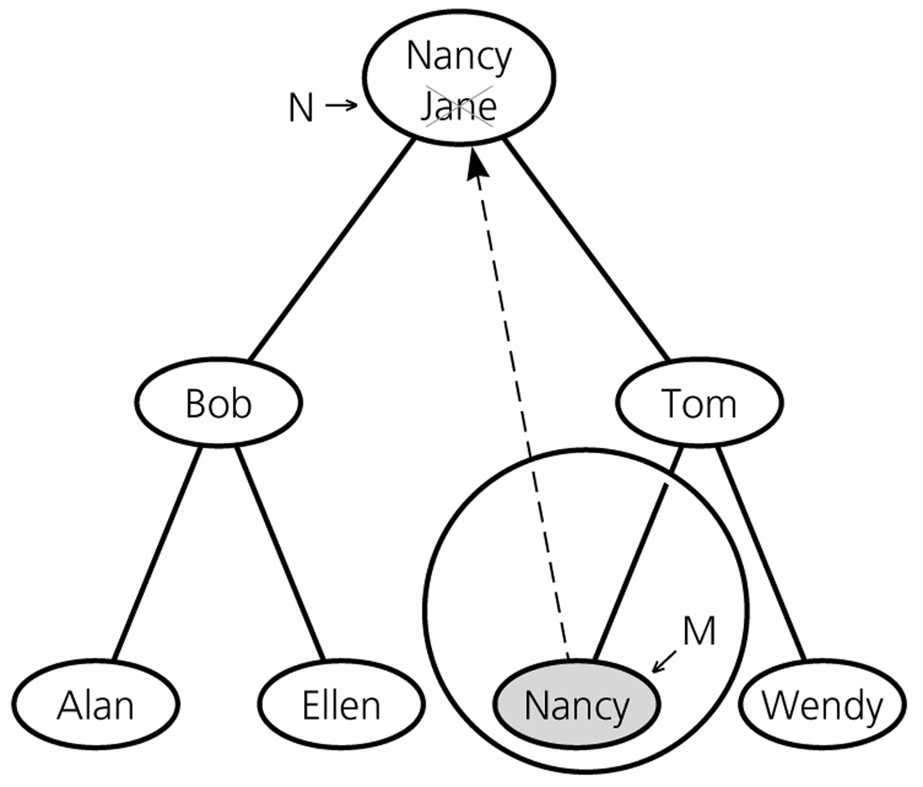
Deletion – Case 3: A Node with two children

Slide 65
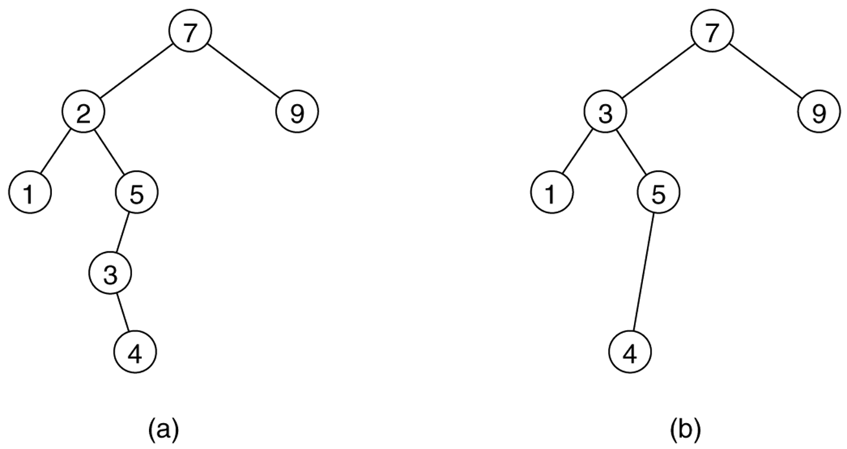
Deletion – Case 3: A Node with two children
➔
Delete 2

Slide 66
Deletion from a BST
void BinarySearchTree::searchTreeDelete(KeyType searchKey)
throw(TreeException) {
deleteItem(root, searchKey);
}
void BinarySearchTree::deleteItem(TreeNode * &treePtr, KeyType searchKey)
throw(TreeException) {
if (treePtr == NULL) // Empty tree
throw TreeException("Delete failed");
// Position of deletion found
else if (searchKey == treePtr->item.getKey())
deleteNodeItem(treePtr);
// Else search for the deletion position
else if (searchKey < treePtr->item.getKey())
deleteItem(treePtr->leftChildPtr, searchKey);
else
deleteItem(treePtr->rightChildPtr, searchKey);
}

Slide 67
Deletion from a BST
void BinarySearchTree::deleteNodeItem(TreeNode * &nodePtr) {
TreeNode *delPtr;
TreeItemType replacementItem;
// (1) Test for a leaf
if ( (nodePtr->leftChildPtr == NULL) &&
(nodePtr->rightChildPtr == NULL) ) {
delete nodePtr;
nodePtr = NULL;
}
// (2) Test for no left child
else if (nodePtr->leftChildPtr == NULL){
delPtr = nodePtr;
nodePtr = nodePtr->rightChildPtr;
delPtr->rightChildPtr = NULL;
delete delPtr;
}

Slide 68
Deletion from a BST
// (3) Test for no right child
else if (nodePtr->rightChildPtr == NULL) {
// ...
// Left as an exercise
}
// (4) There are two children:
// Retrieve and delete the inorder successor
else {
processLeftmost(nodePtr->rightChildPtr, replacementItem);
nodePtr->item = replacementItem;
}
}

Slide 69
Deletion from a BST
void BinarySearchTree::processLeftmost(TreeNode *&nodePtr,
TreeItemType& treeItem){
if (nodePtr->leftChildPtr == NULL) {
treeItem = nodePtr->item;
TreeNode *delPtr = nodePtr;
nodePtr = nodePtr->rightChildPtr;
delPtr->rightChildPtr = NULL; // defense
delete delPtr;
}
else
processLeftmost(nodePtr->leftChildPtr, treeItem);
}

Slide 70
Traversals
The traversals for binary search trees are same as
the traversals for the binary trees.
Theorem: Inorder traversal of a binary search tree will visit
its nodes in sorted search-key order.
Proof: Proof by induction on the height of the binary search tree T.
Basis: h=0 ➔ no nodes are visited, empty list is in sorted order.
Inductive Hypothesis: Assume that the theorem is true for all k, 0≤k<h
Inductive Conclusion: We have to show that the theorem is true for k=h>0. T should be:
Since the lengths of T_{L} and T_{R} are less than h, the theorem holds
for them. All the keys in T_{L} are less than r, and all the keys in T_{R} are
greater than r. In inorder traversal, we visit T_{L} first, then r, and then T_{R}.
Thus, the theorem holds for T with height k=h.

Slide 71
Minimum Height
Complete trees and full trees have minimum height.
The height of an n-node binary search tree ranges
from ⎡log₂(n+1)⎤ to n.
Insertion in search-key order produces a maximum-height BST.
Insertion in random order produces a near-minimum-height BST.
That is, the height of an n-node binary search tree
Best Case – ⎡log₂(n+1)⎤ ➔ O(log₂n)
Worst Case – n ➔ O(n)
Average Case – close to ⎡log₂(n+1)⎤ ➔ O(log₂n)

Slide 72
Average Height
If we insert n items into an empty BST to create a BST with n nodes,
How many different binary search trees with n nodes?
What are their probabilities?
There are n! different orderings of n keys.
But how many different binary search trees with n nodes?
n=0 ➔ 1 BST (empty tree)
n=1 ➔ 1 BST (a binary tree with a single node)
n=2 ➔ 2 BSTs
n=3 ➔ 5 BSTs
•
•
•
•
•
When n=3
•
•
•
•
•
•
•
•
•
•
Probabilities: 1/6 1/6 2/6 1/6 1/6
Insertion Order: 3,2,1 3,1,2 2,1,3 1,3,2 1,2,3
2,3,1

Slide 73
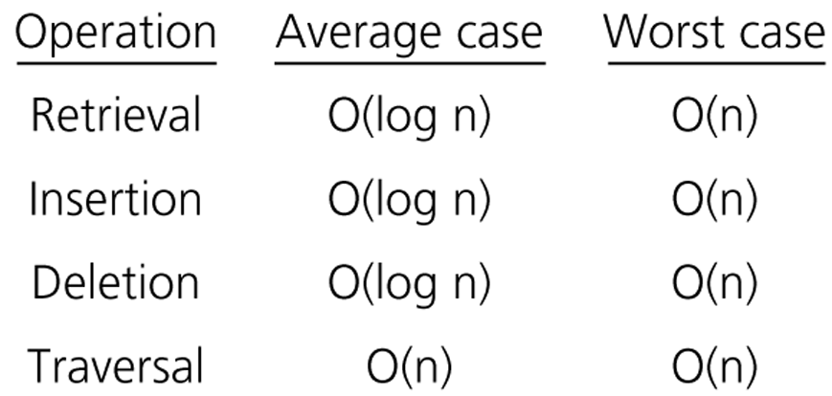
Order of Operations on BSTs

Slide 74
Treesort
We can use a binary search tree to sort an array.
// Sorts n integers in an array anArray into
// ascending order
treesort(inout anArray:ArrayType, in n:integer)
Insert anArray’s elements into a binary search
tree bTree
Traverse bTree in inorder. As you visit bTree’s
nodes, copy their data items into successive
locations of anArray

Slide 75
Treesort Analysis
Inserting an item into a binary search tree:
Worst Case: O(n)
Average Case: O(log₂n)
Inserting n items into a binary search tree:
Worst Case: O(n²) ➔ (1+2+...+n) = O(n²)
Average Case: O(n*log₂n)
Inorder traversal and copy items back into array ➔ O(n)
Thus, treesort is
➔ O(n²) in worst case, and
➔ O(n*log₂n) in average case.
Treesort makes exactly same key comparisons of keys as does quicksort when the pivot for each sublist is chosen to be the first key

Slide 76
Saving a BST into a file and restoring it to its original shape
Save:
Use a preorder traversal to save the nodes of the BST into a file
Restore:
Start with an empty BST
Read the nodes from the file one by one and insert them
into the BST

Slide 77
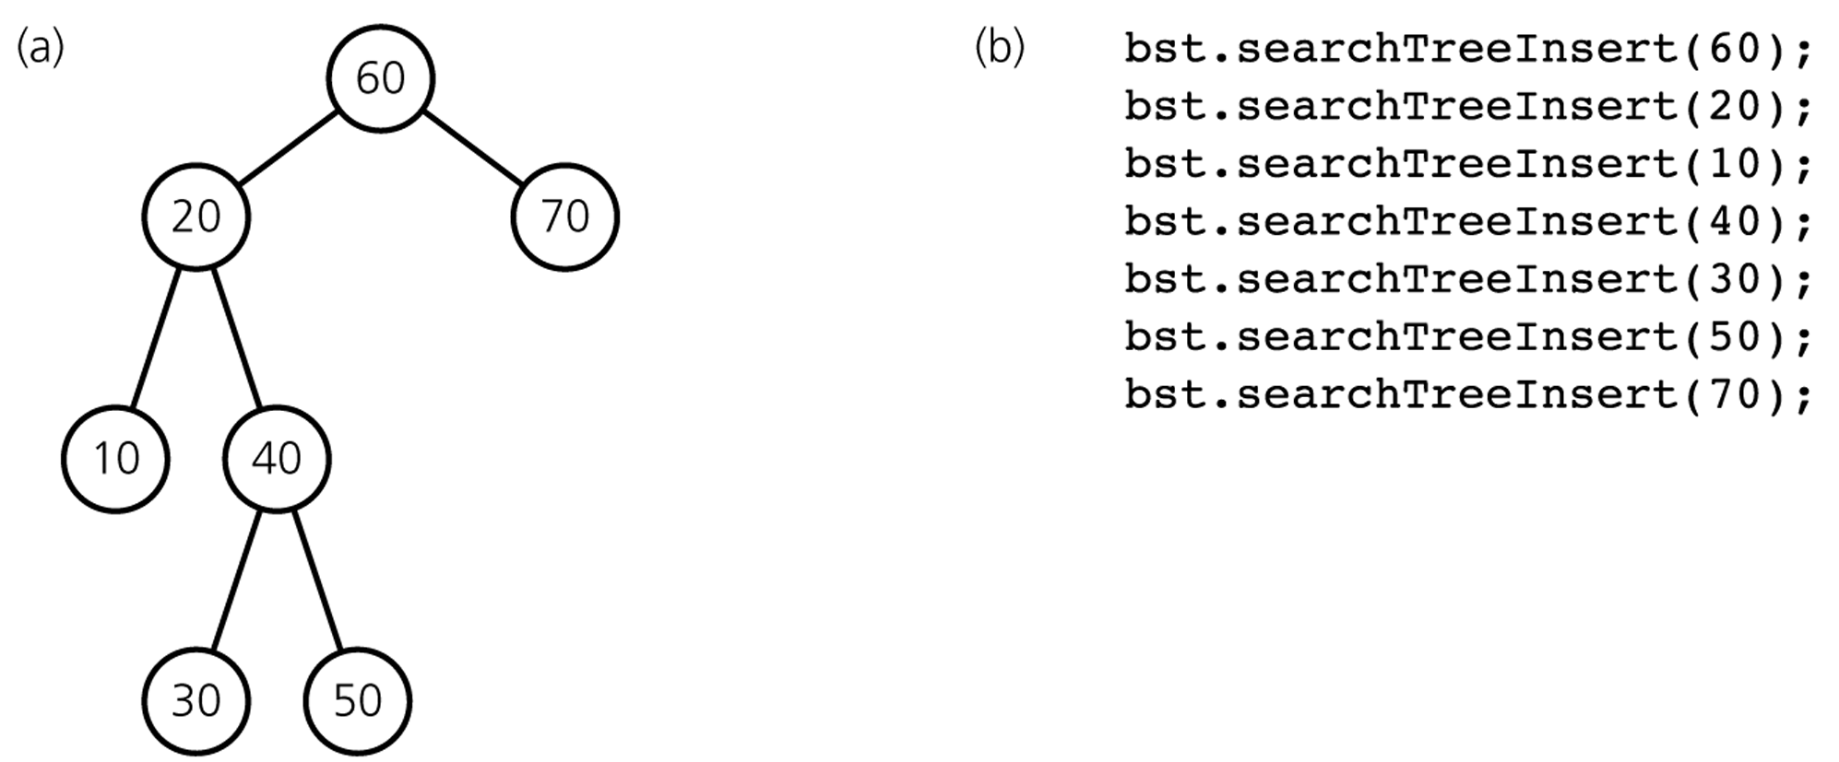
Saving a BST into a file and restoring it to its original shape
Preorder: 60 20 10 40 30 50 70

Slide 78
Saving a BST into a file and restoring it to a minimum-height BST
Save:
Use an inorder traversal to save the nodes of the BST into a file. The saved nodes will be in ascending order
Save the number of nodes (n) in somewhere
Restore:
Read the number of nodes (n)
Start with an empty BST
Read the nodes from the file one by one to create a minimum-height binary search tree

Slide 79
Building a minimum-height BST
// Builds a minimum-height binary search tree from n sorted
// values in a file. treePtr will point to the tree’s root.
readTree(out treePtr:TreeNodePtr, in n:integer)
if (n>0) {
treePtr = pointer to new node with NULL child pointers
// construct the left subtree
readTree(treePtr->leftChildPtr, n/2)
// get the root
Read item from file into treePtr->item
// construct the right subtree
readTree(treePtr->rightChildPtr, (n-1)/2)
}

Slide 80
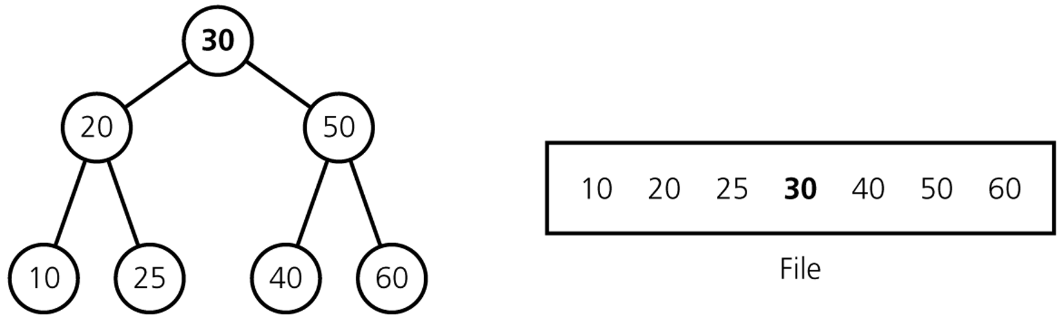
A full tree saved in a file by using inorder traversal

Slide 81
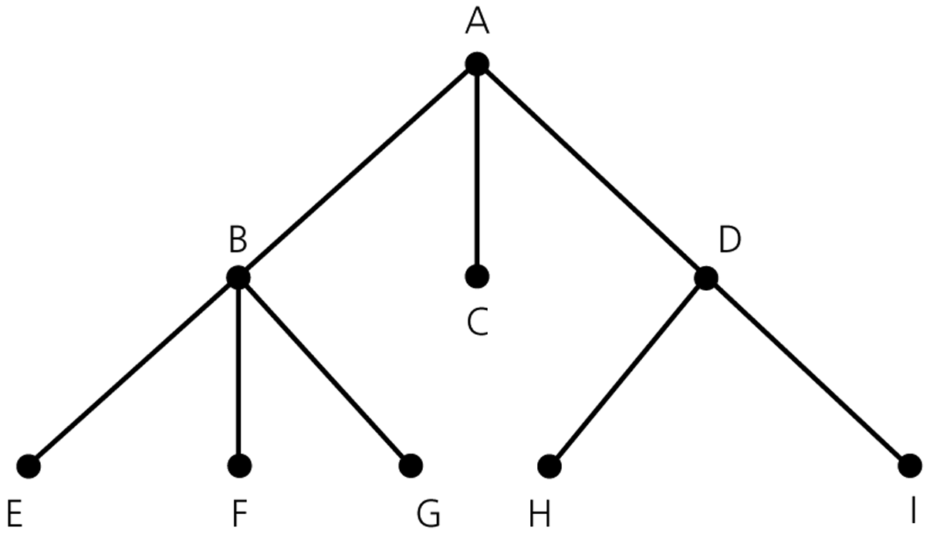
A General Tree

Slide 82
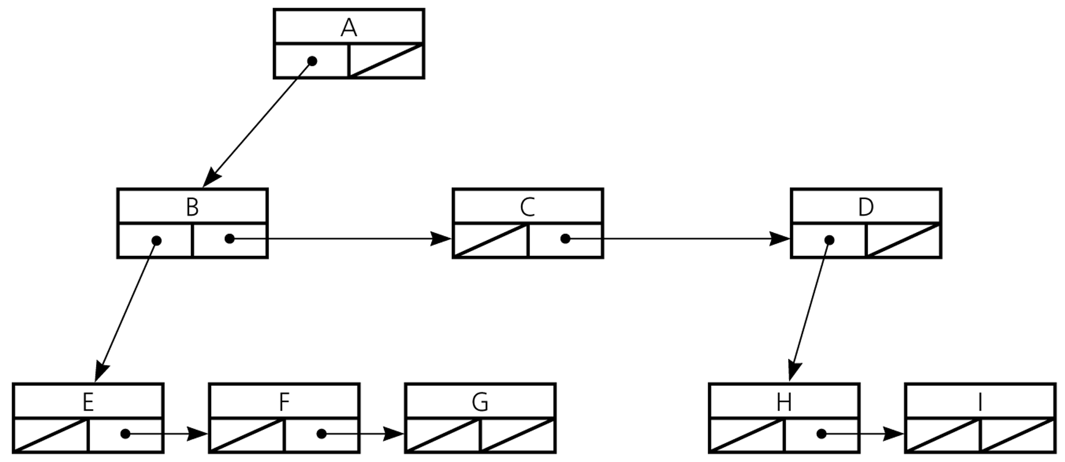
A Pointer-Based Implementation of General Trees

Slide 83
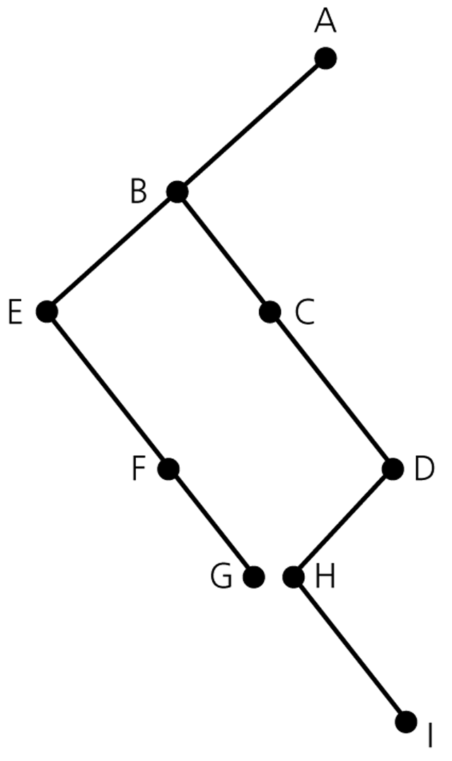
A Pointer-Based Implementation of General Trees
A pointer-based implementation of
a general tree can also represent
a binary tree.

Slide 84
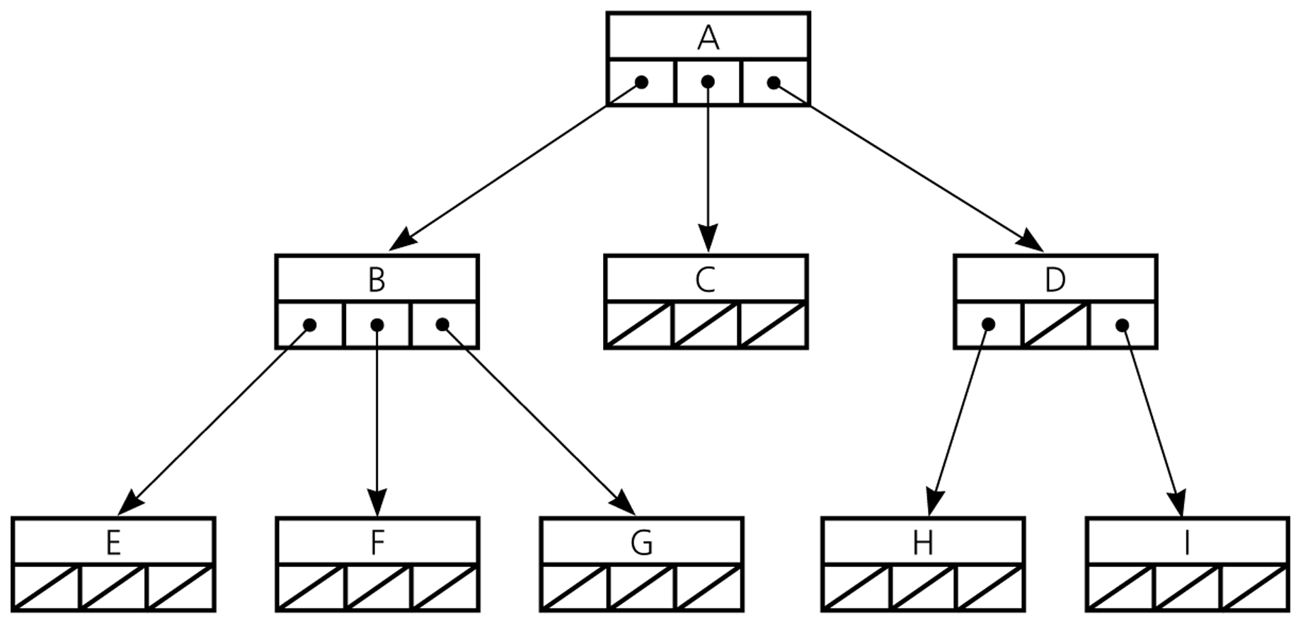
N-ary Tree
An n-ary tree is a generalization of a binary whose
nodes each can have no more than n children.

