Slide 1
Tables and Priority Queues
Initially prepared by Dr. İlyas Çiçekli; improved by various Bilkent CS202 instructors.

Slide 2
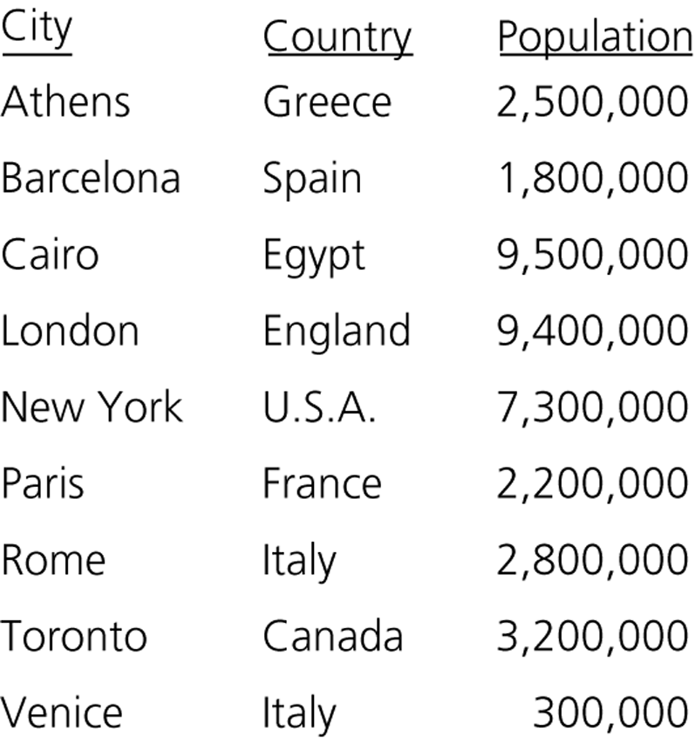
Tables
Appropriate for problems that must manage data by value.
Some important operations of tables:
Inserting a data item containing the value x.
Delete a data item containing the value x.
Retrieve a data item containing the value x.
Various table implementations are possible.
We have to analyze the possible implementations so that we can make an intelligent choice.
Some operations are implemented more efficiently in certain implementations.
An ordinary table of cities

Slide 3
Table Operations
Some of the table operations are possible:
The client may need a subset of these operations or require more
Are keys in the table are unique?
We will assume that keys in our tables are unique.
But, some other tables allow duplicate keys.
Create an empty table
Destroy a table
Determine whether a table is empty
Determine the number of items in the table
Insert a new item into a table
Delete the item with a given search key
Retrieve the item with a given search key
Traverse the table

Slide 4
Selecting an Implementation
Since an array or a linked list represents items one after another, these implementations are called linear.
There are four categories of linear implementations:
Unsorted, array based (an unsorted array)
Unsorted, pointer based (a simple linked list)
Sorted (by search key), array based (a sorted array)
Sorted (by search key), pointer based (a sorted linked list).
We have also nonlinear implementations such as binary search trees.
Binary search tree implementation offers several advantages over linear implementations.

Slide 5

Sorted Linear Implementations
Array-based implementation
Pointer-based implementation

Slide 6
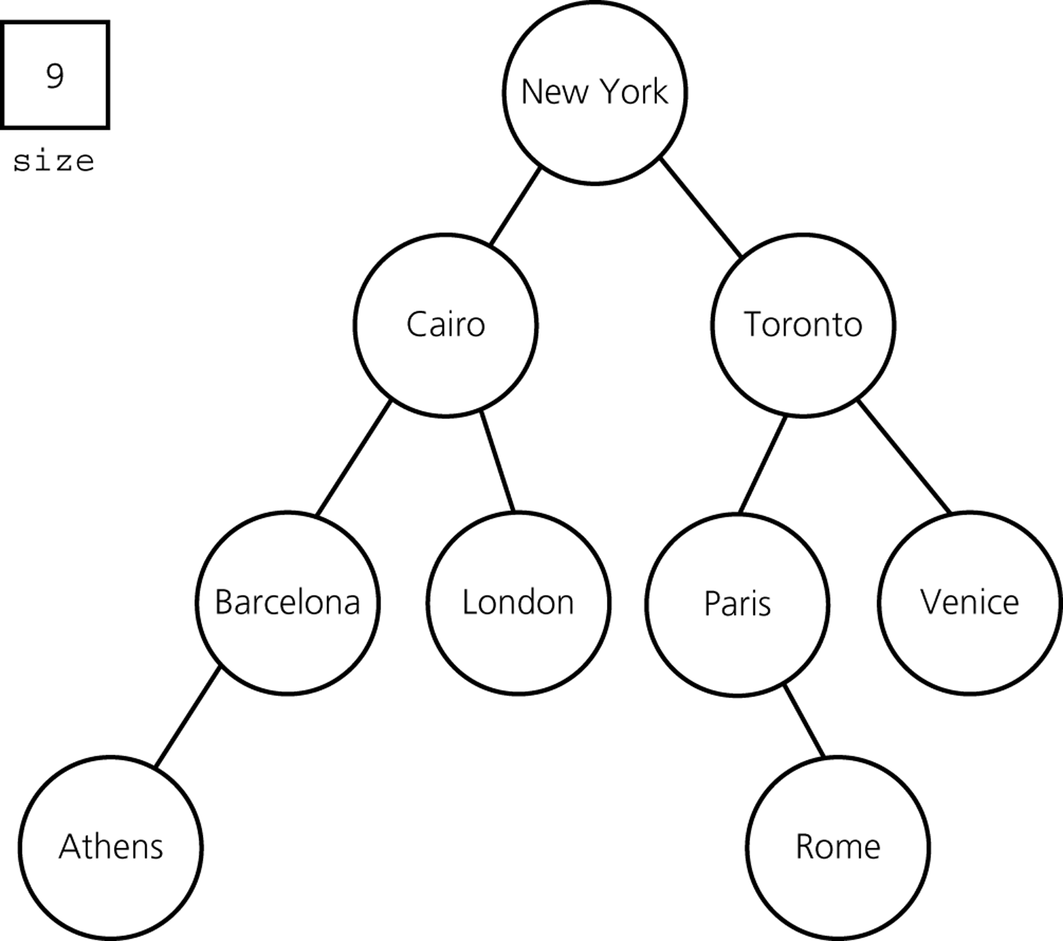
A Nonlinear Implementation
Binary search tree implementation

Slide 7
Which Implementation?
It depends on our application.
Answer the following questions before selecting an implementation.
What operations are needed?
Our application may not need all operations.
Some operations can be implemented more efficiently in one implementation, and some others in another implementation.
How often is each operation required?
Some applications may require many occurrences of an operation, but other applications may not.
For example, some applications may perform many retrievals, but not so many insertions and deletions. On the other hand, other applications may perform many insertions and deletions.

Slide 8
How to Select an Implementation – Scenario A
Scenario A: Let us assume that we have an application:
Inserts data items into a table.
After all data items are inserted, traverses this table in no particular order.
Does not perform any retrieval and deletion operations.
Which implementation is appropriate for this application?
Keeping the items in a sorted order provides no advantage for this application.
In fact, it will be more costly for this application.
➔ Unsorted implementation is more appropriate.

Slide 9

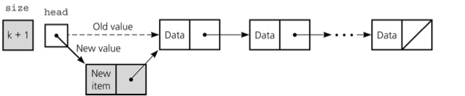
How to Select an Implementation – Scenario A
Which unsorted implementation (array-based, pointer-based)?
Do we know the maximum size of the table?
If we know the expected size is close to the maximum size of the table
➔an array-based implementation is more appropriate
(because a pointer-based implementation uses extra space for pointers)
Otherwise,
➔a pointer-based implementation is more appropriate
(because too many entries will be empty in an array-based implementation)
Time complexity of insertion in an unsorted list: O(1)

Slide 10
How to Select an Implementation – Scenario B
Scenario B: Let us assume that we have an application:
Performs many retrievals, but few insertions and deletions
E.g., a thesaurus (to look up synonyms of a word)
For this application, a sorted implementation is more appropriate
We can use binary search to access data, if we have sorted data.
A sorted linked-list implementation is not appropriate since binary search is not practical with linked lists.
If we know the maximum size of the table
➔ a sorted array-based implementation is more appropriate for frequent retrievals.
Otherwise
➔ a binary search tree implementation is more appropriate for frequent retrievals.
(in fact, balanced binary search trees will be used)

Slide 11
How to Select an Implementation – Scenario C
Scenario C: Let us assume that we have an application:
Performs many retrievals as well as many insertions and deletions.
? Sorted Array Implementation
Retrievals are efficient.
But insertions and deletions are not efficient.
a sorted array-based implementation is not appropriate for this application.
? Sorted Linked List Implementation
Retrievals, insertions, and deletions are not efficient.
a sorted linked-list implementation is not appropriate for this application.
?Binary Search Tree Implementation
Retrieval, insertion, and deletion are efficient in the average case.
a binary search tree implementation is appropriate for this application.
(provided that the height of the BST is O(logn))

Slide 12
Which Implementation?
Linear implementations of a table can be appropriate despite its difficulties.
Linear implementations are easy to understand, easy to implement.
For small tables, linear implementations can be appropriate.
For large tables, linear implementations may still be appropriate
(e.g., for the case that has only insertions to an unsorted table--Scenario A)
In general, a binary search tree implementation is a better choice.
Worst case: O(n) for most table operations
Average case: O(log₂n) for most table operations
Balanced binary search trees increase the efficiency.

Slide 13
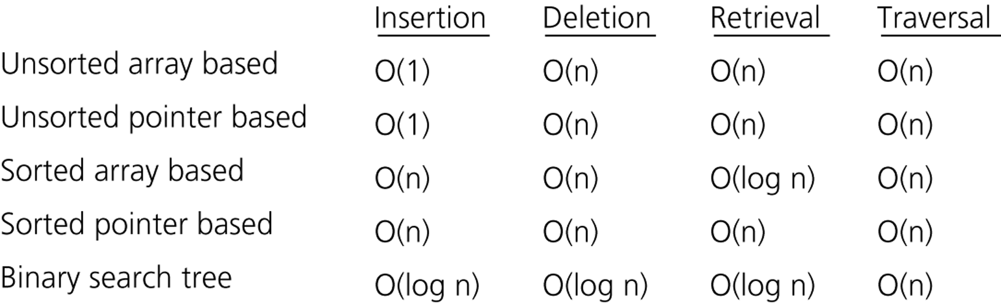
Which Implementation?
The average-case time complexities of the table operations

Slide 14
Binary Search Tree Implementation – TableB.h
#include "BST.h"// Binary search tree operations
typedef TreeItemType TableItemType;
class Table {
public:
Table(); // default constructor
// copy constructor and destructor are supplied by the compiler
bool tableIsEmpty() const;
int tableLength() const;
void tableInsert(const TableItemType& newItem) throw(TableException);
void tableDelete(KeyType searchKey) throw(TableException);
void tableRetrieve(KeyType searchKey, TableItemType& tableItem) const
throw(TableException);
void traverseTable(FunctionType visit);
protected:
void setSize(int newSize);
private:
BinarySearchTree bst; // BST that contains the table’s items
int size; // Number of items in the table
}

Slide 15
Binary Search Tree Implementation – tableInsert
#include "TableB.h"// header file
void Table::tableInsert(const TableItemType& newItem) throw(TableException) {
try {
bst.searchTreeInsert(newItem);
++size;
}
catch (TreeException e){
throw TableException("Cannot insert item");
}
}

Slide 16
The Priority Queue
Priority queue is a variation of the table.
Each data item in a priority queue has a priority value.
Using a priority queue we prioritize a list of tasks:
Job scheduling
Major operations:
Insert an item with a priority value into its proper position in the priority queue.
Deletion is not the same as the deletion in the table. We delete the item with the highest priority.

Slide 17
Priority Queue Operations
create – creates an empty priority queue.
destroy – destroys a priority queue.
isEmpty – determines whether a priority queue is empty or not.
insert – inserts a new item (with a priority value) into a priority queue.
delete – retrieves the item in a priority queue with the highest
priority value, and deletes that item from the priority queue.

Slide 18


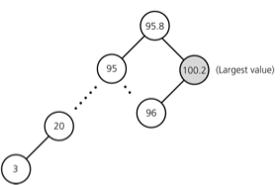
Which Implementations?
Array-based implementation
Insertion will be O(n)
Linked-list implementation
Insertion will be O(n)
BST implementation
Insertion is O(log₂n) in average
but O(n) in the worst case.
We need a balanced BST so that we can get better performance [O(logn) in the worst case] ➔ HEAP

Slide 19
Heaps
Definition:A heap is a complete binary tree such that
It is empty, or
Its root contains a search key greater than or equal to the search key in each of its children, and each of its children is also a heap.
Since the root contains the item with the largest search key, heap in this definition is also known as maxheap.
On the other hand, a heap which places the smallest search key in its root is know as minheap.
We will talk about maxheap as heap in the rest of our discussions.

Slide 20
Heap Data Structure
16
14
10
8
7
9
3
2
4
1
Complete binary tree
Completely filled on all levels except possibly the lowest level
The lowest level is filled from left to right

Slide 21
Heap Property: Min-Heap
1
2
4
The smallest element
in any subtree is the root element in a min-heap
3
7
9
8
10
14
16
Min heap: For every node i other than root, A[parent(i)] ≤ A[i]
➔ Parent node is always smaller than the child nodes

Slide 22
Heap Property: Max-Heap
16
14
10
The largest element
in any subtree is the root element in a max-heap
8
7
9
3
2
4
1
We will focus on max-heaps
Max heap: For every node i other than root, A[parent(i)] ≥ A[i]
➔ Parent node is always larger than the child nodes

Slide 23
Differences between a Heap and a BST
A heap is NOT a binary search tree.
A BST can be seen as sorted, but a heap is ordered in much weaker sense.
Although it is not sorted, the order of a heap is sufficient for the efficient implementation of priority queue operations.
A BST has different shapes, but a heap is always complete binary tree.
50
50
50
HEAPS
40
40
45
40
45
30
35
33
50
42
50
NOT HEAPS
40
40
45
40
30
35

Slide 24
Heap Data Structure
0
16
1
2
Heap can be stored in a linear array
14
10
3
4
5
6
8
7
9
3
7
8
9
Storage
2
4
1
0
1
2
3
4
5
6
7
8
9
items
16
14
10
8
7
9
3
2
4
1

Slide 25
Heap Data Structure
0
The links in the heap are implicit:
16
1
2
14
10
3
4
5
6
8
7
9
3
7
8
9
Storage
2
4
1
0
1
2
3
4
5
6
7
8
9
items
16
14
10
8
7
9
3
2
4
1

Slide 26
Heap Data Structure
0
16
e.g. Left child of node 3 has index 7
1
2
14
10
3
4
5
6
e.g. Right child of node 1 has index 4
8
7
9
3
7
8
9
e.g. Parent of node 6 has index 2
2
4
1
0
1
2
3
4
5
6
7
8
9
items
16
14
10
8
7
9
3
2
4
1

Slide 27
Heap Data Structure
items[0] is always the root element
Array items has two attributes:
MAX_SIZE: Size of the memory allocated for array items
size: The number elements in heap at a given time
size ≤ MAX_SIZE

Slide 28
Major Heap Operations
Two major heap operations are insertion and deletion.
Insertion
Inserts a new item into a heap.
After the insertion, the heap must satisfy the heap properties.
Deletion
Retrieves and deletes the root of the heap.
After the deletion, the heap must satisfy the heap properties.

Slide 29
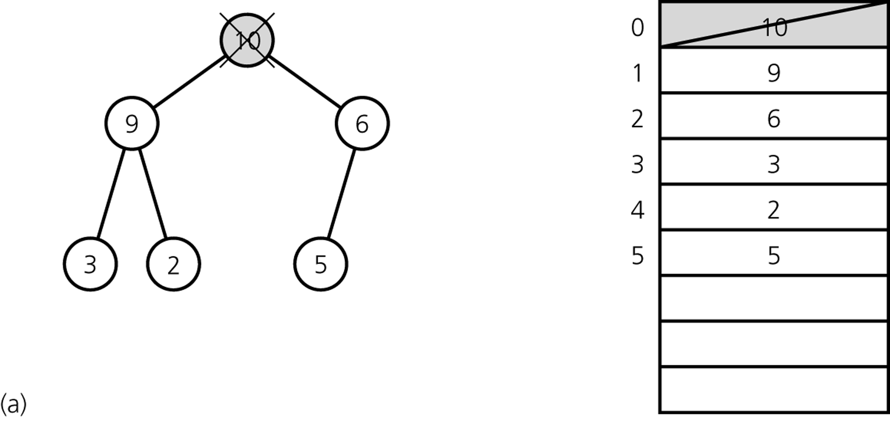
Heap Delete – First Step
The first step of heapDelete is to retrieve and delete the root.
This creates two disjoint heaps.

Slide 30
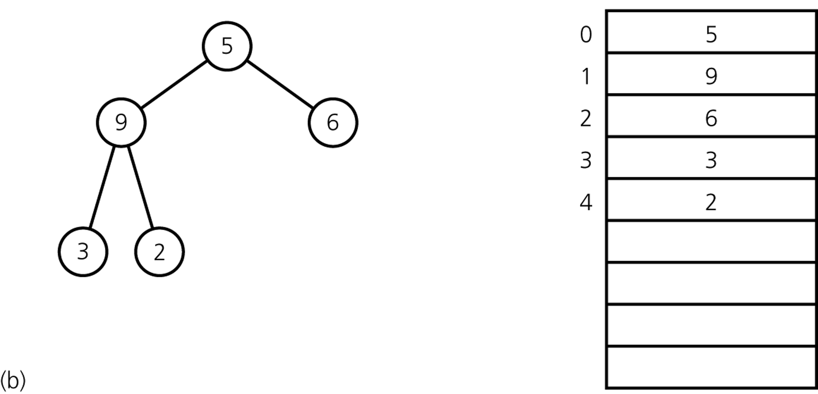
Heap Delete – Second Step
Move the last item into the root.
The resulting structure may not be heap; it is called as semiheap.

Slide 31
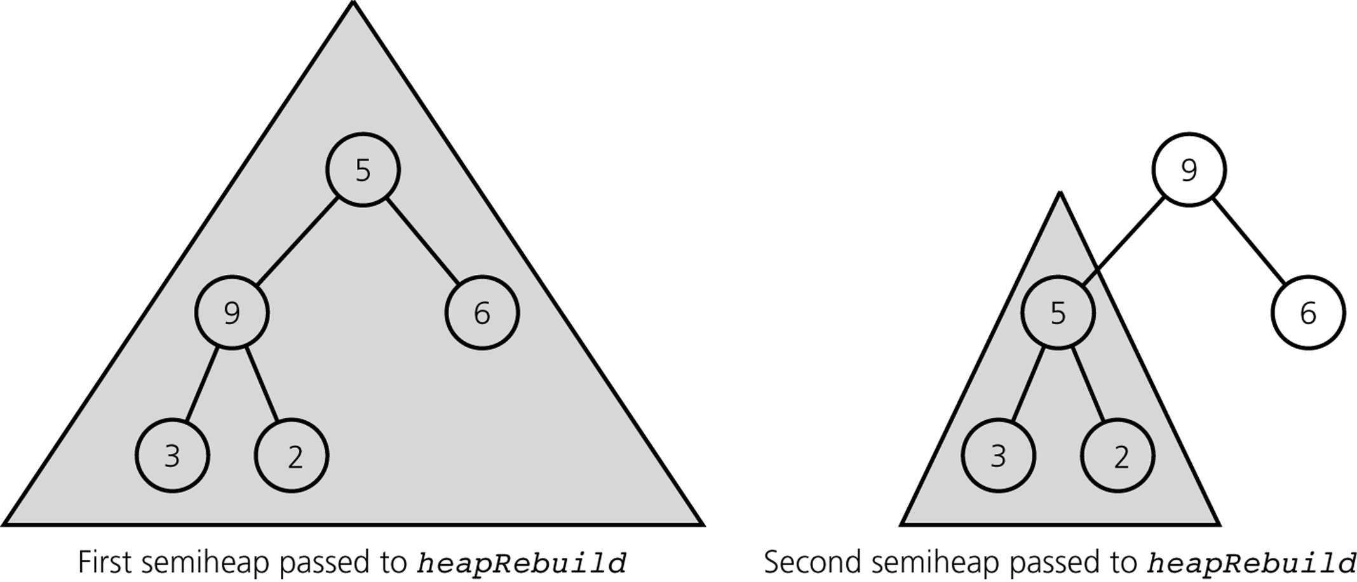
Heap Delete – Last Step
The last step of heapDelete transforms the semiheap into a heap.
Recursive calls to heapRebuild

Slide 32
Heap Delete
max=
0
heapDelete (items, size)
max ← items[0]
items[0] ← items[size-1]
size ← size − 1
heapRebuild(items, 0, size)
return max
16
1
2
14
10
3
4
5
6
8
7
9
3
7
8
9
2
4
1
Return the max element,
and reorganize the heap
to maintain heap property

Slide 33
Rebuild Heap
Heap property violated at the root
Maintaining heap property:
Subtrees rooted at left(i) and right(i) are already heaps.
But, items[i] may violate the heap property (i.e., may be smaller than its children)
Idea: Float down the value at items[i] in the heap so that subtree rooted at i becomes a heap.
0
1
1
2
14
10
3
4
5
6
8
7
9
3
7
8
2
4
Heap property satisfied
for left and right subtrees

Slide 34
Rebuild Heap
rebuildHeap(items, 0, 9)
0
1
1
2
14
10
3
4
5
6
8
7
9
3
7
8
2
4
recursive call

Slide 35
Rebuild Heap
recursive call:
rebuildHeap(items, 1, 9)
0
14
1
2
1
10
3
4
5
6
8
7
9
3
7
8
2
4
recursive call

Slide 36
Rebuild Heap
recursive call:
rebuildHeap(items, 3, 9)
0
14
1
2
8
10
3
4
5
6
1
7
9
3
7
8
2
4
recursive call
(base case)

Slide 37
Rebuild Heap: Summary (Floating Down the Value)
rebuildHeap(items, 0, 9)
0
1
1
2
14
10
3
4
5
6
8
7
9
3
7
8
2
4

Slide 38
Heap Operations: Rebuild Heap
after rebuildHeap:
0
14
1
2
8
10
3
4
5
6
4
7
9
3
7
8
2
1

Slide 39
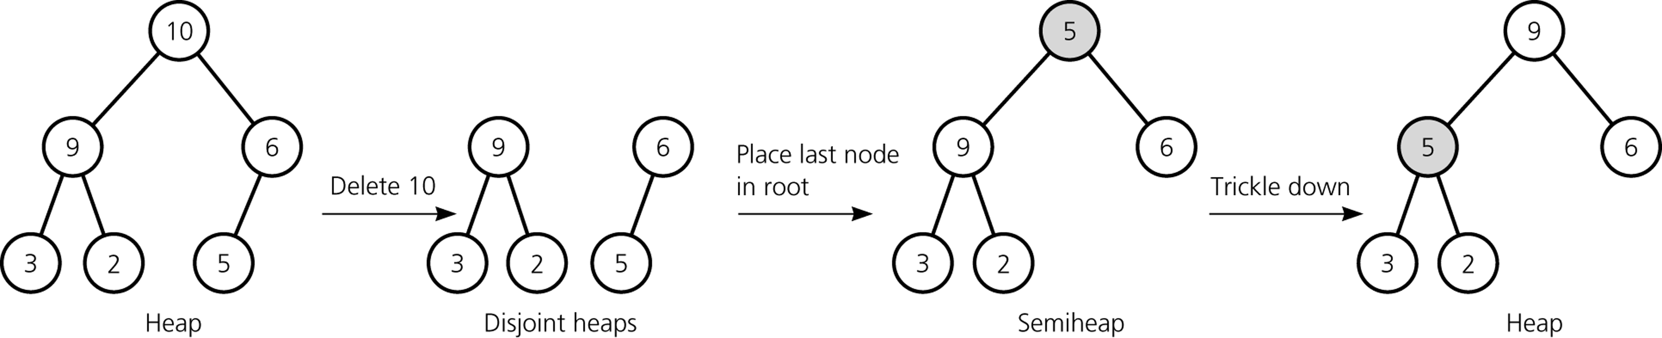
Heap Delete
ANALYSIS
Since the height of a complete binary tree with n nodes is always ⎡ log₂(n+1)⎤
➔ heapDelete is O(log₂n)

Slide 40
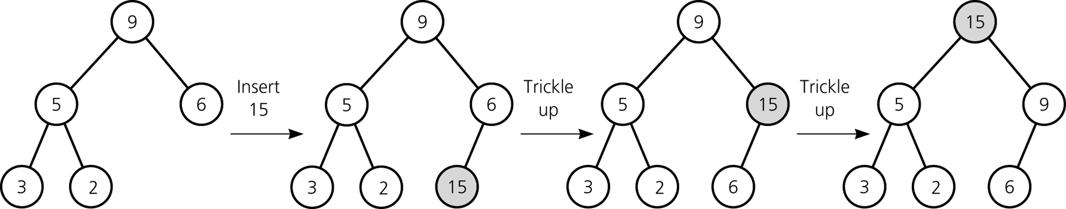
Heap Insert
A new item is inserted at the bottom of the tree,
and it trickles up to its proper place
ANALYSIS
Since the height of a complete binary tree with n nodes is always ⎡ log₂(n+1)⎤
➔ heapInsert is O(log₂n)

Slide 41
Heap Implementation
constint MAX_HEAP = maximum-size-of-heap;
#include "KeyedItem.h"// definition of KeyedItem
typedef KeyedItem HeapItemType;
class Heap {
public:
Heap(); // default constructor
// copy constructor and destructor are supplied by the compiler
bool heapIsEmpty() const;
void heapInsert(const HeapItemType& newItem) throw(HeapException);
void heapDelete(HeapItemType& rootItem) throw(HeapException);
protected:
void heapRebuild(int root); // Converts the semiheap rooted at
// index root into a heap
private:
HeapItemType items[MAX_HEAP]; // array of heap items
int size; // number of heap items
};

Slide 42
Heap Implementation
// Default constructor
Heap::Heap() : size(0) {
}
boolHeap::heapIsEmpty() const {
return (size == 0);
}

Slide 43
Heap Implementation -- heapInsert
void Heap::heapInsert(constHeapItemType&newItem) throw(HeapException) {
if (size >= MAX_HEAP)
throw HeapException("HeapException: Heap full");
// Place the new item at the end of the heap
items[size] = newItem;
// Trickle new item up to its proper position
int place = size;
int parent = (place - 1)/2;
while ( (place > 0) && (items[place].getKey() > items[parent].getKey()) ) {
HeapItemType temp = items[parent];
items[parent] = items[place];
items[place] = temp;
place = parent;
parent = (place - 1)/2;
}
++size;
}

Slide 44
Heap Implementation -- heapDelete
Void Heap::heapDelete(HeapItemType&rootItem) throw(HeapException) {
if (heapIsEmpty())
throwHeapException("HeapException: Heap empty");
else {
rootItem = items[0];
items[0] = items[--size];
heapRebuild(0);
}
}

Slide 45
Heap Implementation -- heapRebuild
voidHeap::heapRebuild(int root) {
int child = 2 * root + 1; // index of root's left child, if any
if ( child < size ) {
// root is not a leaf so that it has a left child
int rightChild = child + 1; // index of a right child, if any
// If root has right child, find larger child
if ( (rightChild < size) &&
(items[rightChild].getKey() >items[child].getKey()) )
child = rightChild; // index of larger child
// If root’s item is smaller than larger child, swap values
if ( items[root].getKey() < items[child].getKey() ) {
HeapItemType temp = items[root];
items[root] = items[child];
items[child] = temp;
// transform the new subtree into a heap
heapRebuild(child);
}
}

Slide 46
Heap Implementation of PriorityQueue
The heap implementation of the priority queue is straightforward
Since the heap operations and the priority queue operations are the same.
When we use the heap,
Insertion and deletion operations of the priority queue will be O(log₂n).

Slide 47
Heap Implementation of PriorityQueue
#include "Heap.h"// ADT heap operations
typedef HeapItemType PQItemType;
class PriorityQueue {
public:
// default constructor, copy constructor, and destructor
// are supplied by the compiler
// priority-queue operations:
bool pqIsEmpty() const;
void pqInsert(const PQItemType& newItem) throw (PQException);
void pqDelete(PQItemType& priorityItem) throw (PQException);
private:
Heap h;
};

Slide 48
Heap Implementation of PriorityQueue
bool PriorityQueue::pqIsEmpty() const {
return h.heapIsEmpty();
}
void PriorityQueue::pqInsert(const PQItemType& newItem) throw (PQException){
try {
h.heapInsert(newItem);
}
catch (HeapException e) {
throw PQueueException("Priority queue is full");
}
}
void PriorityQueue::pqDelete(PQItemType& priorityItem) throw (PQException) {
try {
h.heapDelete(priorityItem);
}
catch (HeapException e) {
throw PQueueException("Priority queue is empty");
}
}

Slide 49
Heap or Binary Search Tree?

Slide 50
Heapsort
We can make use of a heap to sort an array:
Create a heap from the given initial array with n items.
Swap the root of the heap with the last element in the heap.
Now, we have a semiheap with n-1 items, and a sorted array with one item.
Using heapRebuild convert this semiheap into a heap. Now we will have a heap with n-1 items.
Repeat the steps 2-4 as long as the number of items in the heap is more than 1.

Slide 51
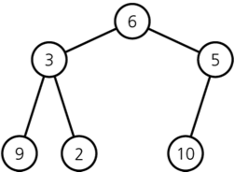

Heapsort -- Building a heap from an array
A heap corresponding to anArray
The initial contents of anArray
for (index = n – 1 ; index >= 0 ; index--) {
// Invariant: the tree rooted at index is a semiheap
heapRebuild(anArray, index, n)
// Assertion: the tree rooted at index is a heap.
}

Slide 52
Where are the leaves stored?
0
Lemma: The last ⎡n/2⎤ nodes of a heap are all leaves
16
1
2
14
10
3
4
5
6
8
7
9
3
7
8
9
Storage
2
4
1
0
1
2
3
4
5
6
7
8
9
A
16
14
10
8
7
9
3
2
4
1

Slide 53
Heapsort -- Building a heap from an array
A heap corresponding to anArray
The initial contents of anArray
for (index = (n/2) – 1 ; index >= 0 ; index--) { → MORE EFFICIENT
// Invariant: the tree rooted at index is a semiheap
heapRebuild(anArray, index, n)
// Assertion: the tree rooted at index is a heap.
}

Slide 54
Build-Heap: Example
0
index=4
4
heapRebuild(A, 4, 10)
1
2
1
3
3
4
5
6
2
7
9
10
7
8
9
14
8
16
0
1
2
3
4
5
6
7
8
9
A
4
1
3
2
7
9
10
14
8
16

Slide 55
Build-Heap: Example
0
index=3
4
heapRebuild(A, 3, 10)
1
2
1
3
3
4
5
6
2
16
9
10
7
8
9
14
8
7
0
1
2
3
4
5
6
7
8
9
A
4
1
3
2
16
9
10
14
8
7

Slide 56
Build-Heap: Example
0
index=2
4
heapRebuild(A, 2, 10)
1
2
1
3
3
4
5
6
14
16
9
10
7
8
9
2
8
7
0
1
2
3
4
5
6
7
8
9
A
4
1
3
14
16
9
10
2
8
7

Slide 57
Build-Heap: Example
0
index=1
4
heapRebuild(A, 1, 10)
1
2
1
10
3
4
5
6
14
16
9
3
7
8
9
2
8
7
0
1
2
3
4
5
6
7
8
9
A
4
1
10
14
16
9
3
2
8
7

Slide 58
Build-Heap: Example
0
index=1 (cont’d)
4
heapRebuild(A, 1, 10)
1
2
16
10
3
4
5
6
14
1
9
3
7
8
9
2
8
7
0
1
2
3
4
5
6
7
8
9
A
4
16
10
14
1
9
3
2
8
7

Slide 59
Build-Heap: Example
0
index=0
4
heapRebuild(A, 0, 10)
1
2
16
10
3
4
5
6
14
7
9
3
7
8
9
2
8
1
0
1
2
3
4
5
6
7
8
9
A
4
16
10
14
7
9
3
2
8
1

Slide 60
Build-Heap: Example
0
index=0 (cont’d)
16
heapRebuild(A, 0, 10)
1
2
4
10
3
4
5
6
14
7
9
3
7
8
9
2
8
1
0
1
2
3
4
5
6
7
8
9
A
16
4
10
14
7
9
3
2
8
1

Slide 61
Build-Heap: Example
0
index=0 (cont’d)
16
heapRebuild(A, 0, 10)
1
2
14
10
3
4
5
6
4
7
9
3
7
8
9
2
8
1
0
1
2
3
4
5
6
7
8
9
A
16
14
10
4
7
9
3
2
8
1

Slide 62
Build-Heap: Example
0
After Build-Heap
16
1
2
14
10
3
4
5
6
8
7
9
3
7
8
9
2
4
1
0
1
2
3
4
5
6
7
8
9
A
16
14
10
8
7
9
3
2
4
1

Slide 63
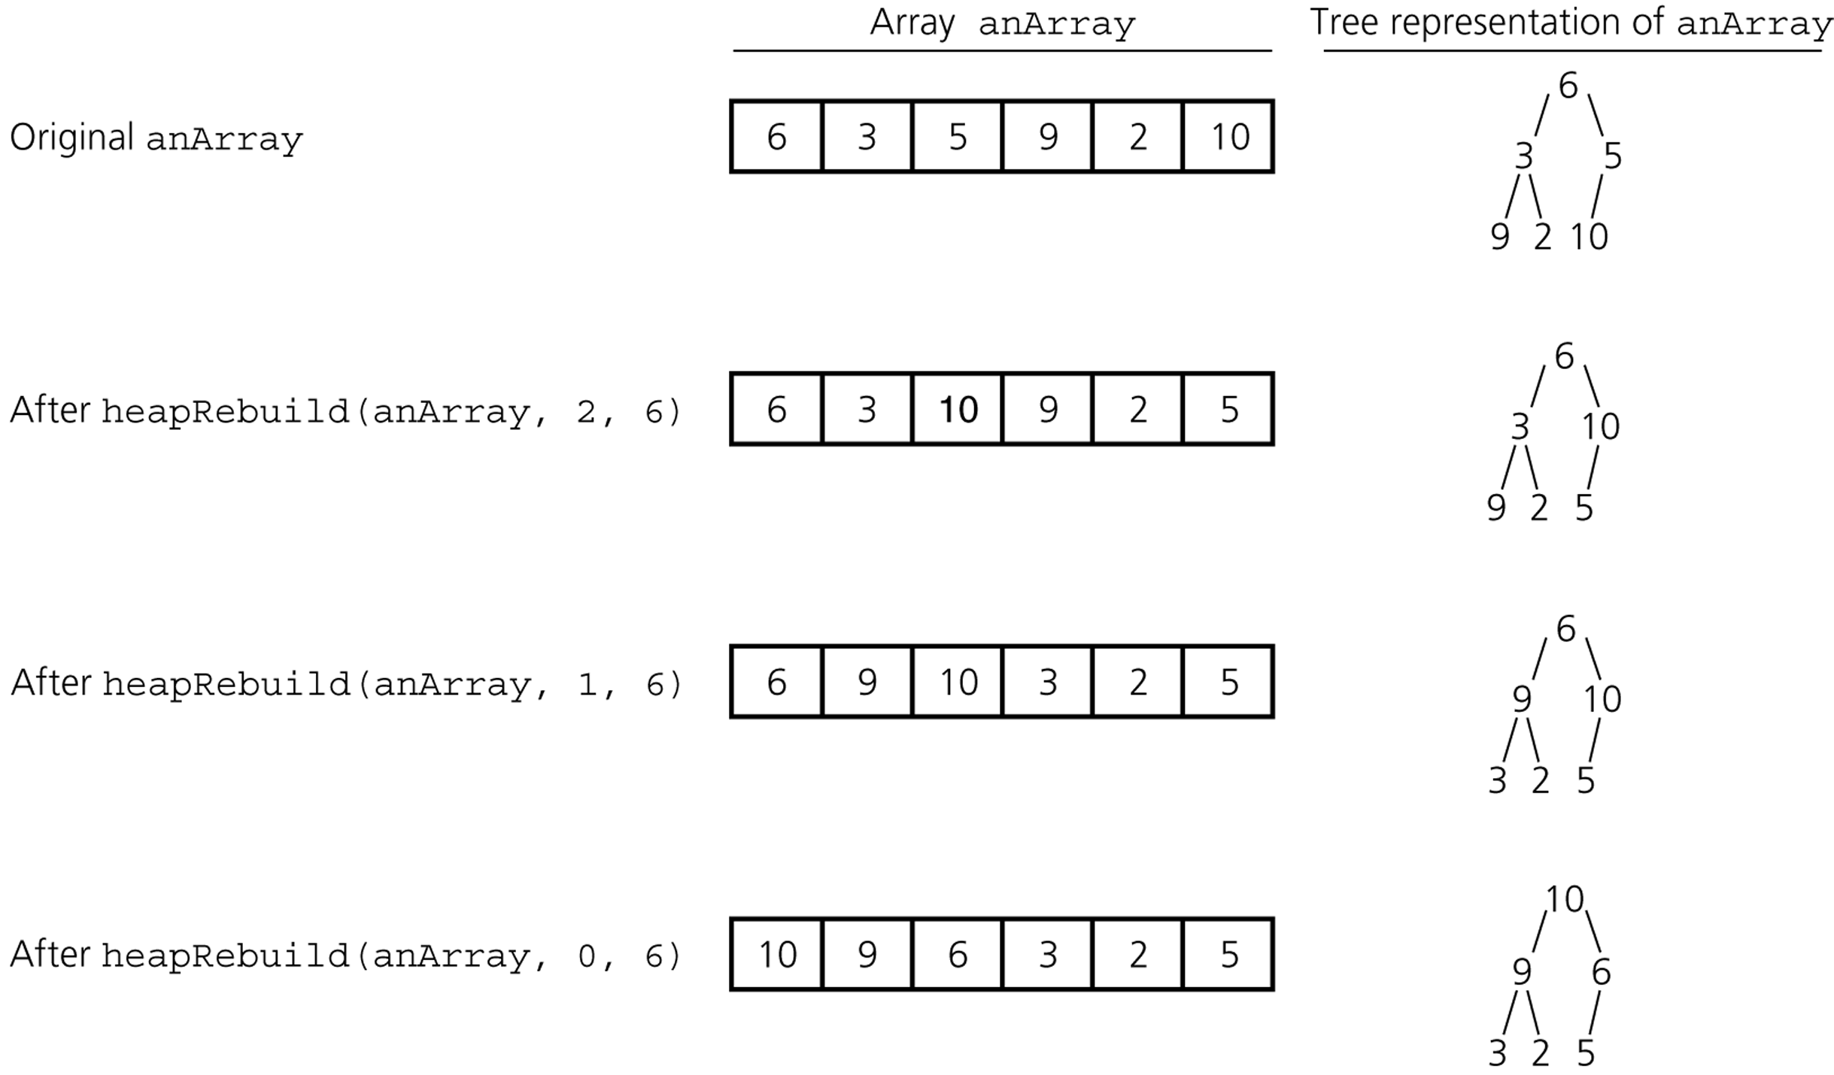
Heapsort -- Building a heap from an array

Slide 64
Heapsort
heapSort(inout anArray:ArrayType, in n:integer) {
// build an initial heap
for (index = (n/2) – 1 ; index >= 0 ; index--)
heapRebuild(anArray, index, n)
for (last = n-1 ; last >0 ; last--) {
// invariant: anArray[0..last] is a heap,
// anArray[last+1..n-1] is sorted and
// contains the largest items of anArray.
swap anArray[0] and anArray[last]
// make the heap region a heap again
heapRebuild(anArray, 0, last)
}
}

Slide 65
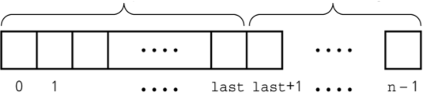
Heapsort
Heapsort partitions an array into two regions.
Each step moves an item from the HeapRegion to SortedRegion.
The invariant of the heapsort algorithm is:
After the kth step,
The SortedRegion contains the k largest value and they are in sorted order.
The items in the HeapRegion form a heap.
HeapRegion
SortedRegion

Slide 66
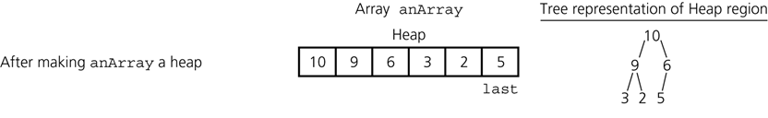
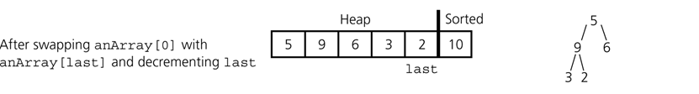
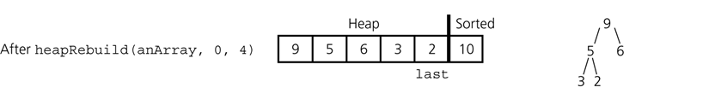
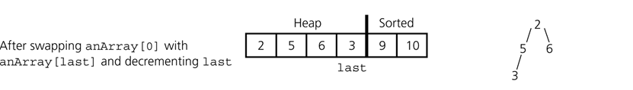
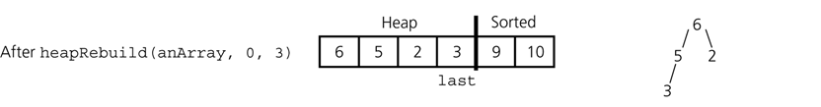
Heapsort -- Trace

Slide 67



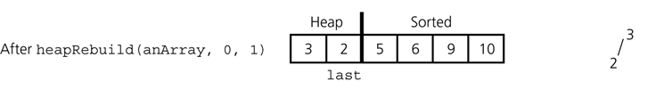
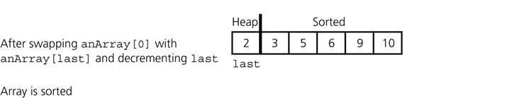
Heapsort -- Trace

Slide 68
Heapsort -- Analysis
Heapsort is
O(n log n) at the average case
O(n log n) at the worst case
Compared against quicksort,
Heapsort usually takes more time at the average case
But its worst case is also O(n log n).

