Slide 1
Hashing
Initially prepared by Dr. İlyas Çiçekli; improved by various Bilkent CS202 instructors.

Slide 2
Hashing
Using balanced search trees (2-3, 2-3-4, red-black, and AVL trees), we implement table operations in O (logN) time
retrieval, insertion, and deletion
Can we find a data structure so that we can perform these table operations even faster (e.g., in O(1) time)?
Hash Tables

Slide 3
Hash Tables
In hash tables, we have
An array (index ranges 0 … n – 1) and
Each array location is called a bucket
An address calculator (hash function), which maps a search key into an array index between 0 … n – 1

Slide 4
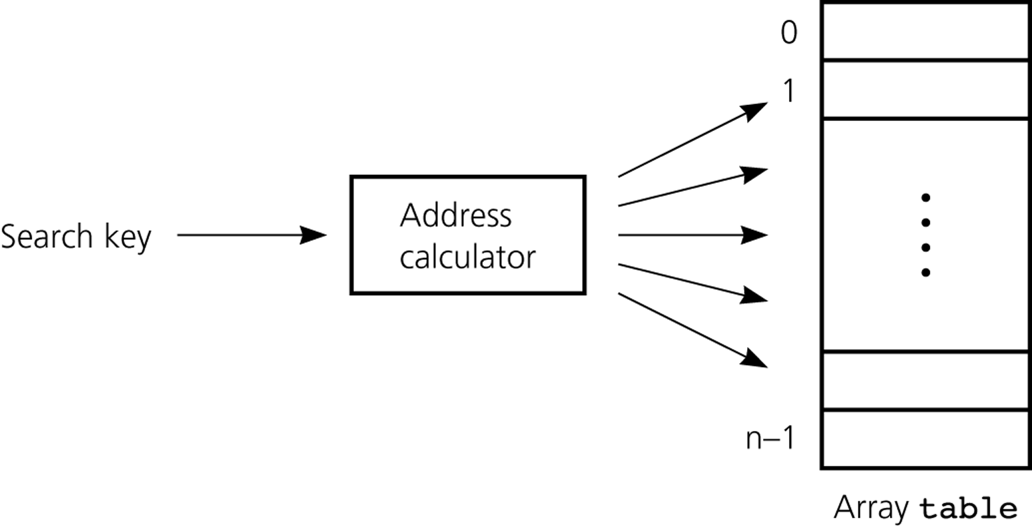
Hash Function -- Address Calculator
Hash Function
Hash Table

Slide 5
Hashing
A hash function tells us where to place an item in array called a hash table.
This method is known as hashing.
Hash function maps a search key into an integer between 0 and n – 1.
We can have different hash functions.
Hash function depends on key type (int, string, ...)
E.g., h(x) = x mod n, where x is an integer

Slide 6
Collisions
A perfect hash function maps each search key into a unique location of the hash table.
A perfect hash function is possible if we know all search keys in advance.
In practice we do not know all search keys, and thus, a hash function can map more than one key into the same location.
Collisions occur when a hash function maps more than one item into the same array location.
We have to resolve the collisions using a certain mechanism.

Slide 7
Hash Functions
We can design different hash functions.
But a good hash function should
be easy and fast to compute
place items uniformly (evenly) throughout the hash table.
We will consider only integer hash functions
On a computer, everything is represented with bits.
They can be converted into integers.
1001010101001010000110…. remember?

Slide 8
Everything is an Integer
If search keys are strings, think of them as integers, and apply a hash function for integers.
For example, strings can be encoded using ASCII codes of characters.
Consider the string “NOTE”
ASCII code of N is 4Eh (01001110), O is 4Fh (01001111),
T is 54h(01010100), E is 45h (01000101)
Concatenate four binary numbers to get a new binary number
01001110010011110101010001000101= 4E4F5445h = 1313821765

Slide 9
How to Design a Hash Function?
Three possibilities
Selecting digits
Folding
Modular Arithmetic
Or, their combinations
Hash Function
Hash Table

Slide 10
Hash Functions -- Selecting Digits
Select certain digits and combine to create the address.
For example, suppose that we have 11-digit Turkish nationality ID’s
Define a hash function that selects the 2nd and 5th most significant digits
h(033475678) = 37
h(023455678) = 25
Define the table size as 100
Is this a good hash function?
No, since it does not place items uniformly.

Slide 11
Hash Functions -- Folding
Folding – selecting all digits and adding them.
For example, suppose previous nine-digit numbers
Define a hash function that selects all digits and adds them
h(033475678) = 0 + 3 + 3 + 4 + 7 + 5 + 6 + 7 + 8 = 43
h(023455678) = 0 + 2 + 3 + 4 + 5 + 5 + 6 + 7 + 8 = 40
Define the table size as 82
We can select a group of digits and add the digits in this group as well.

Slide 12
Hash Functions -- Modular Arithmetic
Modular arithmetic – provides a simple and effective hash function.
h(x) = x mod tableSize
The table size should be a prime number.
Why? Think about it.
We will use modular arithmetic as our hash function in the rest of our discussions.

Slide 13
Why Primes?
Assume you hash the following with x mod 8:
64, 100, 128, 200, 300, 400, 500
0
1
2
3
4
5
6
7
64
128
200
400
100
300
500

Slide 14
Why Primes?
Now try it with x mod 7
64, 100, 128, 200, 300, 400, 500
0
1
2
3
4
5
6
64
128
400
100
500
200
300

Slide 15
Rationale
If we are adding numbers a₁, a₂, a₃ … a₄ to a table of size m
All values will be hashed into multiples of
gcd(a₁, a₂, a₃ … a₄ ,m)
For example, if we are adding 64, 100, 128, 200, 300, 400, 500 to a table of size 8, all values will be hashed to 0 or 4
gcd(64,100,128,200,300,400,500, 8) = 4
When m is a prime gcd(a₁, a₂, a₃ … a₄ ,m) = 1, all values will be hashed to anywhere
gcd(64,100,128,200,300,400,500,7) = 1
unless gcd(a₁, a₂, a₃ … a₄ ) = m, which is rare.

Slide 16
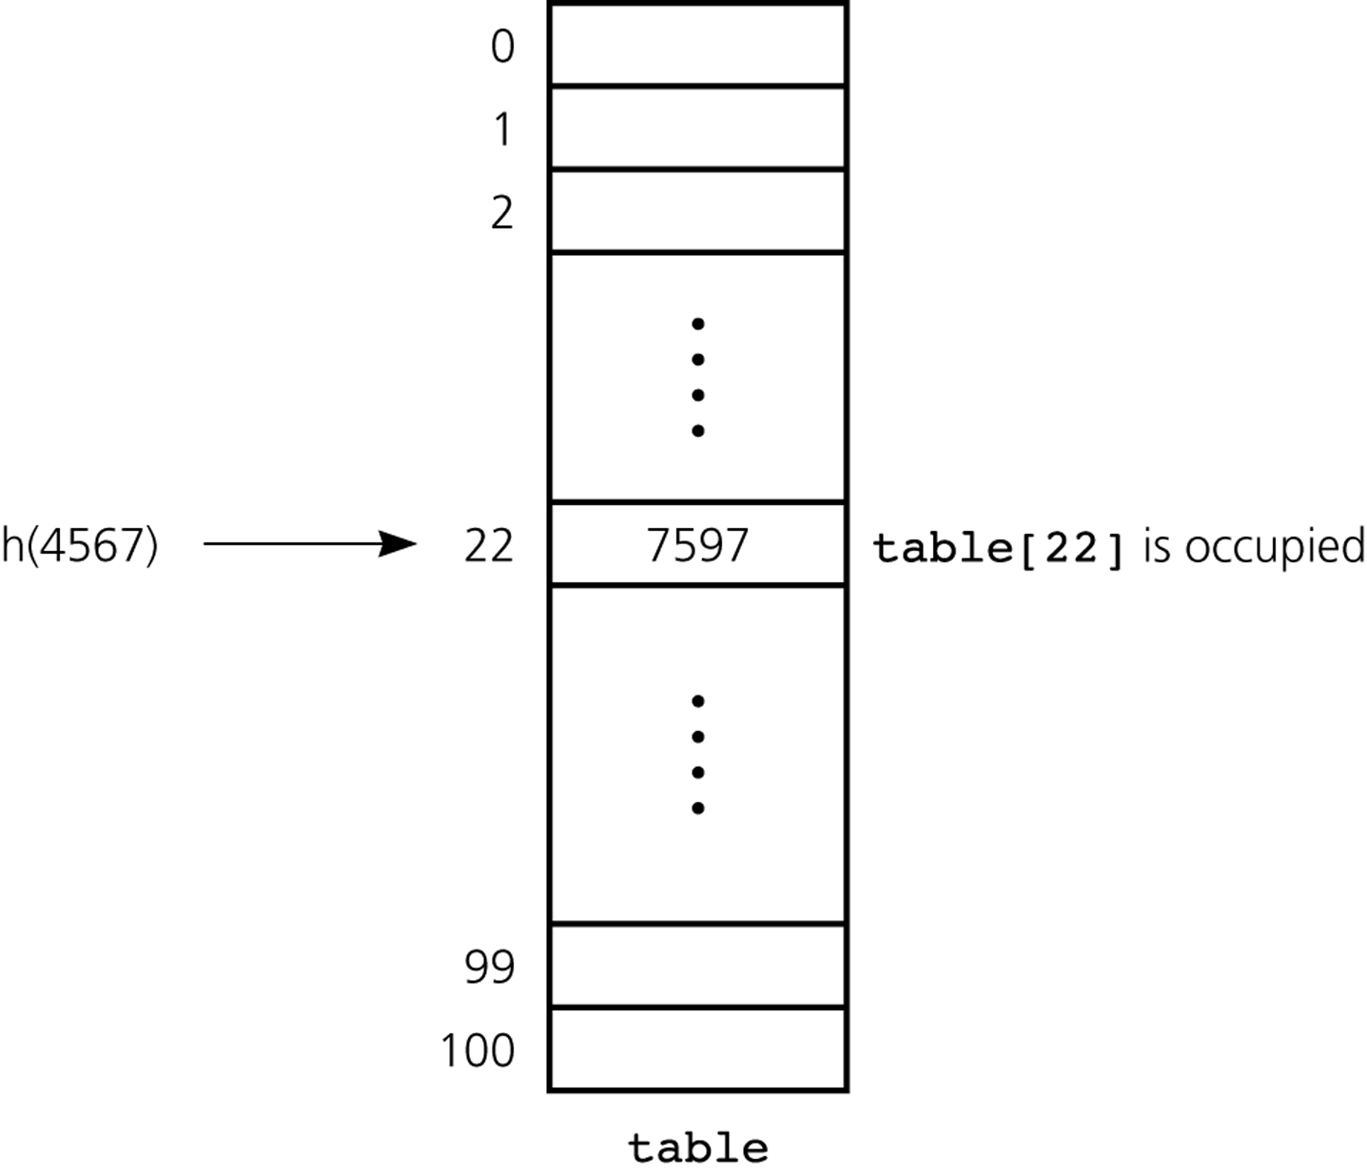
Collision Resolution
Collision resolution – two general approaches
Open Addressing
Each entry holds one item
Chaining
Each entry can hold more than one item
(Buckets – hold certain number of items)
Table size is 101

Slide 17
Open Addressing
Open addressing – probes for some other empty location when a collision occurs.
Probe sequence: sequence of examined locations. Different open-addressing schemes:
Linear Probing
Quadratic Probing
Double Hashing

Slide 18
Open Addressing -- Linear Probing
linear probing: search table sequentially starting from the original hash location.
Check next location, if location is occupied.
Wrap around from last to first table location

Slide 19
Linear Probing -- Example
Example:
Table Size is 11 (0..10)
Hash Function: h(x) = x mod 11
Insert keys: 20, 30, 2, 13, 25, 24, 10, 9
20 mod 11 = 9
30 mod 11 = 8
2 mod 11 = 2
13 mod 11 = 2 ➔ 2+1=3
25 mod 11 = 3 ➔ 3+1=4
24 mod 11 = 2 ➔ 2+1, 2+2, 2+3=5
10 mod 11 = 10
9 mod 11 = 9 ➔ 9+1, 9+2 mod 11 =0
0 | 9
1
2 | 2
3 | 13
4 | 25
5 | 24
6
7
8 | 30
9 | 20
10 | 10

Slide 20
Linear Probing -- Clustering Problem
One of the problems with linear probing is that table items tend to cluster together in the hash table.
i.e. table contains groups of consecutively occupied locations.
This phenomenon is called primary clustering.
Clusters can get close to one another, and merge into a larger cluster.
Thus, the one part of the table might be quite dense, even though another part has relatively few items.
Primary clustering causes long probe searches, and therefore, decreases the overall efficiency.

Slide 21
Open Addressing -- Quadratic Probing
Quadratic probing: almost eliminates clustering problem
Approach:
Start from the original hash location i
If location is occupied, check locations i+1², i+2²,
i+3², i+4² ...
Wrap around table, if necessary.

Slide 22
Quadratic Probing -- Example
Example:
Table Size is 11 (0..10)
Hash Function: h(x) = x mod 11
Insert keys: 20, 30, 2, 13, 25, 24, 10, 9
20 mod 11 = 9
30 mod 11 = 8
2 mod 11 = 2
13 mod 11 = 2 ➔ 2+1²=3
25 mod 11 = 3 ➔ 3+1²=4
24 mod 11 = 2 ➔ 2+1², 2+2²=6
10 mod 11 = 10
9 mod 11 = 9 ➔ 9+1², 9+2² mod 11,
9+3² mod 11 =7
0
1
2 | 2
3 | 13
4 | 25
5
6 | 24
7 | 9
8 | 30
9 | 20
10 | 10

Slide 23
Open Addressing -- Double Hashing
Double hashing also reduces clustering.
Idea: increment using a second hash function h₂. Should satisfy:
h₂(key) ≠0
h₂≠h₁
Probes following locations until it finds an unoccupied place
h₁(key)
h₁(key) + h₂(key)
h₁(key) + 2*h₂(key),
...

Slide 24
Double Hashing -- Example
Example:
Table Size is 11 (0..10)
Hash Function:
h₁(x) = x mod 11
h₂(x) = 7 – (x mod 7)
Insert keys: 58, 14, 91
58 mod 11 = 3
14 mod 11 = 3 ➔ 3+7=10
91 mod 11 = 3 ➔ 3+7, 3+2*7 mod 11=6
0
1
2
3 | 58
4
5
6 | 91
7
8
9
10 | 14

Slide 25
Open Addressing -- Retrieval & Deletion
Retrieving an item with a given key:
(same as insertion): probe the locations until we find the desired item or we reach to an empty location.
Deletions in open addressing cause complications
We CANNOT simply delete an item from the hash table because this new empty (a deleted) location causes to stop prematurely (incorrectly) indicating a failure during a retrieval.
Solution: We have to have three kinds of locations in a hash table: Occupied, Empty, Deleted.
A deleted location will be treated as an occupied location during retrieval.

Slide 26
Separate Chaining
Another way to resolve collisions is to change the structure of the hash table.
In open-addressing, each location holds only one item.
Idea 1: each location is itself an array called bucket
Store items that are hashed into same location in this array.
Problem: What will be the size of the bucket?
Idea 2: each location is itself a linked list. Known as separate-chaining.
Each entry (of the hash table) is a pointer to a linked list (the chain) of the items that the hash function has mapped into that location.

Slide 27
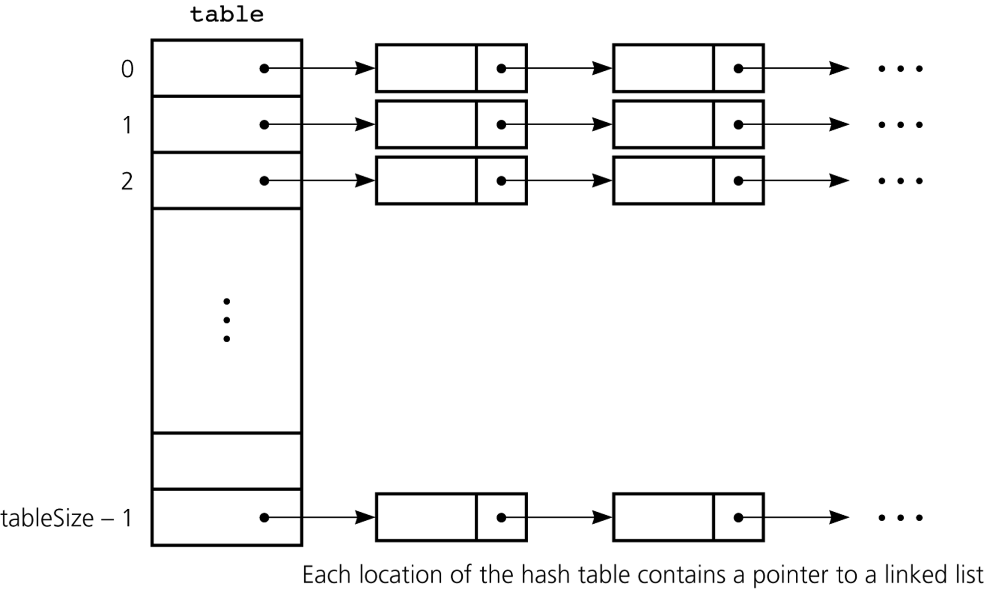
Separate Chaining

Slide 28
Hashing Analysis

Slide 29
Hashing -- Analysis
An analysis of the average-case efficiency of hashing involves the load factor α:
α= (current number of items) / tableSize
α measures how full a hash table is.
Hash table should not be too loaded if we want to get better performance from hashing.
In average case analyses, we assume that the hash function uniformly distributes keys in the hash table.
Unsuccessful searches generally require more time than successful searches.

Slide 30
Separate Chaining -- Analysis
Separate Chaining – approximate average number of comparisons (probes) that a search requires :
for a successful search
for an unsuccessful search
It is the most efficient collision resolution scheme.
But it requires more storage (needs storage for pointers).
It easily performs the deletion operation. Deletion is more difficult in open-addressing.

Slide 31
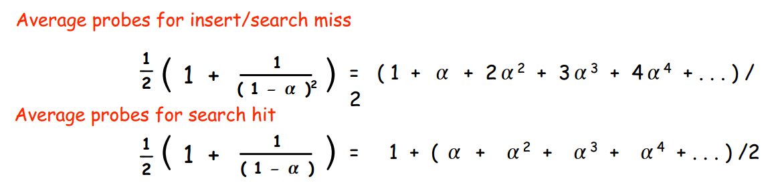
Linear Probing -- Analysis
Linear Probing – approximate average number of comparisons (probes) that a search requires :
for a successful search
for an unsuccessful search
Insert and search cost depend on length of cluster.
Average length of cluster = α = N / M.
Worst case: all keys hash to the same cluster.

Slide 32
Linear Probing -- Analysis
Linear Probing – approximate average number of comparisons (probes) that a search requires :
for a successful search
for an unsuccessful search
As load factor increases, number of collisions increases, causing increased search times.
To maintain efficiency, it is important to prevent the hash table from filling up.

Slide 33
Linear Probing -- Analysis
Example: Find the average number of probes for a successful
search and an unsuccessful search for this hash table? Use the
following hash function: h(x) = x mod 11
Successful Search: Try 20, 30, 2, 13, 25, 24, 10, 9
20: 9 30: 8 2: 2 13: 2,3
25: 3, 4 24: 2, 3, 4, 5 10: 10 9: 9, 10, 0
Avg. no of probes = (1+1+1+2+2+4+1+3)/8 = 1.9
Unsuccessful Search: Try 0, 1, 35, 3, 4, 5, 6, 7, 8, 31, 32
0: 0, 1 1: 1 35: 2, 3, 4, 5, 6
3: 3, 4, 5, 6 4: 4, 5, 6 5: 5, 6
6: 6 7: 7 8: 8, 9, 10, 0, 1
31: 9, 10, 0, 1 32: 10, 0, 1
Avg. no of probes =(2+1+5+4+3+2+1+1+5+4+3)/11 = 2.8
0 | 9
1
2 | 2
3 | 13
4 | 25
5 | 24
6
7
8 | 30
9 | 20
10 | 10

Slide 34
Quadratic Probing & Double Hashing -- Analysis
The approximate average number of comparisons (probes) that a search requires is given as follows:
for a successful search
for an unsuccessful search
On average, both methods require fewer comparisons than linear probing.

Slide 35
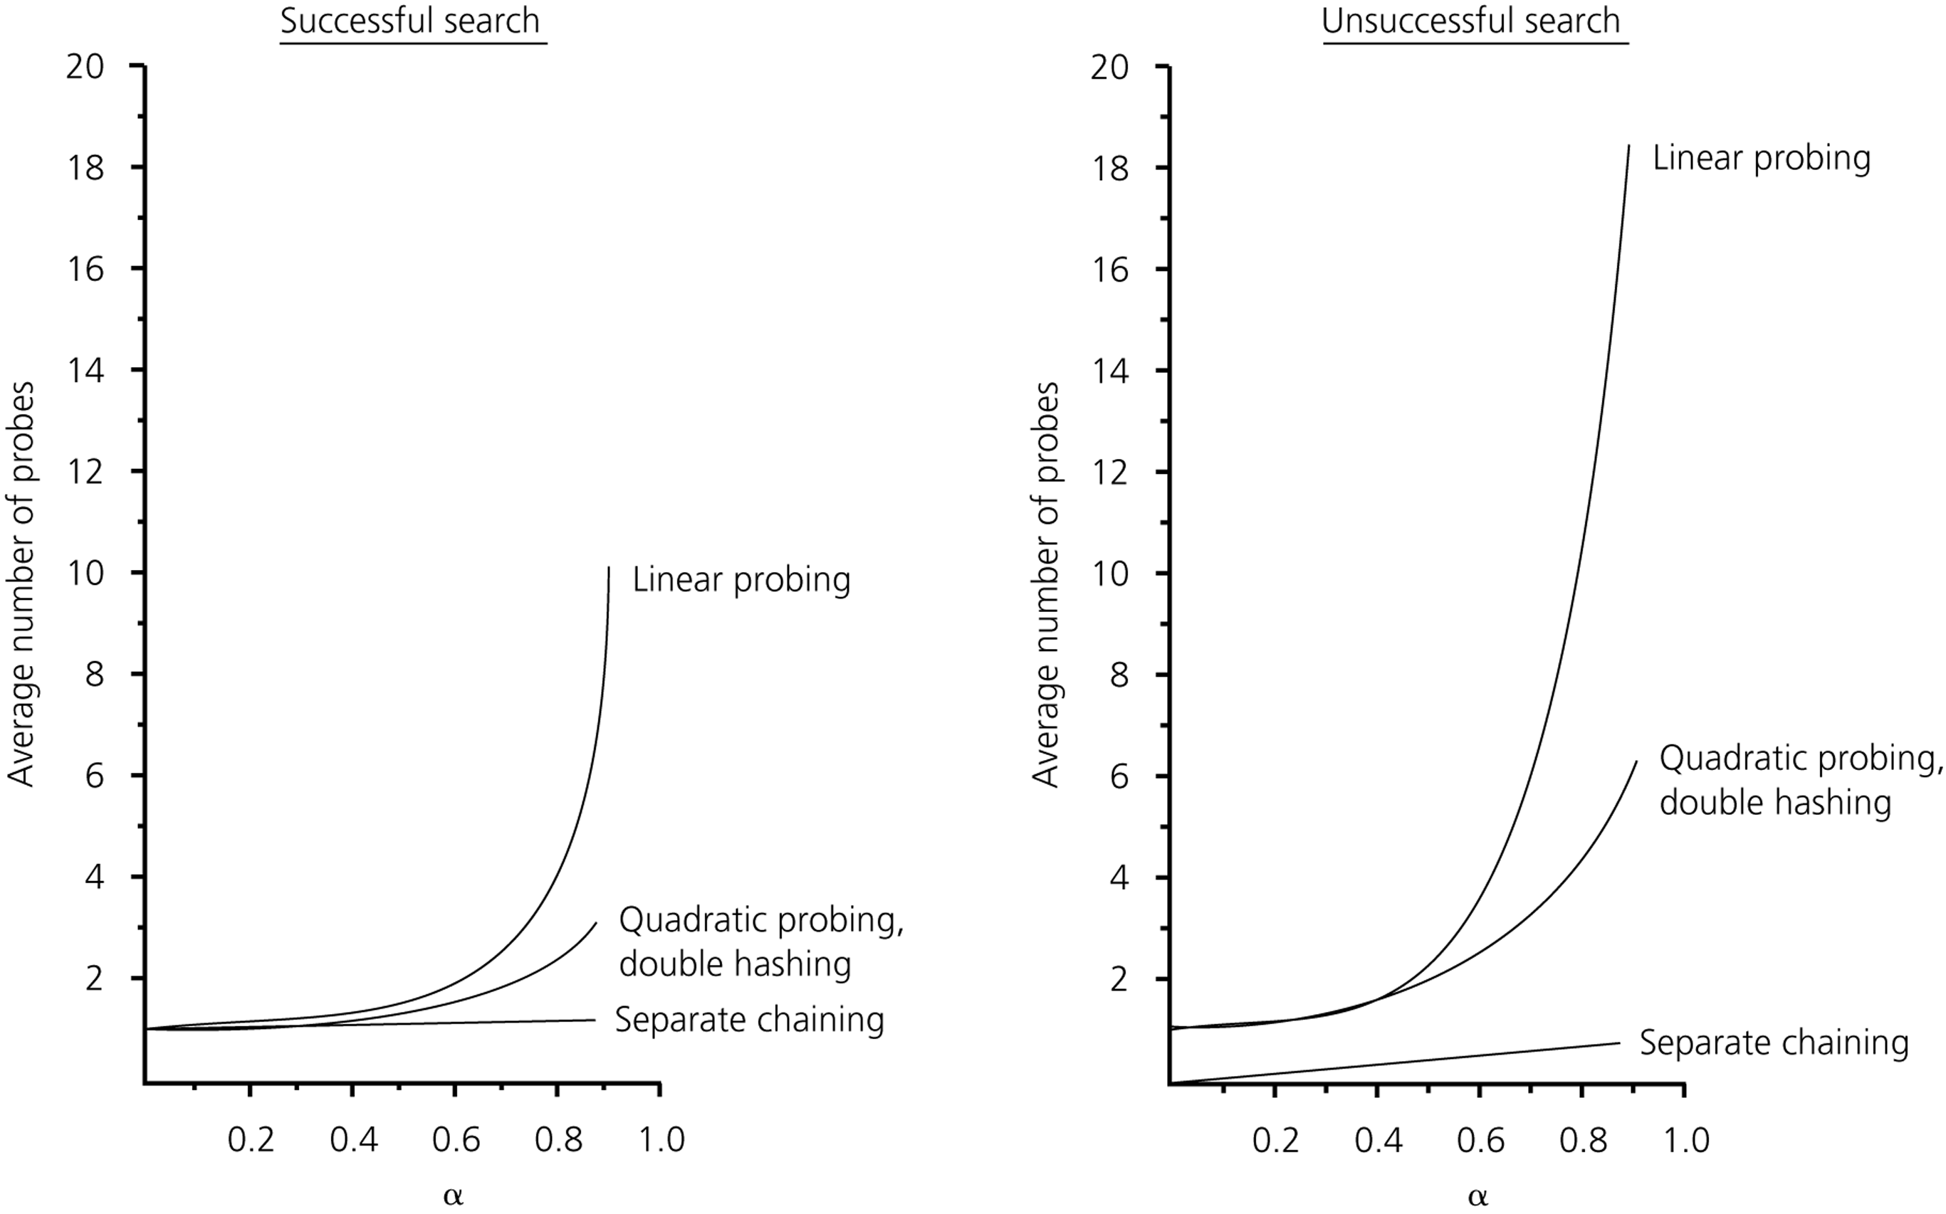
The relative efficiency of four collision-resolution methods

Slide 36
What Constitutes a Good Hash Function
A hash function should be easy and fast to compute.
A hash function should scatter the data evenly throughout the hash table.
How well does the hash function scatter random data?
How well does the hash function scatter non-random data?
Two general principles :
The hash function should use entire key in the calculation.
If a hash function uses modulo arithmetic, the table size should be prime.

Slide 37
Example: Hash Functions for Strings

Slide 38
Hash Function 1
Add up the ASCII values of all characters of the key.
int hash(const string &key, int tableSize)
{
int hasVal = 0;
for (int i = 0; i < key.length(); i++)
hashVal += key[i];
return hashVal % tableSize;
}
Simple to implement and fast.
However, if the table size is large, the function does not distribute the keys well.
e.g. Table size =10000, key length <= 8, the hash function can assume values only between 0 and 1016

Slide 39
Hash Function 2
Examine only the first 3 characters of the key.
int hash (const string &key, int tableSize)
{
return (key[0]+27 * key[1] + 729*key[2]) % tableSize;
}
In theory, 26 * 26 * 26 = 17576 different words can be generated. However, English is not random, only 2851 different combinations are possible.
Thus, this function although easily computable, is also not appropriate if the hash table is reasonably large.

Slide 40
Hash Function 3
int hash (const string &key, int tableSize)
{
int hashVal = 0;
for (int i = 0; i < key.length(); i++)
hashVal = 37 * hashVal + key[i];
hashVal %=tableSize;
if (hashVal < 0) /* in case overflows occurs */
hashVal += tableSize;
return hashVal;
};

Slide 41
Hash function for strings:
98
108
105
key[i]
key
a
l
i
0 1 2
i
KeySize = 3;
hash(“ali”) = (105 * 1 + 108*37 + 98*37²) % 10,007 = 8172
0
hash function
1
2
“ali”
……
ali
8172
……
10,006 (TableSize)

Slide 42
Hash Table versus Search Trees
In most of the operations, the hash table performs better than search trees.
However, traversing the data in the hash table in a sorted order is very difficult.
For similar operations, the hash table will not be good choice (e.g., finding all the items in a certain range).

Slide 43
Performance
With either chaining or open addressing:
Search - O(1) expected, O(n) worst case
Insert - O(1) expected, O(n) worst case
Delete - O(1) expected, O(n) worst case
Min, Max and Predecessor, Successor - O(n+m) expected and worst case
Pragmatically, a hash table is often the best data structure to maintain a dictionary/table. However, the worst-case time is unpredictable.
The best worst-case bounds come from balanced binary trees.

Slide 44
Other applications of hash tables
To implement Table ADT, Dictionary ADT
Compilers
Spelling checkers
Games
Substring Pattern Matching
Searching
Document comparison

Slide 45
Applications of Hashing
Compilers use hash tables to implement the symbol table (a data structure to keep track of declared variables).
Game programs use hash tables to keep track of positions it has encountered (transposition table)
Online spelling checkers.

Slide 46
Substring Pattern Matching
Input: A text string t and a pattern string p.
Problem: Does t contain the pattern p as a substring, and if so where?
e.g: Is Bilkent in the news?
Brute Force: search for the presence of pattern string p in text t overlays the pattern string at every position in the text. → O(mn) (m: size of pattern, n: size of text)
Via Hashing: compute a given hash function on both the pattern string p and the m-character substring starting from the ith position of t. → O(n)
Slide by Steven Skiena

Slide 47
Hashing, Hashing, and Hashing
Udi Manber says that the three most important algorithms at Yahoo are hashing, hashing, and hashing.
Hashing has a variety of clever applications beyond just speeding up search, by giving you a short but distinctive representation of a larger document.
Slide by Steven Skiena

Slide 48
Document Comparison
Is this new document different from the rest in a large database? – Hash the new document, and compare it to the hash codes of database.
How can I convince you that a file isn’t changed? – Check if the cryptographic hash code of the file you give me today is the same as that of the original. Any changes to the file will change the hash code.
Slide by Steven Skiena

