Slide 1
Graphs
Initially prepared by Dr. İlyas Çiçekli; improved by various Bilkent CS202 instructors.

Slide 2
Graphs
Graphs are one of the unifying themes of computer science.
A graph G = (V, E) is defined by a set of vertices V , and a set of edges E consisting of ordered or unordered pairs of vertices from V .

Slide 3
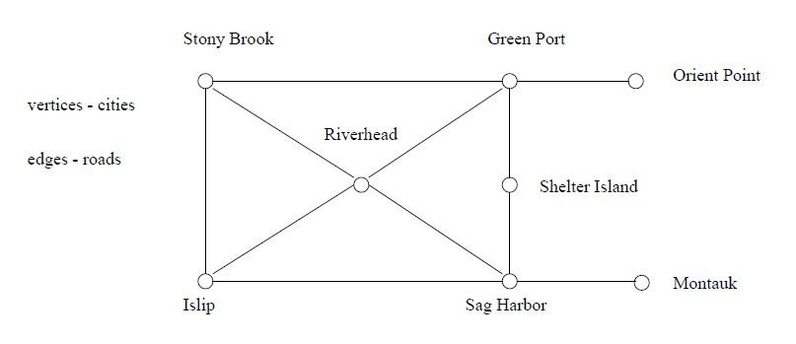
Road Networks
In modeling a road network, the vertices may represent the cities or junctions, certain pairs of which are connected by roads/edges.

Slide 4
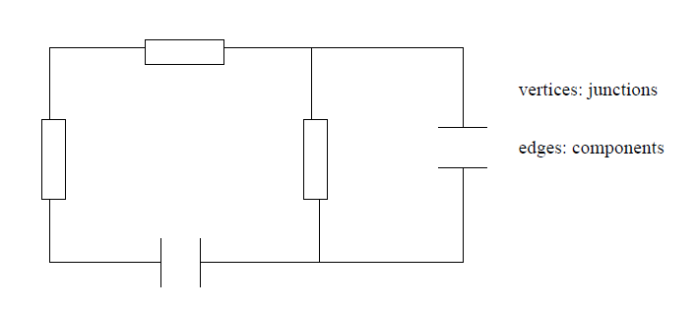
Electronic Circuits
In an electronic circuit, with junctions as vertices and components as edges.

Slide 5
Applications
Social networks (facebook ...)
Courses with prerequisites
Computer networks
Google maps
Airline flight schedules
Computer games
WWW documents
... (so many to list!)

Slide 6
Graphs – Definitions
A graph G = (V, E) consists of
a set of vertices, V, and
a set of edges, E, where each edge is a pair (v,w) s.t. v,w ∈ V
Vertices are sometimes called nodes, edges are sometimes called arcs.
If the edge pair is ordered then the graph is called a directed graph (also called digraphs) .
We also call a normal graph (which is not a directed graph) an undirected graph.
When we say graph we mean that it is an undirected graph.

Slide 7
Graphs – Definitions
Two vertices of a graph are adjacent if they are joined by an edge.
Vertex w is adjacent to v iff (v,w) ∈ E.
In an undirected graph with edge (v, w) and hence (w,v) w is adjacent to v and v is adjacent to w.
A path between two vertices is a sequence of edges that begins at one vertex and ends at another vertex.
i.e. w₁, w₂, …, w_{N} is a path if (w_{i}, w_{i+1}) ∈ E for 1 ≤ i ≤. N-1
A simple path passes through a vertex only once.
A cycle is a path that begins and ends at the same vertex.
A simple cycle is a cycle that does not pass through other vertices more than once.

Slide 8
Graphs – An Example
1
2
A graph G (undirected)
3
4
5
The graph G= (V,E) has 5 vertices and 6 edges:
V = {1,2,3,4,5}
E = { (1,2),(1,3),(1,4),(2,5),(3,4),(4,5), (2,1),(3,1),(4,1),(5,2),(4,3),(5,4) }
Adjacent:
1 and 2 are adjacent -- 1 is adjacent to 2 and 2 is adjacent to 1
Path:
1,2,5 ( a simple path), 1,3,4,1,2,5 (a path but not a simple path)
Cycle:
1,3,4,1 (a simple cycle), 1,3,4,1,4,1 (cycle, but not simple cycle)

Slide 9
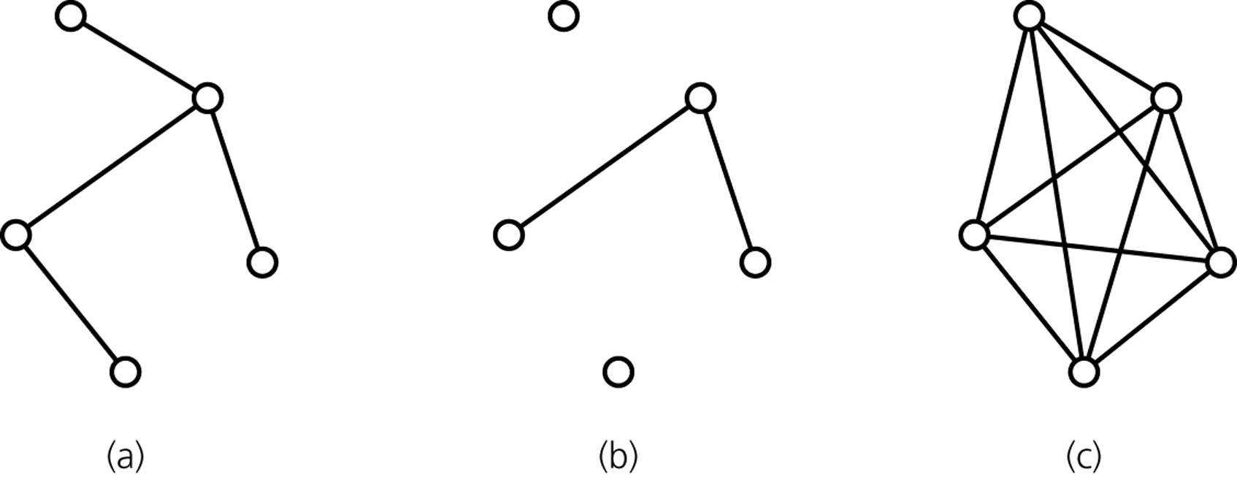
Graphs – Definitions
A connected graph has a path between each pair of distinct vertices.
A complete graph has an edge between each pair of distinct vertices.
A complete graph is also a connected graph. But a connected graph may not be a complete graph.
connected
disconnected
complete

Slide 10
Directed Graphs
If edge pair is ordered, then graph is called a directed graph (also called digraphs) .
Each edge in a directed graph has a direction. Called a directed edge.
Definitions given for undirected graphs apply also to directed graphs, with changes that account for direction.
Vertex w is adjacent to v iff (v,w) ∈ E.
i.e. There is a direct edge from v to w
w is successor of v
v is predecessor of w
A directed path between two vertices is a sequence of directed edges that begins at one vertex and ends at another vertex.
i.e. w₁, w₂, …, w_{N} is a path if (w_{i}, w_{i+1}) ∈ E for 1 ≤ i ≤. N-1

Slide 11
Directed Graphs
A cycle in a directed graph is a path of length >= 1 such that w₁ = w_{N}.
This cycle is simple if the path is simple.
For undirected graphs, the edges must be distinct
A directed acyclic graph (DAG) is a directed graph with no cycles.
An undirected graph is connected if there is a path from every vertex to every other vertex.
A directed graph with this property is called strongly connected.
If a directed graph is not strongly connected, but the underlying graph (without direction to arcs) is connected then the graph is weakly connected.

Slide 12
Directed Graph – An Example
1
2
3
4
5
The graph G= (V,E) has 5 vertices and 6 edges:
V = {1,2,3,4,5}
E = { (1,2),(1,4),(2,5),(4,5),(3,1),(4,3) }
Adjacent:
2 is adjacent to 1, but 1 is NOT adjacent to 2
Path:
1,2,5 ( a directed path),
Cycle:
1,4,3,1 (a directed cycle),

Slide 13
Weighted Graph
We can label the edges of a graph with numeric values, the graph is called a weighted graph.
1
8
2
Weighted (Undirect) Graph
10
3
6
3
5
4
7
5
1
8
2
Weighted Directed Graph
10
3
6
3
5
4
7
5

Slide 14
Graph Implementations
The two most common implementations of a graph are:
Adjacency Matrix
A two dimensional array
Adjacency List
For each vertex we keep a list of adjacent vertices

Slide 15
Adjacency Matrix
An adjacency matrix for a graph with n vertices is an n by n array matrix such that
matrix[i][j] is 1 (true) if there is an edge from vertex i to vertex j
0 (false) otherwise.
When the graph is weighted:
matrix[i][j] is weight that labels edge from vertex i to vertex j instead of simply 1,
matrix[i][j] equals to ∞ instead of 0 when there is no edge from vertex i to j
Adjacency matrix for an undirected graph is symmetrical.
i.e. matrix[i][j] is equal to matrix[j][i]
Space requirement O(|V|²)
Acceptable if the graph is dense.

Slide 16
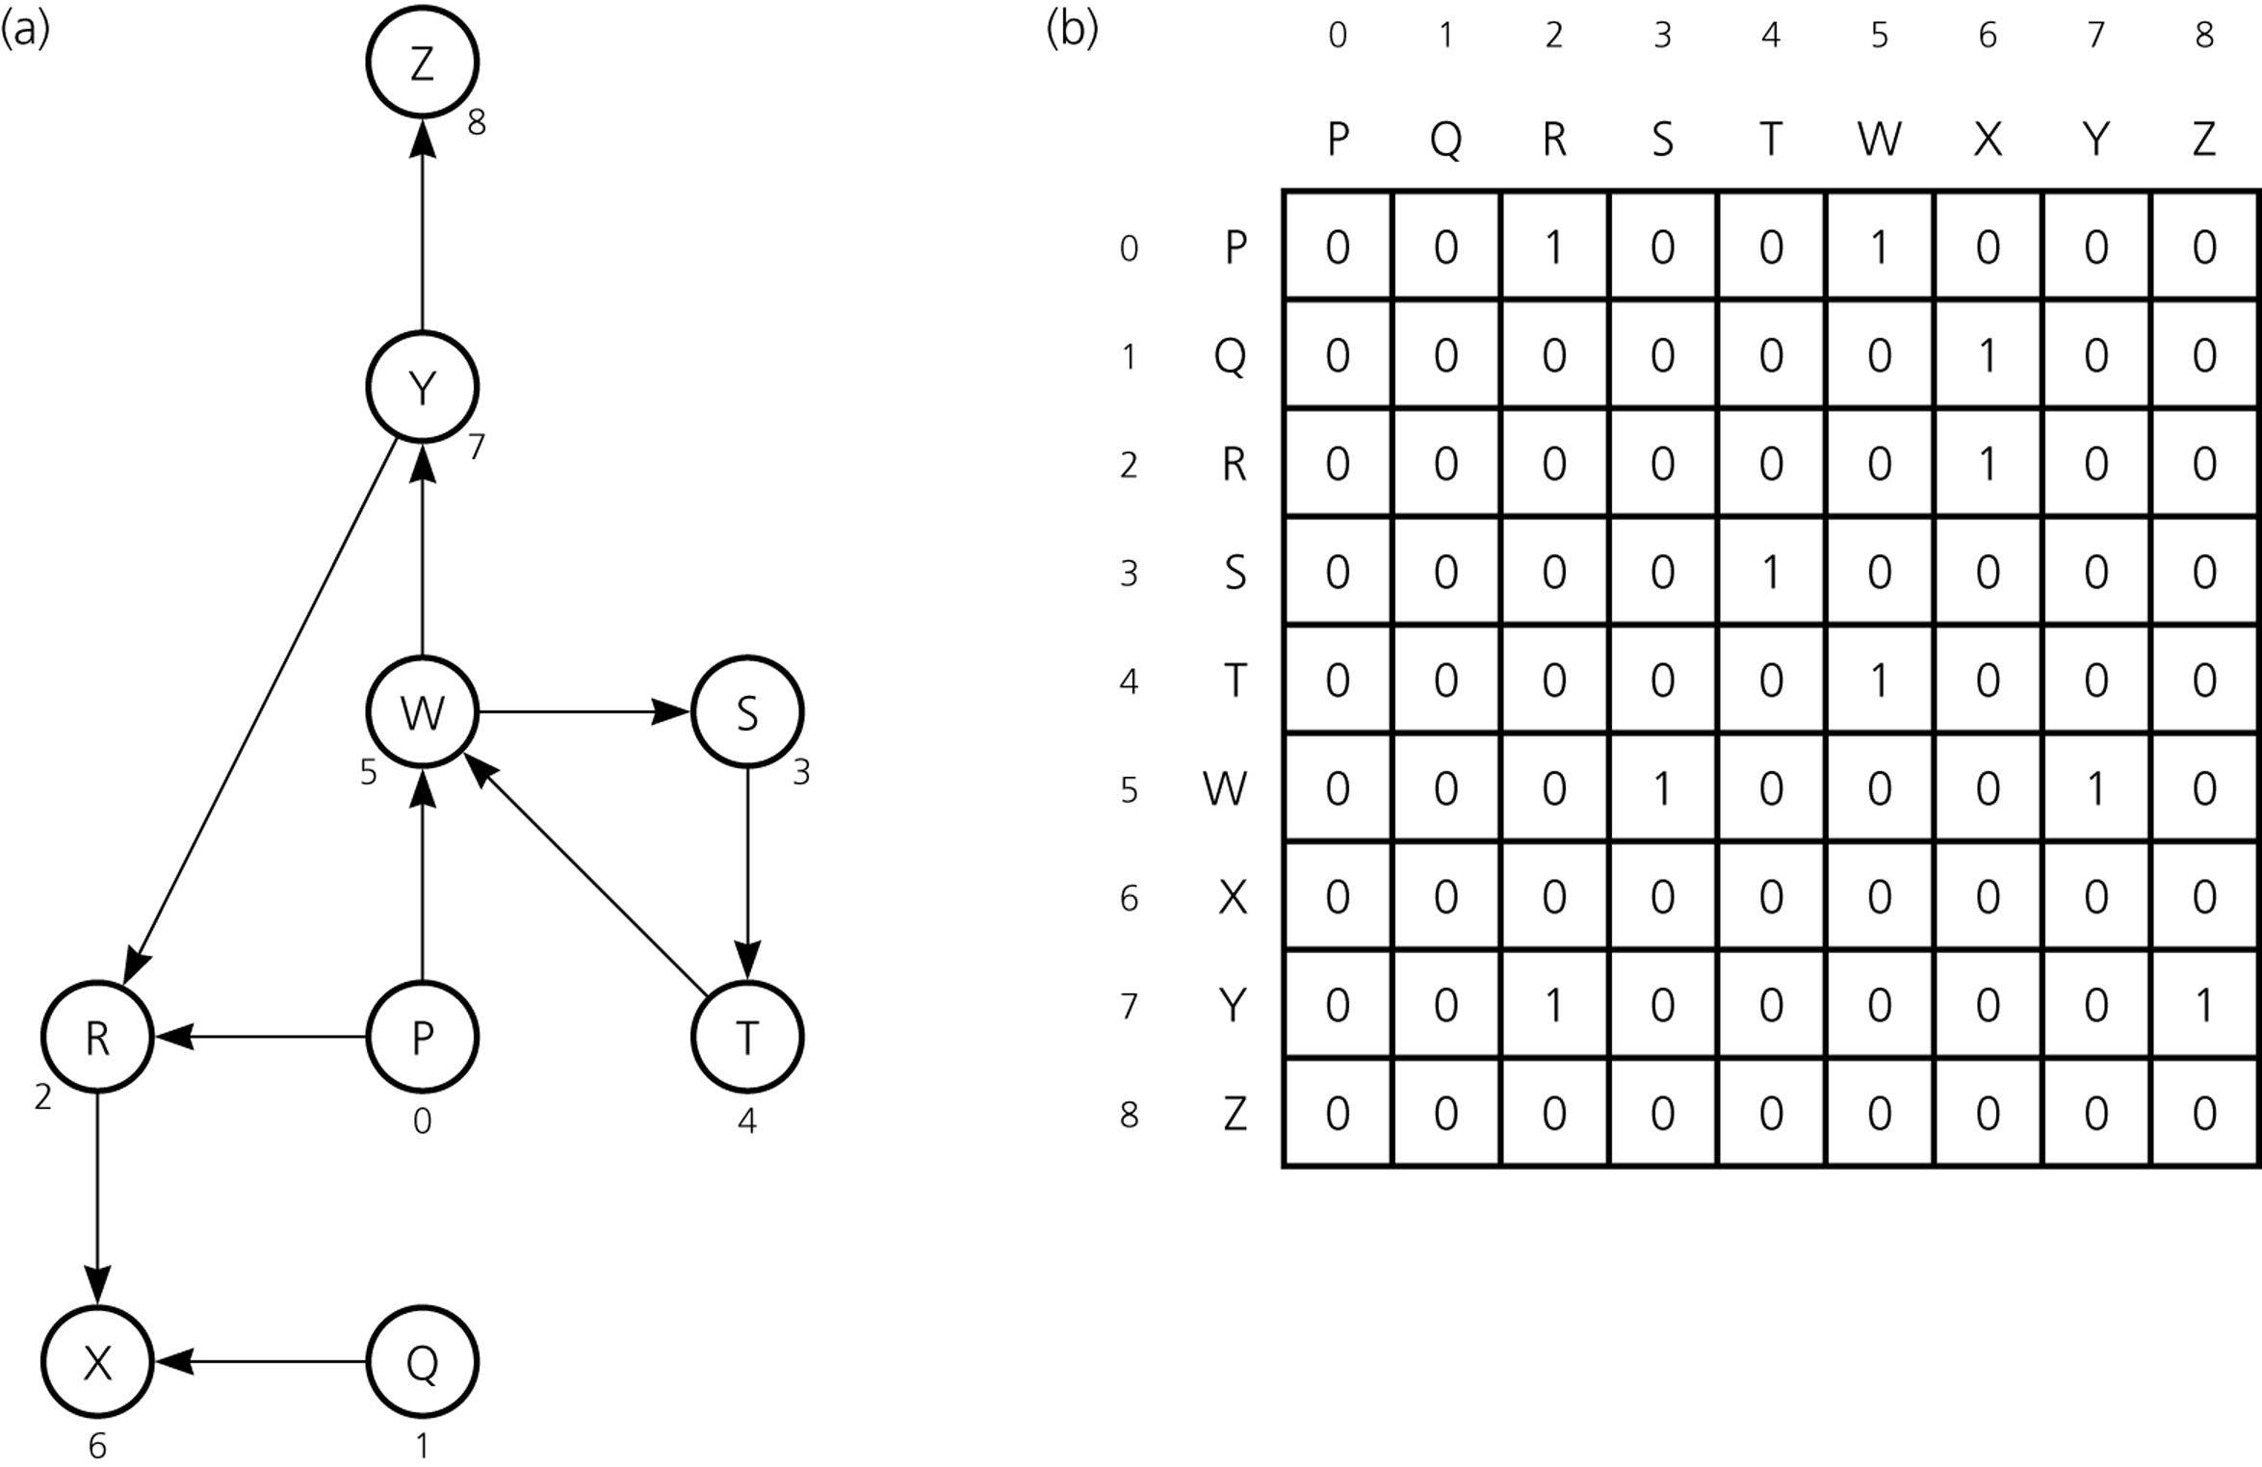
Adjacency Matrix – Example1
A directed graph
Its adjacency matrix

Slide 17
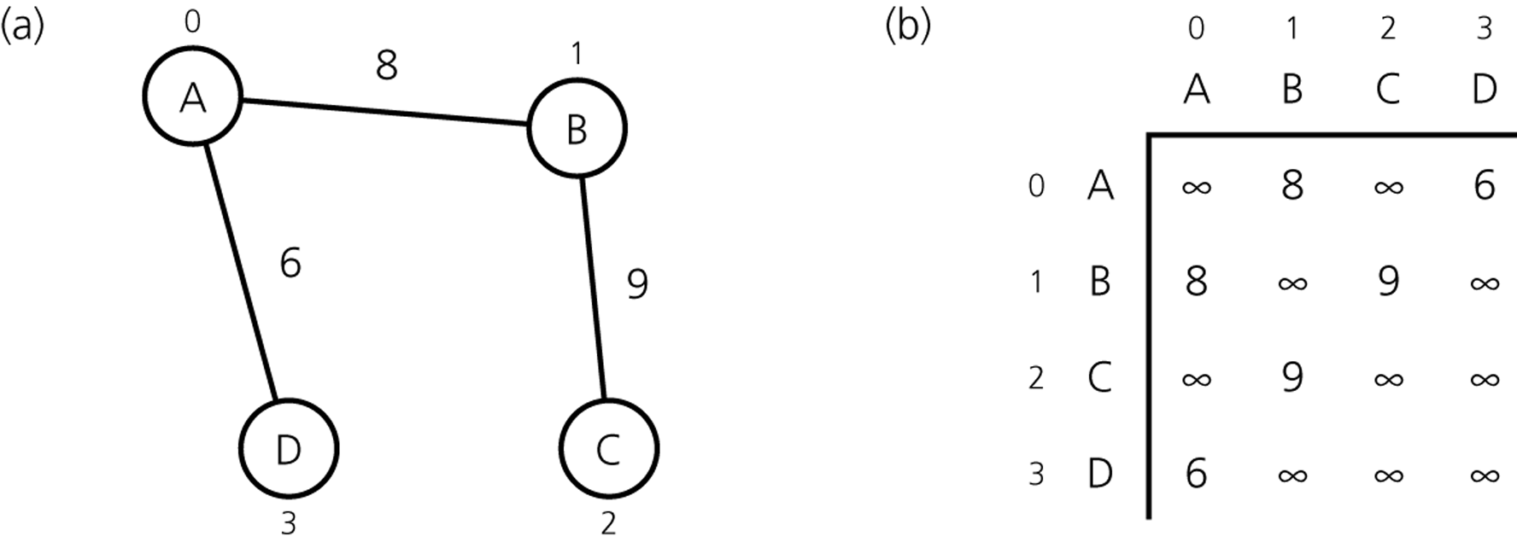
Adjacency Matrix – Example2
An Undirected Weighted Graph
Its Adjacency Matrix

Slide 18
Adjacency List
An adjacency list for a graph with n vertices numbered 0,1,...,n-1 consists of n linked lists. The i^{th} linked list has a node for vertex j if and only if the graph contains an edge from vertex i to vertex j.
Adjacency list is a better solution if the graph is sparse.
Space requirement is O(|E| + |V|), which is linear in the size of the graph.
In an undirected graph each edge (v, w) appears in two lists.
Space requirement is doubled.

Slide 19
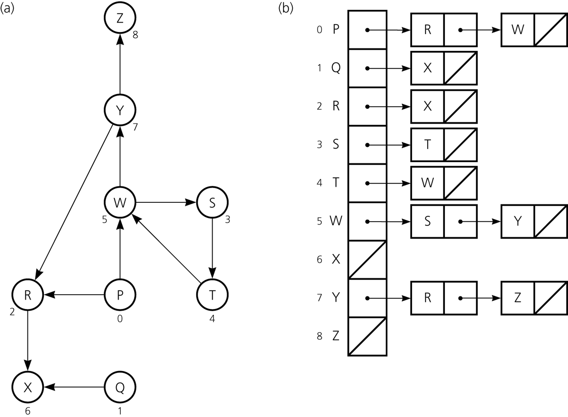
Adjacency List – Example1
A directed graph
Its Adjacency List

Slide 20
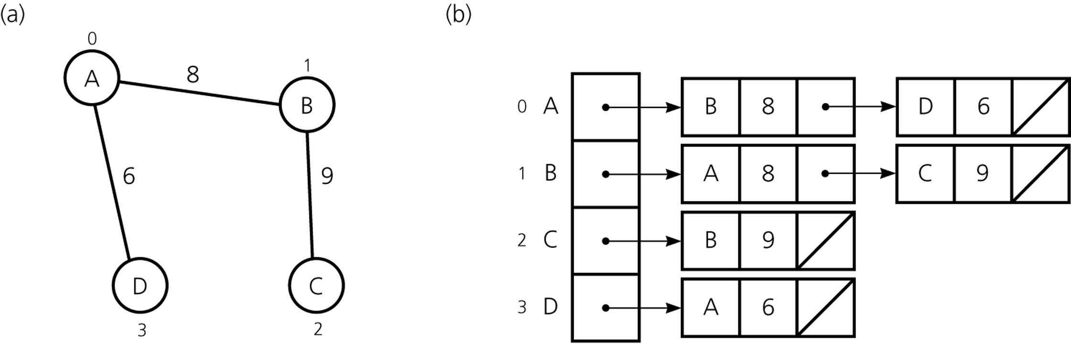
Adjacency List – Example2
An Undirected Weighted Graph
Its Adjacency List

Slide 21
Adjacency Matrix vs Adjacency List
Two common graph operations:
Determine whether there is an edge from vertex i to vertex j.
Find all vertices adjacent to a given vertex i.
An adjacency matrix supports operation 1 more efficiently.
An adjacency list supports operation 2 more efficiently.
An adjacency list often requires less space than an adjacency matrix.
Adjacency Matrix: Space requirement is O(|V|²)
Adjacency List : Space requirement is O(|E| + |V|), which is linear in the size of the graph.
Adjacency matrix is better if the graph is dense (too many edges)
Adjacency list is better if the graph is sparse (few edges)

Slide 22
Tradeoffs Between Adjacency Lists and Adjacency Matrices
Faster to test if (x; y) exists?
Faster to find vertex degree?
Less memory on sparse graphs?
Less memory on dense graphs?
Edge insertion or deletion?
Faster to traverse the graph?
Better for most problems?

Slide 23
Tradeoffs Between Adjacency Lists and Adjacency Matrices
Faster to test if (x; y) exists? matrices
Faster to find vertex degree? lists
Less memory on sparse graphs? lists – (m+ n) vs. (n²)
Less memory on dense graphs? matrices (small win)
Edge insertion or deletion? matrices O(1)
Faster to traverse the graph? lists – (m + n) vs. (n²)
Better for most problems? lists

Slide 24
Graph Traversals
A graph-traversal algorithm starts from a vertex v, visits all of the vertices that can be reachable from the vertex v.
A graph-traversal algorithm visits all vertices if and only if the graph is connected.
A connected component is the subset of vertices visited during a traversal algorithm that begins at a given vertex.
A graph-traversal algorithm must mark each vertex during a visit and must never visit a vertex more than once.
Thus, if a graph contains a cycle, the graph-traversal algorithm can avoid infinite loop.
We look at two graph-traversal algorithms:
Depth-First Traversal
Breadth-First Traversal

Slide 25
Depth-First Traversal
For a given vertex v, depth-first traversal algorithm proceeds along a path from v as deeply into the graph as possible before backing up.
That is, after visiting a vertex v, the algorithm visits (if possible) an unvisited adjacent vertex to vertex v.
The depth-first traversal algorithm does not completely specify the order in which it should visit the vertices adjacent to v.
We may visit the vertices adjacent to v in sorted order.

Slide 26
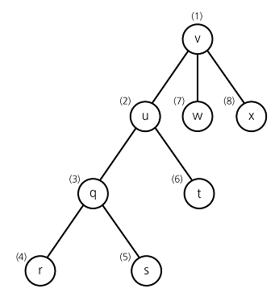
Depth-First Traversal – Example
A depth-first traversal of the
graph starting from vertex v.
Visit a vertex, then visit a vertex
adjacent to that vertex.
If there is no unvisited vertex adjacent
to visited vertex, back up to the previous
step.

Slide 27
Recursive Depth-First Traversal Algorithm
dft(in v:Vertex) {
// Traverses a graph beginning at vertex v
// by using depth-first strategy
// Recursive Version
Mark v as visited;
for (each unvisited vertex u adjacent to v)
dft(u)
}

Slide 28
Iterative Depth-First Traversal Algorithm
dft(in v:Vertex) {
// Traverses a graph beginning at vertex v
// by using depth-first strategy: Iterative Version
s.createStack();
// push v into the stack and mark it
s.push(v);
Mark v as visited;
while (!s.isEmpty()) {
if (no unvisited vertices are adjacent to the vertex on
the top of stack)
s.pop(); // backtrack
else {
Select an unvisited vertex u adjacent to the vertex
on the top of the stack;
s.push(u);
Mark u as visited;
}
}
}

Slide 29
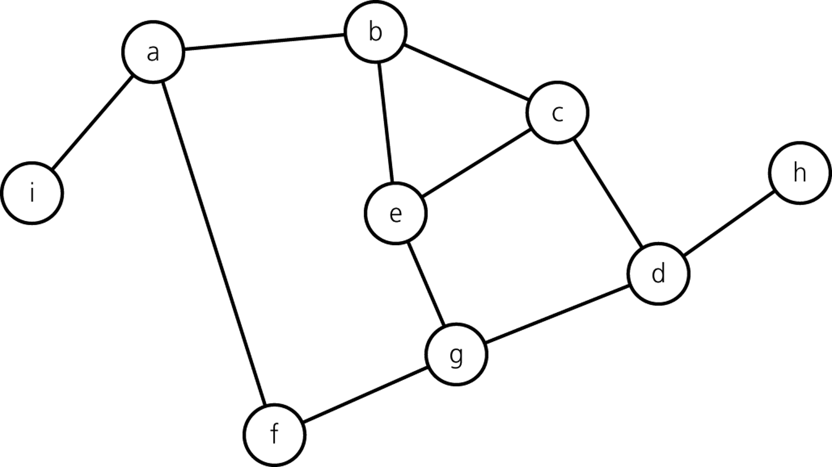
Trace of Iterative DFT – starting from vertex a

Slide 30
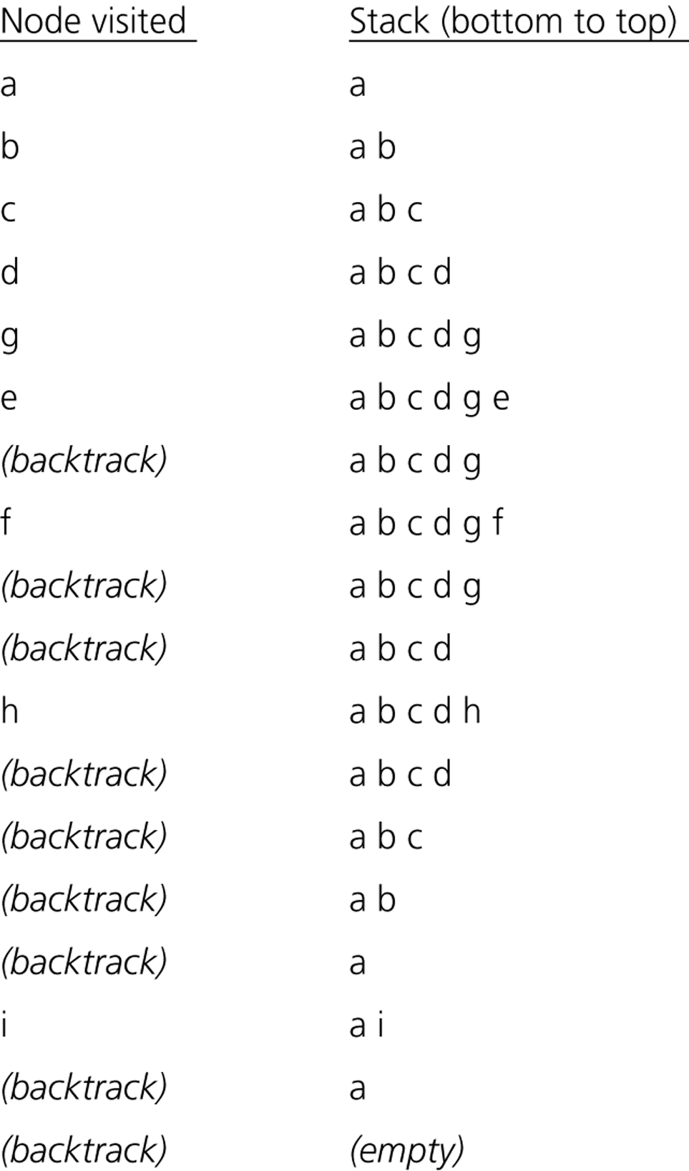
Trace of Iterative DFT – starting from vertex a
1
2
3
9
8
6
4
5
7

Slide 31
Breadth-First Traversal
After visiting a given vertex v, the breadth-first traversal algorithm visits every vertex adjacent to v that it can before visiting any other vertex.
The breadth-first traversal algorithm does not completely specify the order in which it should visit the vertices adjacent to v.
We may visit the vertices adjacent to v in sorted order.

Slide 32
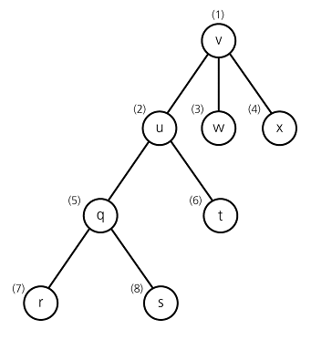
Breadth-First Traversal – Example
A breadth-first traversal of the
graph starting from vertex v.
Visit a vertex, then visit all vertices
adjacent to that vertex.

Slide 33
Iterative Breadth-First Traversal Algorithm
bft(in v:Vertex) {
// Traverses a graph beginning at vertex v
// by using breadth-first strategy: Iterative Version
q.createQueue();
// add v to the queue and mark it
Mark v as visited;
q.enqueue(v);
while (!q.isEmpty()) {
q.dequeue(w);
for (each unvisited vertex u adjacent to w) {
Mark u as visited;
q.enqueue(u);
}
}
}

Slide 34
Trace of Iterative BFT – starting from vertex a

Slide 35
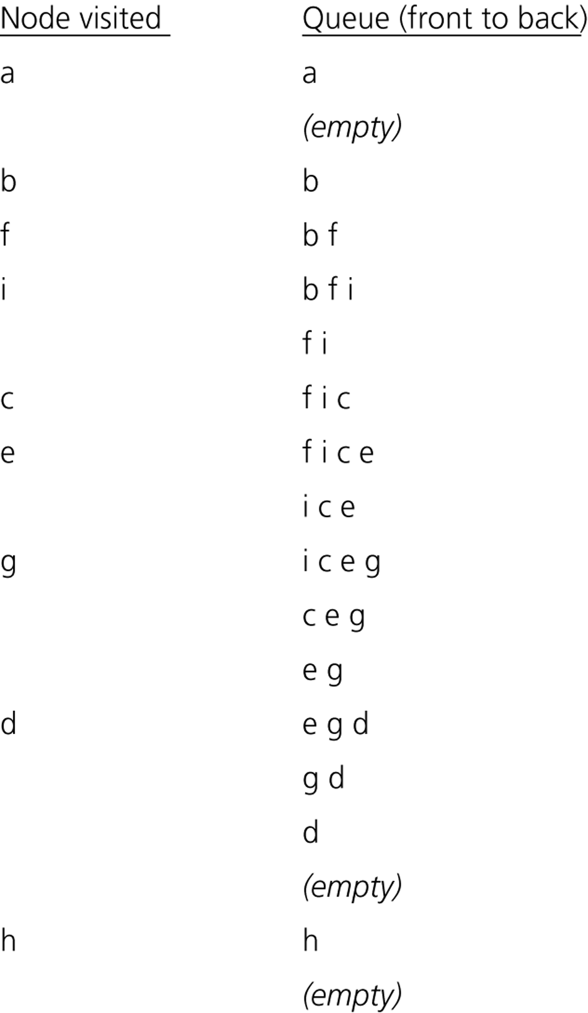
Trace of Iterative BFT – starting from vertex a
2
1
5
4
9
6
8
7
3

Slide 36
Topological Sorting
A directed graph without cycles has a natural order.
That is, vertex a precedes vertex b, which precedes c
For example, the prerequisite structure for the courses.
In which order we should visit the vertices of a directed graph without cycles so that we can visit vertex v after we visit its predecessors.
This is a linear order, and it is known as topological order.
For a given graph, there may be more than one topological order.
Arranging the vertices into a topological order is called topological sorting.

Slide 37
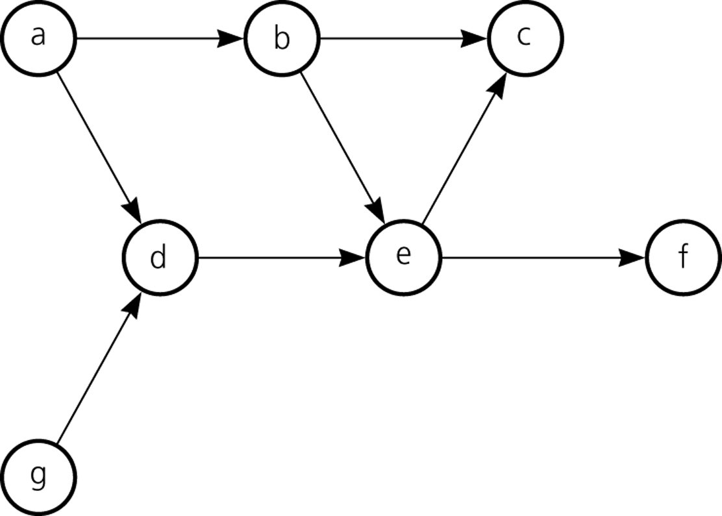
Topological Order – Example
Some Topological Orders
for this graph:
a, g ,d, b, e, c, f
a, b, g, d, e, f, c

Slide 38
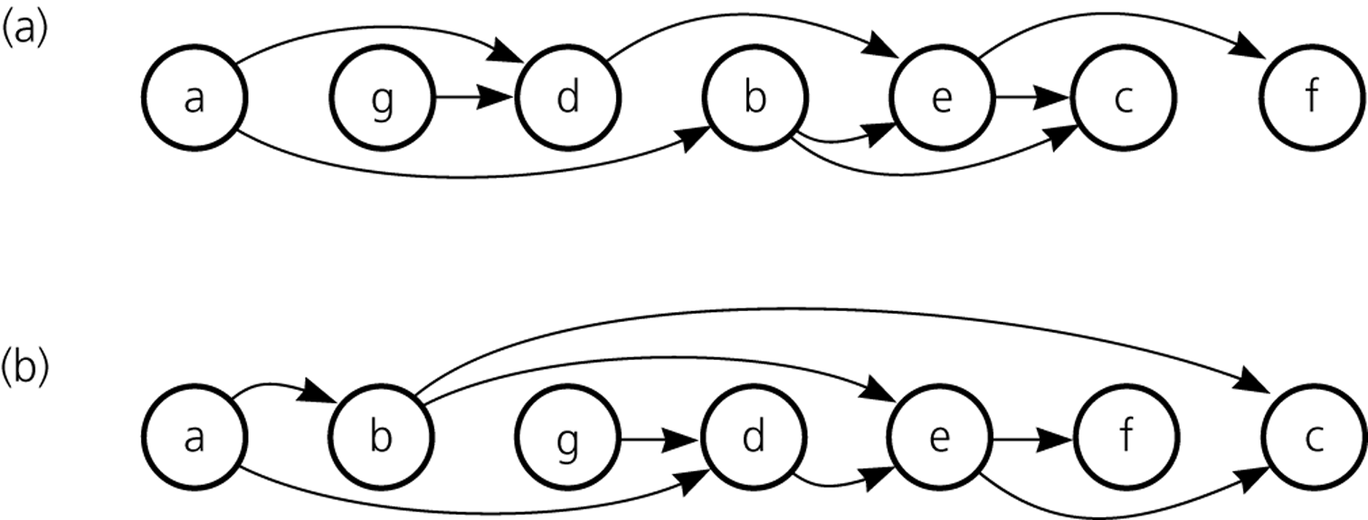
Topological Order – Example (cont.)
The graph arranged according to
the topological orders
a, g, d, b, e, c, f and
a, b, g, d, e, f, c

Slide 39
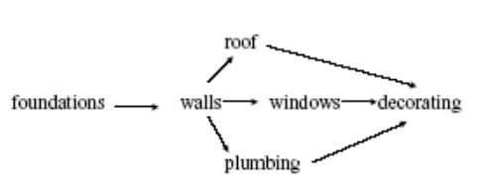
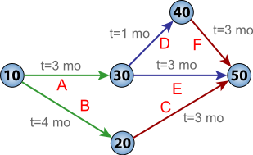
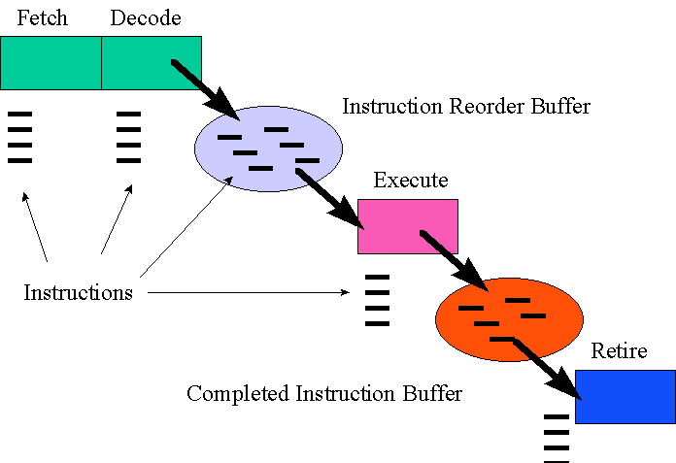
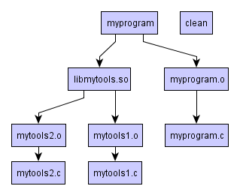
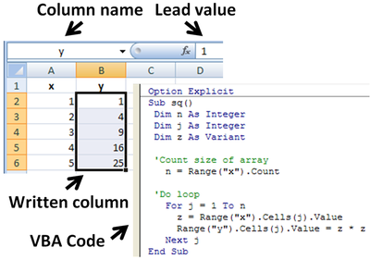
Applications of Topological Sorting
Course prerequisites – which courses should you take next semester?
Project scheduling (PERT)
Processors: Instruction scheduling
Spreadsheets
Makefiles

Slide 40
Simple Topological Sorting Algorithm1 – topSort1
topSort1(in theGraph:Graph, out aList:List) {
// Arranges the vertices in graph theGraph into a
// toplogical order and places them in list aList
n = number of vertices in theGraph;
for (step=1 through n) {
select a vertex v that has no successors;
aList.insert(1,v);
Delete from theGraph vertex v and its edges;
}
}

Slide 41
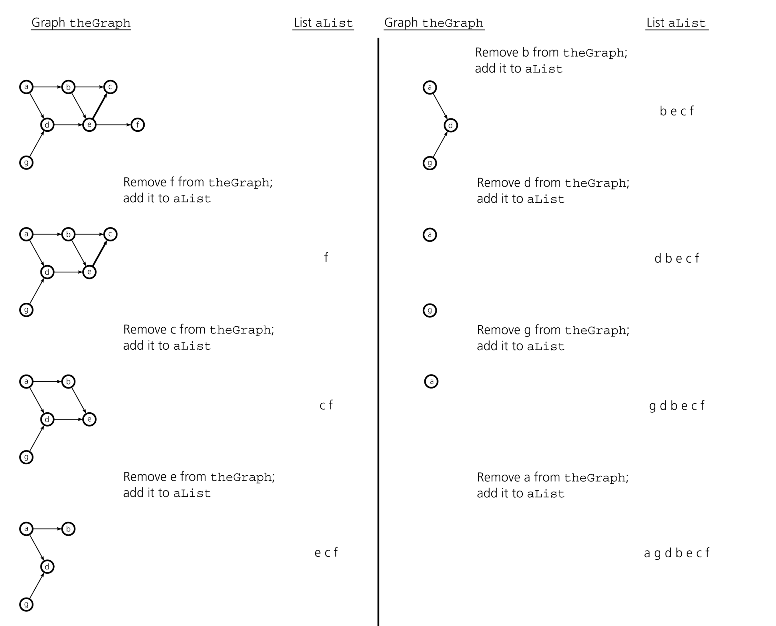
Trace of topSort1

Slide 42
DFS Topological Sorting Algorithm – topSort2
topSort2(in theGraph:Graph, out aList:List) {
// Arranges the vertices in graph theGraph into a topological order and
// places them in list aList
s.createStack();
for (all vertices v in the graph)
if (v has no predecessors) {
s.push(v);
Mark v as visited;
}
while (!s.isEmpty()) {
if (all vertices adjacent to the vertex on the top of stack
have been visited) {
s.pop(v);
aList.insert(1,v);
}
else {
Select an unvisited vertex u adjacent to the vertex on
the top of the stack;
s.push(u);
Mark u as visited;
}
}
}

Slide 43
Remember: Iterative Depth-First Traversal Algorithm
dft(in v:Vertex) {
// Traverses a graph beginning at vertex v
// by using depth-first strategy: Iterative Version
s.createStack();
// push v into the stack and mark it
s.push(v);
Mark v as visited;
while (!s.isEmpty()) {
if (no unvisited vertices are adjacent to the vertex on
the top of stack)
s.pop(); // backtrack
else {
Select an unvisited vertex u adjacent to the vertex
on the top of the stack;
s.push(u);
Mark u as visited;
}
}
}

Slide 44
Trace of topSort2

Slide 45
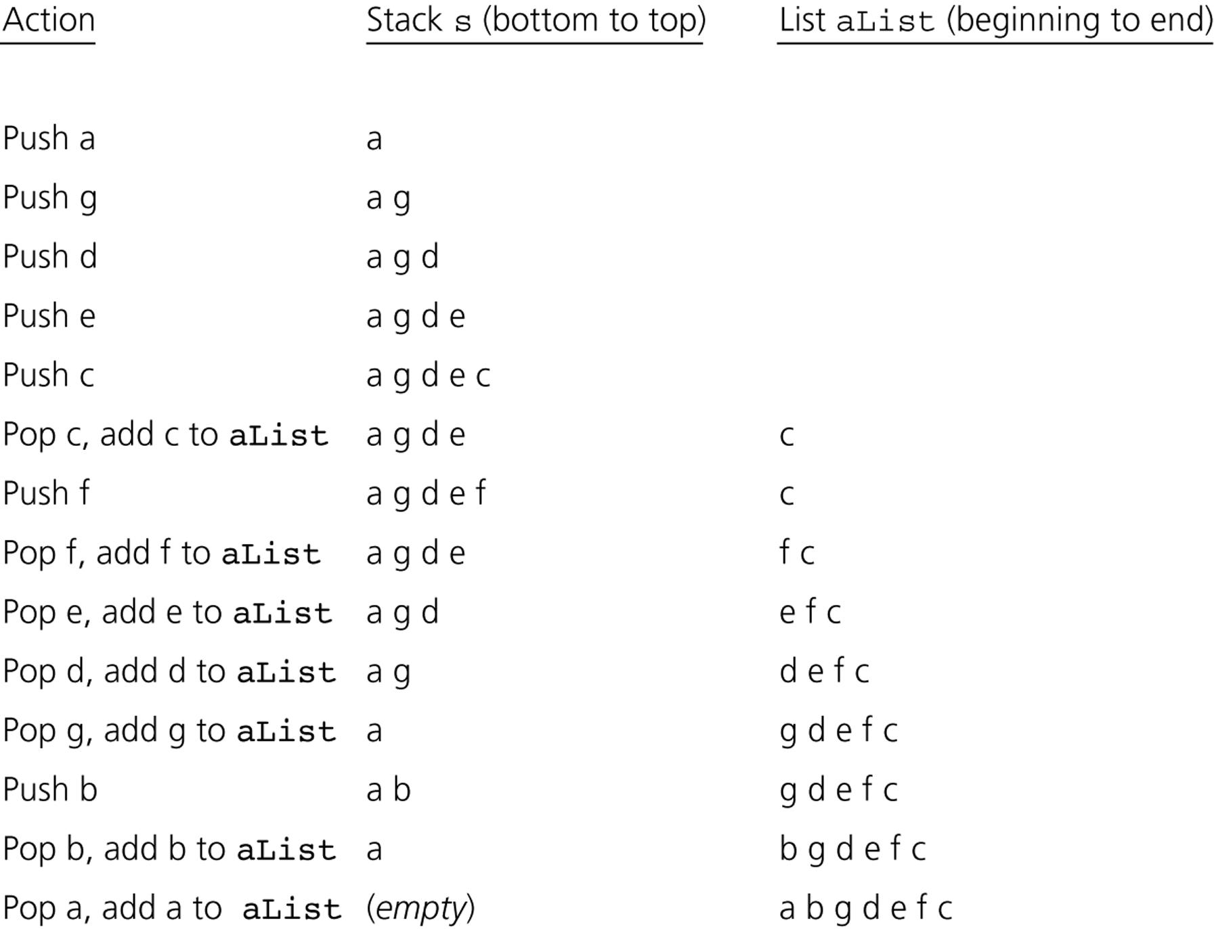
Trace of topSort2

Slide 46
Spanning Trees
A tree is a special kind of undirected graph.
That is, a tree is a connected undirected graph without cycles.
All trees are graphs, not all graphs are trees. Why?
A spanning tree of a connected undirected graph G is a sub-graph of G that contains all of G’s vertices and enough of its edges to form a tree.
There may be several spanning trees for a given graph.
If we have a connected undirected graph with cycles, and we remove edges until there are no cycles to obtain a spanning tree.

Slide 47
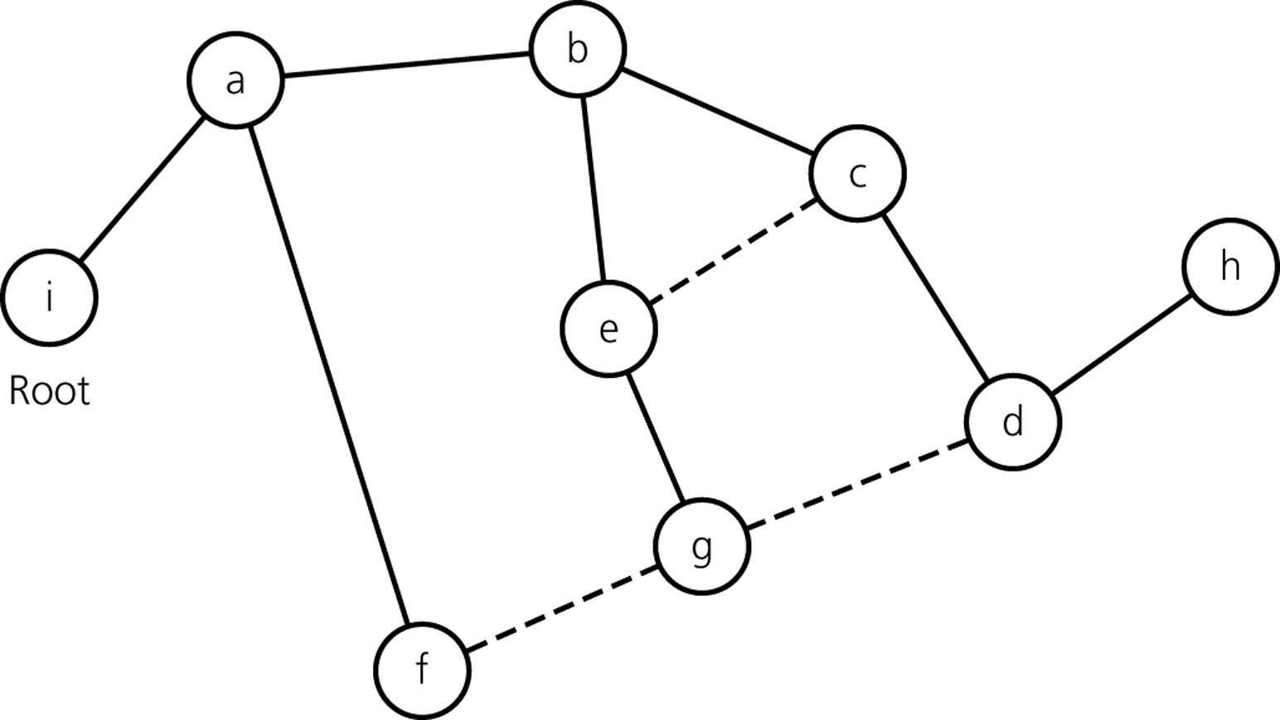
A Spanning Tree
Remove dashed lines to obtain a spanning tree

Slide 48
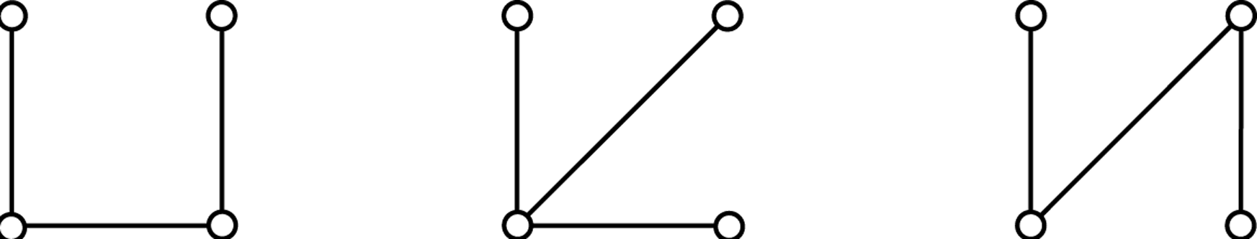
Cycles?
Observations about graphs:
A connected undirected graph that has n vertices must have at least n-1 edges.
A connected undirected graph that has n vertices and exactly n-1 edges cannot contain a cycle.
A connected undirected graph that has n vertices and more than n-1 edges must contain a cycle.
Connected graphs that each
have four vertices and
three edges

Slide 49
DFS Spanning Tree
dfsTree(in v:vertex) {
// Forms a spanning tree for a connected undirected graph
// beginning at vertex v by using depth-first search;
// Recursive Version
Mark v as visited;
for (each unvisited vertex u adjacent to v) {
Mark the edge from u tu v;
dfsTree(u);
}
}

Slide 50
Remember: Recursive Depth-First Traversal Algorithm
dft(in v:Vertex) {
// Traverses a graph beginning at vertex v
// by using depth-first strategy
// Recursive Version
Mark v as visited;
for (each unvisited vertex u adjacent to v)
dft(u)
}

Slide 51
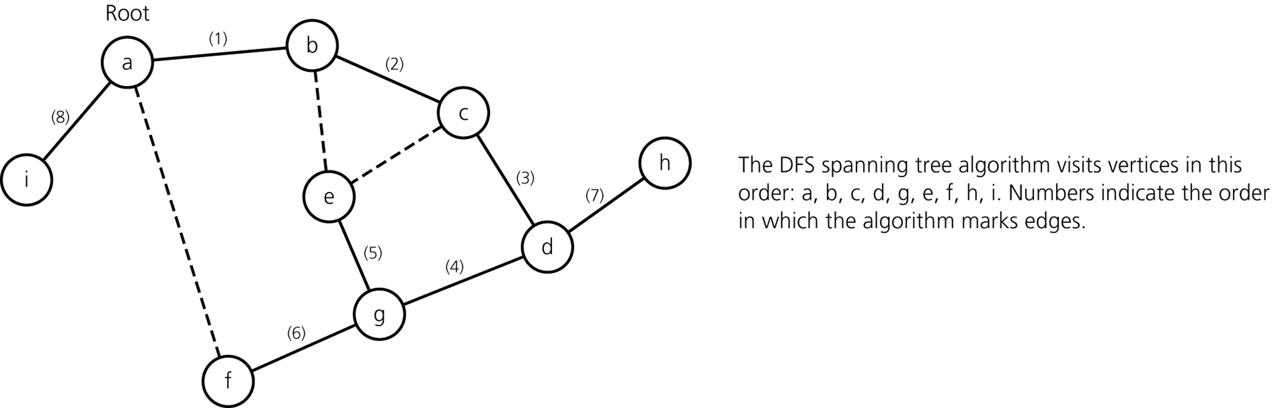
DFS Spanning Tree – Example
The DFS spanning tree rooted at vertex a

Slide 52
BFS Spanning tree
bfsTree(in v:vertex) {
// Forms a spanning tree for a connected undirected graph
// beginning at vertex v by using breadth-first search;
// Iterative Version
q.createQueue();
q.enqueue(v);
Mark v as visited;
while (!q.isEmpty()) {
q.dequeue(w);
for (each unvisited vertex u adjacent to w) {
Mark u as visited;
Mark edge between w and u;
q.enqueue(u);
}
}
}

Slide 53
Remember: Iterative Breadth-First Traversal Algorithm
bft(in v:Vertex) {
// Traverses a graph beginning at vertex v
// by using breadth-first strategy: Iterative Version
q.createQueue();
// add v to the queue and mark it
q.enqueue(v);
Mark v as visited;
while (!q.isEmpty()) {
q.dequeue(w);
for (each unvisited vertex u adjacent to w) {
Mark u as visited;
q.enqueue(u);
}
}
}

Slide 54
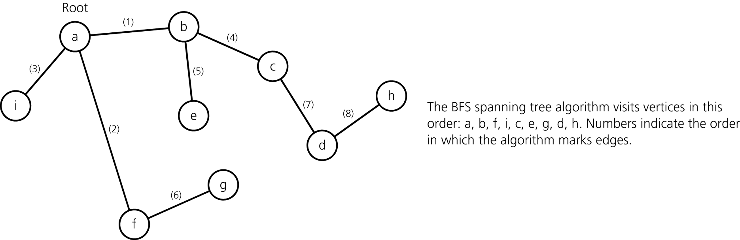
BFS Spanning tree – Example
The BFS spanning tree rooted at vertex a

Slide 55
Minimum Spanning Tree
If we have a weighted connected undirected graph, the edges of each of its spanning tree will also be associated with costs.
The cost of a spanning tree is the sum of the costs of edges in the spanning tree.
A minimum spanning tree of a connected undirected graph has a minimal edge-weight sum.
A minimum spanning tree of a connected undirected may not be unique.
Although there may be several minimum spanning trees for a particular graph, their costs are equal.

Slide 56
Prim’s Algorithm
Prim’s algorithm finds a minimum spanning tree that begins any vertex.
Initially, the tree contains only the starting vertex.
At each stage, the algorithm selects a least-cost edge from among those that begin with a vertex in the tree and end with a vertex not in the tree.
The selected vertex and least-cost edge are added to the tree.

Slide 57
Prim’s Algorithm
primsAlgorithm(in v:Vertex) {
// Determines a minimum spanning tree for a weighted,
// connected, undirected graph whose weights are
// nonnegative, beginning with any vertex.
Mark vertex v as visited and include it in
the minimum spanning tree;
while (there are unvisited vertices) {
Find the least-cost edge (v,u) from a visited vertex v
to some unvisited vertex u;
Mark u as visited;
Add the vertex u and the edge (v,u) to the minimum
spanning tree;
}
}

Slide 58
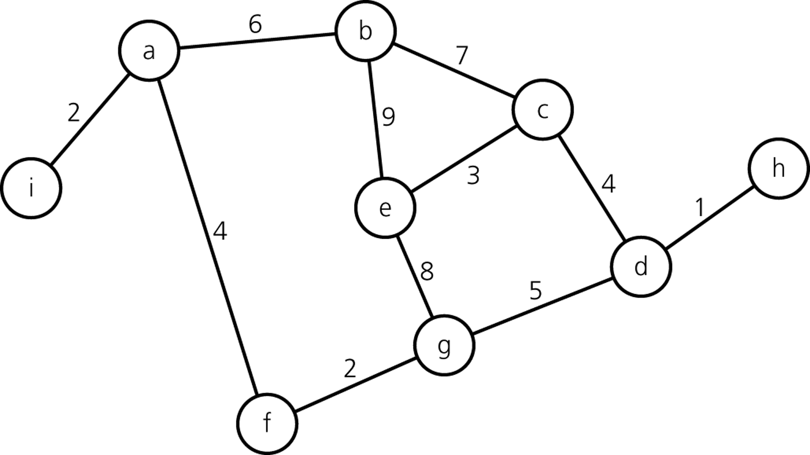
Prim’s Algorithm – Trace
A weighted, connected, undirected graph

Slide 59
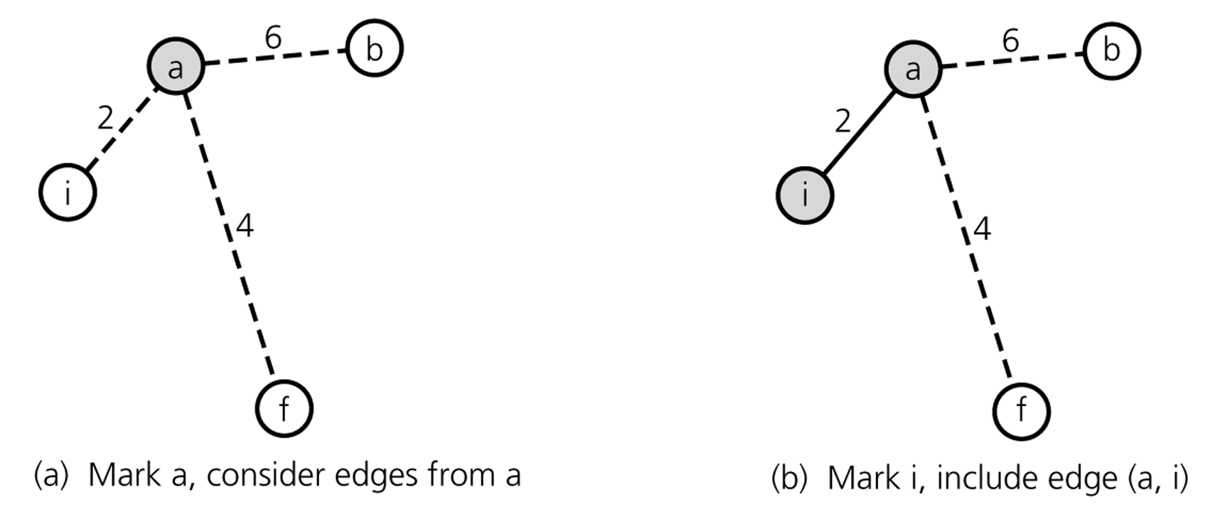
Prim’s Algorithm – Trace (cont.)
beginning at vertex a

Slide 60
Prim’s Algorithm – Trace (cont.)
beginning at vertex a

Slide 61
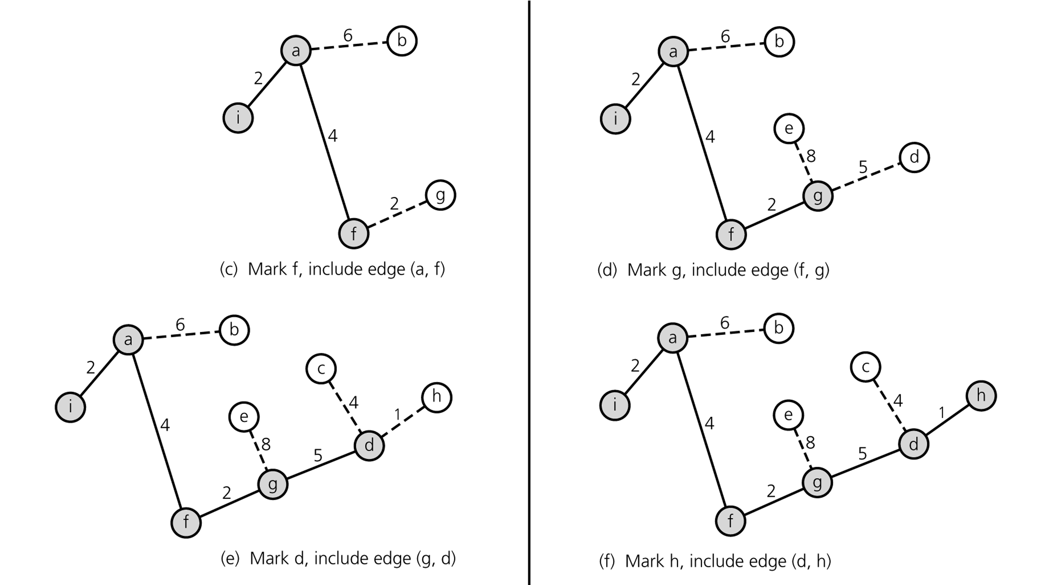
Prim’s Algorithm – Trace (cont.)

Slide 62
Prim’s Algorithm – Trace (cont.)

Slide 63
Prim’s Algorithm – Trace (cont.)

Slide 64
Prim’s Algorithm – Trace (cont.)

Slide 65
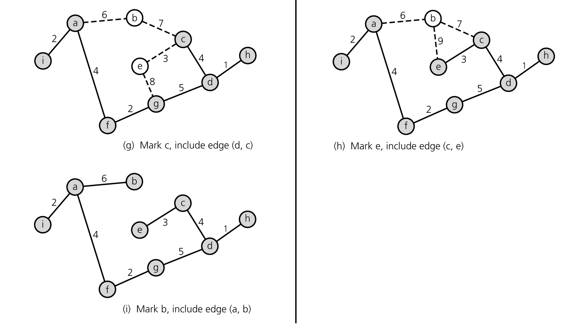
Prim’s Algorithm – Trace (cont.)

Slide 66
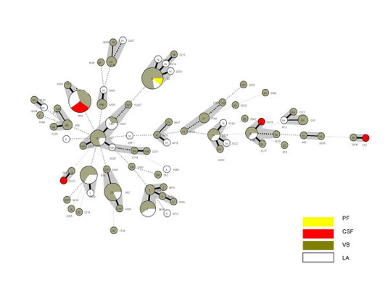
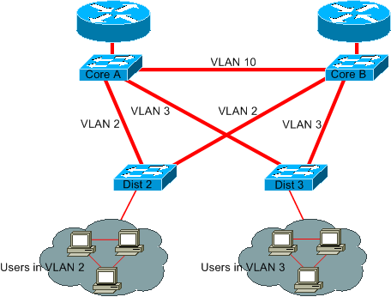
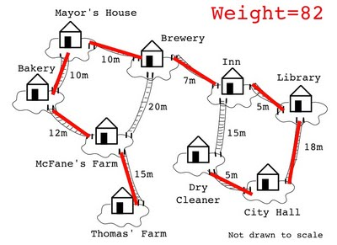
Applications of Minimum Spanning Trees
Building low-cost network
Grouping objects into clusters, where each cluster is a set of similar objects.
Minimum bottleneck

Slide 67
Shortest Paths
The shortest path between two vertices in a weighted graph has the smallest edge-weight sum.
Dijkstra’s shortest-path algorithm finds the shortest paths between vertex 0 (a given vertex) and all other vertices.

Slide 68
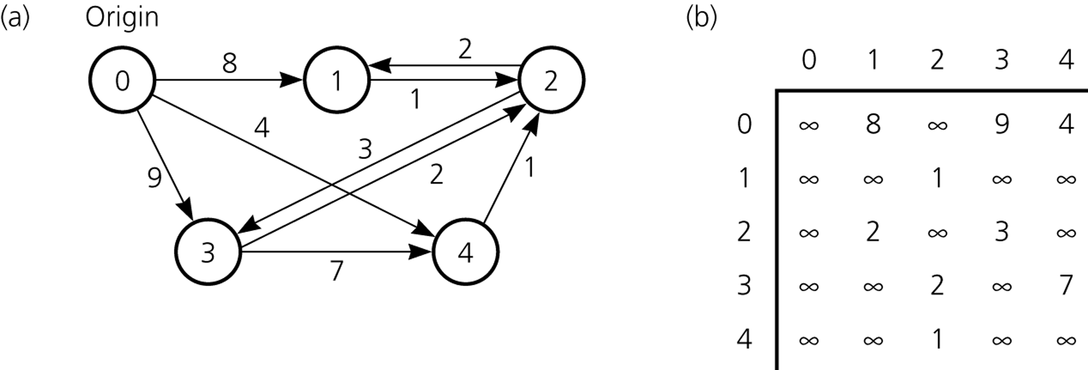
Shortest Paths
A Weighted Directed Graph Its Adjacency Matrix

Slide 69
Dijkstra’s Shortest-Path Algorithm
shortestPath(in theGraph, in weight:WeightArray) {
// Finds the minimum-cost paths between an origin vertex (vertex 0)
// and all other vertices in a weighted directed graph theGraph;
// theGraph’s weights are nonnegative
Create a set vertexSet that contains only vertex 0;
n = number of vertices in the Graph;
// Step 1
for (v=0 through n-1)
weight[v] = matrix[0][v];
// Steps 2 through n
for (v=2 through n) {
Find the smallest weight[v] such that v is not in vertexSet;
Add v to vertexSet;
for (all vertices u adjacent to v but not in vertexSet)
if (weight[u] > weight[v]+matrix[v][u])
weigth[u] = weight[v]+matrix[v][u];
}
}

Slide 70
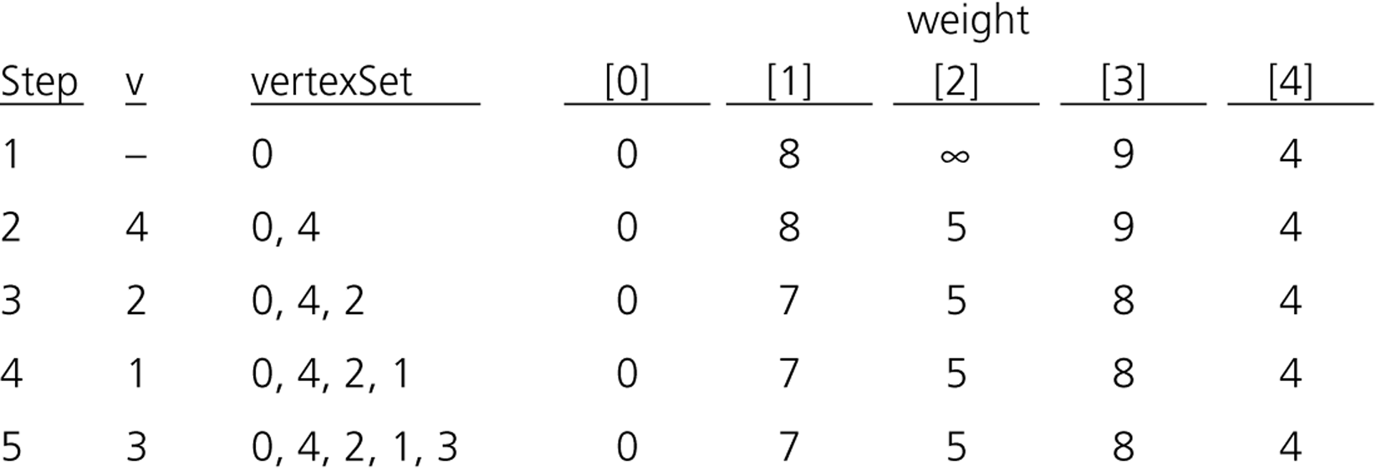
Dijkstra’s Shortest-Path Algorithm – Trace

Slide 71
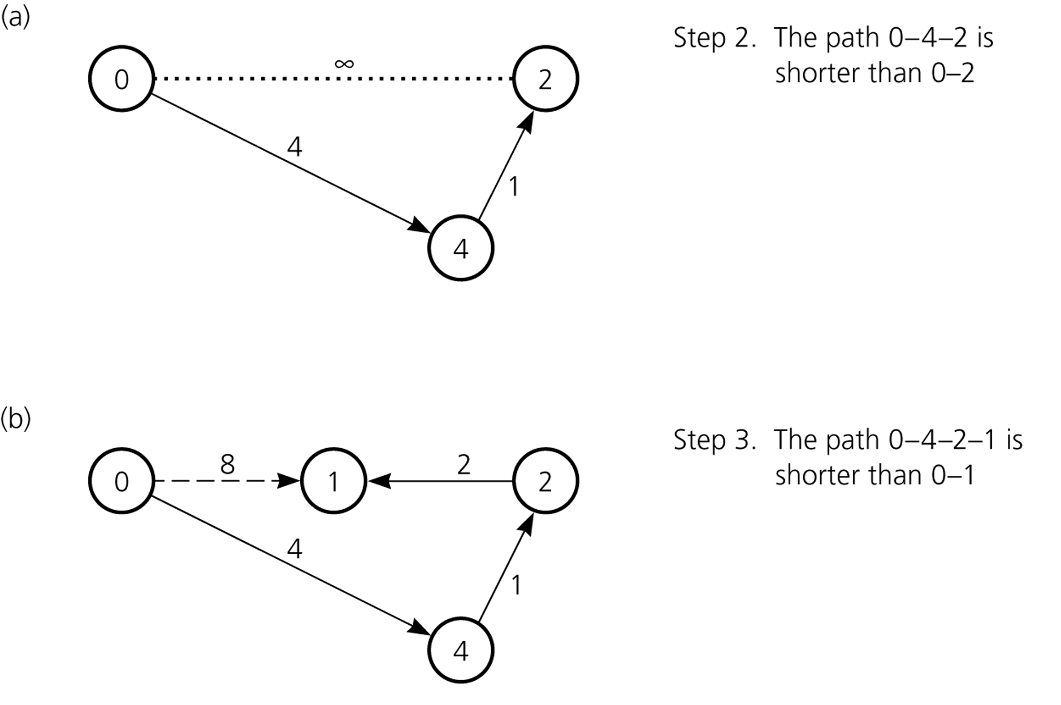
Dijkstra’s Shortest-Path Algorithm – Trace (cont.)

Slide 72
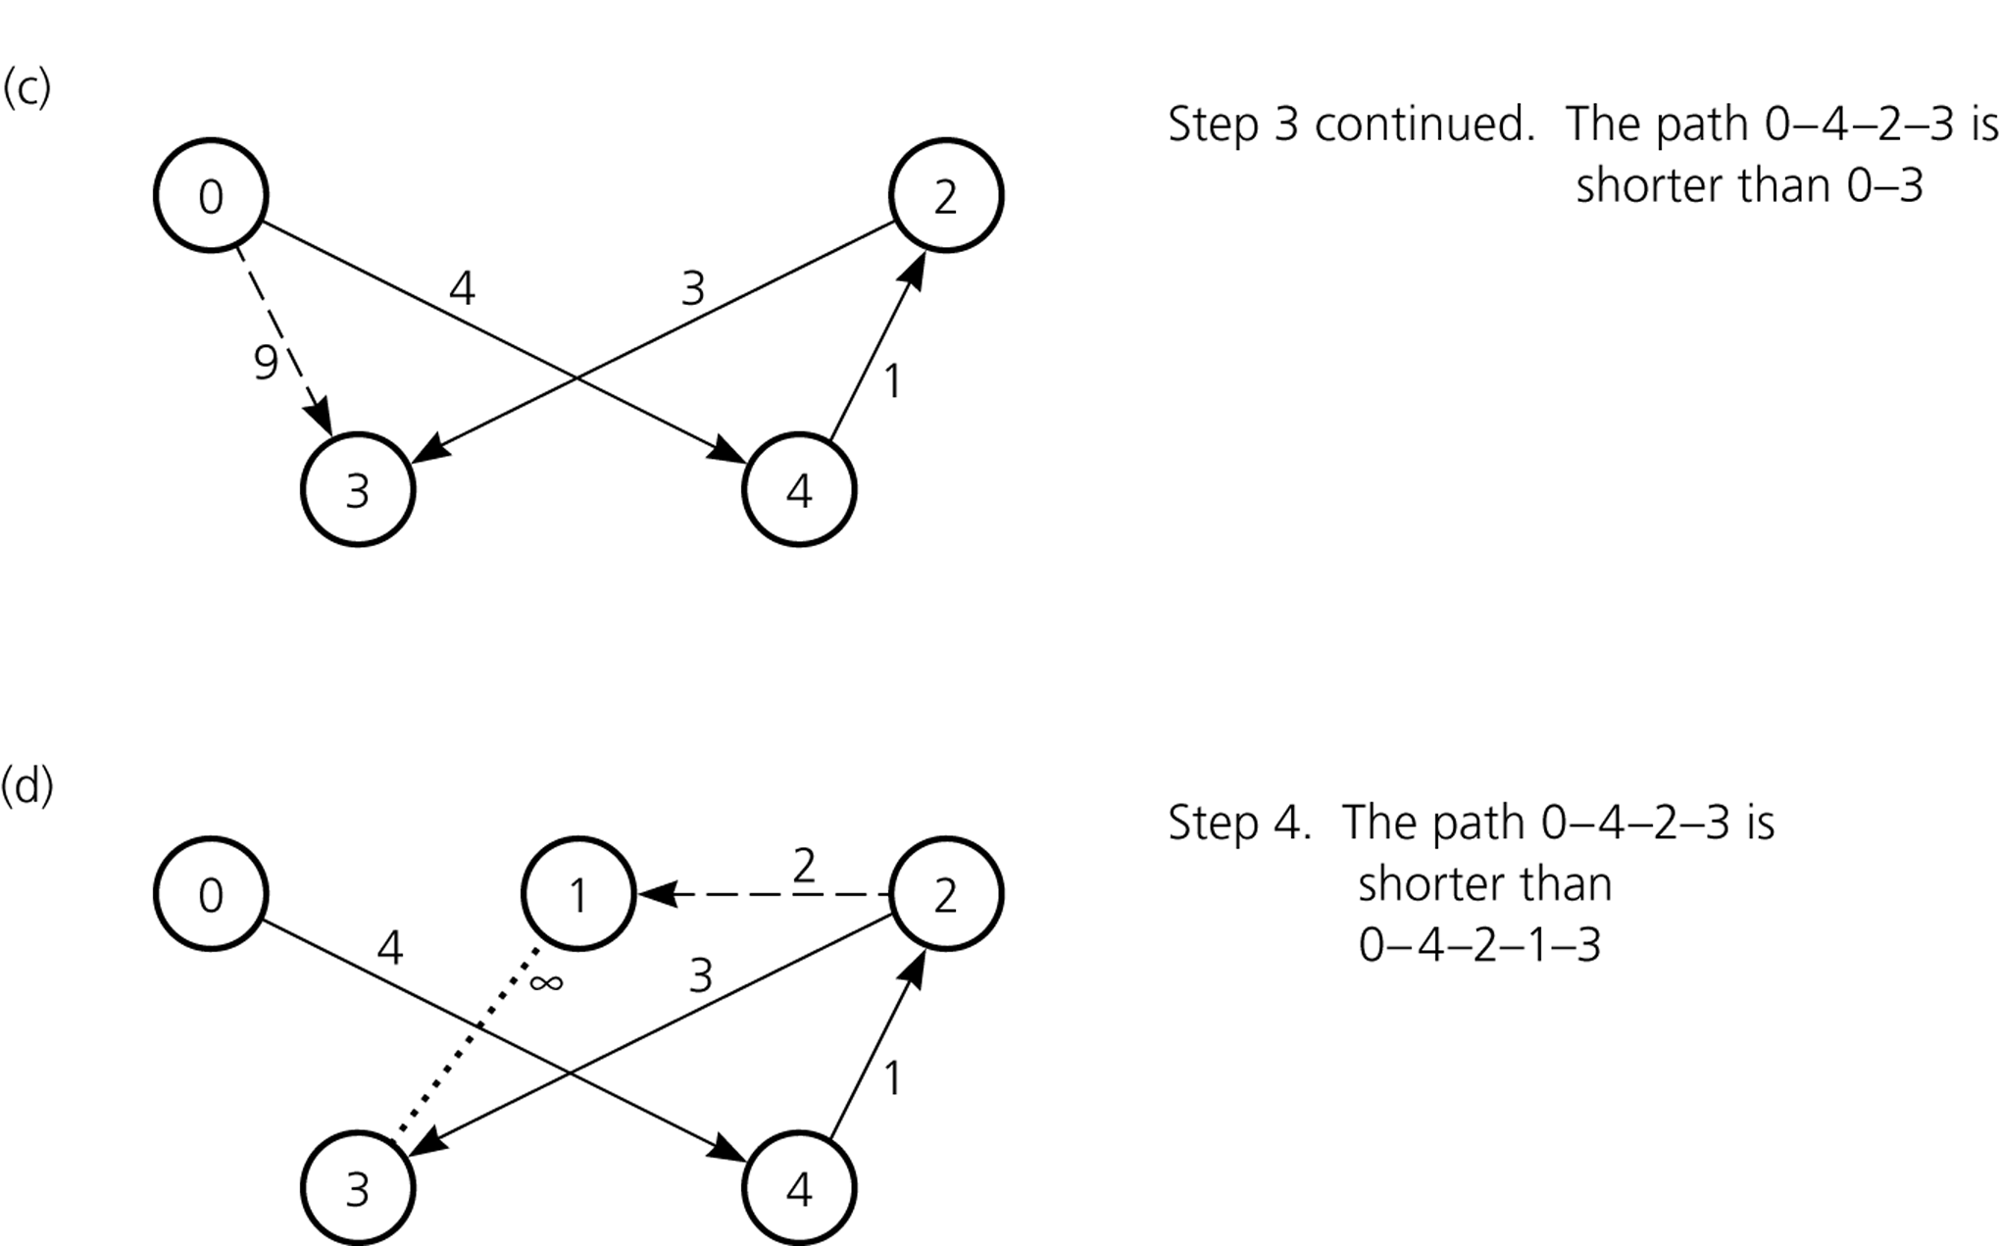
Dijkstra’s Shortest-Path Algorithm – Trace (cont.)

