Slide 1
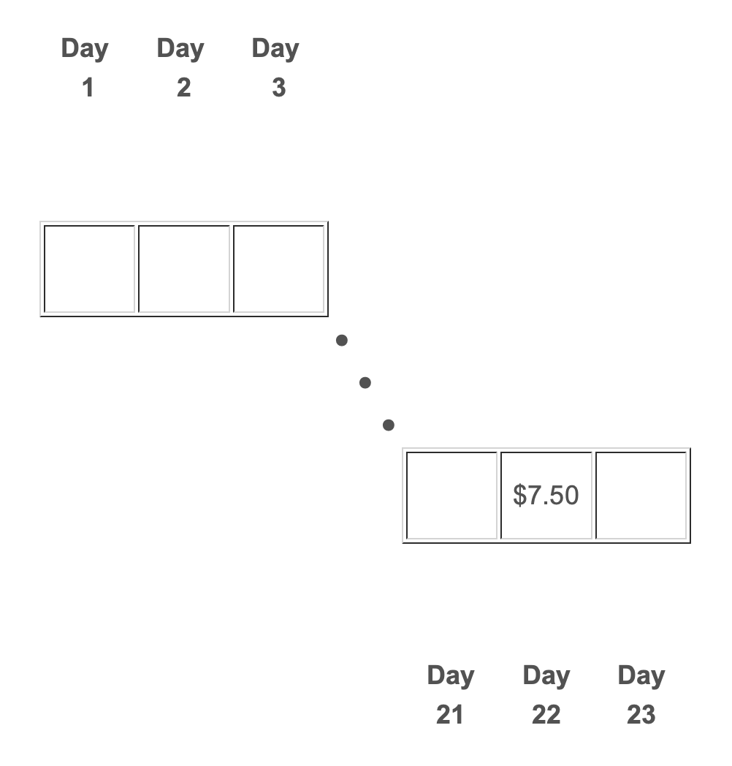

Slide 2
$X

Slide 3
$Y

Slide 4
$Y

Slide 5
$Y

Slide 8
Green Red Blue
X Y Z
+
Urn A
Urn B
Black Gold White
L M N

Slide 9
Green Red Blue
X Y Z
$D
+
Urn A
Urn B
Black Gold White
L M N

Slide 10
Green Red Blue
X Y Z
+
Urn A
Urn B
$C
Black Gold White
L M N

Slide 11
Green Red Blue
X Y Z
+
Urn A
Urn B
Black Gold White
L M N

Slide 12
Green Red Blue
X Y Z
+
Urn A
Urn B
Black Gold White
L M N

Slide 13
Green Red Blue
100 0 0
+
Urn A
Urn B
Black Gold White
25 50 25

Slide 14
Green Red Blue
X Y Z
+
Urn A
Urn B
Gold Black White
L M N

Slide 15
Green Red Blue
X Y Z
$D
+
Urn A
Urn B
Gold Black White
L M N

Slide 16
Green Red Blue
X Y Z
+
Urn A
Urn B
$C
Gold Black White
L M N

Slide 17
Green Red Blue
X Y Z
+
Urn A
Urn B
Gold Black White
L M N

Slide 18
Green Red Blue
X Y Z
+
Urn A
Urn B
Gold Black White
L M N

Slide 19
Green Red Blue
100 0 0
+
Urn A
Urn B
Gold Black White
50 25 25

