Slide 1
BLOB
A Blob is a group of connected pixels in an image that share some common property ( E.g. grayscale value ). In the image above, the dark connected regions are blobs, and the goal of blob detection is to identify and mark these regions.
BLOB stands for Binary Large Object and refers to a group of connected pixels in a binary image. The term “Large” indicates that only objects of a certain size are of interest and that “small” binary objects are usually noise.

Slide 2
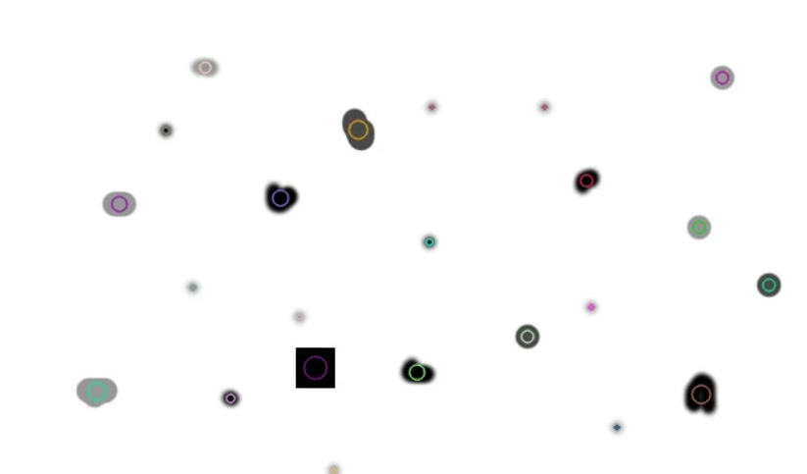

Slide 3
WHAT IS THE PROBLEM
The problem was to detect vehicles whether in a video or in an image.
The approach in image will be different from videos.

Slide 4
Approach for Video
Have an empty background image.
When there are vehicles in the image, subtract both the images.
You will have an image with only vehicles.
Now convert them into binary by a threshold value.
These white chunks are blobs.
When these blobs crosses a predefined line then a counter is increased by one.
Background reference image is constantly changing as it will handle day and night.

Slide 5
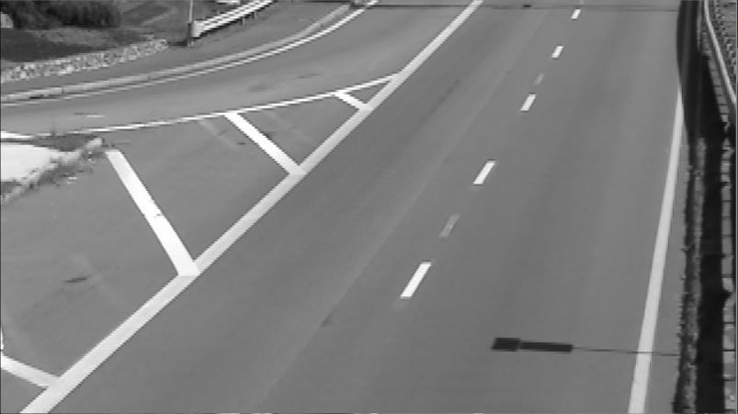
Averaged Background:

Slide 6
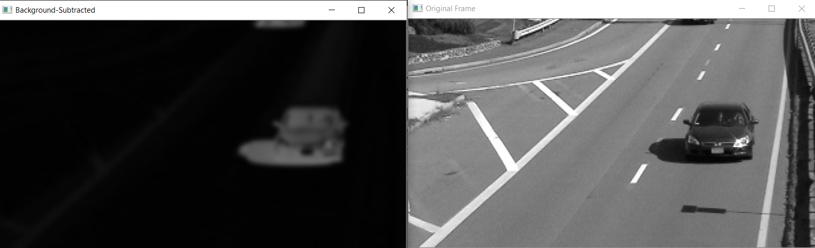
Subtract from Background:

Slide 7
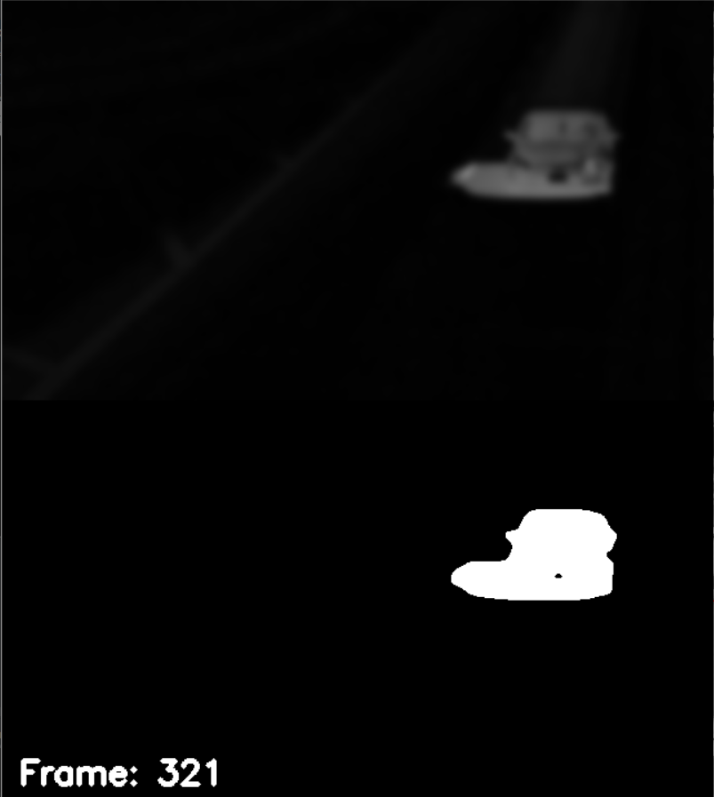
Thresholding:

Slide 8
Thresholding:

Slide 9
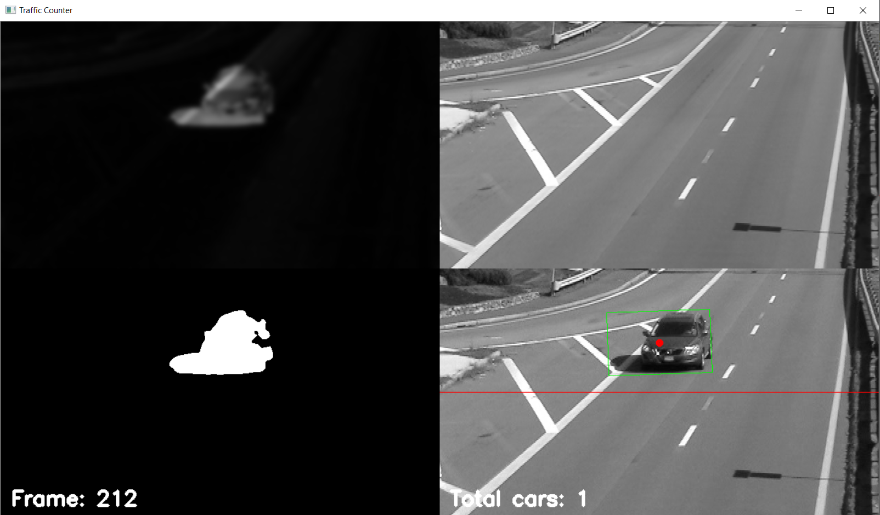

Slide 10
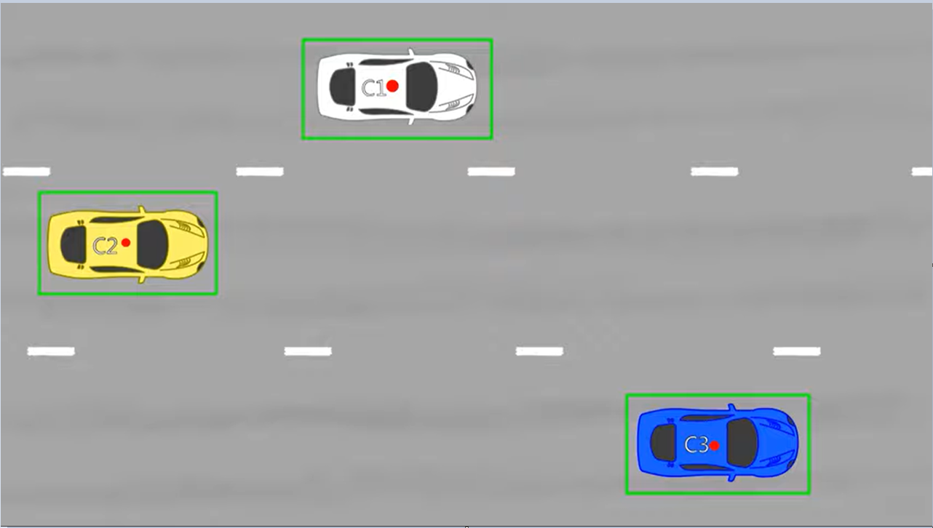
Find contours of the cars from frame

Slide 11
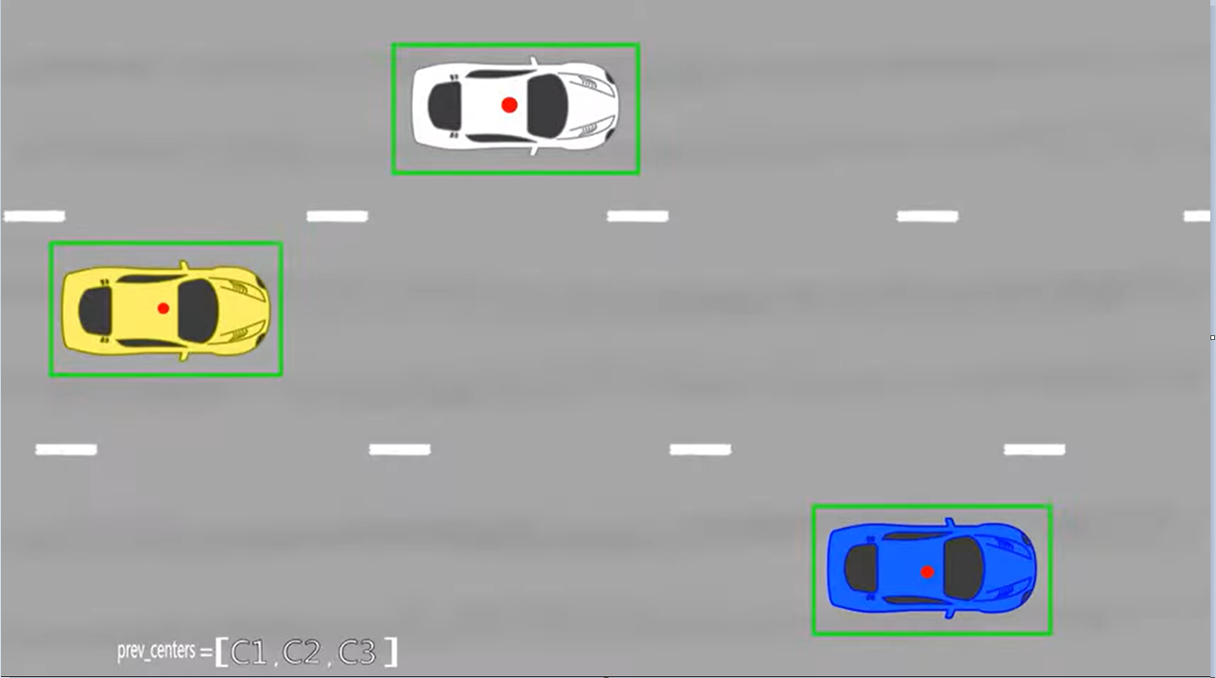
Store centers of blobs of the cars into an array

Slide 12
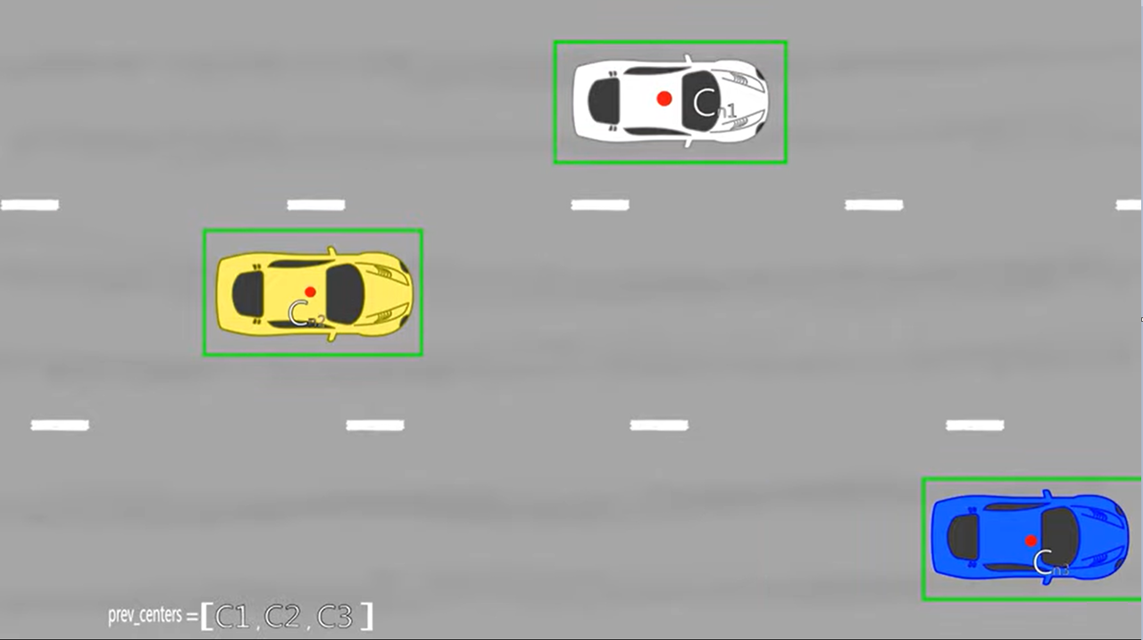
Read the next frame and also find center of blobs of cars for this frame.

Slide 13
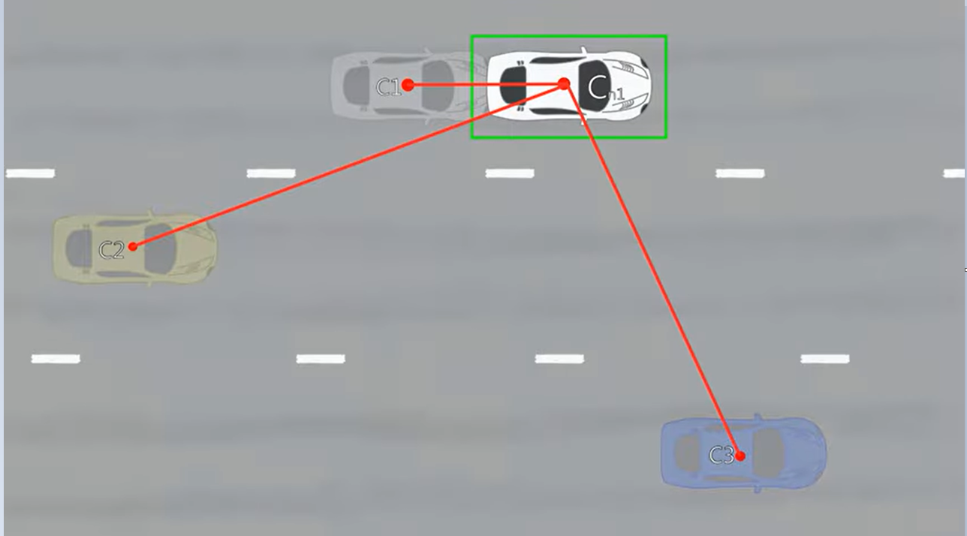
Compute the Euclidian distance of the center of each car from all the centers of previous frame.

Slide 14
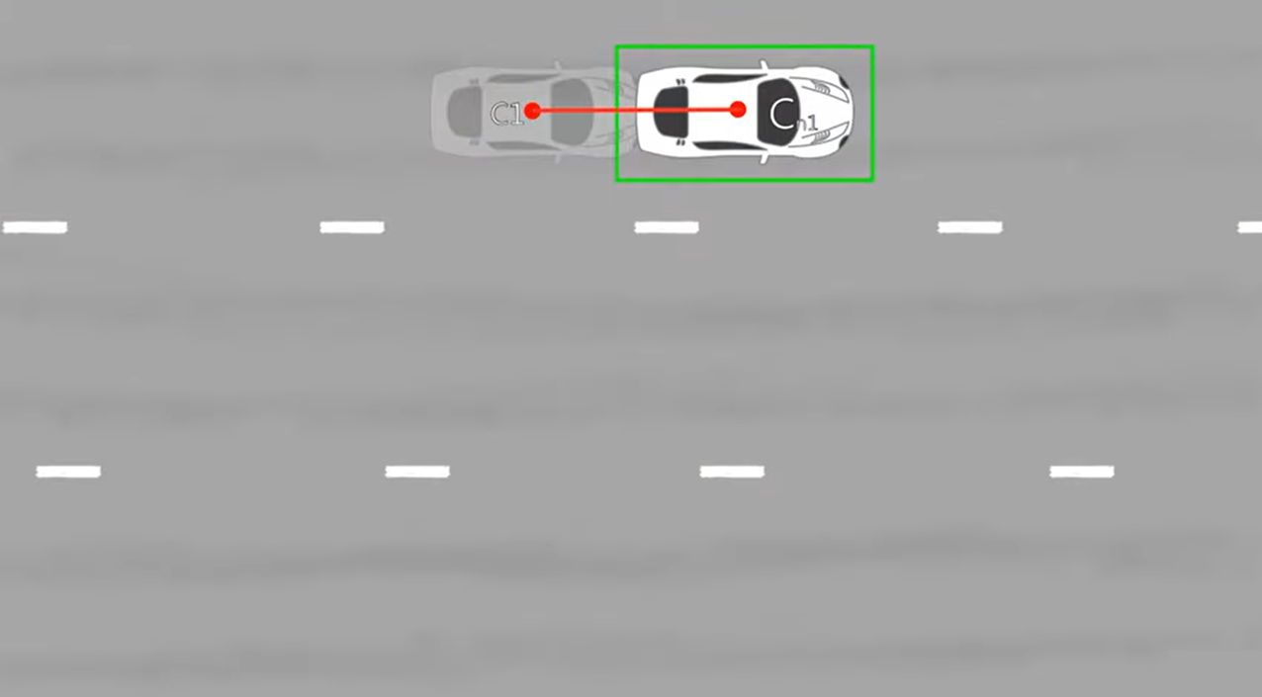
The point which has the smallest Euclidian value will be the center of this car in previous frame.

Slide 15
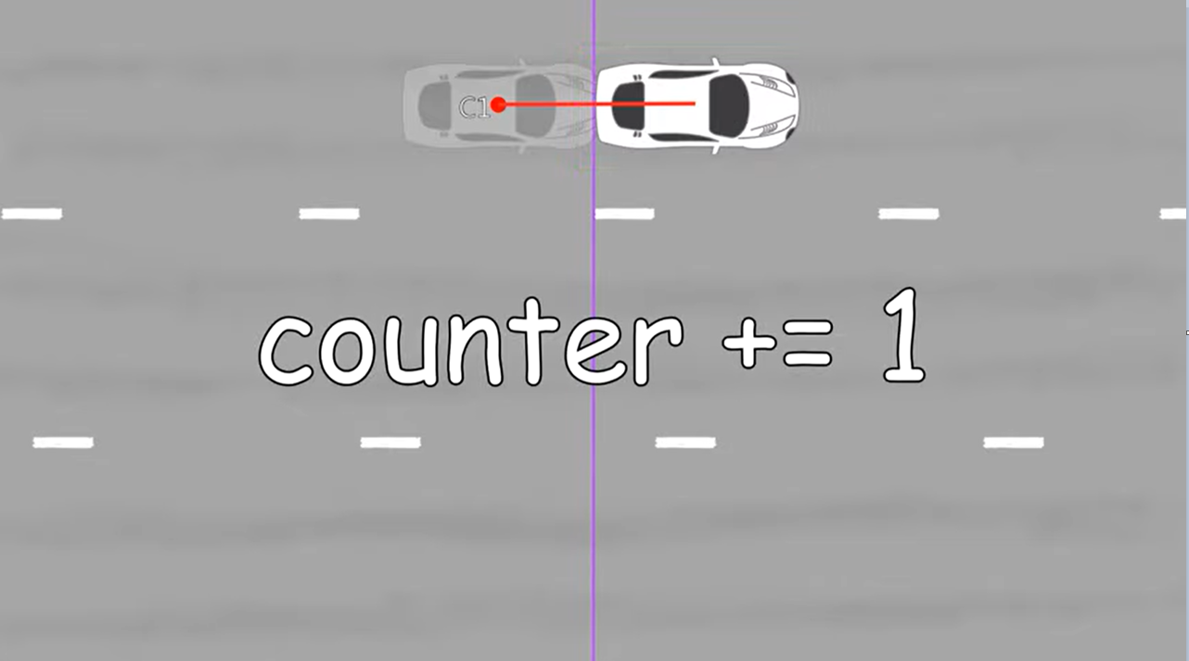

Slide 16
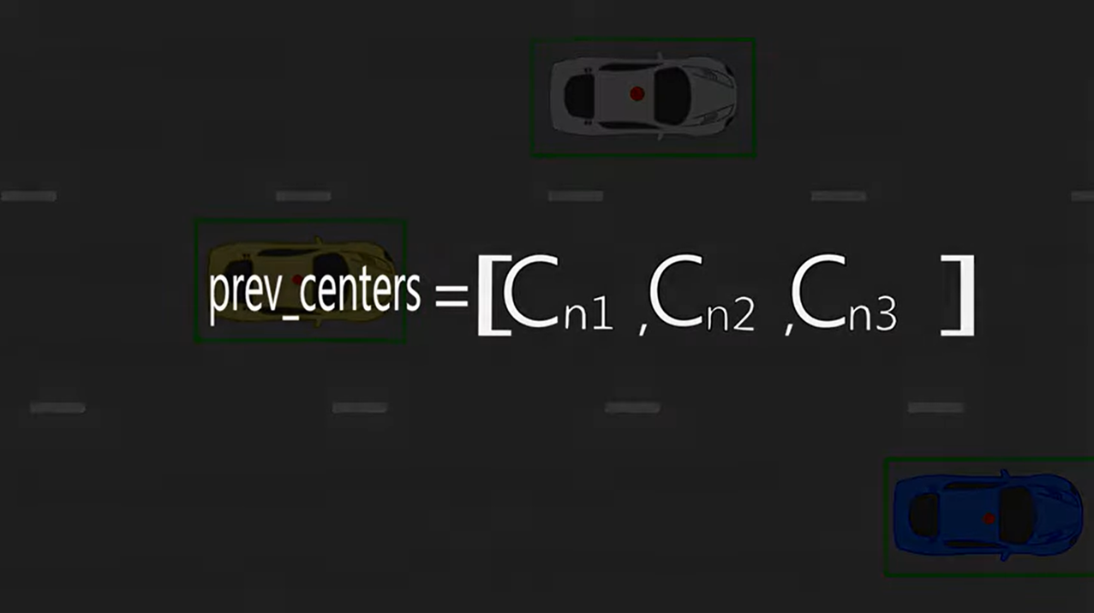

Slide 17
Drawbacks.
It will detect any object that passes through line, we must define a blob size of some range so that only objects that fall in this range are vehicles.
Background reference image will have bad impact if the very first frames are not empty background frames.
If vehicles stops at a signal, our reference image will have very bad impact as it will start adding vehicles in the background image because the frame is moving,

