Slide 1
UML Diagrams
Prepared by: Sheikh Haseeb-Ur-Rehman

Slide 2
Big questions
What is UML?
  Why should I bother? Do people really use UML?
What is a UML class diagram?
  What kind of information goes into it?
  How do I create it?
  When should I create it?

Slide 3
Uses for UML
as a sketch: to communicate aspects of system
  forward design: doing UML before coding
  backward design: doing UML after coding as documentation
  often done on whiteboard or paper
  used to get rough selective ideas
as a blueprint: a complete design to be implemented
  sometimes done with CASE (Computer-Aided Software Engineering) tools
as a programming language: with the right tools, code can be auto-generated and executed from UML
  only good if this is faster than coding in a "real" language

Slide 4
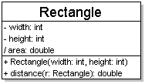
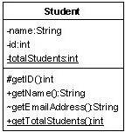
Diagram of one class
class name in top of box
  write <<interface>> on top of interfaces' names
  use italics for an abstract class name
attributes (optional)
  should include all fields of the object
operations / methods (optional)
  may omit trivial (get/set) methods
    but don't omit any methods from an interface!
  should not include inherited methods

Slide 5
Class attributes
attributes (fields, instance variables)
  visibility name : type [count] = default_value
  visibility: + public
  # protected
  - private
  ~ package (default)
  / derived
  underline static attributes
  derived attribute: not stored, but can
  be computed from other attribute values
  attribute example:
  - balance : double = 0.00

Slide 6
Class operations / methods
operations / methods
  visibility name (parameters) : return_type
  visibility: + public
  # protected
  - private
  ~ package (default)
  underline static methods
  parameter types listed as (name: type)
  omit return_type on constructors and
  when return type is void
  method example:
  + distance(p1: Point, p2: Point): double

Slide 7
Relationships btwn. classes
generalization: an inheritance relationship
  inheritance between classes
  interface implementation
association: a usage relationship
  dependency
  aggregation
  composition

Slide 8
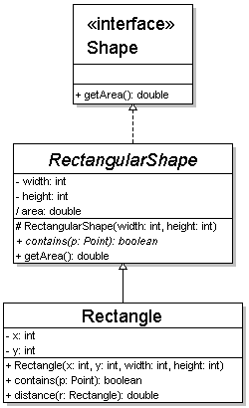
Generalization relationships
generalization (inheritance) relationships
  hierarchies drawn top-down with arrows pointing upward to parent
  line/arrow styles differ, based on whether parent is a(n):
    class:
    solid line, black arrow
    abstract class:
    solid line, white arrow
    interface:
    dashed line, white arrow
  we often don't draw trivial / obvious generalization relationships, such as drawing the Object class as a parent

Slide 9
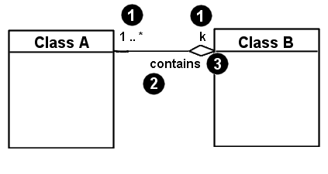
Associational relationships
associational (usage) relationships
  1. multiplicity (how many are used)
    * ⇒ 0, 1, or more
    1 ⇒ 1 exactly
    2..4 ⇒ between 2 and 4, inclusive
    3..* ⇒ 3 or more
  2. name (what relationship the objects have)
  3. navigability (direction)

Slide 10
Association types
Car
1
1
aggregation
aggregation: "is part of"
  symbolized by a clear white diamond
composition: "is entirely made of"
  stronger version of aggregation
  the parts live and die with the whole
  symbolized by a black diamond
dependency: "uses temporarily"
  symbolized by dotted line
  often is an implementation
  detail, not an intrinsic part of
  that object's state
Engine
Book
composition
1
*
Page
dependency
Lottery
Ticket
Random

Slide 11
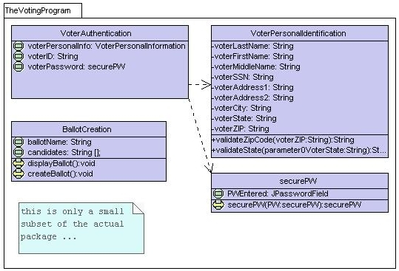
Class diagram example 1

Slide 12
Class diagram example 2
Multiplicity
Customer
1
Simple
Aggregation
Class
Abstract
Class
Rental Invoice
Rental Item
1..*
1
0..1
Composition
Simple
Association
Generalization
Checkout Screen
DVD Movie
VHS Movie
Video Game

Slide 13
Class diagram example 3
StudentBody
Student
1
100
- firstName : String
- lastName : String
- homeAddress : Address
- schoolAddress : Address
+ main (args : String[])
+ toString() : String
Address
- streetAddress : String
- city : String
- state : String
- zipCode : long
+ toString() : String

Slide 14
Tool Used.
Visual Paradigm UML Suite (trial)
  http://www.visual-paradigm.com/
  direct download link:
  http://www.visual-paradigm.com/vp/download.jsp?product=vpuml&edition=ce

Slide 15
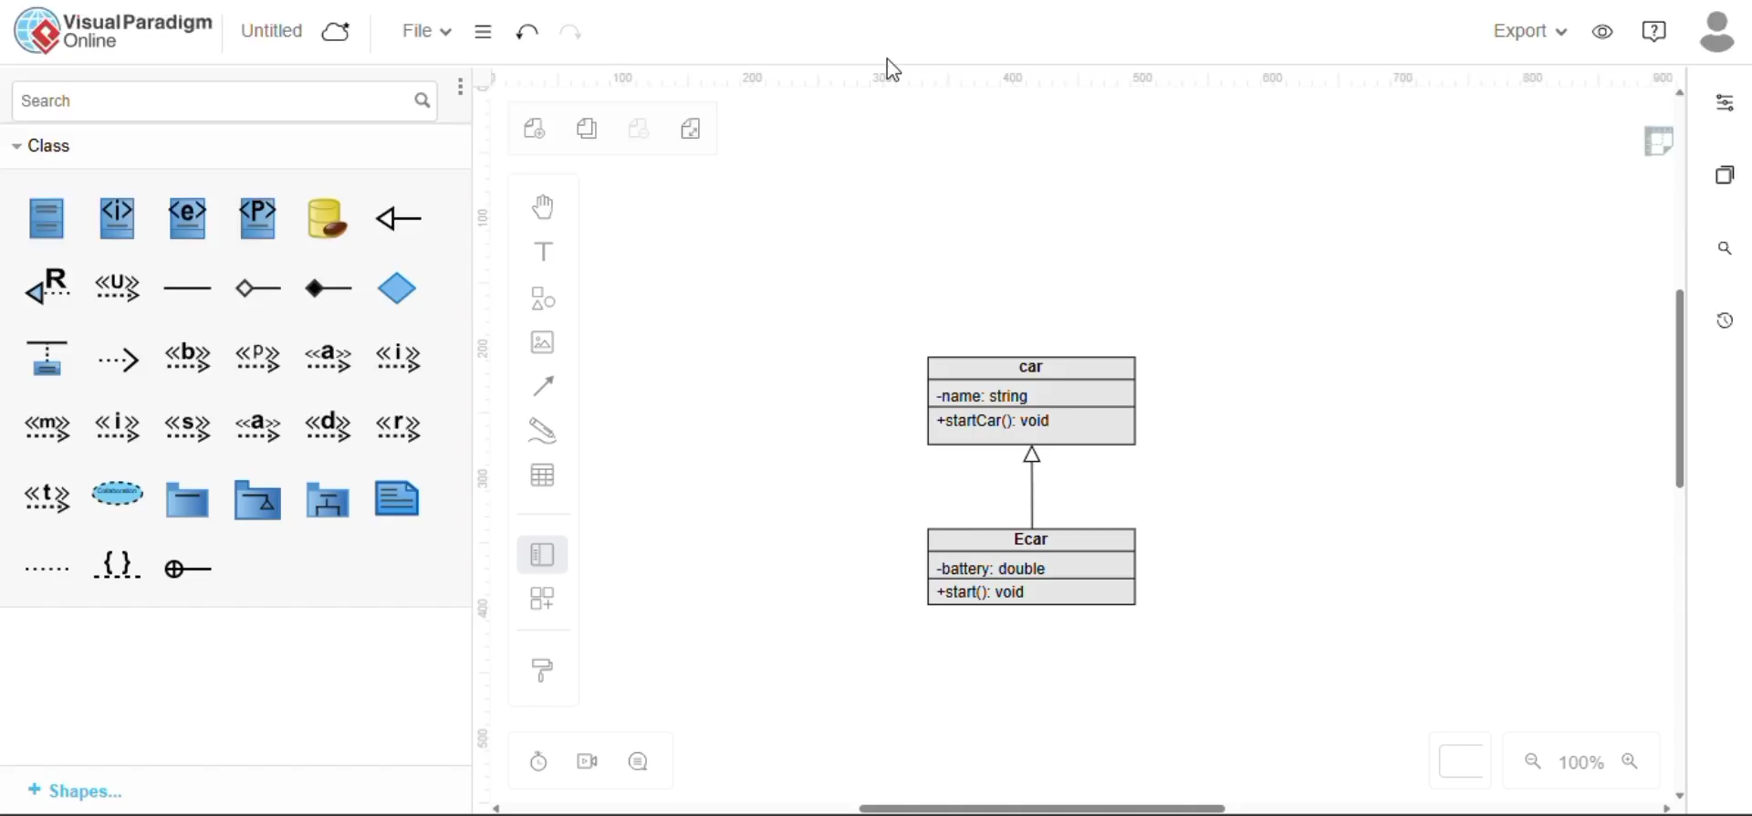
Tool Exploration
This video shows the exploration of the Visual Paradigm Software

