Slide 1
How earnings vary with age in urban Punjab
ECO346 Assignment 1 · FA24-BEDS-001 · Variant 1: Punjab, urban
Data: PSLM 2019–20 person file, joined to the household file by hhid
Sample: 3,768 earners aged 15–64 with annual earnings above zero
Every statistic weighted by hhweight
Figures drawn in R (ggplot2); band table reproduced in Python

Slide 2
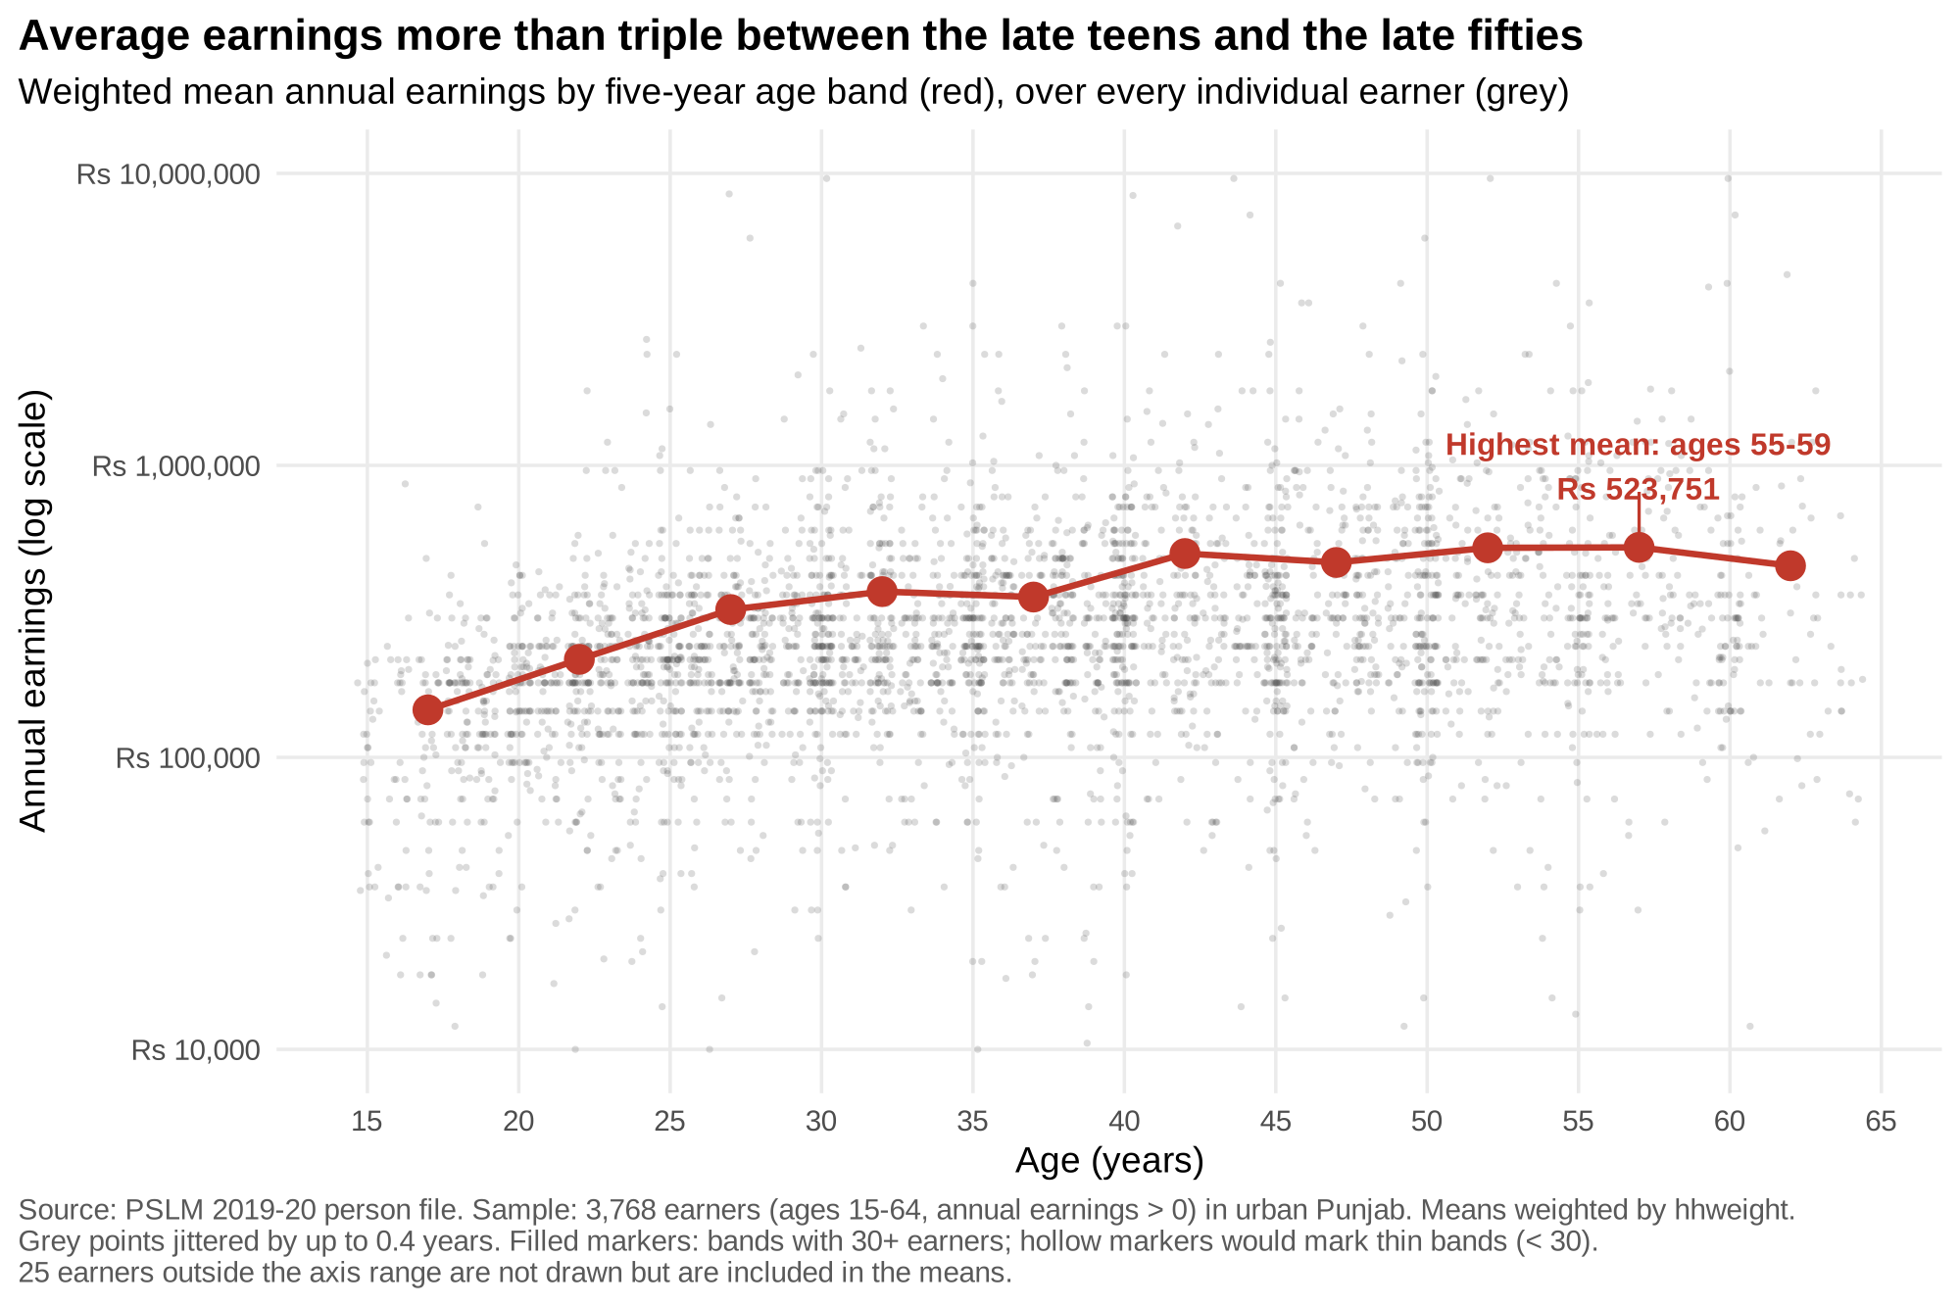
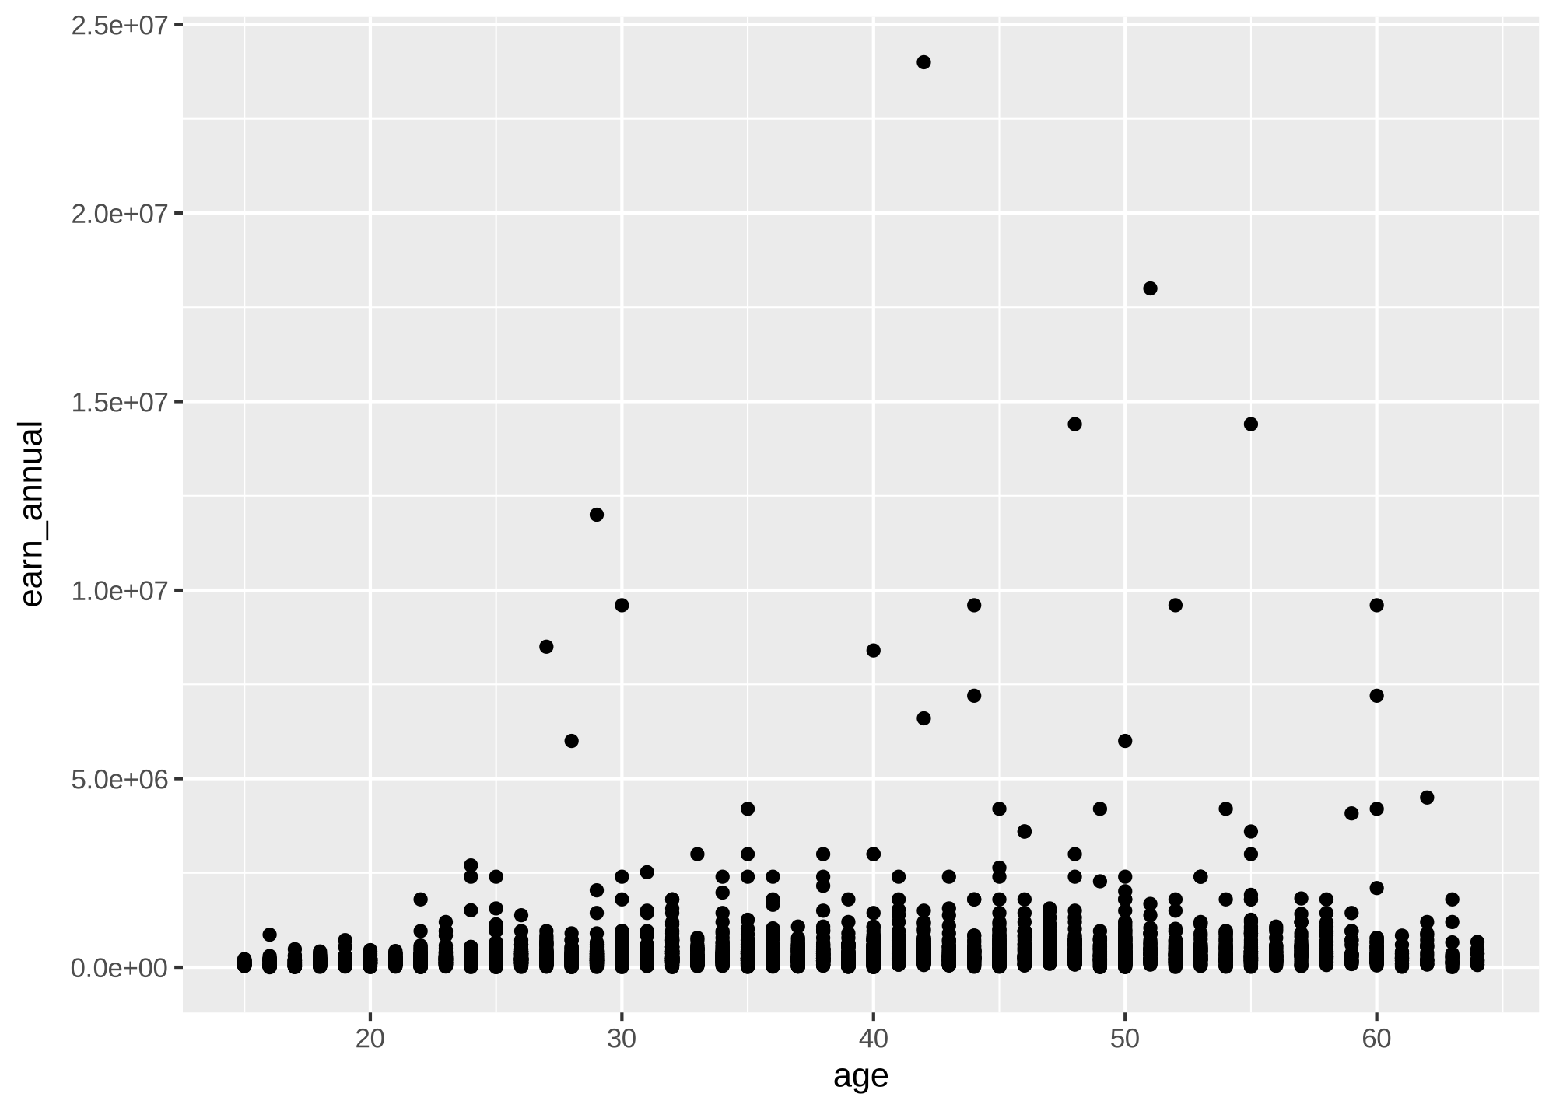
The makeover: R's default vs. my redesign
Default: linear scale, overplotted columns, 2.5e+07 labels
Log scale · jitter + transparency · weighted band means · rupee labels

Slide 3
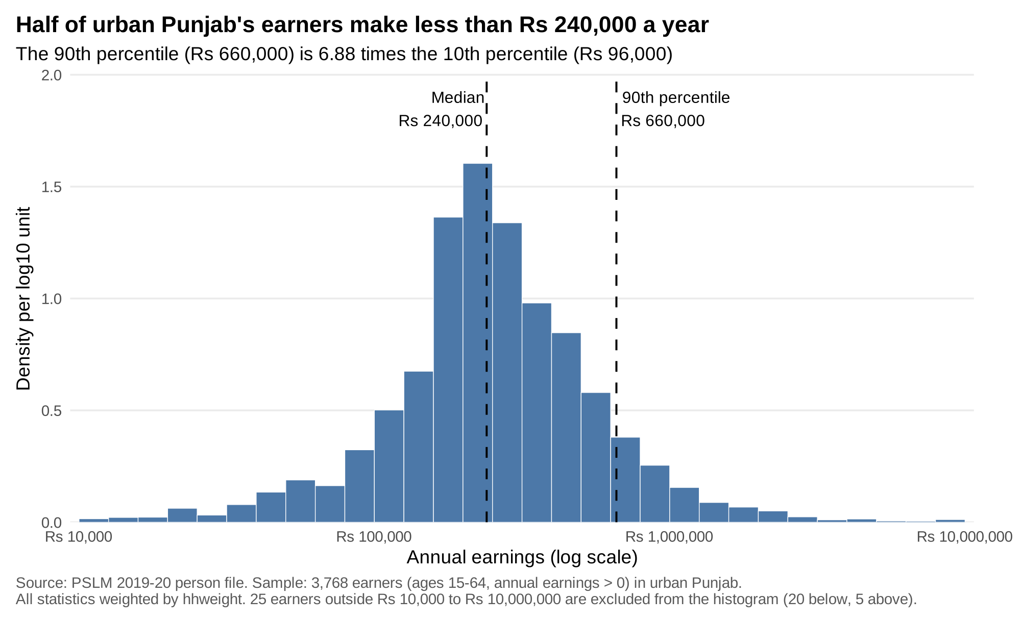
The distribution: half earn under Rs 240,000 a year
Weighted median: Rs 240,000 (unweighted: Rs 240,000)
p10 Rs 96,000 · p90 Rs 660,000
p90 / p10 = 6.88
Medians match: 7% of earners report exactly Rs 240,000 (Rs 20,000/month)

Slide 4
Key finding: earnings rise 3.6× from the late teens to the late fifties
Ages 15–19: Rs 145,444
Ages 25–29: Rs 320,776
Ages 45–49: Rs 465,073
Peak, ages 55–59: Rs 523,751
Steepest growth before 35, then a plateau: a concave age–earnings profile
Caveat
One cross-section: age and cohort effects are mixed, so this is not one person's career path.
Spread within each age band is far larger than the gap between bands.

