Slide 1
Scraping Fiverr
Freelancing Market Trends
Haseeb Durrani

Slide 2
Outline
Why Fiverr?
Data Scraping
Exploratory Data Analysis
Representation by Country
Category and Location
Top Countries by Category
Top Countries by Subcategory
Future Work

Slide 3

Why Fiverr?
Digital Marketplace
Who can benefit?

Slide 4
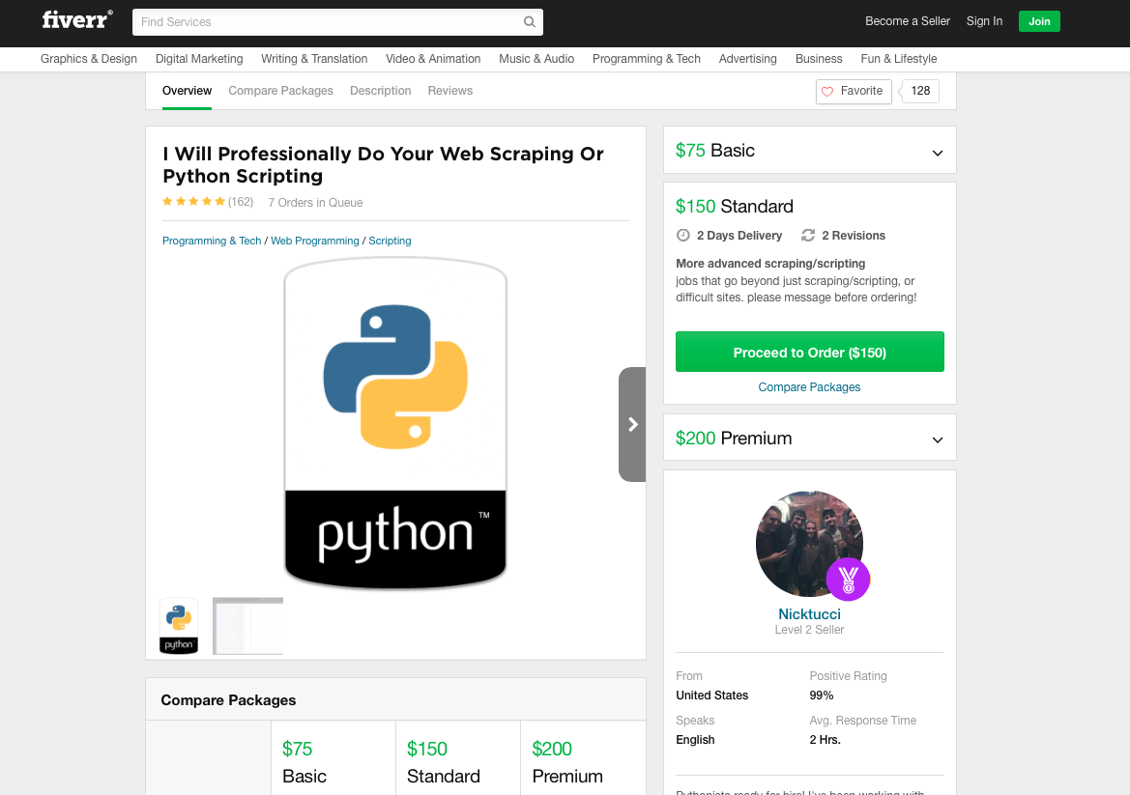
Data Scraping
Scrapy
Selenium
403 Forbidden

Slide 5
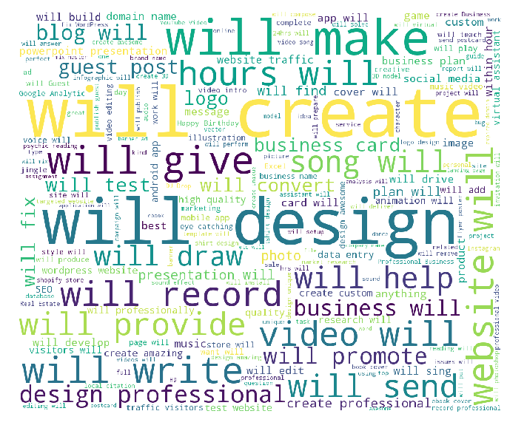
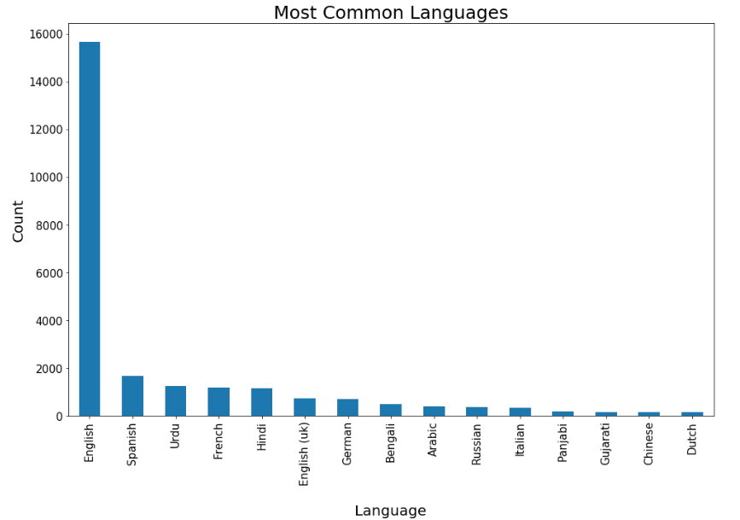
Exploratory Data Analysis

Slide 6
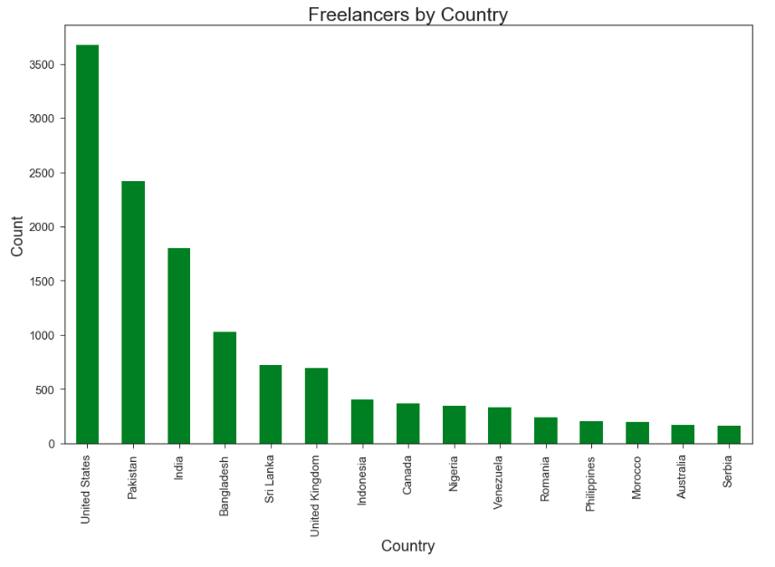
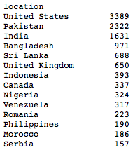
Representation by Country

Slide 7
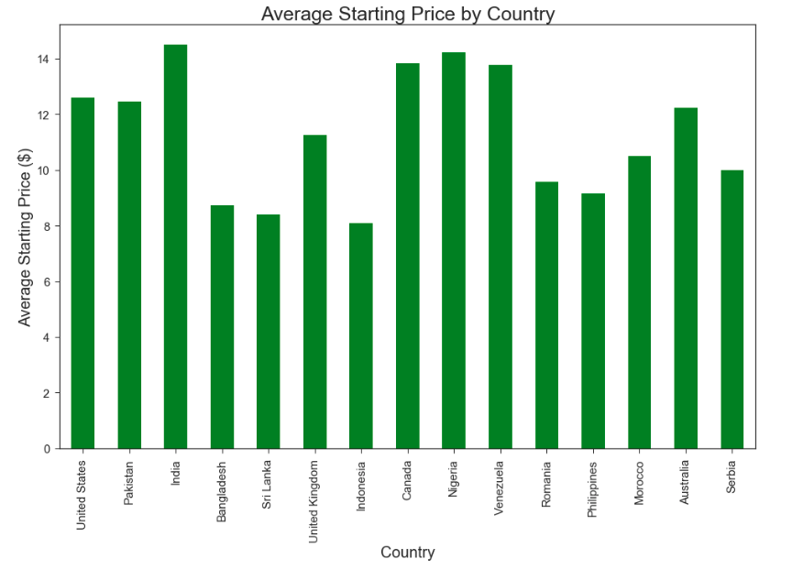
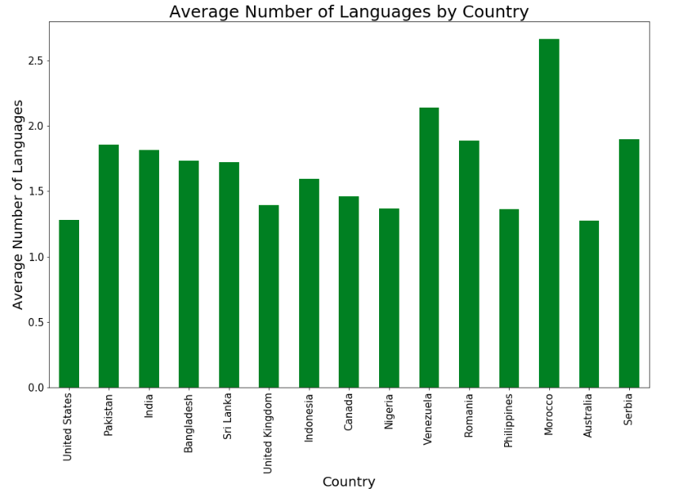
Representation by Country.. continued

Slide 8
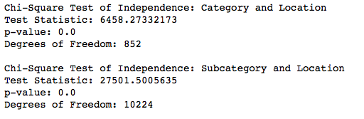
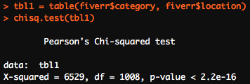
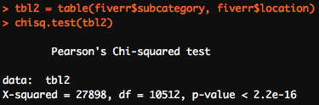
Category and Location

Slide 9
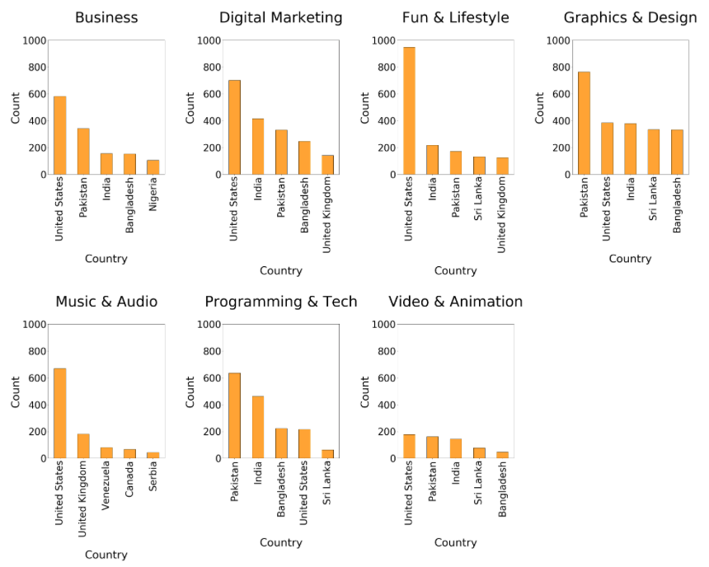
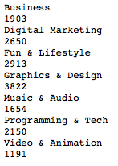
Top Countries by Category

Slide 10
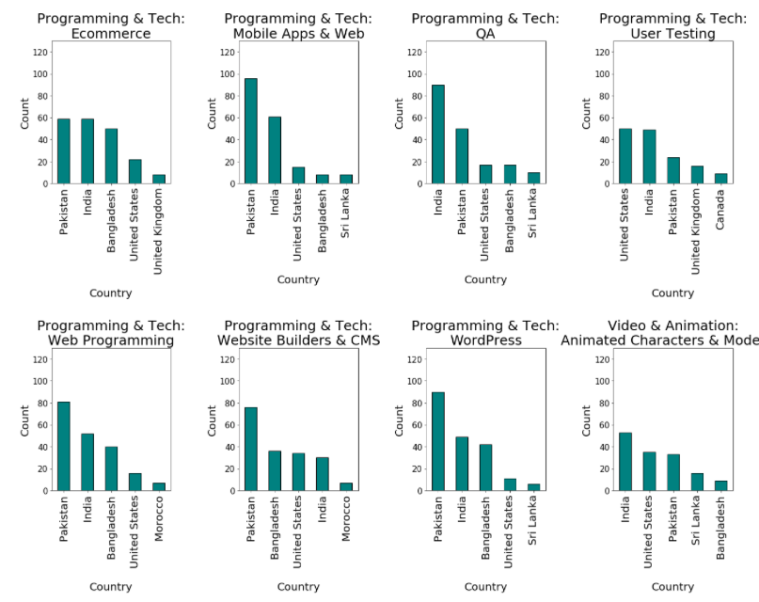
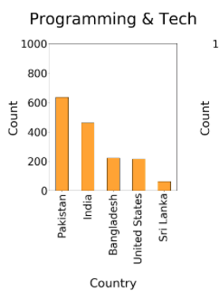

Top Countries by Subcategory

Slide 11
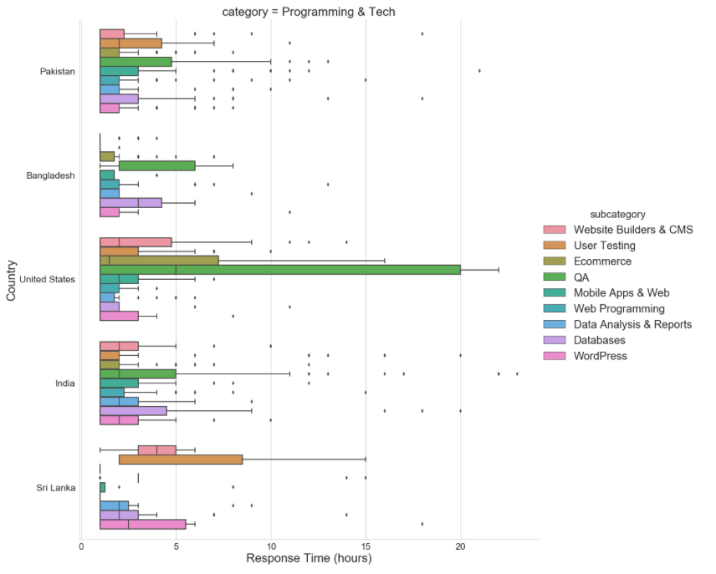
Top Countries by Subcategory.. continued

Slide 12
Future Work
More Data
International Economic Statistics
Predictive/Prescriptive Data Analysis

Slide 13
Thank you for your time Any Questions?

