Slide 1
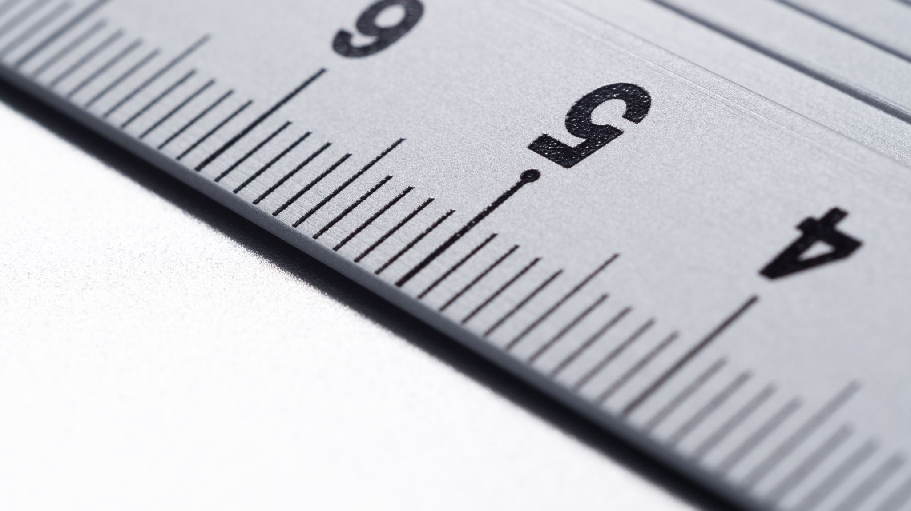
Industrial Surface Area Measurement Tool
Progress summary and next steps

Slide 2
Project Overview
Goal: extract equipment dimensions from images and compute surface area.
Focus: industrial containers, buckets, scoops, cylinders, and frustums.
Output: labeled images, detected dimensions, and calculated areas.

Slide 3
What We Built
Local web app to upload images and run OCR.
Visualization output with bounding boxes and labels.
Surface-area calculator for common equipment shapes.
Manual calculator page for exact measurements.

Slide 4
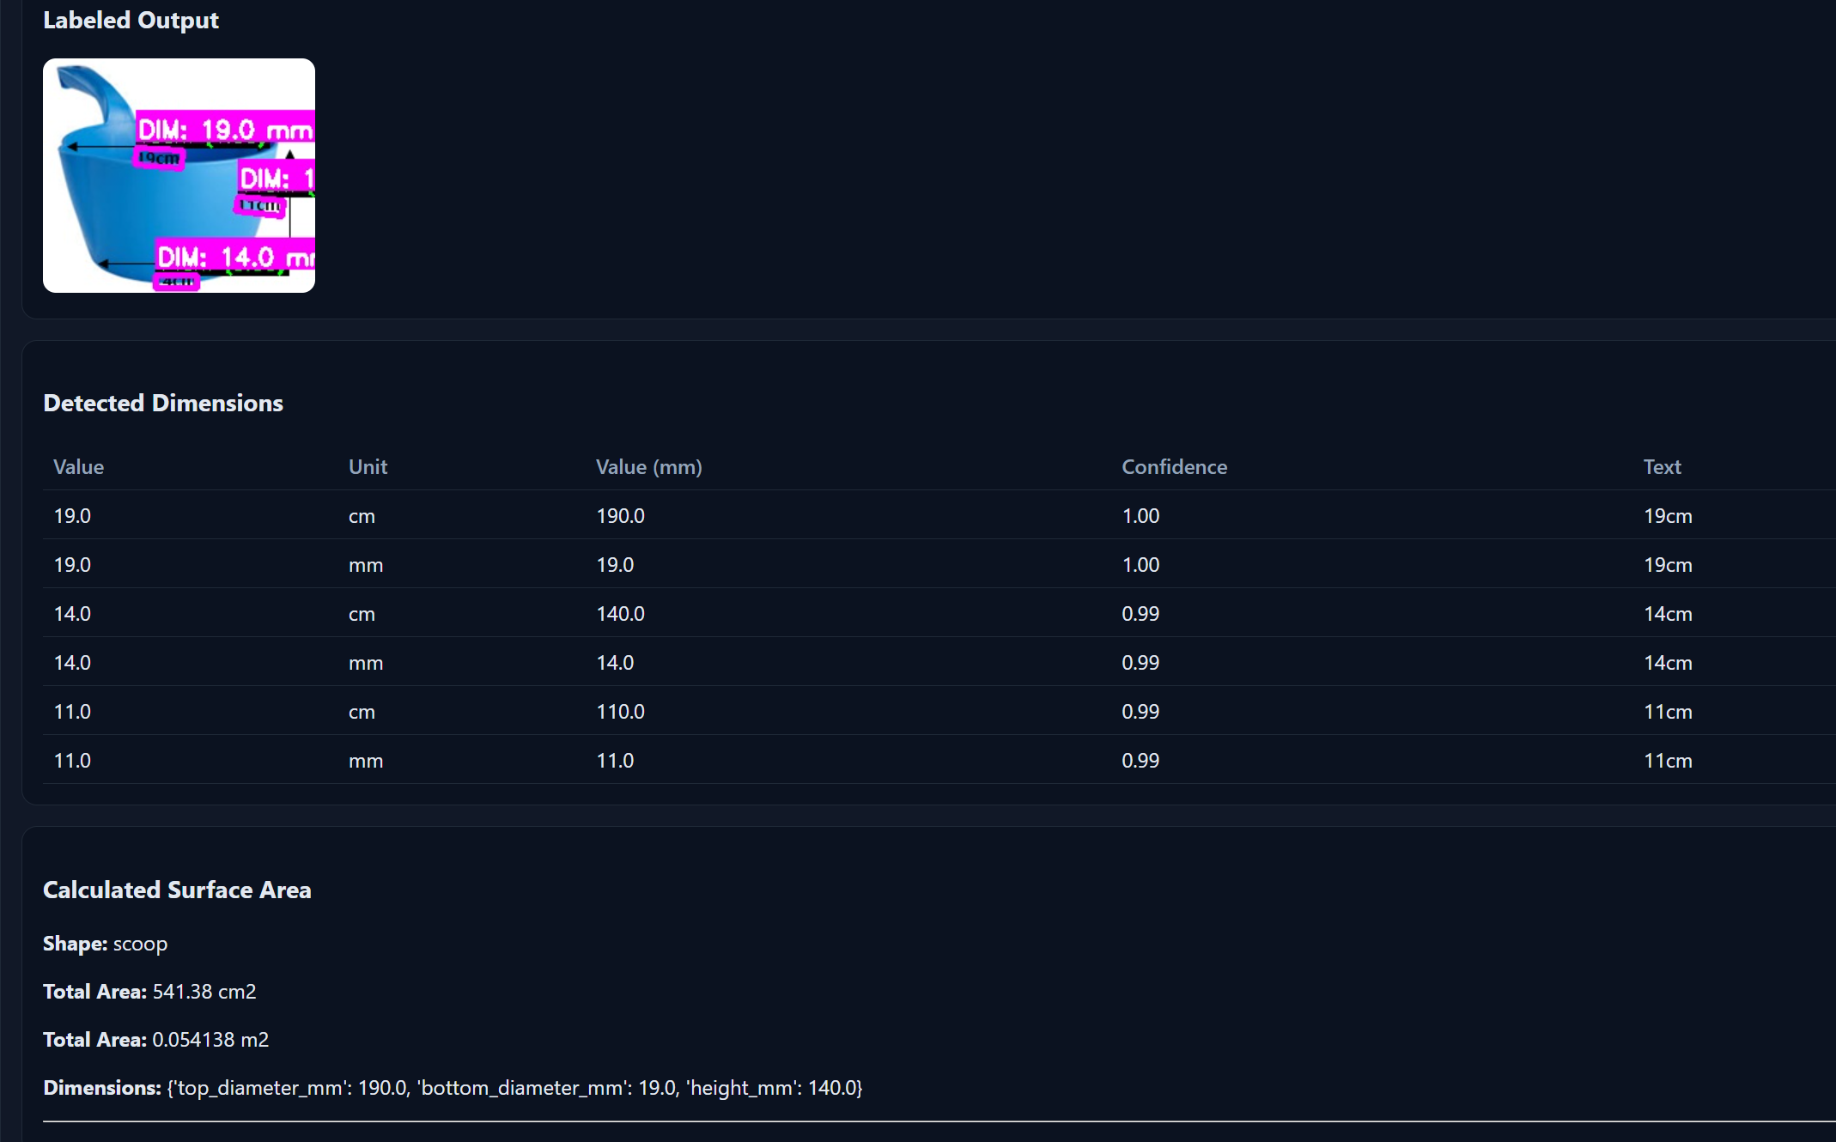
Sample Results

Slide 5
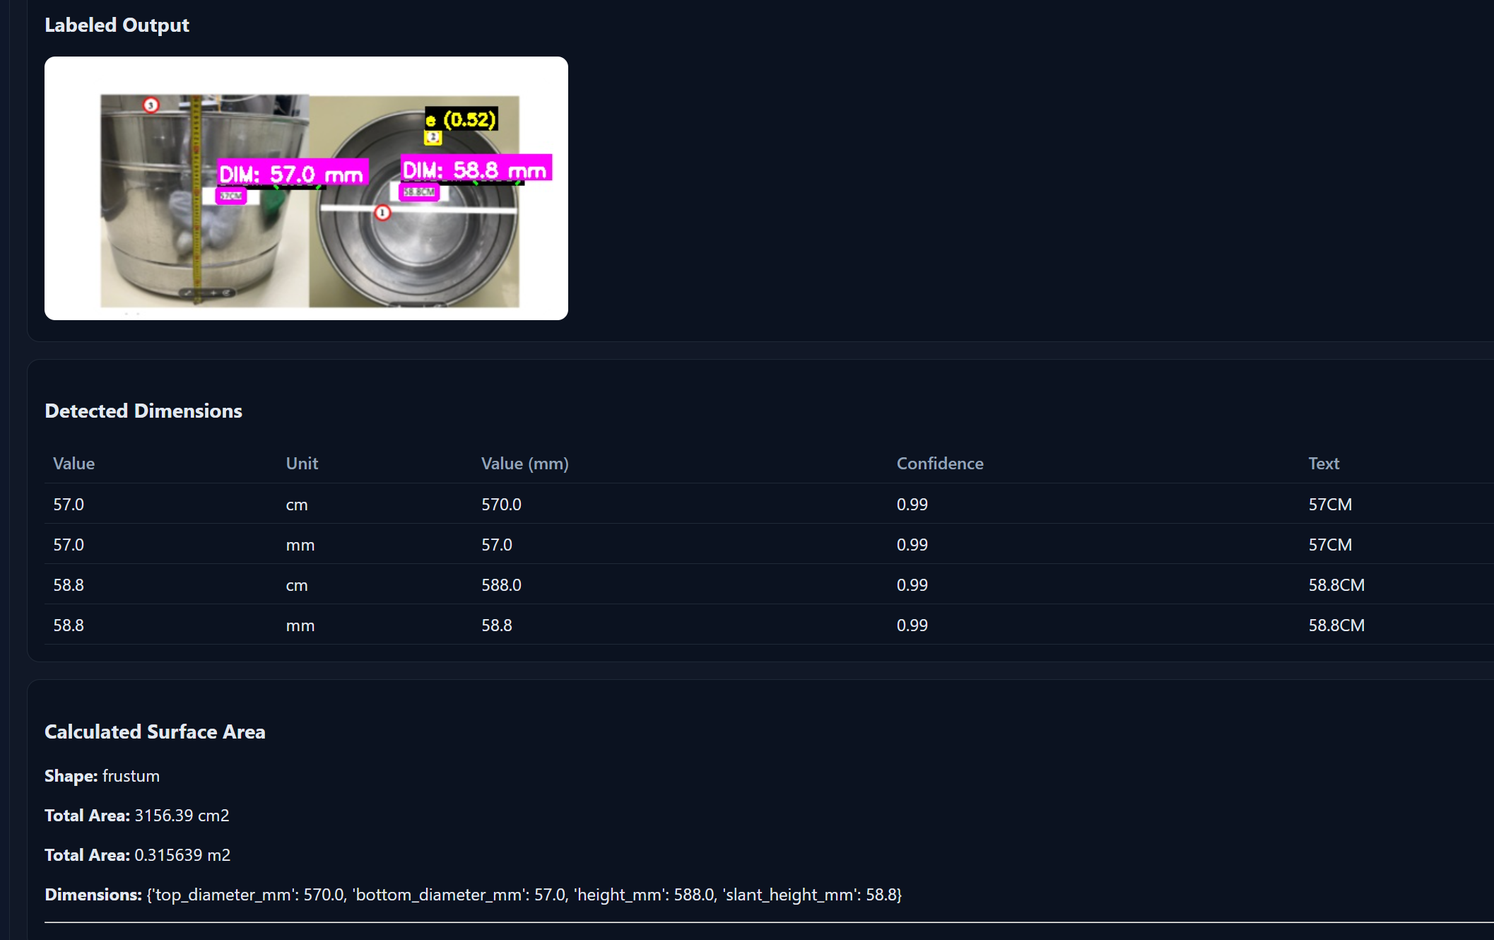
Sample Results

Slide 6
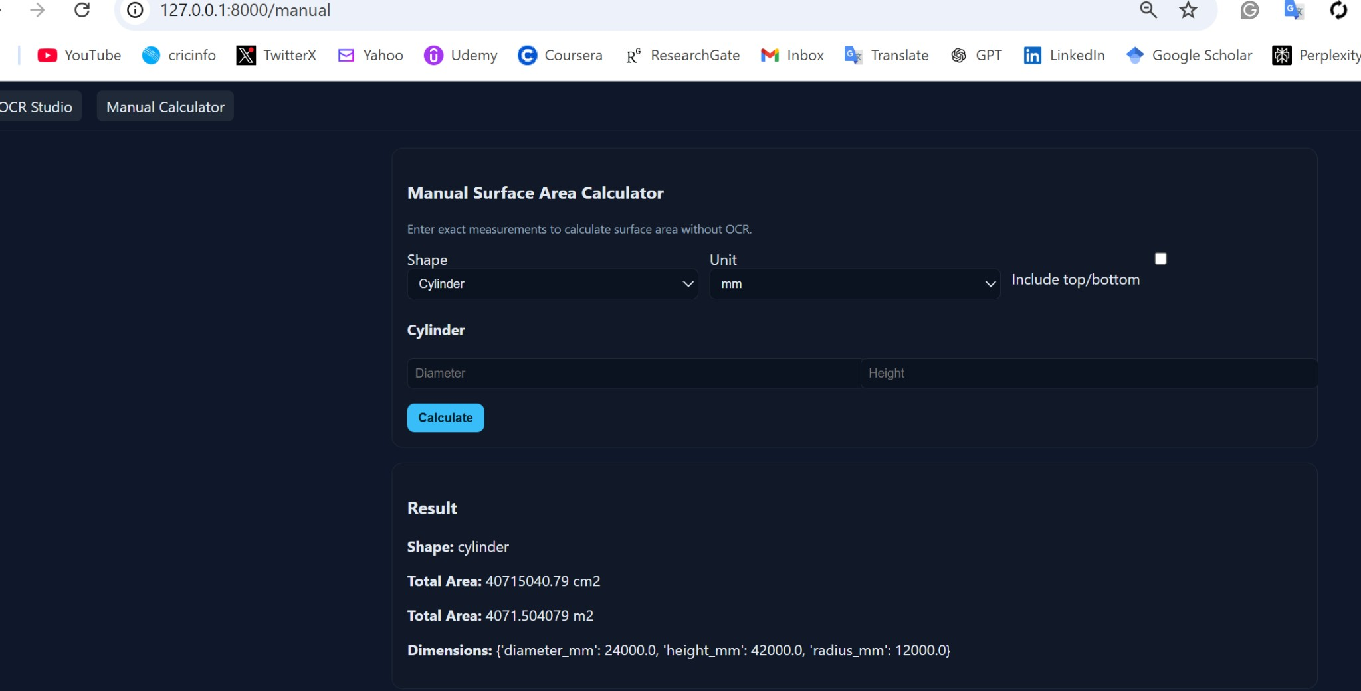
Sample Results

Slide 7
Next Steps
I will host the app online so more people can use it easily.
Improve OCR accuracy on new dataset images.
Add more equipment types and measurement rules.
Collect feedback and iterate on the UI.

