Slide 1
Industrial OCR Measurement Tool
Progress summary and next steps

Slide 2
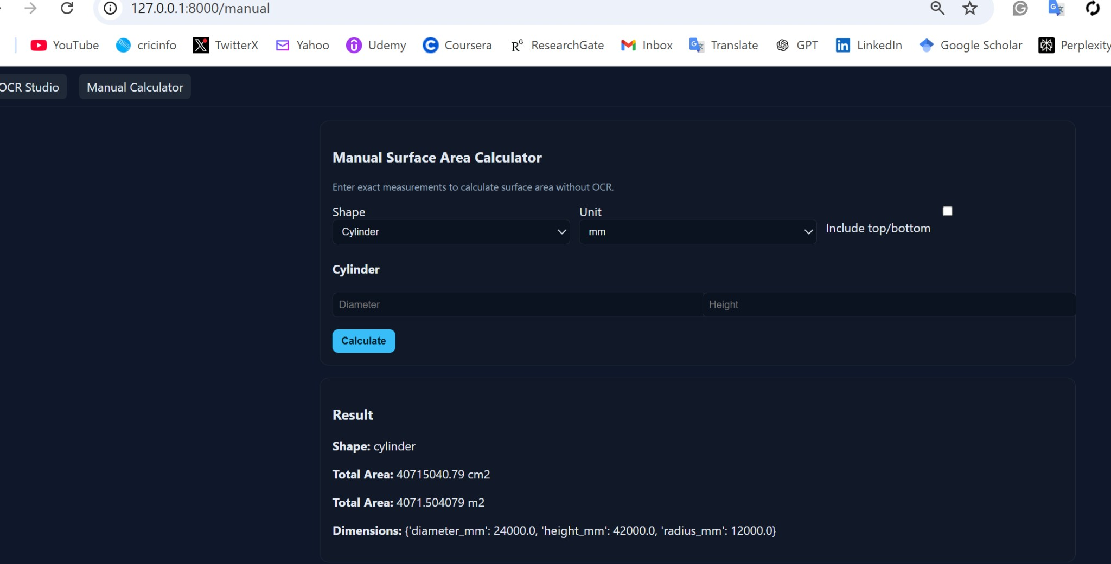
What we did and what comes next
Built a local web app to upload images and extract dimensions with OCR.
Added visualization output and surface-area calculations for common equipment shapes.
Stabilized dependencies to keep the app running on Windows.
Created a clean UI for OCR results and a separate manual calculator.
Next: I will host the app online so more people can use it easily.

