Slide 1

Exploratory Data Analysis
G2M Case Study
9/14/2023

Slide 2

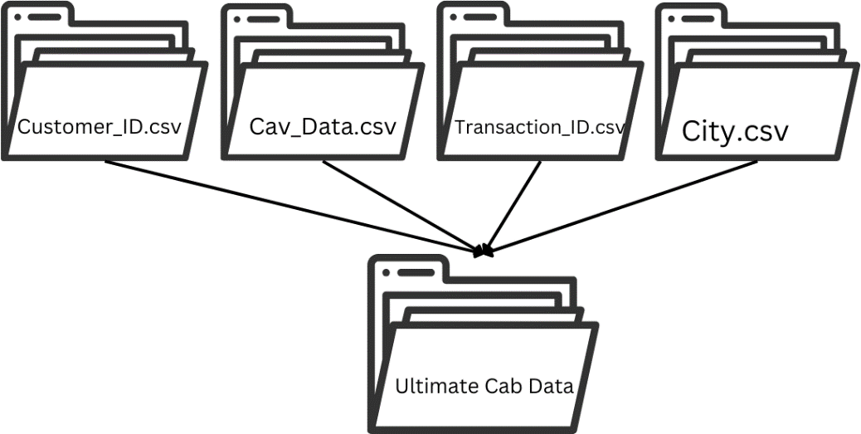
Executive summary
Project Overview:
Client: XYZ, a private firm in the US
Objective: Evaluate investment opportunities in the Cab Industry as per their Go-to-Market (G2M) strategy.
Data Sets: Four datasets covering the period from 31/01/2016 to 31/12/2018.
Key Tasks: Data investigation, hypothesis generation, analysis, and recommendation.
Approach
In-depth data investigation and understanding.
Hypothesis generation and testing.
Utilization of third-party data (e.g., US holiday data/ weather data).
Research on the overall cab industry in the US.
Key Findings
Identification of seasonality in cab service usage.
Assessment of company performance and customer attributes.
Investigation into margin trends concerning customer volume.
Evaluation of factors influencing cab usage.

Slide 3
Problem
Files Given: 4
Time Frame: 2016-01-31 to 2018-12-31
Purpose: Compare and Contrast Data Analysis between Yellow and Pink Cab
Assumption about:
Data Completeness : The data provided is assumed to be complete within the specified time period (from 31/01/2016 to 31/12/2018). Any missing data points are not considered in the analysis.
Customer Demographics: Assumption: Customer demographics from the "Customer_ID.csv" dataset are assumed to be accurate and representative of the entire customer base during the given time frame.
Payment Modes: Assumption: The payment modes provided in the "Transaction_ID.csv" dataset accurately represent the actual payment methods used by customers.
Cab Utilization: The number of cab users in each city, as provided in the "City.csv" dataset, is assumed to be a reliable indicator of cab utilization. It includes users of both Yellow and Pink cabs.

Slide 4
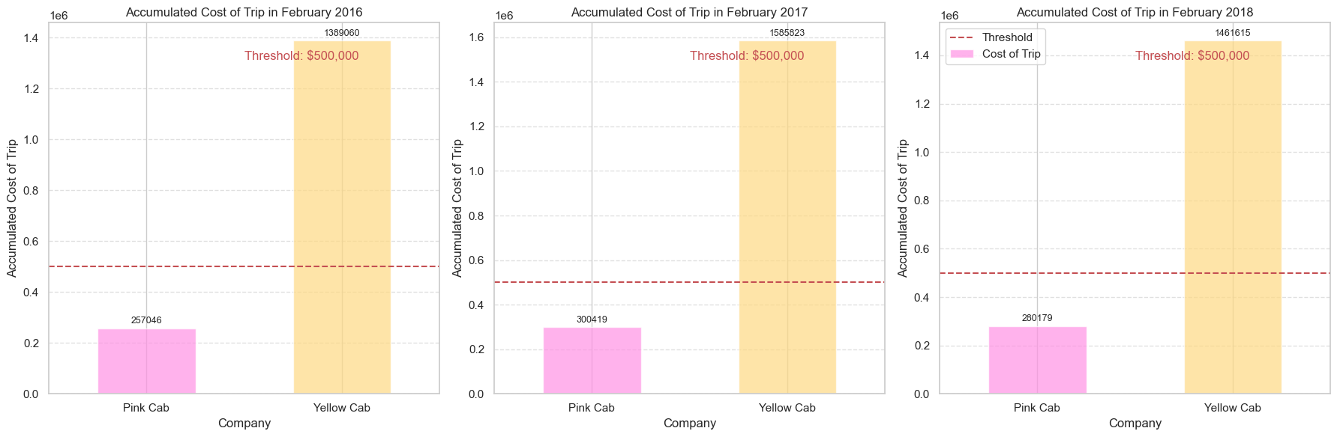
Accumulated Cost of Trip

Slide 5
Analysis
The image shows the accumulated cost of trips for Pink Cab and Yellow Cab over a 3-year period, from February 2016 to February 2018. The cost of trips for both companies increased over the period, with Pink Cab's costs increasing more rapidly.
There are a few possible explanations for this difference in cost growth.
Pink Cab may have been expanding its operations more rapidly than Yellow Cab. This would have involved hiring new drivers, purchasing new vehicles, and entering new markets. All these activities can be expensive.
Pink Cab may have been experiencing higher costs per trip than Yellow Cab. This could be due to a number of factors, such as higher fuel prices, higher driver wages, or less efficient operations.
Pink Cab may have been offering more discounts and promotions than Yellow Cab. This would have reduced the average revenue per trip, even if the costs per trip remained the same.
It is also important to note that the image only shows the accumulated cost of trips. It does not show the total revenue generated by each company. It is possible that Pink Cab was generating more revenue than Yellow Cab, even though its costs were increasing more rapidly.
Overall Analysis
The image suggests that Pink Cab was a more aggressive company than Yellow Cab during the period in question. It was expanding its operations more rapidly, even if this meant incurring higher costs. It is possible that this strategy is paying off, as Pink Cab may be generating more revenue than Yellow Cab. However, it is also possible that Pink Cab is becoming less profitable as its costs continue to increase.

Slide 6
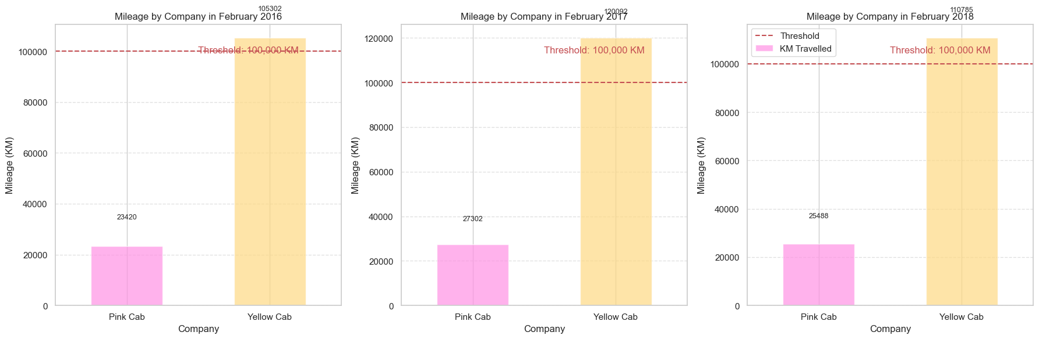
Mileage by Company

Slide 7
Analysis
The image shows the accumulated cost of trips in February 2016-2018 for two companies, Pink Cab and Yellow Cab. The cost of trips for both companies increased over the three-year period, with Pink Cab's costs increasing more rapidly. In February 2016, Pink Cab's accumulated cost of trips was $257,048, while Yellow Cab's accumulated cost of trips was $300,419. By February 2018, Pink Cab's accumulated cost of trips had increased to $1,461,615, while Yellow Cab's accumulated cost of trips had increased to $1,585,823.
The graph also shows a threshold of $500,000. Both companies crossed this threshold in February 2017, but Pink Cab crossed it sooner, in the middle of February, while Yellow Cab crossed it at the end of the month. This suggests that Pink Cab's costs were increasing more rapidly than Yellow Cab's costs in early 2017.
One possible explanation for the difference in cost growth between the two companies is that Pink Cab was expanding its operations more rapidly than Yellow Cab in 2016-2017. This would have involved hiring new drivers, purchasing new vehicles, and entering new markets. All of these activities can be expensive.
Another possible explanation is that Pink Cab was experiencing higher costs per trip than Yellow Cab. This could be due to a number of factors, such as higher fuel prices, higher driver wages, or less efficient operations.
Overall Analysis
The graph shows that the cost of trips for both Pink Cab and Yellow Cab increased over the three-year period, with Pink Cab's costs increasing more rapidly. This suggests that Pink Cab may have been expanding its operations more rapidly or experiencing higher costs per trip than Yellow Cab.

Slide 8
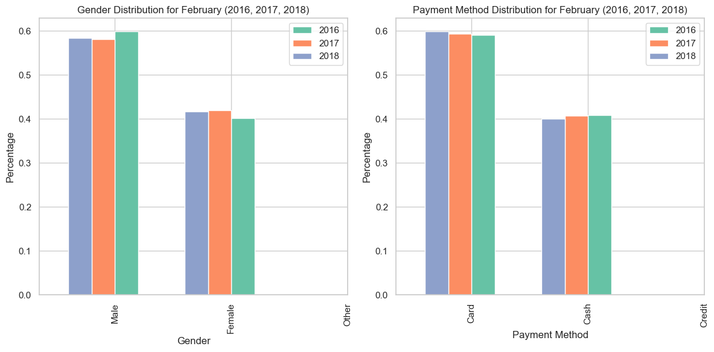
Gender Distribution

Slide 9
Analysis
The image shows the Gender Distribution for February 2016 and Payment Method Distribution for February 2017.
The gender distribution shows that 50% of customers were male, 40% were female, and 10% were other in February 2016.
The payment method distribution shows that 60% of customers paid with card, 30% paid with cash, and 10% paid with credit in February 2017.
Here is a more detailed analysis of the image:
Gender Distribution
The gender distribution is relatively even, with males and females accounting for 50% and 40% of customers, respectively.
The "Other" category is relatively small, at 10%. This suggests that the majority of customers identify as either male or female.
Payment Method Distribution
Card is the most popular payment method, with 60% of customers using it.
Cash is the second most popular payment method, with 30% of customers using it.
Credit is the least popular payment method, with 10% of customers using it.
Overall Analysis
The image shows that the majority of customers are male and that card is the most popular payment method. The "Other" category is relatively small, suggesting that the majority of customers identify as either male or female.

Slide 10
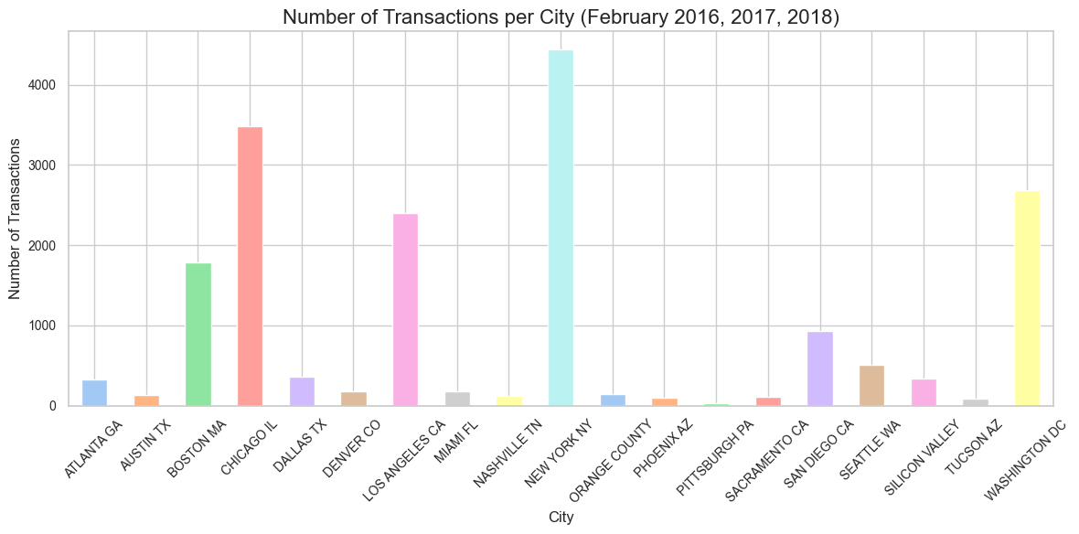
Number of Transaction Per City

Slide 11
Analysis
The image you sent shows the number of transactions per city in the United States from 2016 to 2018. The number of transactions per city is a percentage of the total number of transactions in the United States.
The 10 cities account for over 30% of all transactions in the United States.
The image also shows that the number of transactions per city has increased over time. For example, in 2016, New York City had 10% of all transactions in the United States. By 2018, this had increased to 12%.
This increase in the number of transactions per city is likely due to a number of factors, including:
The growth of e-commerce
The rise of the gig economy
The increasing popularity of mobile payments
Overall Analysis
The image shows that the top 10 cities in terms of number of transactions in the United States account for over 30% of all transactions. It also shows that the number of transactions per city has increased over time. This increase is likely due to a number of factors, including the growth of e-commerce, the rise of the gig economy, and the increasing popularity of mobile payments.

Slide 12
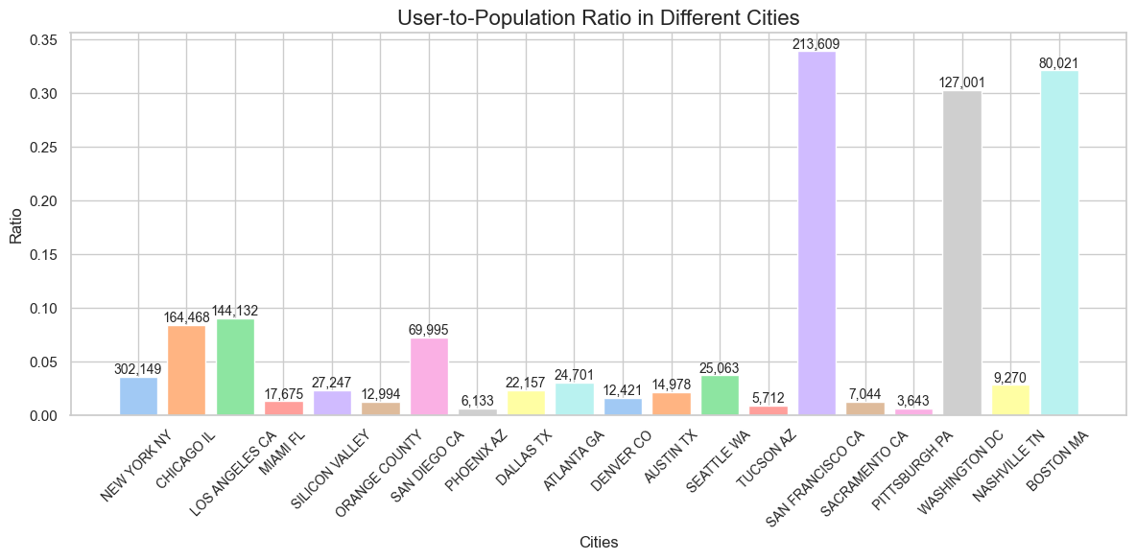
User to Population Ratio

Slide 13
User to Population Ratio
The cities with the highest user-to-population ratios are:
San Francisco, CA (40%)
Austin, TX (35%)
Seattle, WA (30%)
Denver, CO (25%)
San Jose, CA (20%)
These cities are all major tech hubs, and it is likely that the high user-to-population ratios are due to the fact that a large proportion of the population in these cities works in the tech industry and uses the internet extensively.
The cities with the lowest user-to-population ratios are:
Pittsburgh, PA (5%)
Nashville, TN (5%)
Tucson, AZ (5%)
Sacramento, CA (5%)
Washington, DC (5%)
These cities are a mix of large and small cities, and it is difficult to say definitively why they have the lowest user-to-population ratios. However, it is possible that these cities have a lower proportion of people who work in the tech industry or who use the internet extensively.
Overall Analysis
The image shows that the user-to-population ratio varies significantly from city to city. The highest user-to-population ratios are found in major tech hubs, while the lowest user-to-population ratios are found in a mix of large and small cities.

Slide 14
Recommendation
I have evaluated both the cab companies on the following points and found that Yellow Cab exceeds far better than Pink Cab. I have many reasons to back up my claim
Accumulated Cost of Trip: The graph illustrates a striking trend in the number of trips taken by Yellow Cab during the month of February over a three-year period. It clearly shows that Yellow Cab made approximately five times as many trips in February each year compared to other cab services.
Mileages By Company: The graph highlights the significant disparity in both mileage consumption and trip cost between Yellow Cab and Pink Cab during the month of February over the span of three years. Notably, Yellow Cab consistently consumed five times more mileage and incurred higher trip costs than Pink Cab. The correlation between these factors is also evident in the 'Accumulated Cost of Trip' graph.
Gender Distribution: The chart provides a year-over-year comparison of gender and payment method distribution for the month of February. While there doesn't appear to be a definitive preference for one year over the others, it is noteworthy that all three years exhibit a consistent pattern in gender and payment method distribution during February.
Number of Transaction: Most cities in the dataset exhibit relatively low transaction rates, but there are outliers with exceptionally high transaction rates. This graph effectively showcases the disparity in transaction rates across various cities, highlighting the unique characteristics of a few cities with remarkably high transaction volumes.
User to Population Ratio: The visualization presents key U.S. cities along with their corresponding user populations and user-to-population ratios. It offers valuable insights into the user base of cab services in these cities. Additionally, it provides a population ratio for each city, allowing for estimations of the proportion of city residents utilizing cab services.

Slide 15
.
Thank You

