Slide 1
CodeFlow Project
Group Members:
Muhammad Haseeb Nawaz
Muhammad Mujeeb
Rohan Qamar
Advisor: Mohsin Sami

Slide 2
Project Motivation
Challenges in Programming Education
Abstract nature of code.
Complexity in creating logical program flows.
Lack of user-friendly tools for beginners.
Objective
Simplify programming concepts.
Improve comprehension and problem-solving skills.
Boost confidence among novice programmers.

Slide 3
Project Description
CodeFlow
A web-based platform for novice programmers.
Key Features
Drag-and-drop flowchart creation.
Accurate flowchart-to-code and code-to-flowchart Conversion.
Step-by-step program execution with memory map visualization.

Slide 4
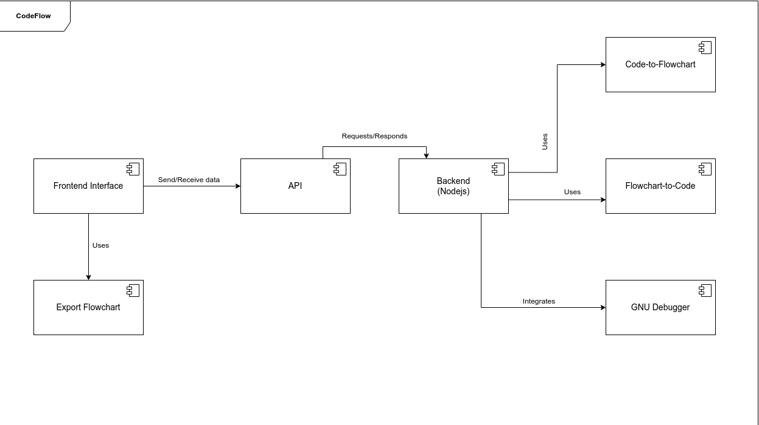
Diagrams - Component Diagram

Slide 5
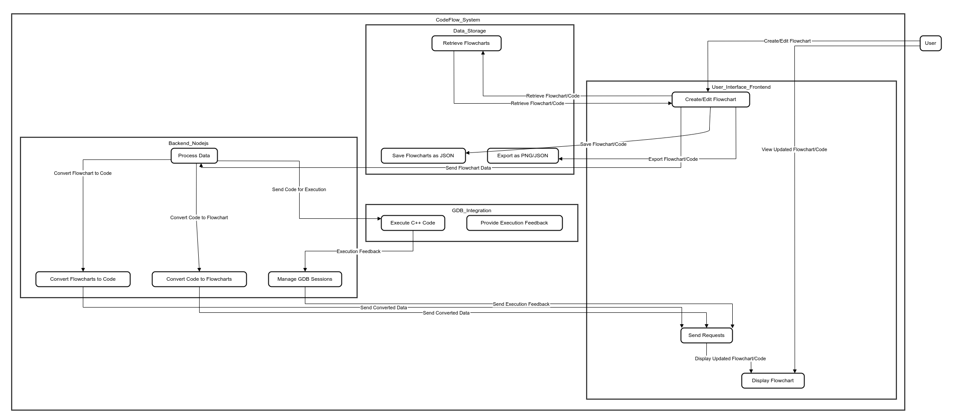
Diagrams - Data Flow Diagram (DFD)

Slide 6
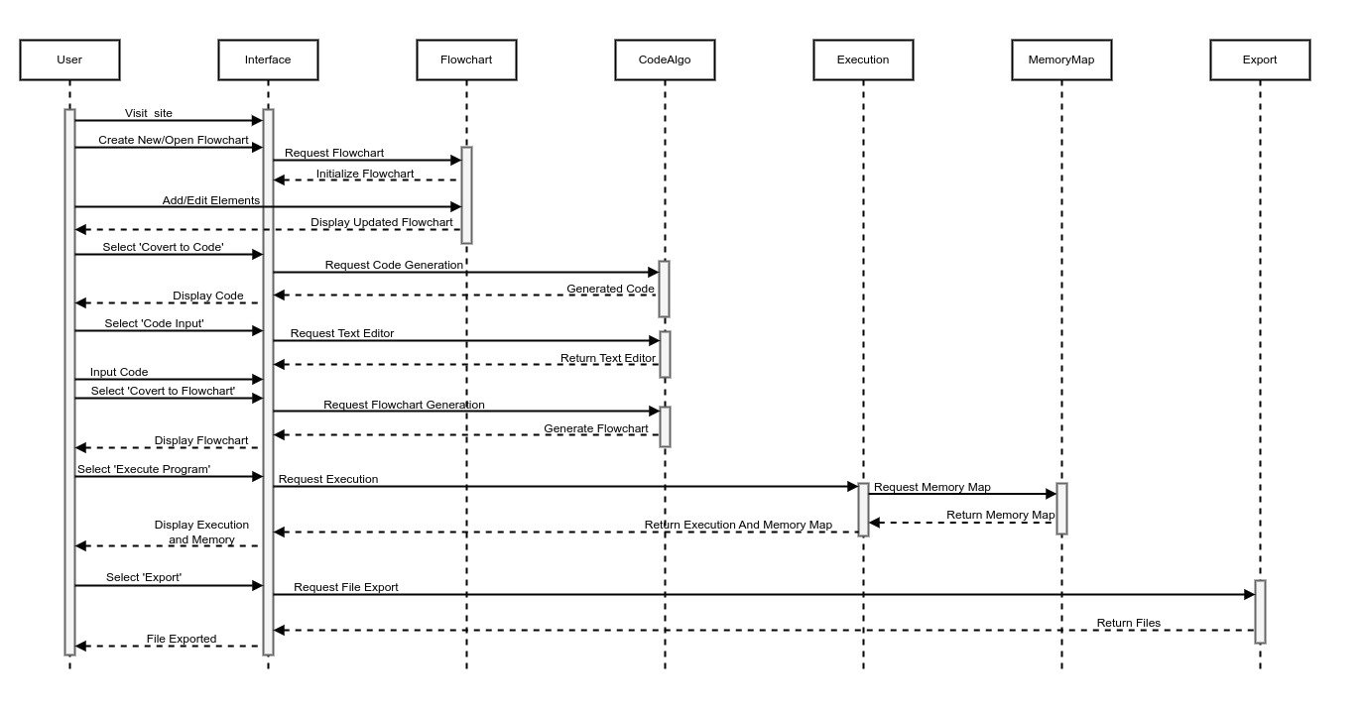
Diagrams - Sequence Diagram

Slide 7
Screenshots

Slide 8
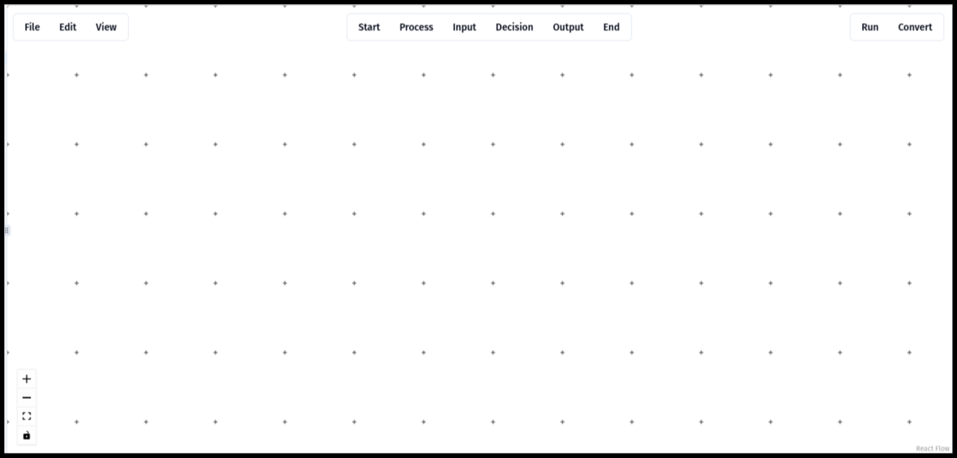

Slide 9
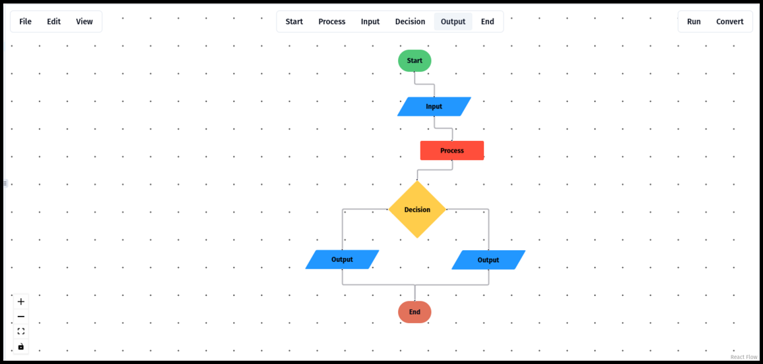

Slide 10
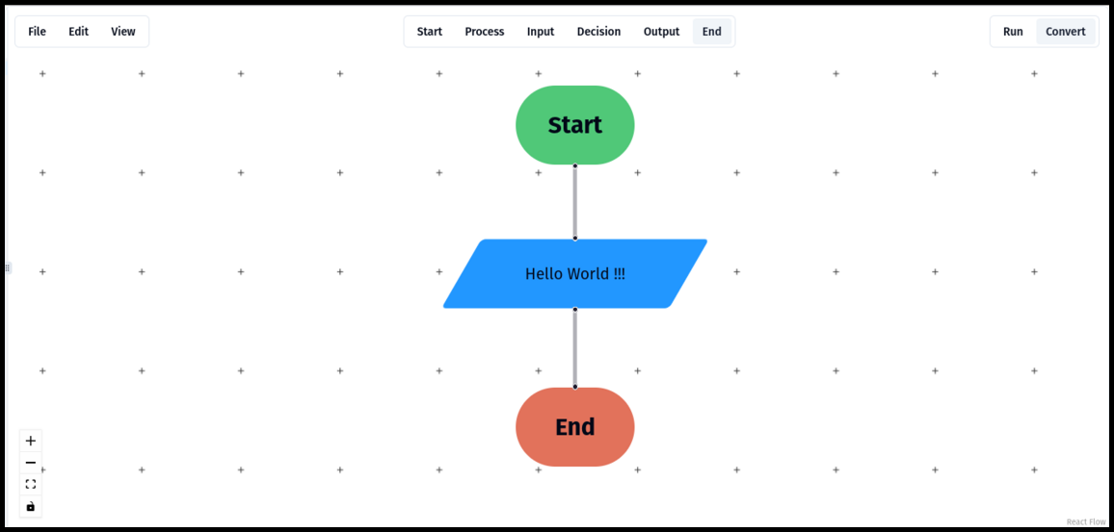

Slide 11
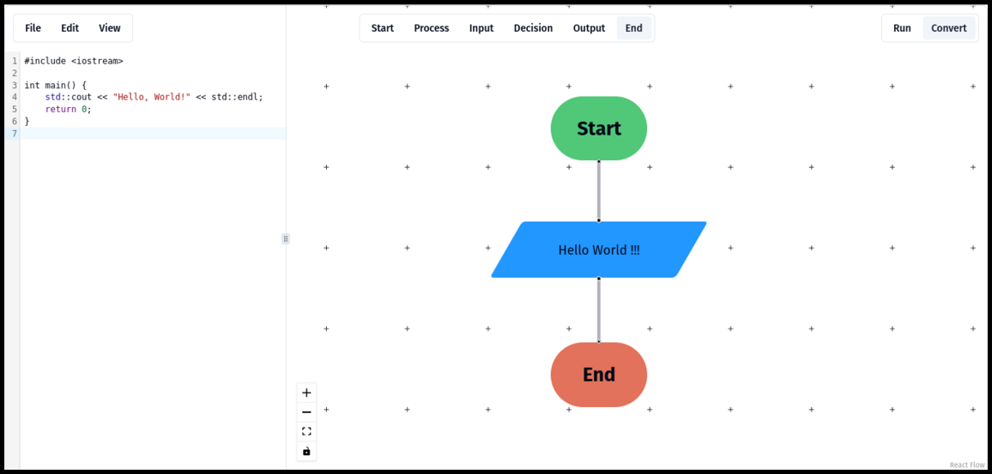

Slide 12
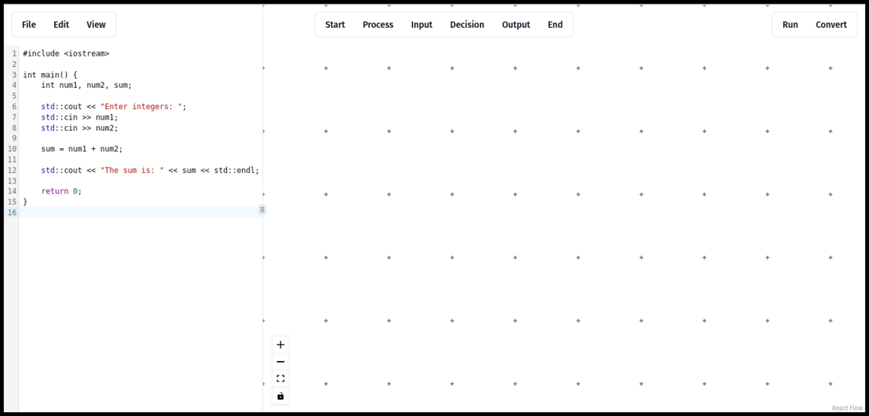

Slide 13
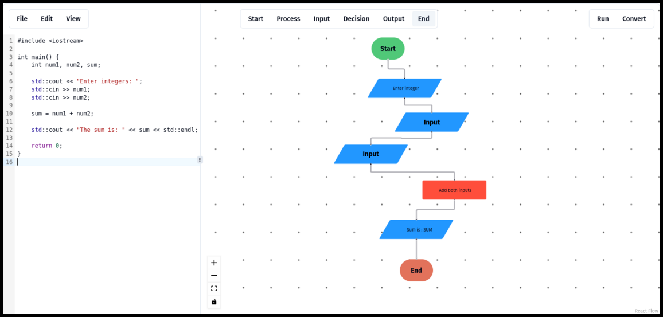

Slide 14
Future Plans & Enhancements
Short-Term Goals
Enhance program execution functionality.
Improve user interface based on feedback.
Enhance flowchart-to-code conversion accuracy.
Long-Term Goals
Integrate additional programming languages.
Develop mobile-friendly version.
Add collaborative features for team projects.
Implement AI-based code suggestion and error detection.

Slide 15
Conclusion
CodeFlow
Innovative solution for programming education.
Bridges gap between visual and textual programming.
Empowers novice programmers with intuitive tools.
Acknowledgments
Special thanks to project advisor Mohsin Sami for their support.

