Slide 1
CodeFlow: Bridging The Gap in Programming Education
Group Members
Muhamad Haseeb Nawaz
Muhammad Mujeeb
Rohan Qamar

Slide 2
What is CodeFlow?
Web-Based Visual IDE
Interactive Flowchart Builder
Flowchart-to-Code Conversion
Code-to-Flowchart Conversion
Step-by-Step Code Execution
Real-Time Memory Map

Slide 3
Why CodeFlow ?
CodeFlow addresses the critical gap learners face transitioning from flowchart logic to coding, by providing a tool that translates visual flowcharts directly into executable code. This initiative aims to simplify the learning process, making programming more accessible and intuitive for beginners.

Slide 4
Developing Logic Through Assembling Flowchart Elements
Central Feature
Assemble code logic using drag and drop interactive flowchart elements.
Advantage
Intuitively construct code while understanding its underlying structure.

Slide 5
Logic Conversion Through converting Flowchart to code and vice versa
Translating Flowchart
to Code
CodeFlow generates code from your flowchart , making it easy to covert your visual logic of flowchart into textual code.
Translating Code to
Flowchart
CodeFlow generates flowcharts from your code in real-time, making it easy to understand and Visualize code logic through flowcharts

Slide 6
Guided Execution: Code in Action Step-by-step program execution and visualization
Step-by-Step Execution
Real-Time Visualizstion
Understanding Control Flow
CodeFlow offers a unique and immersive experience by allowing you to execute your code step by step.
As you step through your code, see each line in action in real time. Watch variables change and logic unfold before your eyes.
Gain understanding of how control flows through your program. Identify decision points, loops, and branching paths as they occur.

Slide 7
Memory Map Unveiling the Code’s Memory Playground
Real-Time Memory Allocation and Visualization
Visual representation of how a program’s variables are allocated and managed during execution. Making it easy for the user to understand how their code manipulates data in memory.

Slide 8
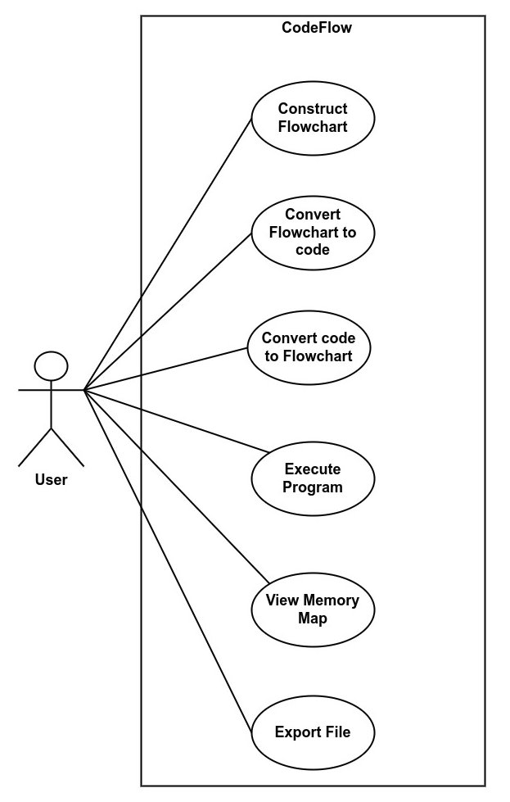
Use Case
Diagram

Slide 9
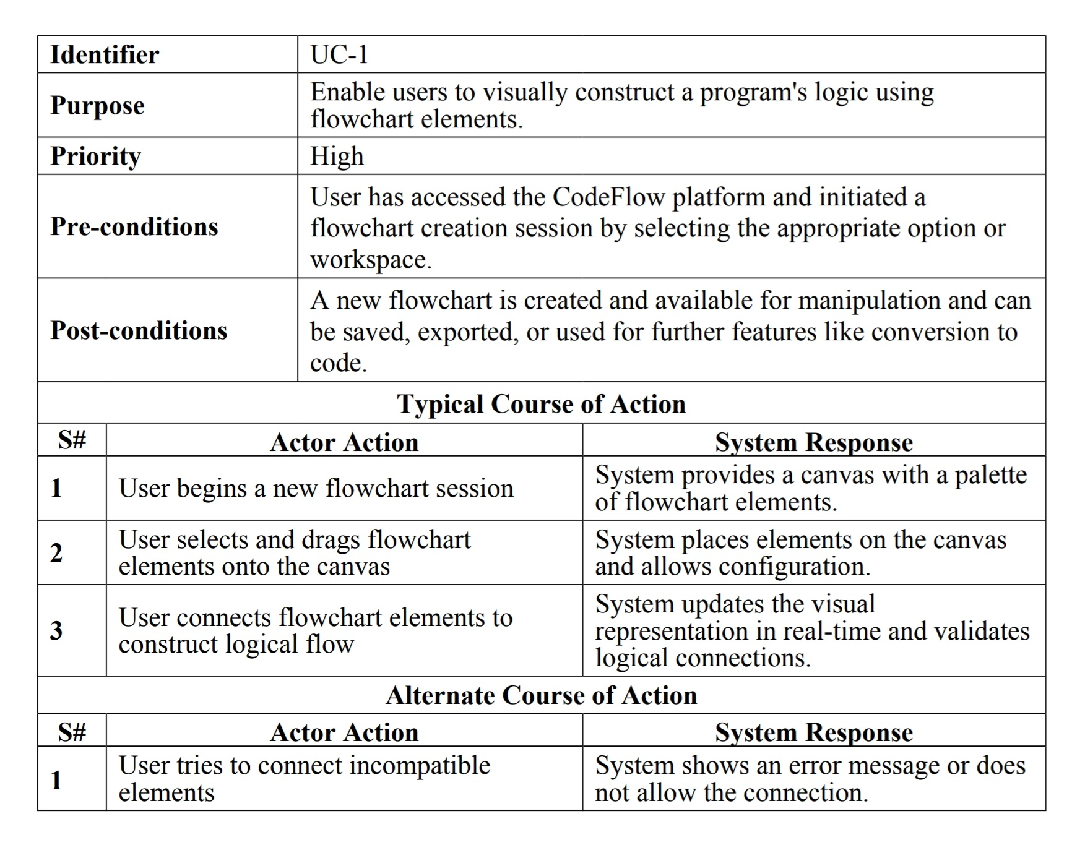

Slide 10
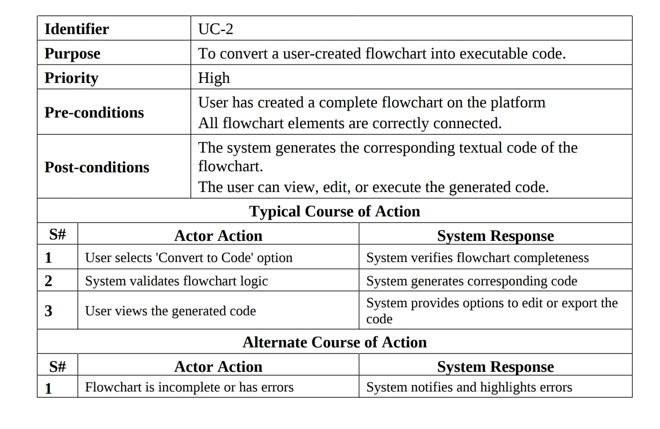

Slide 11
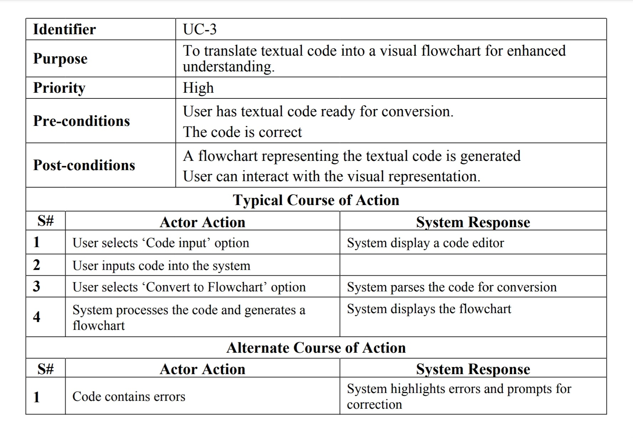

Slide 12
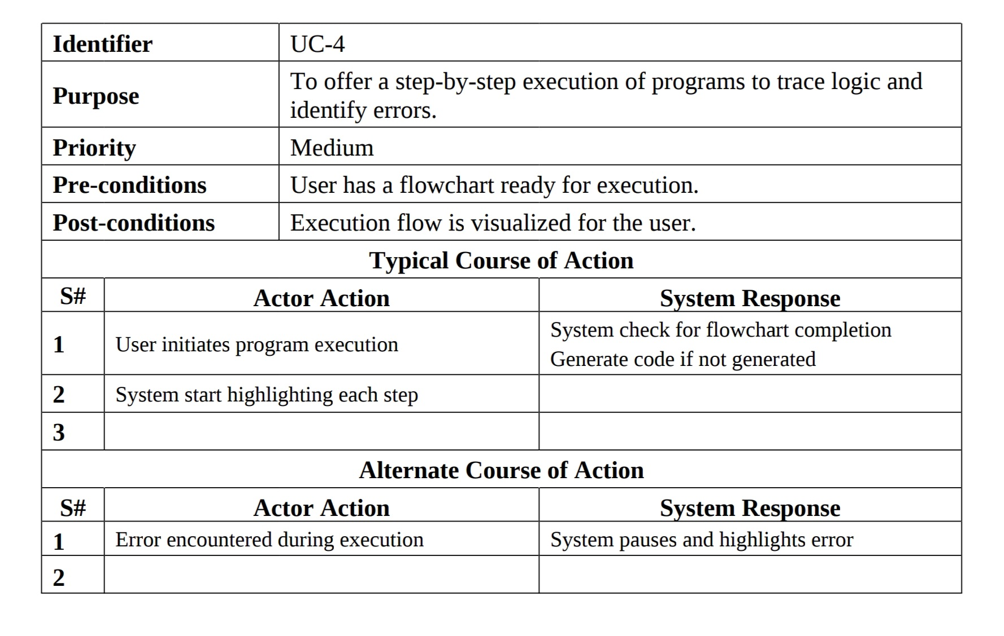

Slide 13
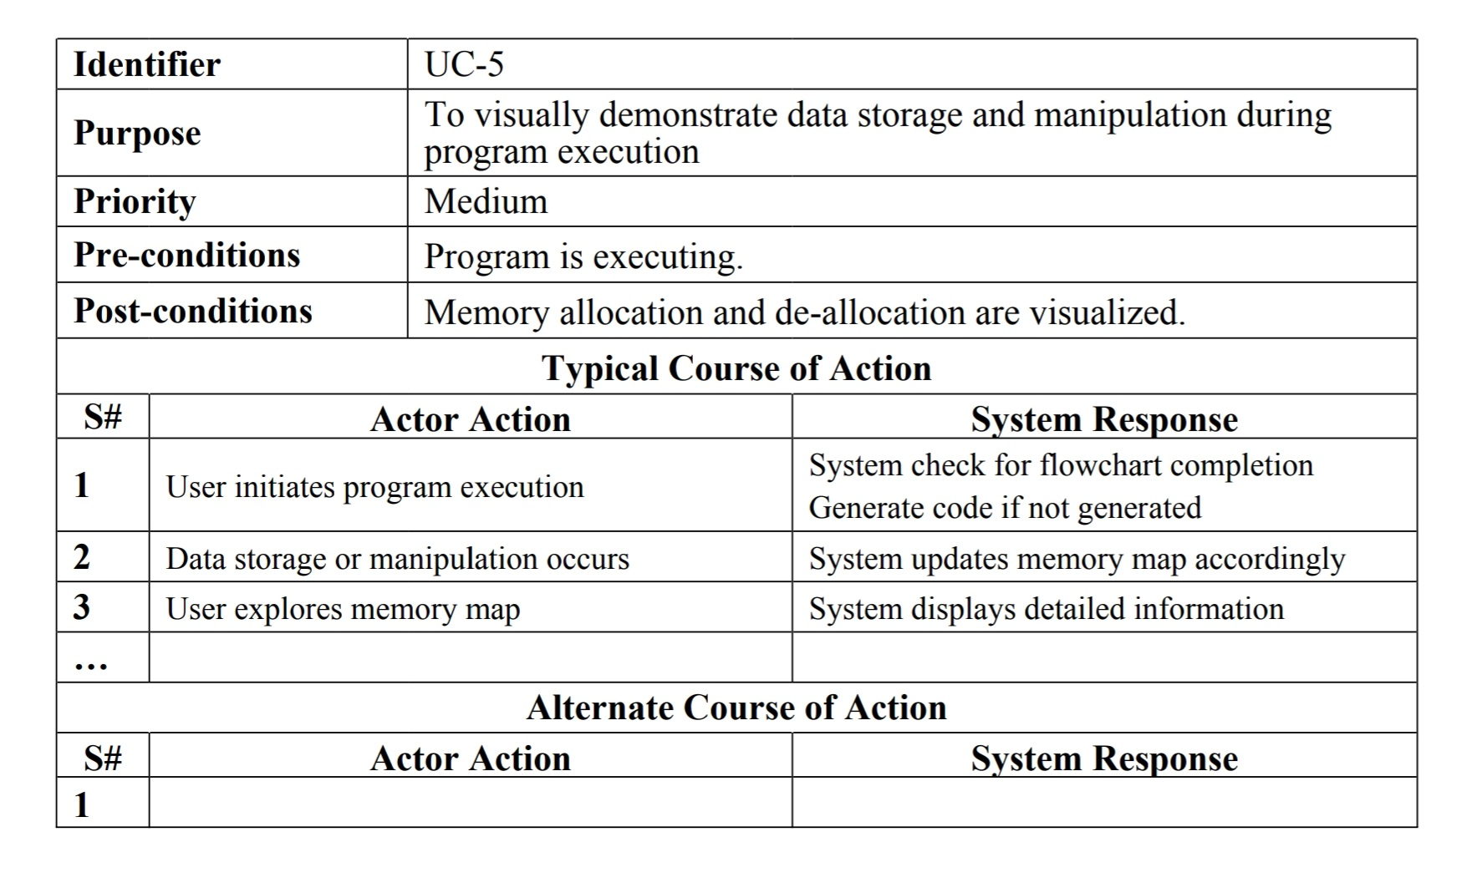

Slide 14
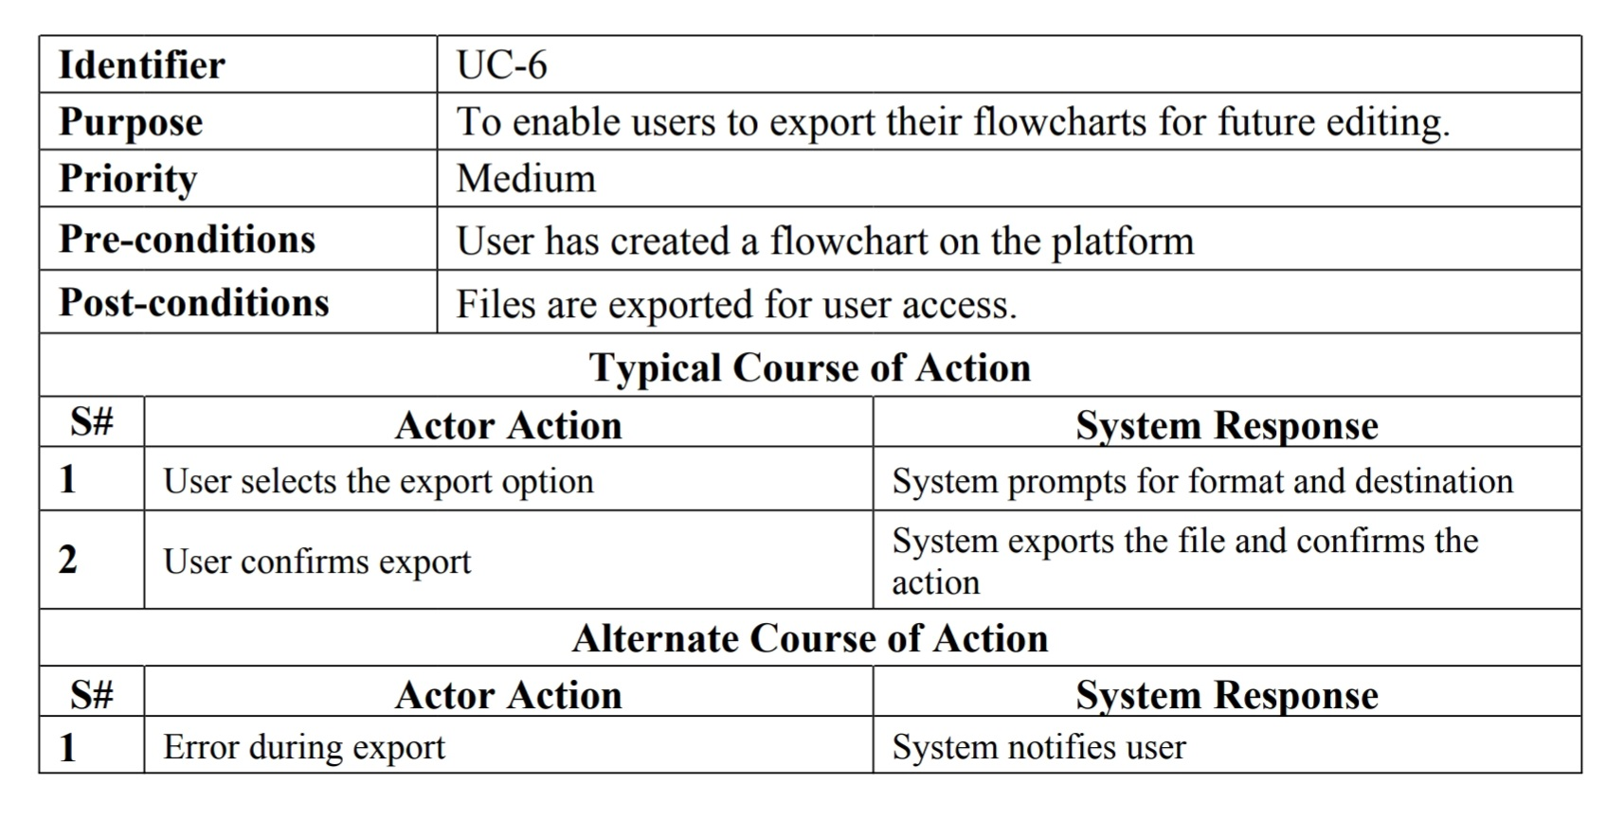

Slide 15
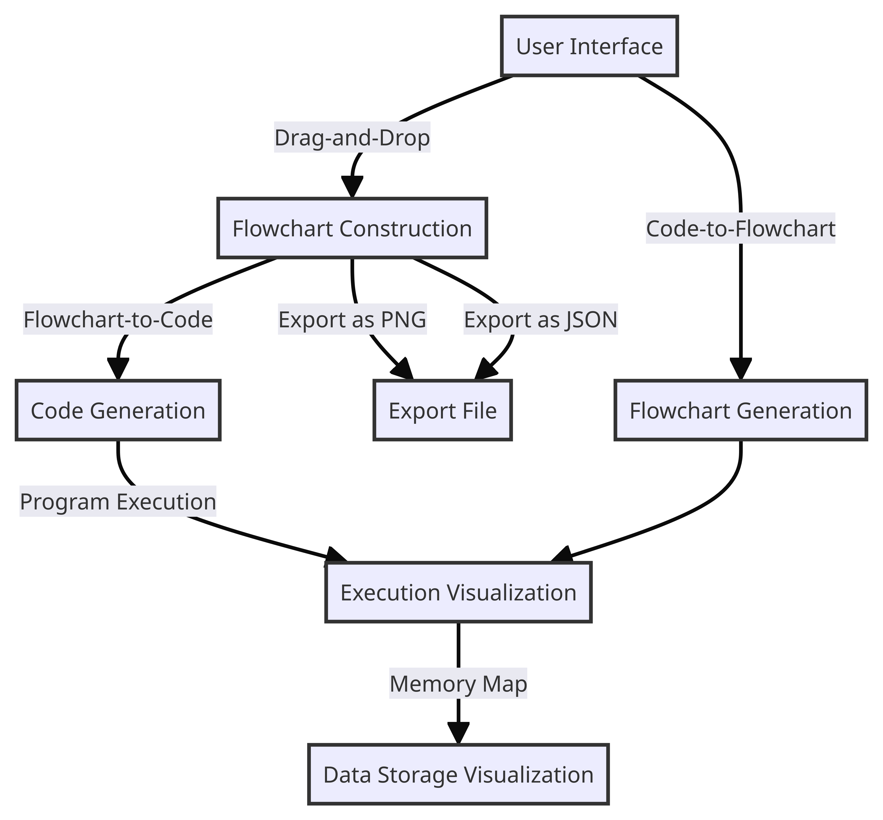
DataFlow Diagram

Slide 16
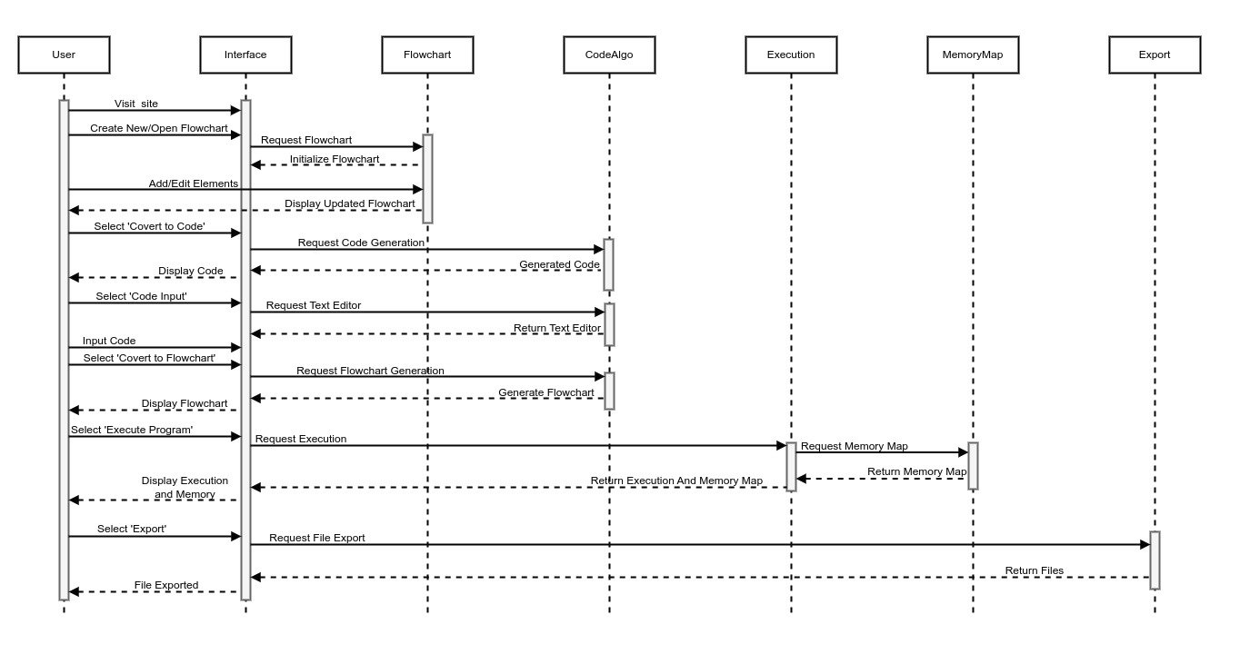
Sequence
Diagram

Slide 17
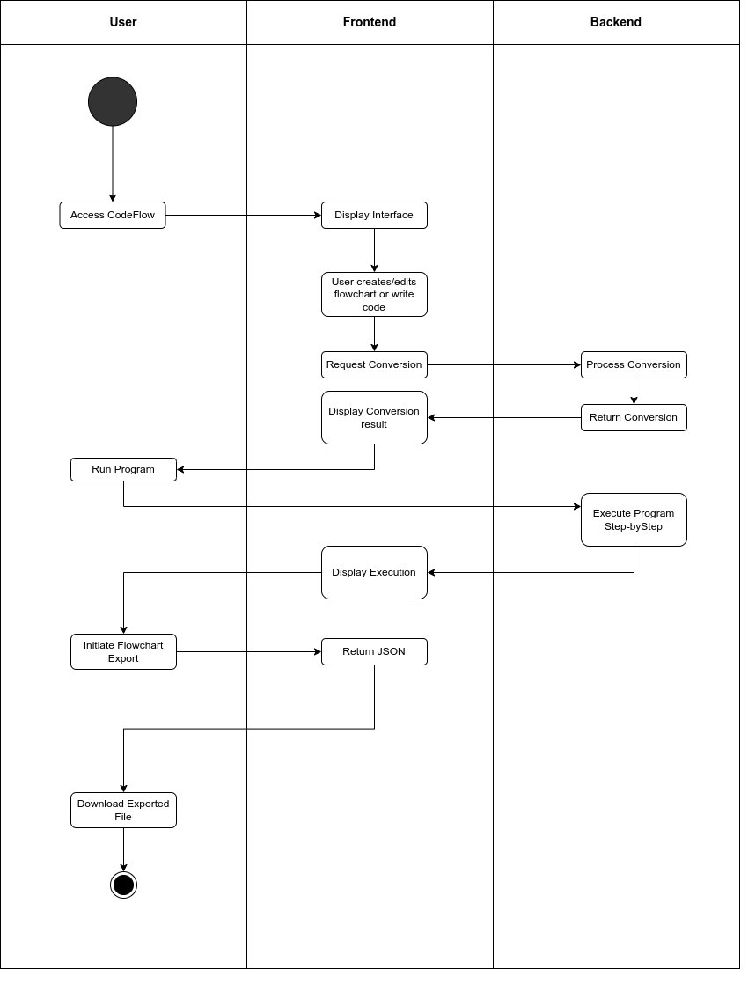
Work Flow

Slide 18
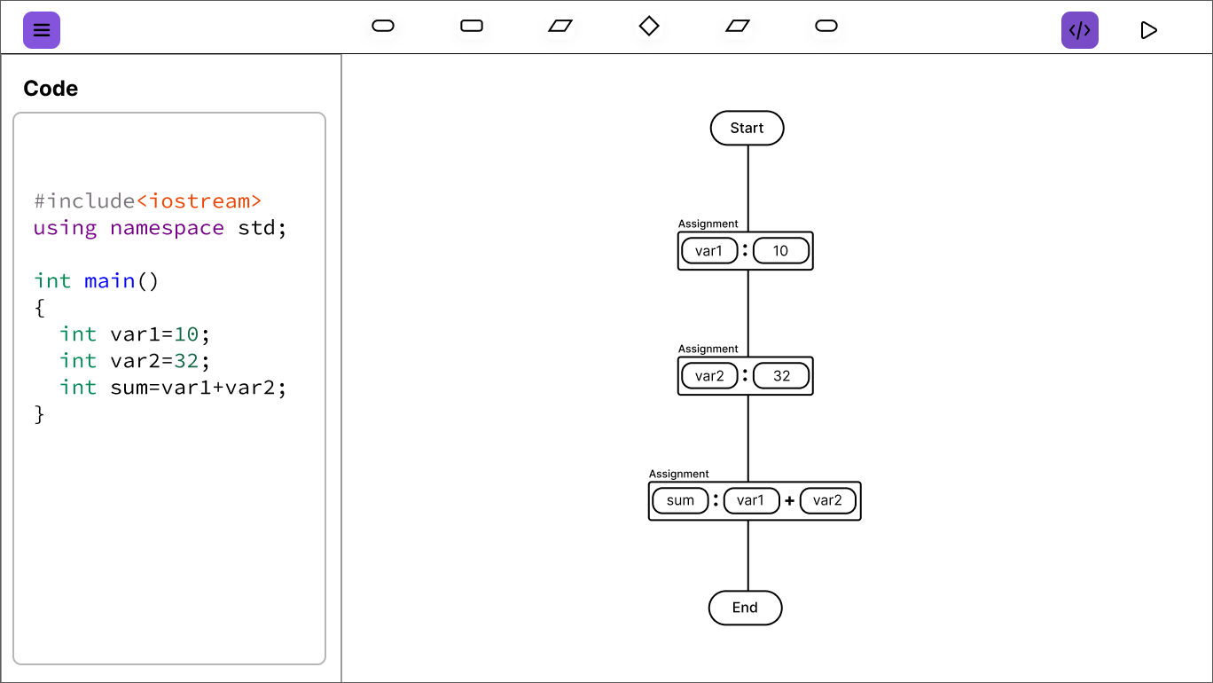

Slide 19
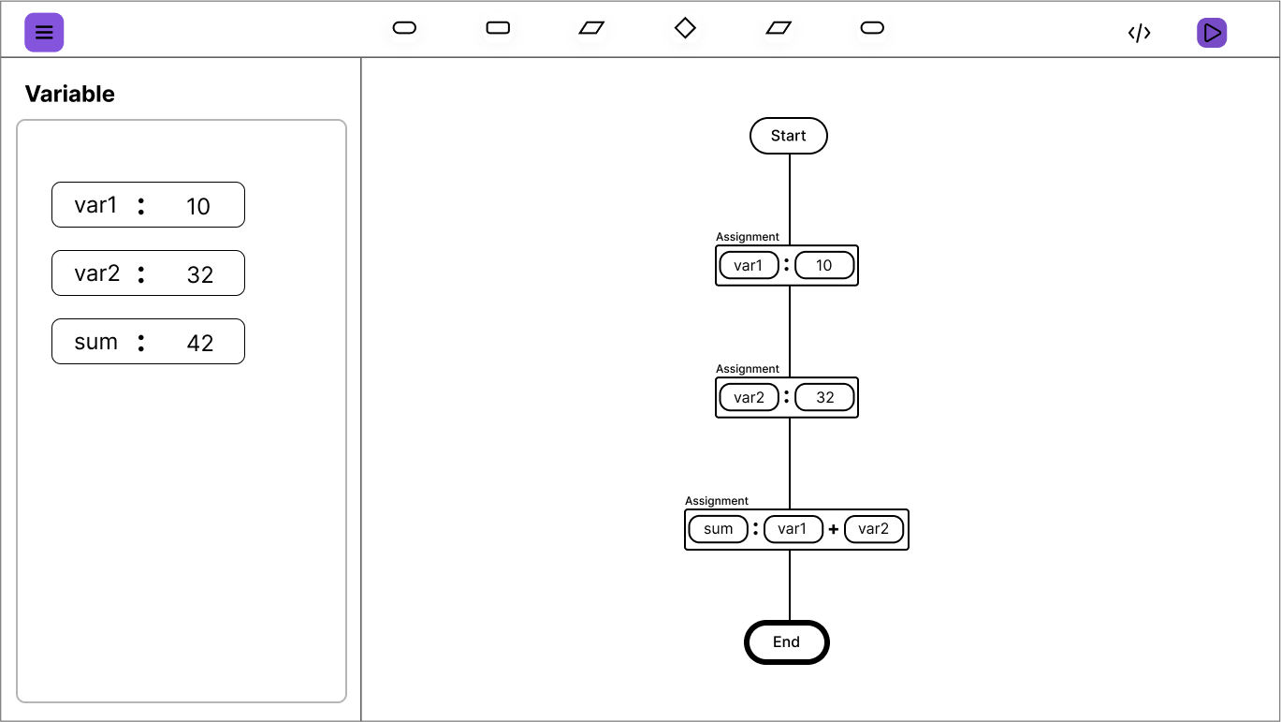

Slide 20
THANK YOU
Please feel free to ask any Questions

