Slide 1


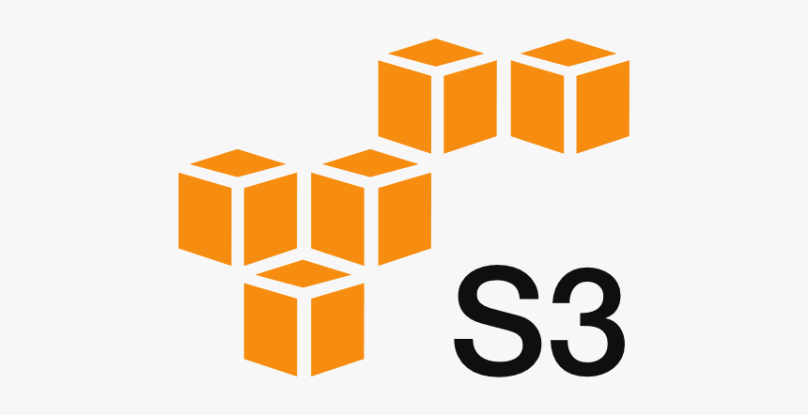
















A
API Gateway
SNS Push
Notification
/ Scheduler
AWS Lambda
A
gdelt-open-data
EKS for RT Processing
Model Deployment (API)
Amazon Athena
Amazon S3 (Raw, Refined)
Realtime/NRT Processing Layer
Validation Engine
Amazon RDS
Batch/Analytics Processing Layer
S&P 500 Data lake Formation
Glue Crawlers
ETL on gdelt open data
Data Catalog
Amazon Redshift
Search Service (Kibana)
Model Development
Lifecycle
External
Internal
Amazon QuickSight
B
A
Model Training
B
B
Data Ingestion Layer
Data Storage Layer
Data Usage / Processing Layer
Data Consumption Layer
Notes:
AWS Architecture Icons: AWS Architecture Icons (amazon.com)

