Slide 1



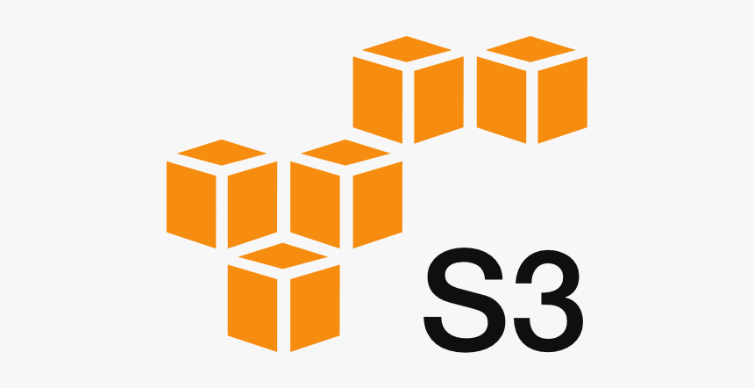














EKS for RT Processing
API Gateway
AWS Lambda
Model Deployment (API)
SNS Push Notification
gdelt-open-data
Amazon S3 (Raw, Refined)
Amazon Athena
Realtime/NRT Processing Layer
Amazon RDS
Batch/Analytics Processing Layer
S&P 500 Datalake Formation
Glue Crawlers
ETL on gdelt open data
Data Catalog
Amazon Redshift
Model Development Lifecycle
Search Service (Kibana)
Model Training
Amazon QuickSight
External Data Sources
Data Consumption Layer
Notes:
AWS Architecture Icons: AWS Architecture Icons (amazon.com)

