Slide 1


Chill Me Out: IntelliJ smart plugin
Department of Informatics | Technical University of Munich
Shaharyar Shaukat | Anand Devarajan | Yadunandan Kini | Hashir Ahmad
Jetbrains Challenge @ hackaTUM 2019
22. – 24. November, 2019

Slide 2
Department of Informatics | Technical University of Munich
Approach
„Chill Me Out!“ - Inspiration
What it does?
How we built it?
Challenges
Accomplishments
What we learned?
What’s next?
Shaharyar Shaukat | Anand Devarajan | Yadunandan Kini | Hashir Ahmad

Slide 3

Department of Informatics | Technical University of Munich
„Chill Me Out!“ - Inspiration
Coding is fun! But sometimes, stressful!
How do you manage stress?
What if your IDE could cheer you up while you code? Pretty cool, right!
That’s when Chill Me Out! dives in
Make your Dev life great again!
Shaharyar Shaukat | Anand Devarajan | Yadunandan Kini | Hashir Ahmad

Slide 4

Department of Informatics | Technical University of Munich
What it does?
Displays your stress level and suggests ideas to reduce stress
Prompt response from the IDE
You are 70% stressed. Take a break!
Here is a joke for you: “It hurts when IP”
Shaharyar Shaukat | Anand Devarajan | Yadunandan Kini | Hashir Ahmad

Slide 5
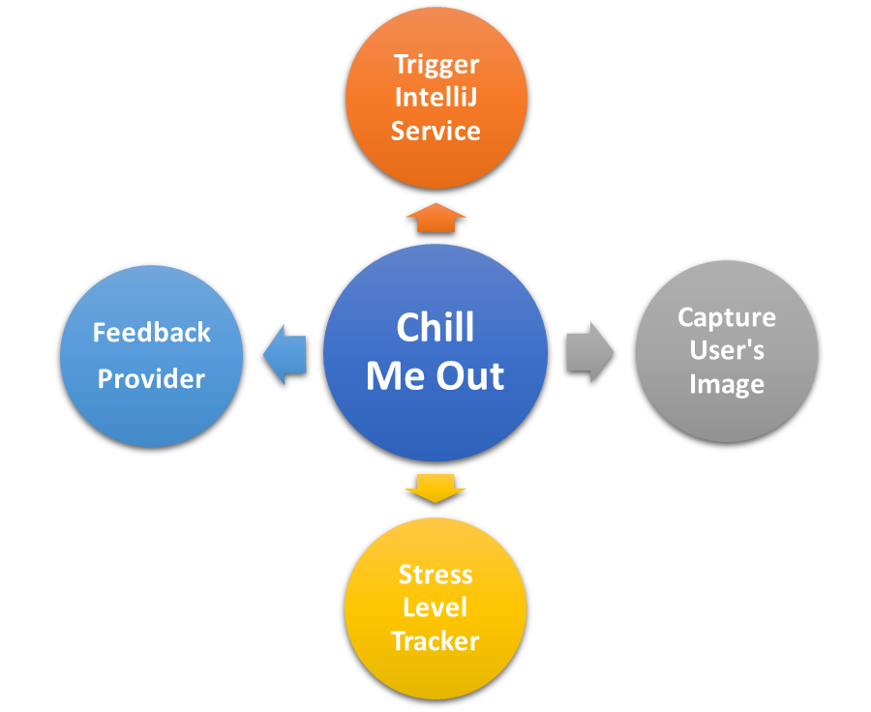
How we built it?
Department of Informatics | Technical University of Munich
Developed a Deep Learning Model which recognizes facial expressions
Display stress level on the basis of facial expressions
Developed an IntelliJ plugin which invokes the model
Provide feedback using the predicted stress level to the user on the IDE
Shaharyar Shaukat | Anand Devarajan | Yadunandan Kini | Hashir Ahmad

Slide 6
Challenges
Department of Informatics | Technical University of Munich
Real-time implementation of the Deep Learning Model
Synchronize output of model with the IntelliJ plugin
Invoke the model only when the user requires it
Provide a feedback based on the history of stress levels
Shaharyar Shaukat | Anand Devarajan | Yadunandan Kini | Hashir Ahmad

Slide 7
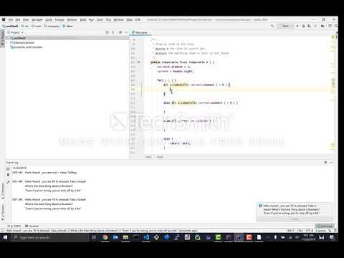
Accomplishments
Department of Informatics | Technical University of Munich
Shaharyar Shaukat | Anand Devarajan | Yadunandan Kini | Hashir Ahmad

Slide 8
What we learned?
Chair of Robotics, Artificial Intelligence and Real-Time Systems
Department of Informatics | Technical University of Munich
Coping with Stress!
Knowing more about yourself, how far can you push?
Turning an idea into a product
Sharing diverse perspectives
Shaharyar Shaukat | Anand Devarajan | Yadunandan Kini | Hashir Ahmad

Slide 9
What‘s next?
Department of Informatics | Technical University of Munich
Make Chill Me Out! a cross-platform service across all IntelliJ products
Improve the performance of the deep learning model – include variations in image profiles
Identify the code segments where the stress levels were high!
Shaharyar Shaukat | Anand Devarajan | Yadunandan Kini | Hashir Ahmad

Slide 10
Questions?

