Slide 1
EQUITY RESEARCH · CONFIDENTIAL
Robinhood is the aggressor
Coinbase vs. Robinhood — a full product-offering teardown across the new growth verticals
The answer. Across six product verticals, Robinhood leads three, Coinbase two, one is even — and Robinhood's are the consumer-facing, fastest-monetizing ones. Its prediction-market revenue already exceeds its crypto revenue.
CORE TRADING
DERIVATIVES & PERPS
PREDICTION MARKETS
TOKENIZATION / RWA
STABLECOINS & PAY
WEALTH & CONSUMER
EVEN
COIN
HOOD
HOOD
COIN
HOOD
As of 4 August 2026 · COIN Q2'26 revenue $1.2bn (-14% q/q) · HOOD Q2'26 revenue $1.31bn (+32% y/y) · first draft

Slide 2
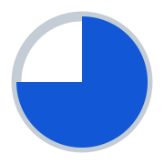
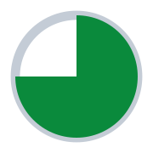

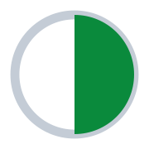
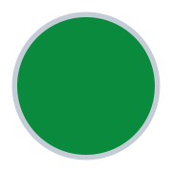
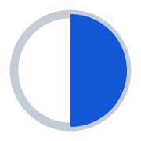
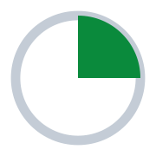

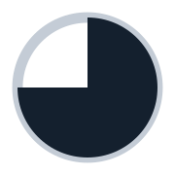
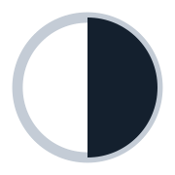
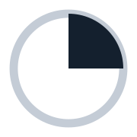

EXECUTIVE SUMMARY
Robinhood enters more categories faster; Coinbase goes deeper in two
Raw win-count is close, but Robinhood leads the consumer-facing verticals where new-product revenue is compounding fastest.
01
Robinhood is expanding across the whole retail-finance surface
POSITION BY VERTICAL
Prediction-market exchange (Rothera), tokenized equities, its own L2, multi-asset perps, banking, retirement, RIA custody and credit cards — most shipped in ~18 months.
COIN
HOOD
LEAD
Core trading & investing
even
02
Its new-product revenue is already turning
Derivatives & perps
COIN
Prediction-market revenue now exceeds crypto revenue at Robinhood (~$156mn in Q2'26, ~6x Coinbase's ~$100mn ARR) — direct evidence for the revenue-mix-shift thesis.
Prediction markets
HOOD
Tokenization & RWA
HOOD
03
Coinbase is deeper, but concentrated in two lanes
Stablecoins & payments
COIN
Clear leadership only in regulated derivatives and USDC / stablecoin economics — defensible and structural, but thin across consumer finance.
Wealth, banking & consumer
HOOD
Implication. On the “share of new-product revenue” thesis, momentum favours Robinhood; Coinbase's perps, stablecoin and tokenized-equity rails are the swing factor to watch.
HOOD 3 COIN 2 EVEN 1 verticals led
Leads
Scaling
Regional
Planned
None
Source: company IR & Q2'26 results; Coinbase & Robinhood newsrooms; CFTC actions; press. Position marks are editorial judgment on the product-velocity framework.
COIN vs. HOOD · Product teardown Summary

Slide 3
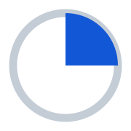
EXHIBIT 1 · CORE TRADING & INVESTING
Leads
Scaling
Regional
Planned
None
The shared base — Robinhood owns the brokerage, Coinbase owns the crypto book
Coinbase is attacking Robinhood's equities turf; its clearer wins are the crypto-native staking and lending rails.
PRODUCT
COINBASE (COIN)
ROBINHOOD (HOOD)
LEADER
Spot crypto trading
GLOBAL · LIVE
US + EU · LIVE
exchange & advanced
Deepest US book; ~90% of US institutional volume; record 10.3% global share.
US, EU; UK launching. Crypto revenue $100mn in Q2'26 (-38% y/y).
— even
Equities & ETF trading
US · LIVE (NEW)
US · LIVE
real shares
24/5, zero-commission, via Apex; opened to all US users Feb'26.
Core since 2015; deep retail penetration, fractional, Legend desktop.
HOOD
Equity options
US · PLANNED
US · LIVE
listed options
Equity + crypto options announced Jun'26; not yet live.
Index + single-stock options — a core, high-margin revenue engine.
HOOD
Crypto staking
GLOBAL · LIVE
US + EU · LIVE
yield
Broad asset set (ETH, SOL, many); institutional staking.
US (ETH, SOL) and EU; narrower asset set.
COIN
Lending / borrow
US · LIVE
US · LIVE
credit
Borrow vs BTC / USDC / staked SOL; crypto-backed mortgages (Better).
Margin & securities-based lending; no crypto collateral.
COIN
Source: company IR & Q2'26 results; Coinbase & Robinhood newsrooms; CFTC actions; press. Position marks are editorial judgment on the product-velocity framework.
COIN vs. HOOD · Product teardown Exhibit 1 / 5

Slide 4
EXHIBIT 2 · DERIVATIVES & PERPETUAL FUTURES
Leads
Scaling
Regional
Planned
None
Coinbase's one lane of clear leadership — and it is a deep one
The only regulated US crypto and equity-index perps, plus offshore 50x and global Deribit access. Robinhood's perps are EU-only.
PRODUCT
COINBASE (COIN)
ROBINHOOD (HOOD)
LEADER
Crypto perpetual futures
US ONSHORE + OFFSHORE
EU ONLY
onshore + offshore
US onshore (CFTC / CFM, nano BTC-ETH-SOL-XRP, 10x); plus offshore up to 50x via Int'l Exchange & Deribit access.
EU only via Bitstamp; nothing available to US persons, onshore or offshore.
COIN
Equity & index perps
US ONSHORE + OFFSHORE
EU ONLY
single-stock + indices
US perp-style index (AI / Defense, Nasdaq-100); S&P 500 live 17-Aug, 20x. Single-stock offshore.
Multi-asset perps incl. equity indices (Jul'26); no single-stock.
COIN
Commodity, FX & other perps
US + OFFSHORE
EU ONLY
metals, FX, pre-IPO
Metals onshore; commodities & pre-IPO / pre-launch offshore. No FX.
Commodity and FX perps (Jul'26), up to 10x — EU only.
— even
Crypto options
US · LIVE
—
options
Via CFM → Deribit, the world's largest options book; in-app options planned.
No crypto options (equity options only).
COIN
Listed futures & binaries
US · LIVE
US · LIVE
CME + up/down
Coinbase Derivatives futures + crypto binaries (Q2'26: 3x traders, 4x revenue).
40+ CME products via Legend; no binaries.
— even
Source: company IR & Q2'26 results; Coinbase & Robinhood newsrooms; CFTC actions; press. Position marks are editorial judgment on the product-velocity framework.
COIN vs. HOOD · Product teardown Exhibit 2 / 5

Slide 5
EXHIBIT 3 · PREDICTION MARKETS & TOKENIZATION / RWA
Leads
Scaling
Regional
Planned
None
The new growth verticals — Robinhood is out-executing on both
Robinhood owns the prediction-market exchange and out-earns Coinbase ~6x, and it shipped tokenized equities and its own L2 first.
PRODUCT
COINBASE (COIN)
ROBINHOOD (HOOD)
LEADER
Prediction — distribution
US · LIVE
US · LIVE
in-app contracts
Sports + crypto / macro; ~$100mn ARR, +106% q/q in Q2'26.
Largest retail distributor; ~16bn contracts traded YTD'26.
HOOD
Prediction — own exchange
—
US · LIVE
DCM + DCO
Distributes via a 3rd-party CFTC venue; owns no exchange.
Rothera (DCM + DCO via MIAXdx) — now 3rd-largest US exchange.
HOOD
Prediction — economics
US · LIVE
US · LIVE
revenue capture
~$100mn annualized run-rate.
$156mn in Q2'26 (~$625mn ann.) — now exceeds crypto revenue.
HOOD
Tokenized US equities
US · PLANNED
EU ONLY
retail
1:1-backed with on-chain dividends (Jun'26); non-US first, no US date.
200+ US stocks / ETFs tokenized (Jun'25), 30 EU / EEA countries.
HOOD
Tokenization platform & L2
LIVE
LIVE
RWA infrastructure
Coinbase Tokenize (institutional RWA) on Base — mature, real usage.
Robinhood Chain (Arbitrum); fast DAU but >80% memecoins; RWA EU-facing.
— even
Source: company IR & Q2'26 results; Coinbase & Robinhood newsrooms; CFTC actions; press. Position marks are editorial judgment on the product-velocity framework.
COIN vs. HOOD · Product teardown Exhibit 3 / 5

Slide 6
EXHIBIT 4 · STABLECOINS & PAYMENTS
Leads
Scaling
Regional
Planned
None
Coinbase's structural moat — Robinhood is barely in the arena
USDC economics and the x402 agentic rail are Coinbase's to lose; the open question is how fast it monetizes the developer / agent layer.
PRODUCT
COINBASE (COIN)
ROBINHOOD (HOOD)
LEADER
Stablecoin economics
GLOBAL · LIVE
—
USDC float & yield
USDC (Circle partner): ~50% of USDC economics, $20bn held, >30% of float.
No first-party stablecoin; USDG consortium participant only.
COIN
Agentic payments (x402)
GLOBAL · LIVE
—
machine / agent rails
x402 (Coinbase-built); 97%+ of onchain agentic transactions; monetization early.
Not offered.
COIN
Merchant payments
LIVE
—
checkout infrastructure
Coinbase Commerce + x402 facilitator; Marex USDC collateral.
No comparable merchant-payments stack.
COIN
Consumer card
US · LIVE
US · LIVE
credit / rewards
One Card — BTC rewards, 5% on travel, USDC-backed variant.
Gold / Platinum credit cards; scaled to 100k+ users.
— even
Source: company IR & Q2'26 results; Coinbase & Robinhood newsrooms; CFTC actions; press. Position marks are editorial judgment on the product-velocity framework.
COIN vs. HOOD · Product teardown Exhibit 4 / 5

Slide 7
EXHIBIT 5 · WEALTH, BANKING & CONSUMER FINANCE
Leads
Scaling
Regional
Planned
None
The breadth gap — an entire surface Coinbase does not touch
The heart of the thesis: Robinhood has built a full consumer-finance stack, while Coinbase offers almost none of it.
PRODUCT
COINBASE (COIN)
ROBINHOOD (HOOD)
LEADER
Managed portfolios / robo
US · LIVE
US · LIVE
advisory
Coinbase Advisor — SEC-registered AI adviser (portfolio + tax-loss harvesting).
Robinhood Strategies — managed portfolios; deeper wealth product.
HOOD
Banking
—
US · LIVE
checking / savings
Not offered.
Robinhood Banking (Gold): 4% APY, private-banking perks.
HOOD
Retirement / IRA
—
US · LIVE
long-term accounts
Not offered.
IRA with 3% match; custodial & trust accounts (Mar'26).
HOOD
RIA custody
—
US · LIVE
adviser channel
Not offered.
TradePMR — RIA custody platform (>$40bn).
HOOD
AI research & subscription
US · LIVE
US · LIVE
engagement
Coinbase Advisor + autonomous agents; Coinbase One subscription.
Cortex AI research digests; Robinhood Gold ($5 / mo).
— even
Source: company IR & Q2'26 results; Coinbase & Robinhood newsrooms; CFTC actions; press. Position marks are editorial judgment on the product-velocity framework.
COIN vs. HOOD · Product teardown Exhibit 5 / 5

