Slide 1
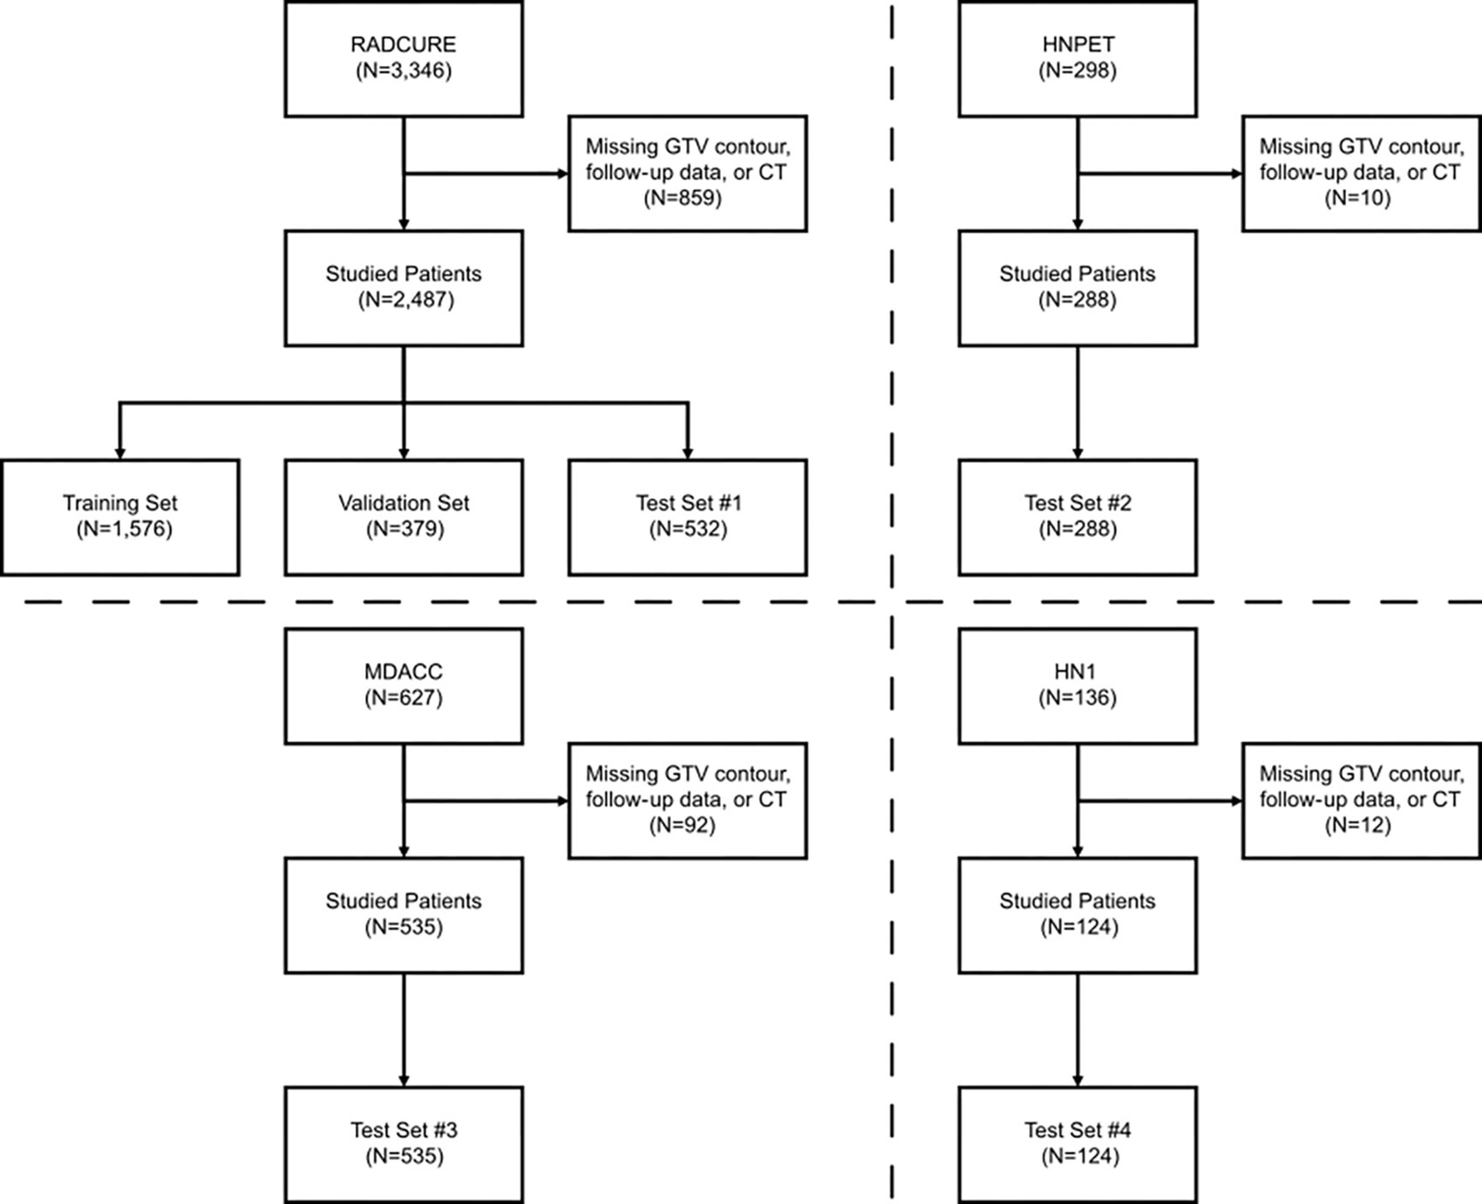
Figure 1: Patient inclusion and exclusion criteria. Flowchart shows the patient inclusion data for the four TCIA datasets studied, as well as the composition of the training, validation, and testing datasets studied in this work. GTV = gross target volume, HNPET = Head-Neck-PET-CT dataset, HN1 = Head-Neck-Radiomics-HN1 dataset, MDACC = MD Anderson Cancer Center head and neck squamous cell carcinoma dataset, RADCURE = Computed Tomography Images from Large Head and Neck Cohort dataset, TCIA = The Cancer Imaging Archive.
Bae J. Published Online: February 21, 2025
https://doi.org/10.1148/rycan.240161

