Slide 1
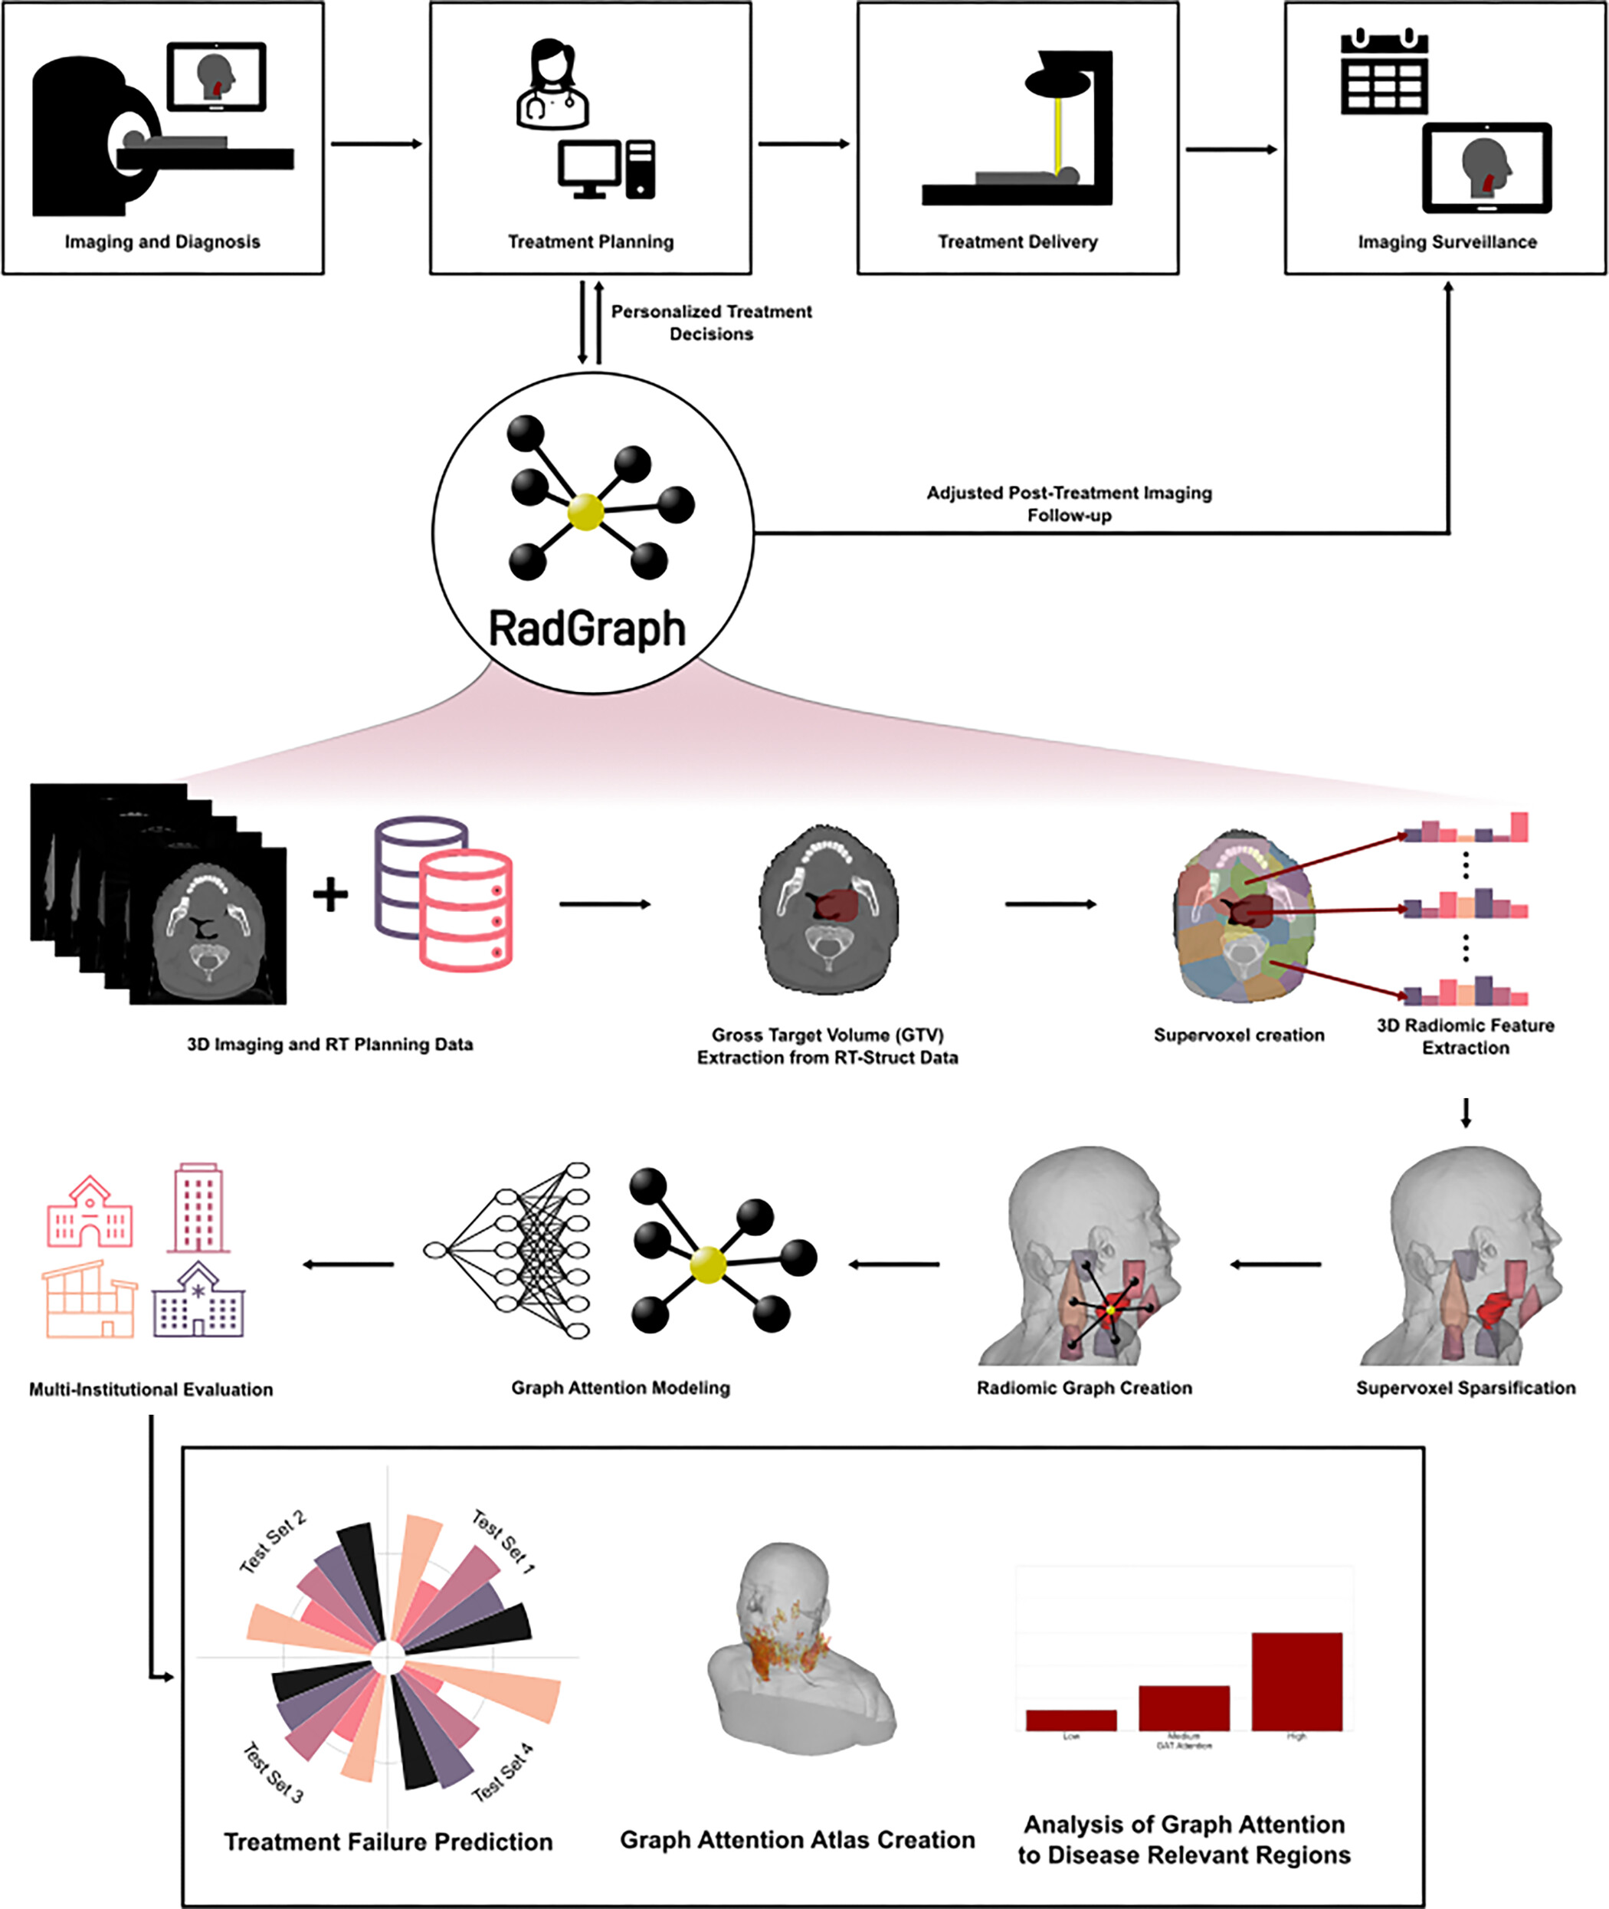
Figure 2: Study overview shows the radiomic graph framework (RadGraph), as well as its potential place in the current radiation treatment pipeline. RT = radiation therapy, 3D = three-dimensional.
Bae J. Published Online: February 21, 2025
https://doi.org/10.1148/rycan.240161

