Slide 1
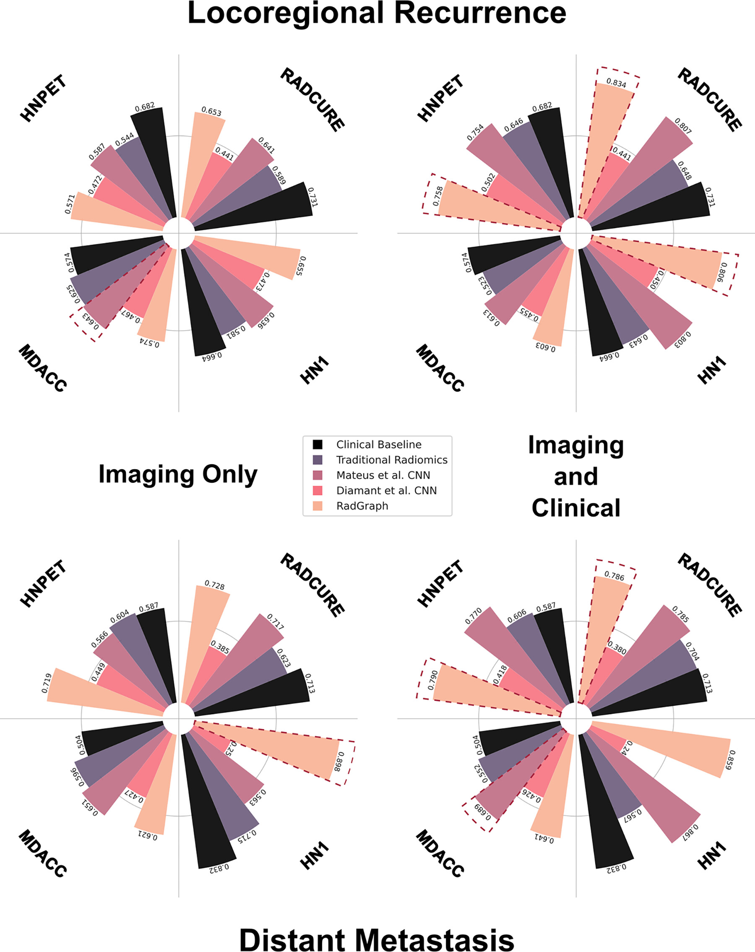
Figure 3: Model performance on outcome prediction tasks. Graphs show AUCs for RadGraph and baseline model predictions of LR (top) and DM (bottom) across the four datasets studied. Bars outlined in dashed red lines indicate the highest performance achieved on each dataset. AUC = area under the receiver operating characteristic curve, CNN = convolutional neural network, DM = distant metastasis, HNPET = Head-Neck-PET-CT dataset, HN1 = Head-Neck-Radiomics dataset, LR = local-regional recurrence, MDACC = MD Anderson Cancer Center Head and Neck Squamous Cell Carcinoma dataset, RADCURE = Computed Tomography Images from Head and Neck Cohort dataset, RadGraph = radiomic graph framework.
Bae J. Published Online: February 21, 2025
https://doi.org/10.1148/rycan.240161

