Slide 1
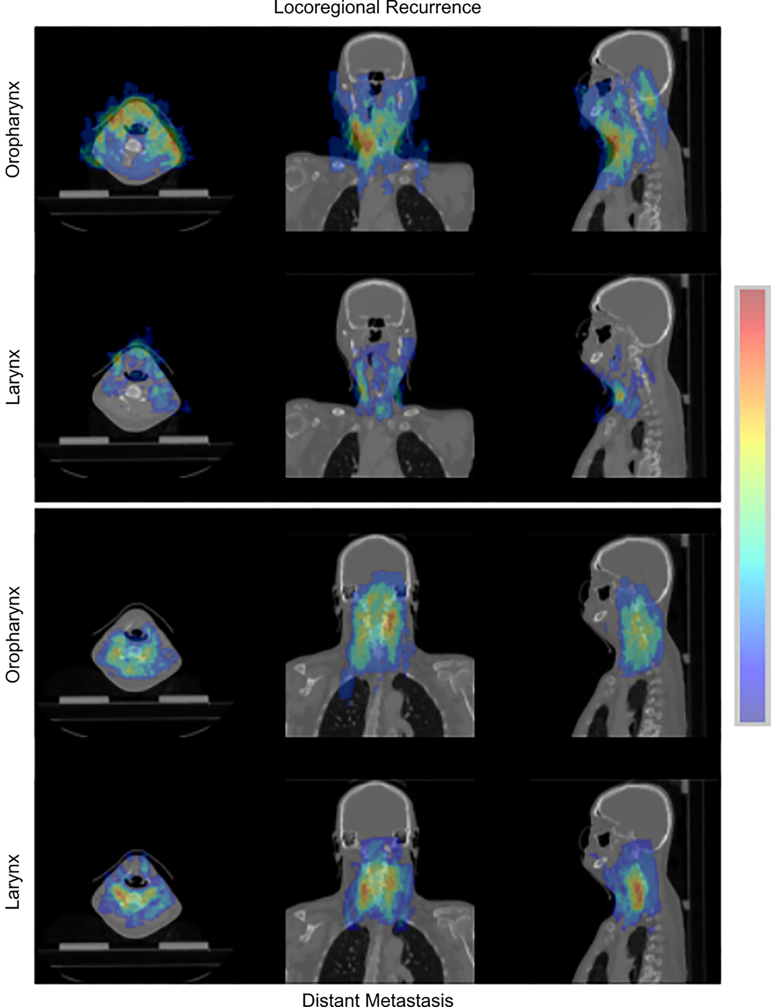
Figure 4: Graph attention atlases created via coregistration of patient CT images and attention maps from the HN1 dataset for oropharyngeal and laryngeal HNSCC tumors. Images in a 56-year-old male patient are shown. Top: Atlases for attention values from models predict local-regional recurrence. Bottom: Atlases for models predict distant metastasis. HN1 = Head-Neck-Radiomics-HN1 dataset, HNSCC = head and neck squamous cell carcinoma.
Bae J. Published Online: February 21, 2025
https://doi.org/10.1148/rycan.240161

