Slide 1
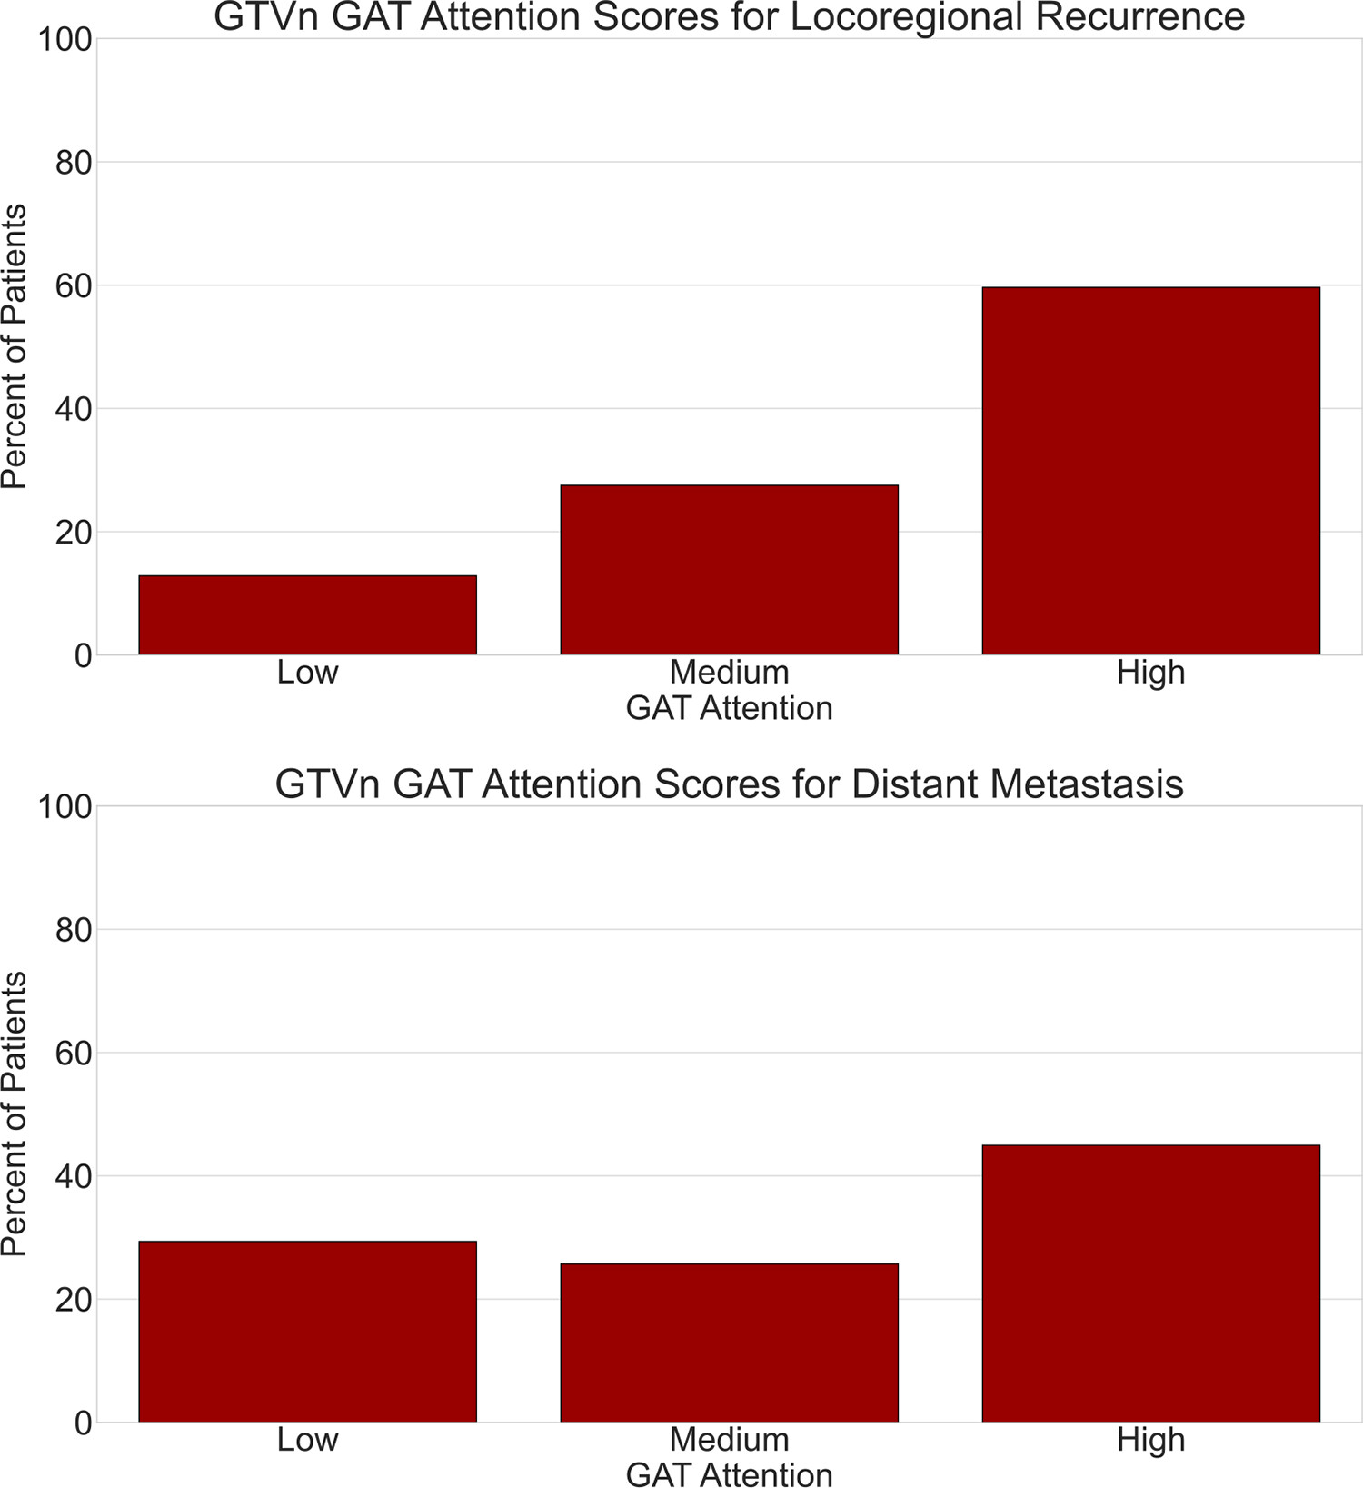
Figure 5: Radiomic attention to GTVn. Bar graphs show model attention values to GTVn regions from the HNPET dataset for models predicting local-regional recurrence (top) and distant metastasis (bottom). Model attention is calculated directly from the final GAT layer and discretized into low, medium, and high values. GAT = graph attention network, GTVn = lymph node gross target volume, HNPET = Head-Neck-PET-CT dataset.
Bae J. Published Online: February 21, 2025
https://doi.org/10.1148/rycan.240161

