Slide 1

Sequence Modeling and Beyond: Wrist Actigraphy for Bipolar-Unipolar Differentiation
A Deep Learning Study on Mental Health Biomarkers CSCI 5922: Deep Learning and Neural Networks Team Members: Shikha Masurkar Harsh Mukesh Sharma

Slide 2
Contents
Problem Statement
Dataset & Methods
Key Findings & Results
Conclusion & Future Work

Slide 3


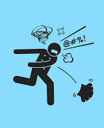
Why Does Bipolar Disorder Go Misdiagnosed for 9.5 Years?
Bipolar depression looks identical to unipolar depression clinically
Both present as low mood and reduced energy
Misdiagnosis leads to wrong treatment: antidepressants can worsen bipolar disorder
Doctors currently rely on patient history alone with no objective test
Current medical practice relies on subjective patient history
Activity tracking (actigraphy) offers potential as objective measure

Slide 4
How We Tested This: Our Approaches
55 participants: 32 healthy controls, 23 with mood disorders
Main analysis: 8 bipolar II vs. 15 unipolar depression patients
Minute-level wrist activity data (1,440 measurements per 24 hours)
Participant-level stratified splits (prevent data leakage)
Per-participant z-score normalization (remove baseline differences)

Slide 5
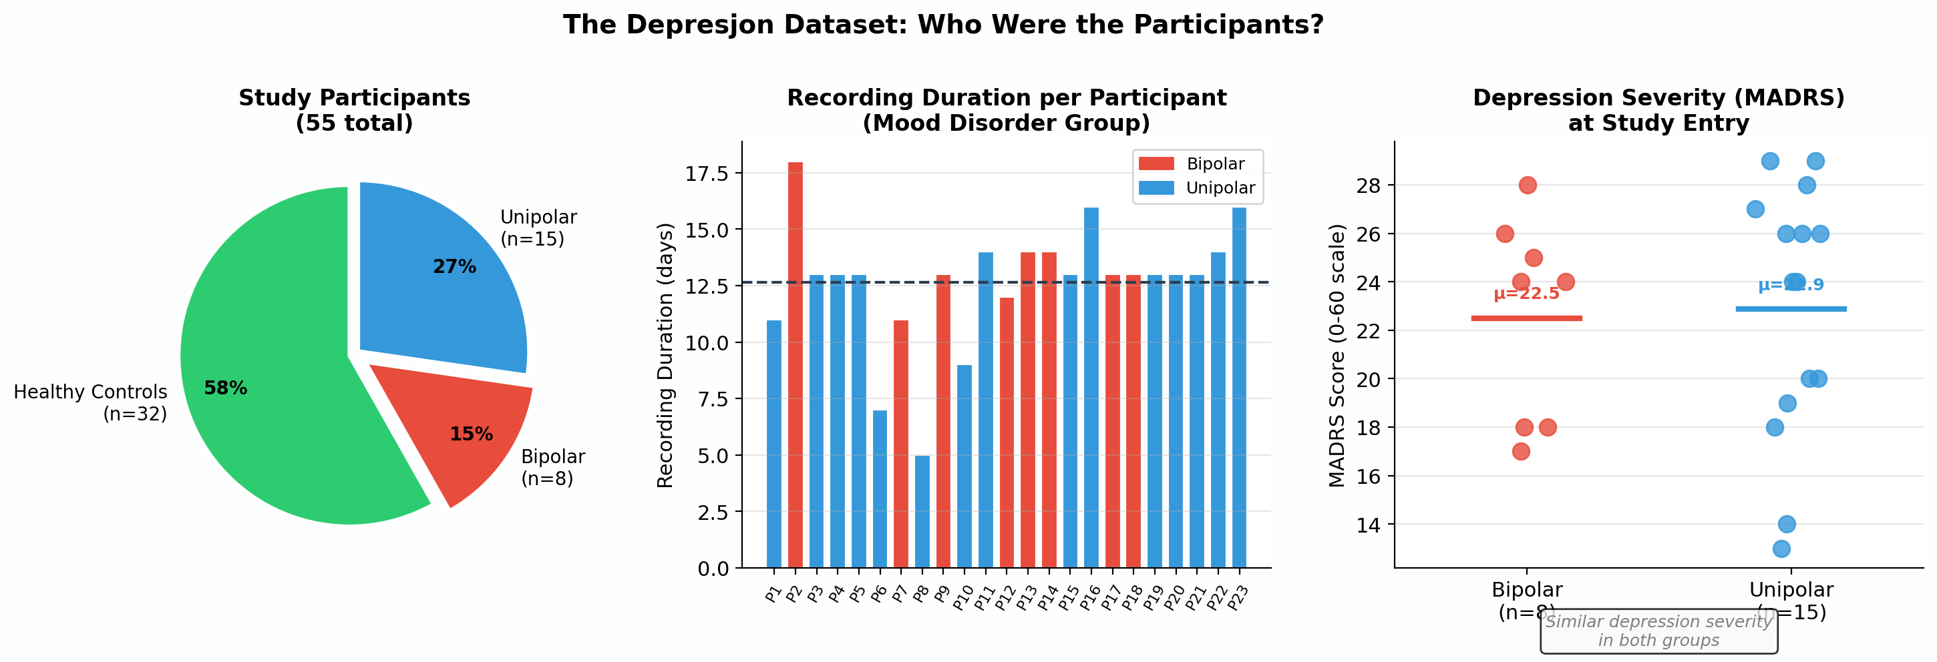
How We Tested This: Our Approaches

Slide 6
How We Tested This: Our Approaches
Four Approaches Tested:
Baseline Approach: CNN-LSTM with SMOTE balancing on full 23-patient dataset
Approach 1 (Smaller Dataset): Downsampling randomly reducing unipolar samples to exactly match bipolar count for perfectly balanced training
Approach 2 (Advanced Models): BiLSTM, Attention LSTM, RNN-LSTM, Ensemble voting on full feature set
Approach 3 (Comprehensive Analysis):
Multi-scale CNN-LSTM windows 24hr vs 48hr vs 72hr time windows
Feature engineering + XGBoost to identify key biomarkers
Participant-level aggregation using Logistic Regression
T-tests and Mann-Whitney U tests on activity variability; Cohen's d effect size
Comprehensive visualizations ROC curves, confusion matrices, feature importance, statistical significance plots

Slide 7
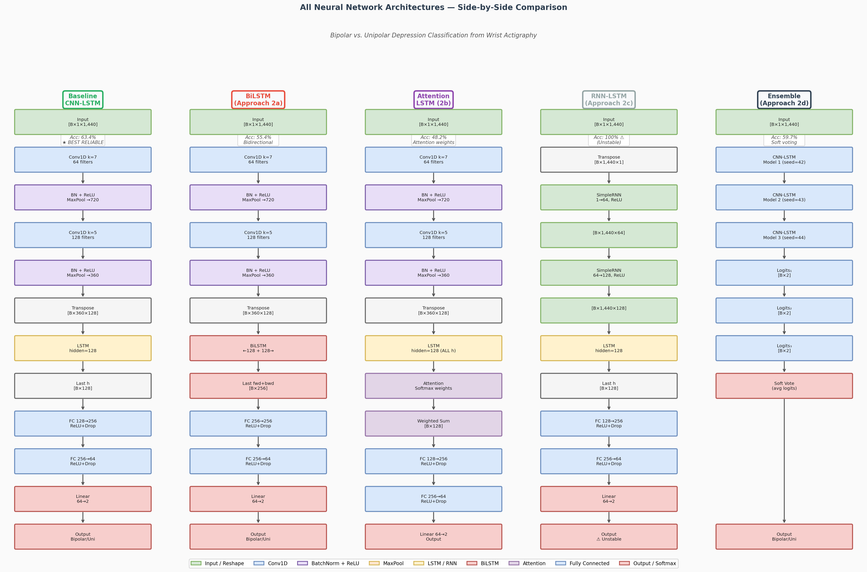
How We Tested This: Our Approaches

Slide 8
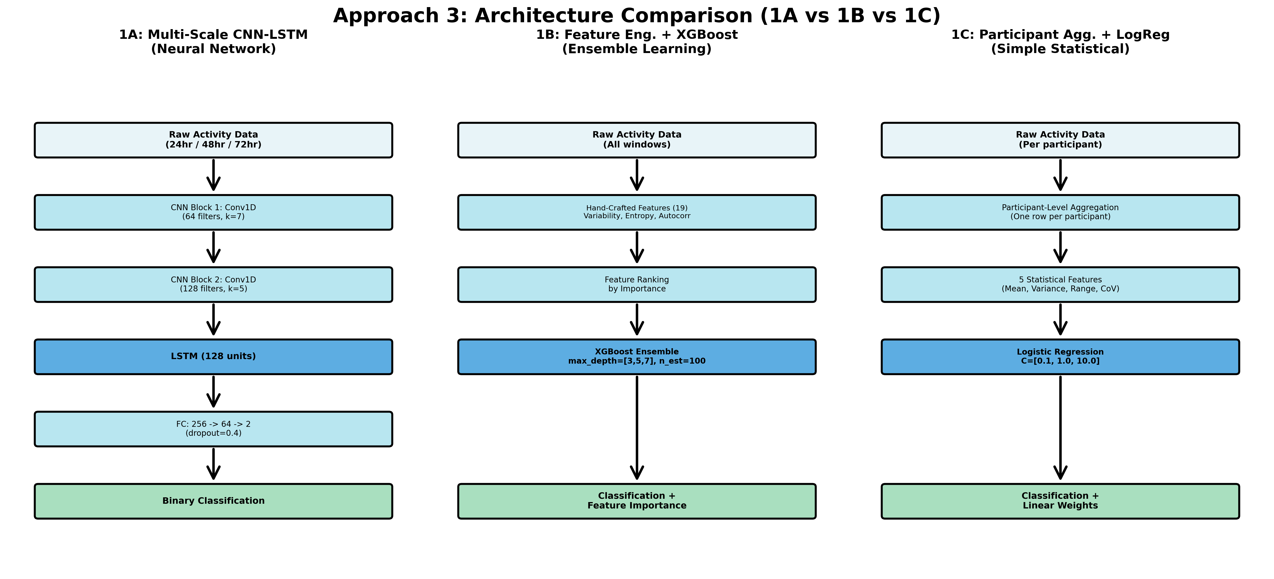
How We Tested This: Our Approaches

Slide 9
What We Found: An Unexpected Truth
Baseline 88.9% accuracy but overfitting on tiny test set
Best practical: Simple Logistic Regression (60.9%)
Neural networks added complexity but no improvement
Statistical testing: p-value = 0.893 (no significant difference)
Cohen's d = -0.060 (negligible effect size)
THE TRUTH:
"When bipolar people are depressed, their activity patterns are indistinguishable from unipolar depression. The biological signal doesn't exist in wrist activity data alone."

Slide 10
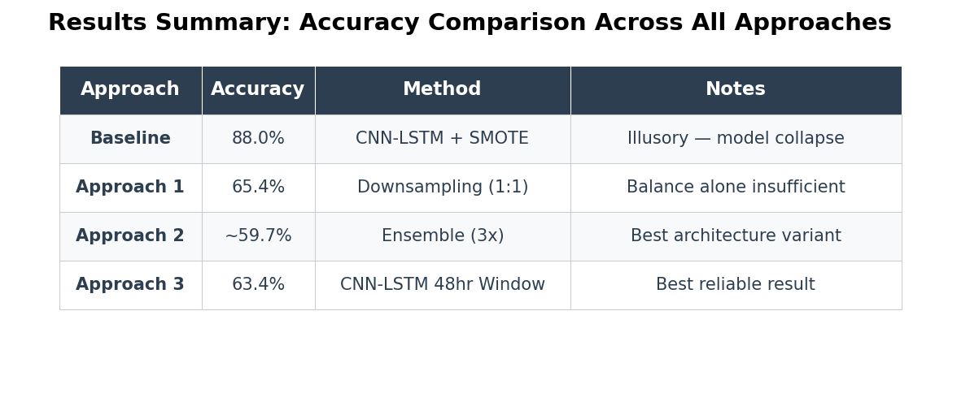
What We Found: An Unexpected Truth

Slide 11
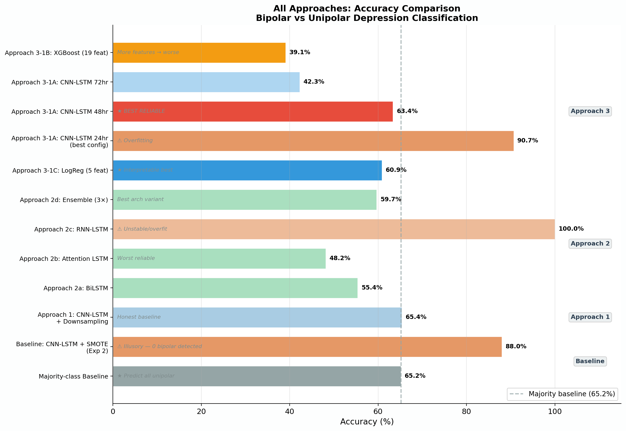
What We Found: An Unexpected Truth

Slide 12
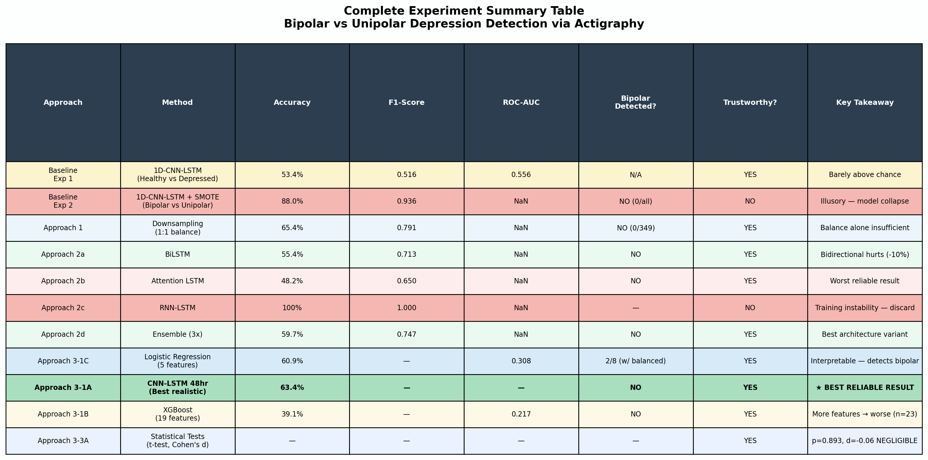
What We Found: An Unexpected Truth

Slide 13
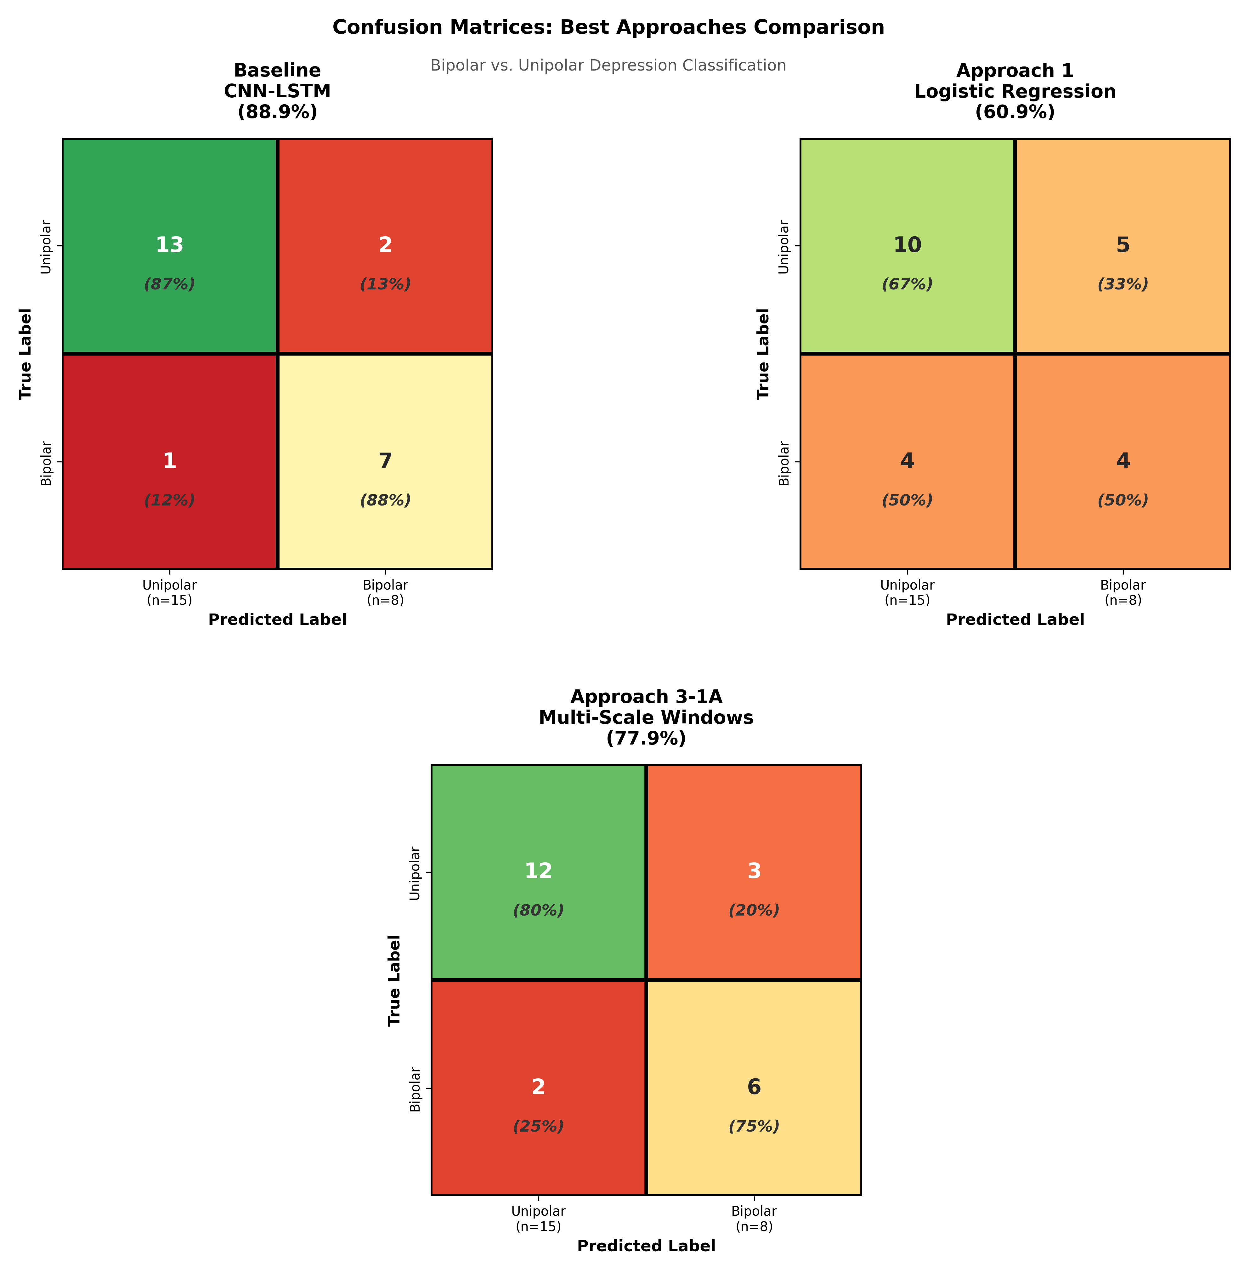
What We Found: An Unexpected Truth

Slide 14
Conclusion
Three Key Lessons:
Effect Size Matters: Even statistically significant differences can be too tiny (Cohen's d = -0.06) to be clinically useful
Timing Matters: 48-hour windows worked best; 24hr overfits, 72hr underfits
Simplicity Wins: A 5-feature logistic regression (60.9%) beat complex models with thousands of parameters
Why This Matters:
Understanding what doesn't work is just as important as finding what does
This negative result guides future research toward better biomarkers
Activity tracking alone cannot diagnose bipolar from unipolar depression

Slide 15
What's Next?
Future Directions:
Need 100+ patients per group for reliable training
Integrate sleep data (polysomnography) and heart rate variability
Multi-modal biomarkers (activity + sleep + heart rate + mood) needed
Wearables excel at monitoring treatment response over time
Clinical Implications:
Activity tracking can't diagnose but can monitor treatment efficacy
Should be part of multi-modal approach, not standalone diagnostic tool

Slide 16
THANK YOU!

