Slide 1

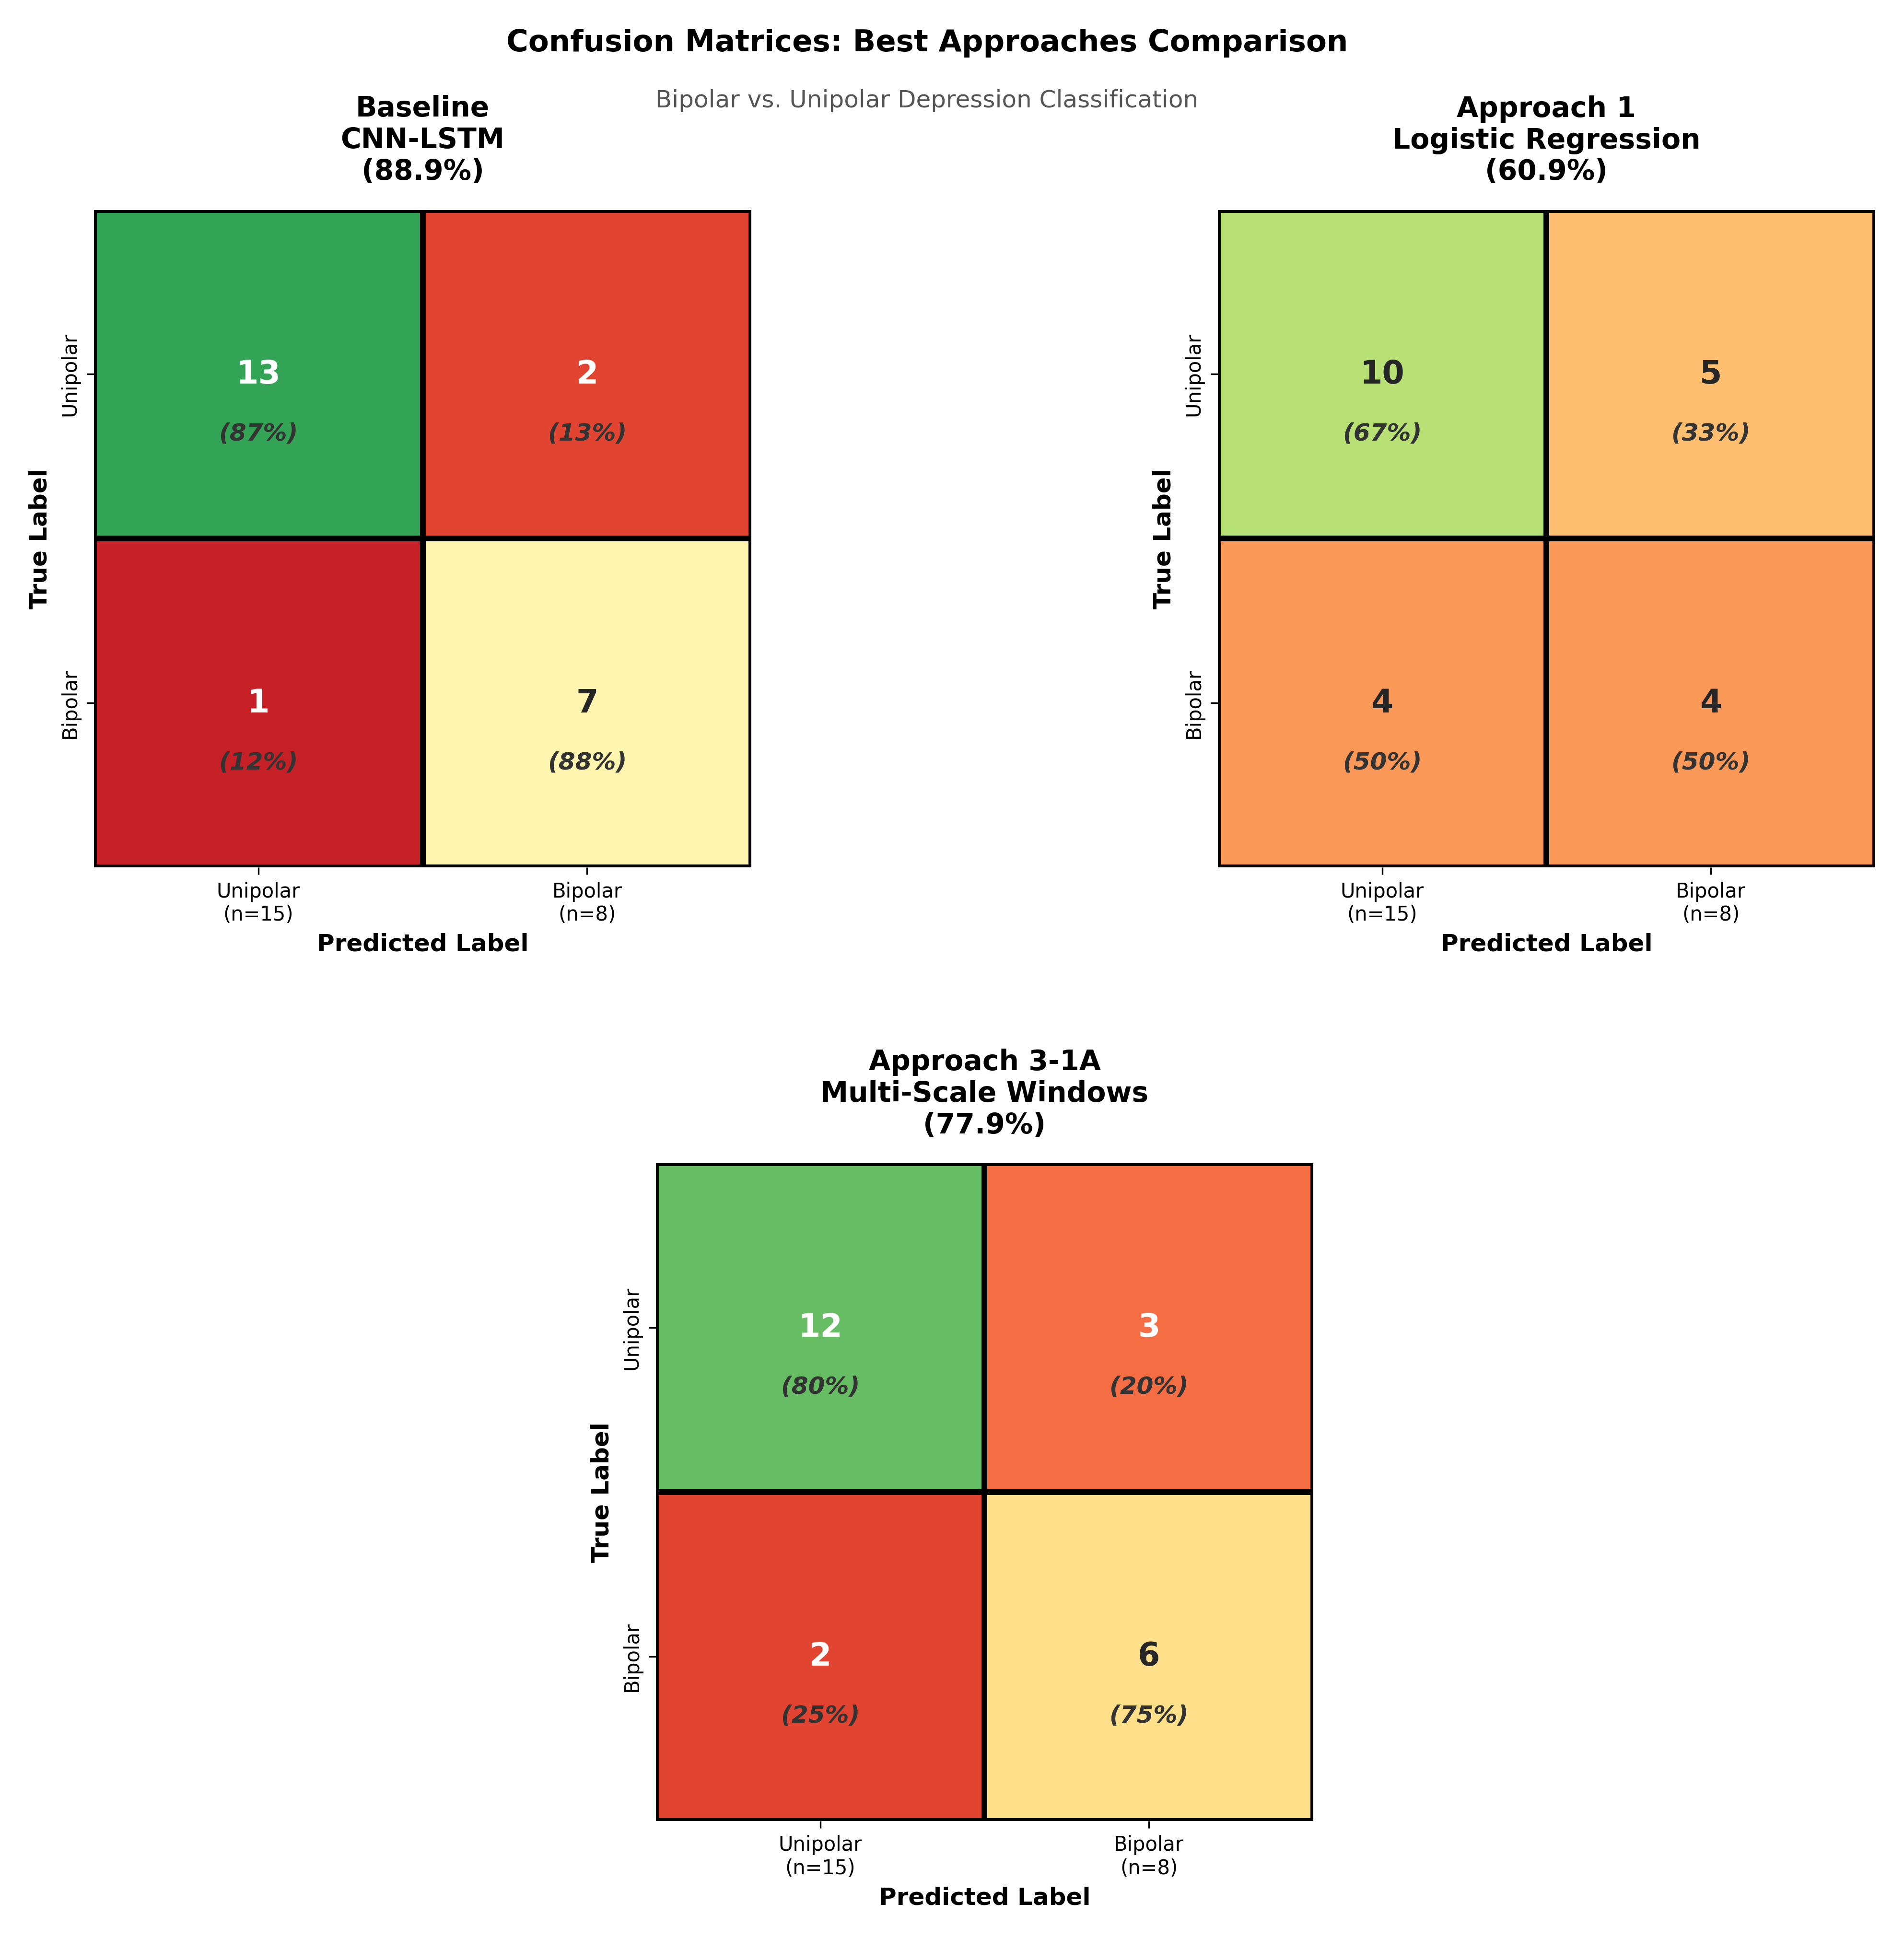
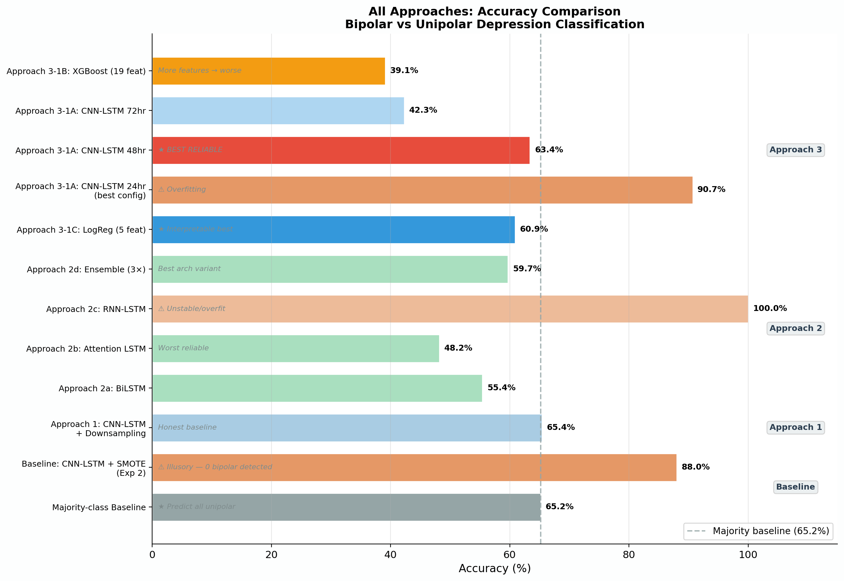
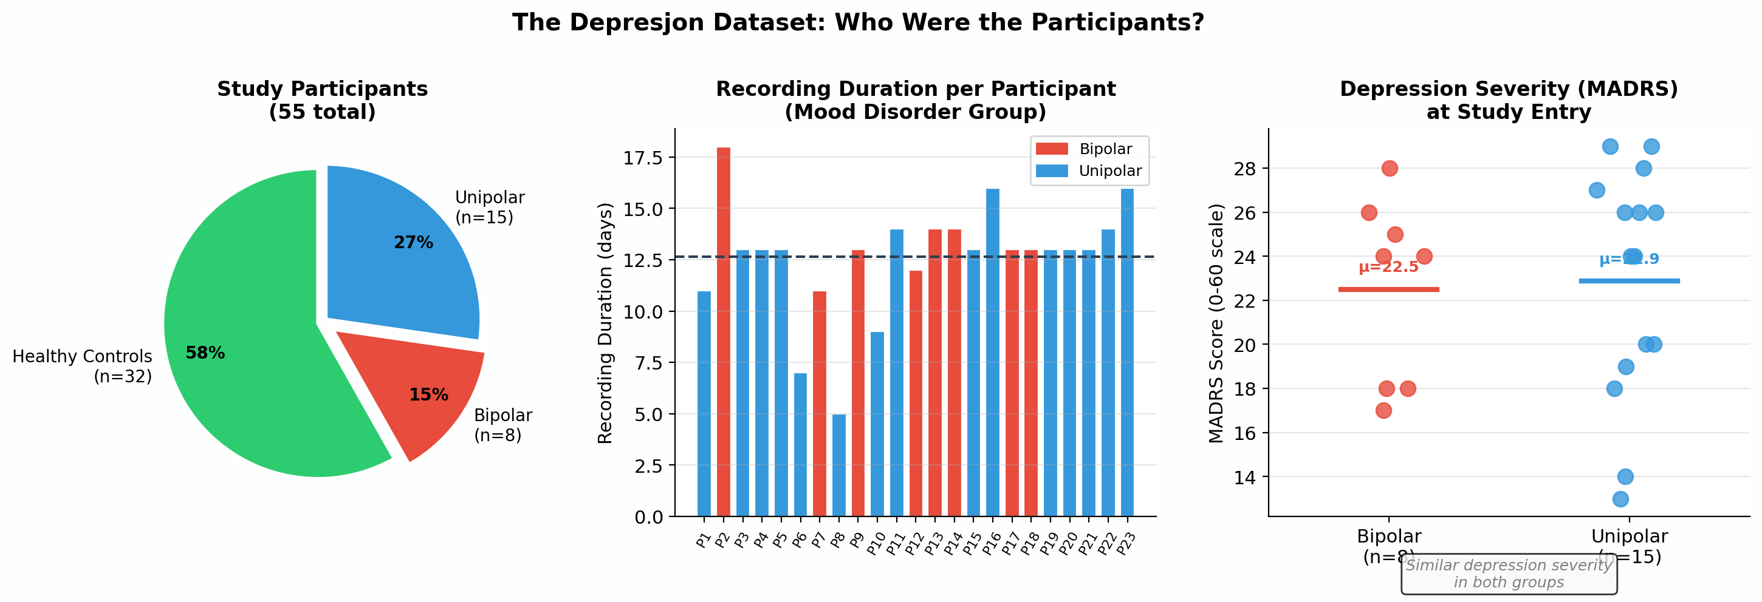
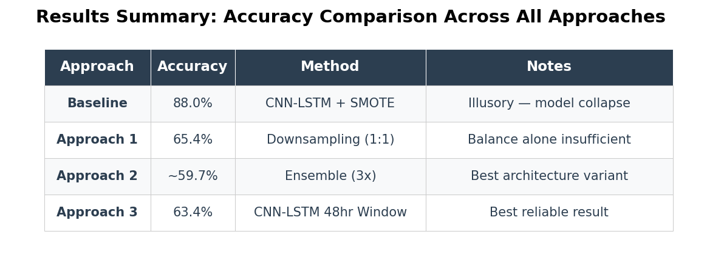

Sequence Modeling and Beyond: Wrist Actigraphy for Bipolar-Unipolar Differentiation
Shikha Masurkar, Harsh Mukesh Sharma
Why does bipolar disorder go misdiagnosed for 9.5 years?
Model Training and Evaluation
Bipolar depression looks identical to unipolar depression clinically both present as low mood and reduced energy. Misdiagnosis can lead to incorrect treatment, and antidepressants can worsen bipolar disorder. Doctors currently rely on patient history alone with no objective test. Prior research used simple statistical summaries (average activity, variance) that miss subtle multi-day temporal patterns. We test if deep learning and statistical analysis can capture the complex temporal structures that distinguish these conditions.
Bipolar II depression is extremely hard to distinguish from unipolar depression clinically
Misdiagnosis is common and leads to treatment failure
Current medical practice relies on subjective patient history
Activity tracking (actigraphy) is a potential objective biomarker
Machine learning has successfully found patterns in other medical conditions using wearable data
Dataset & Methods
We analyzed 55 participants (32 controls, 23 with mood disorders): 8 bipolar II vs. 15 unipolar depression patients using minute-level wrist activity data. To establish baseline performance and identify meaningful patterns, we first ran baseline experiments comparing healthy vs. depressed individuals and bipolar vs. unipolar patients. Using these thresholds as our benchmark, we then tested three complementary approaches: classical machine learning models across different time windows (24-72 hours), advanced neural networks (BiLSTM, Attention LSTM), and statistical hypothesis testing. Across all approaches, we applied rigorous experimental controls participant-level stratified train/validation/test splits to prevent data leakage and per-participant z-score normalization to remove individual baseline activity differences.
Figure 2: Models and their accuracies.
Figure 3: Results of the best trained models.
No meaningful difference found between bipolar and unipolar activity patterns. Wrist activity data alone is insufficient for diagnosis.
1. Effect Size Matters: Even statistically significant differences can be too tiny (Cohen's d = -0.06) to be clinically useful.
2. Timing Matters: 48-hour windows worked best for recording and analyzing the data; 24hrs data overfits the model, 72hrs underfits.
3. Simplicity Wins: A 5-feature logistic regression (60.9%) beat complex models with thousands of parameters.
Statistical testing revealed NO meaningful difference (p=0.893, Cohen's d=-0.06) between bipolar and unipolar activity patterns suggesting single modality wearables are insufficient for clinical differentiation.
Conclusion & Future Work
Wrist activity data alone cannot distinguish bipolar from unipolar depression. To improve this work, we need 200+ patients per group, longitudinal tracking across mood episodes, and multi-modal biomarkers (activity + sleep + heart rate). This negative result is valuable as it guides researchers toward better biomarkers. Future research should combine actigraphy with polysomnography (sleep monitoring) and heart rate data. A multi-modal machine learning approach integrating these signals rather than activity in isolation may finally unlock the biomarker that distinguishes these devastating conditions and accelerates diagnosis from years to weeks.
References
1. Garcia-Ceja et al. (2018). Depresjon dataset. ACM Multimedia Systems.
2. Fawaz, H. I., Lucas, B., Forestier, G., Pelletier, C., Smaïl-Tabbone, M., Koegh, E. J., & Mueen, A. (2019). Deep learning for time series classification: A review. Data Mining and Knowledge Discovery, 33(4), 917–963.
3. Chawla, N. V., Bowyer, K. W., Hall, L. O., & Kegelmeyer, W. P. (2002). SMOTE: Synthetic minority over-sampling technique. Journal of Artificial Intelligence Research, 16, 321–357.
4. Cohen, J. (1988). Statistical Power Analysis for the Behavioral Sciences (2nd ed.). Lawrence Erlbaum Associates, Inc.
5. Kaplan, K. A., Talbot, L. S., & Haynes, P. L. (2007). Psychiatric illness and sleep. Current Psychiatry Reports, 9(6), 440–447.
6. Goodwin, F. K., & Jamison, K. R. (2007). Manic-Depressive Illness: Bipolar Disorders and Recurrent Depression (2nd ed.). Oxford University Press.
Figure 1: Visualizing the Depresjon dataset.
Table 1: Best performing models from each approach.

