Slide 1
evt_s4_002
evt_s4_010
evt_s14_007
R005
evt_s13_031
cited evidence IDs — red: invalid citation, flagged by the validator
Augmenting Rule-Based Private-Cloud Forensic Investigation with Evidence-Grounded LLM Reasoning
Every claim must cite real evidence. The validator checks. The failures are kept.
Md. Nazmul Hasan (2610031)
Dept. of Computer Science and Engineering, United International University, Dhaka, Bangladesh
115 controlled scenarios | open-weight Gemma 27B | deterministic 7-check validator
Notes:
OPENING — speak slowly, you have time. "Good morning. I'm Nazmul. My project asks a practical question: can we let an AI help investigate a security breach WITHOUT it making things up? These small tags at the top are evidence IDs — the red one is a citation the system caught as invalid. That picture is the whole idea: make the AI cite its evidence, then automatically check it. Let me start with why this problem is hard."

Slide 2
PROBLEM
After an incident, the evidence is everywhere — and nowhere
auth
file_access
admin
network
logins, failures
reads, downloads
privileges, log deletion
DNS, firewall, VPN
database
web_server
email
0
queries, exports
requests, errors
messages, attachments
unified audit planes.
No CloudTrail in a private cloud.
Post-incident triage = reconstruct, classify, explain — from fragmented logs, defensibly. Not real-time detection.
2
Notes:
THE PROBLEM. (Point at the seven cards.) "When a private organisation — a bank, a hospital, a government office — gets attacked, the clues are scattered across seven separate systems: logins, file activity, admin actions, network, database, web, and email. Unlike Amazon's cloud, there is NO single place to see it all — that's the big '0' on the right. So investigators piece it together by hand, which is slow and error-prone. That manual reconstruction is the bottleneck we attack."

Slide 3
MOTIVATION
Rules are brittle. Unconstrained LLMs are dangerous.
RULE-BASED CORRELATION (SIEM)
UNCONSTRAINED LLM ANALYSIS
Transparent, deterministic, auditable
Alert floods on travel & maintenance (33 alerts on one benign scenario)
Cannot aggregate across days — slow insider exfiltration maps to BENIGN
0% on multi-day scope-creep family
Synthesizes weak signals across time and sources
Hallucinates evidence, overclaims intent, picks wrong actors
Non-determinism undermines forensic reproducibility
Unacceptable where every claim faces legal review
3
Notes:
TWO TOOLS, EACH FLAWED. (Left column, then right.) "There are two obvious options today, and each has a fatal flaw. Rule engines — what industry uses — are reliable and transparent, but brittle: they flood analysts with false alarms and miss slow attacks spread over days. A raw AI is the opposite: smart enough to connect the dots, but it hallucinates — invents evidence — which is unacceptable when a claim might end up in court. We want the intelligence of the AI with the trustworthiness of rules."

Slide 4
THIS WORK
Constrain the LLM to cited evidence — then audit the citations
RQ: Can an LLM that may only reason over normalized events, and must cite an event identifier for every claim, improve forensic triage over a transparent rule baseline — while staying traceable?
1
Normalize
2
Correlate
3
Analyze ×2
4
Validate
7 log sources → one event schema (OCSF/ECS-mapped)
chronological, session-grouped, cross-source timeline
12-rule engine and grounded LLM see the SAME evidence
7 deterministic checks on every LLM citation
Privacy by architecture: open-weight model, swappable to in-boundary vLLM / Ollama serving.
4
Notes:
OUR QUESTION AND APPROACH. (Read the banner, then the 4 steps.) "So our question is narrow: can an AI that may only use the given evidence — and must cite an event ID for every claim — beat the rule baseline while staying traceable? The pipeline is four steps: normalise the seven sources into one format, build a timeline, run BOTH the rules and the AI on that same evidence, and finally validate every citation. The key word is 'same' — both judges see identical evidence, so any difference is reasoning, not extra clues. It's a fair fight."

Slide 5
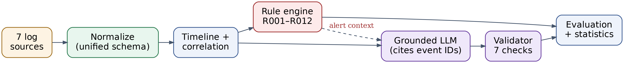
SYSTEM
One pipeline, two analyzers, equal evidence
Equal evidence access
Rule-alert context
Implementation
Both analyzers consume the identical correlated timeline — any accuracy gap is reasoning, not privileged input.
Rule output is ALSO fed to the LLM — and that design choice is itself measured (ablation, slide 11).
Python 3.11 · FastAPI · PostgreSQL 15 · Docker · 59 tests green · Laravel audit layer
5
Notes:
THE SYSTEM. (Trace the diagram left to right with your hand.) "Here's the actual system. Evidence flows left to right: clean it up, build the timeline, then it splits — the rule engine and the AI both analyse it, the validator checks the AI's output, and everything goes to scoring. This is not a mock-up. It's working software — Python, a database, Docker — with 59 automated tests passing. Every result I show comes from running this."

Slide 6
METHOD
Grounded output: every claim carries an event ID
Deterministic validator — 7 checks
"verdict": "YES", "suspect": "user_03",
"attack_chain": [
{"step": 1, "event_id": "evt_s4_002",
"description": "read access to
finance reports, ticket HR-2026-441",
"confidence": "HIGH"}, ... ],
"evidence_for": ["evt_s4_002",
"evt_s4_010", "evt_s4_012", ...]
event-ID existence
chronology of cited chain
actor consistency
entity consistency (IP/file)
temporal claims
volume claims
uncited-claim structure
actual Gemma response, scenario S4 (3-day insider)
Checks that citations are REAL — not that the interpretation is RIGHT.
6
Notes:
THE HEART OF THE METHOD. (Left = AI answer, right = validator.) "This slide is the core idea, made concrete. On the left is a REAL AI answer — notice every step cites a specific event ID, shown in teal. It doesn't just say 'user_03 did it'; it says 'see events evt_s4_002, evt_s4_010.' On the right, the validator checks each citation: do the events exist? is the named user real? are the files real? Seven checks. Here it passed six and FLAGGED one ordering mistake — which is the point: the check is real, it actually catches things."

Slide 7
EVALUATION DESIGN
From 15 hand-written cases to a 115-scenario holdout design
15
100
44 / 56
calibration scenarios
holdout scenarios
benign / attack split
hand-designed; the LLM prompt was tuned here — and only here
generator-created from 10 families, seeded (42), never seen during tuning
incl. 34 hard-benign: legitimate activity designed to flood the rule layer
Anti-designer-bias controls: parameter distributions committed to an auditable spec (corpus_spec.yaml) · fixed seed → byte-identical regeneration · calibration/holdout split reported separately · frozen prompt, rules, and validator
7
Notes:
HOW WE TESTED IT FAIRLY. (Three number cards.) "A fair test matters. We tuned the system on 15 hand-built scenarios — think practice problems. Then we tested on 100 FRESH scenarios, generated automatically from a fixed recipe, so we could not hand-pick them — that's the real exam. Everything I'm about to show is from those 100 unseen cases, including 34 deliberately tricky 'hard benign' ones: innocent activity designed to look alarming."

Slide 8
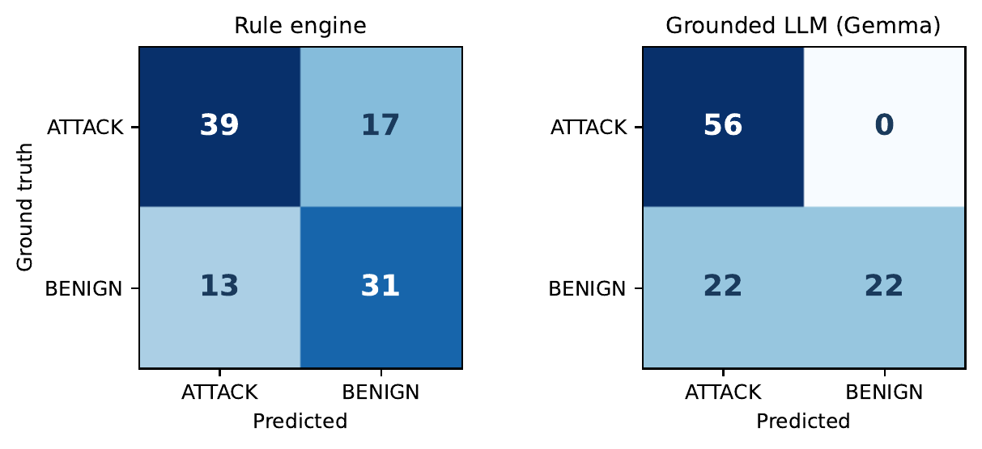
RESULTS
Holdout (n=100): the asymmetry is the result
slice
rules
Gemma
Overall
70.0%
78.0%
p = 0.243
Attack only (56)
69.6%
100%
p < 0.001
Benign only (44)
70.5%
50.0%
p = 0.064
Hard benign (34)
61.8%
38.2%
p = 0.096
Rules: errs both ways. Gemma: misses NOTHING, over-flags benign.
McNemar exact, paired on identical scenarios. CIs in the paper.
8
Notes:
THE HEADLINE RESULT. (Point at the AI's grid, then the table.) "Here's the main result, and it's more interesting than a single number. Look at the AI's grid: zero missed attacks — it catches everything. But it also wrongly flags 22 of 44 innocent cases. So overall it's 78 percent versus the rules' 70 — and honestly, at this sample size that gap is NOT statistically significant, and we say so. The real finding is the shape: very high recall, at a real false-alarm cost. Remember that trade-off — it's the spine of the talk."

Slide 9
RESULTS
Grounding holds at scale
99.95%
citation validity
0
fabricated event IDs
2,067 of 2,068 event-ID references resolve to real events
across all 115 scenarios; the one invalid reference is a cited rule ID
κ = 1.0
verdict determinism
ABSTAINS
under evidence starvation
110 repeated runs (22 scenarios × 5): zero verdict flips at T = 0.1
60–80% event removal → INSUFFICIENT, not fabrication
“Zero hallucinated evidence” is now a measured property under a published validator — not a vibe.
9
Notes:
DOES THE CITATION-CHECKING WORK? (Four stat cards.) "Yes. Across all 115 scenarios, 2,067 of 2,068 cited references were real events — 99.95 percent, zero invented IDs. And it's repeatable: we reran it 110 times and got identical verdicts every time — that's the kappa of 1.0. When we starve it of evidence, it says 'insufficient' rather than guessing. So 'no fabricated evidence' isn't a hope here — it's a measured fact."

Slide 10
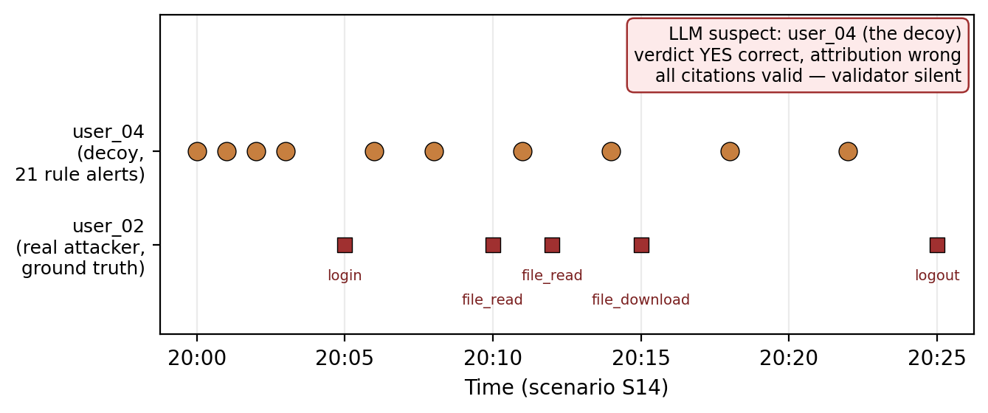
FAILURE CASE 1
S14: every citation valid — wrong suspect
Grounding ≠ attribution
Loud decoy (user_04) draws 21 alerts; quiet attacker (user_02) exfiltrates source code
Verdict YES = correct. Suspect = the decoy.
Validator is silent: every cited event is real and ordered
Citation grounding is necessary — not sufficient — for interpretive correctness.
10
Notes:
FAILURE CASE 1 — THE DECOY. (Point at the two timeline lanes.) "Now the honest part — where it breaks. In this scenario we planted a LOUD decoy attacker and a QUIET real one. The AI correctly said 'yes, attack' — but it blamed the decoy, the wrong person. And here's the subtle bit: every event it cited was genuine, so the validator stayed silent. The lesson is the slide title: checking that citations are real does NOT guarantee the conclusion is right. We feature this failure rather than hide it — that's what makes the work credible."

Slide 11
FAILURE CASE 2
Rule alerts are not neutral context — but they're not the main culprit
S15 ablation (5 runs / condition)
Does it generalize? 44 scenarios × 2 × 5 (440 calls)
with alerts
YES × 5 (wrong)
6 / 44
without alerts
NO × 5 (correct)
verdicts reverse without rule context — real, but a minority mechanism. The dominant benign-FP behavior is a model-intrinsic prior: foreign-IP travel and quarter-end volume read as “attack” even with no alerts in the prompt.
Same model, same timeline. The verdict reverses on the rule-alert artifact alone — the LLM treats upstream alerts as quasi-ground-truth.
11
Notes:
FAILURE CASE 2 — RULE-CONTEXT BIAS. "A second failure. We feed the rule alerts to the AI as context — is that safe? We tested it directly. With the alerts in the prompt, it wrongly cried 'attack' five times out of five. Remove just the alerts — same evidence — and it correctly says 'no,' five out of five. So rule output is not neutral context; it can bias the AI. But across 44 scenarios it only flipped six, so it's a real but MINOR effect — not the main cause of the false alarms."

Slide 12
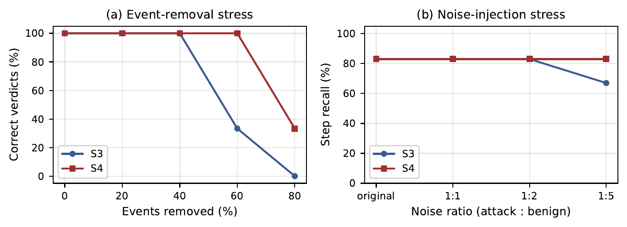
ROBUSTNESS
Stress tests: degrade to abstention, not fabrication
Evidence removal — correct through 40% removal; 60–80% → INSUFFICIENT
Noise injection — verdicts stable to 5:1 benign:attack event ratio
Timestamp jitter — verdicts stable; validator flags perturbed chronology (as designed)
Raw logs vs pipeline — same verdicts — structuring removes the grounding violations
12
Notes:
ROBUSTNESS — WE TRIED TO BREAK IT. "We stress-tested it on purpose — deleted evidence, injected noise, scrambled timestamps. The reassuring result: when stressed, it degrades to 'insufficient evidence' rather than making things up. It fails in the SAFE direction. That's exactly what you want from a forensic tool."

Slide 13
GENERALIZATION
Third-party data (CERT r4.2): the asymmetry intensifies
CERT insiders — independently labeled by CMU, MD5-verified download
Q1 Does the recall / FP asymmetry replicate?
Yes — and it widens. Benign-accuracy gap: 50pp on synthetic holdout → ≥87pp on CERT.
ATTACK windows (n=20)
Gemma 100% · Rules 0%
Q2 Does multi-day insider recall hold?
BENIGN windows (n=15)
Yes. 100% (20/20) across CERT insider scenario types 1, 2, 3 — real labeled insiders, not designed cases.
Rules 100% · Gemma near-0% (≤2/15)
Honest caveat: on the richer CERT inputs the model returned Markdown, not JSON, in 34/35 windows — verdicts parsed from prose; structured grounding could be checked on only the 1 JSON response (20/20 valid). Not a grounding result at scale.
The “authors built everything” critique is answered: an independent CMU corpus, same pipeline and frozen prompt, reproduces the result — 100% attack recall AND near-total benign false positives (≥13 of 15).
13
Notes:
THE STRONGEST SLIDE — REAL THIRD-PARTY DATA. "This is the result I'm proudest of. We didn't only test our own data — we ran the whole pipeline on CERT, a real insider-threat dataset from Carnegie Mellon that we had NO hand in building. The same pattern held and even intensified: it caught all 20 real insiders, but over-flagged nearly every innocent month. One honest caveat — read the red note: on this richer data the AI often returned prose instead of structured output, so the citation-check couldn't run at full strength here. We report that openly. But a finding that survives data you never touched is the strongest evidence you can give."

Slide 14
LIMITATIONS & NEXT
What this proves — and what's next
Honest boundaries
Next axes
Single model (Gemma) — now the dominant limitation; the benign-FP prior may be model-specific
Synthetic + partial 3rd-party (CERT auth/file/email/http/device; 35 of 40 windows scored)
Rules not re-tuned for CERT vocabulary — its benign-mapping inflates rule “accuracy”
Validator cannot catch wrong-suspect-with-real-evidence (S14)
Multi-model replication (Llama / Mistral) — isolate model-specific vs general behavior
Finish the 5 outage-dropped CERT windows (pipeline is resumable)
LANL real-enterprise auth replay — adapter built & tested
Multi-suspect hypothesis tracking — the S14 countermeasure
14
Notes:
LIMITATIONS — STATE THEM CONFIDENTLY. "I want to be clear about the limits, because that builds trust. We tested ONE AI model, so the over-flagging might be specific to it. Most of our data is synthetic. And as the decoy showed, the validator can't catch a wrong conclusion built from real evidence. The next steps follow directly: try other models like Llama and Mistral, use more real data, and teach it to weigh multiple suspects before naming one."

Slide 15
The supported role for LLMs in forensics
Bounded reasoning, not autonomous detection
candidate verdict + chain + suspect, every claim cited, analyst decides
Rules and LLM are complements
rules: cheap, deterministic triggers · LLM: 100% attack recall on synthetic AND real CERT insiders — at a benign-FP cost
Validate mechanically, keep the failures
99.95% citation validity on the 115-scenario corpus; S14, S15 & CERT format-drift mark exactly where it breaks
Thank you. Artifacts: 115-scenario corpus · frozen prompts & rules · validator · statistics — all reproducible.
Notes:
CONCLUSION — land it slowly, then invite questions. "To wrap up: the right role for an AI in forensics isn't an autonomous detector — it's a bounded, high-recall first pass that a human reviews. Rules and the AI are partners, not rivals. And what makes it trustworthy is mechanical validation plus the honesty to report where it fails. Everything here is reproducible from the code. Thank you — I'm happy to take questions."

