Slide 1
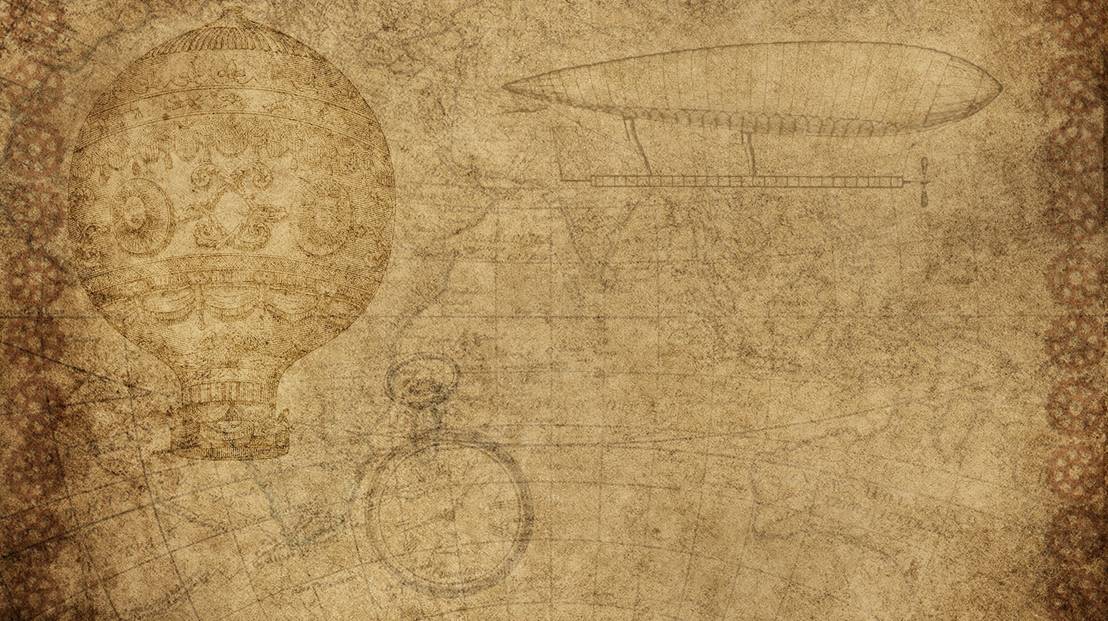

Hesham Asif
Data Science intern at oasis infobyte

Slide 2
Project name:
Sales Price Prediction

Slide 3

Data Exploration and Cleaning
Inspected the dataset for missing values, duplicates, and overall structure.
Performed descriptive statistics and visualized relationships between features and the target variable.

Slide 4
Exploratory Data Analysis (EDA)
Plotted regression lines to visualize correlations between sales and advertising budgets (TV, radio, and newspapers).
Used pair plots to analyze relationships between all variables comprehensively.

Slide 5
Feature Engineering and Scaling
Separated features and the target variable for modeling.
Applied StandardScaler to standardize the features for improved model performance.

Slide 6
Model Implementation
Built a Linear Regression model to capture the linear relationship between advertising spend and sales.
Used a Random Forest Regressor to model complex, non-linear relationships for improved prediction accuracy.

Slide 7
Performance Evaluation
Evaluated the models on test data using metrics like R² score.
Compared predictions from both models to determine which performed better on unseen data.

Slide 8
Predictive Insights
Demonstrated how advertising budgets influence sales, providing actionable insights for optimizing marketing strategies.
Provided predictions using both models for real-world application.

