Slide 1
The Quantum Leap: Solving Unsolvable Problems
Presented by Synapse AI Chat on 2025-10-19

Slide 2
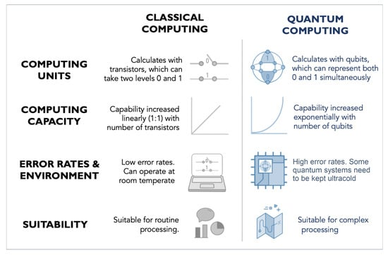
Quantum Computing: Solving the Impossible
Quantum computing is an emerging technology that utilizes the laws of quantum mechanics [3]. A quantum computer is a computer, either real or theoretical, that essentially uses quantum mechanical phenomena, specifically exploiting superposed and entangled states [4].
It differs from classical computers by being able to solve problems that are too complex for classical computers [3].

Slide 3
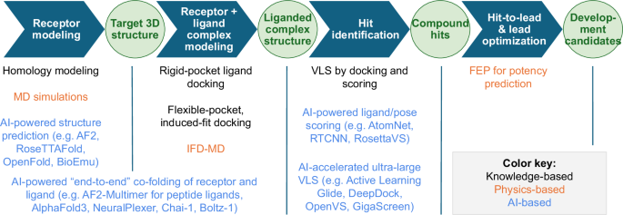
Applications: Awaiting Powerful Computers
I couldn't find a definitive answer in the provided web search results. The context mentions that there are "important real world applications just waiting for sufficiently large and powerful computers" [5] and "hypothetical real life applications of turning NP problems into P problems" [1], as well as "complex problems that we do not know how to solve with classical computers at any practical scale" [4]. However, it does not specify what these significant real-world applications are.

Slide 4

Quantum & Internet Security: The Missing Answers
I couldn't find a definitive answer in the provided web search results regarding how quantum computing could break current internet security or what the solution is. The context discusses general cybersecurity topics such as career paths and penetration testing, but does not mention quantum computing or its implications for internet security [1], [3], [5].

Slide 5

Quantum Computing: Challenges & Future Unclear
I couldn't find a definitive answer in the provided web search results regarding the main challenges holding back quantum computing or when we can realistically expect to see widespread use of this technology.

