Slide 1
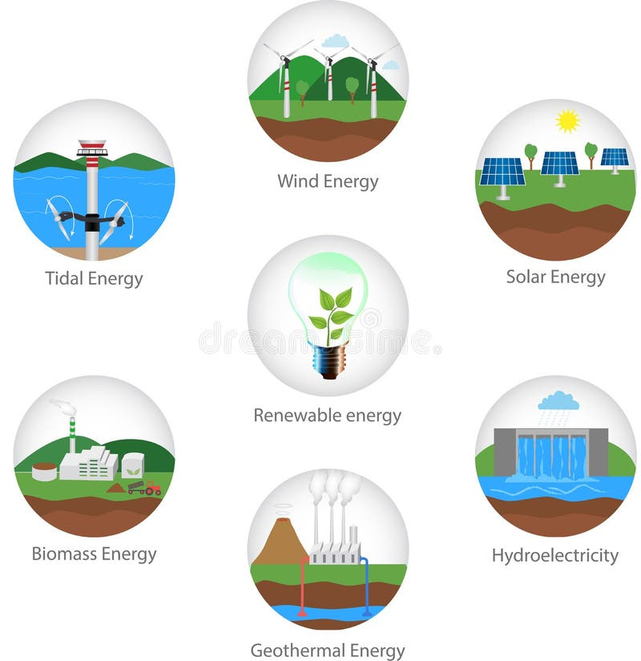
Harnessing Nature's Power: Key Renewable Energy Sources
The main types of renewable energy sources available today include wind, solar, hydroelectric (or hydropower), and bioenergy [1, 3]. Geothermal power is also a significant renewable energy type in some countries [3]. These renewable resources are considered virtually inexhaustible [5].

Slide 2

Harness the Sun: Benefits of Solar Power
The advantages of solar power include:
It allows you to keep the lights on if the electrical grid goes down [1].
The sun is an unchangeable and inexhaustible source of energy [2].
Solar energy can power your home [3].
It can help reduce your electricity costs [3].

Slide 3
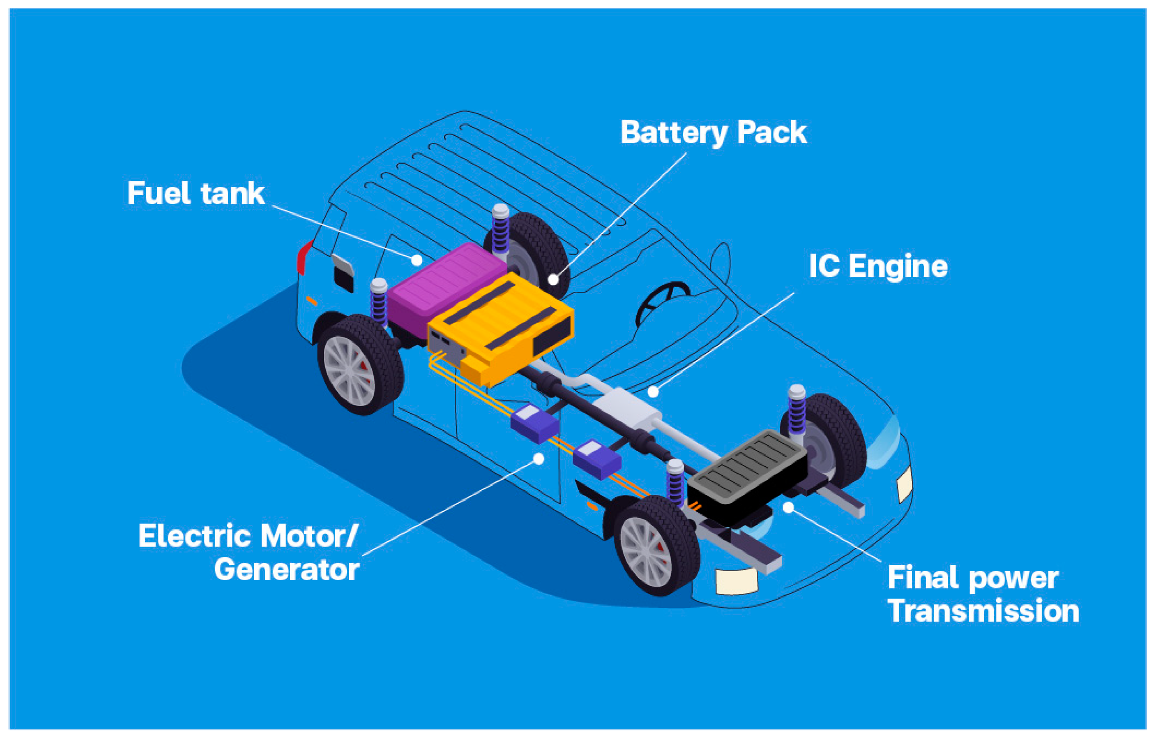
Solar Power: Addressing the Challenges and Drawbacks
Some challenges and disadvantages of solar power include:
Some people cannot afford the monthly payments to finance solar installations [1].
Solar power can potentially cost more over the years [1].
Solar panels are not suitable for every homeowner's situation, such as some mobile homeowners [4].
For whole-house backup power, a single battery might not be sufficient to run the entire system [3].

Slide 4
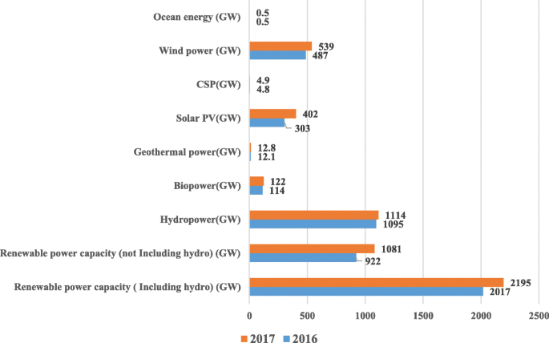
Renewable Energy's Future: Investment Challenges, Economic Growth
Based on the provided web search context, the future outlook for renewable energy includes several considerations:
One perspective suggested that if a certain amount of power was needed, costing another trillion in renewable energy, then the outlook wasn't good [1].
Renewable energy is also noted for "firing up emerging industries" and is explored as part of the future of location technology across the business world [4].
A major program of renewable energy development is anticipated to involve large costs [5].
There are discussions about renewable energy tax credit finance series and negotiating tax credit equity investment processes in the future, with investors coming in for cash and depreciation benefits [3].

