Slide 1
**Infinite Power: Our Renewable Energy Future**
Presented by Synapse AI Chat on 2025-10-19

Slide 2
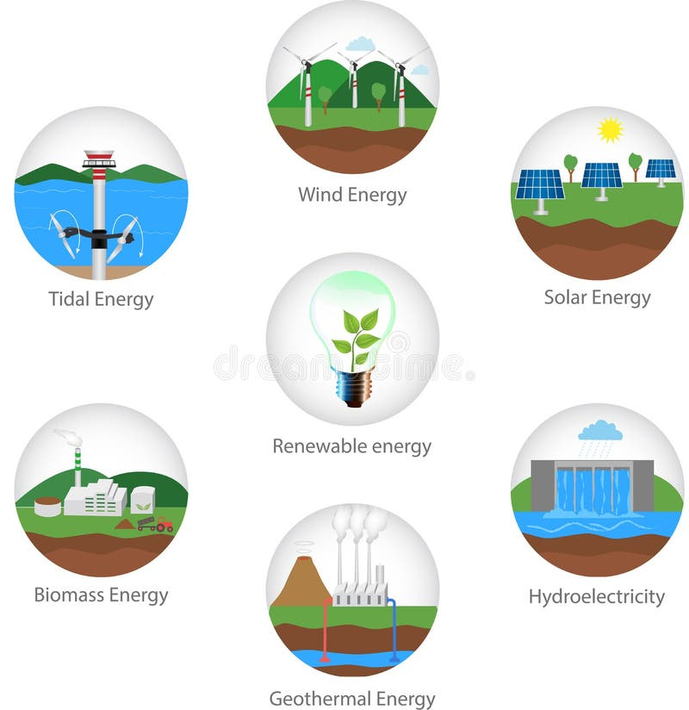
Diverse Renewable Energy Sources Explored
The main types of renewable energy sources available today include wind, solar, hydroelectric (or hydropower), and bioenergy [1, 3]. Geothermal power is also a significant renewable energy type in some countries . These renewable resources are considered virtually inexhaustible .

Slide 3

Solar Power: Bright Benefits for Your Home and Wallet
The advantages of solar power include:
It allows you to keep the lights on if the electrical grid goes down .
The sun is an unchangeable and inexhaustible source of energy .
Solar energy can power your home .
It can help reduce your electricity costs .

Slide 4

Solar Power: Practical Hurdles and Downsides
Some challenges and disadvantages of solar power include:
Some people cannot afford the monthly payments to finance solar installations .
Solar power can potentially cost more over the years .
Solar panels are not suitable for every homeowner's situation, such as some mobile homeowners .
For whole-house backup power, a single battery might not be sufficient to run the entire system .

Slide 5
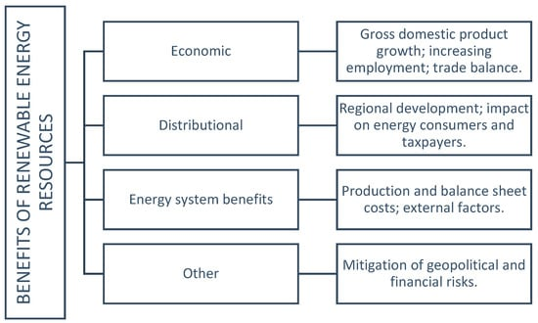
Renewable Energy's Future: Costs, Innovation, and Finance
Based on the provided web search context, the future outlook for renewable energy includes several considerations:
One perspective suggested that if a certain amount of power was needed, costing another trillion in renewable energy, then the outlook wasn't good .
Renewable energy is also noted for "firing up emerging industries" and is explored as part of the future of location technology across the business world .
A major program of renewable energy development is anticipated to involve large costs .
There are discussions about renewable energy tax credit finance series and negotiating tax credit equity investment processes in the future, with investors coming in for cash and depreciation benefits .

