Slide 1


MapReduce vs Spark
CS5229 – Big Data Analytics Technologies
Hashani Kithulgoda
239327K

Slide 2
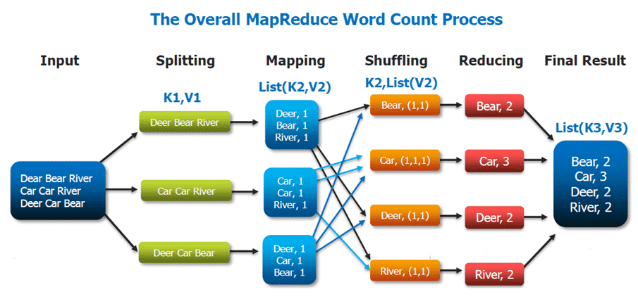
MapReduce
Parallel processing software framework for batch data distributed in multiple clusters.
Main Features
Process structured/unstructured data
Fault tolerant
Schedules resources using YARN
Process data locally
Notes:
MapReduce
Input – Input separate key value pairs
Split Phase – each data line is passed to individual mapper instance
Map Phase – Transform each input into key-value pair
Shuffle Phase – Perform sort and each list must have identical keys
Reduce Phase – Aggregate values and reduce into one key-value pair
Output – Aggregated list of key-values

Slide 3
Spark
It is a real-time/batch data processing framework to process big data in a distributing computing environment.
Main Features
Process, query, analyze, transform
Fast processing with RDD – resilient distributed datasets
In memory computing
Multi language support
Fault tolerant
Support better analytics with algorithms, SQL queries, complex analytics
Notes:
RDD – saves time in reading, writing operations hence making it faster
In memory computing – data is stored in RAM which makes it easily accessible
Multi language – supports Java, Scala, R, Python

Slide 4
Demo
These queries are processed using MapReduce and Spark;
Year wise carrier delay from 2003-2010
Year wise NAS delay from 2003-2010
Year wise Weather delay from 2003-2010
Year wise late aircraft delay from 2003-2010
Year wise security delay from 2003-2010

Slide 5
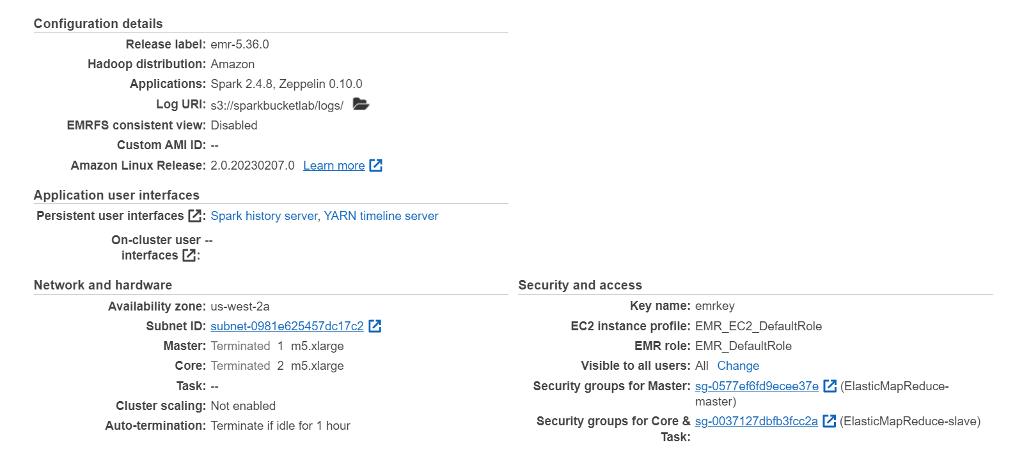
Spark Cluster
Dig 1: Spark cluster created with 2 cores and 1 master

Slide 6
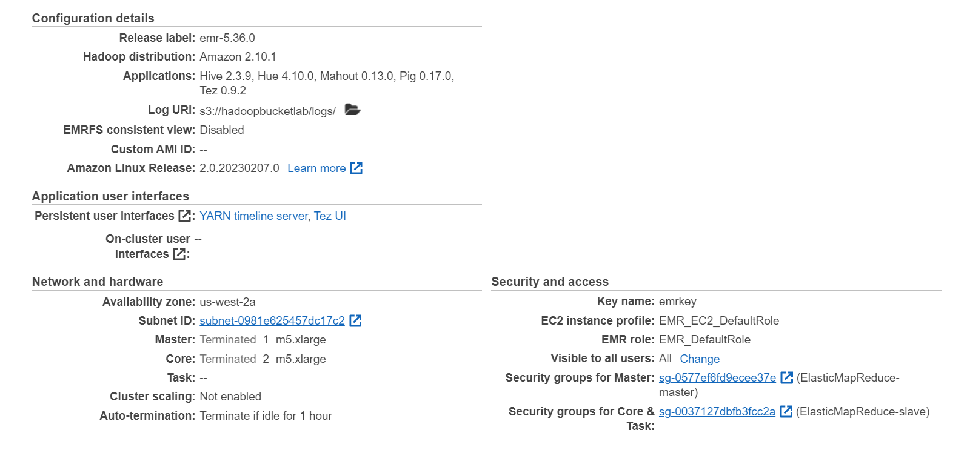
MapReduce Cluster
Dig 2: MapReduce cluster created with 2 cores and 1 master

Slide 7
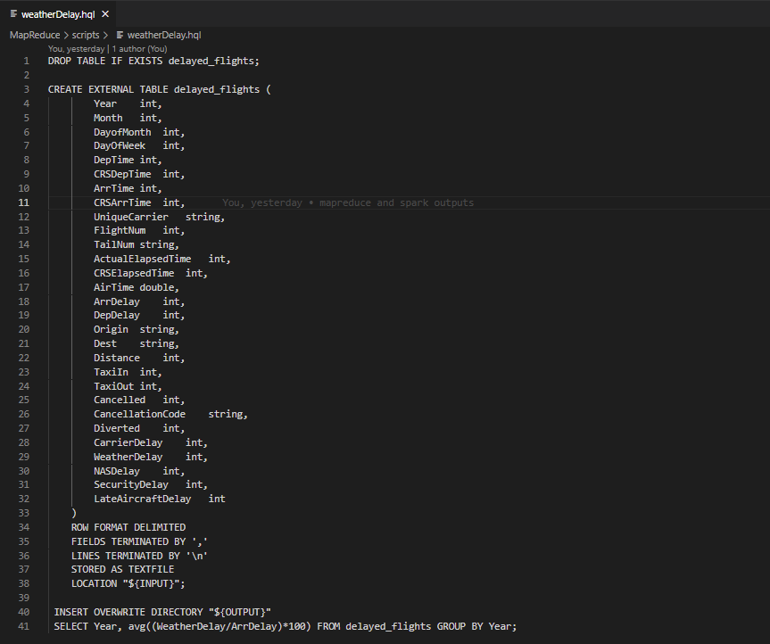
Cluster Inputs
Dig 3: Hive Query

Slide 8
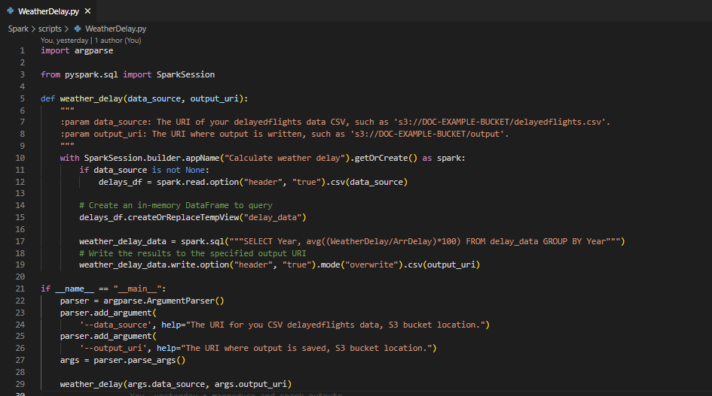
Cluster Inputs
Dig 4: Python script

Slide 9
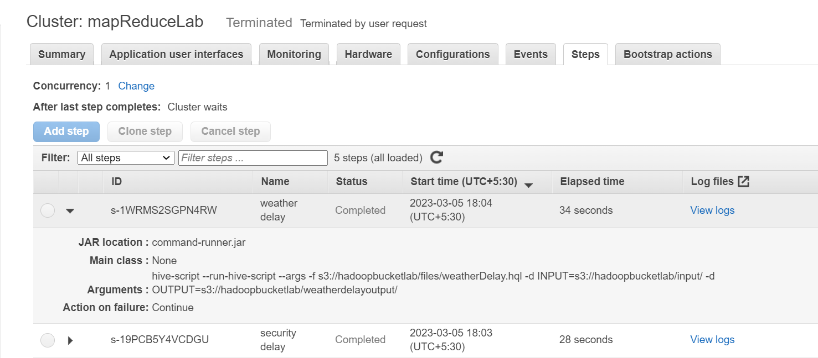
Jobs
Dig 5: MapReduce cluster jobs

Slide 10
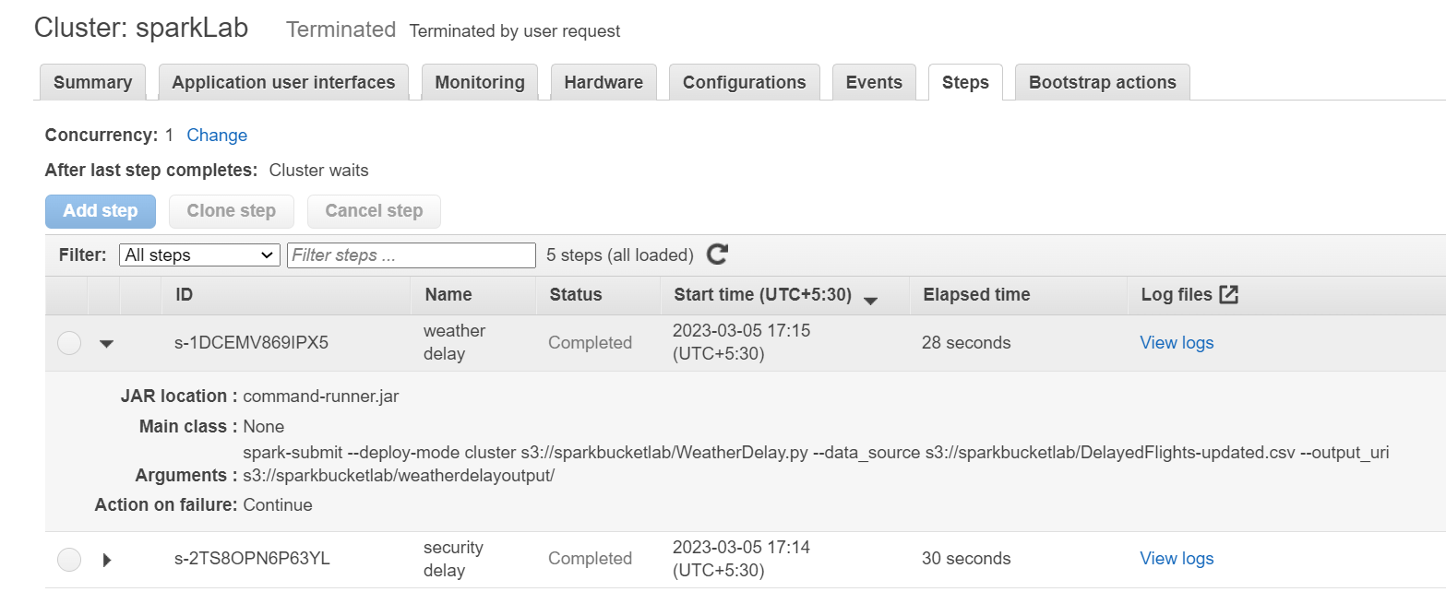
Jobs
Dig 6: Spark cluster jobs

Slide 11
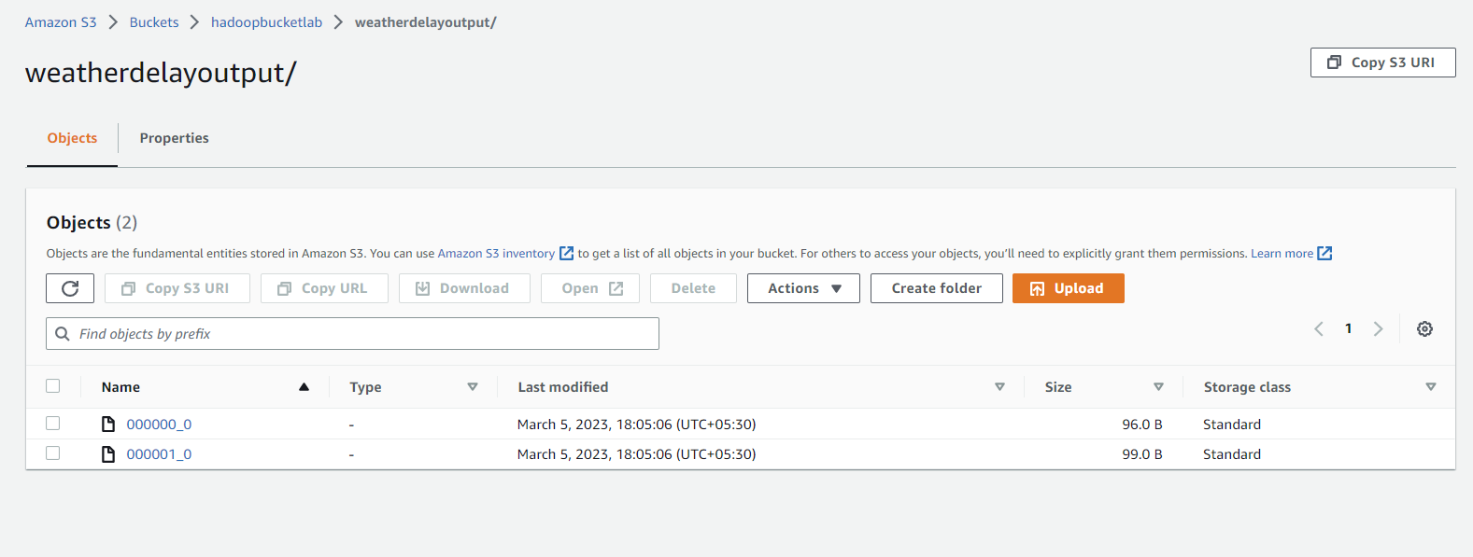
Output
Dig 7: MapReduce cluster output

Slide 12
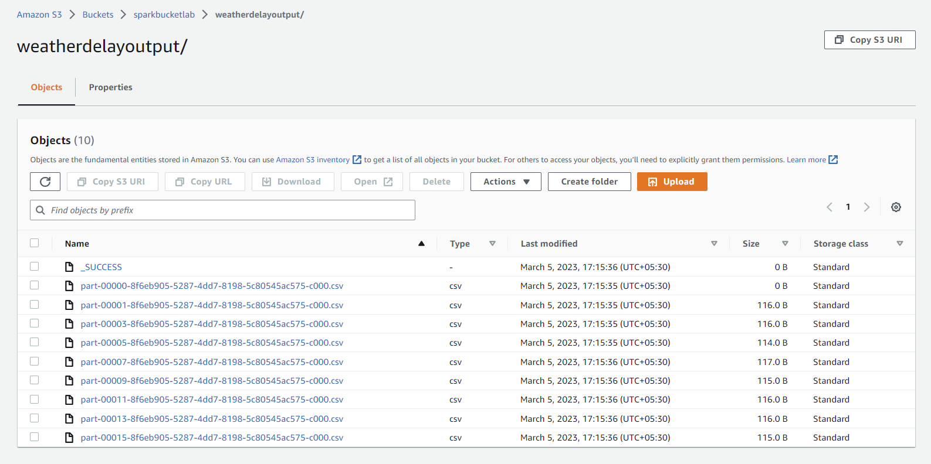
Output
Dig 8: Spark cluster output

Slide 13
MapReduce vs Spark
 | Ease of use | Fast processing
MapReduce | Process structured/unstructured data easily compared to traditional data systems Error prone since programmer has to handle complex algorithms | Faster than traditional systems Disk-based processing slows down processing
Spark | User friendly Support multiple languages Easy ETL | Faster compared to MapReduce because of in-memory data processing

Slide 14
Conclusion
Dig 9: Query execution time vs iteration for Carrier Delay
Notes:
Although spark has lesser elapsed time compared to MapReduce, this data doesn’t show a clear pattern to arrive at a proper conclusion

Slide 15
Conclusion
Dig 10: Query execution time vs type of query
Notes:
Carrier delay query execution has taken more time in both Spark as well as MapReduce and generally Spark-SQL queries are faster than HQL.

Slide 16
Conclusion
Spark-SQL queries process faster compared to Hive queries because spark uses in-memory data processing.
Running the same query more times in both frameworks didn’t produce clear patterns.
Extraction, loading and processing data is easier with spark.

Slide 17
Thank You!

