Slide 1

Notes:
Speaker notes will appear here.

Slide 2

Notes:
- Doing Drupal for 15+ years. - Programming for 20. - This is a picture of a Lily58 mechanical keyboard.

Slide 3
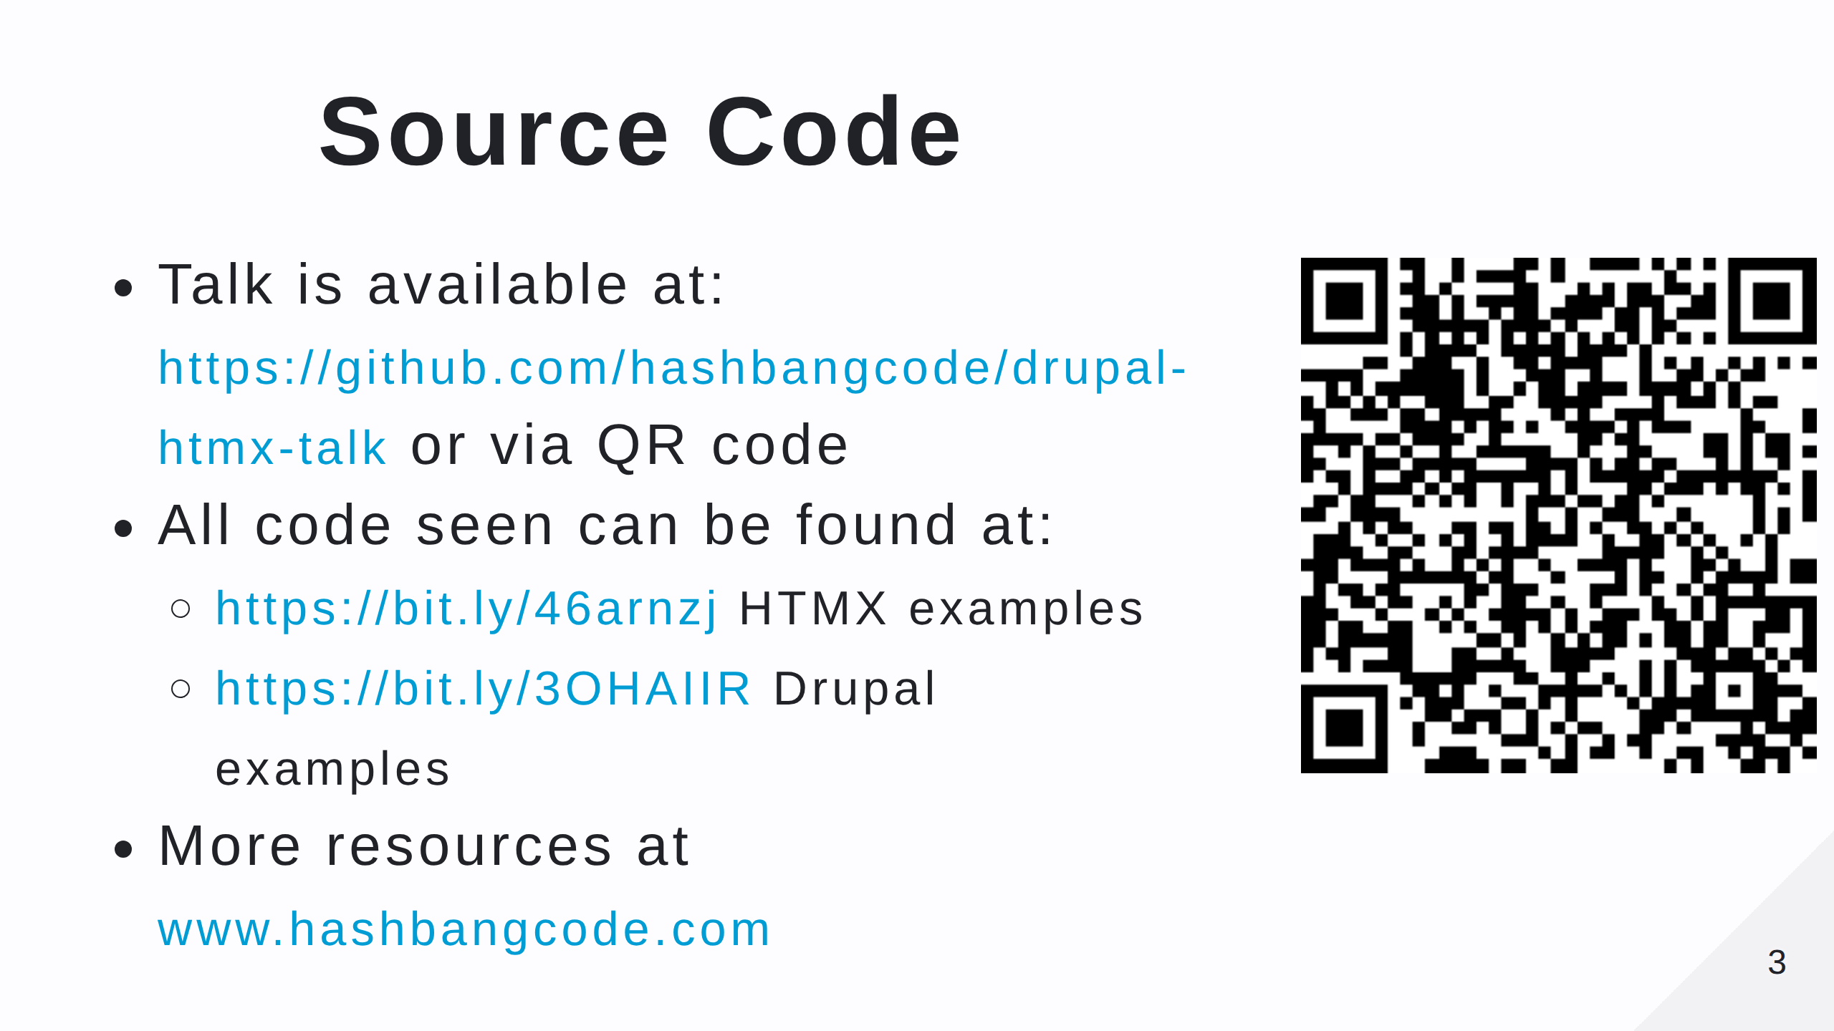
Notes:
- Scan the QR code for the talk repo. Which has links to all of the resources you need. - There's also some information about HTMX and links to these projects on hashbangcode.

Slide 4


Slide 5
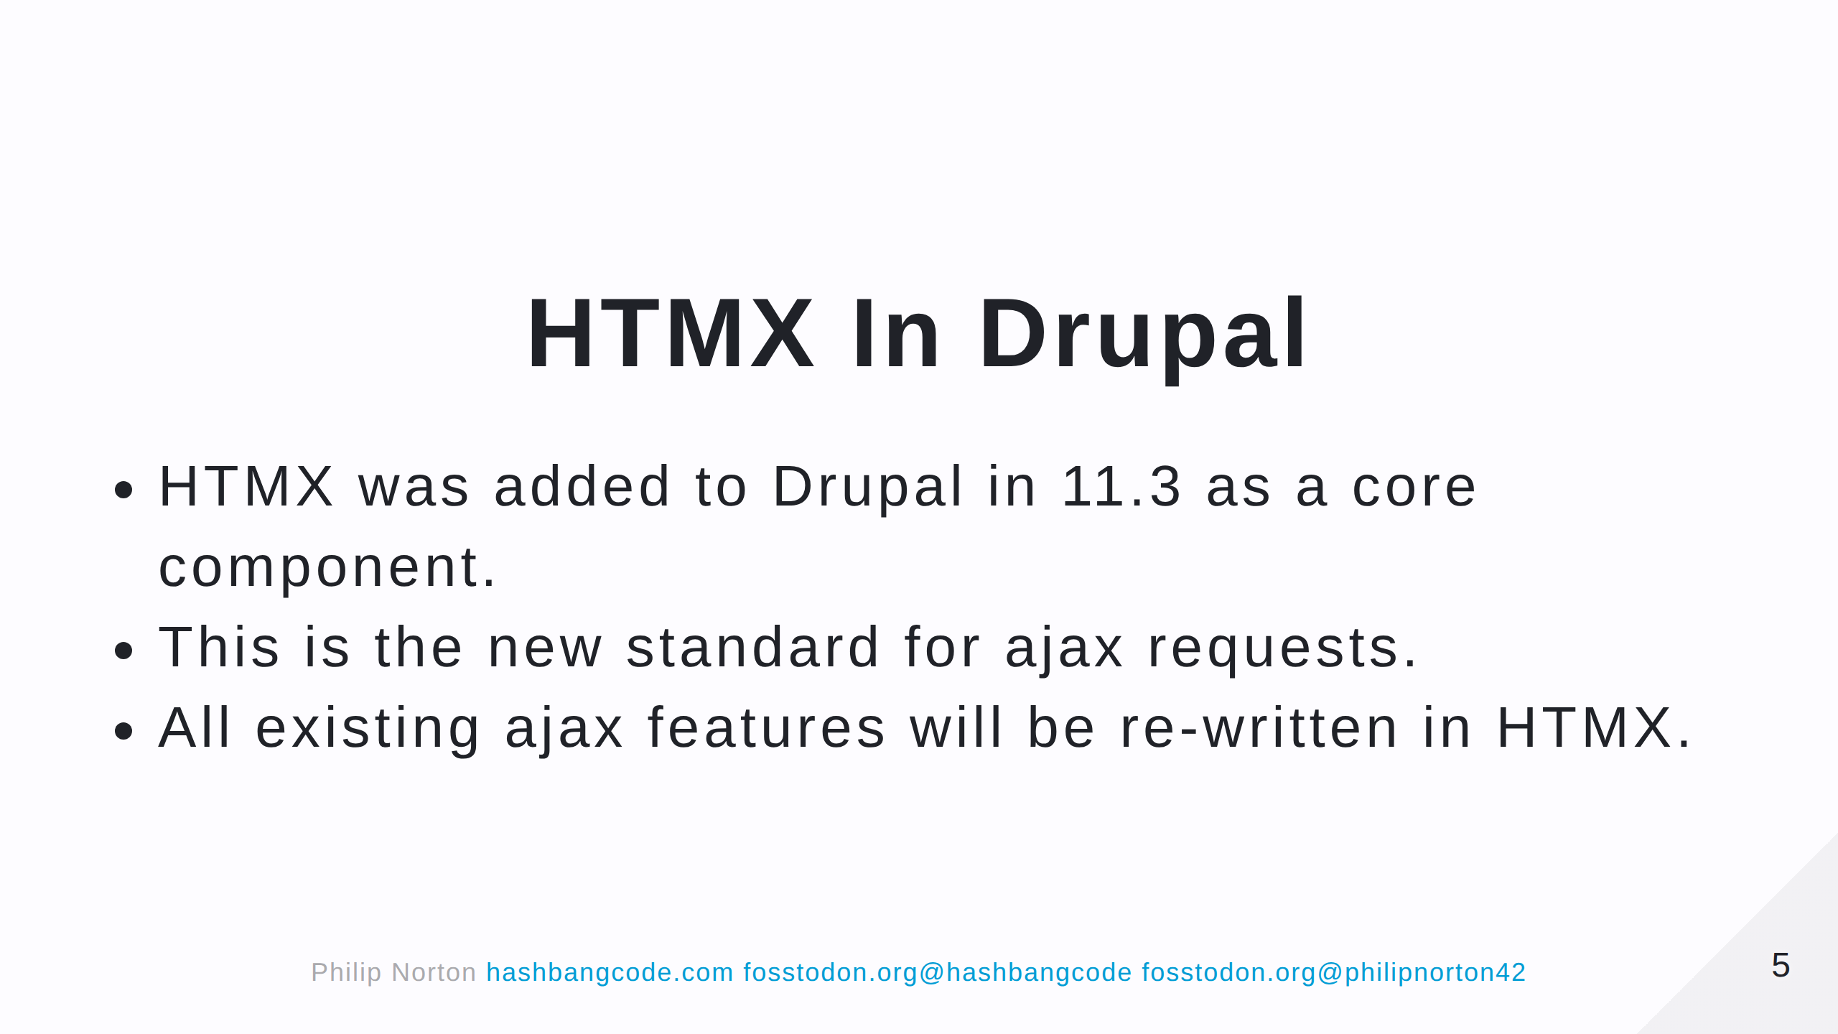
Notes:
- Technically, it's been in Drupal since 11.2, but only as experimental. - First I'm going to introduce you to HTMX. - Run a couple of examples using PHP has a backend. - Then look at using HTMX in Drupal.

Slide 6
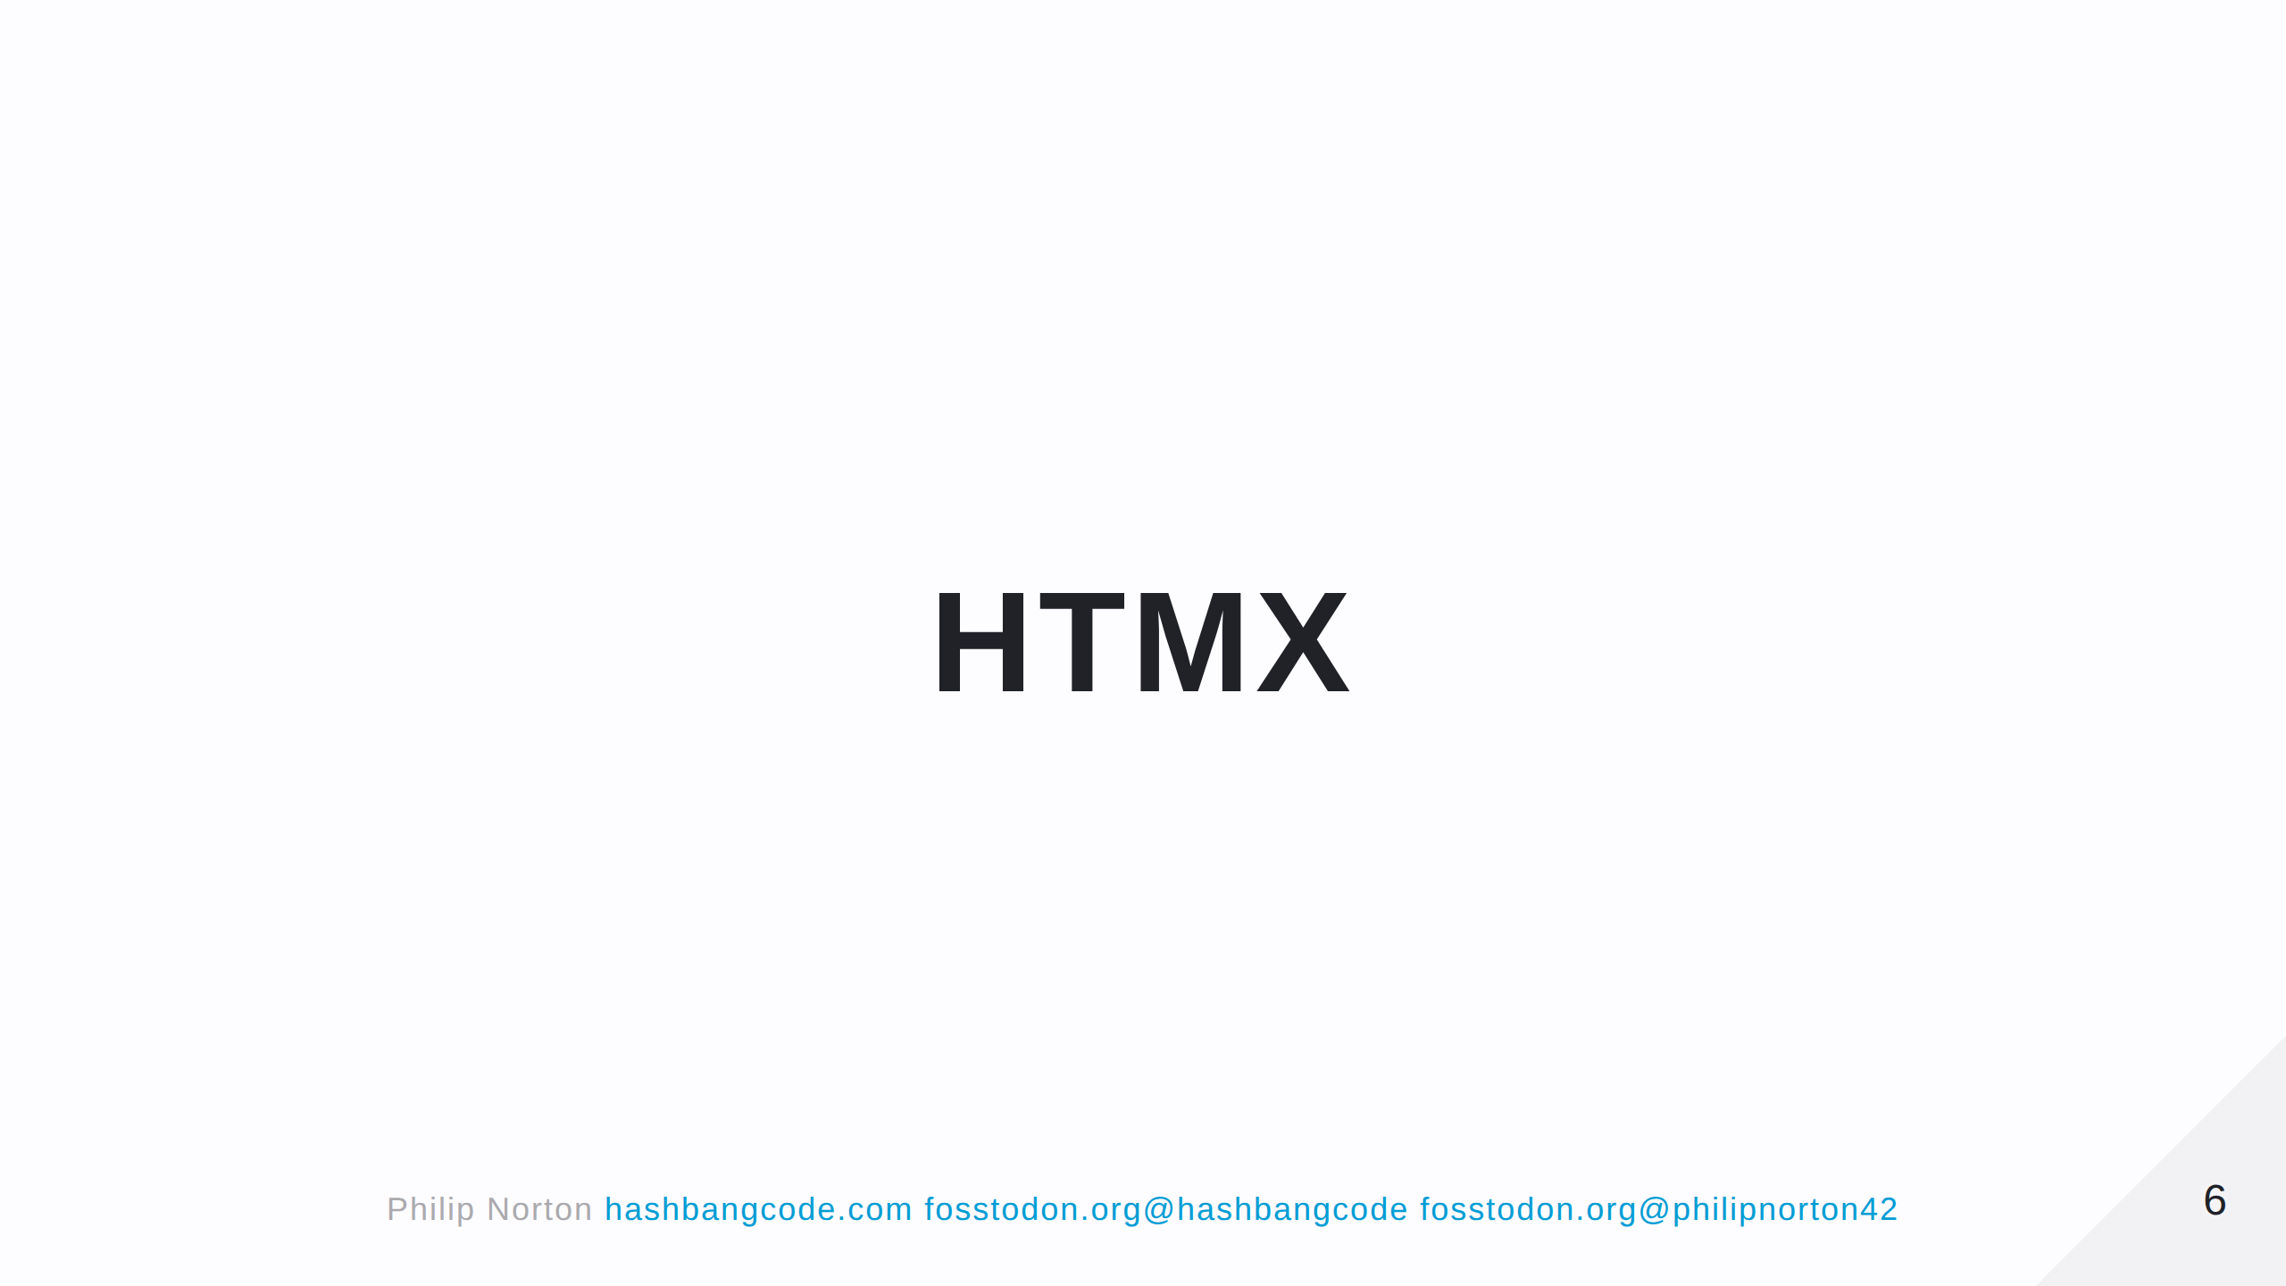

Slide 7
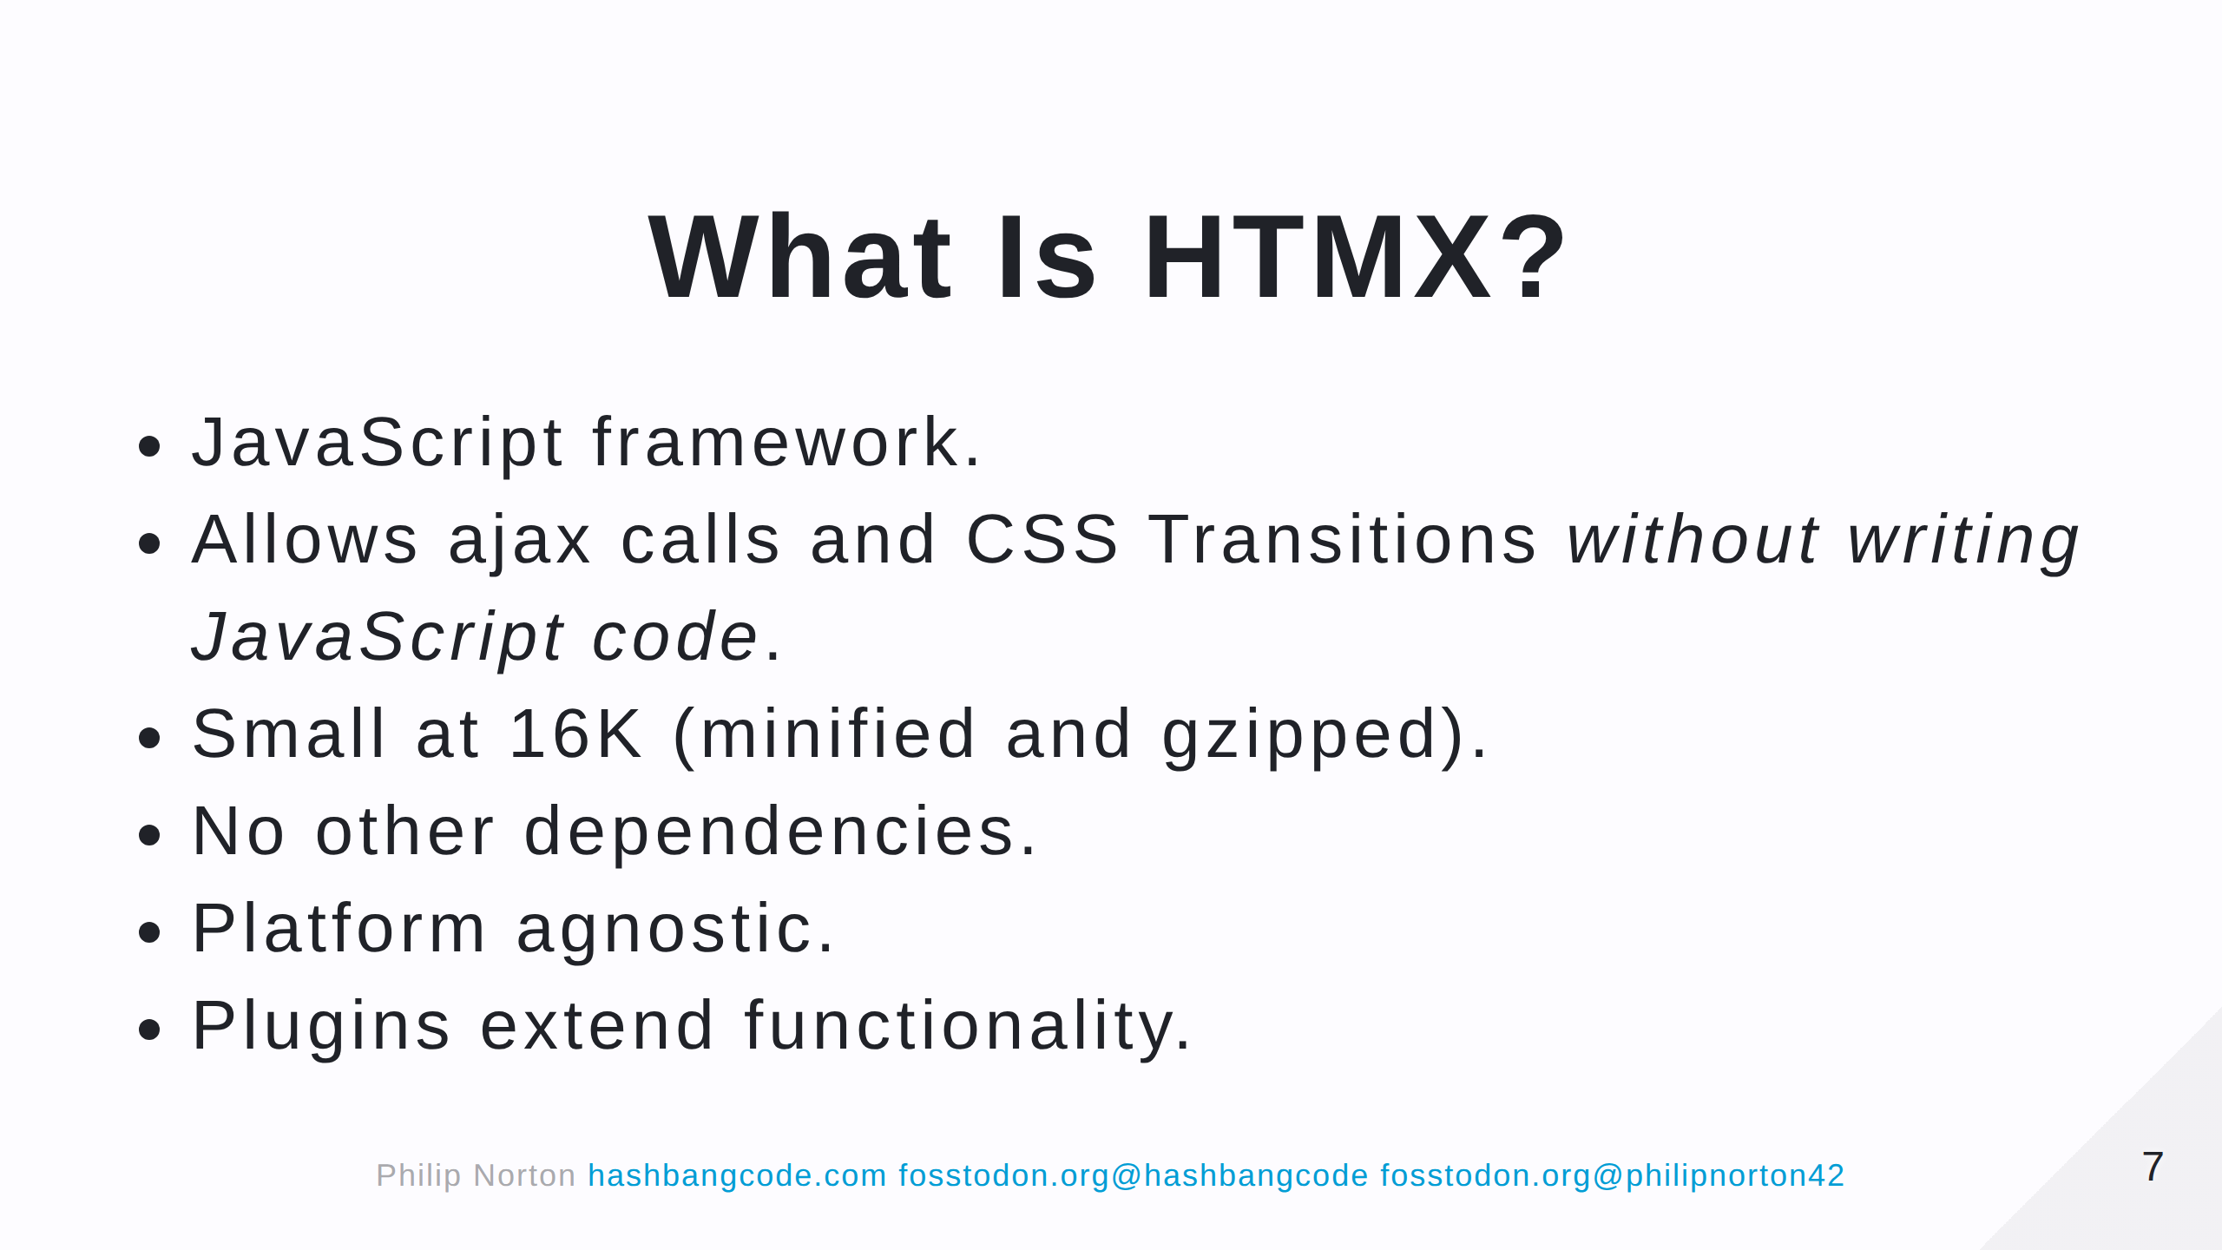
Notes:
Using HTMX means that you don't need to write any JavaScript to make ajax requests. Everything is powered through HTML attributes.

Slide 8
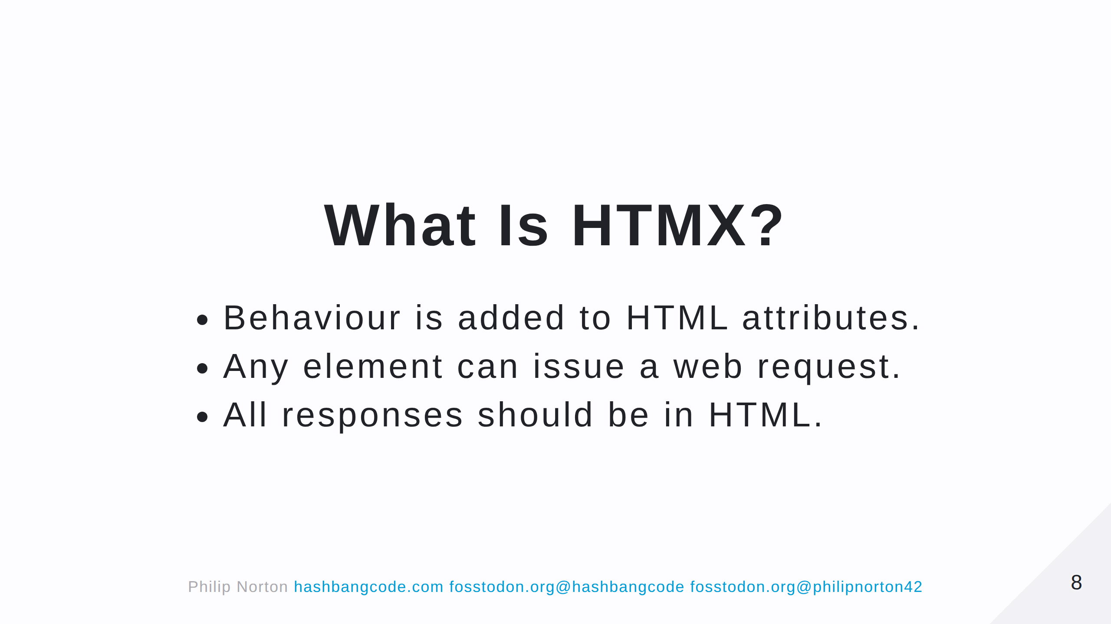
Notes:
No strange JSON formatted data. The state of the application is in the HTML, rather than kept external to it.

Slide 9
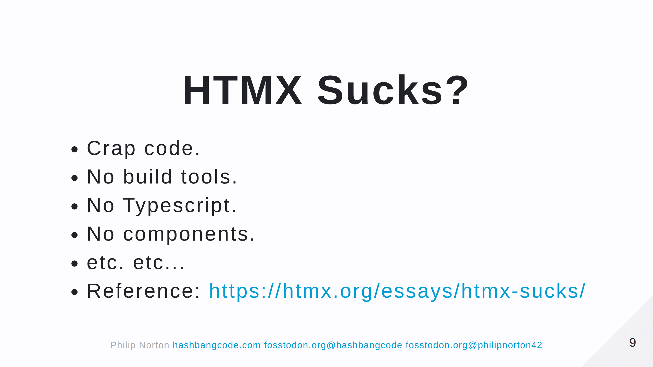
Notes:
- To address the elephant in the room. - Ok, so HTMX doesn't solve all the problems, but what framework would? - As a pragmatist, I like HTMX as it solves a problem and means we can move away from another proprietary JSON standard that is highly complex and poorly documented. - Drupal is GOOD at producing HTML output.

Slide 10
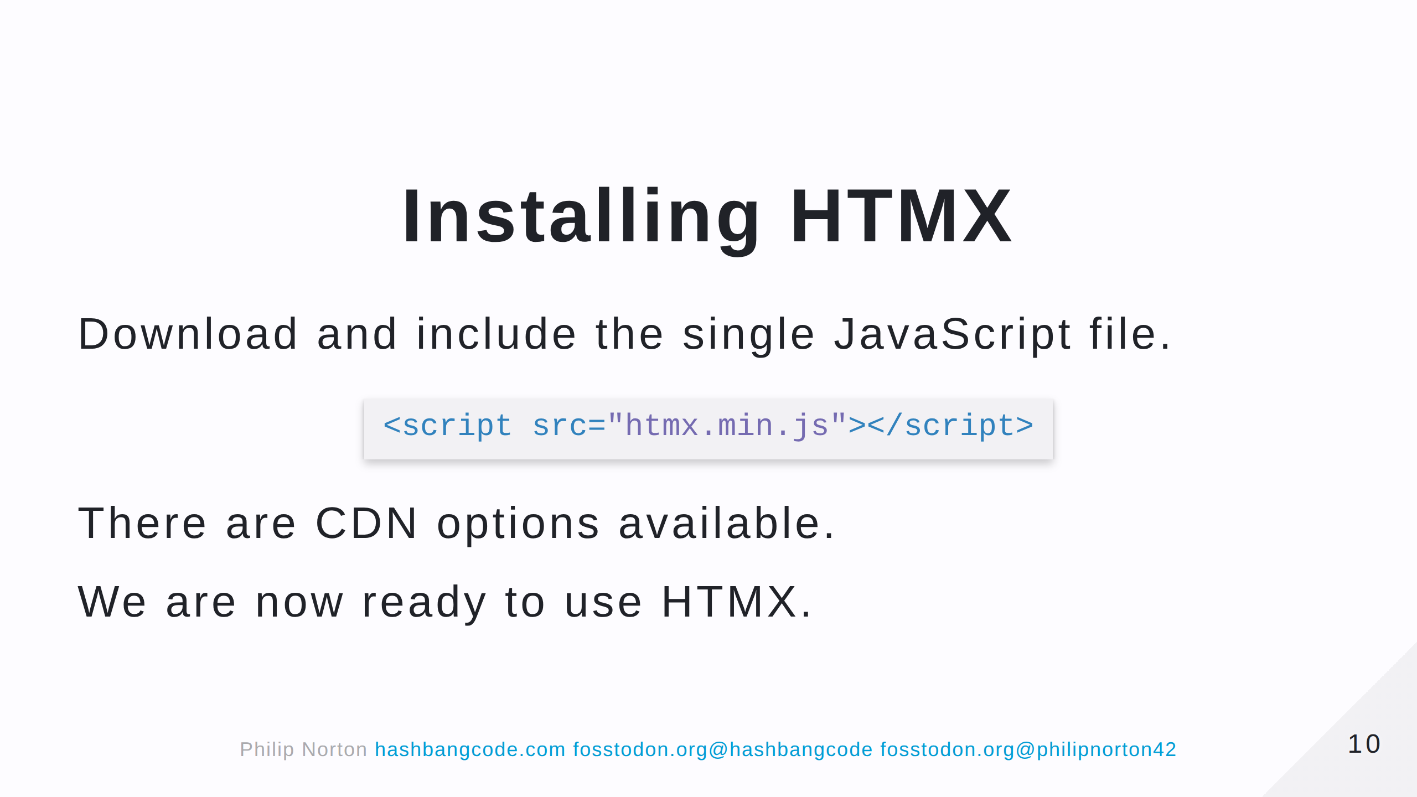
Notes:
- Just needs one file to be present.

Slide 11
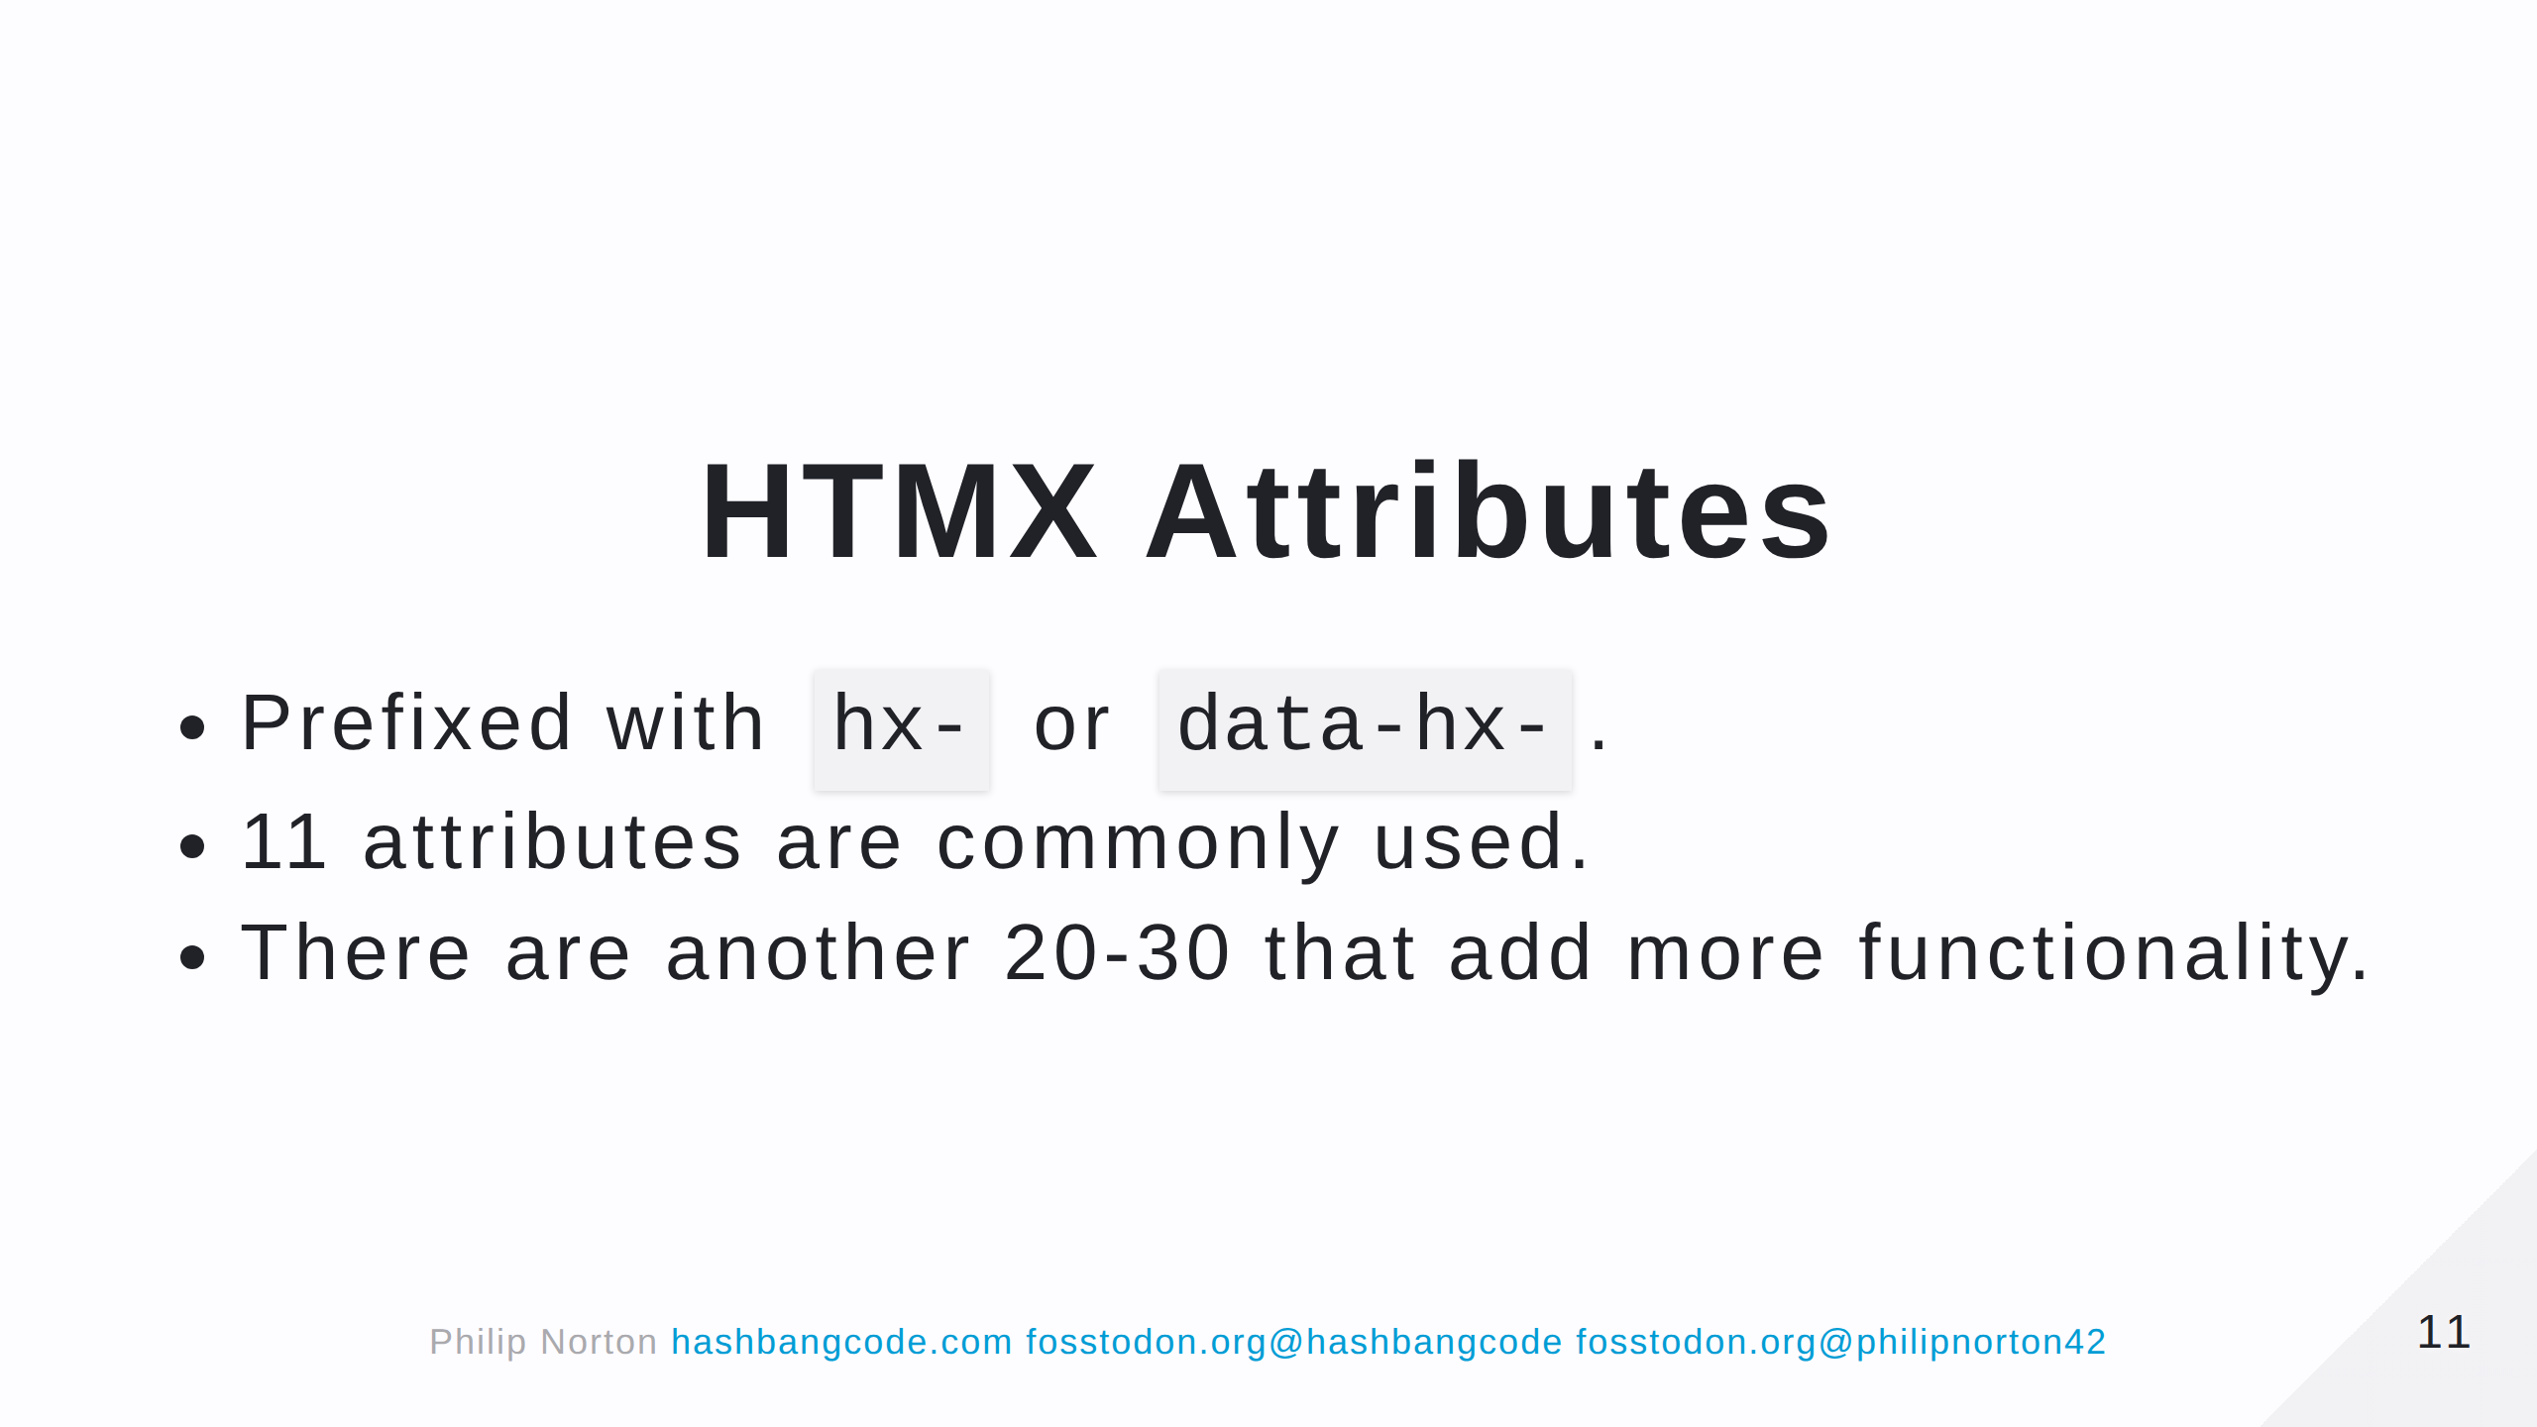

Slide 12
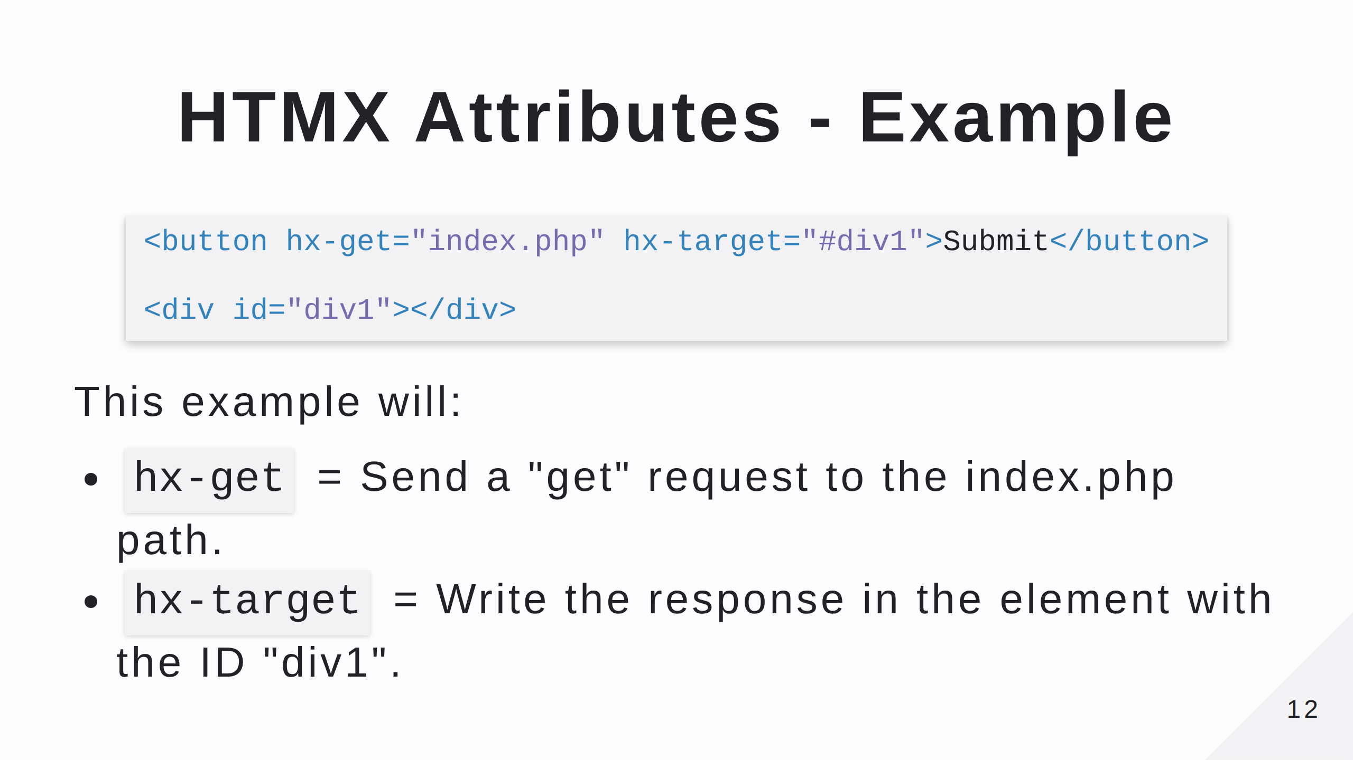
Notes:
- We could also add 'hx-trigger'. The event that triggers the request. As the default is 'click' for buttons it isn't needed here. - What does the response look like? - It just needs to return HTML.

Slide 13
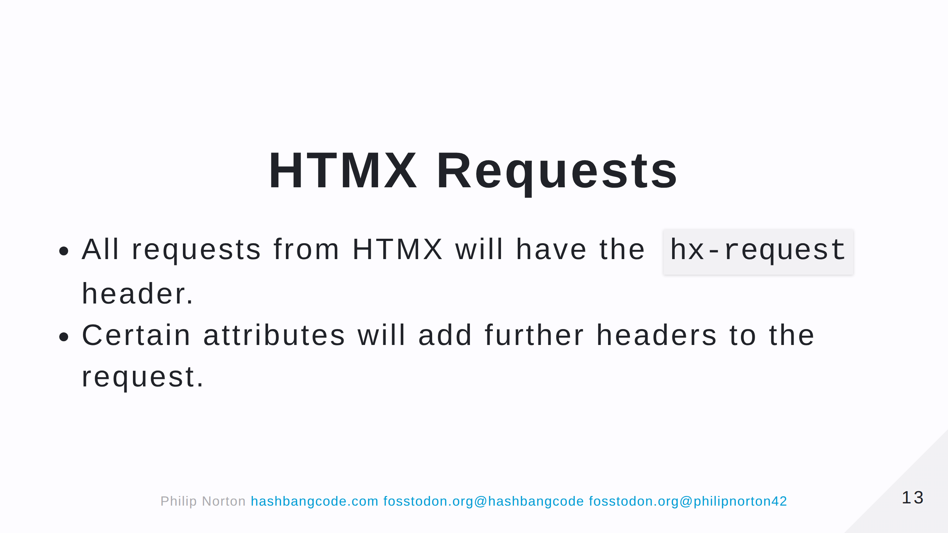

Slide 14
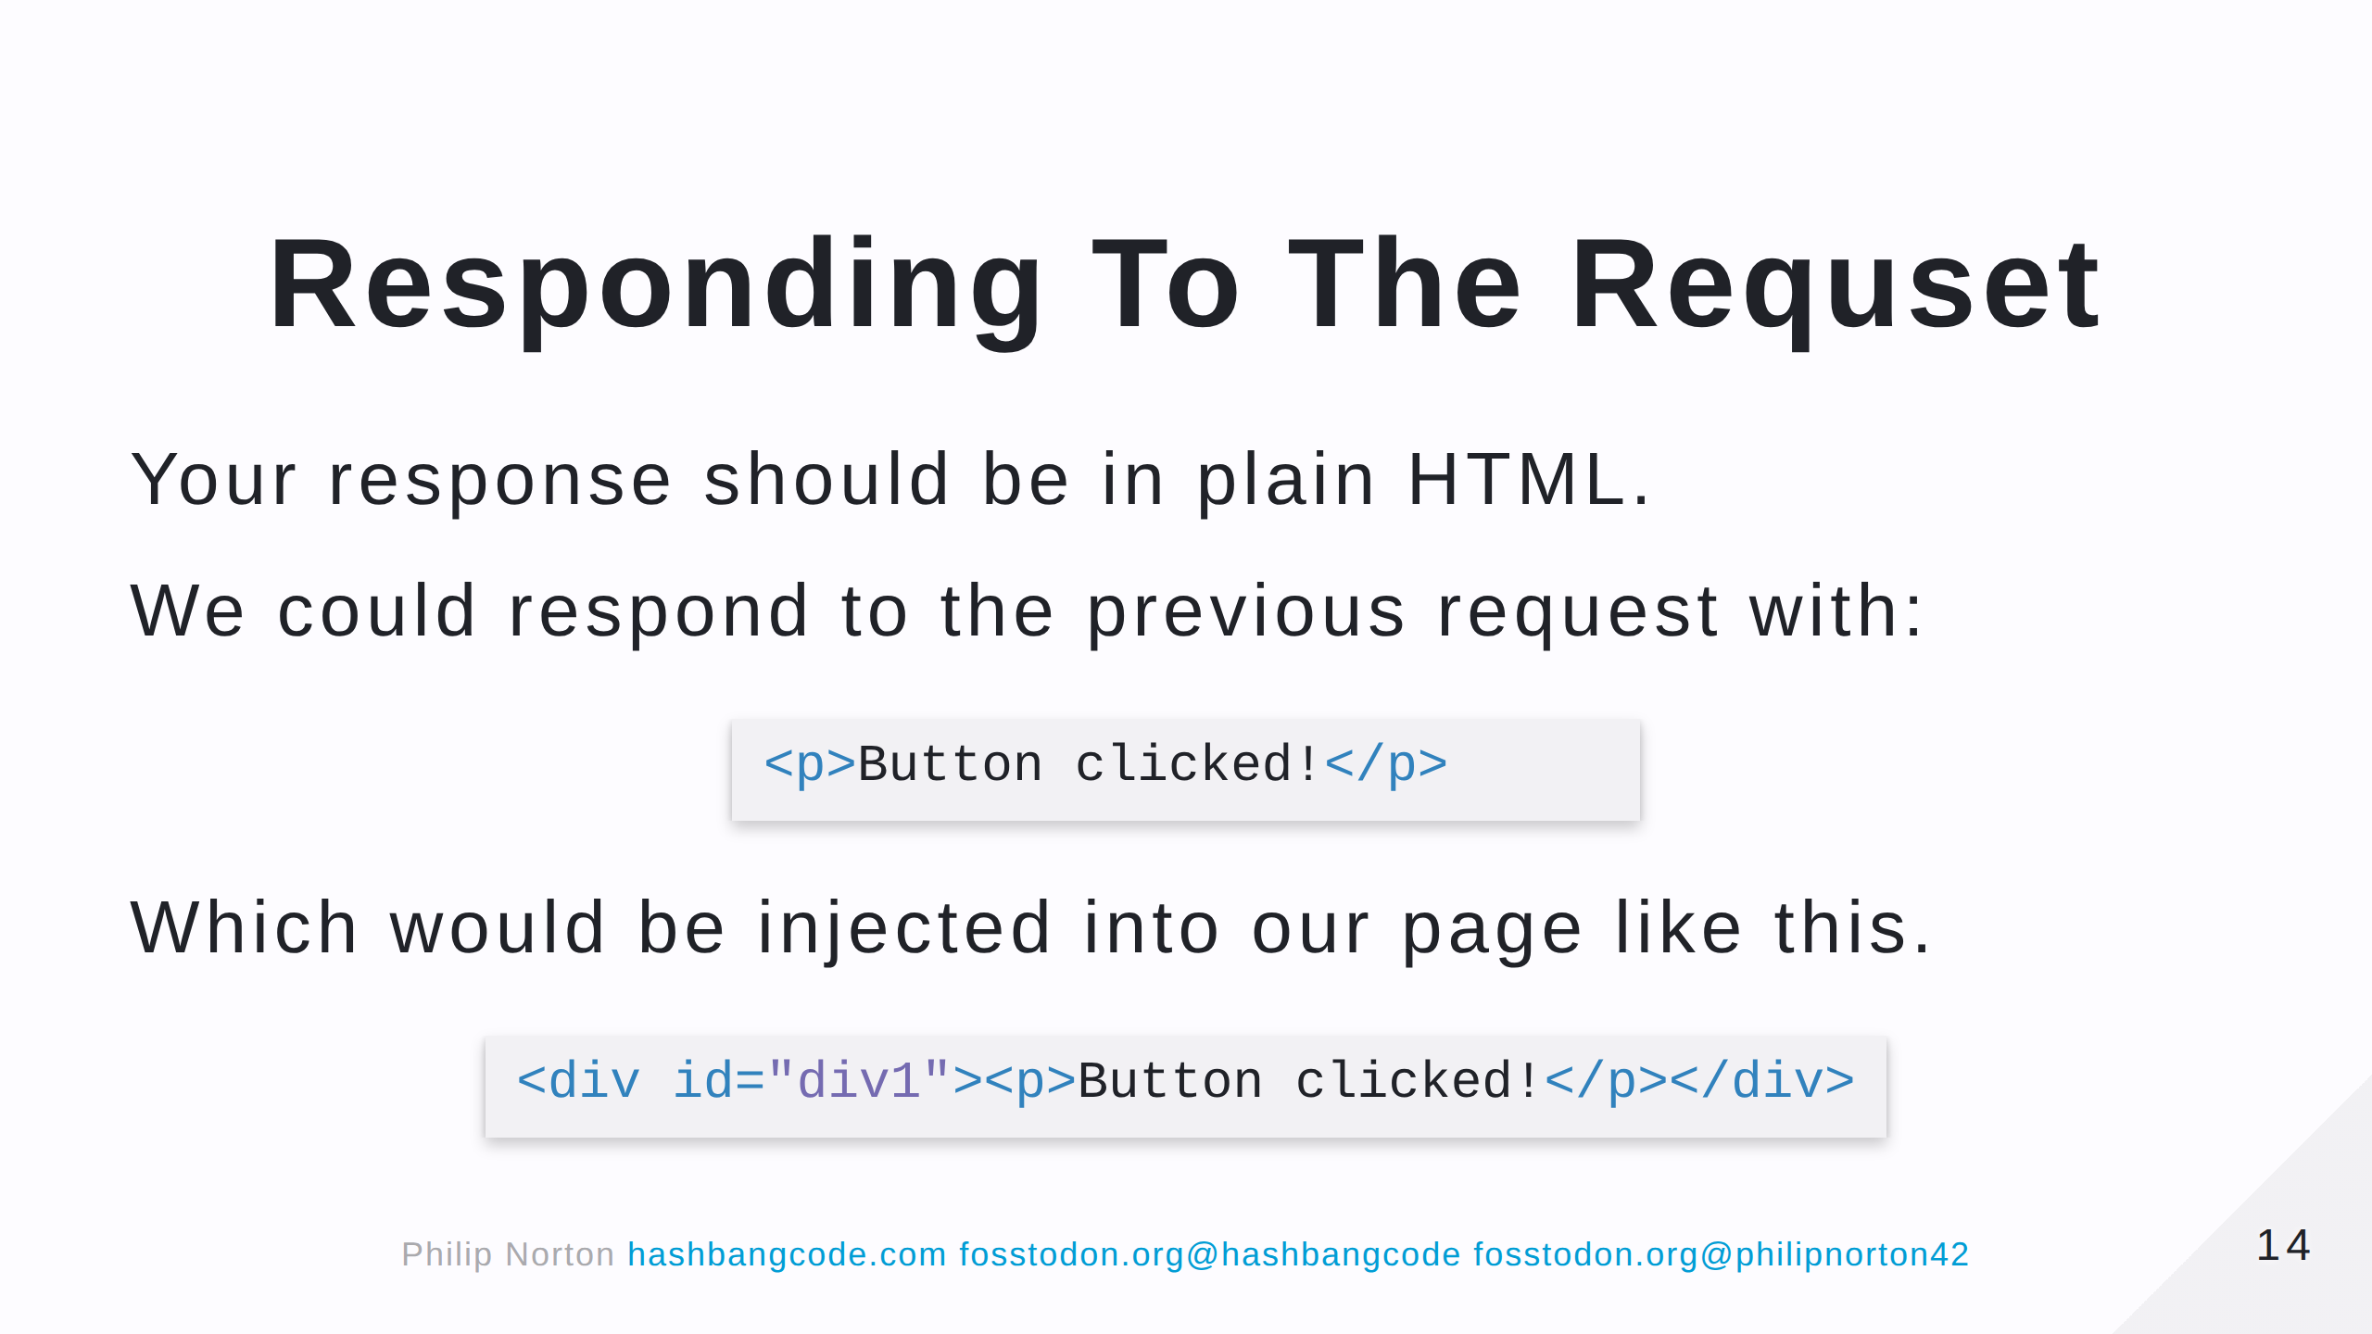
Notes:
Let's do something more interesting.

Slide 15
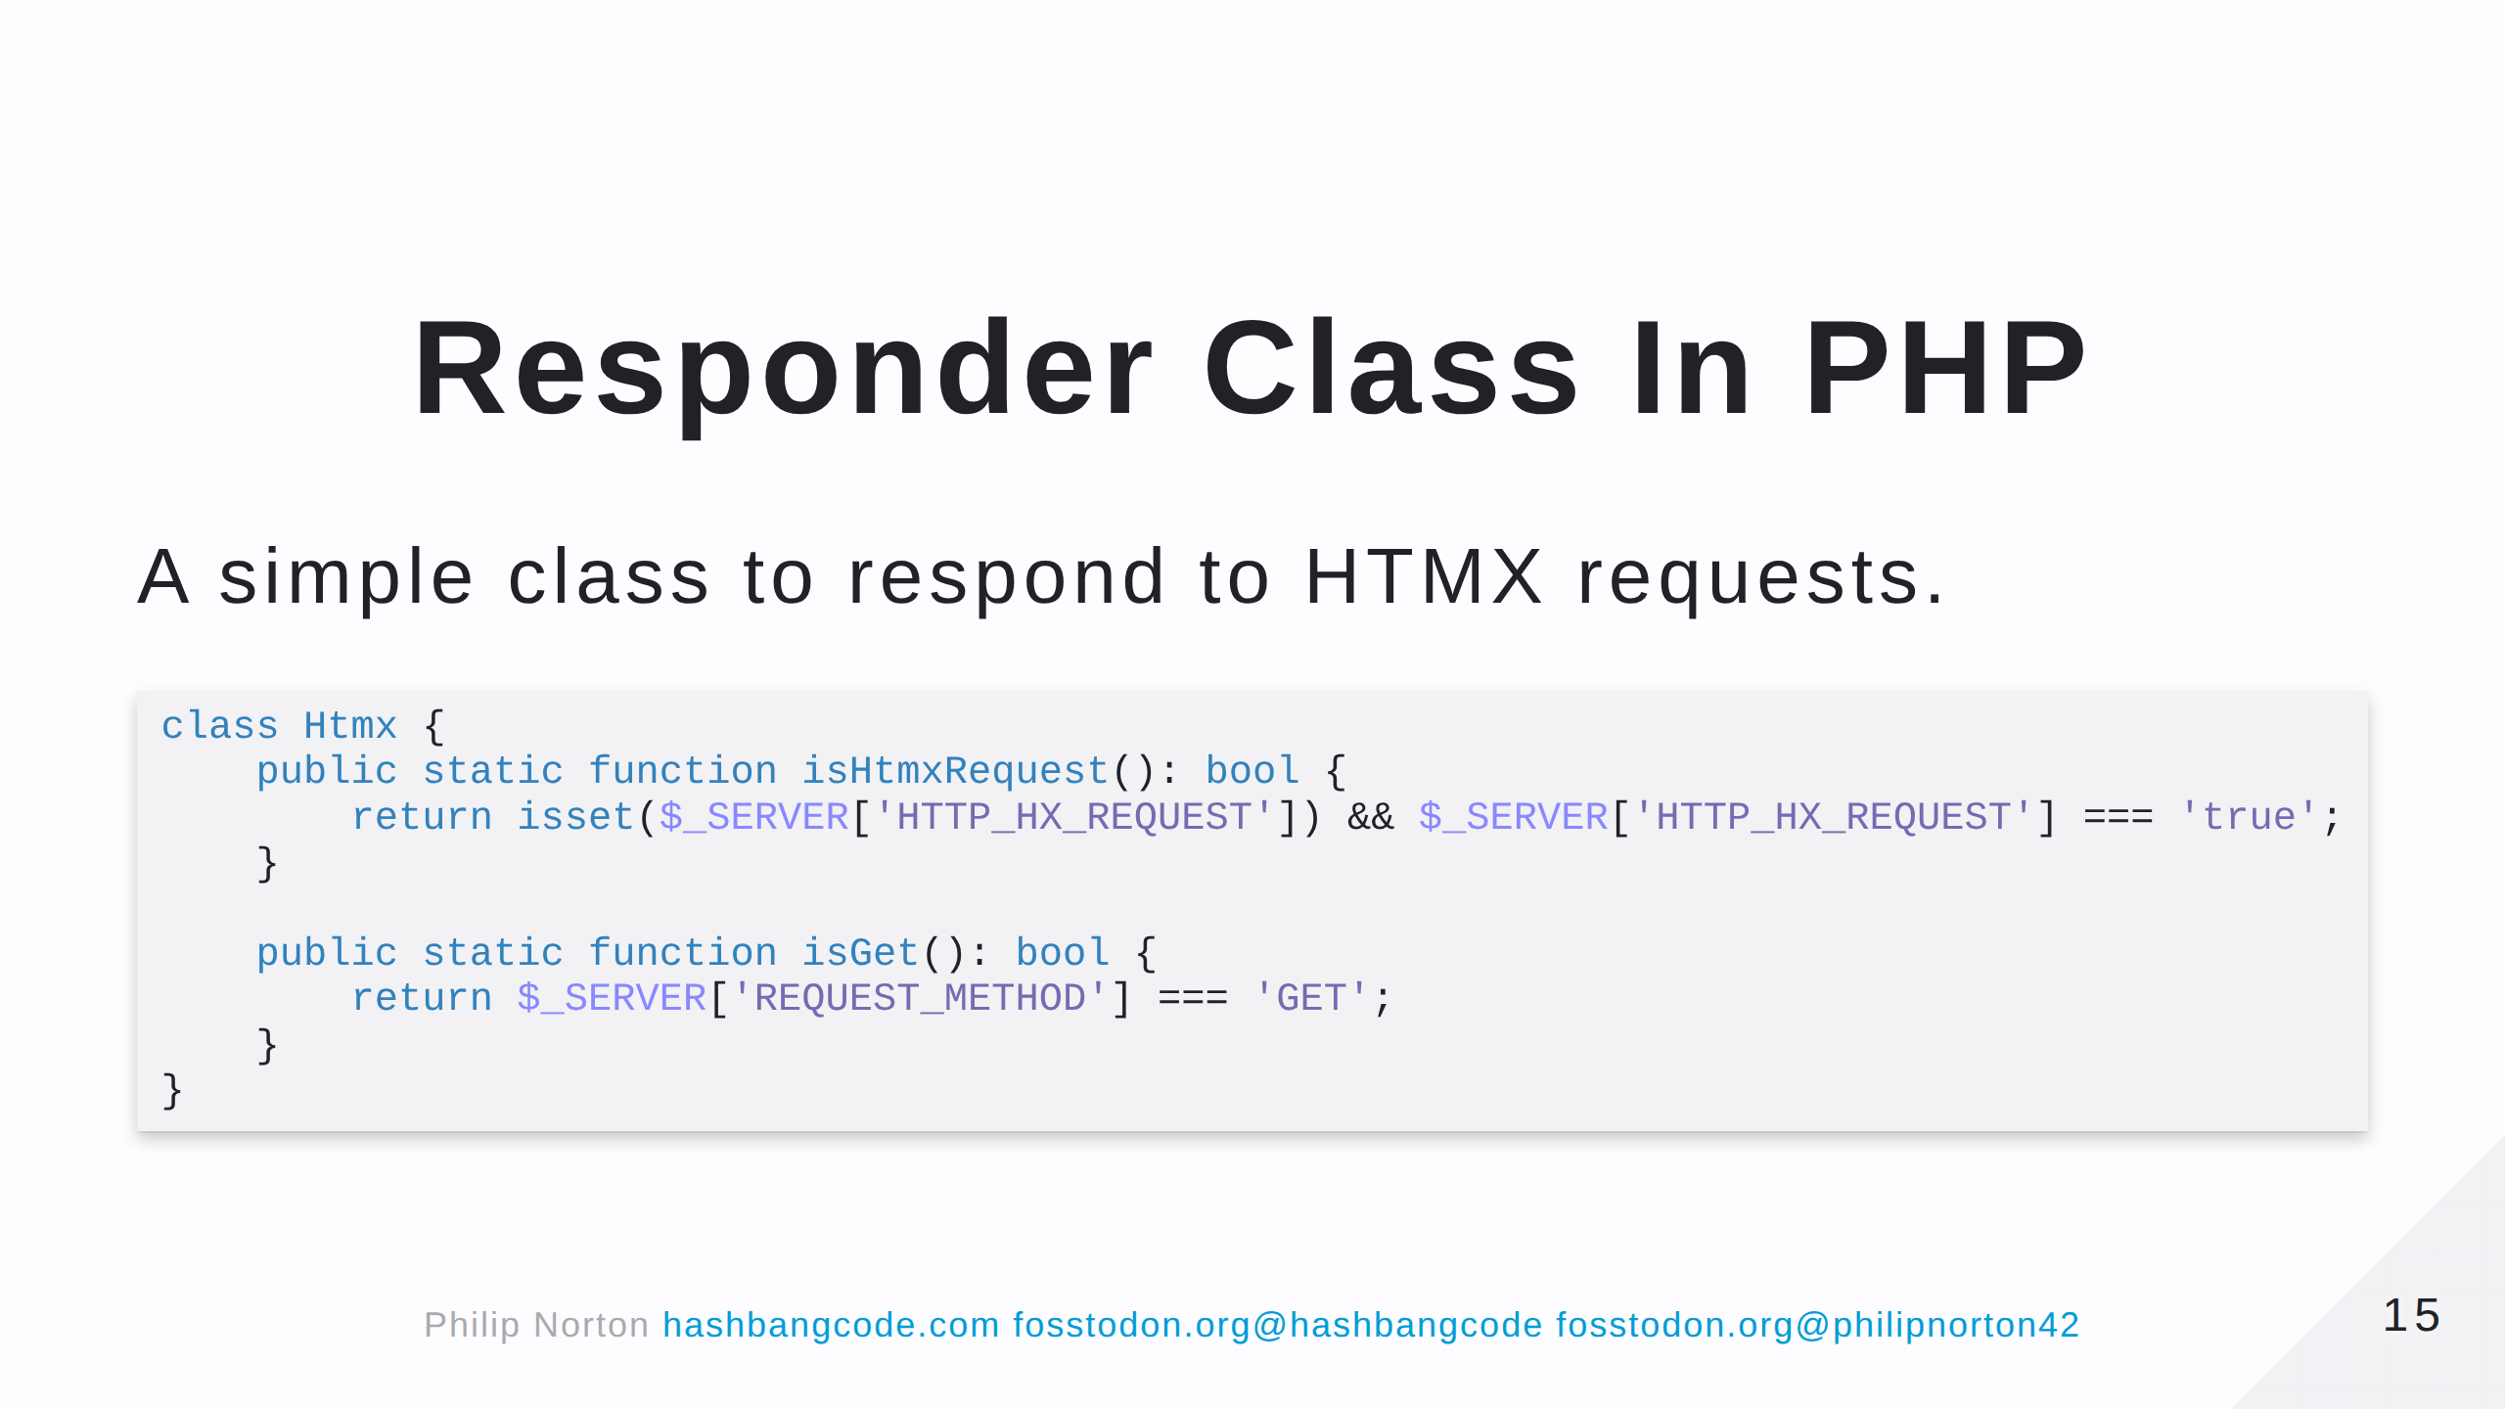
Notes:
- Generally, you shouldn't need to detect that the request is a HTMX request, but Drupal makes use of it quite a bit.

Slide 16
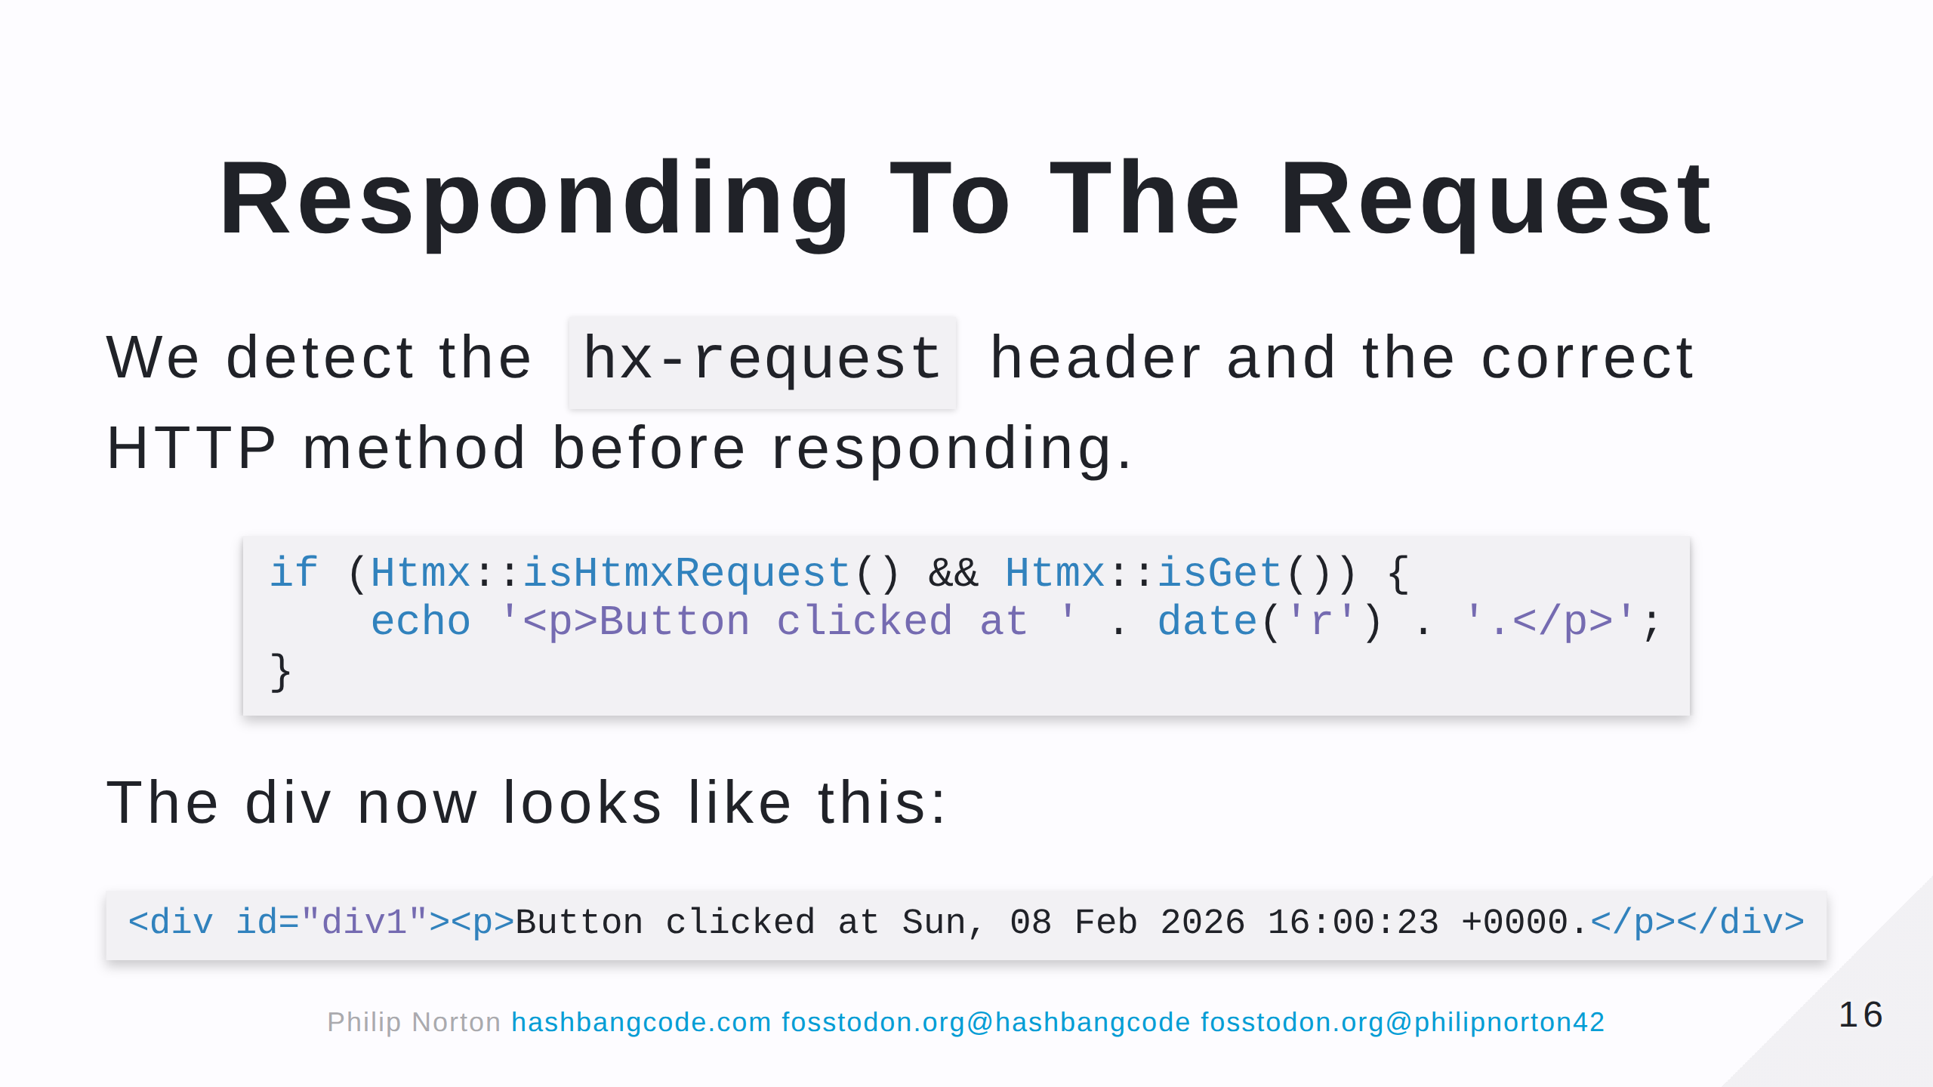

Slide 17


Slide 18
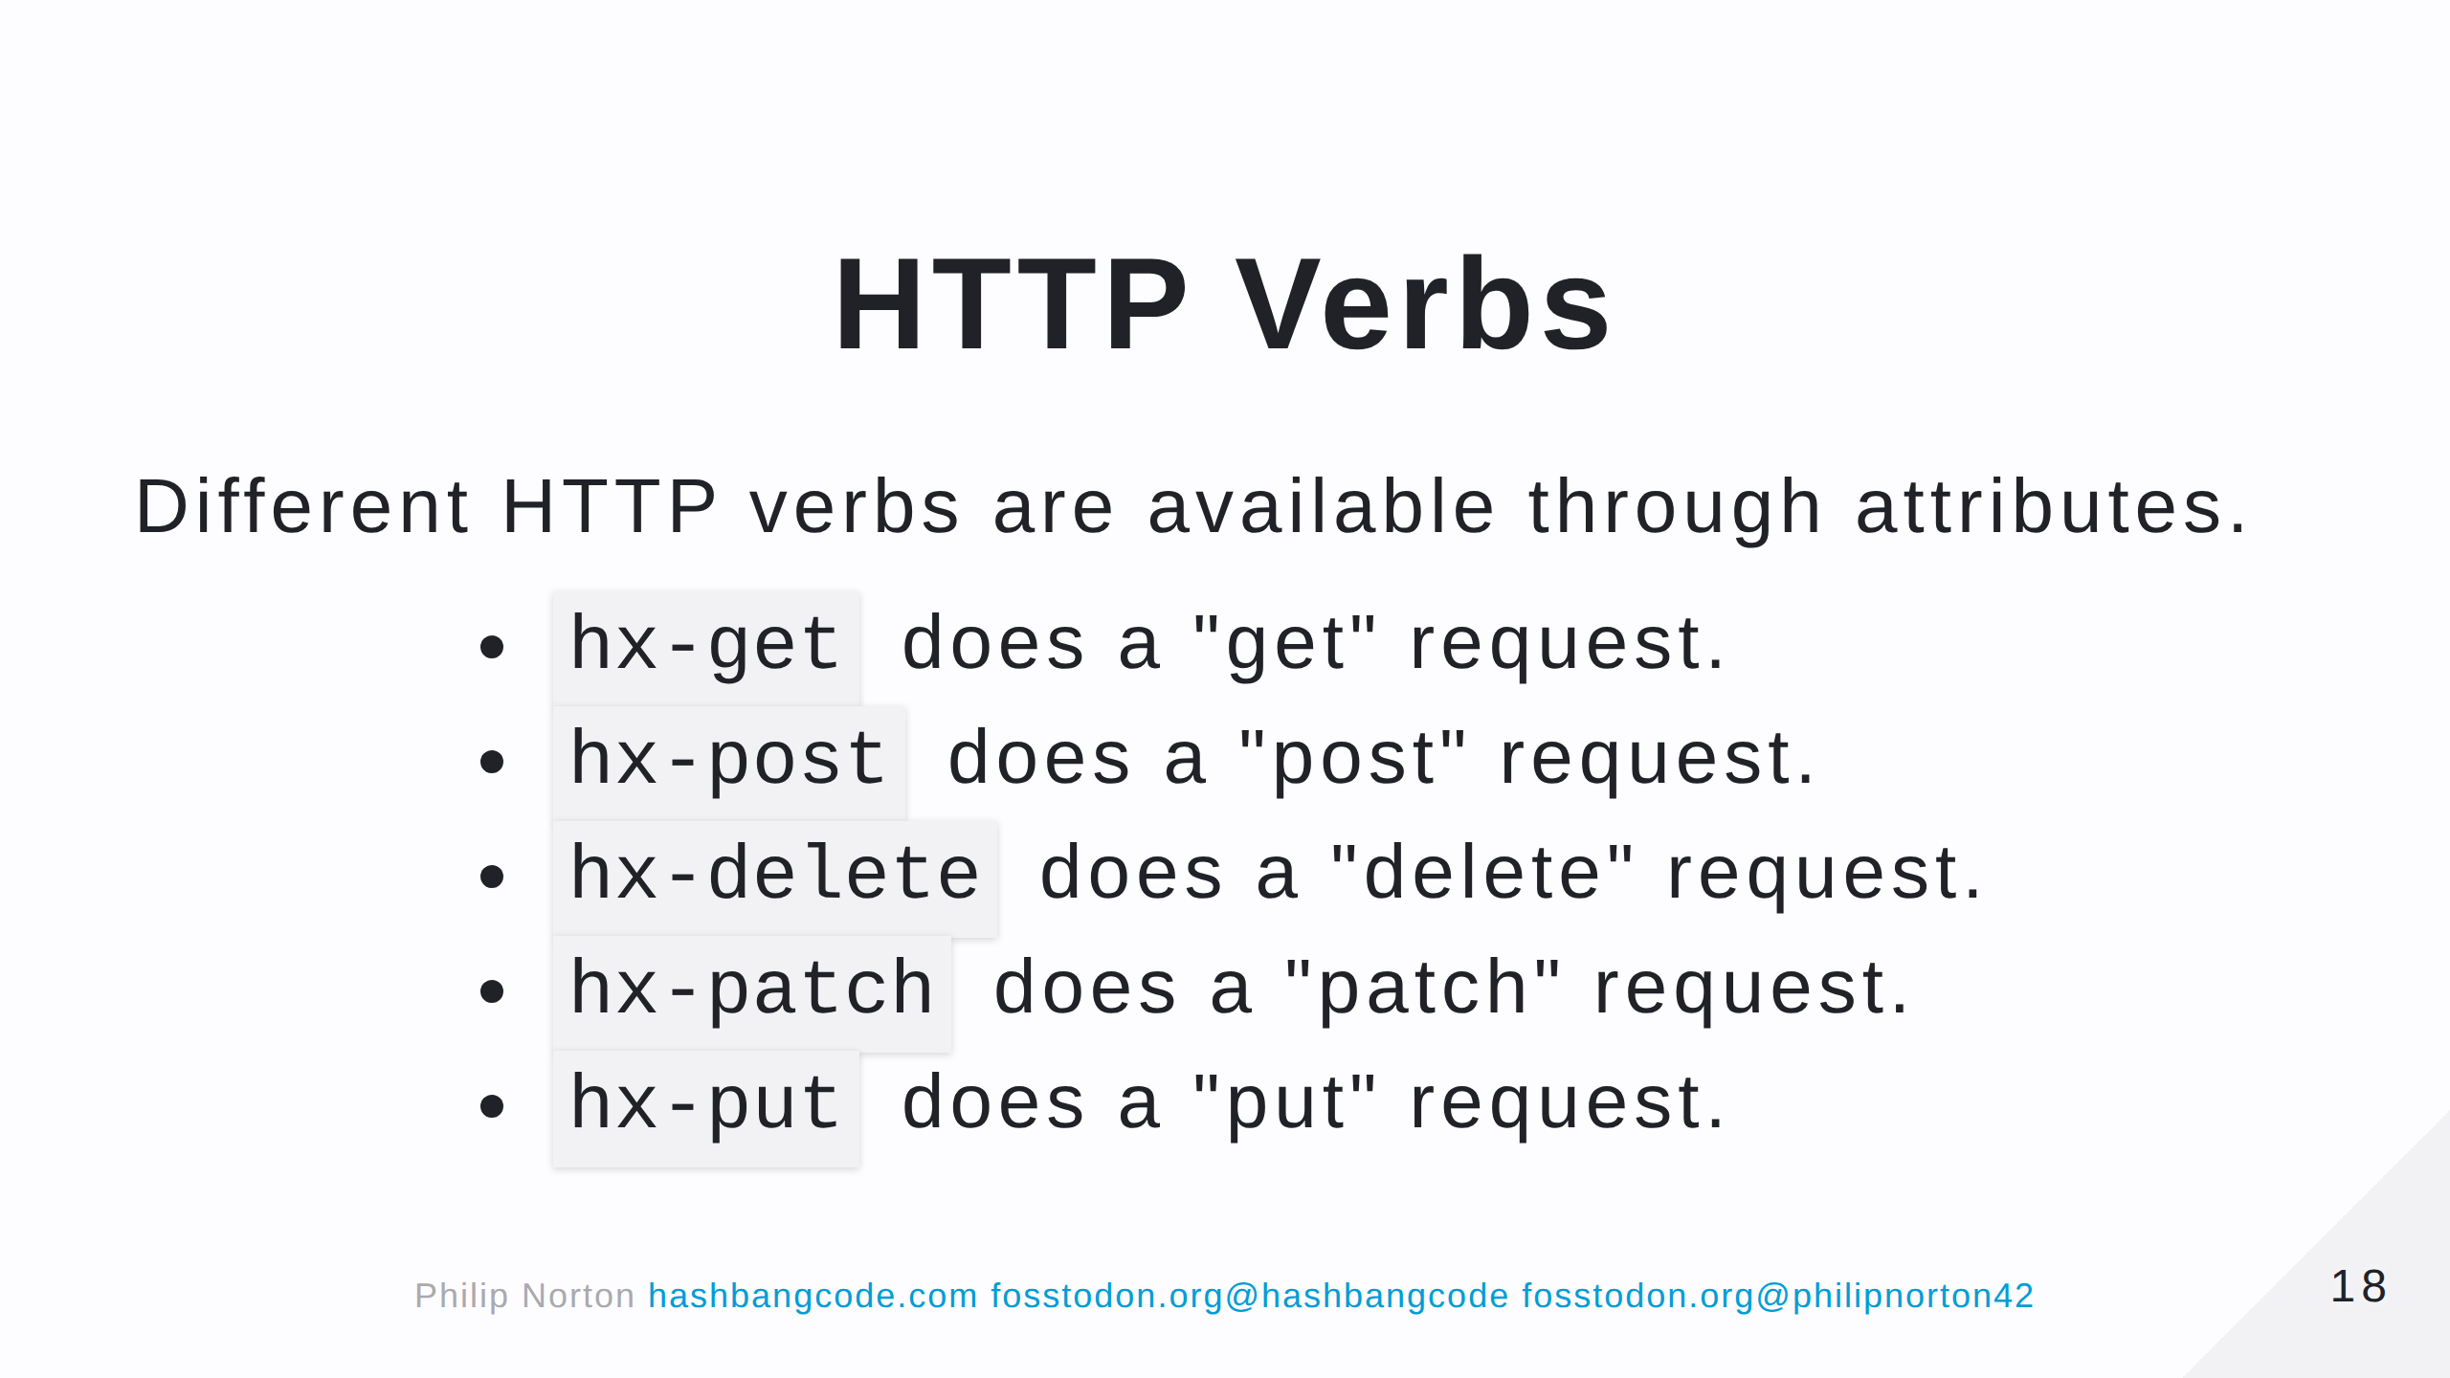

Slide 19
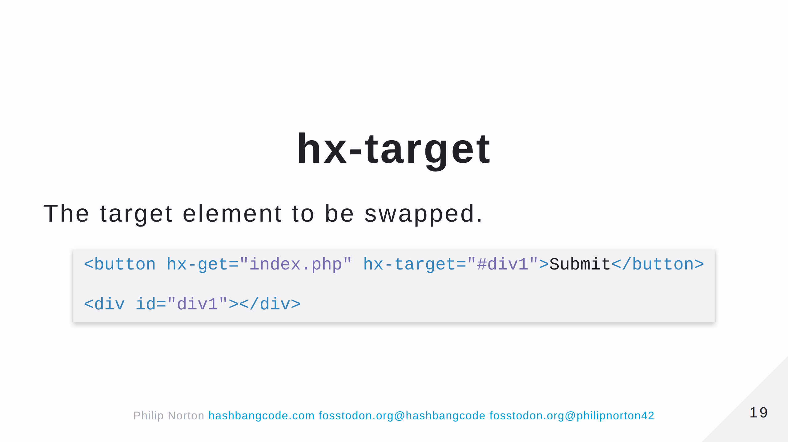

Slide 20
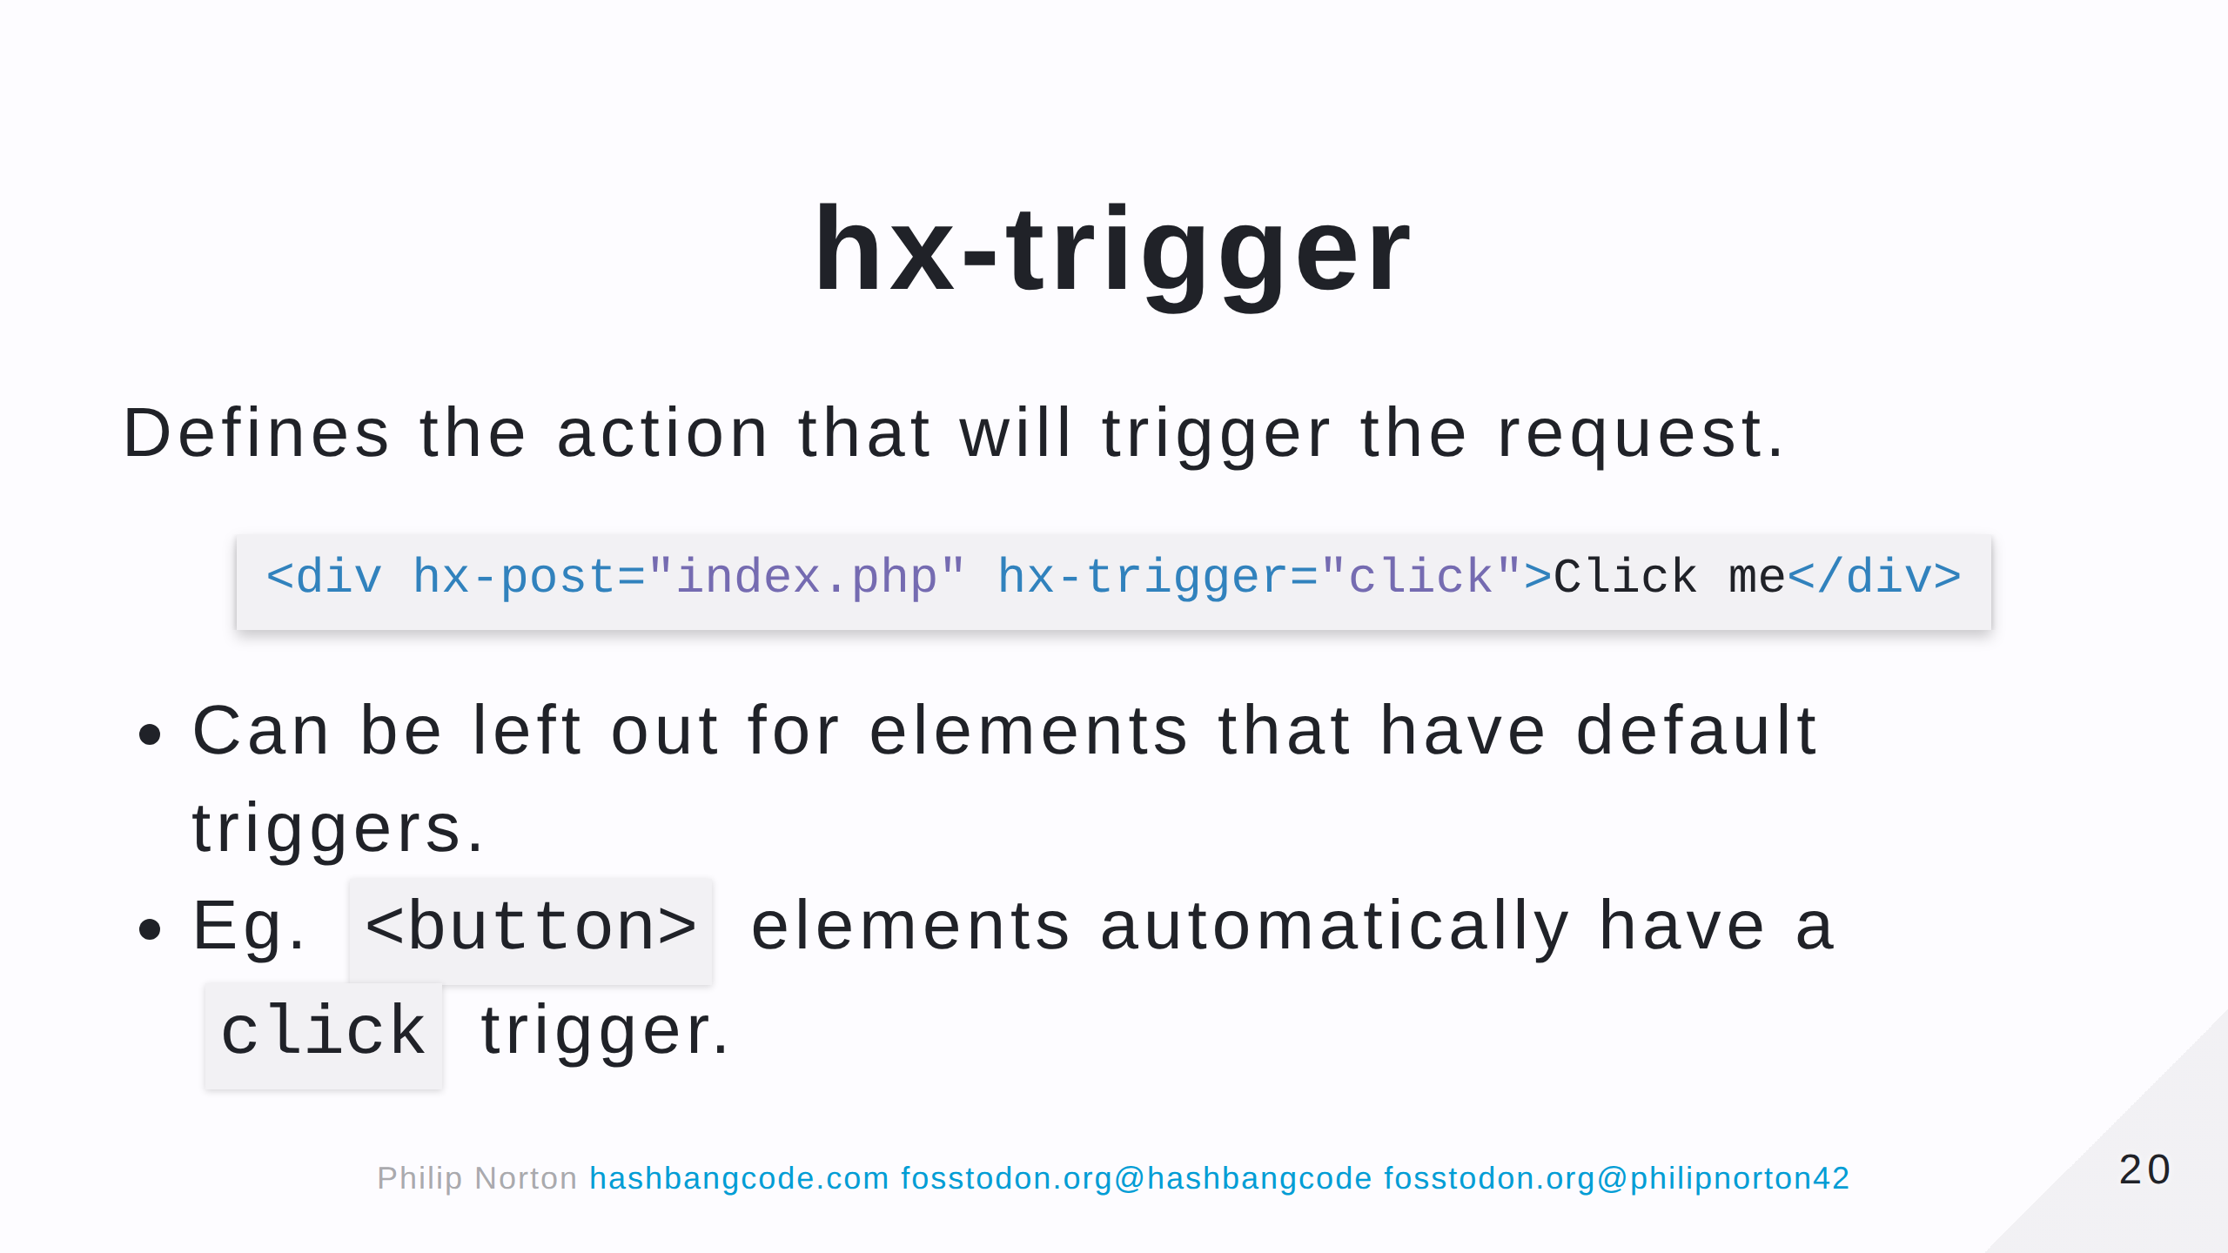

Slide 21
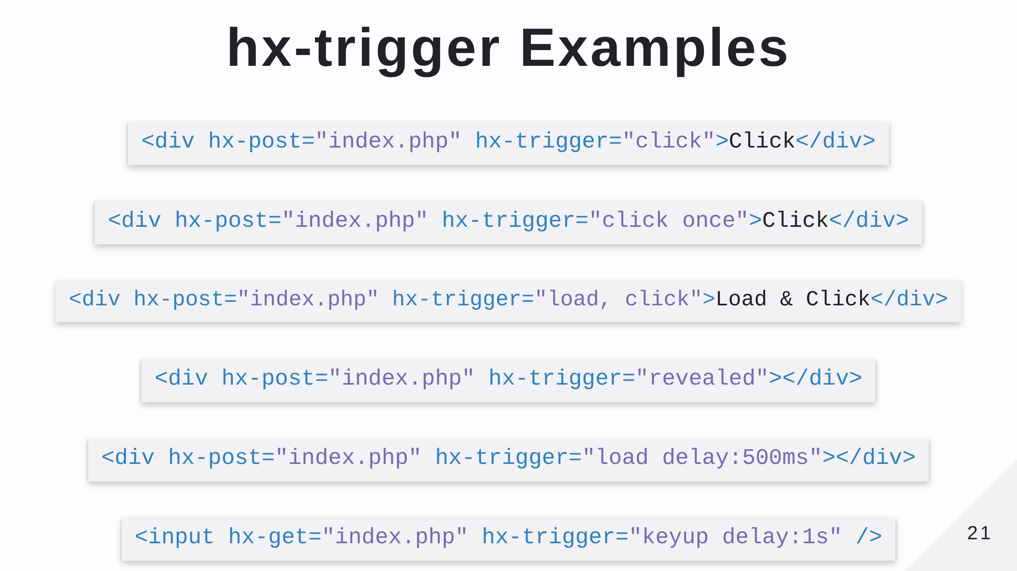

Slide 22
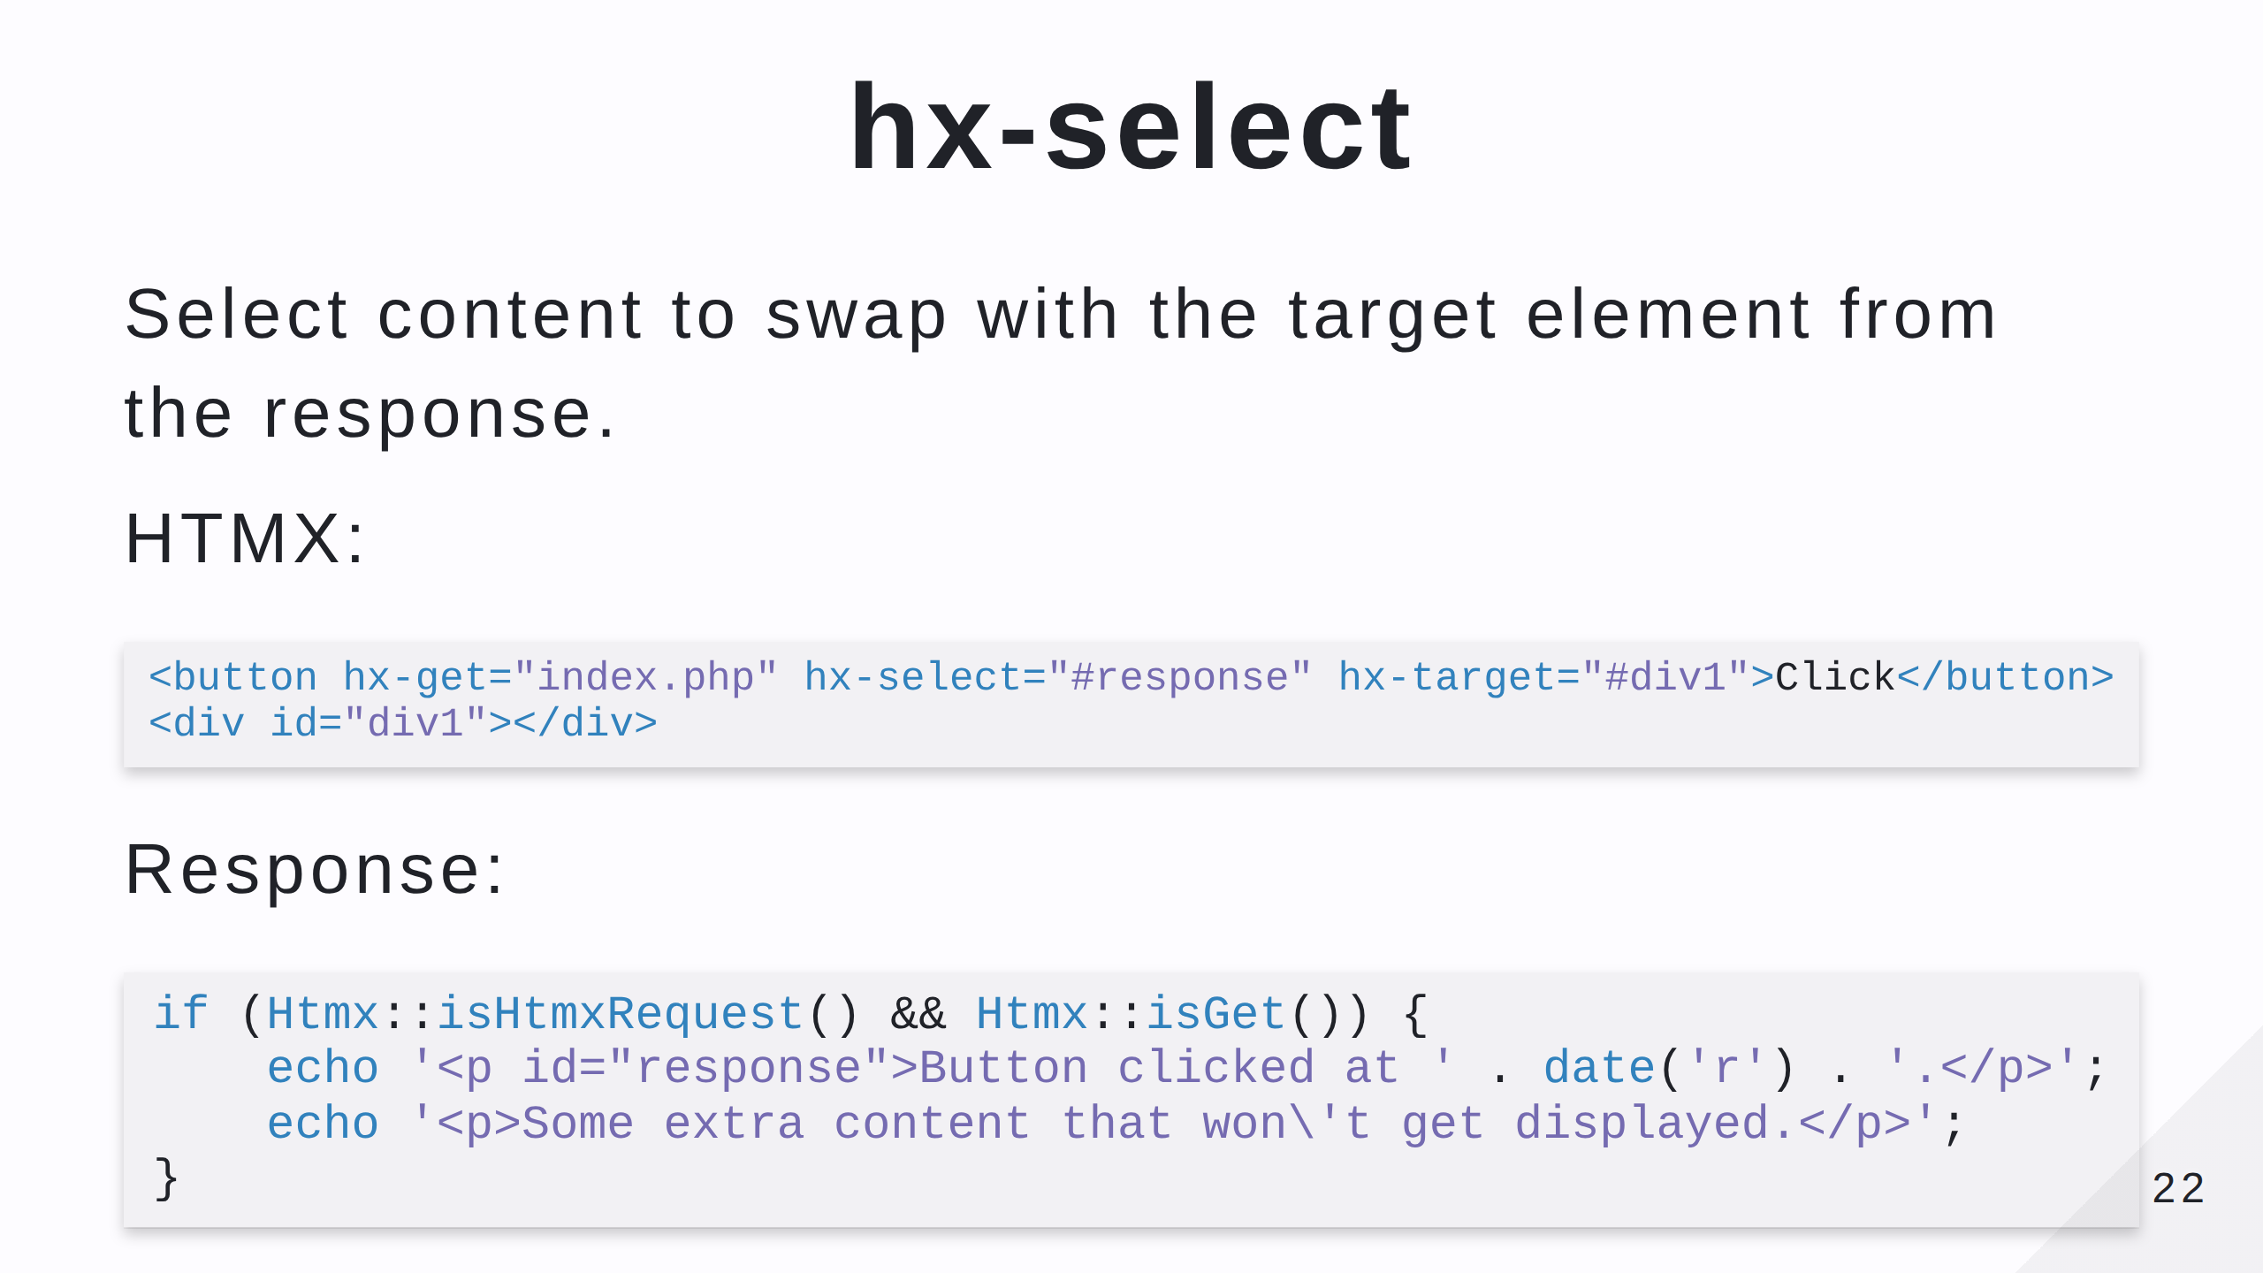

Slide 23
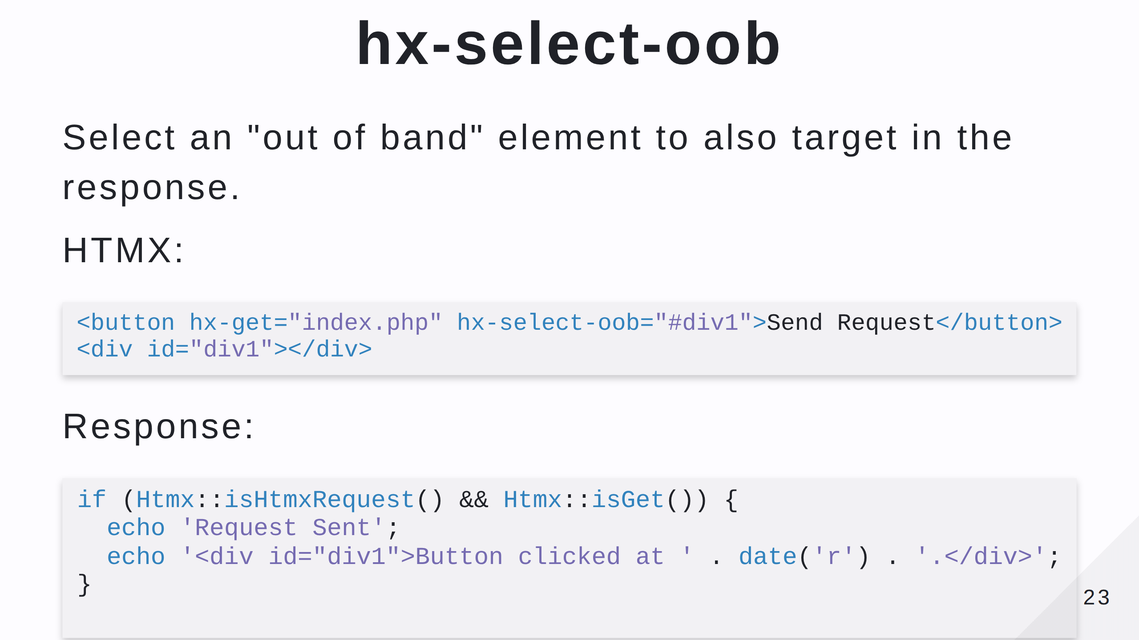
Notes:
Out of band refers to the element and the result not being tied closely together. HTMX is based on the "locality of behavior" rule, which means things should happen close to where they originated. This will: - Replace the "Send Request" text with "Requset Sent". - Replace the #div1 with the selected element from the request.

Slide 24
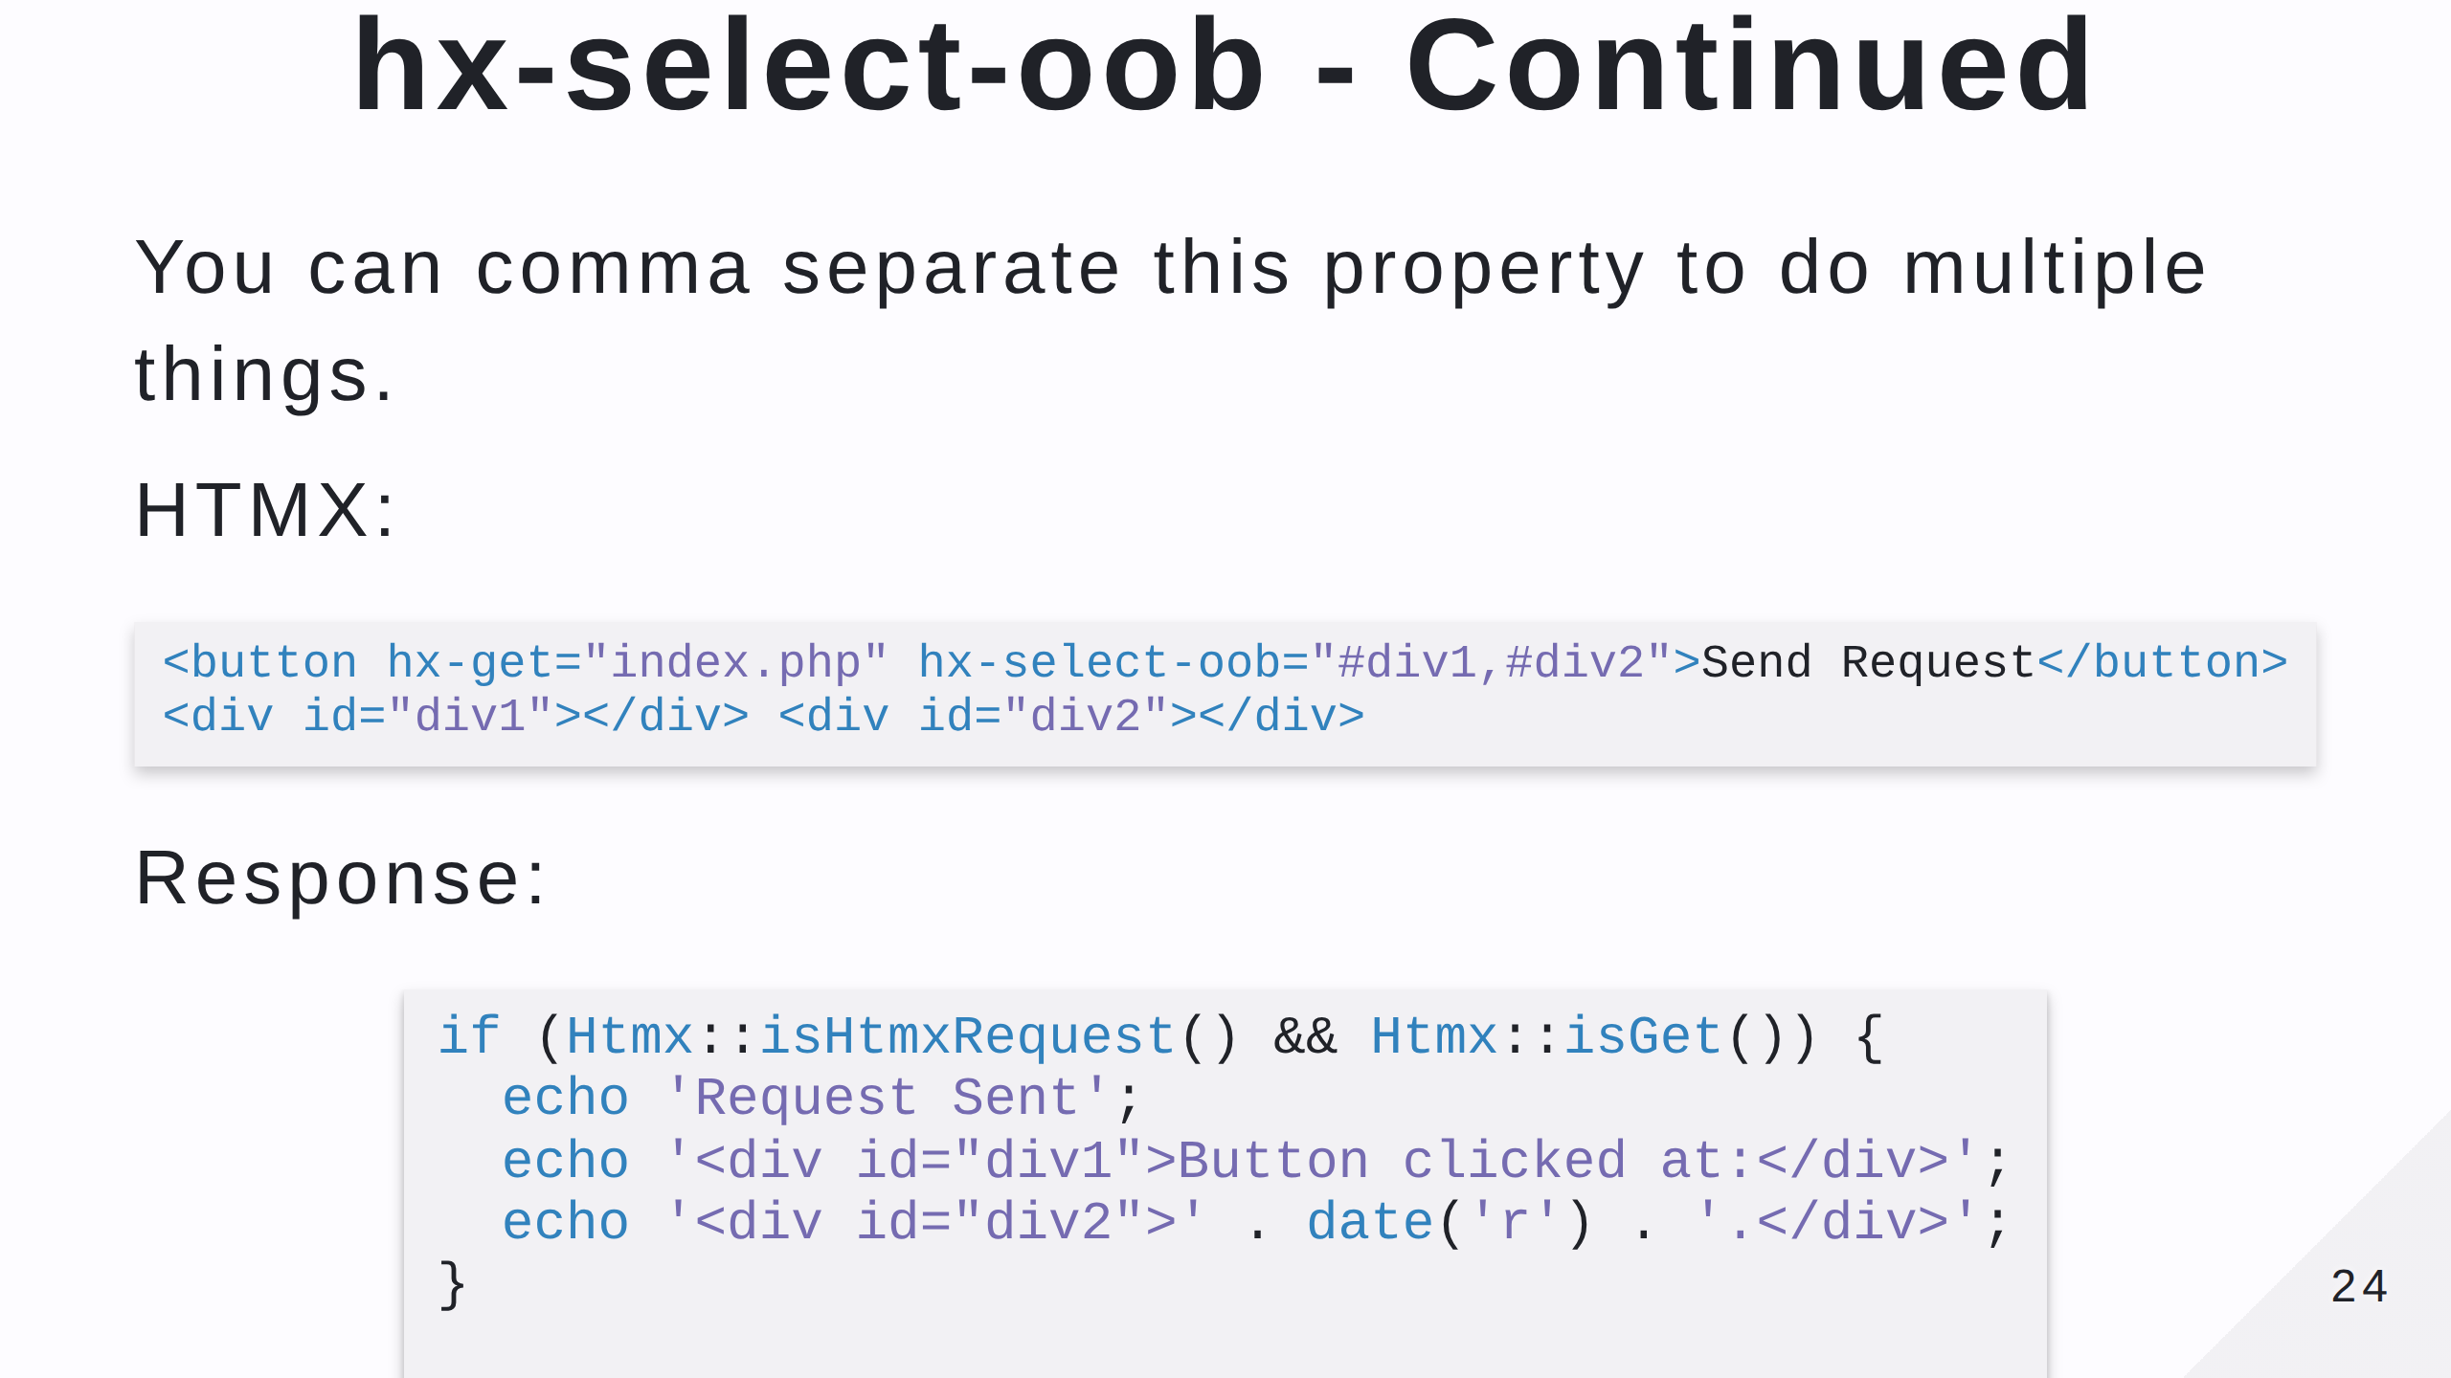
Notes:
This will: - Replace the "Send Request" text with "Requset Sent". - Replace the #div1 with the selected element from the request. - Replace the #div2 with the selected element from the request. Be careful, anything not part of the hx-select-oob attribute will be injected into the triggering element.

Slide 25
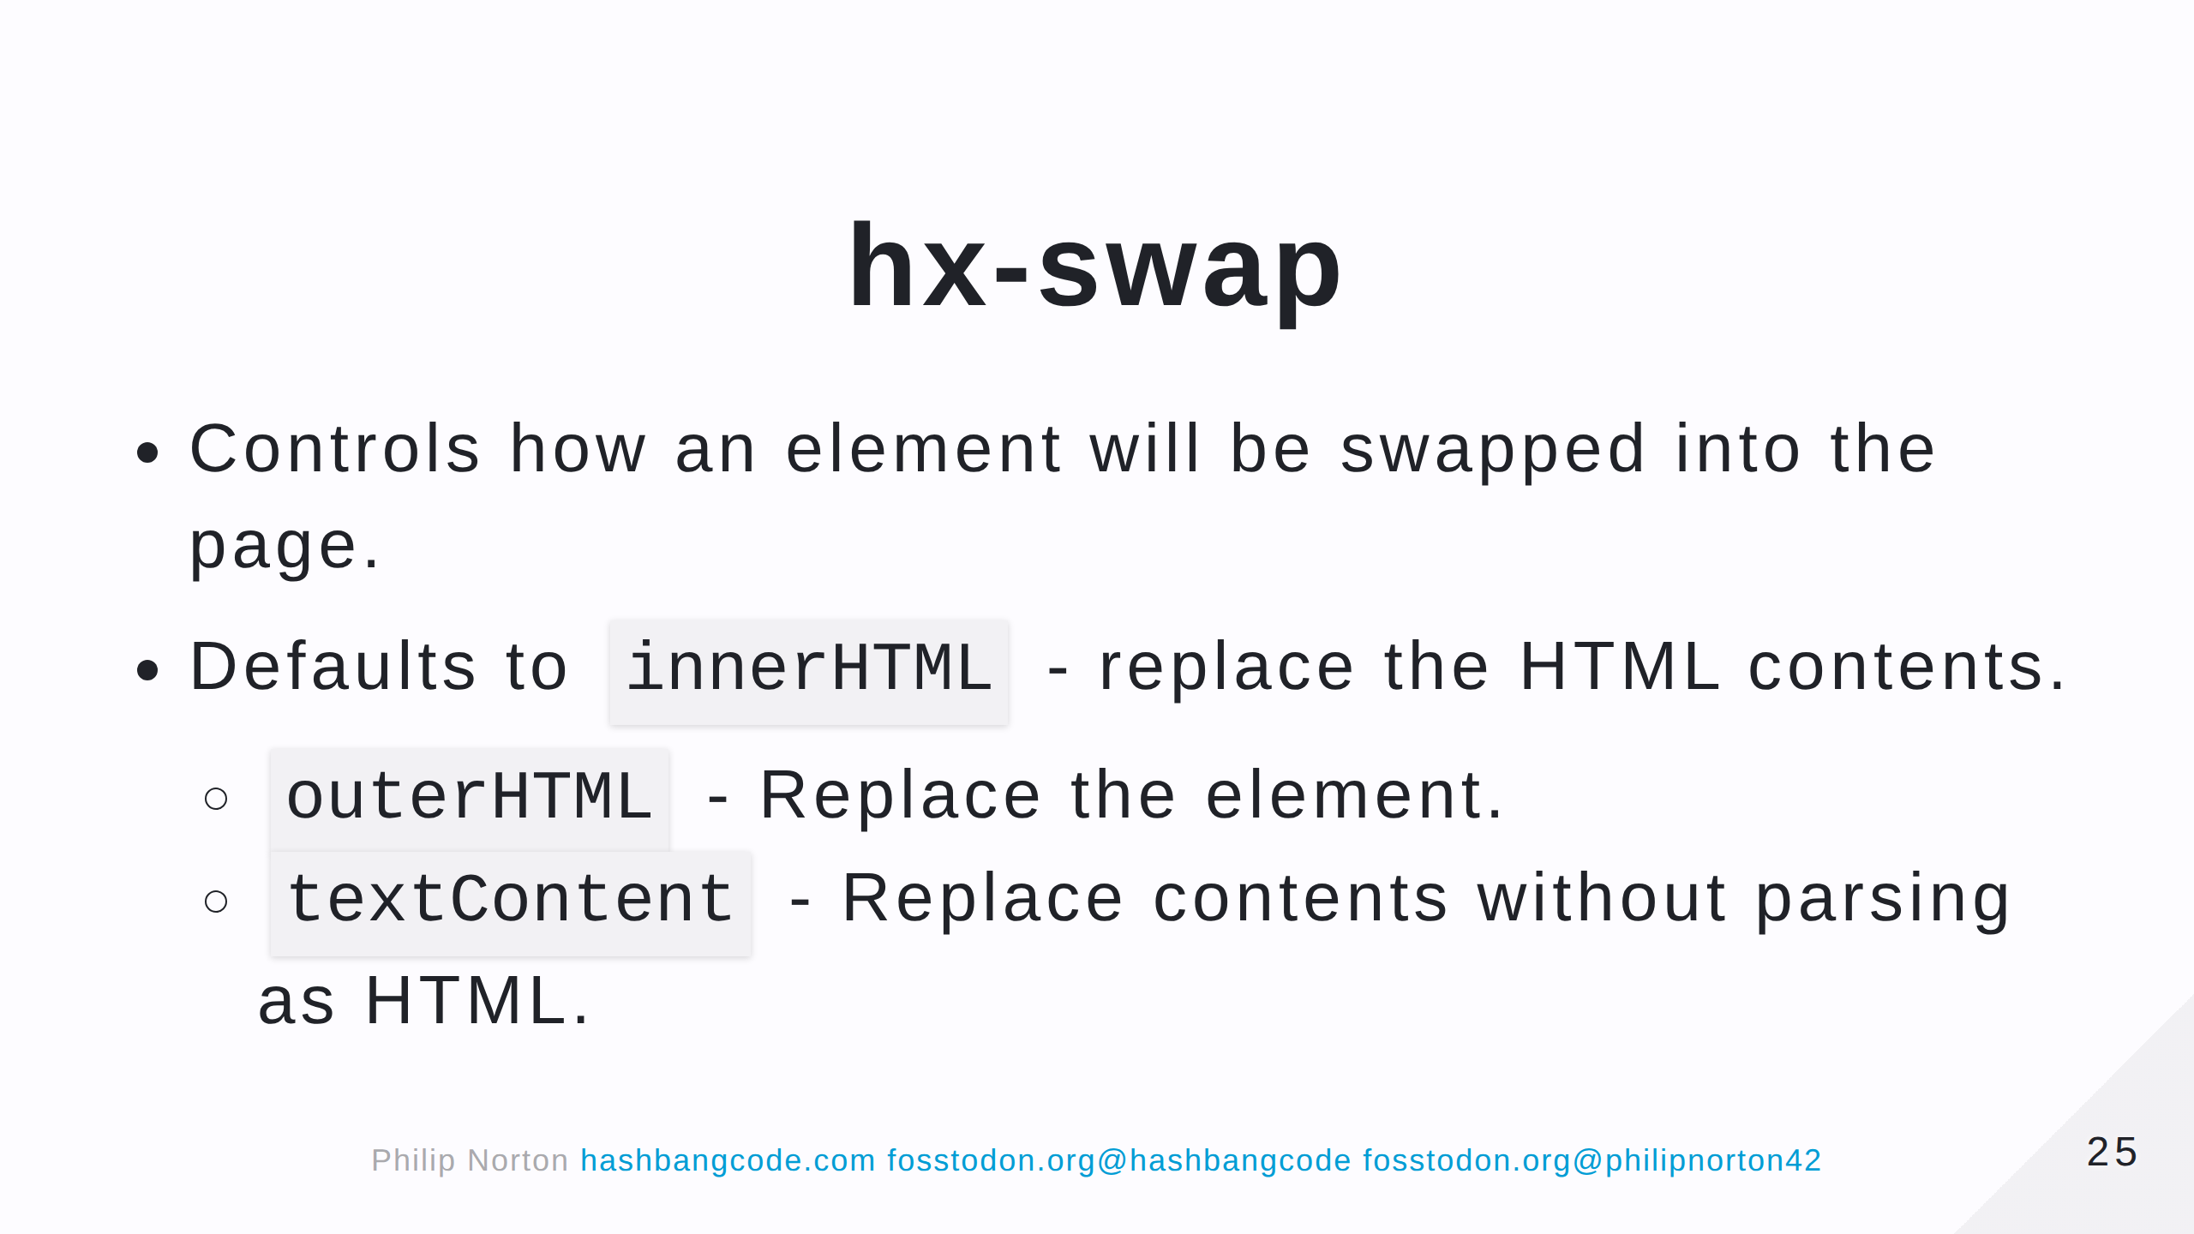

Slide 26
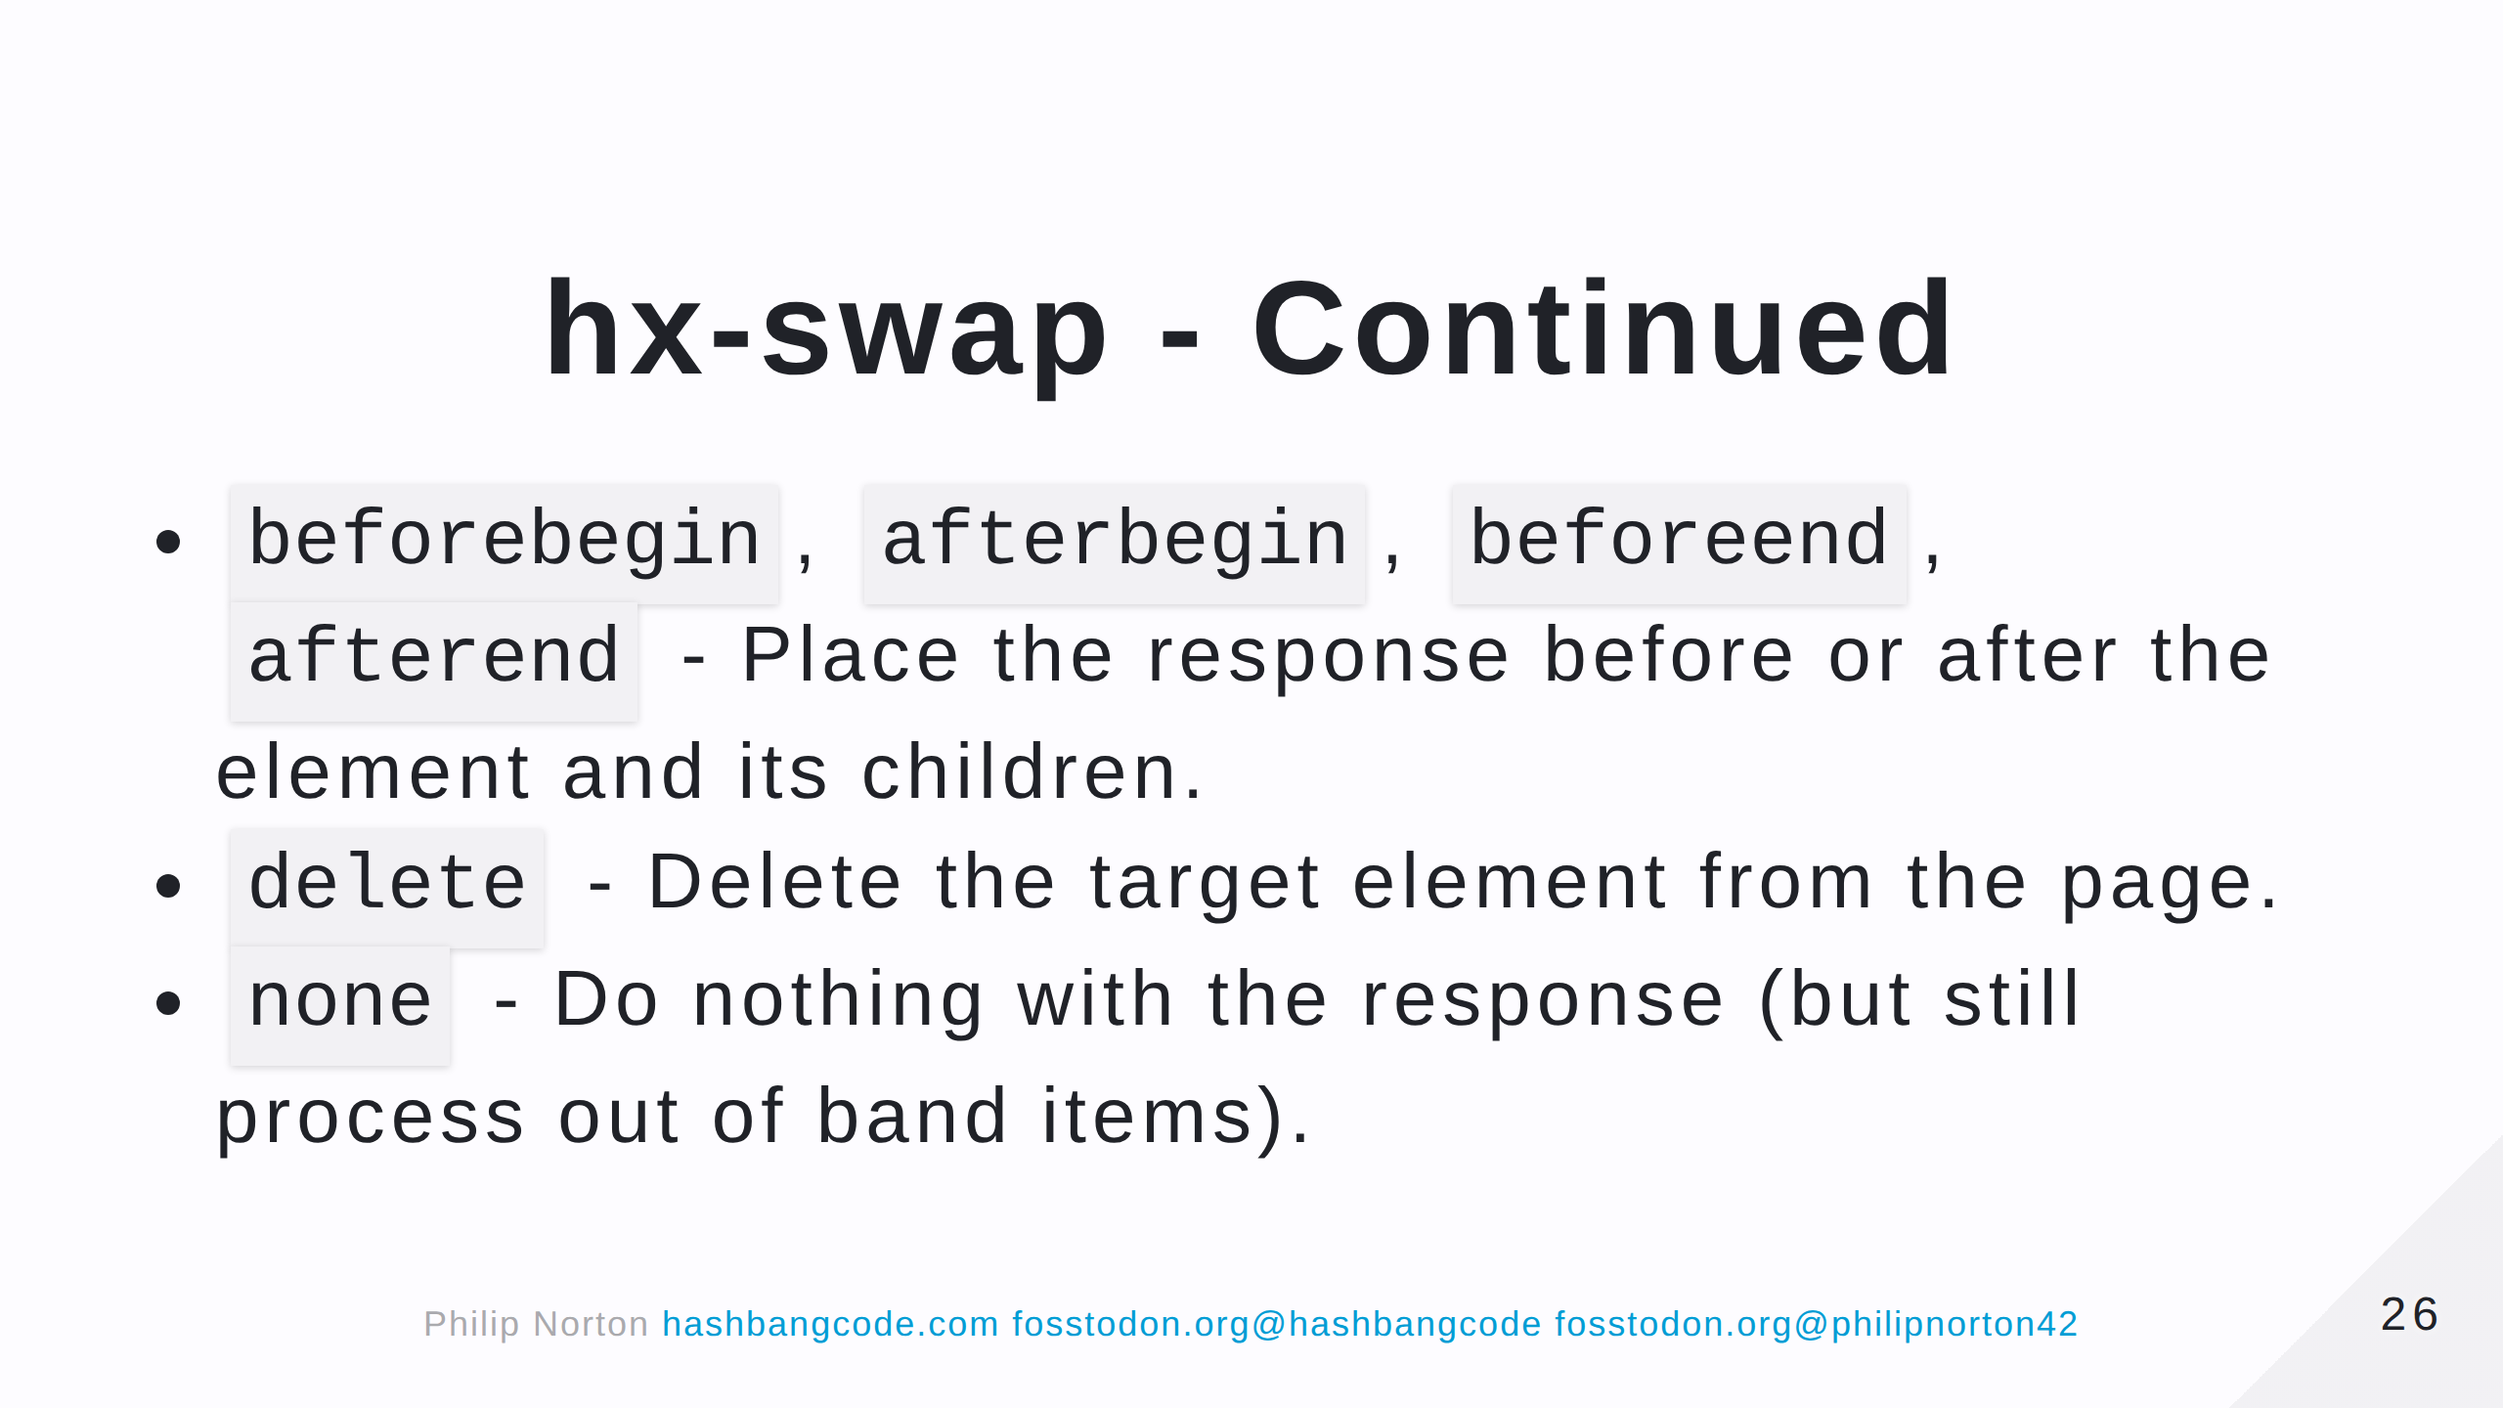

Slide 27
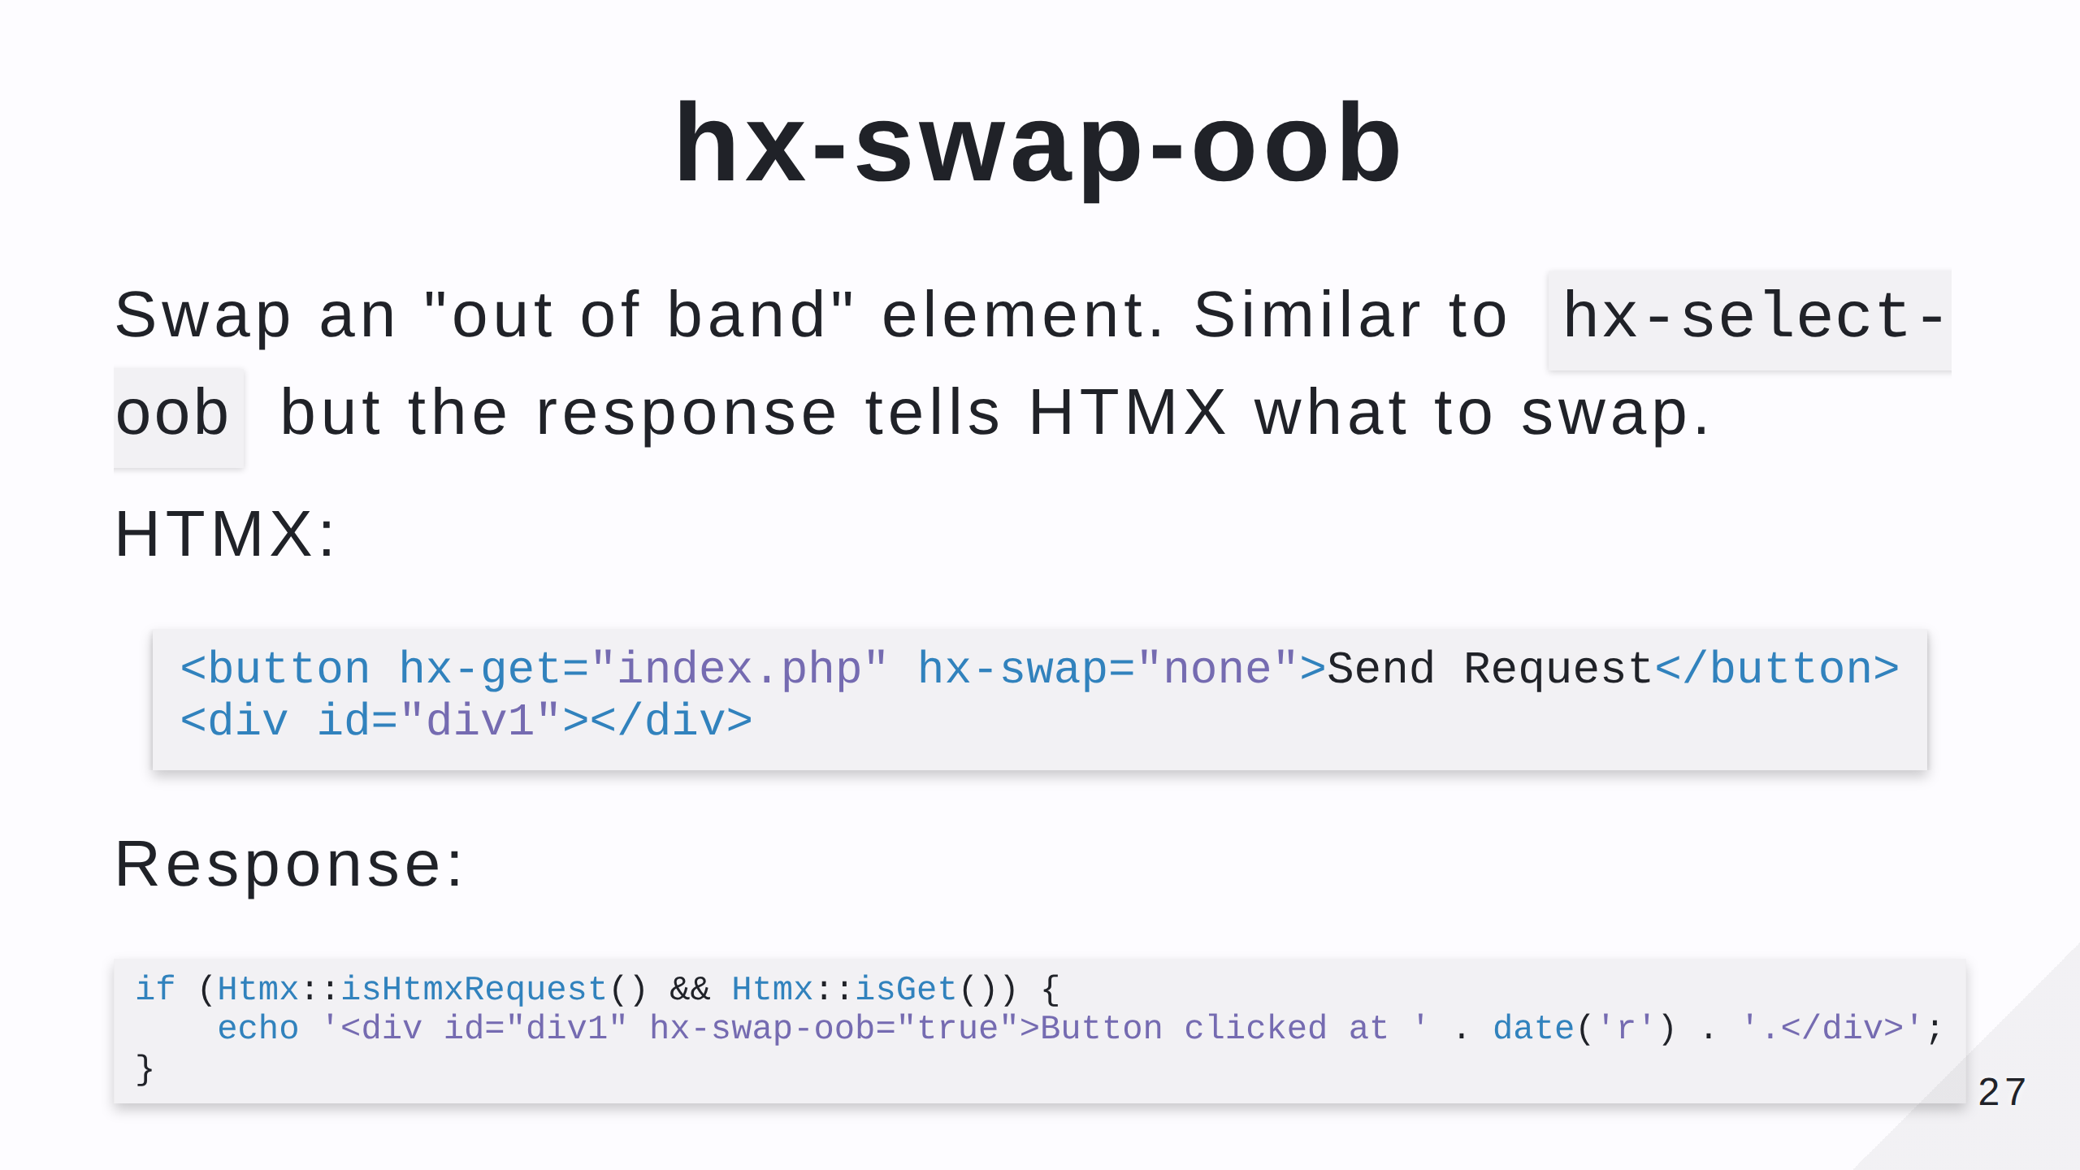
Notes:
- The hx-swap="none" means that the triggering element won't be altered. - We can piggy back other things that we want to inject into the page in the response.

Slide 28
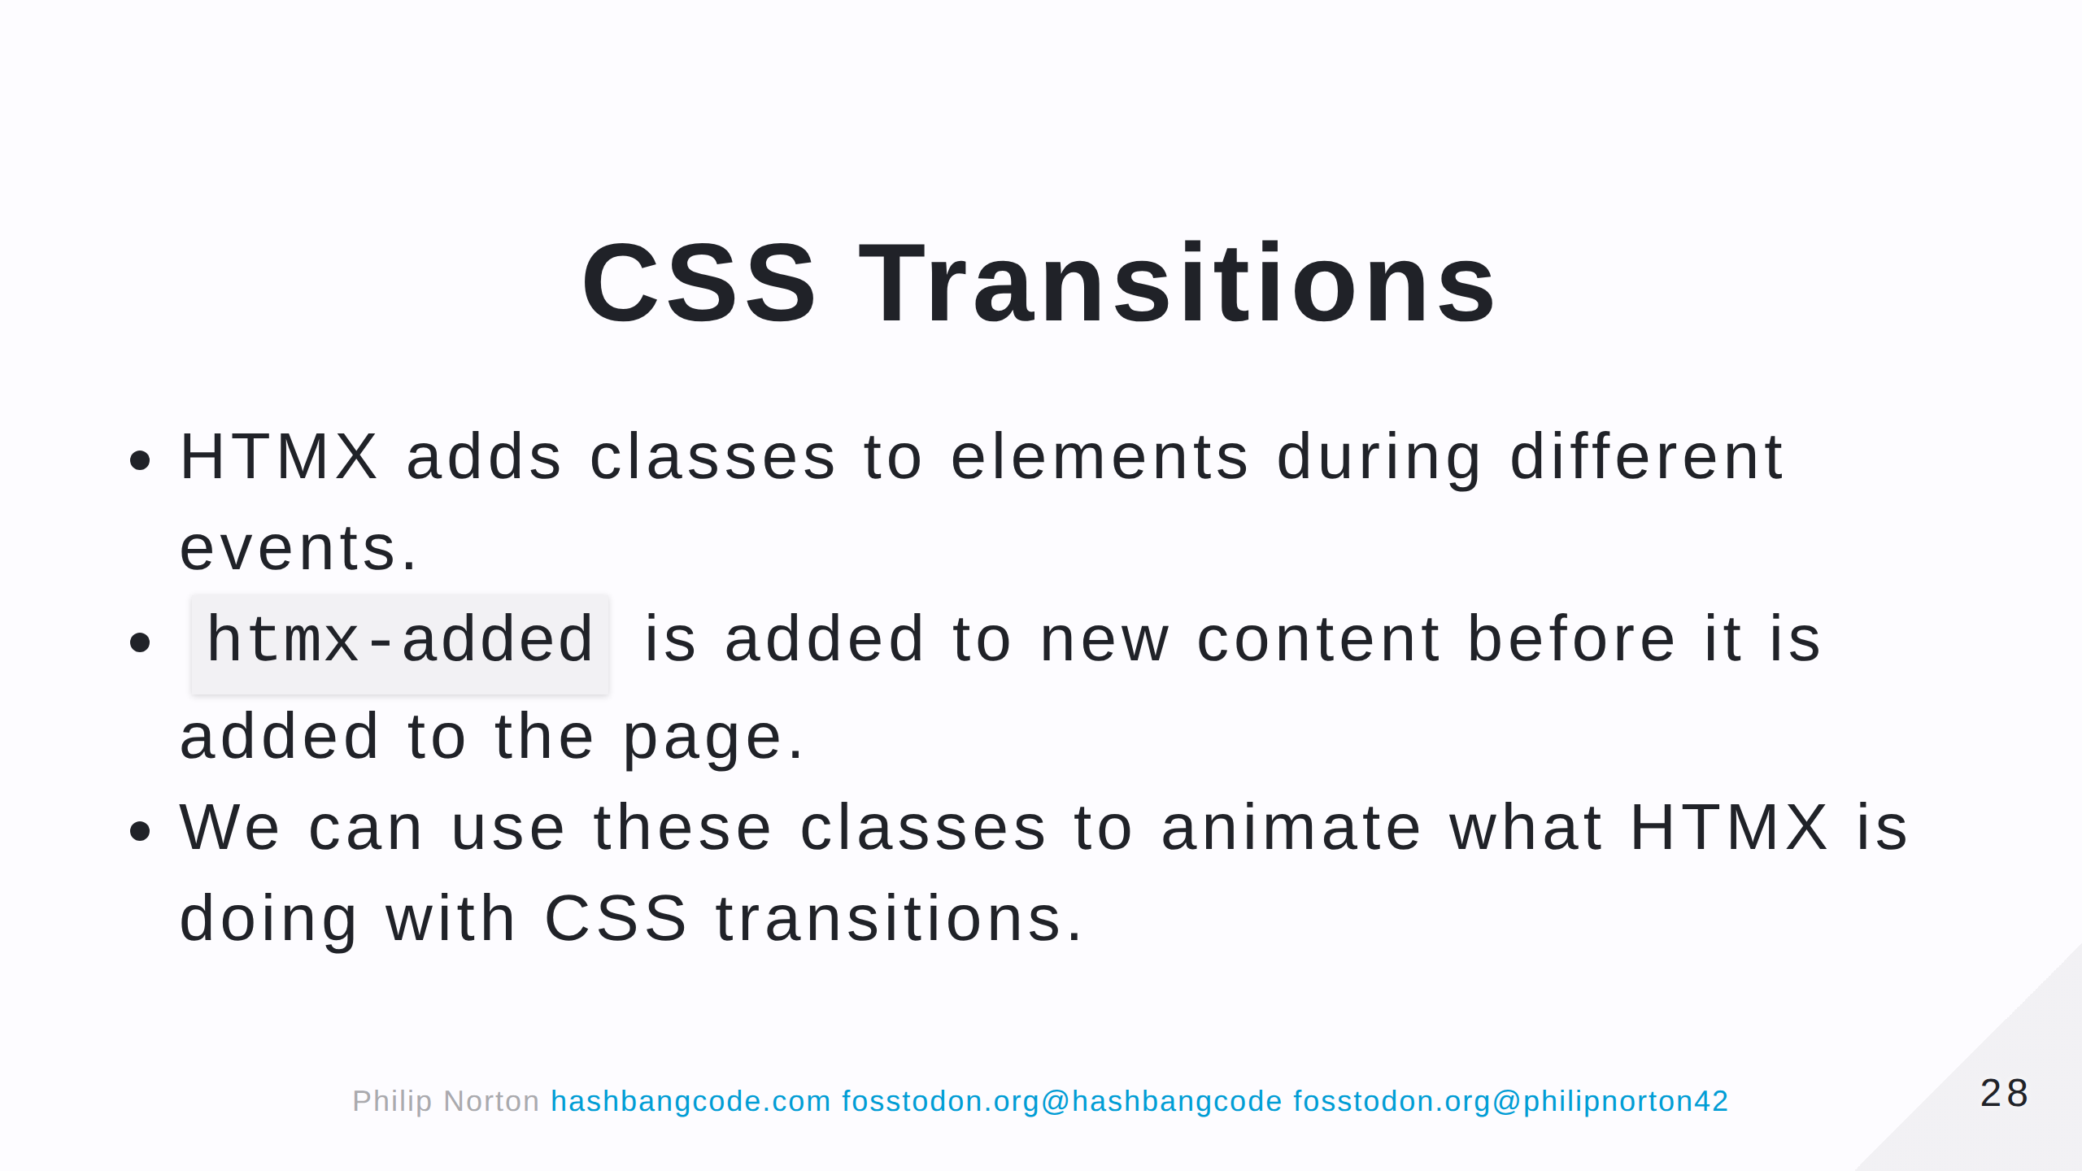

Slide 29
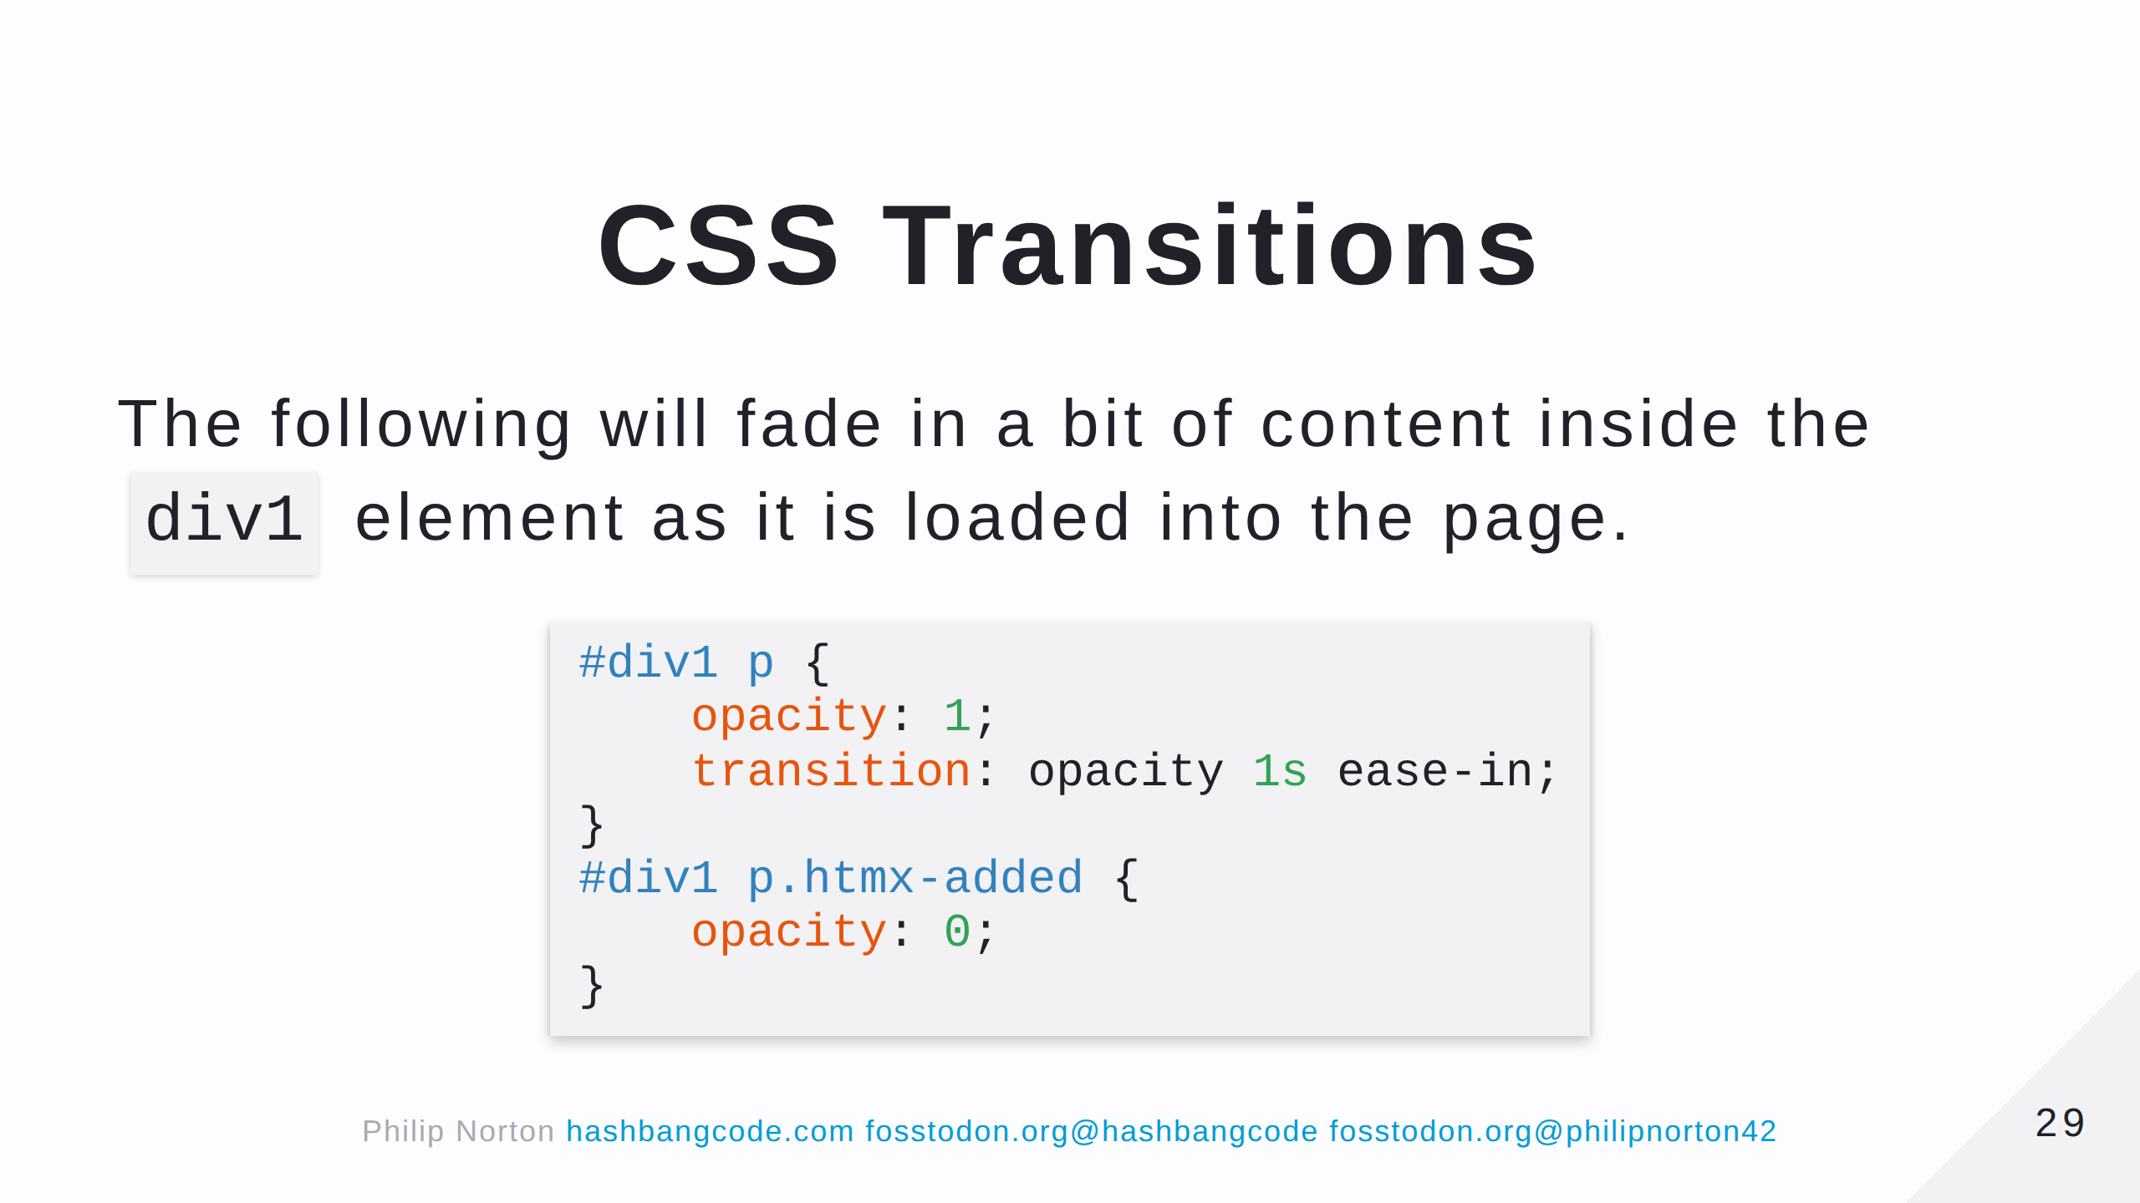
Notes:
When the element is first put onto the page HTMX will add the 'htmx-added' class. Which will be removed once the element is in place (or settled). This means we can set the htmx-added to be transparent and then fade it in to the default using the transition property.

Slide 30
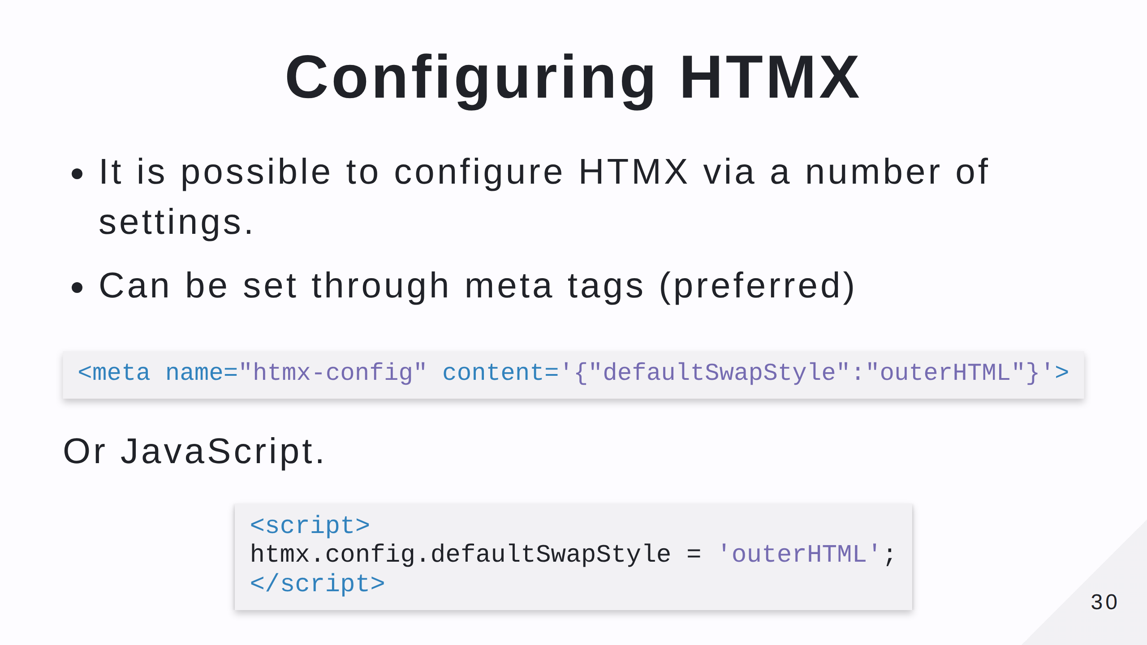
Notes:
This means that every time an element is added to the page it will use outerHTML, rather than the default of innerHTML. This will replace the elements instead of injecting data into them. This configuration option changes how the response is handled. This changes the global swap style that HTMX uses. Be careful! This can change how your application operates.

Slide 31

Notes:
HTMX has the concept of inherited attributes. So you can make the whole form an ajax form.

Slide 32


Slide 33
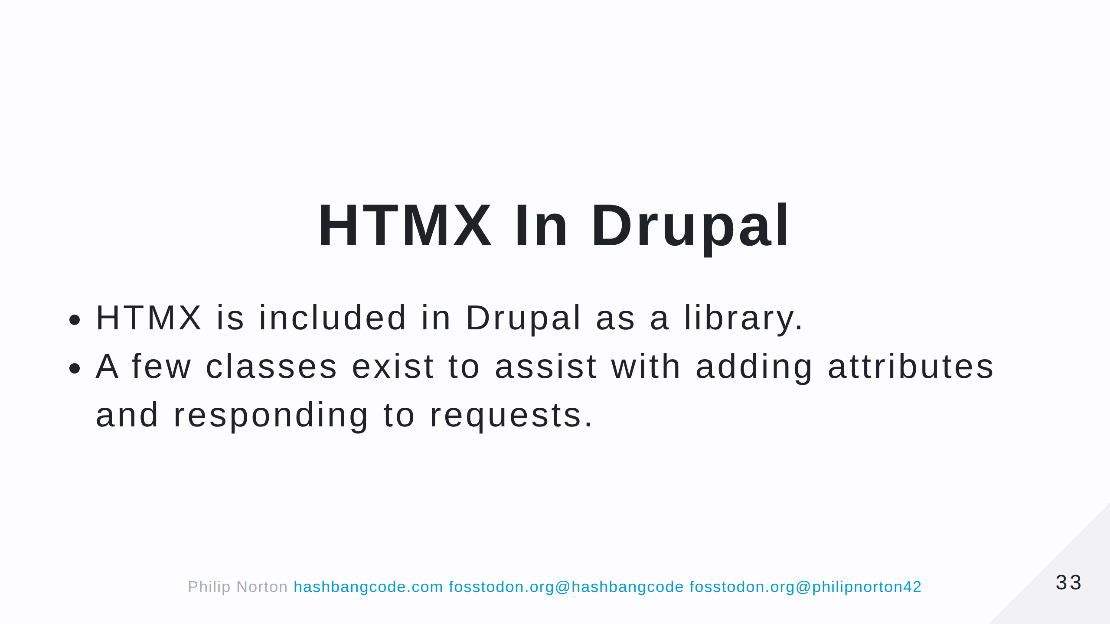

Slide 34
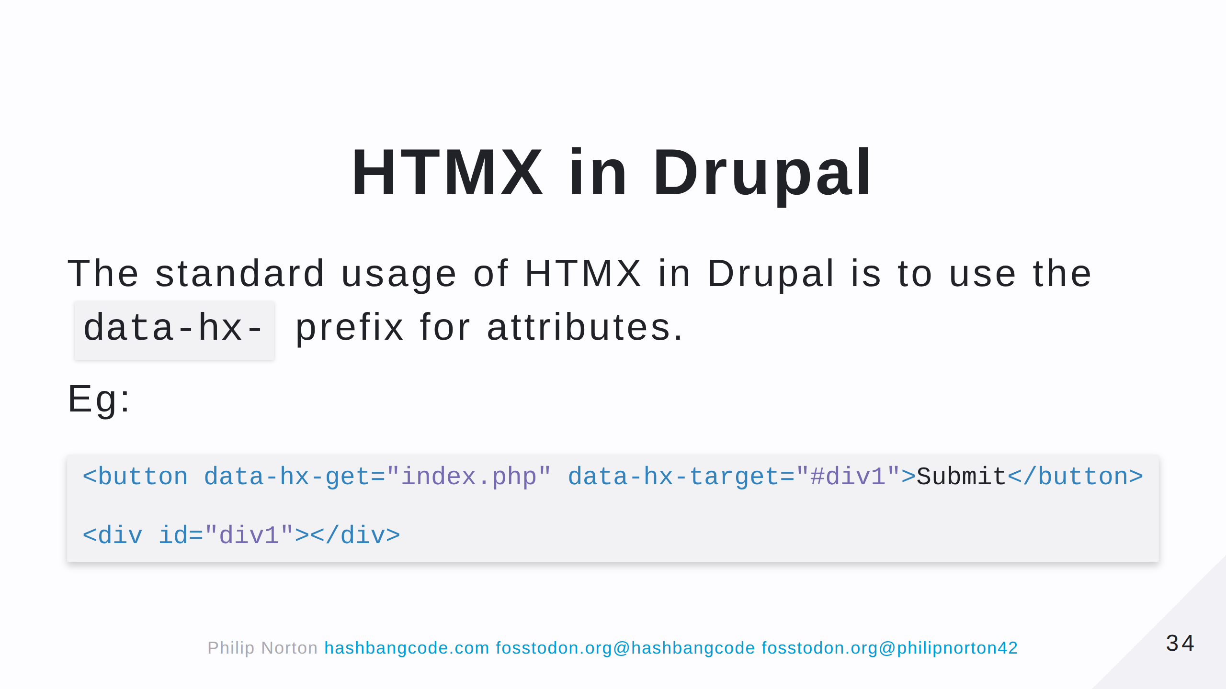

Slide 35
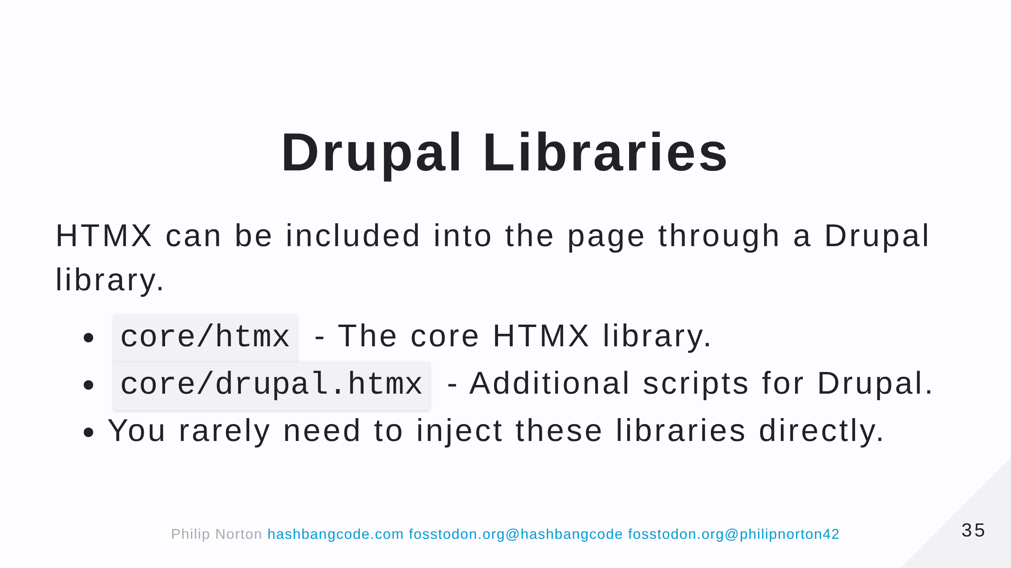

Slide 36
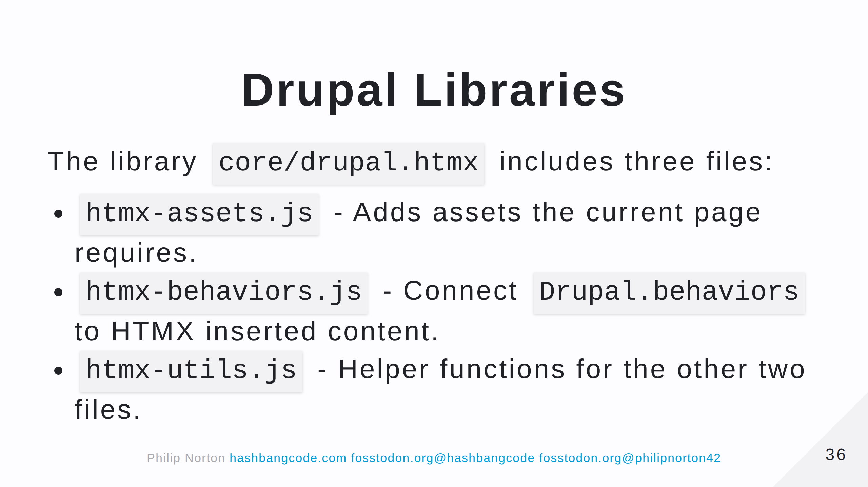

Slide 37
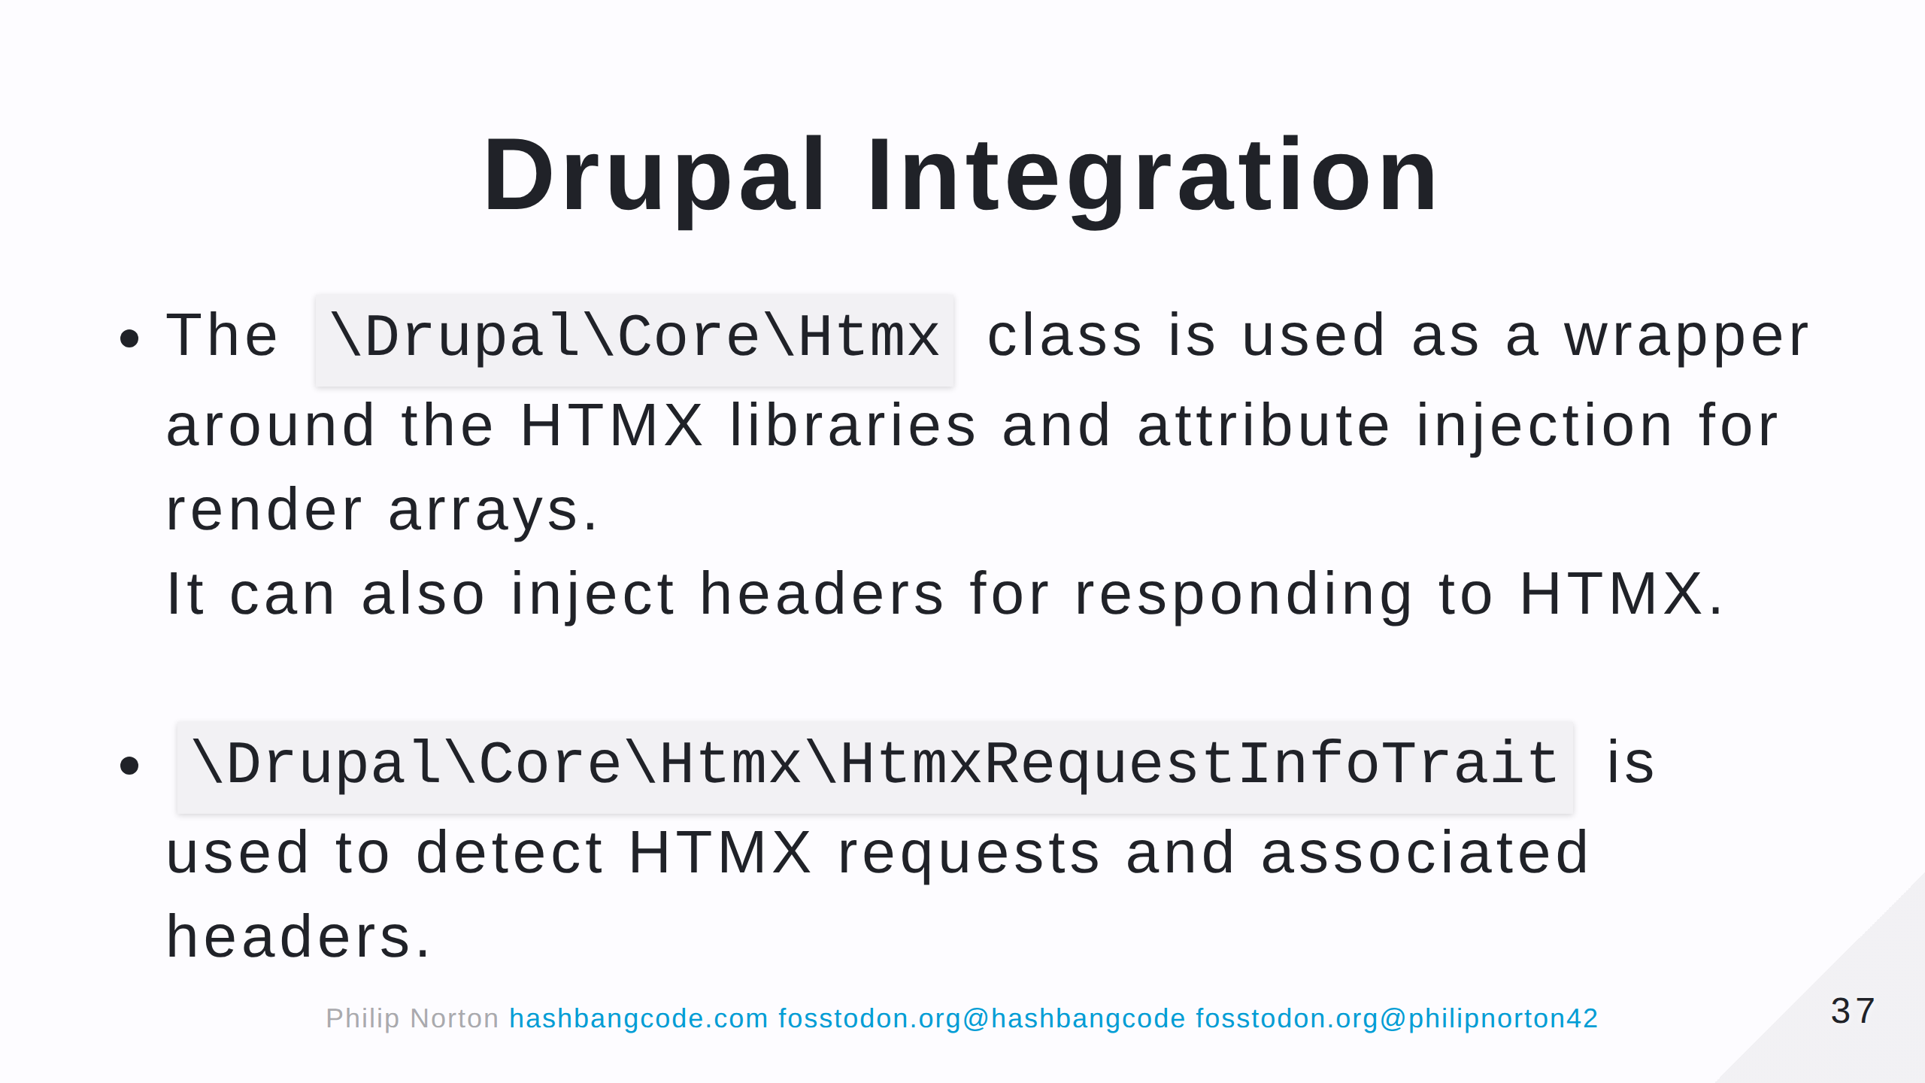
Notes:
Of couse, there is technically nothing to stop you from just including the HTMX library and adding the attributes to your HTML. The Htmx class just facilitates this.

Slide 38
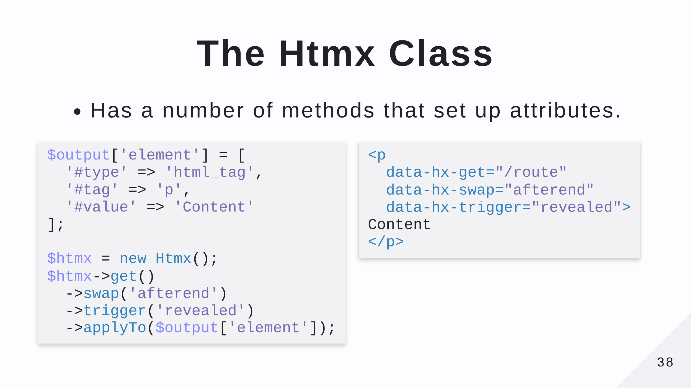

Slide 39
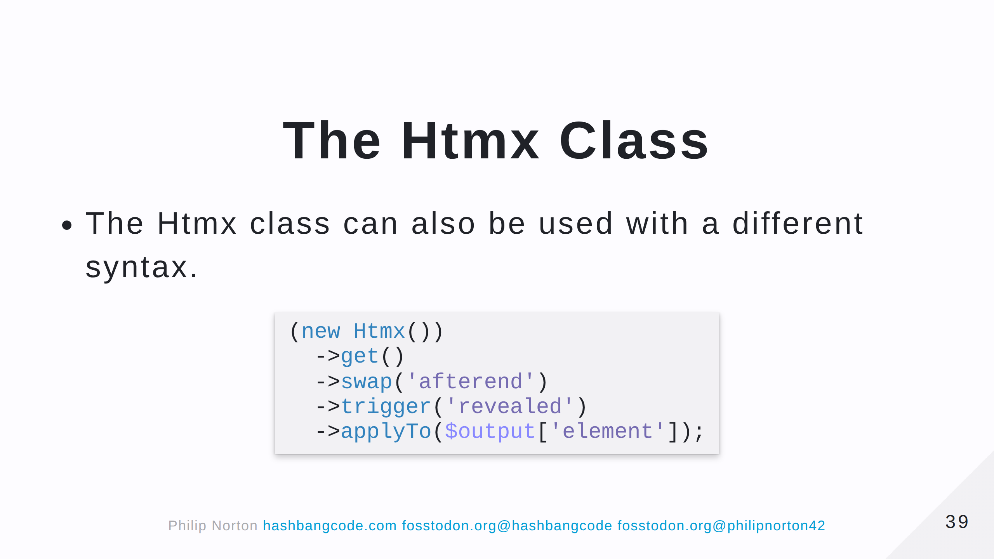

Slide 40
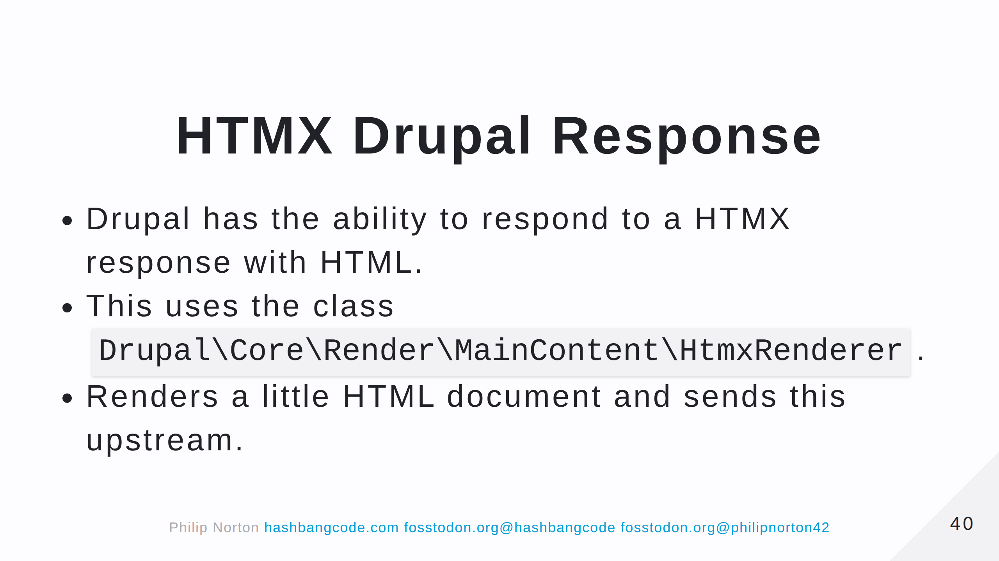

Slide 41
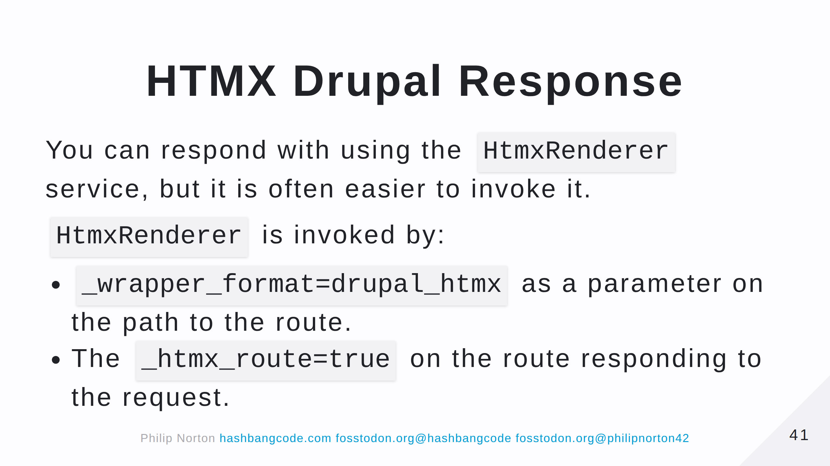

Slide 42


Slide 43
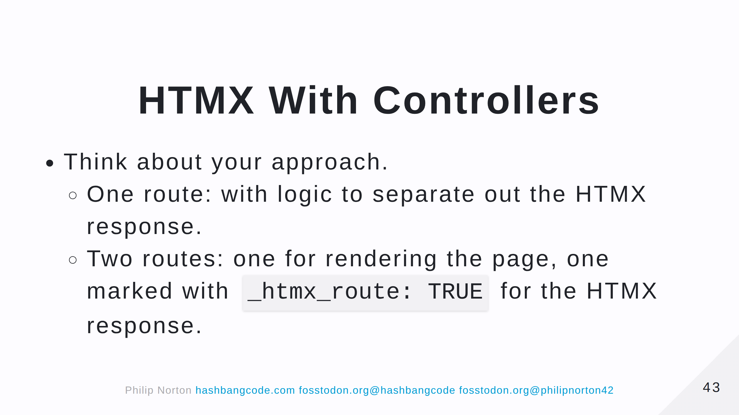
Notes:
- Do you have two actions in your controller or one action that serve normal and one for HTMX requests?

Slide 44
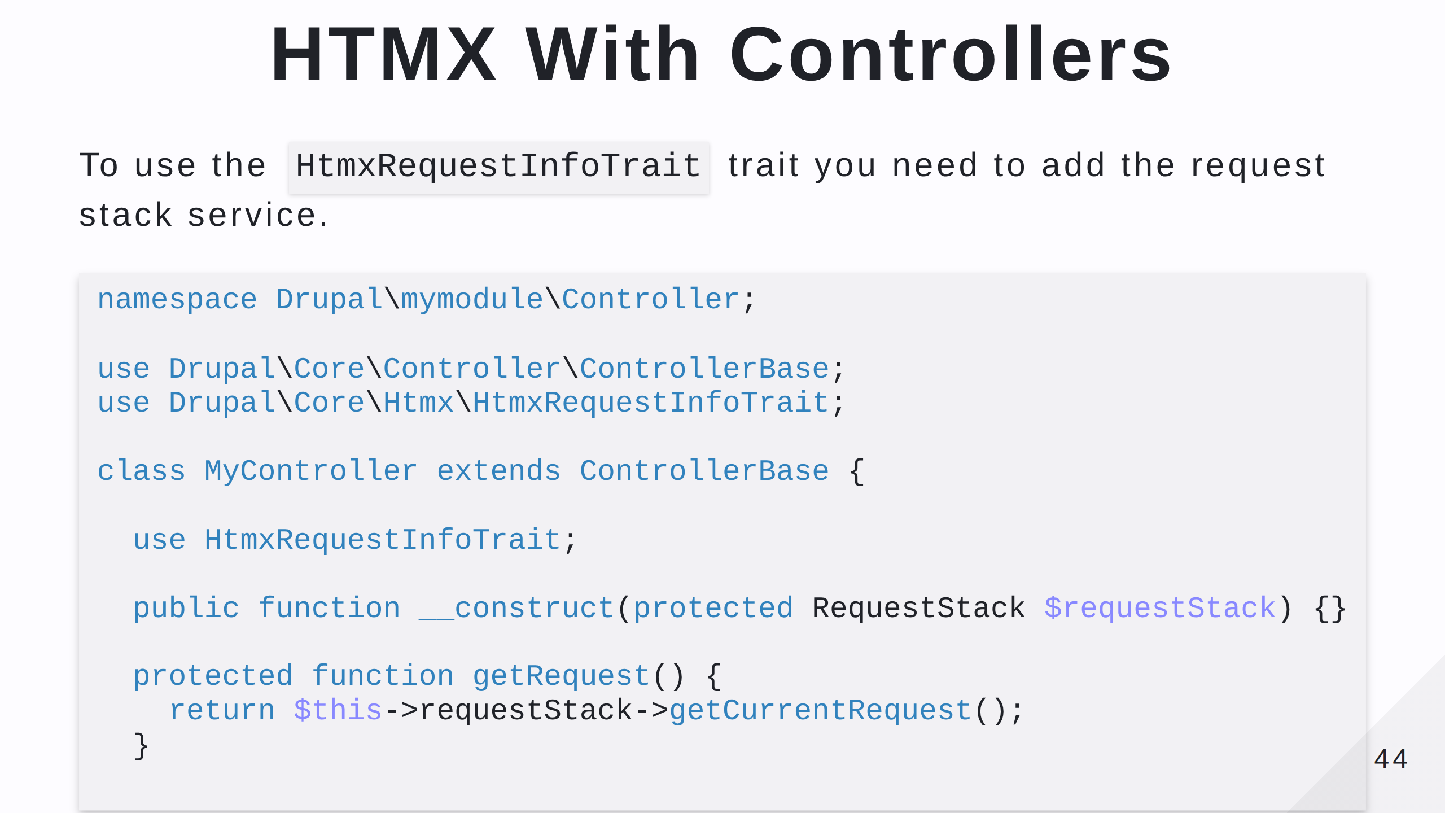
Notes:
This uses constructor property promotion and auto-wiring to inject the request stack into the controller class. The service is called "request_stack". You also need to create a method called getRequest() in the controller as this is abstract method in the trait.

Slide 45
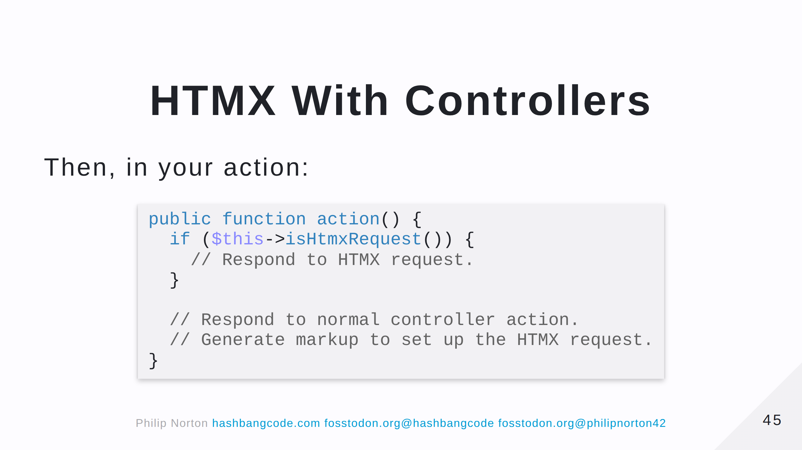

Slide 46
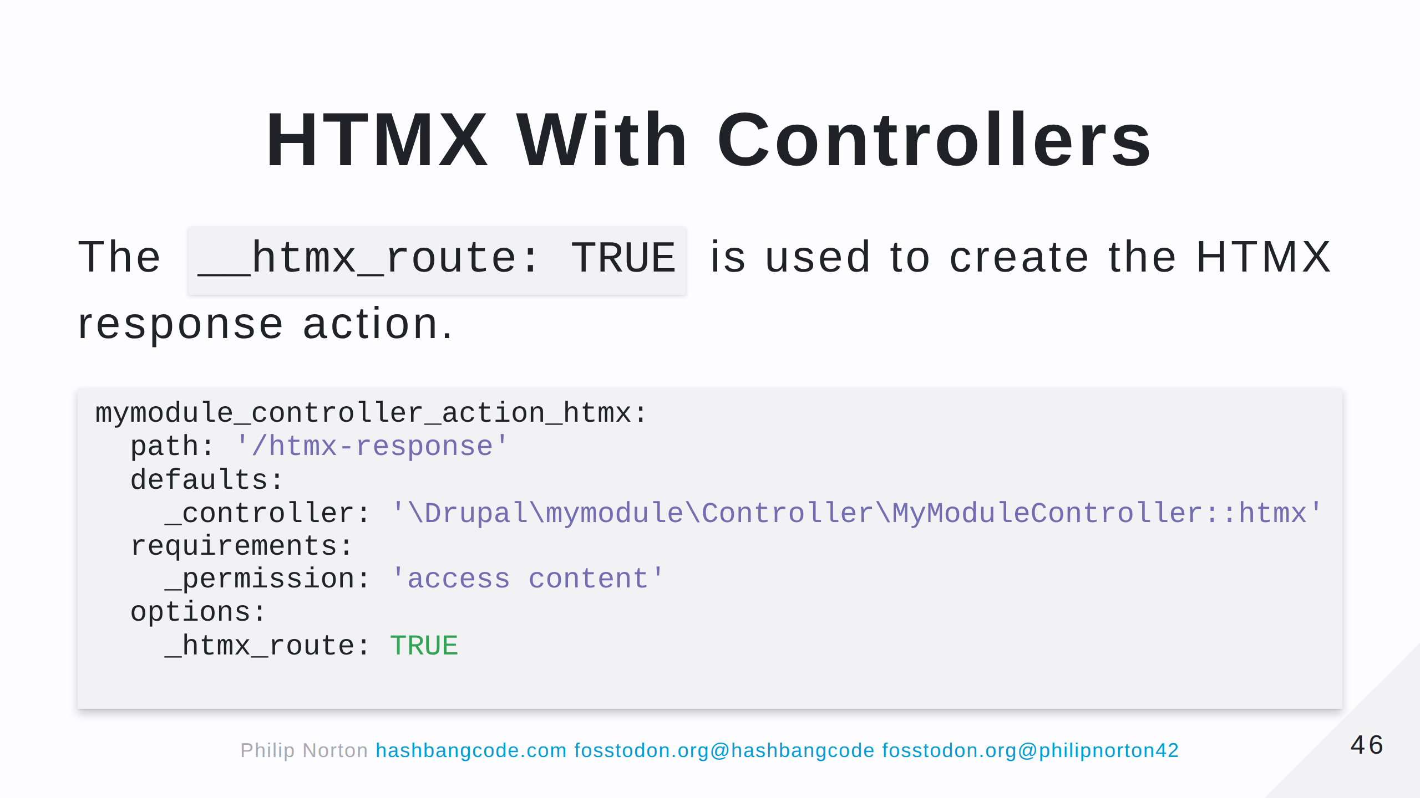

Slide 47
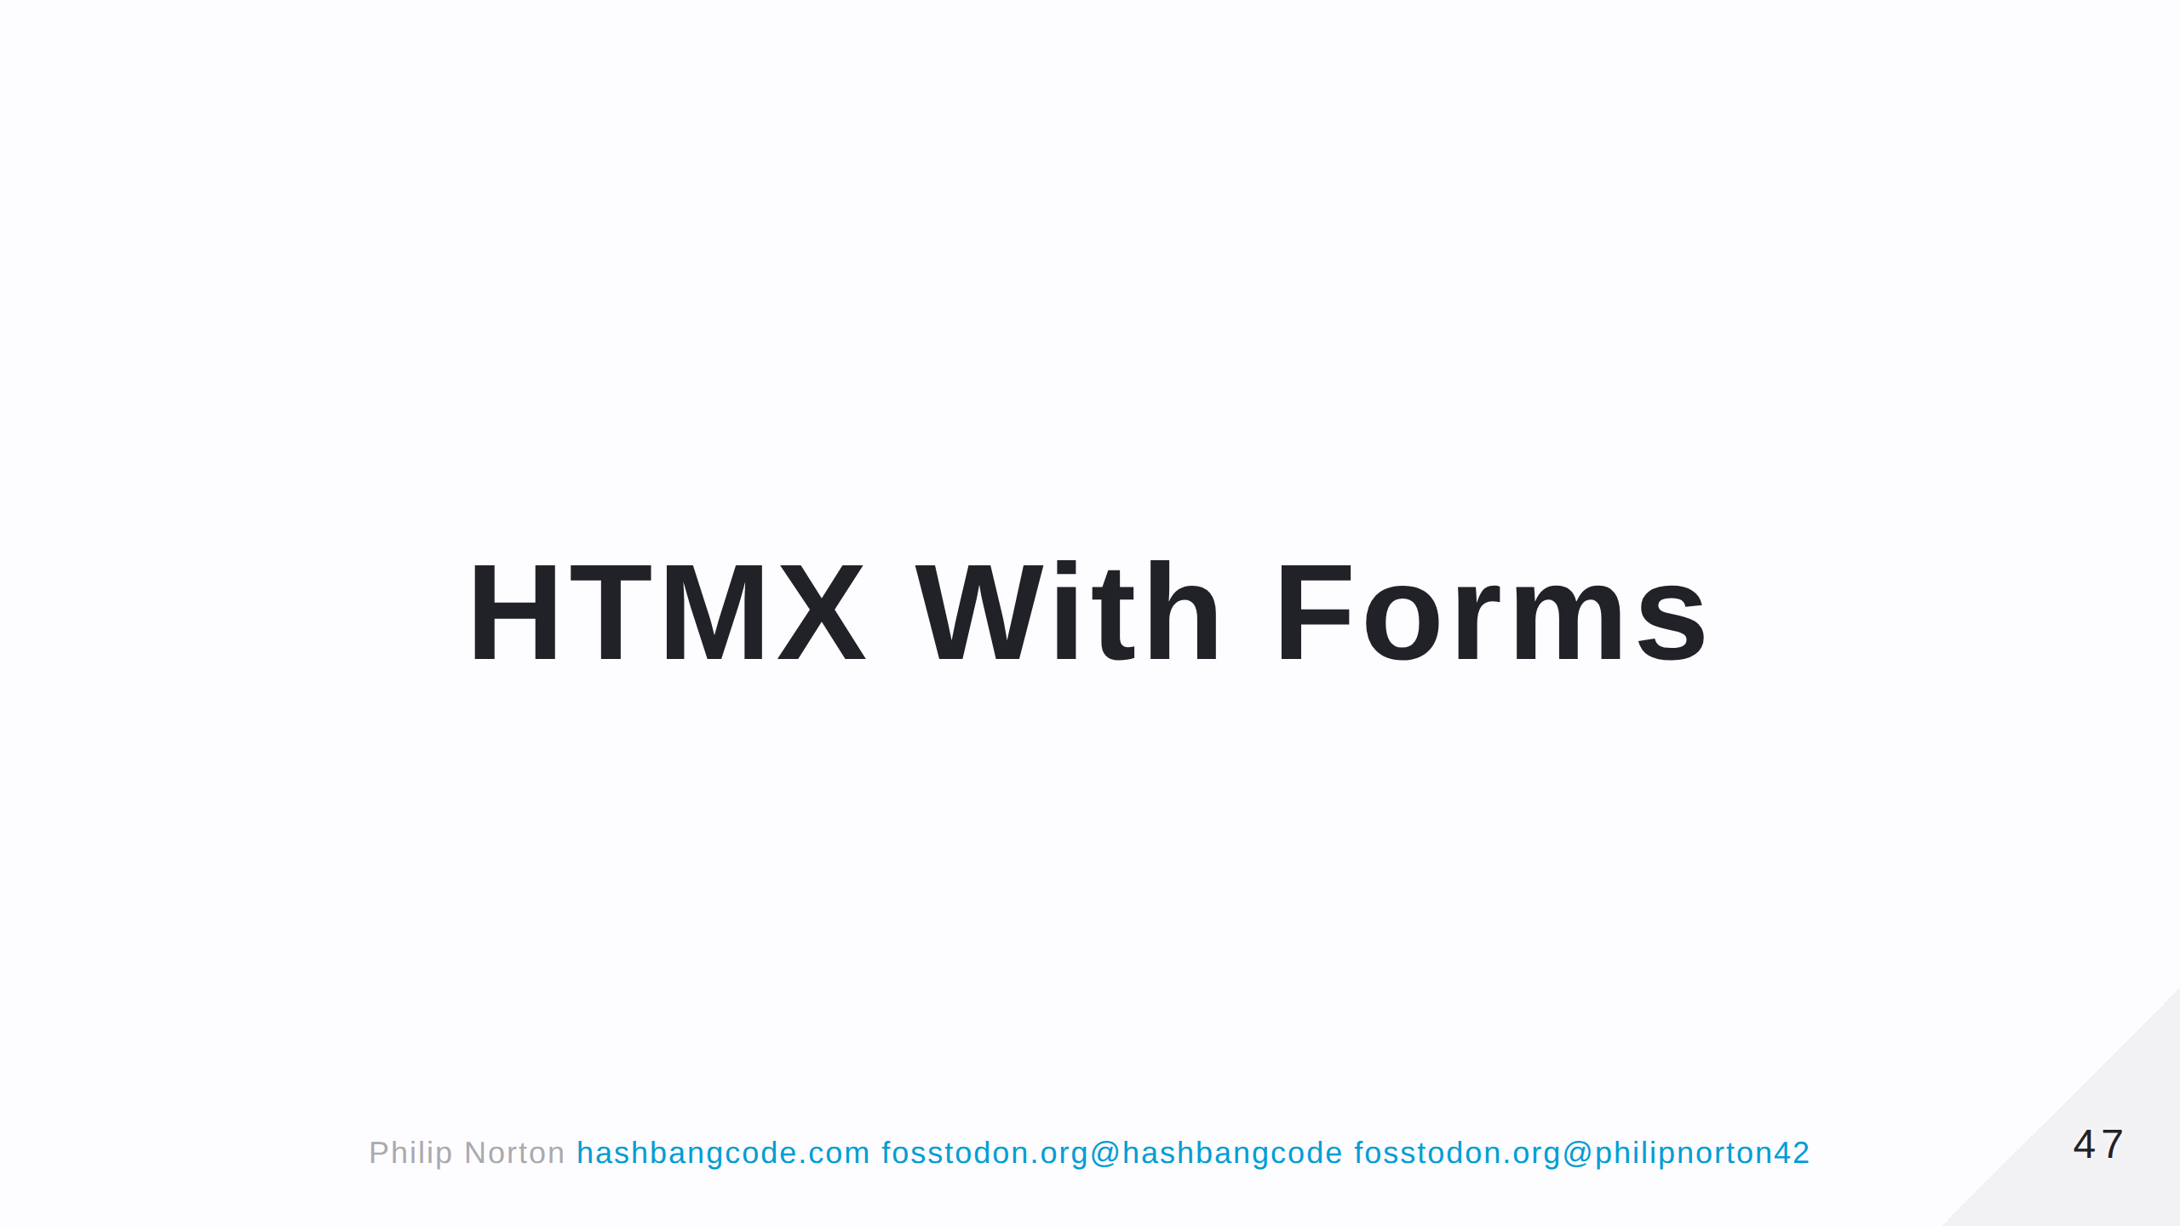

Slide 48
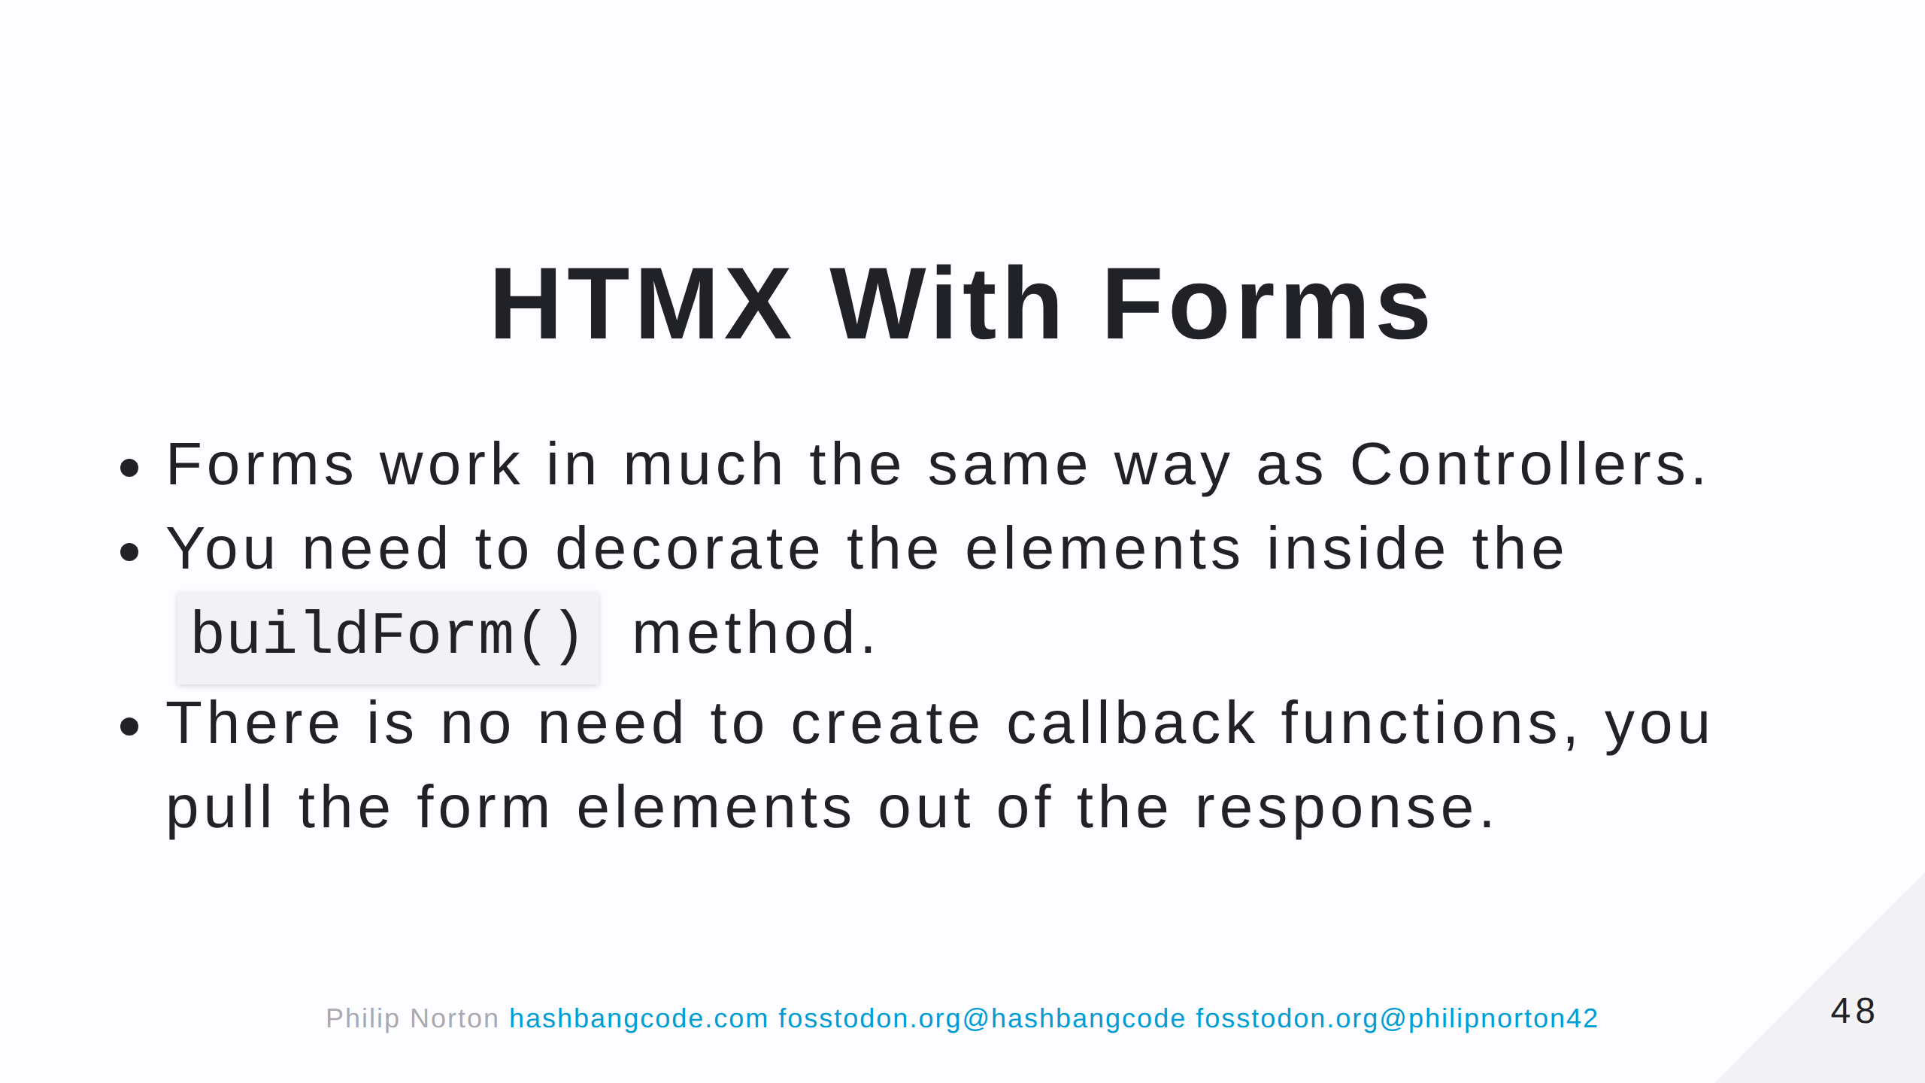

Slide 49
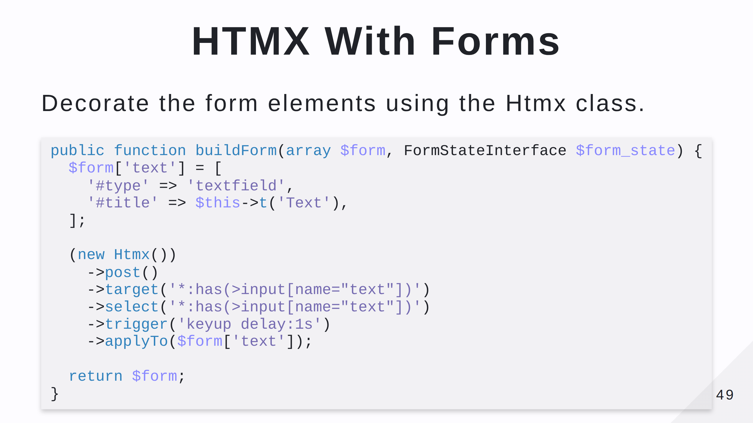
Notes:
- This decorates the form element with the HTMX elements.

Slide 50
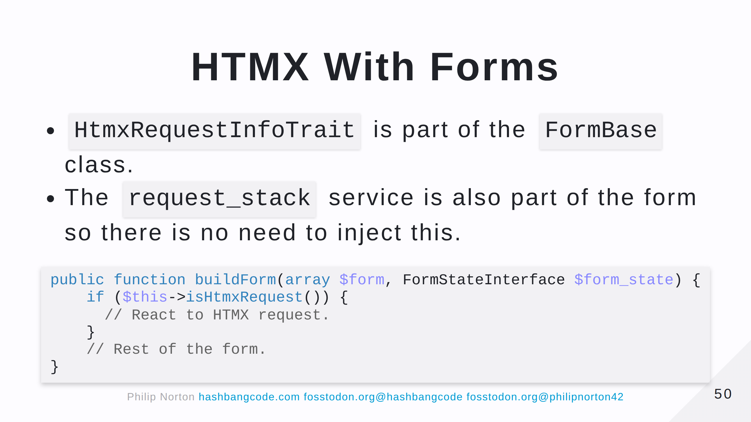
Notes:
- There's no need to include the request object in the form.

Slide 51
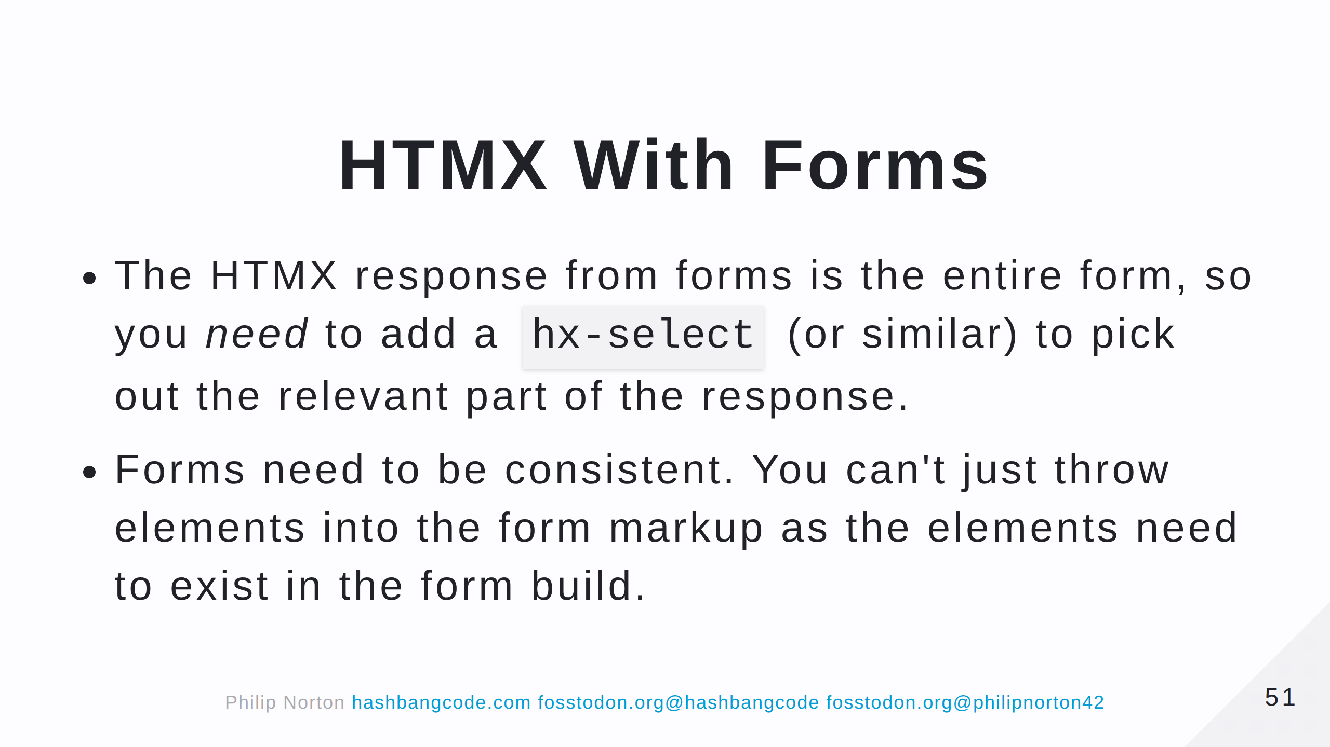
Notes:
Think about what would happen if you created the form from scratch. Form intput parameters can alter the . If the elemnts don't exist in the form build they won't be part of the submit process. Also, use post requests for HTMX in forms.

Slide 52


Slide 53
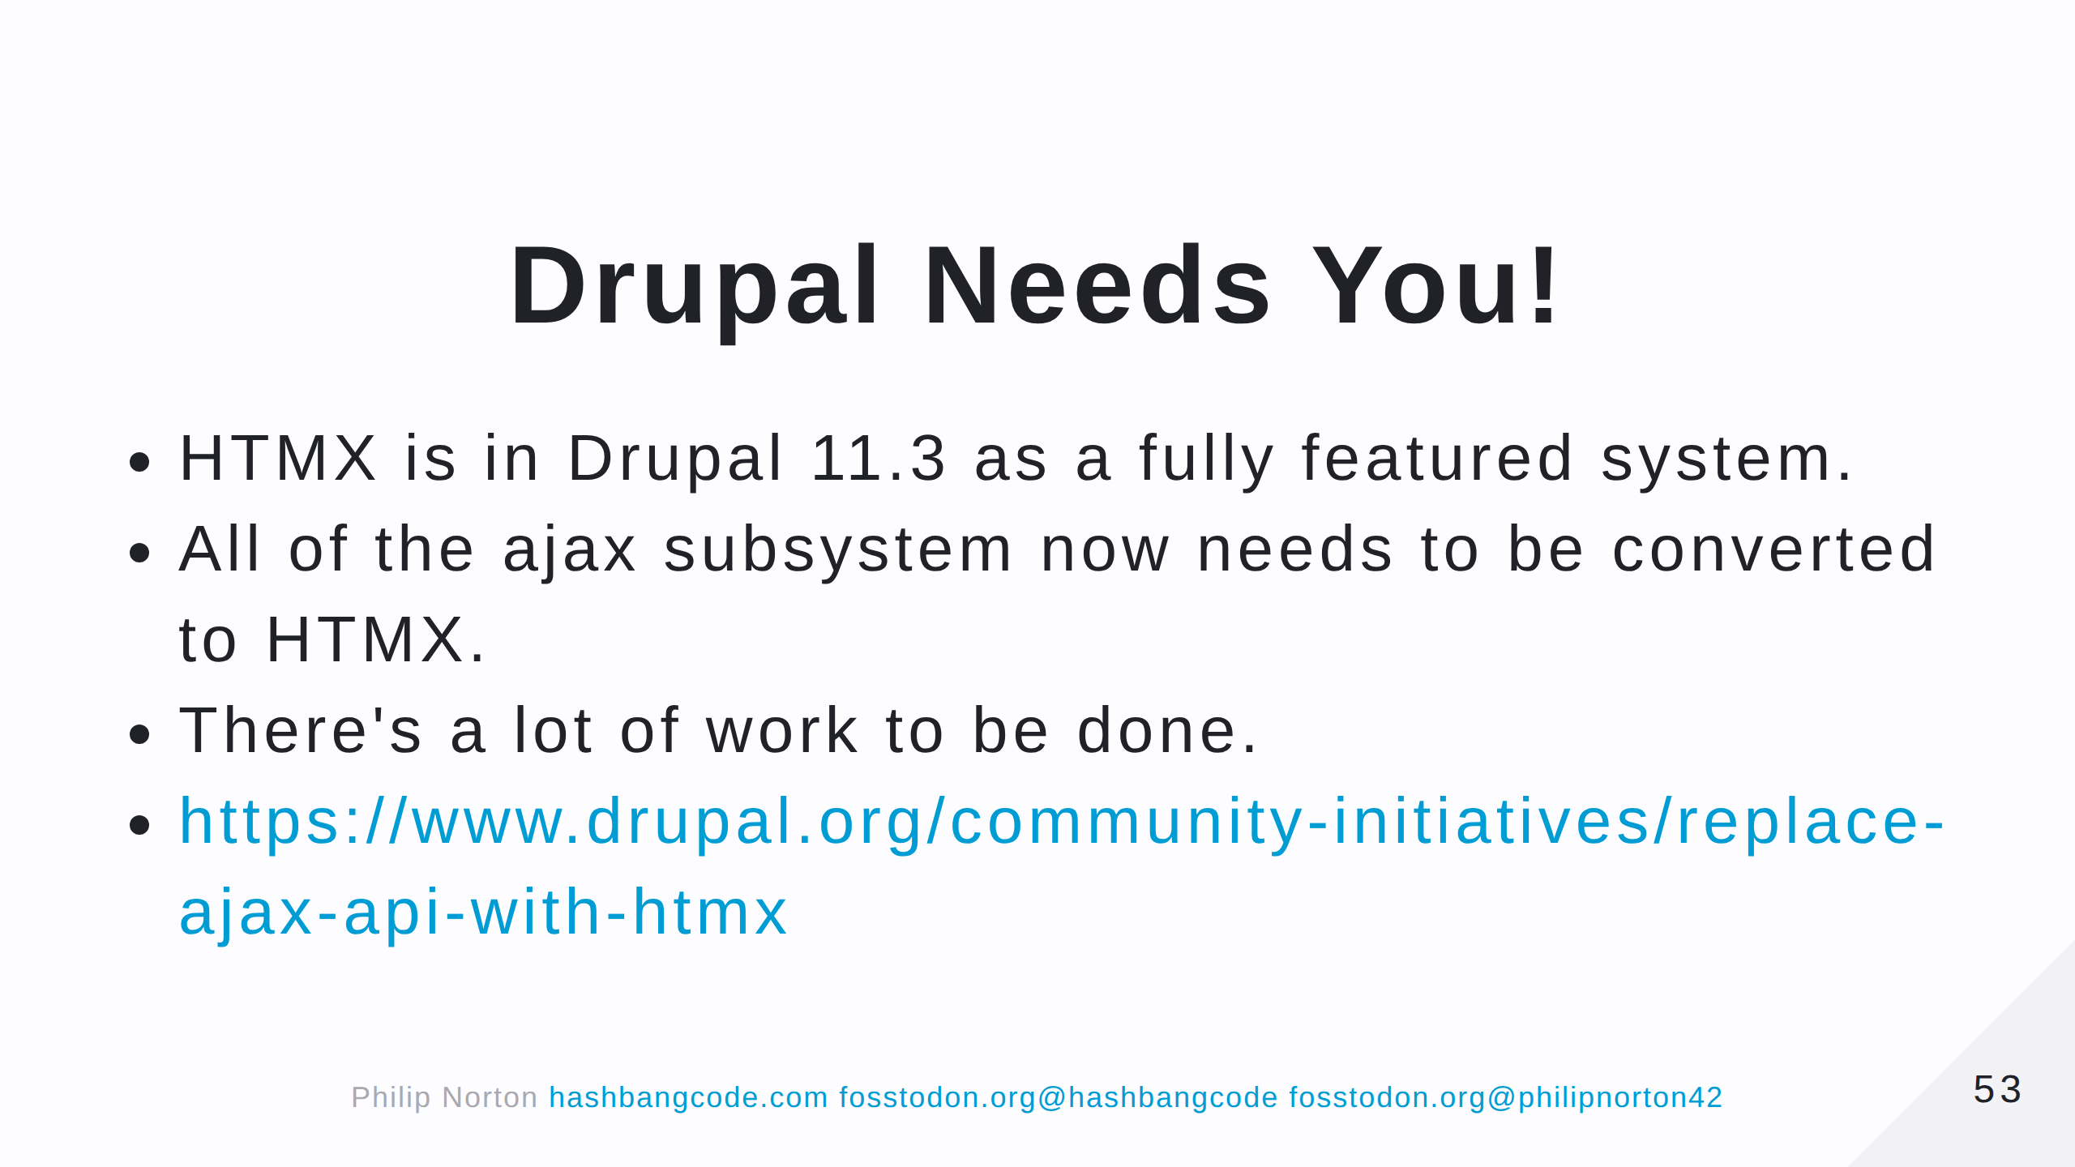

Slide 54
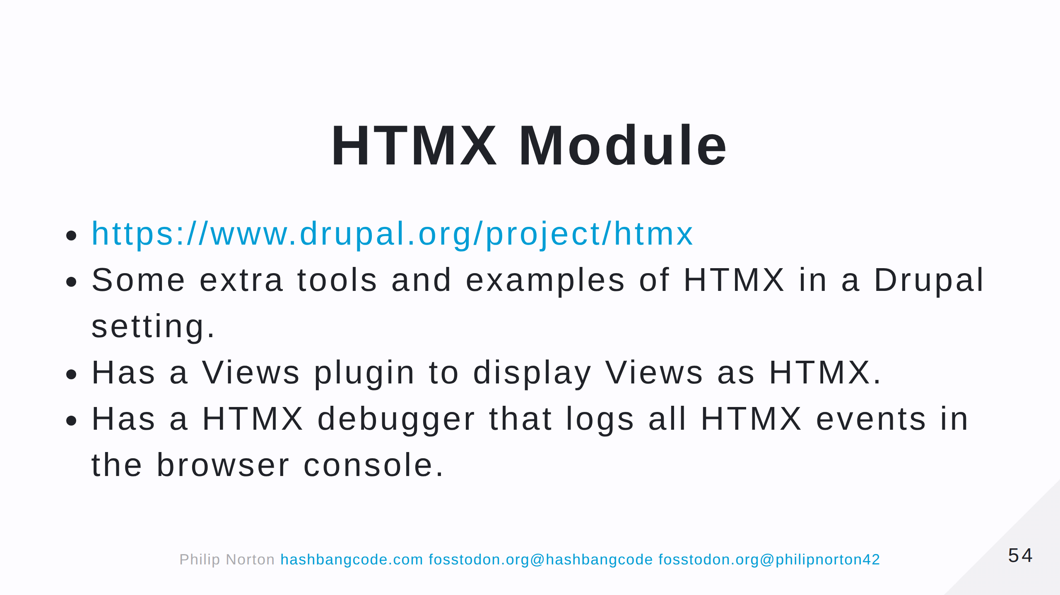

Slide 55
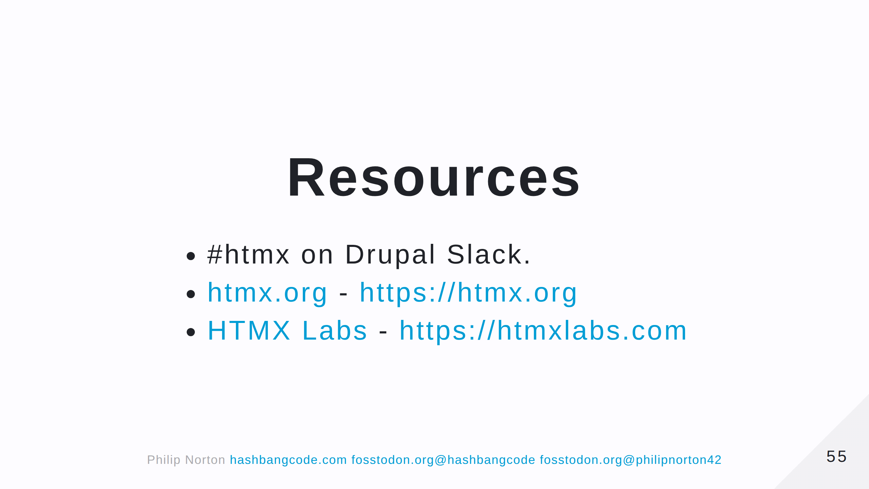

Slide 56


Slide 57


