Slide 1

Notes:
Speaker notes will appear here.

Slide 2
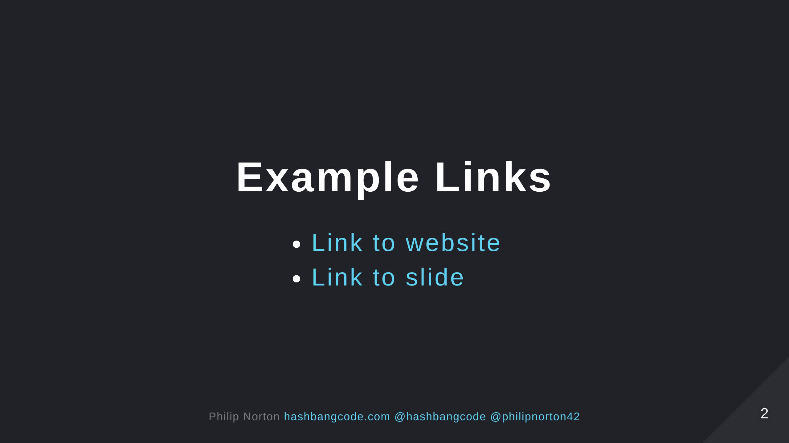

Slide 3


Slide 4
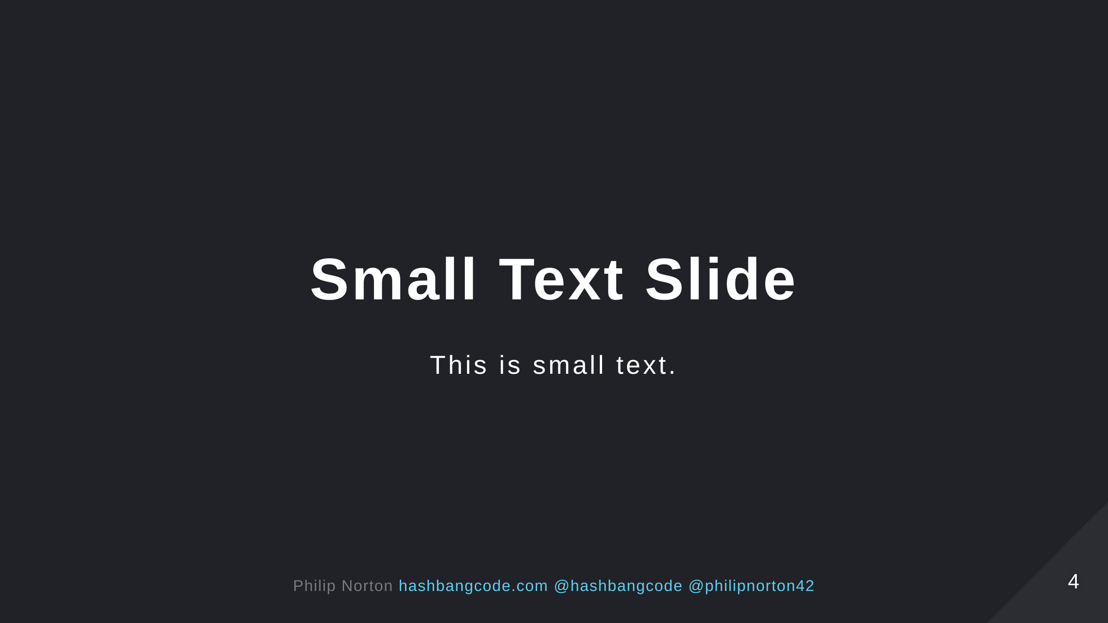

Slide 5


Slide 6


