Slide 1
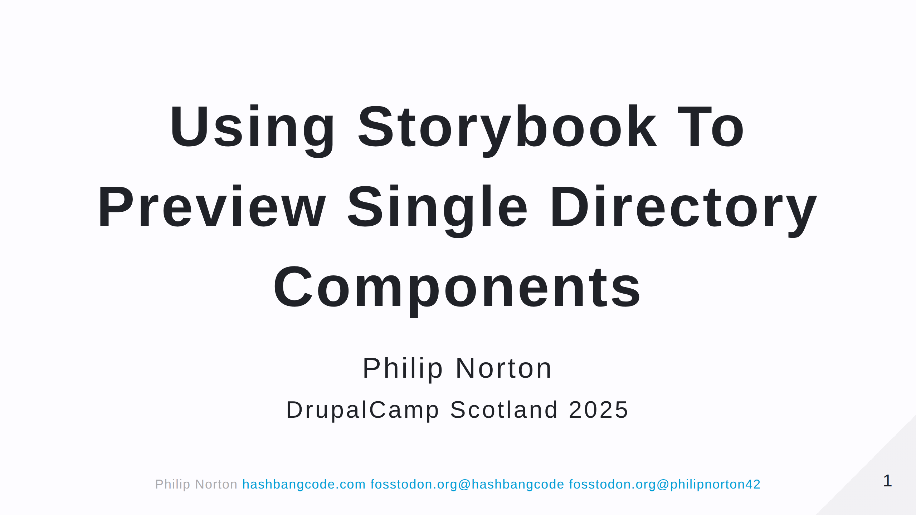

Slide 2
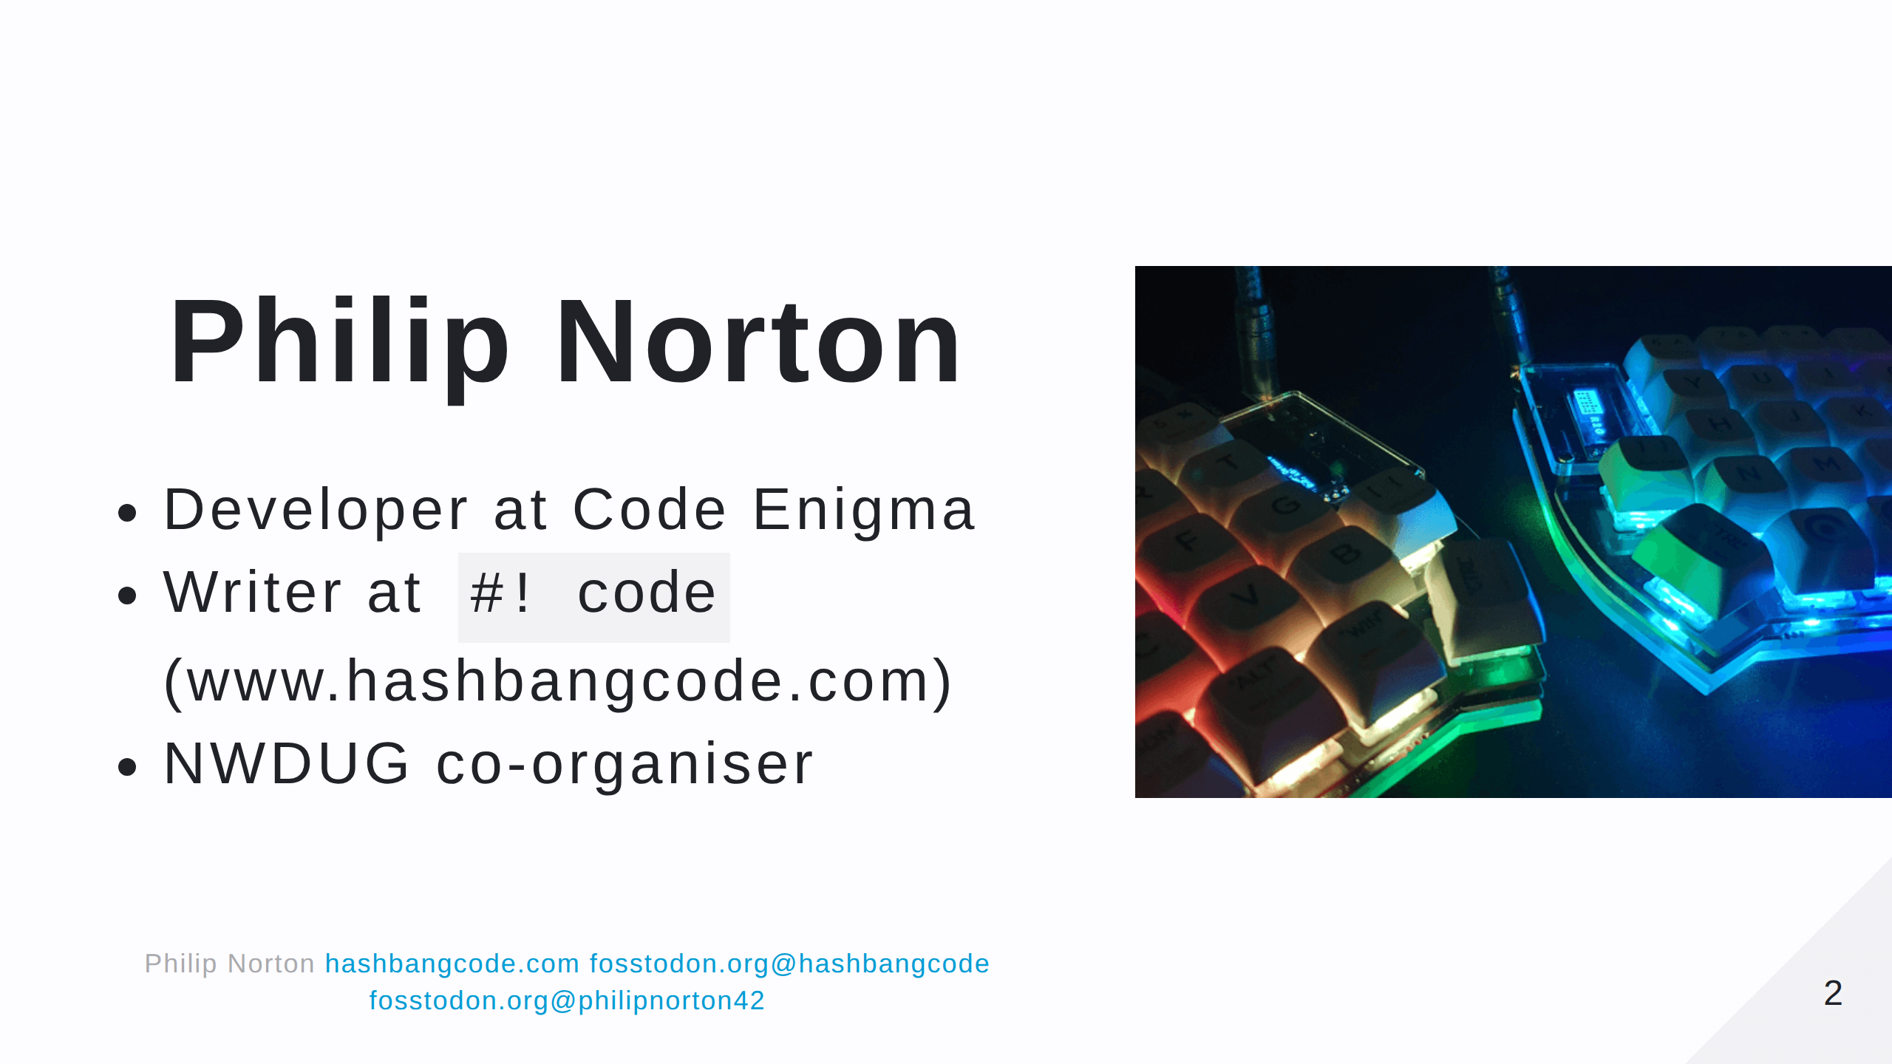
Notes:
- Doing Drupal for 15 years. - Programming in general for 20. - This is a picture of a Lily58 mechanical keyboard.

Slide 3
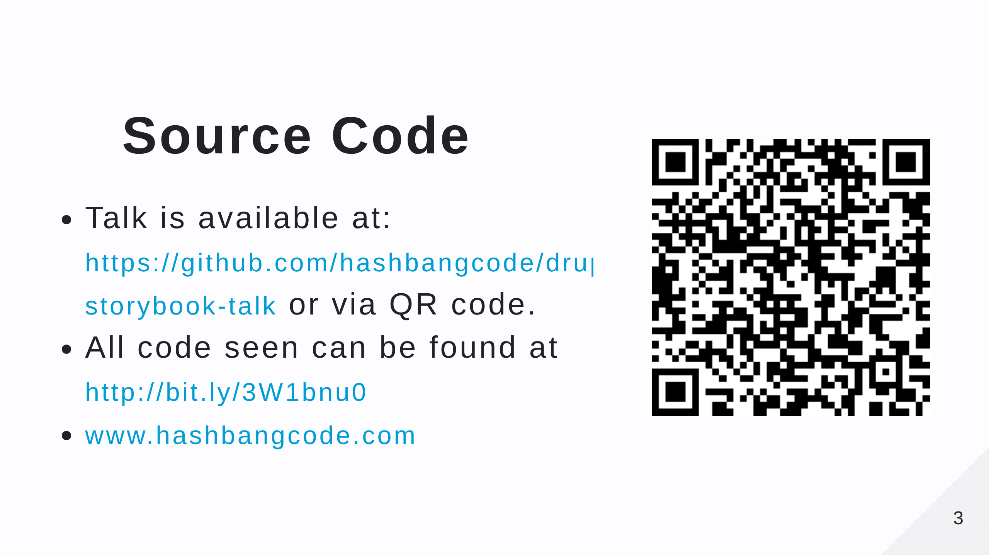
Notes:
- Scan the QR code for the talk repo. Which has links to all of the resources you need. - There's also a Drupal and Storybook article on my site.

Slide 4
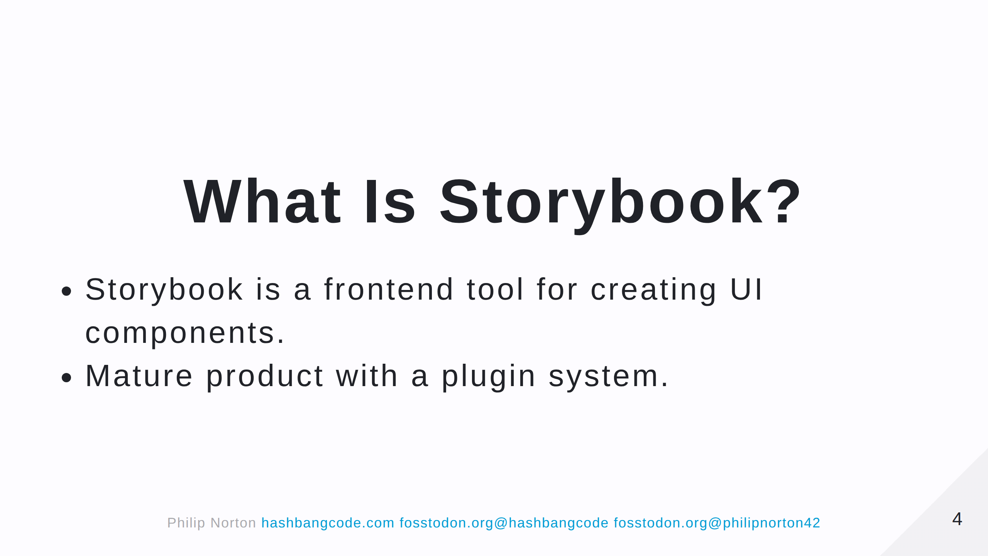

Slide 5
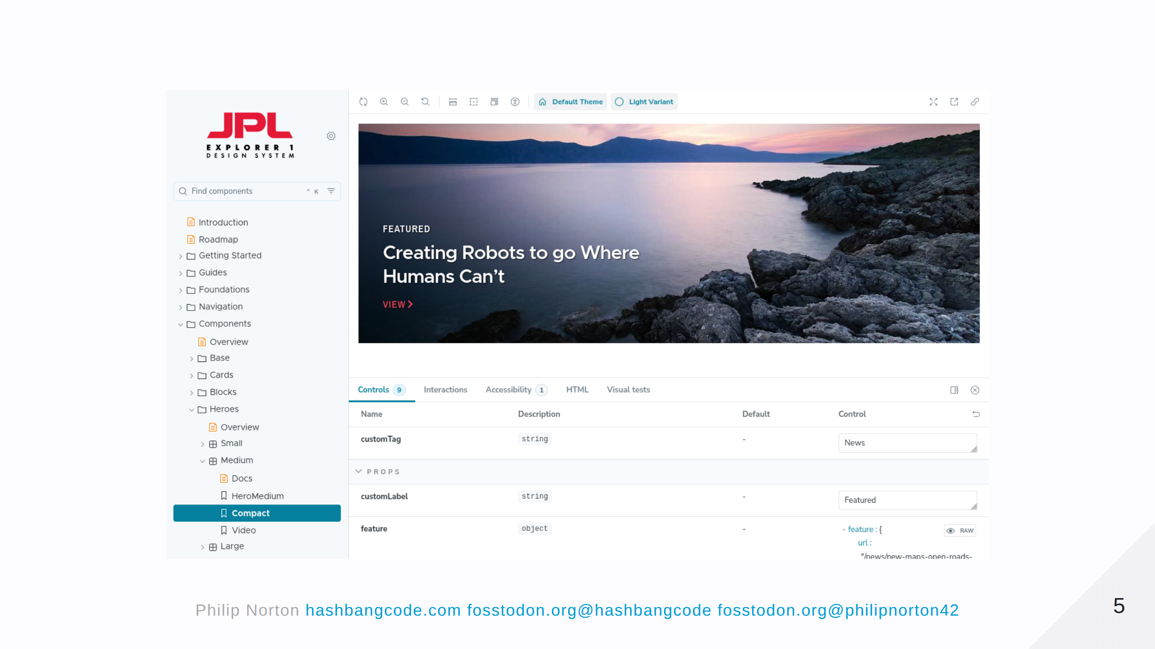
Notes:
I've been looking at Storybook for a few years, but there's always been a disconnect between Storybook and Drupal. I could build the stories in Storybook, but I'd then have to rebuild them in Drupal. That changed with SDC and is facilitied by the Storybook module. Here is an example of Storybook used by the JPL.

Slide 6
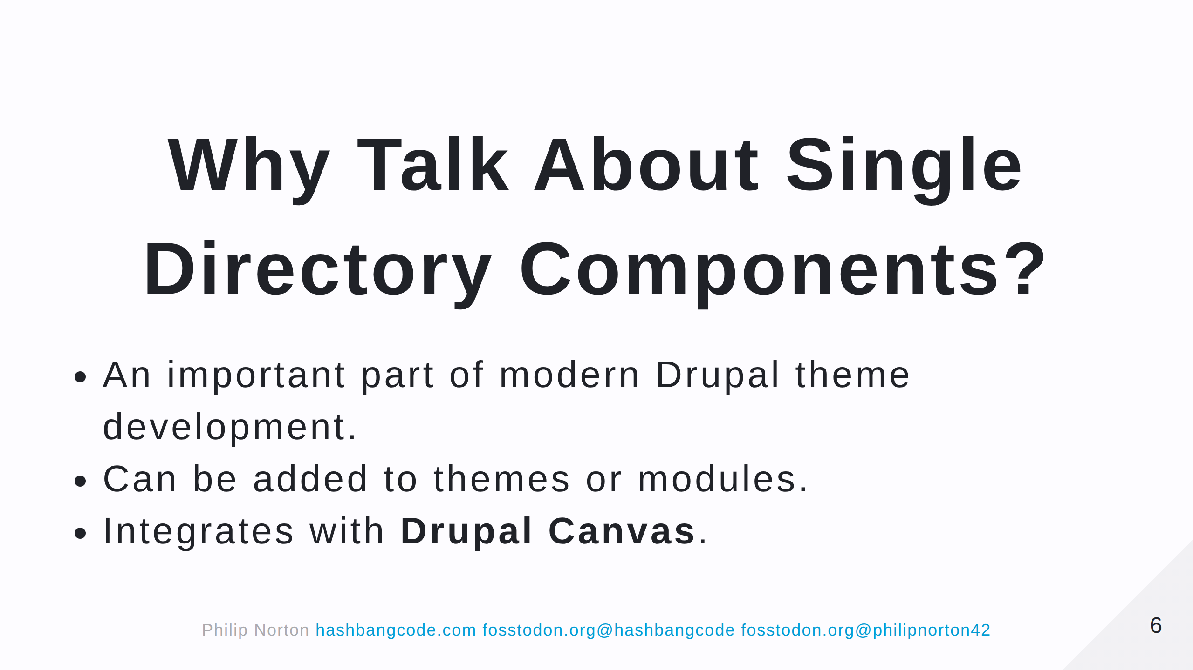
Notes:
Now is a good time to get into SDC.

Slide 7
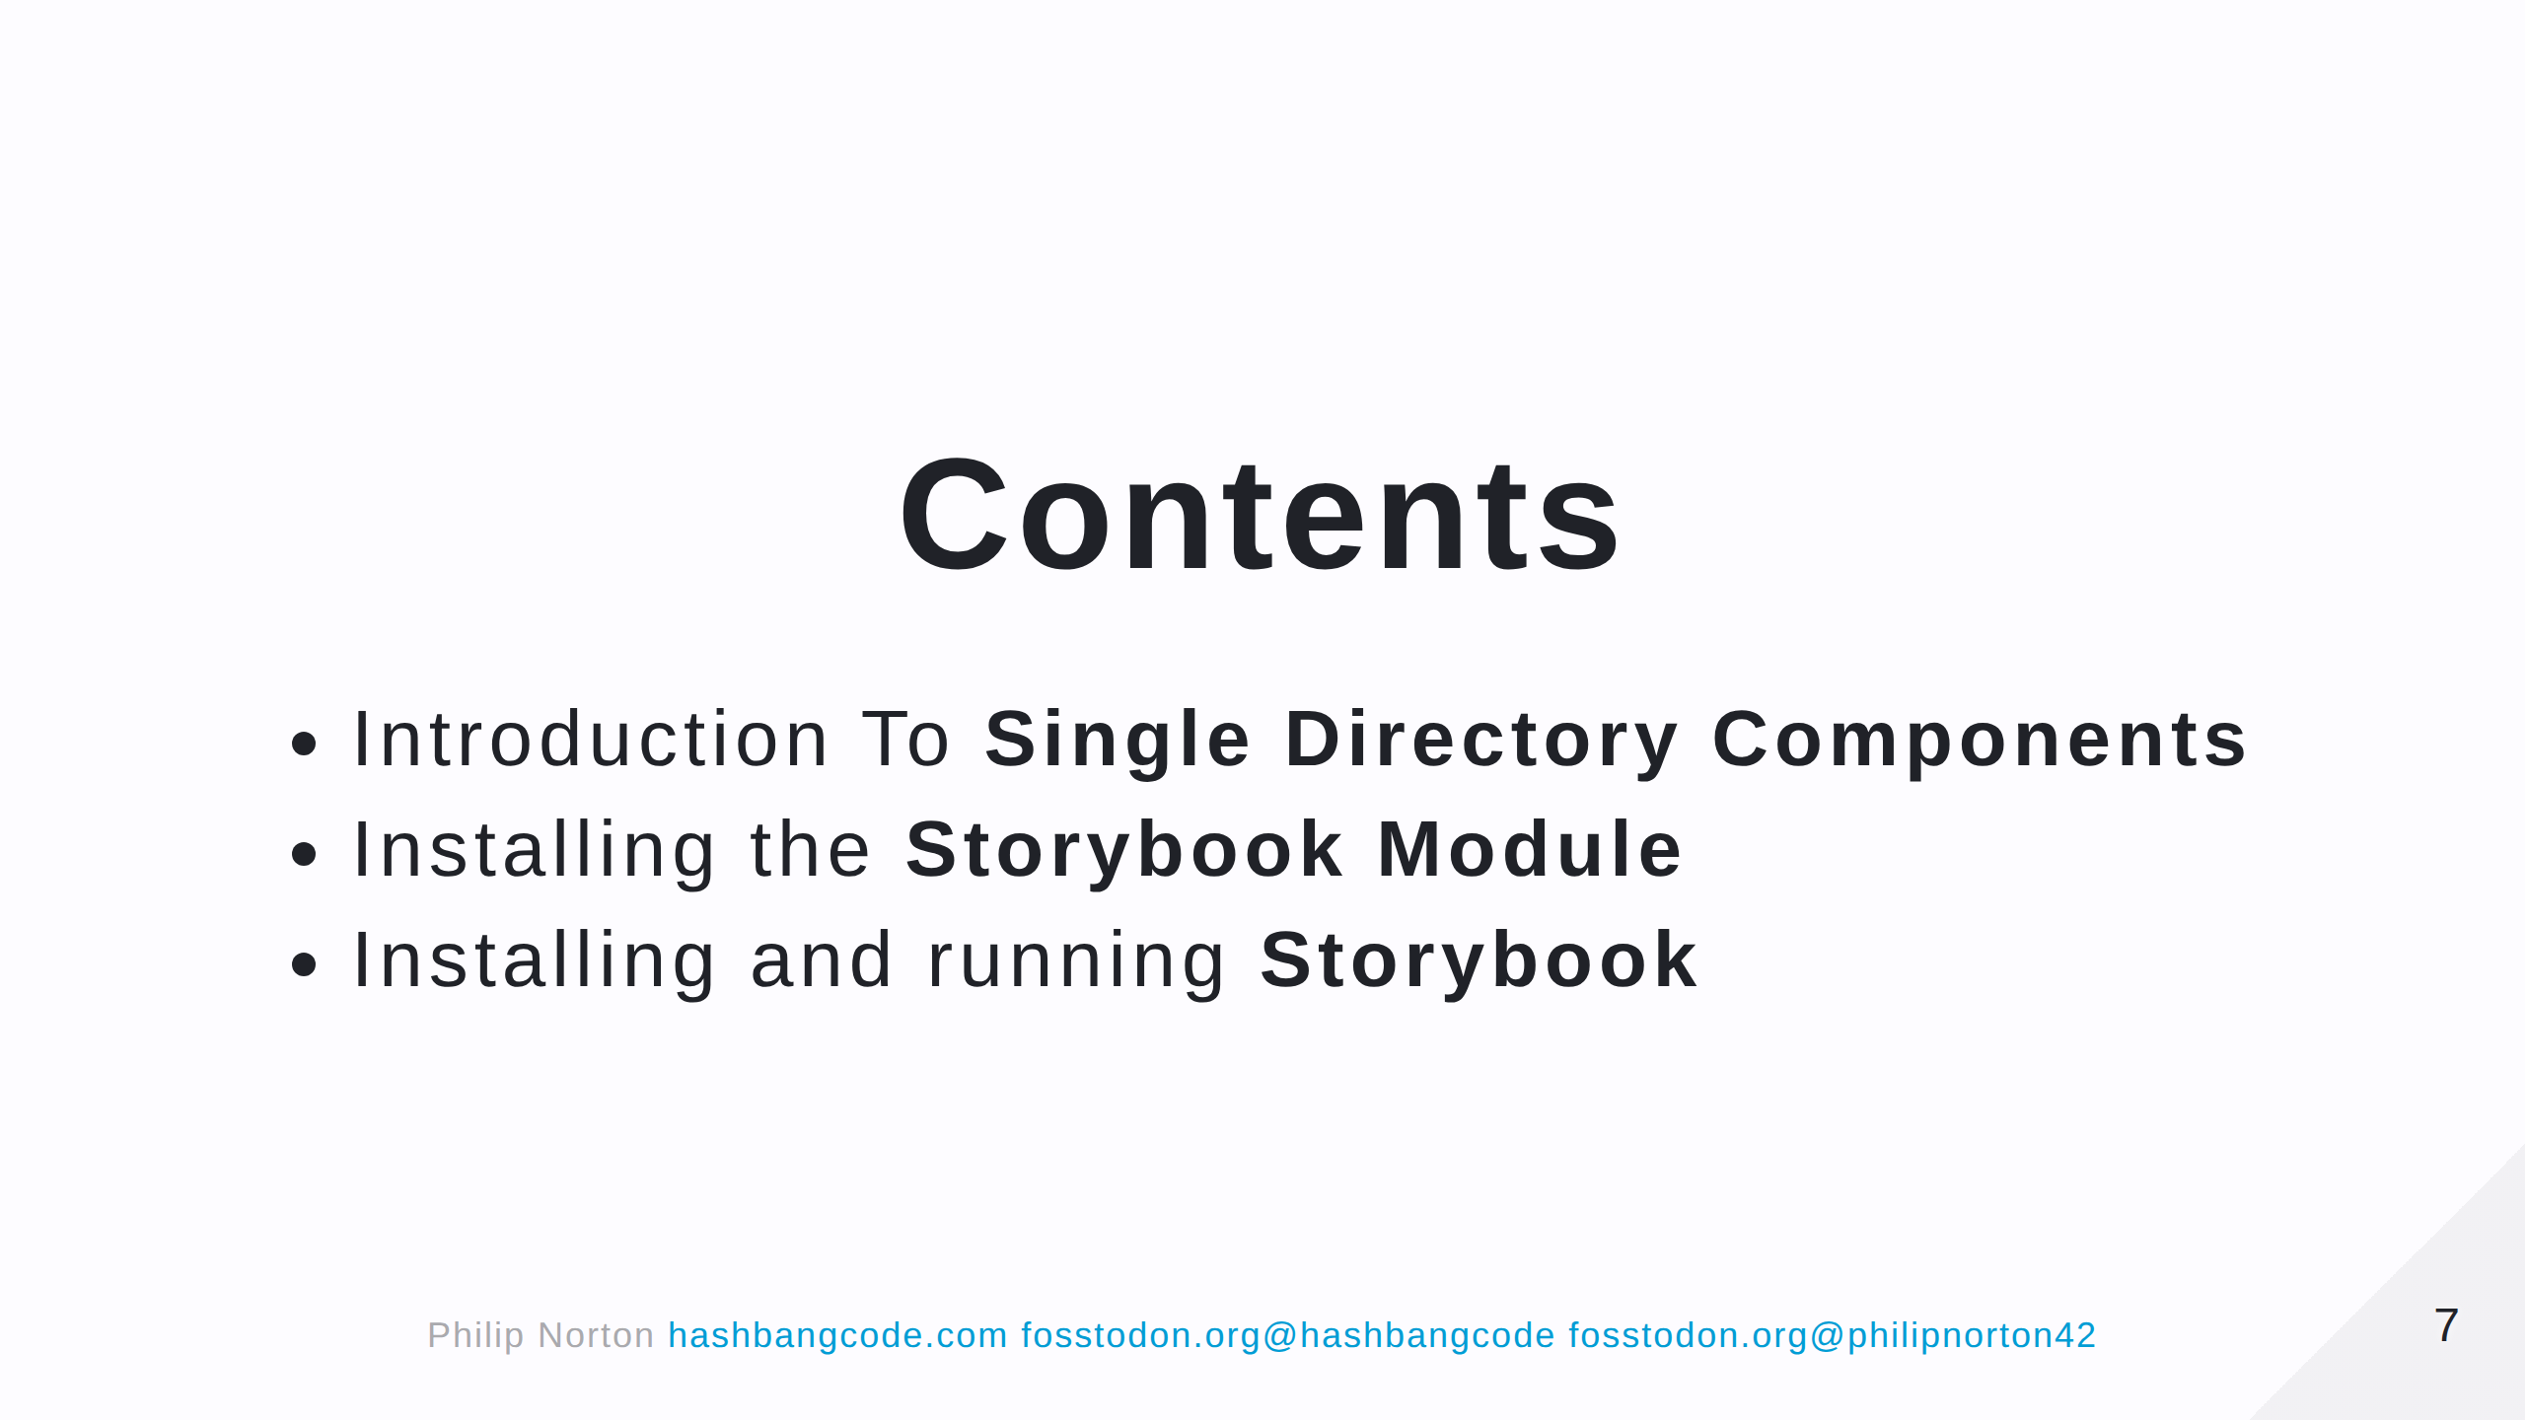

Slide 8
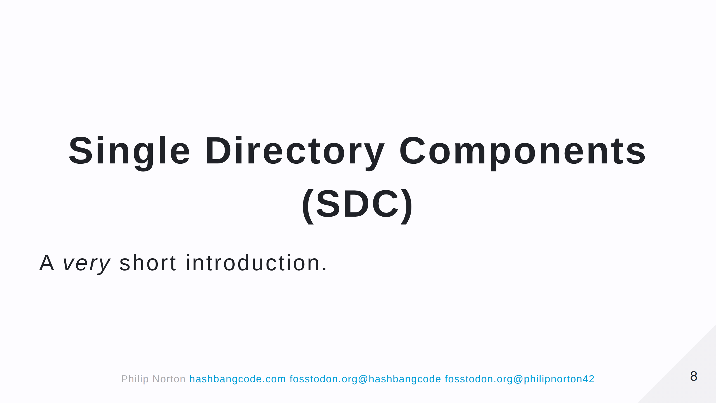
Notes:
From this point on SDC will be Single Directory Components.

Slide 9
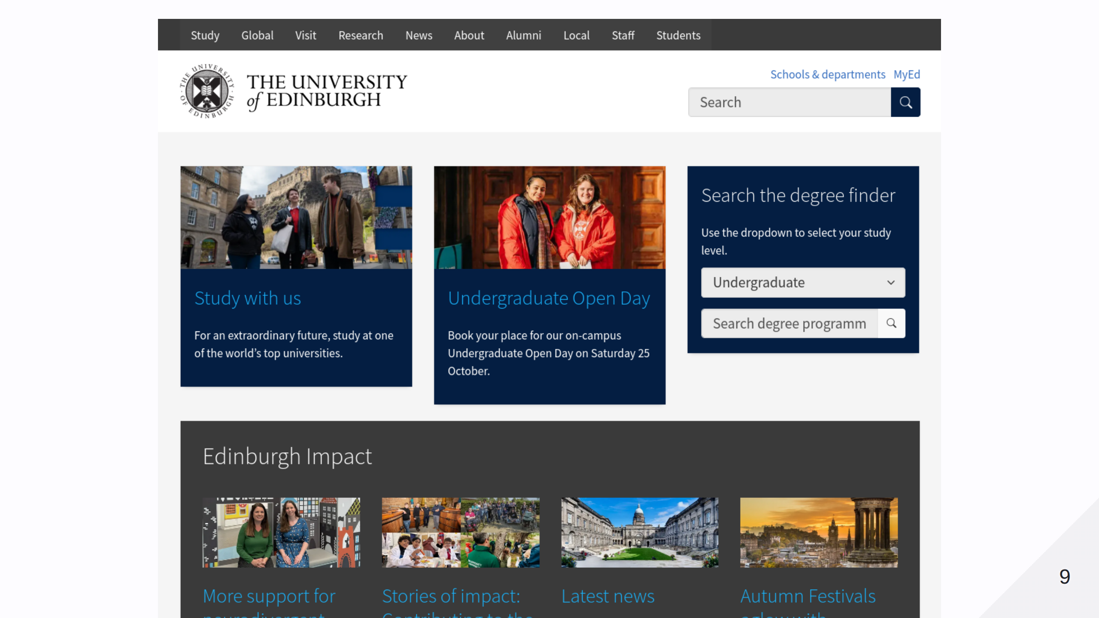

Slide 10
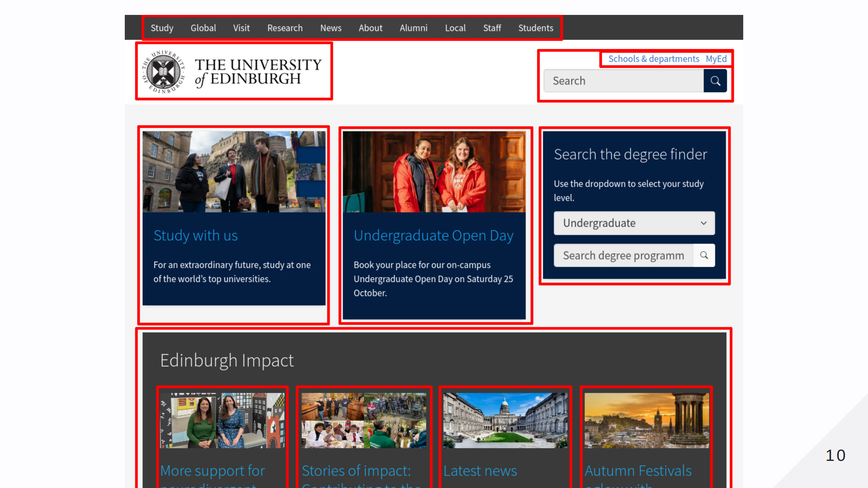

Slide 11
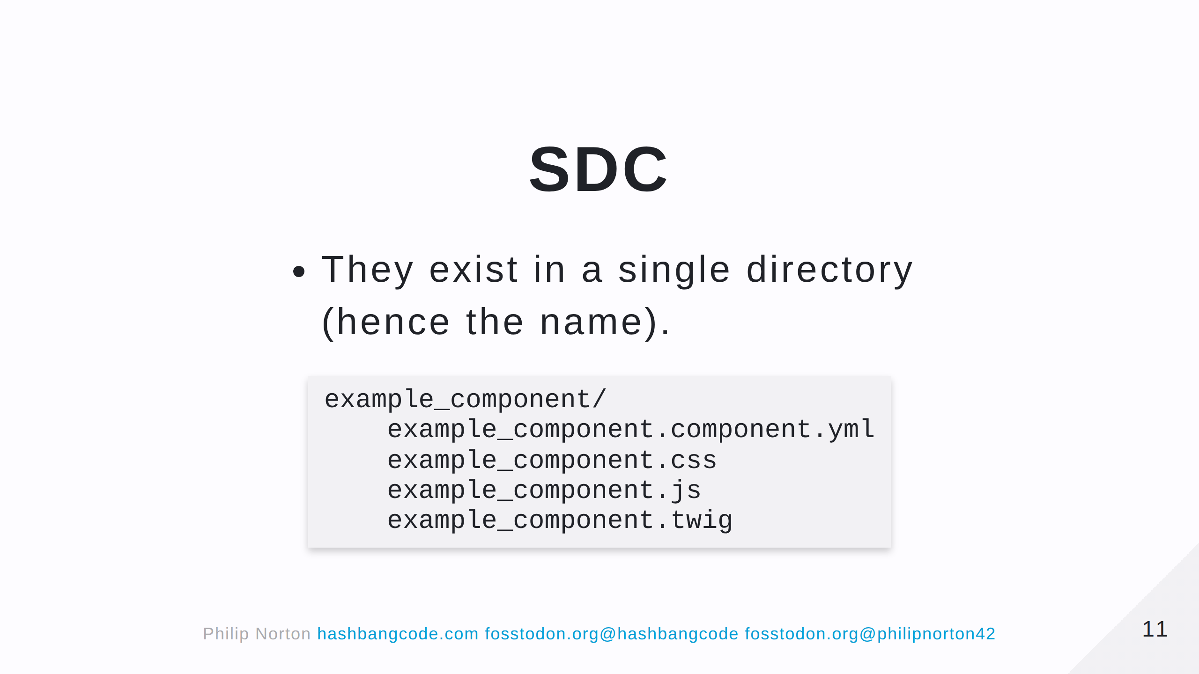
Notes:
This directory can exist in a theme or module. Let's look at each of the files.

Slide 12
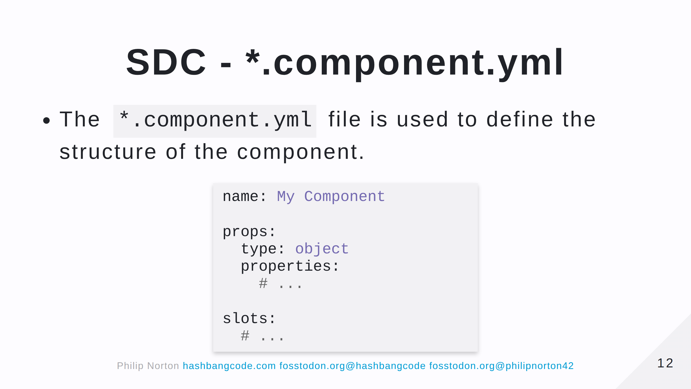
Notes:
Note that when you create a component in a module this file is heavily validated. In the theme, you can 'get away' with a bit more.

Slide 13
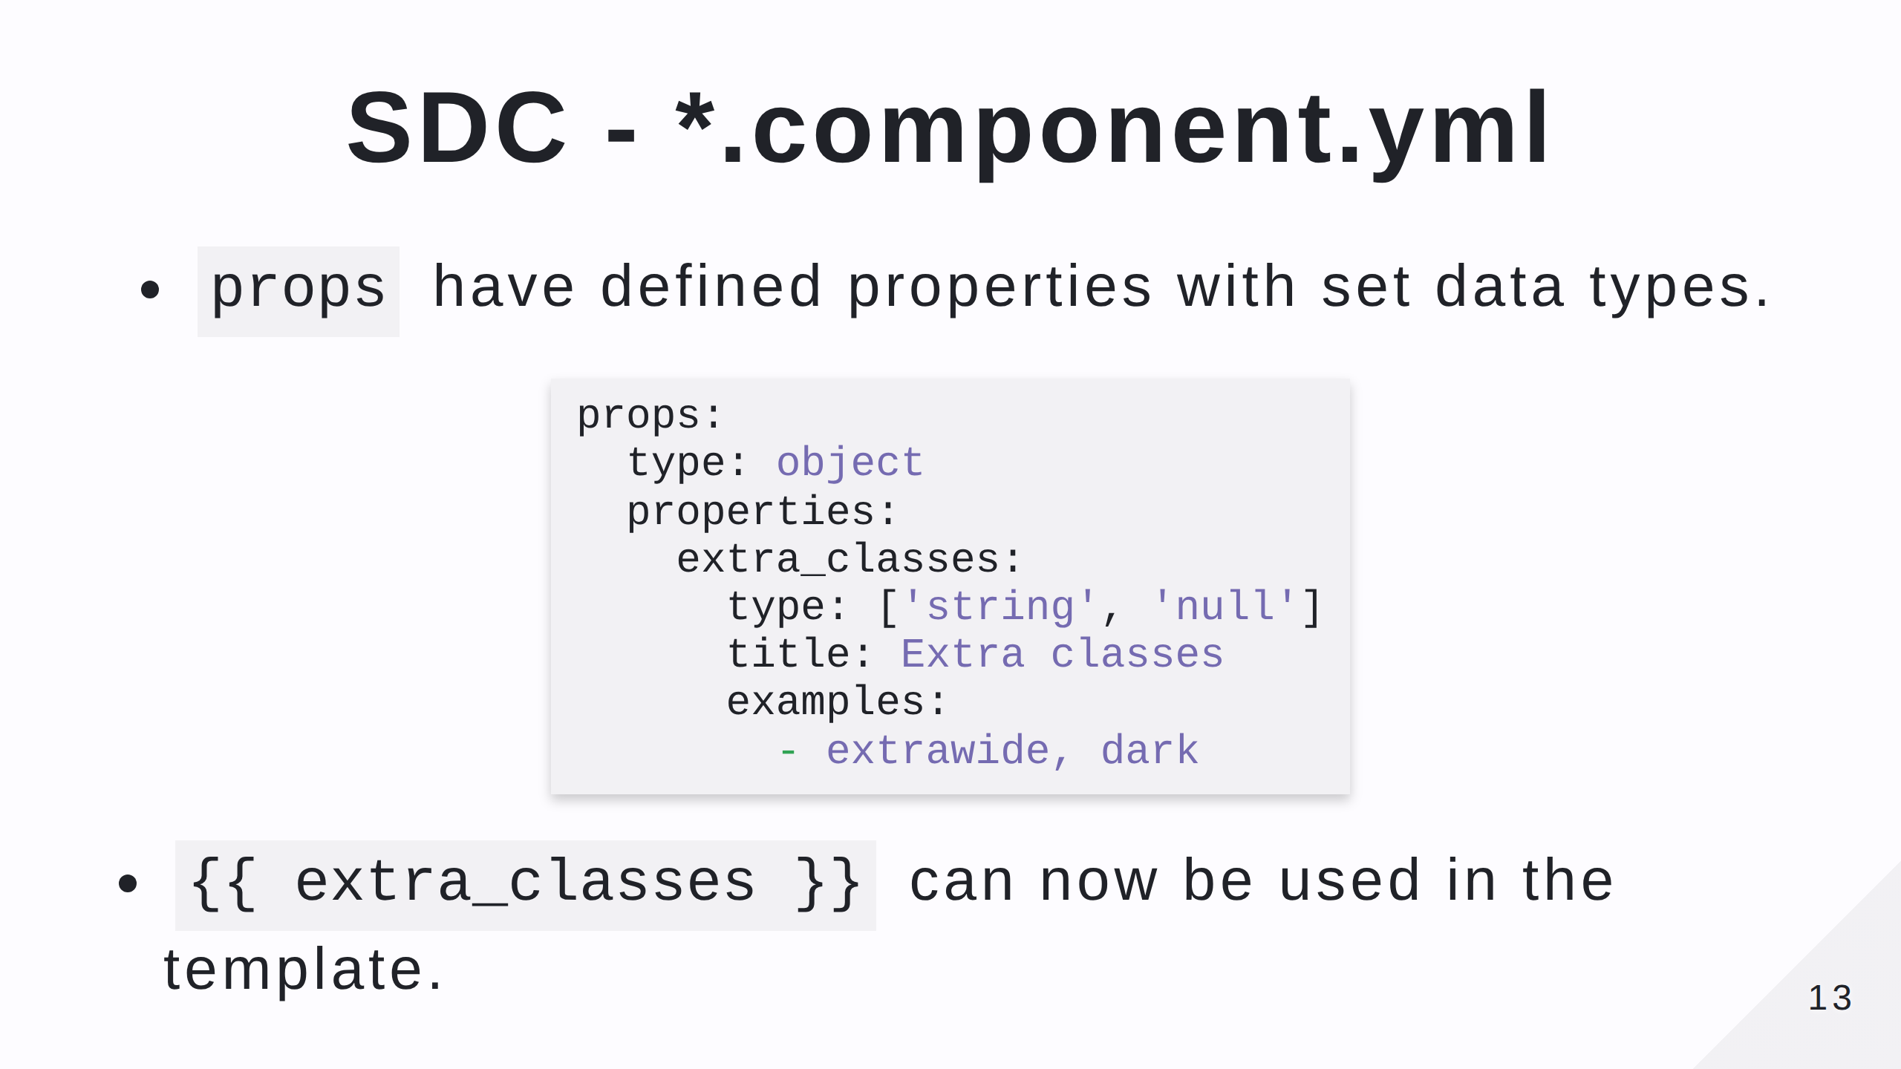

Slide 14
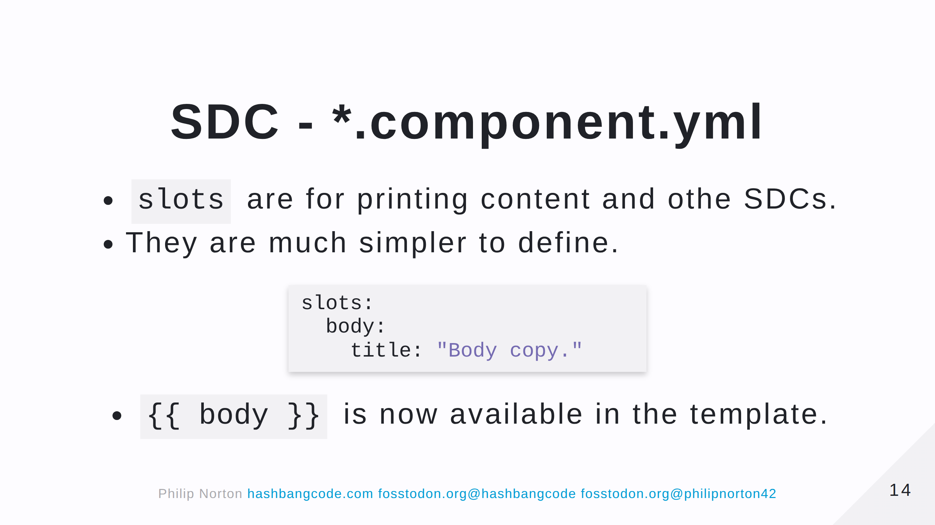

Slide 15
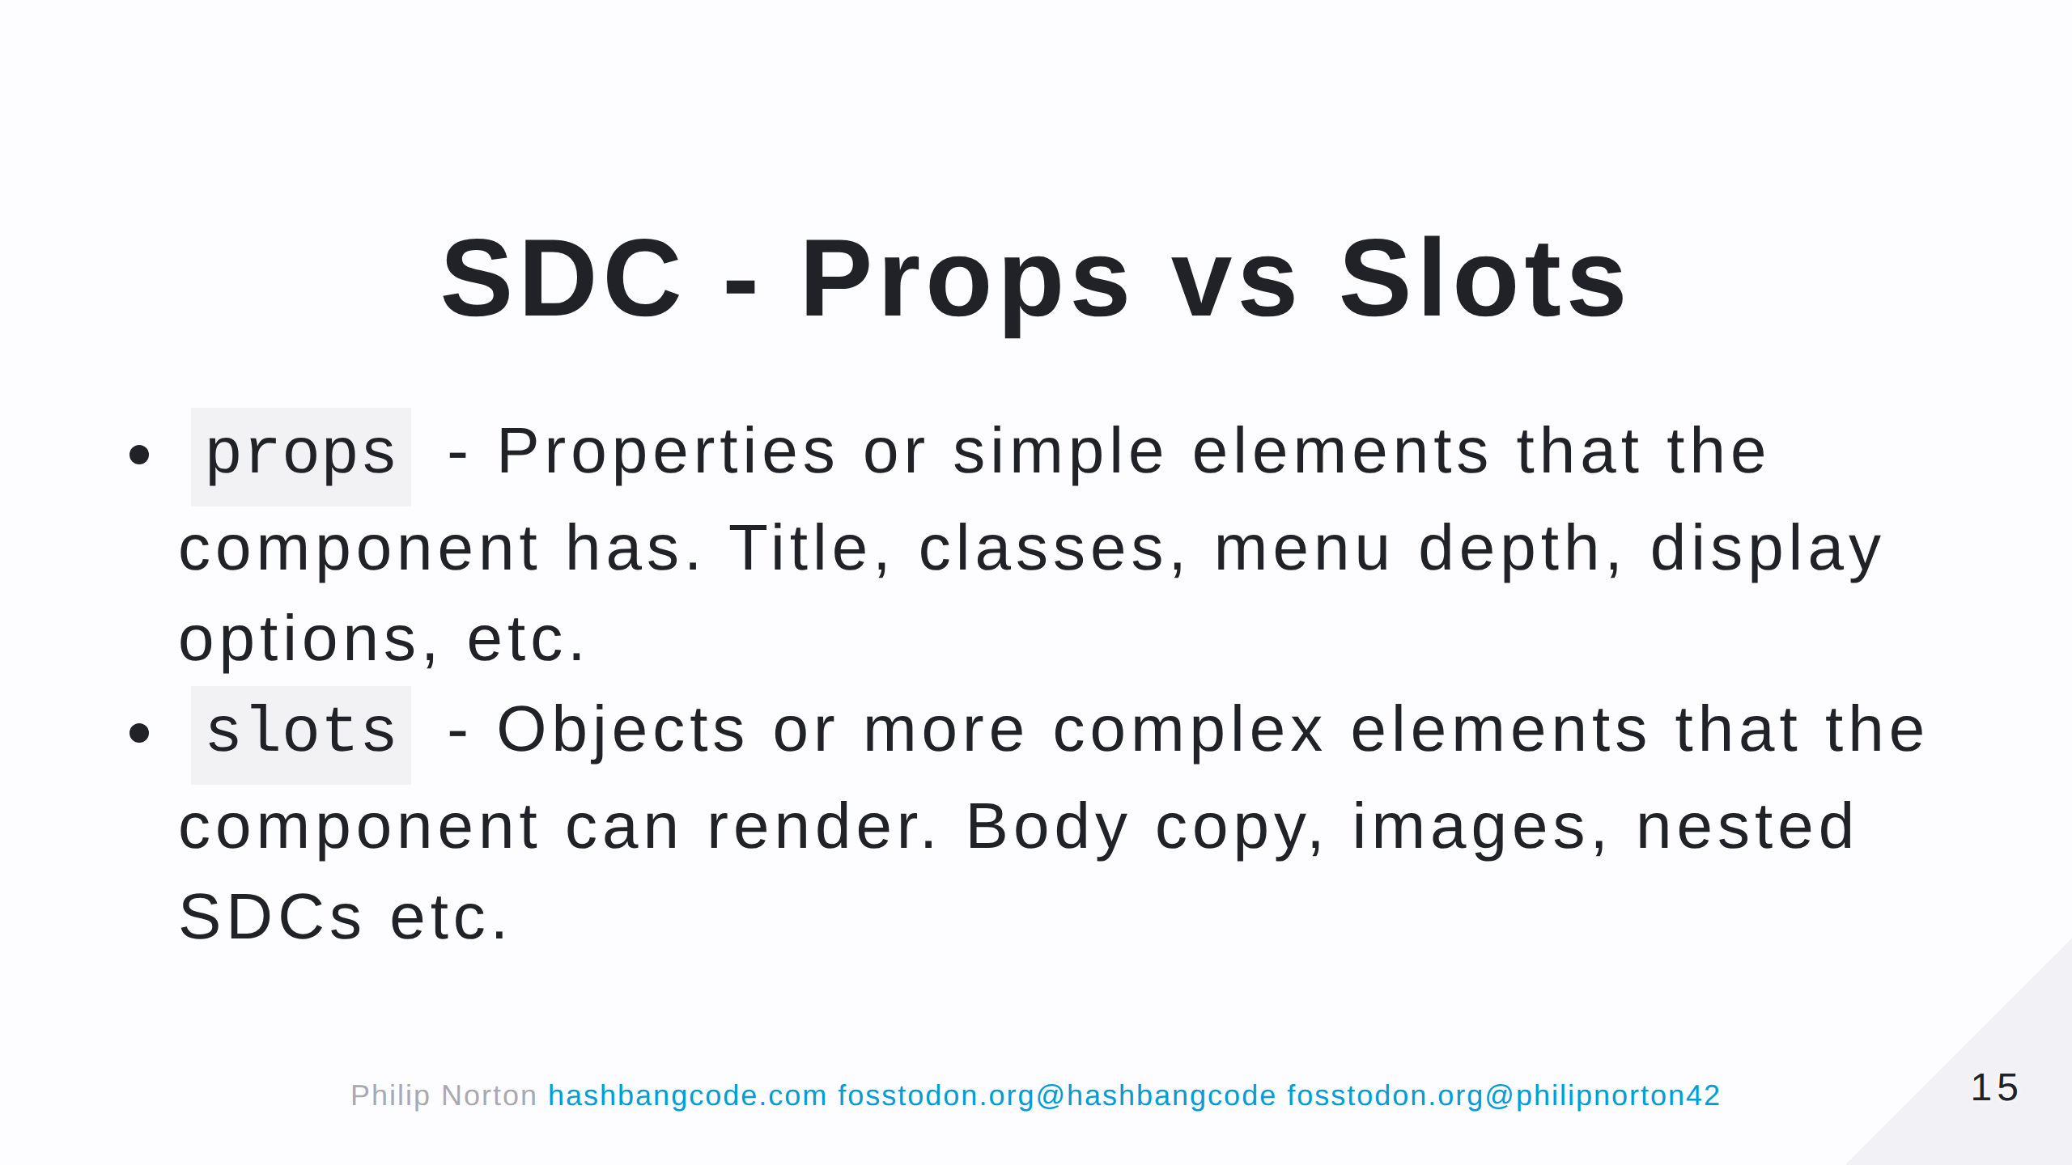

Slide 16
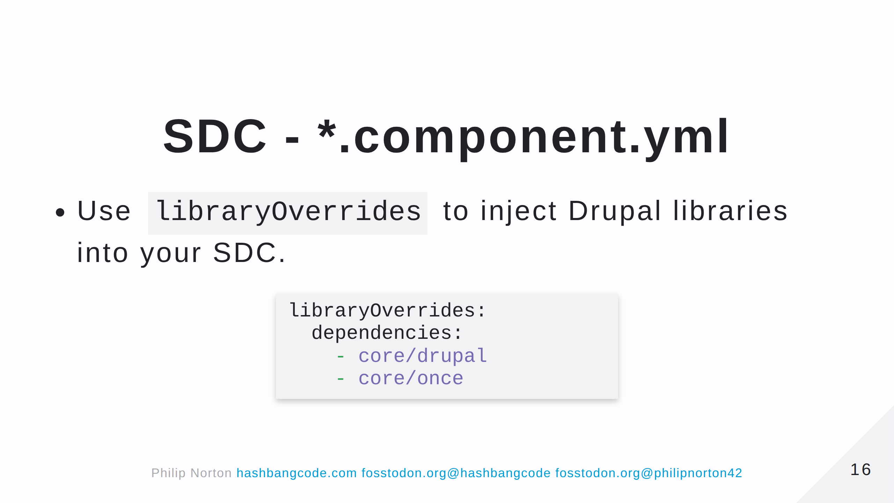

Slide 17
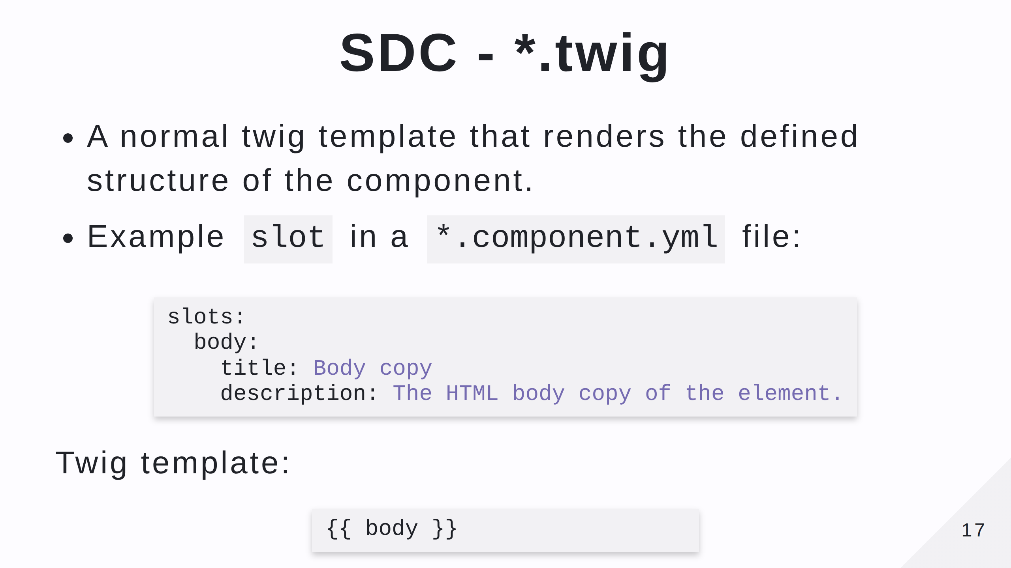

Slide 18
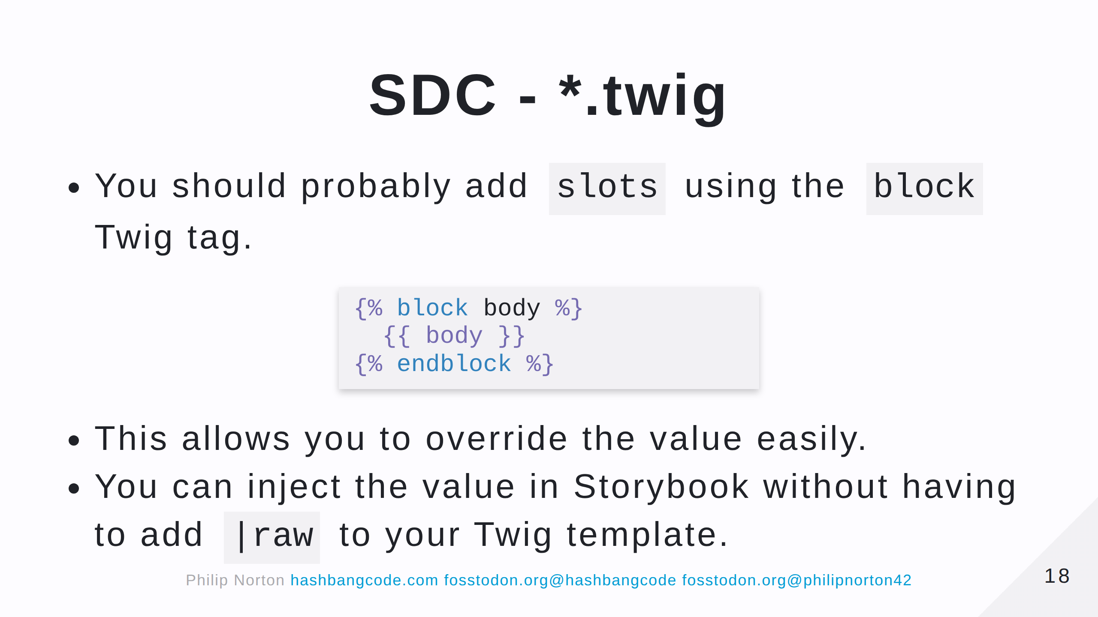

Slide 19
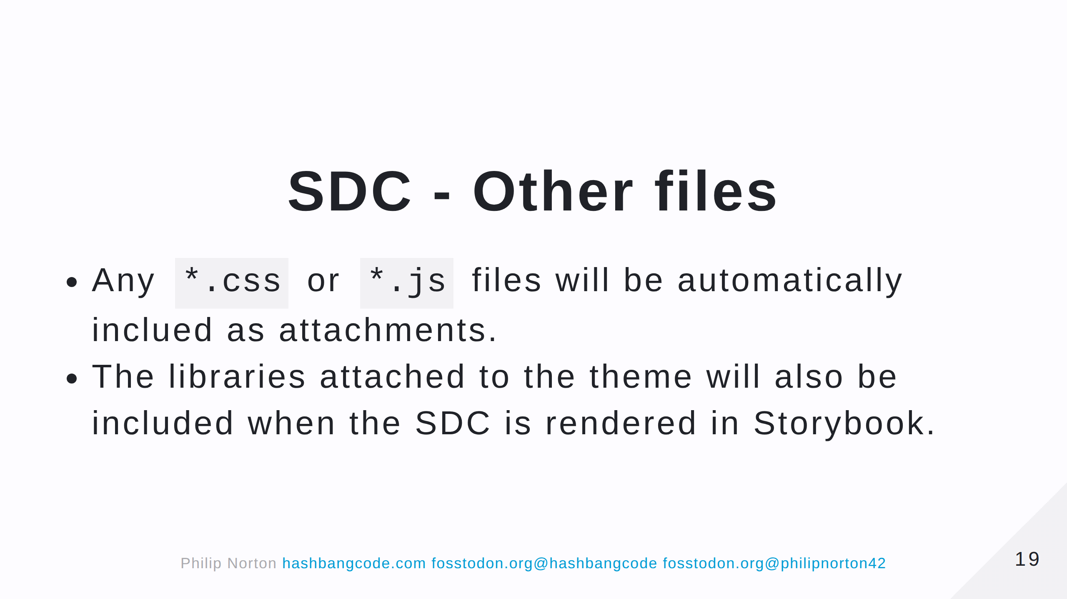

Slide 20
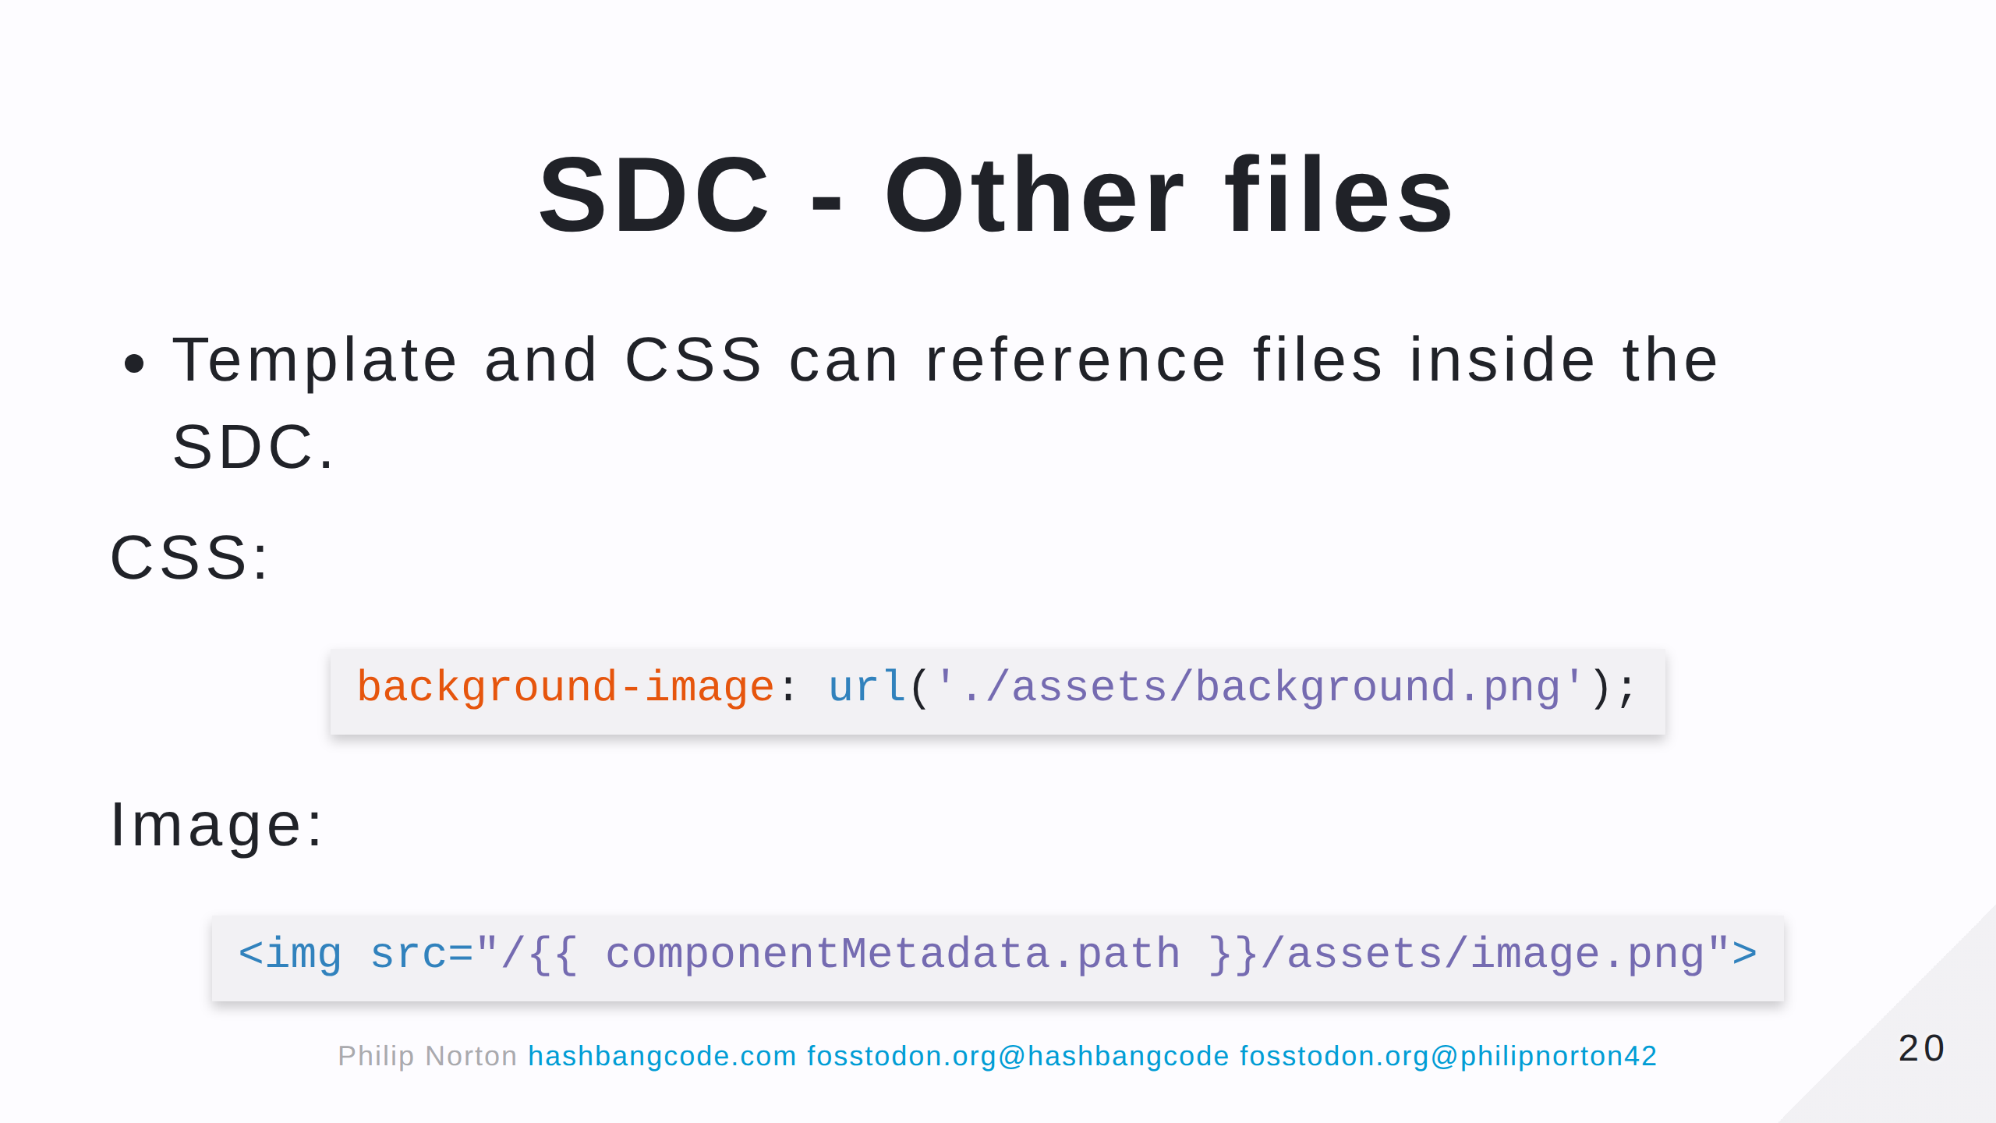
Notes:
The componentMetadata object contains some information about the component. In this case we are using the .path property that contains the current path of the SDC.

Slide 21
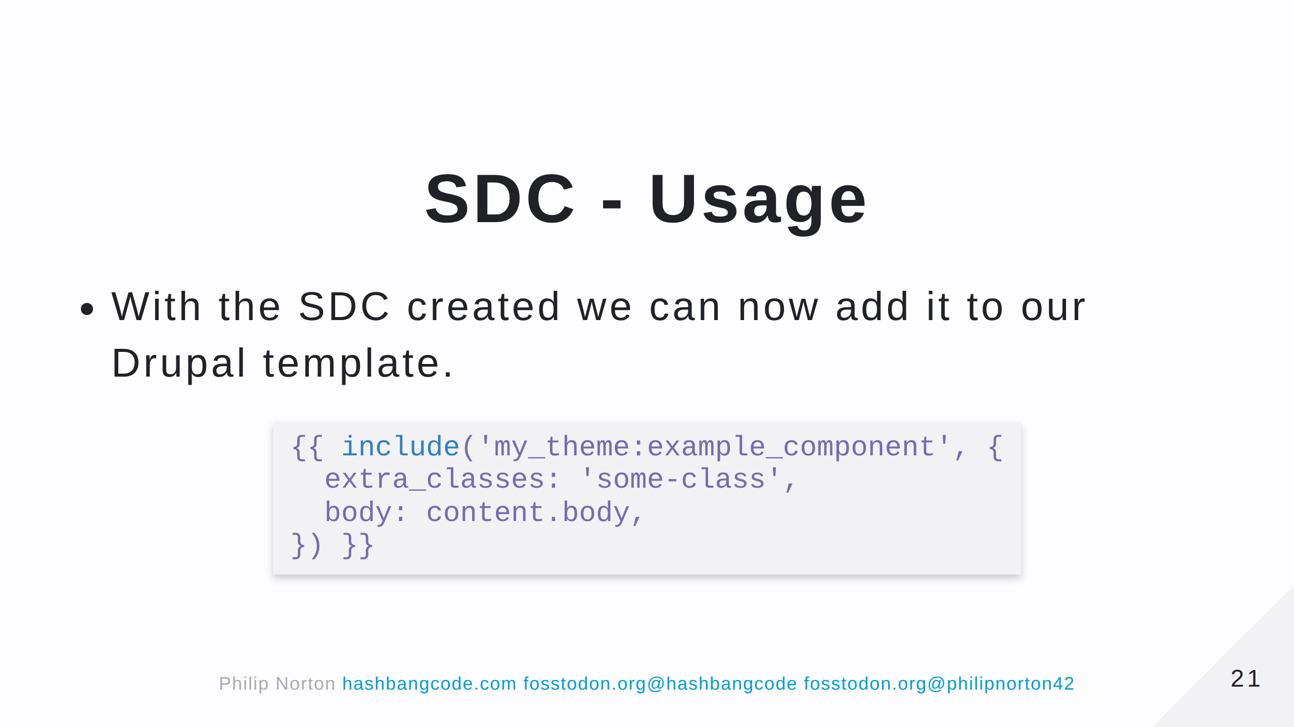

Slide 22
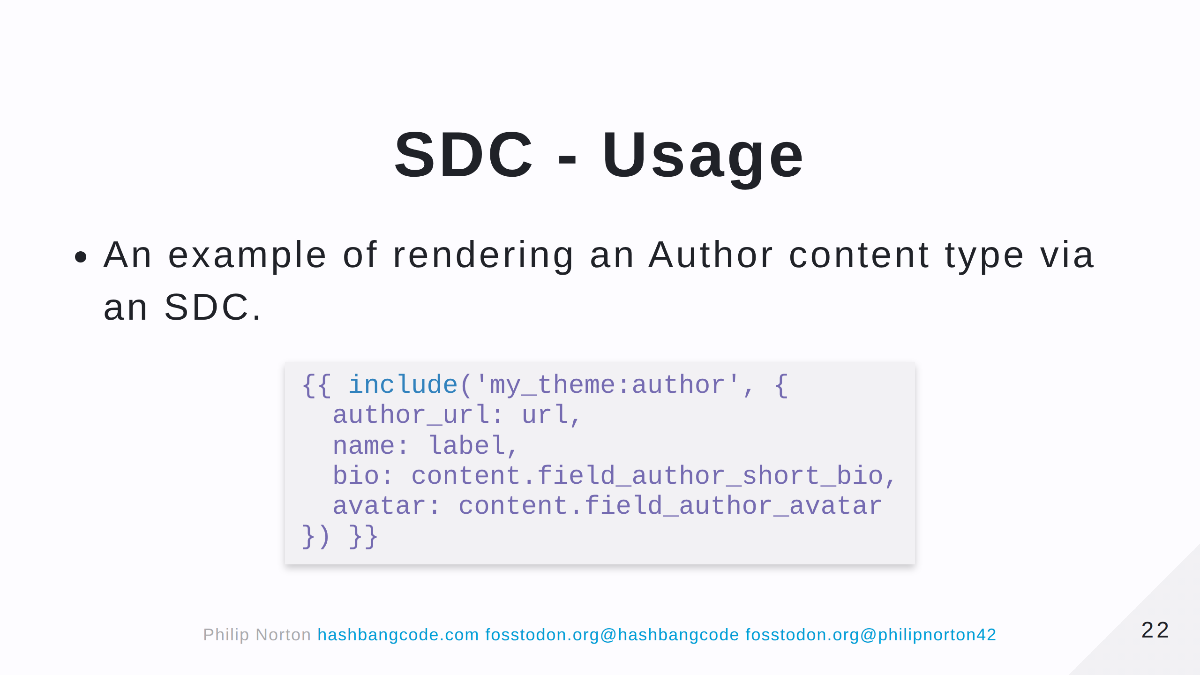

Slide 23
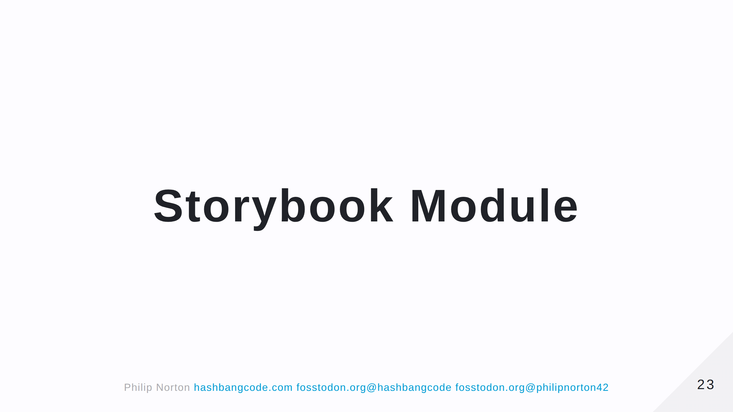

Slide 24
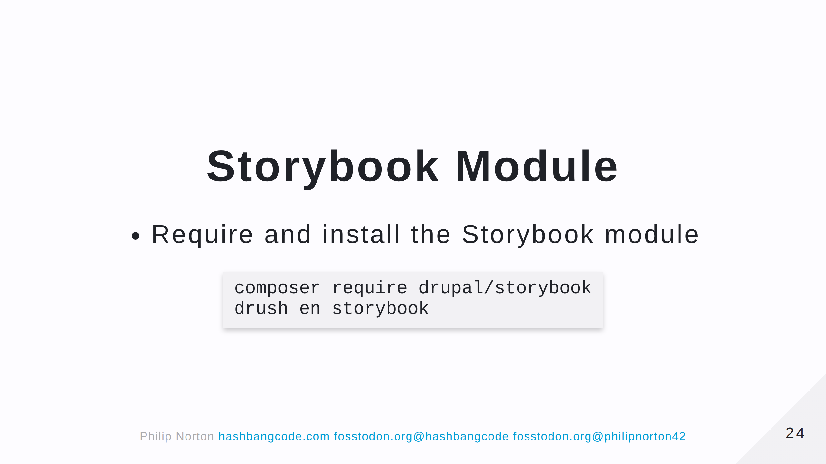

Slide 25
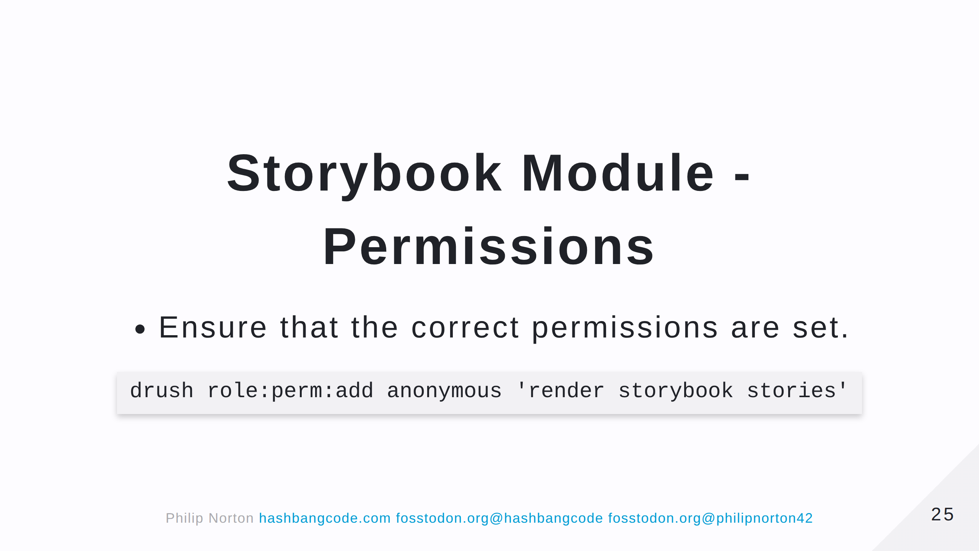

Slide 26
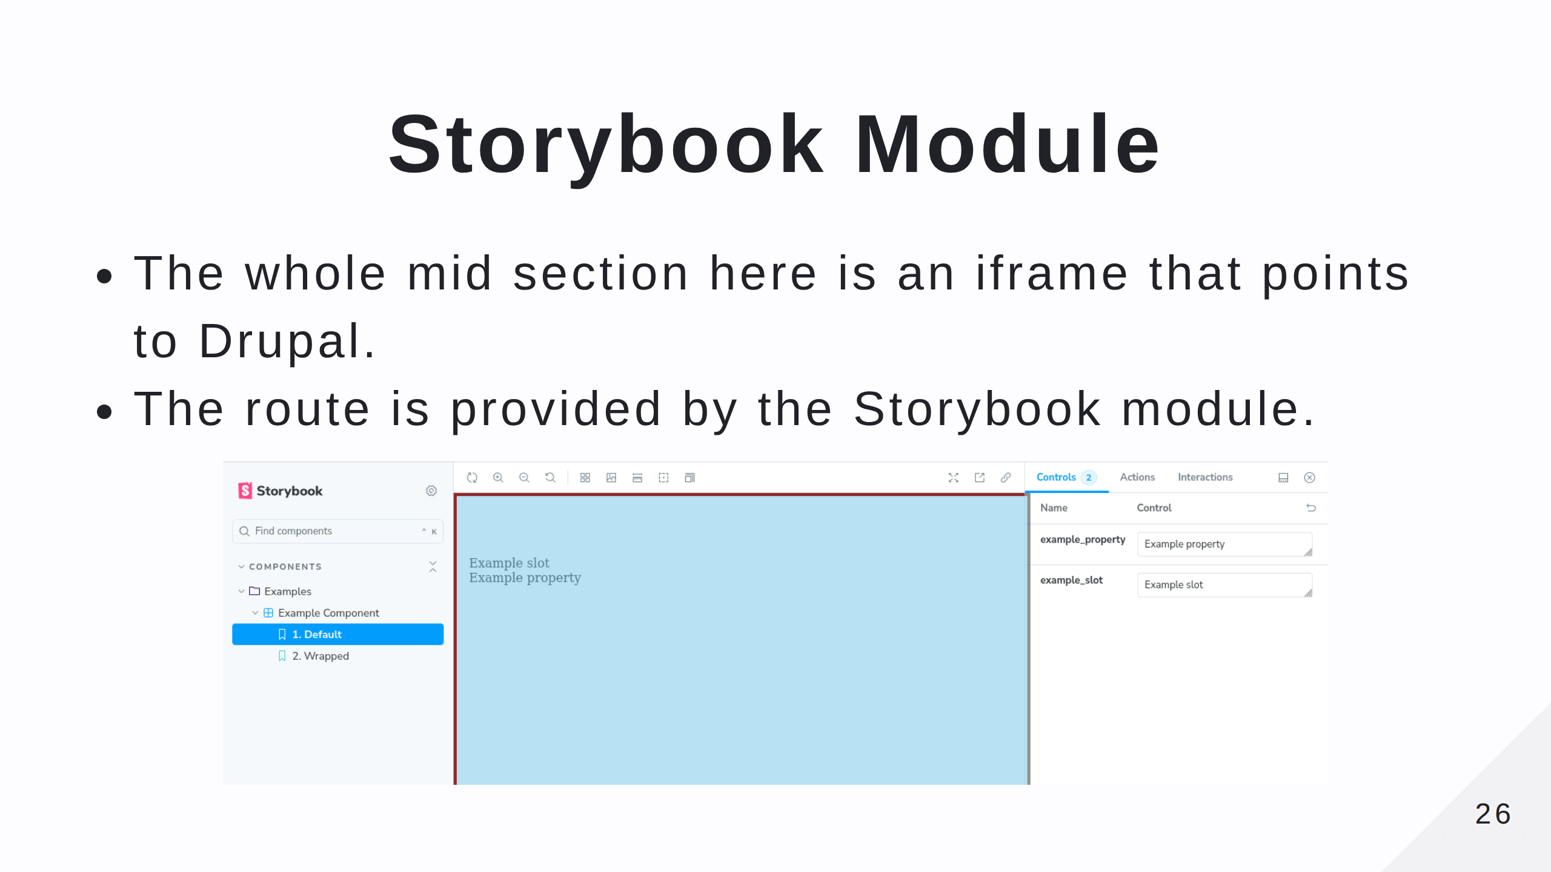

Slide 27
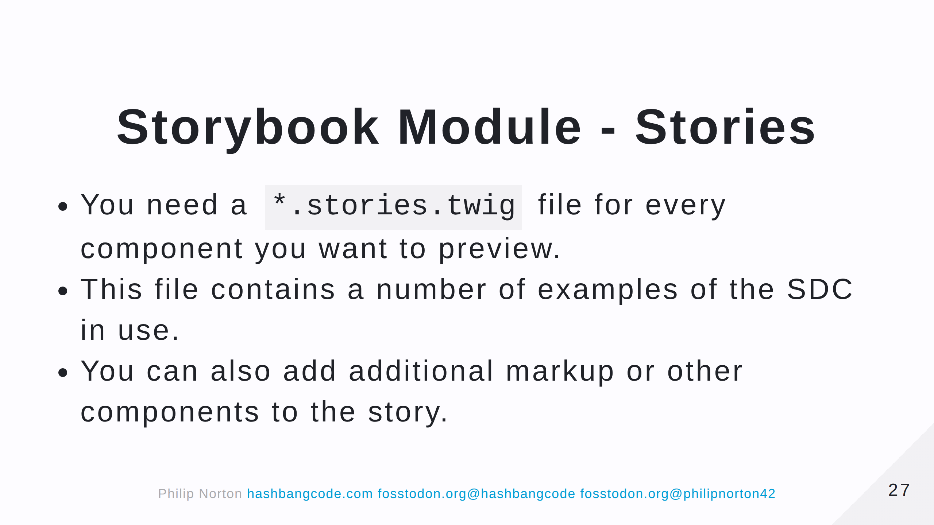

Slide 28
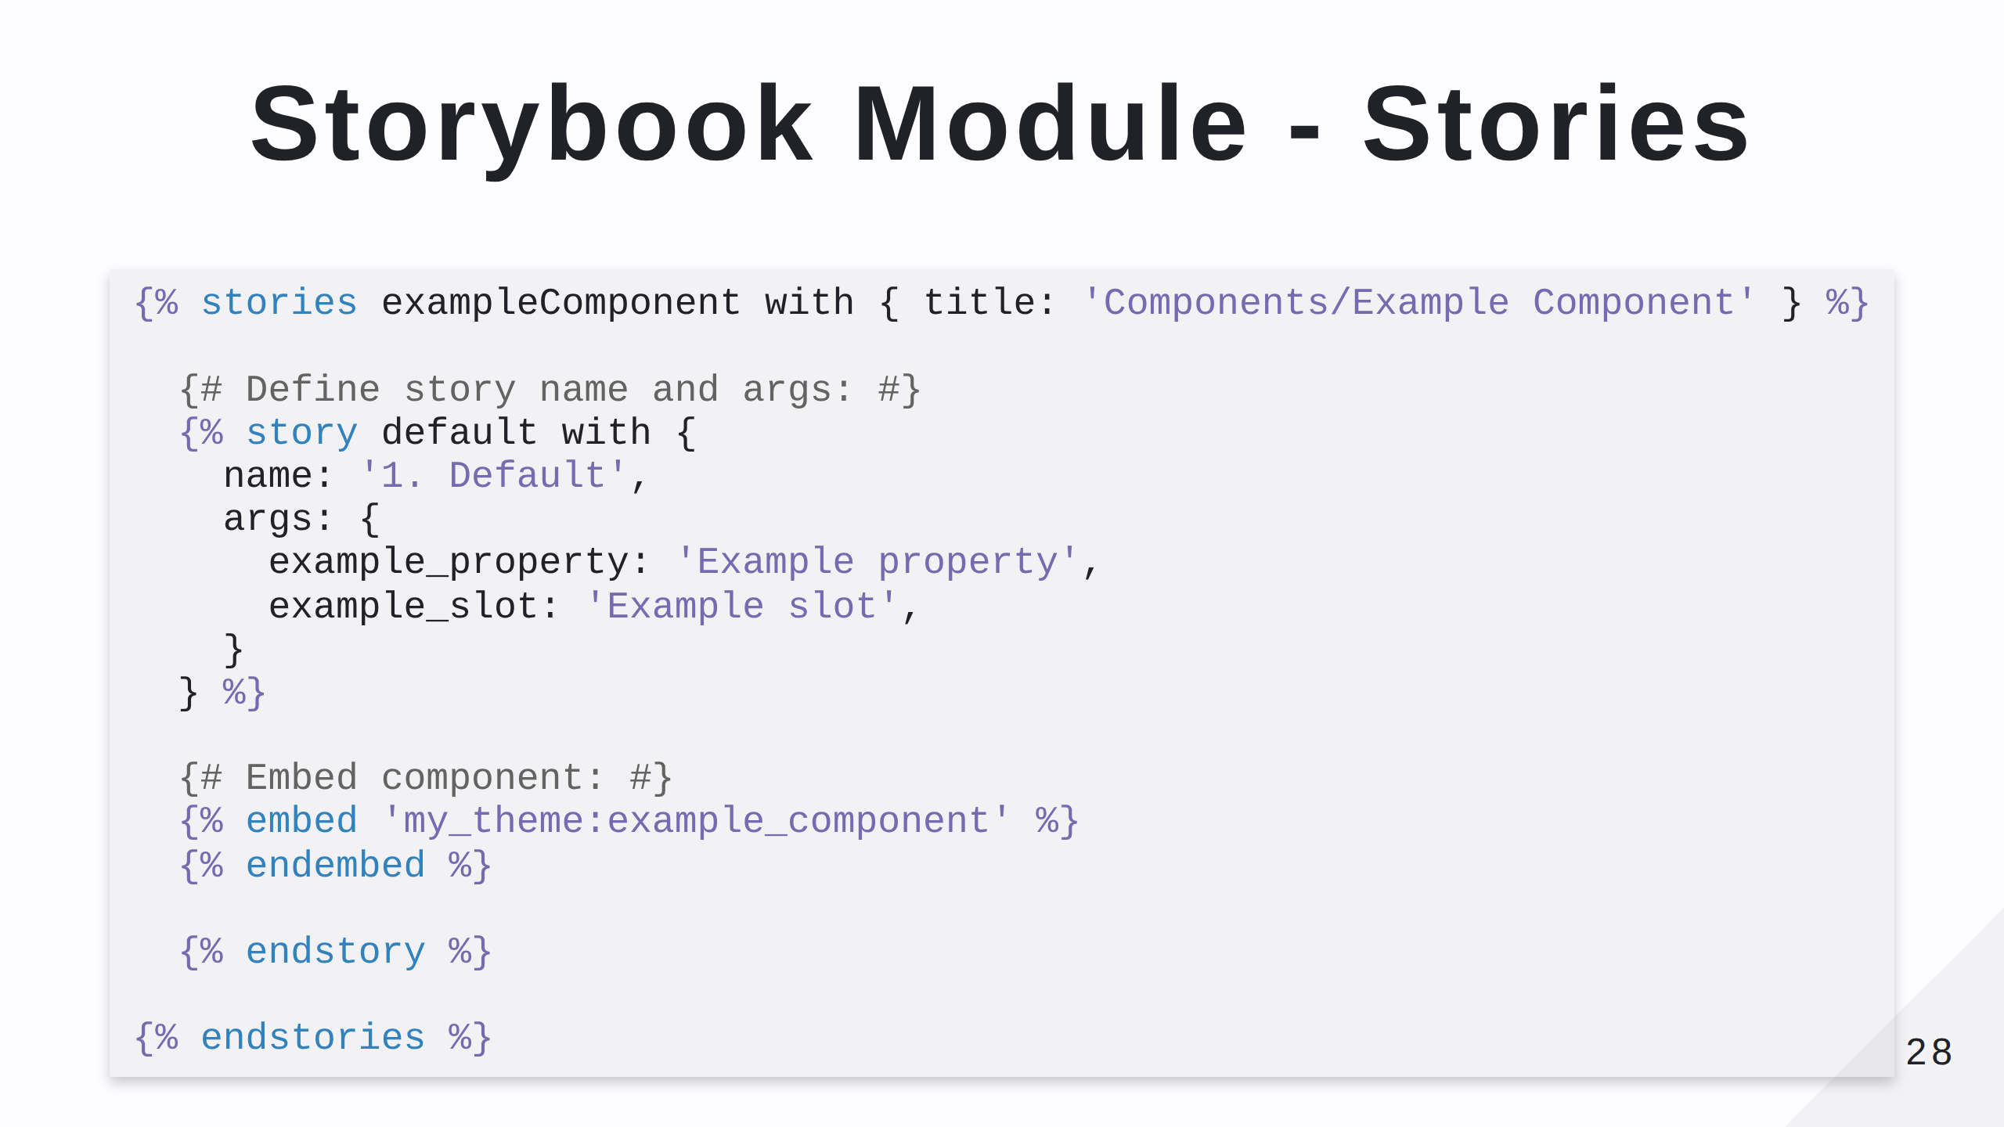

Slide 29
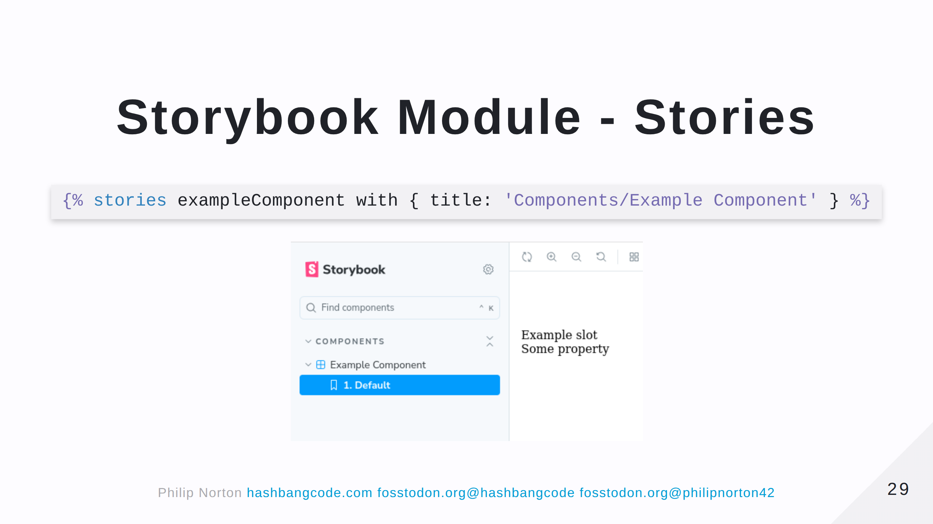

Slide 30
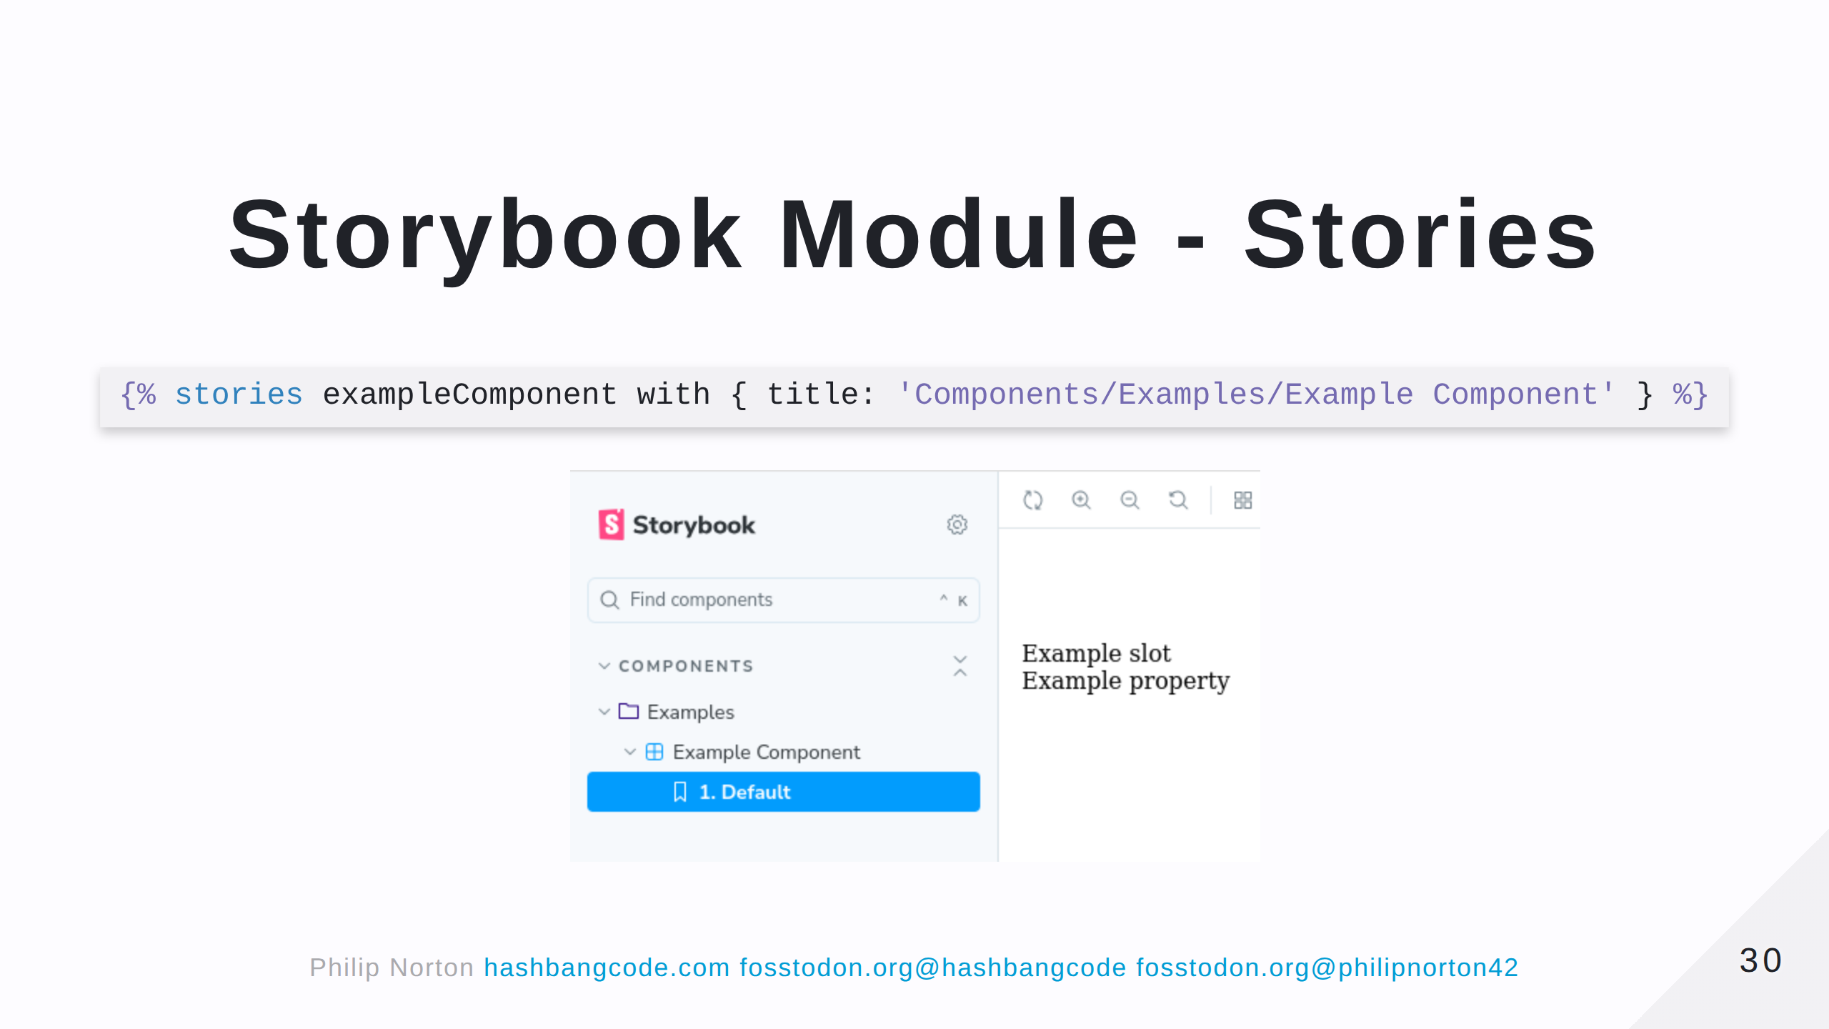

Slide 31
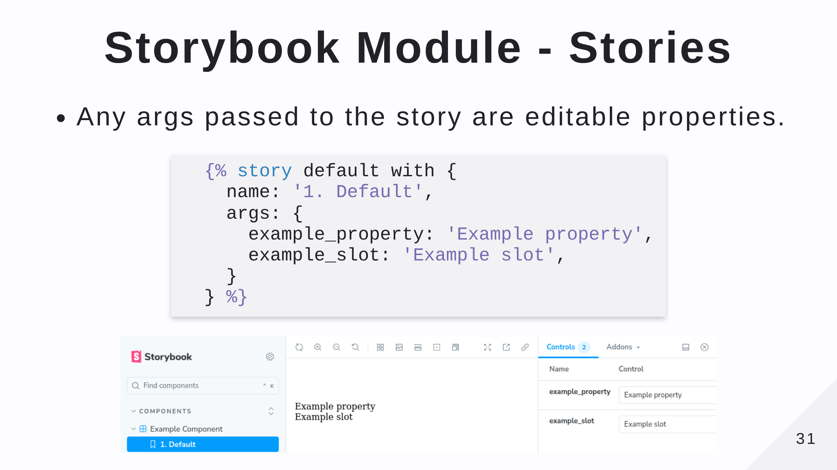
Notes:
The data types of the args are pulled from the *.component.yml file.

Slide 32
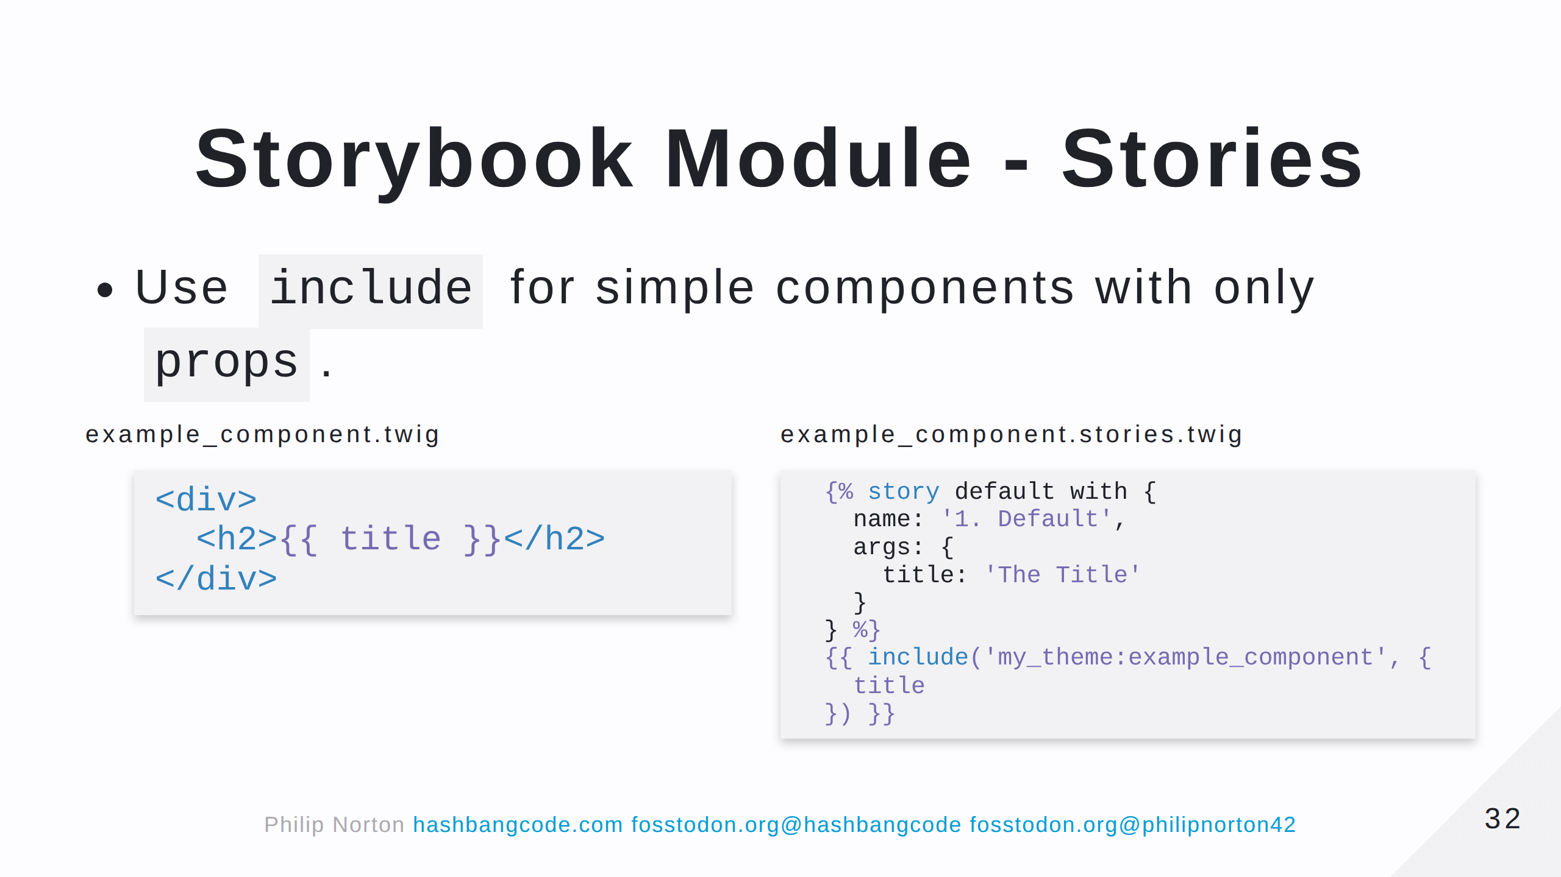

Slide 33
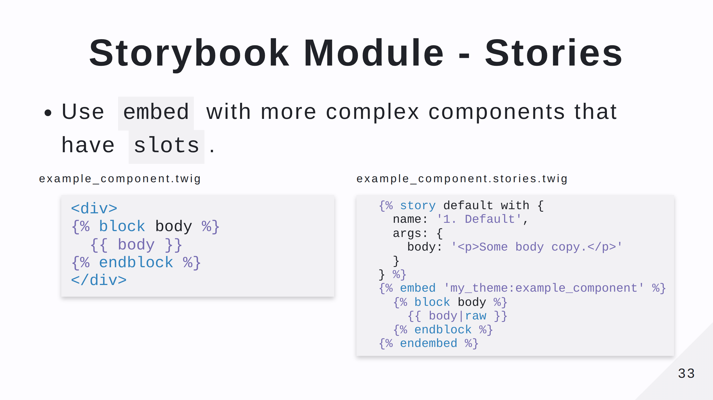
Notes:
Note that in this case any `props` we have defined will be passed to the template automatically.

Slide 34
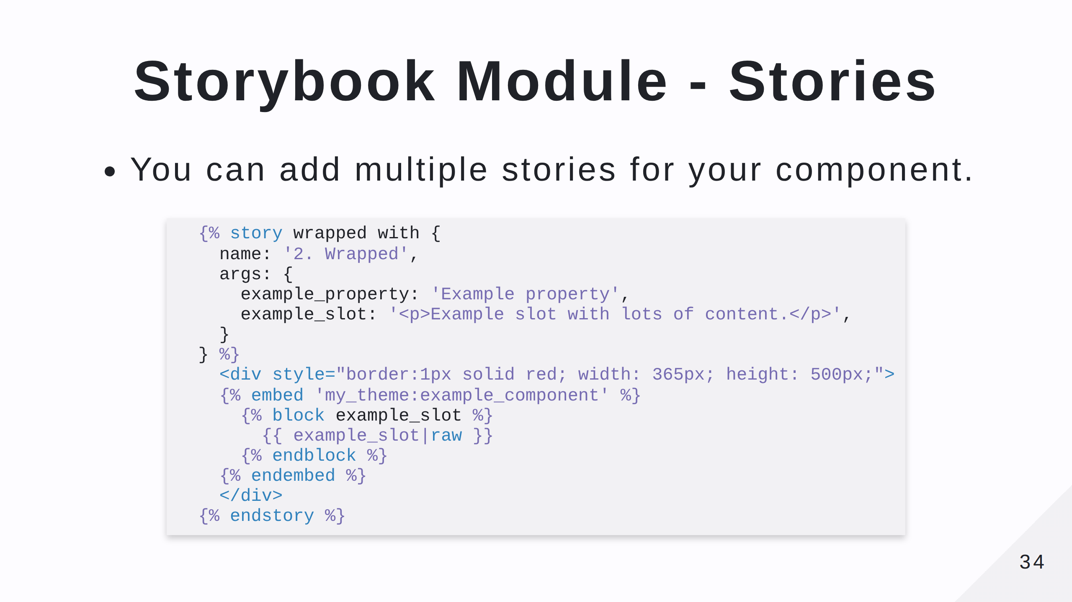
Notes:
This shows a second story where the element in question is wrapped in a restrictive red box. You can add stories to show different content for your component, but also think about the surrounding elements on the page. Adding in some example markup to show the component in situ can be really useful.

Slide 35
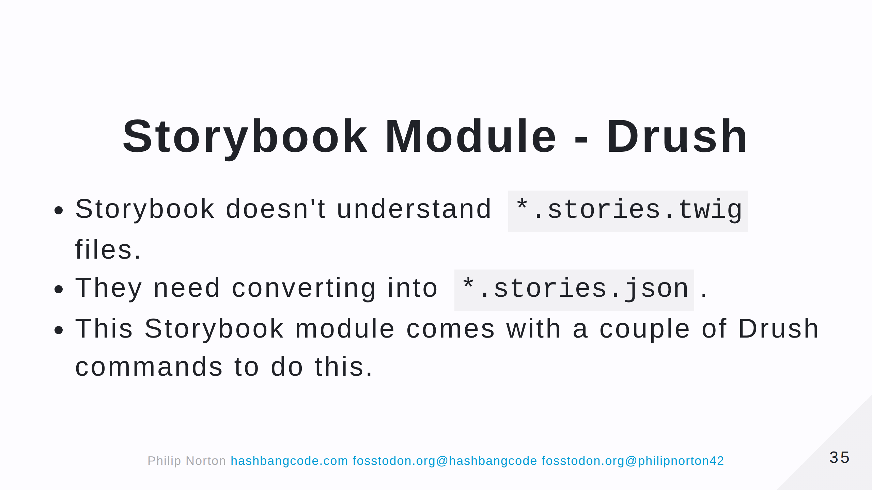

Slide 36
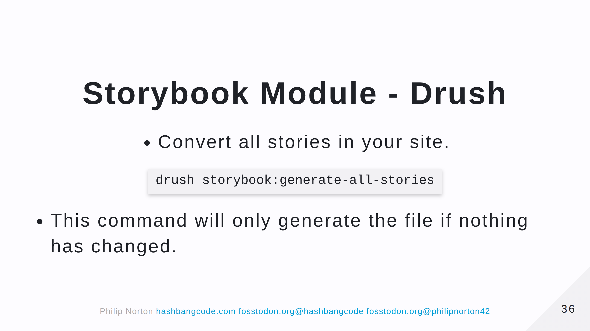

Slide 37
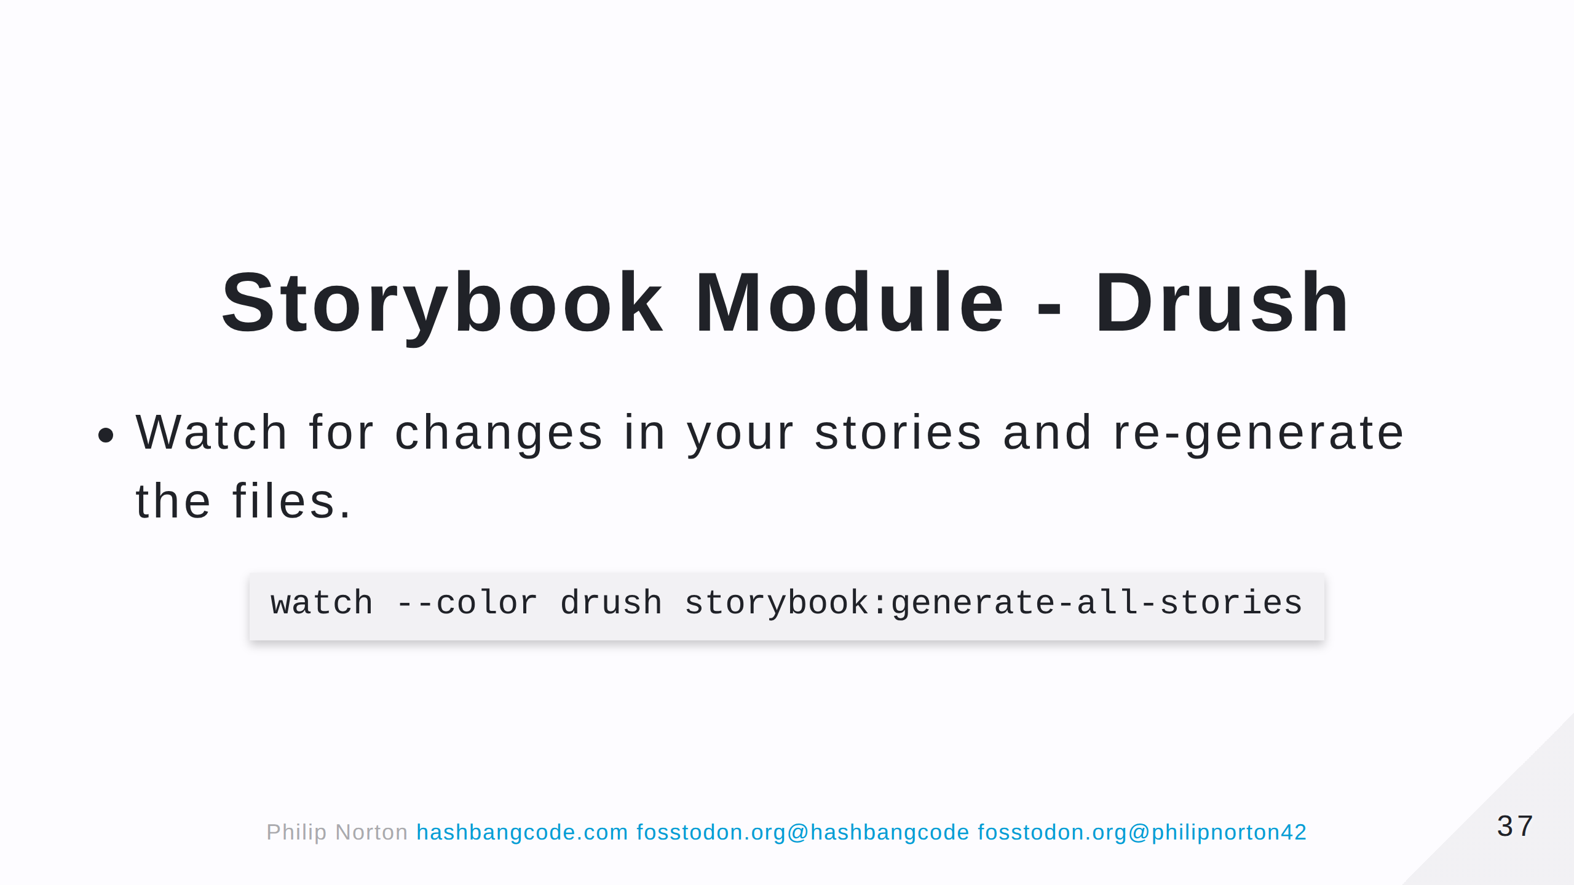

Slide 38
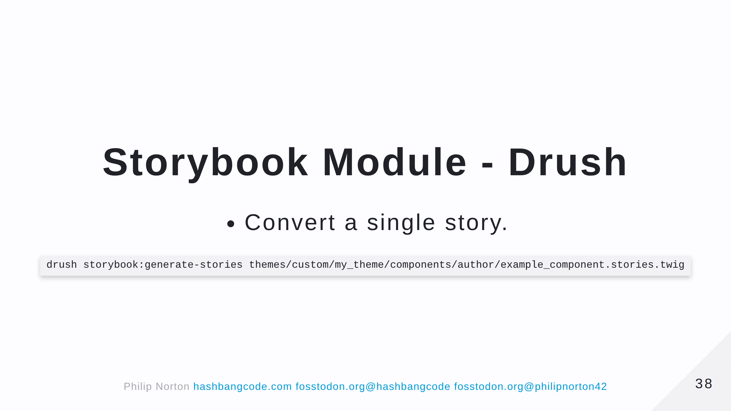

Slide 39
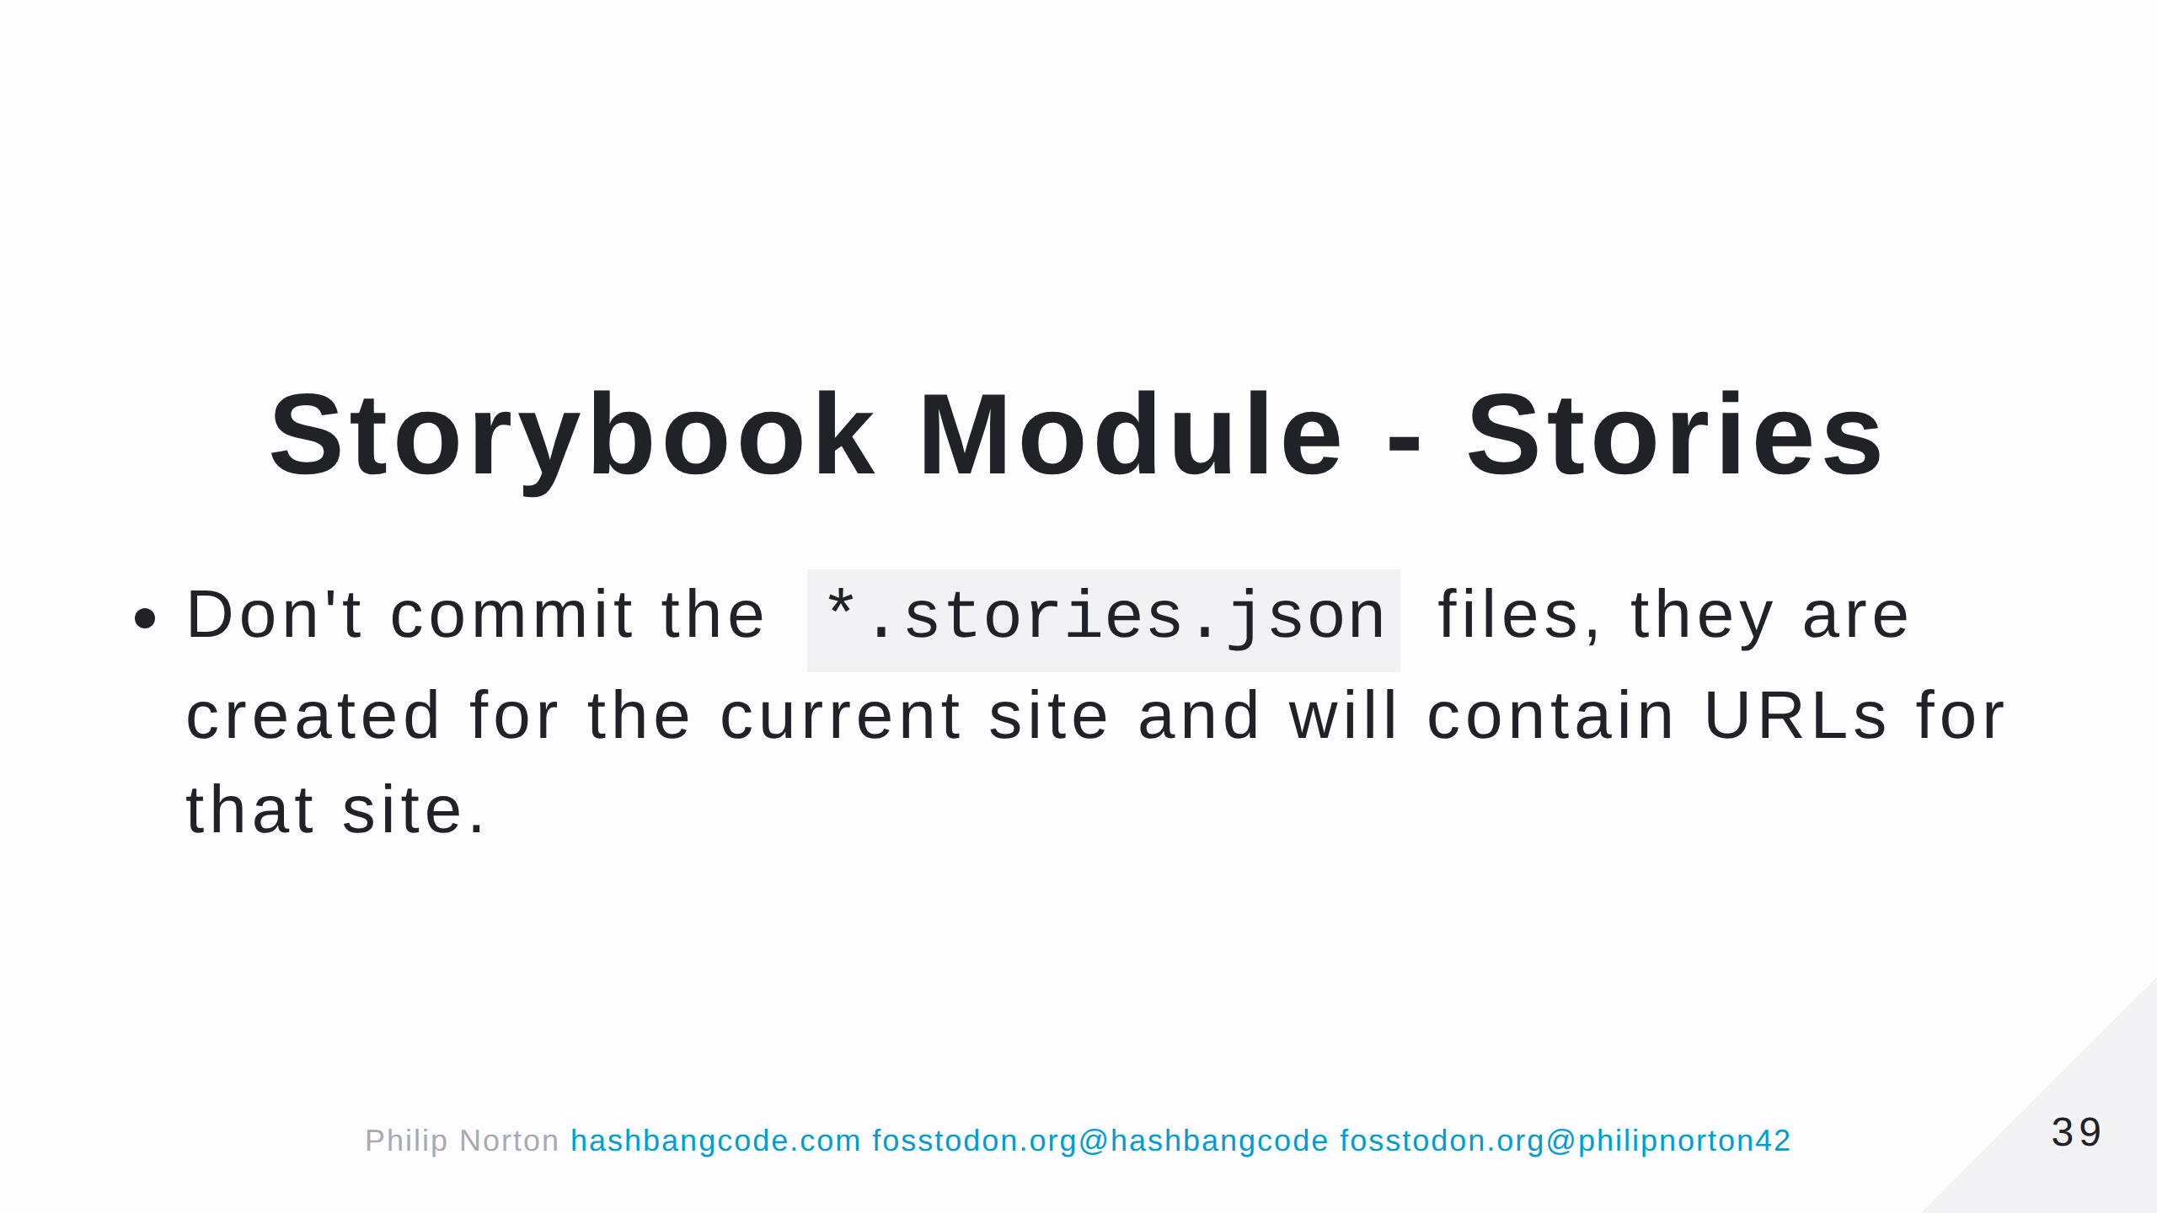

Slide 40
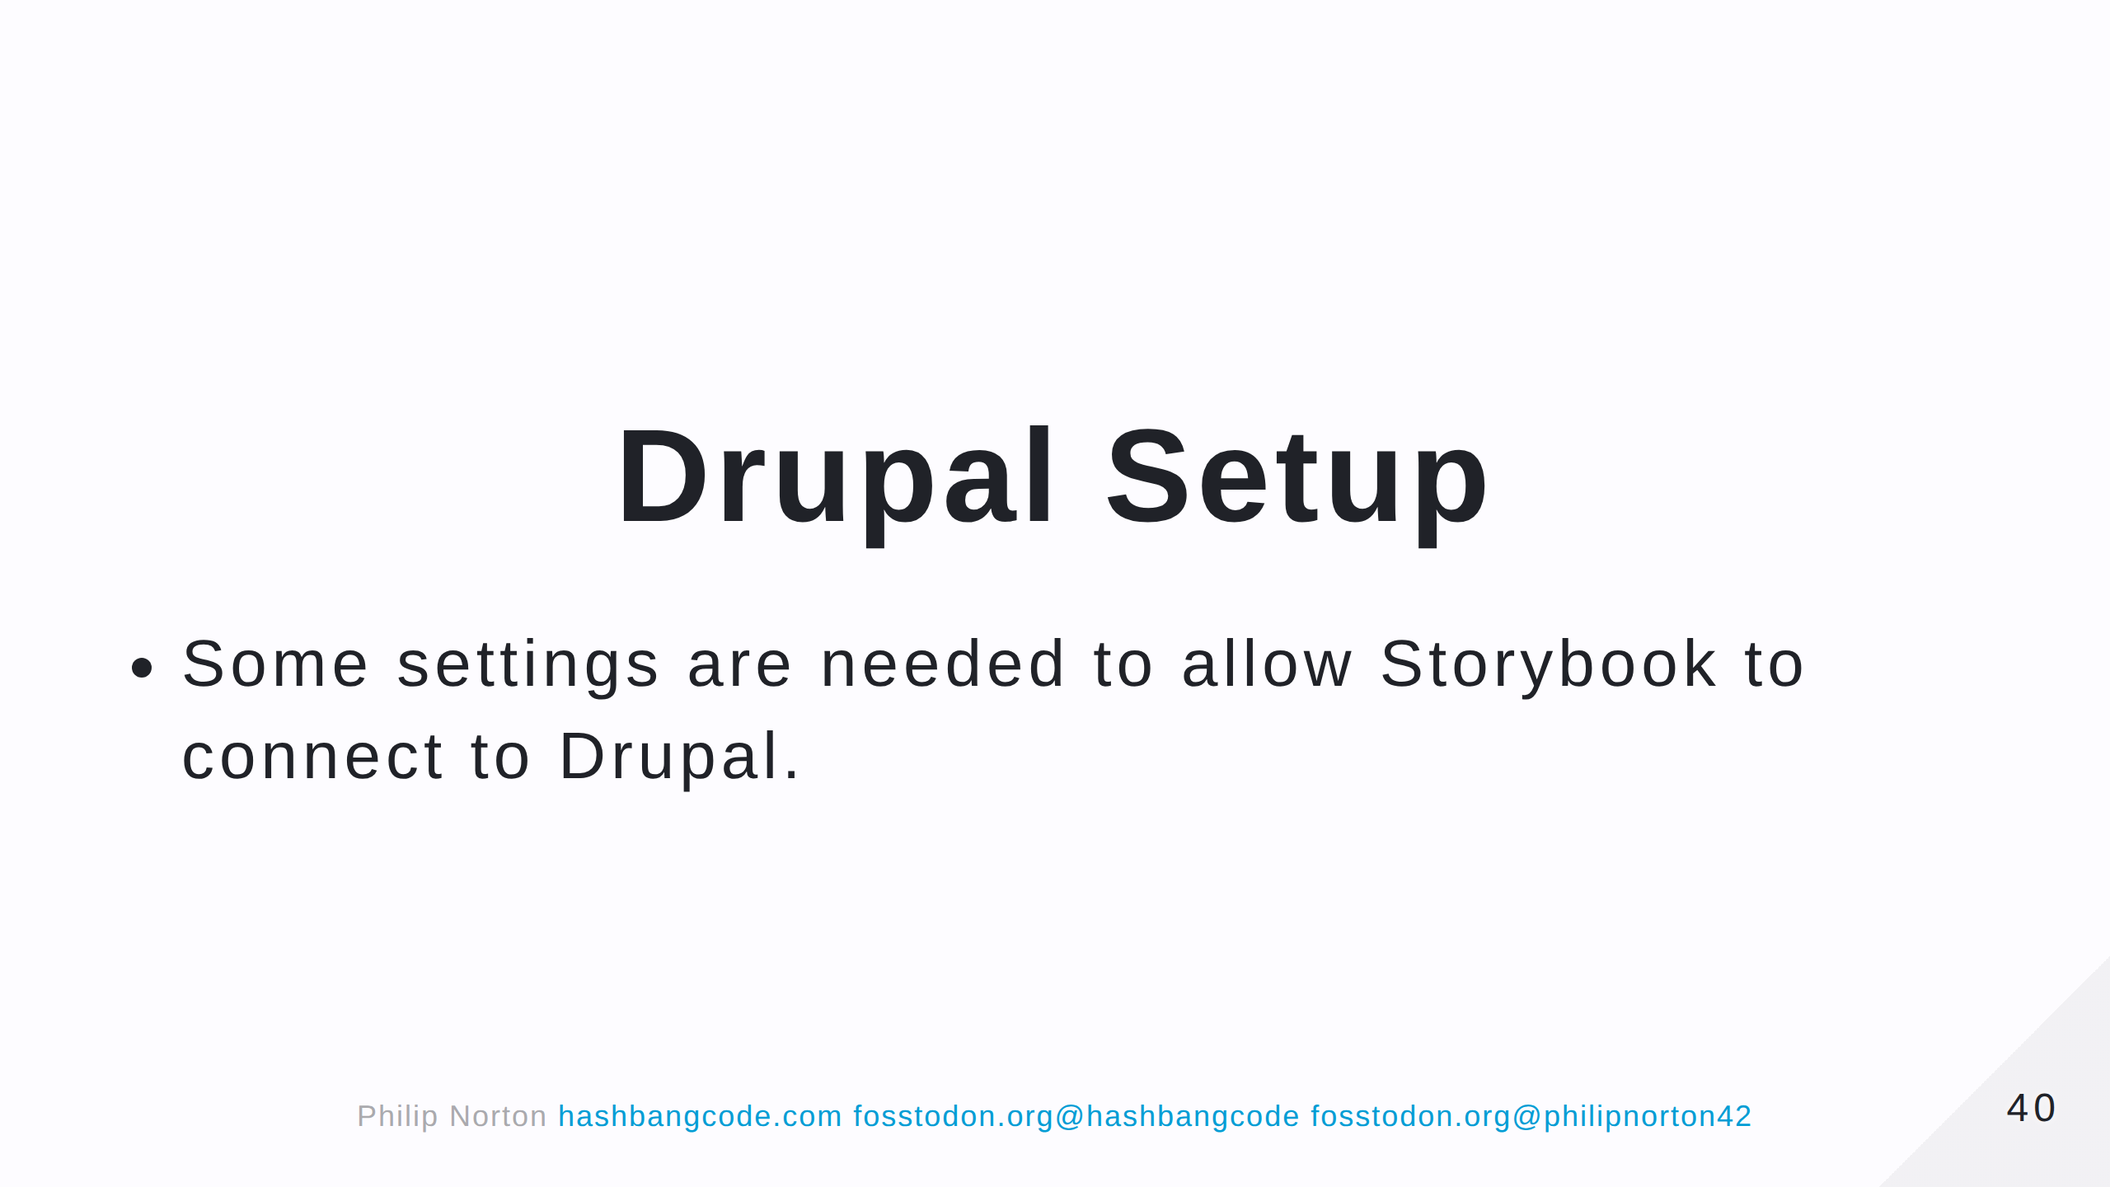

Slide 41
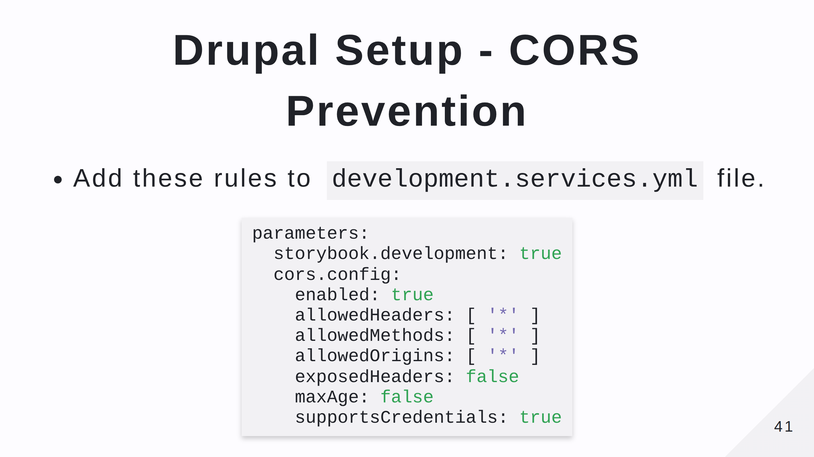
Notes:
CORS = Cross-Origin Resource Sharing Prevents websites from serving content to sites that they haven't previouly agreed to. This creates a problem when we do want to share content.

Slide 42
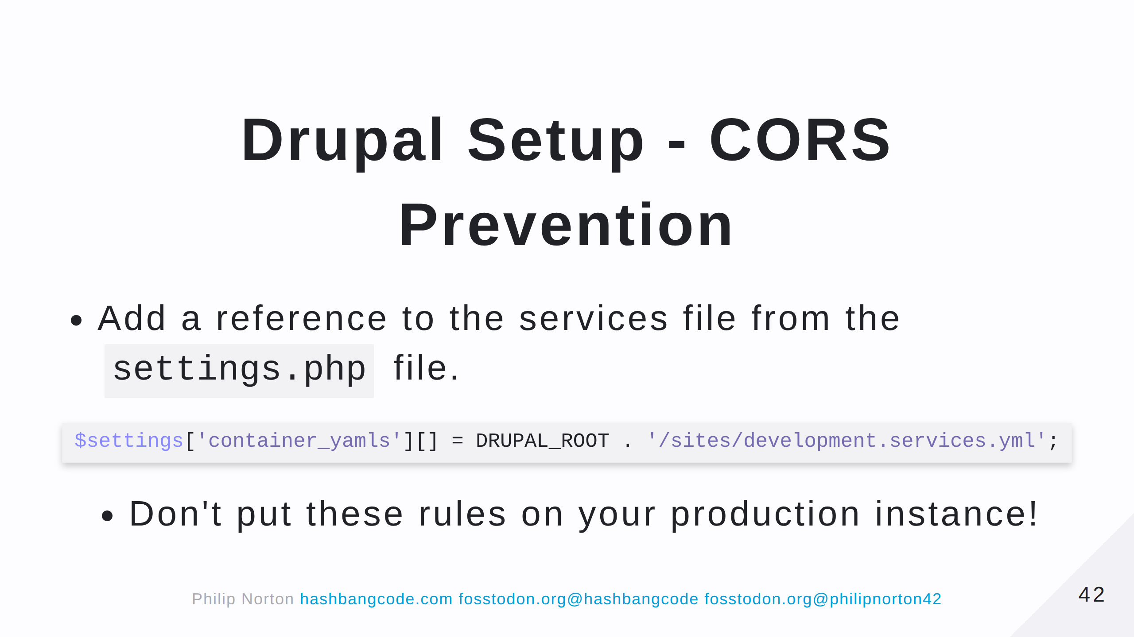

Slide 43
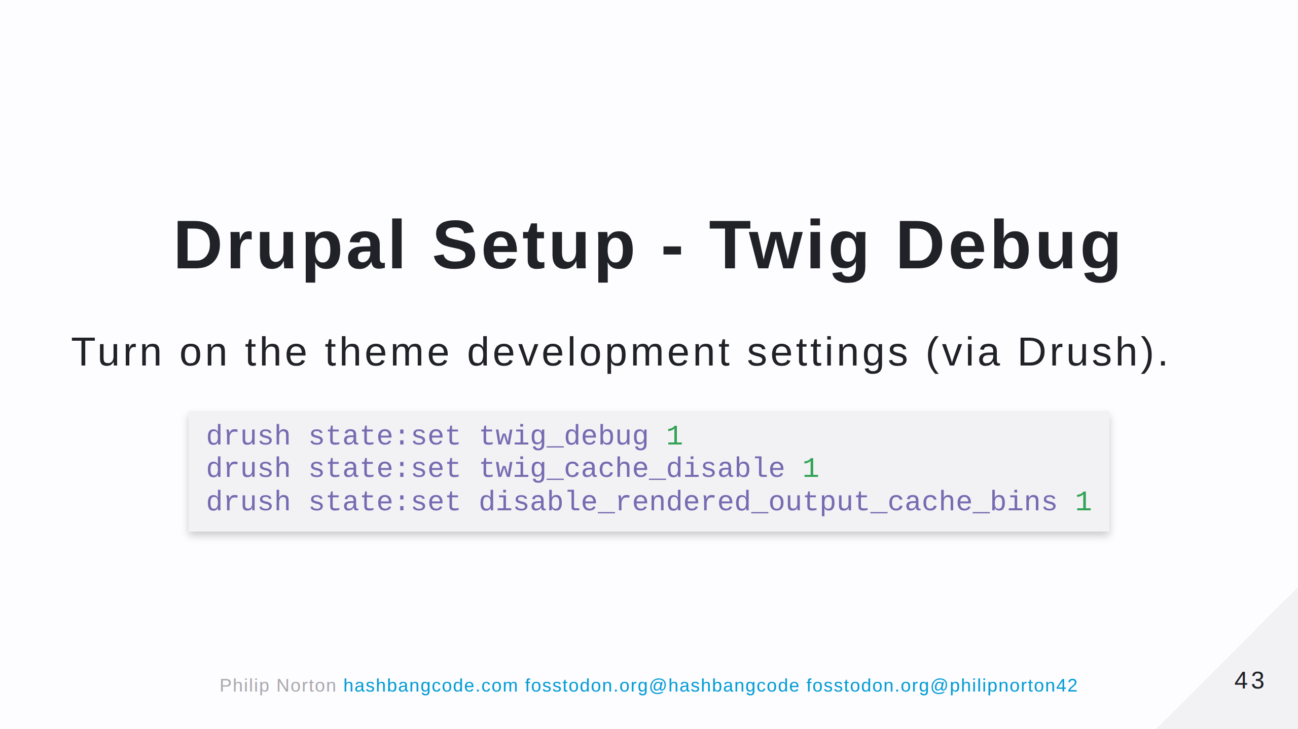

Slide 44
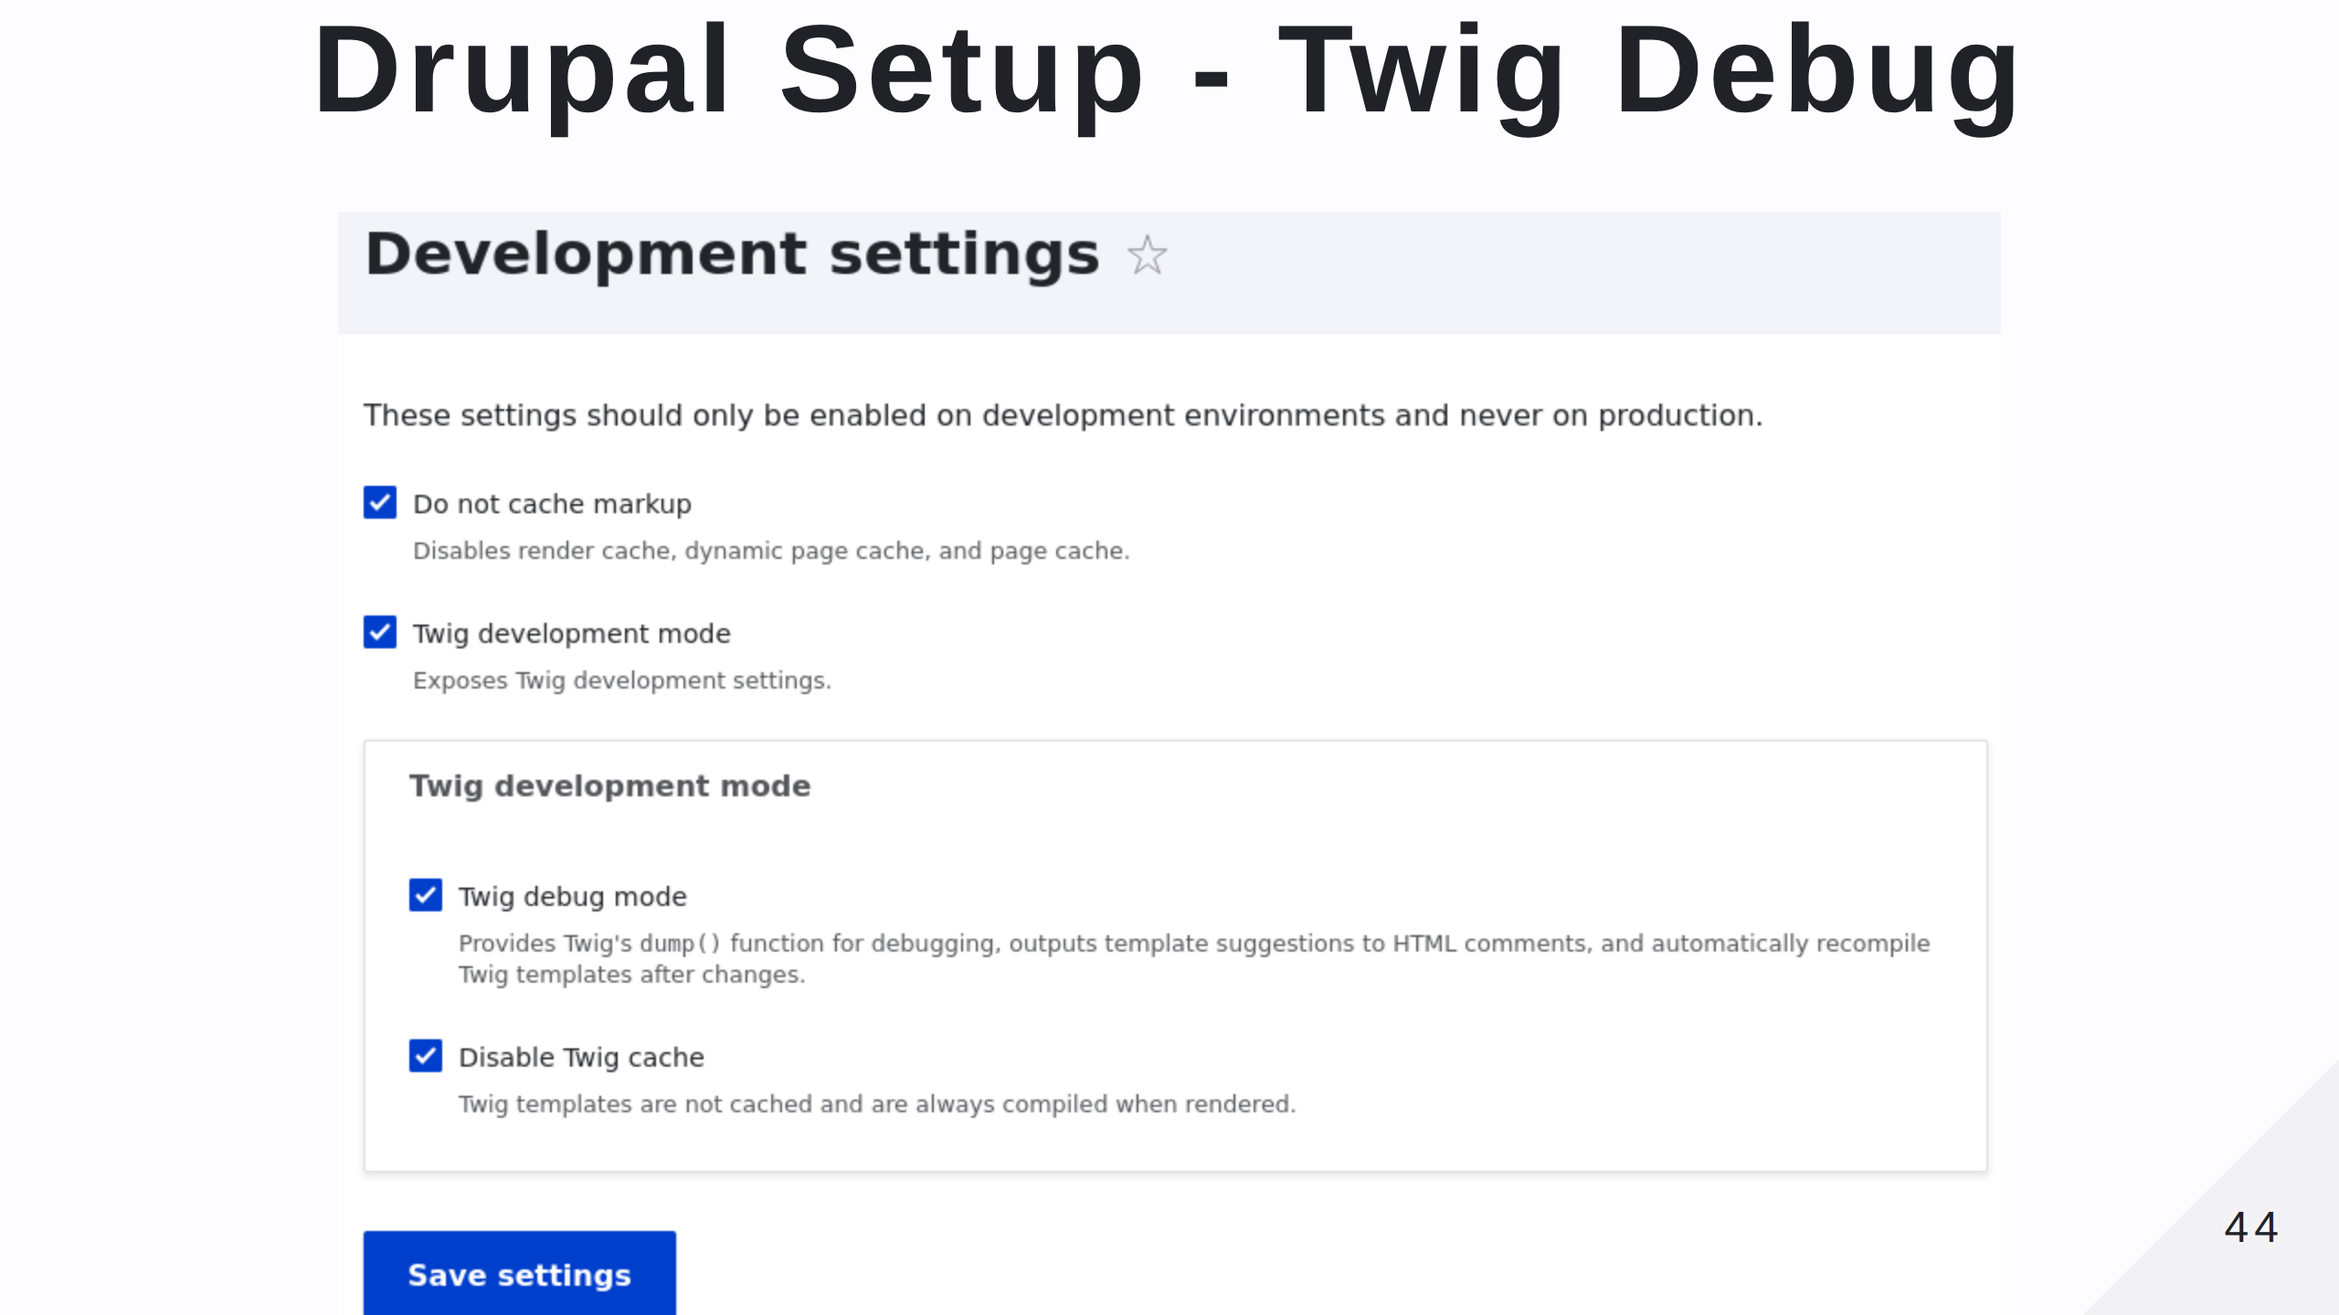

Slide 45


Slide 46
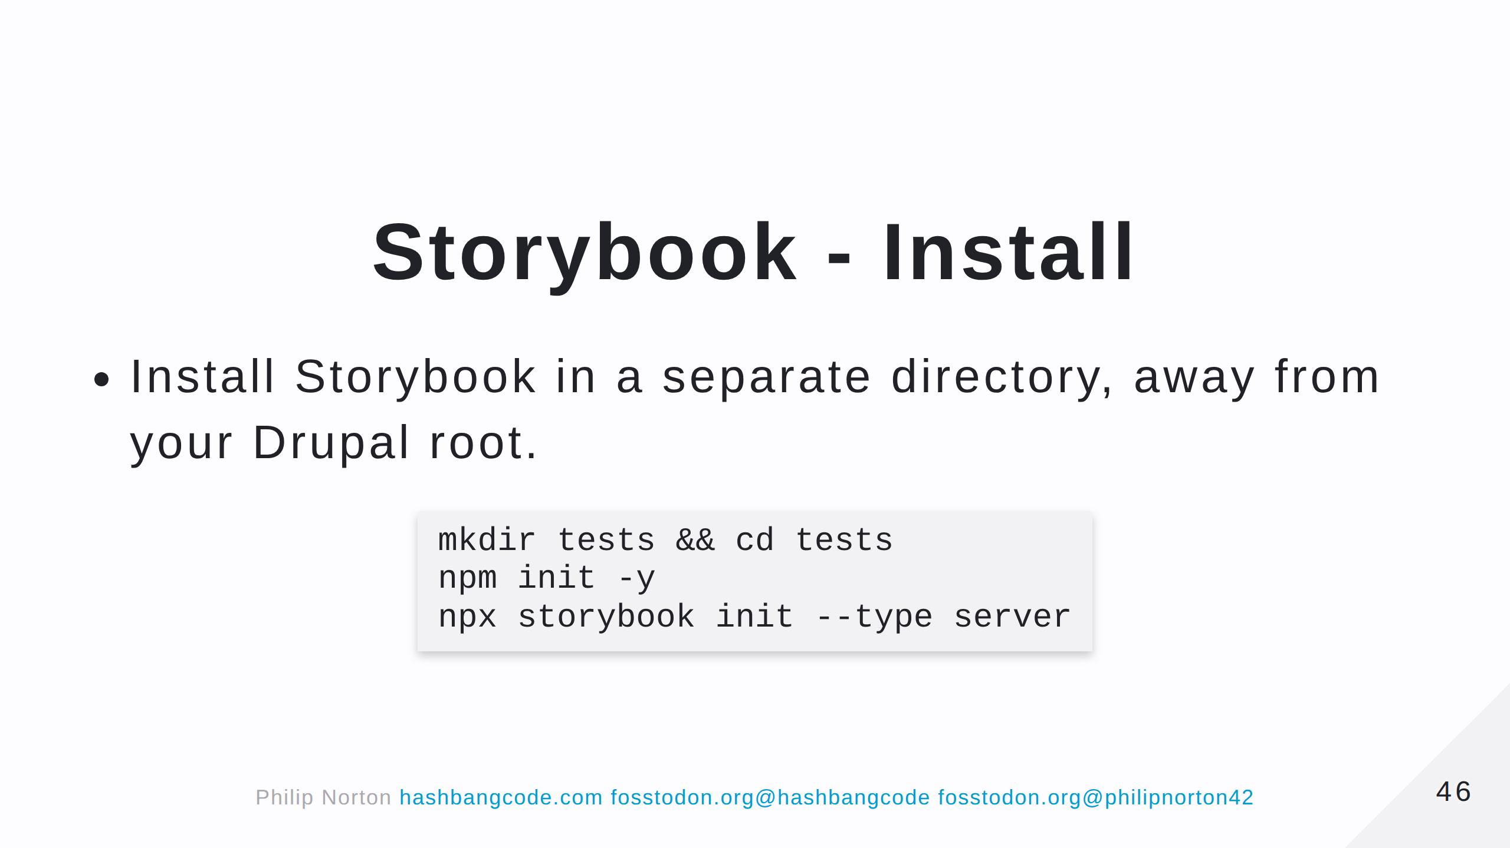

Slide 47
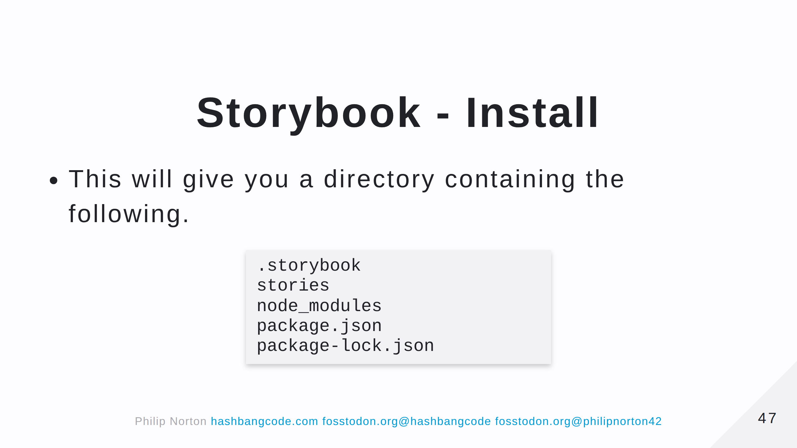
Notes:
- .storybook is the storybook configuration directory. - stories contains some example stories. - The other directories are standard node directories.

Slide 48
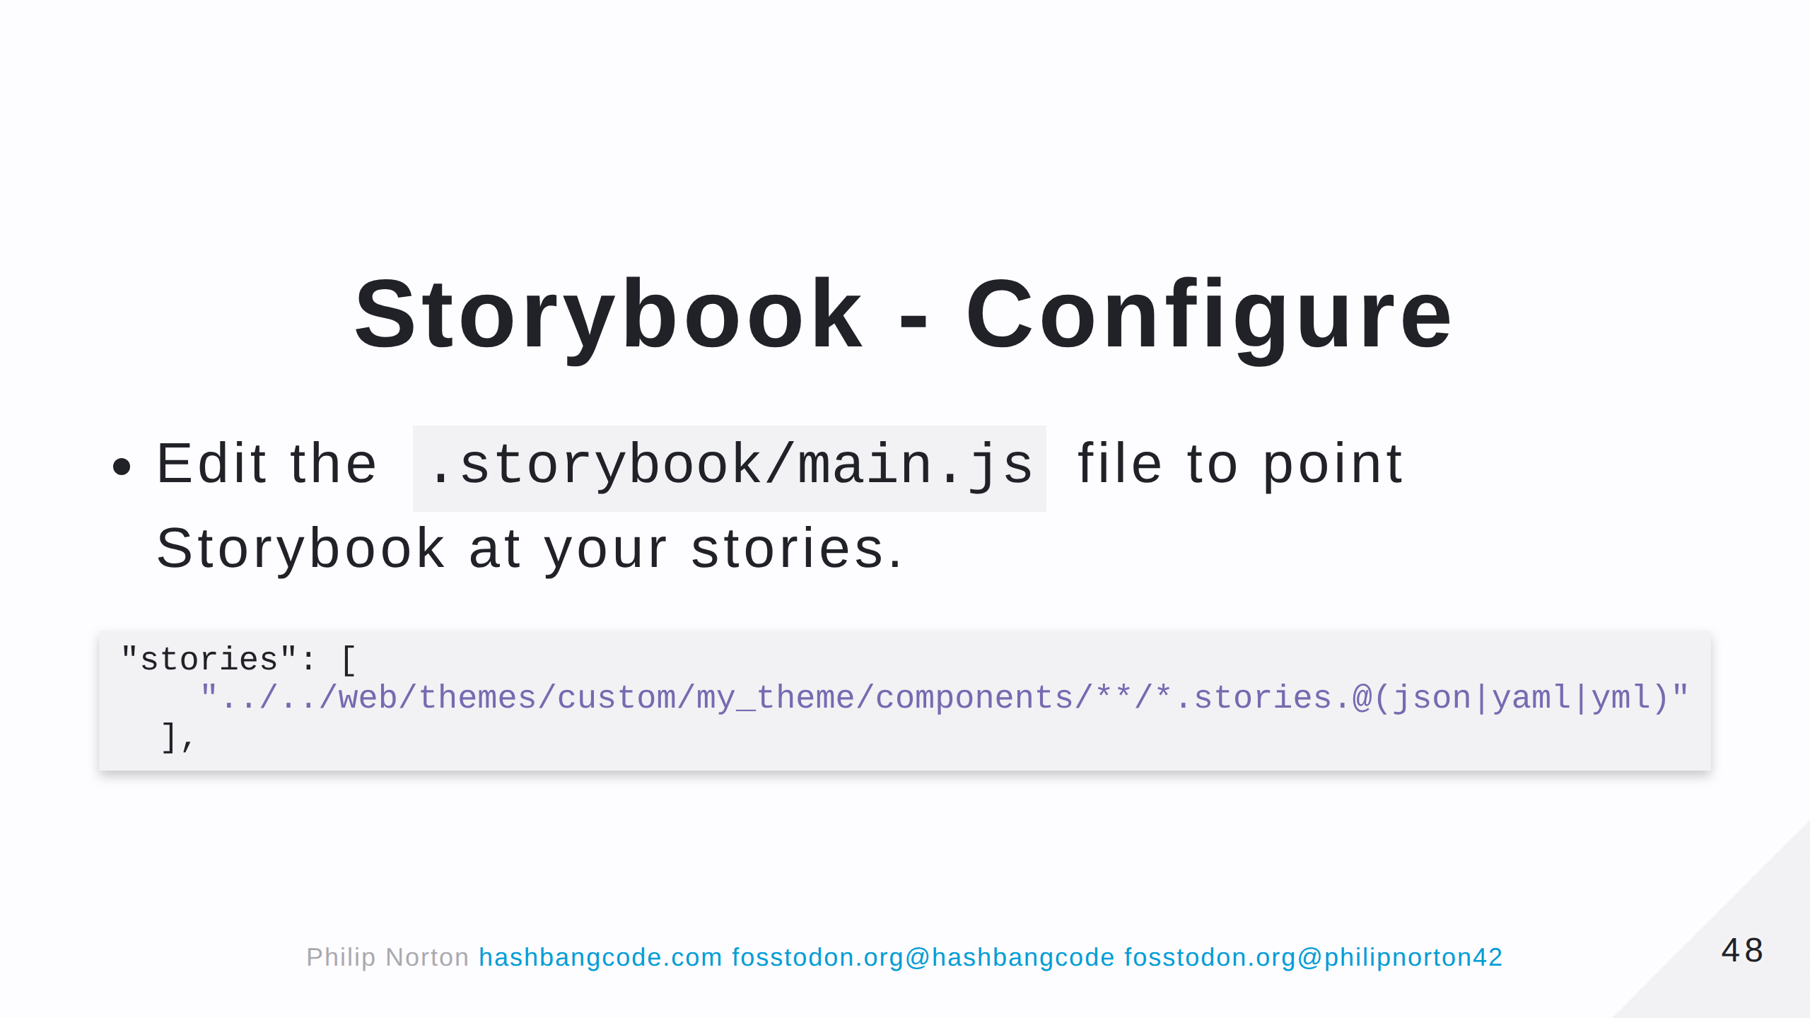
Notes:
Remember that you can have stories in themes and modules, so you can have multiple lines here pointing at different directories. The modules and themes don't need to be active, as long as they have a *.stories.twig

Slide 49
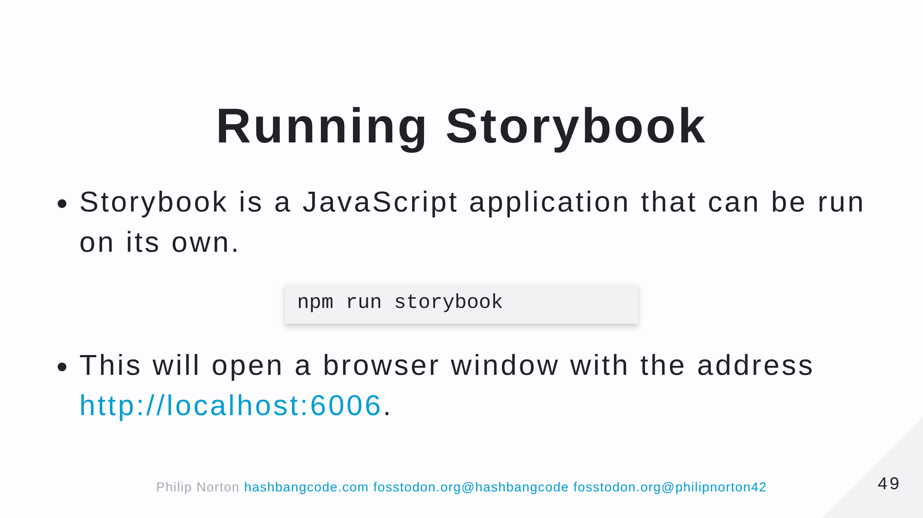
Notes:
If you are running Storybook inside DDEV then there are some extra options you need to set to get this working.

Slide 50
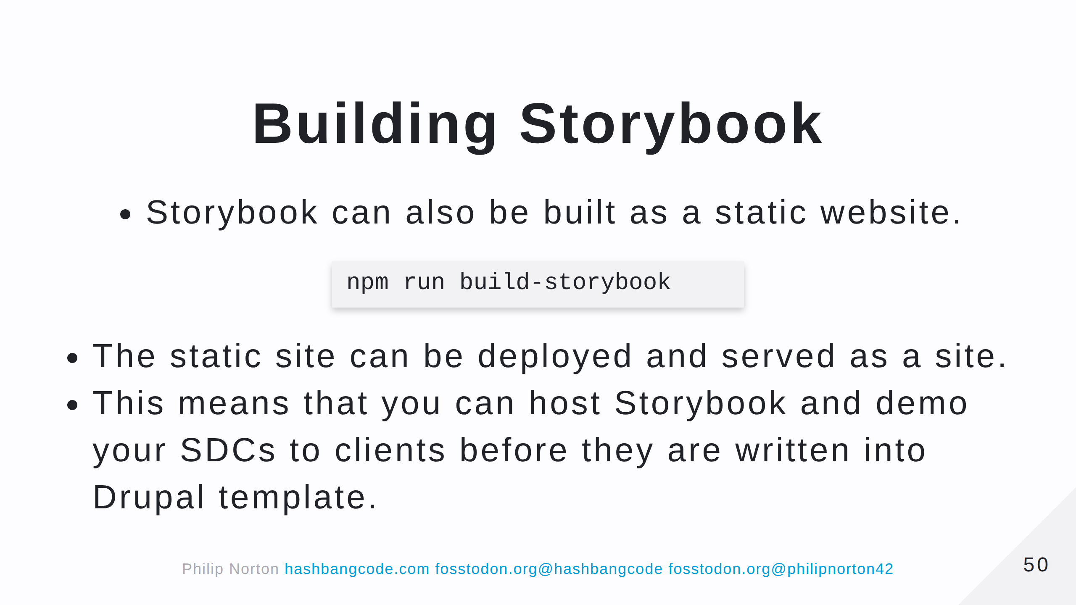

Slide 51
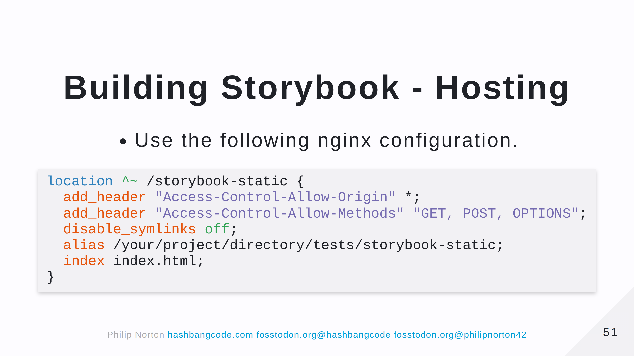

Slide 52


Slide 53


Slide 54


Slide 55

Notes:
CORS errors will likey be your biggest headache. Make notes as you solve them as you can use these notes on other projects.

Slide 56


Slide 57


Slide 58

Notes:
A good alternative if you don't want to muck about with storybook. Plus, comes with an accessibility scanner.

Slide 59

Notes:
A bit unstable in places.

Slide 60

Notes:
This seems a bit backwards to me. Whilst theoretically possible, no SDC is an island. You will find that Drupal has injected some markup or styles into your theme.

Slide 61


Slide 62


Slide 63


Slide 64


Slide 65

Notes:
Add this to your .ddev/config.yml file and restart ddev.

Slide 66


