Slide 1
Empirically Prototyping and Evaluating Shape-Changing Architecture in Virtual Reality
Student: Rami Khalil Supervisors: Prof. Dr. Albrecht Schmidt
Dr.-Ing. Katrin Wolf
Dipl.-Inf. Markus Funk
Pascal Knierim M.Sc.

Slide 2
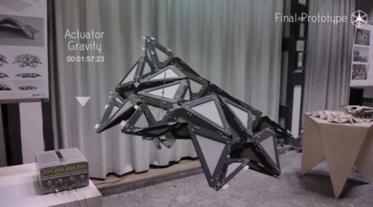
Shape-Changing Architecture
Easy to conceptualize.
Difficult to realize.
Might not turn out as great as expected.
Simulate it in VR and evaluate user response!

Slide 3
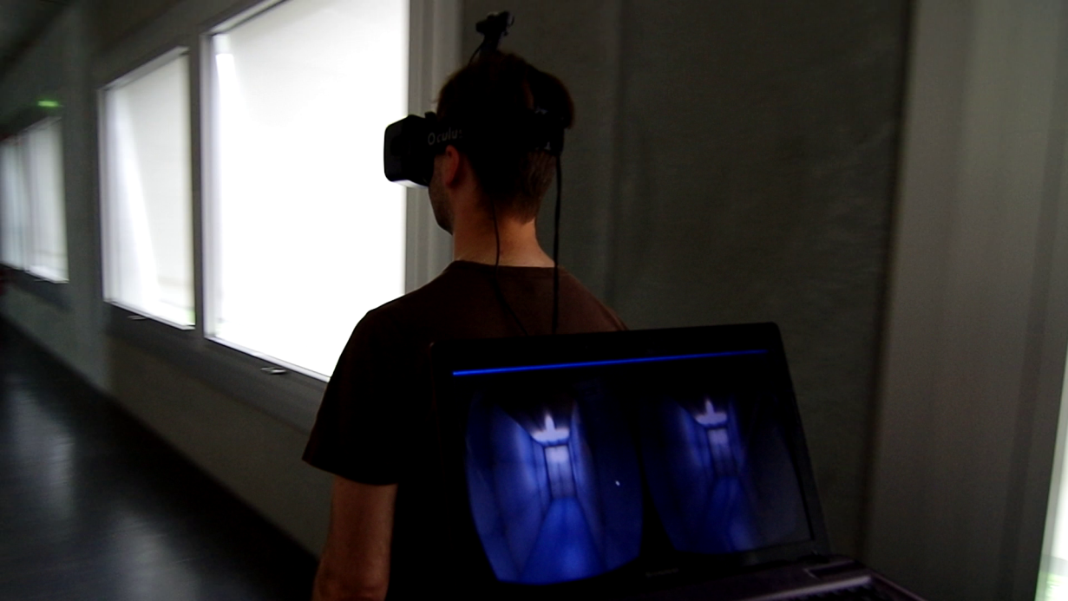
Vision-Based GPS And the Oculus Rift
A cheap and simple way to implement an indoor GPS using a camera and some paper markers.
Combined with the Oculus Rift HMD, this allows for a flexible VR experience.

Slide 4
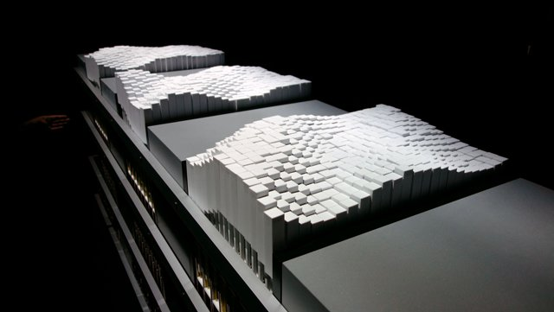
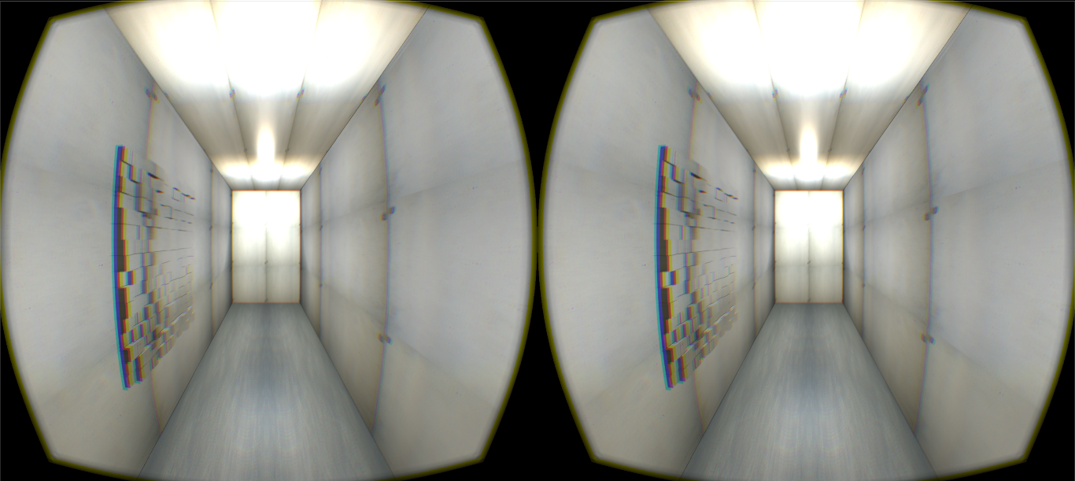
Empirical Evaluation
Example: MIT Media Lab’s shape-shifting table top simulated on the side of a wall.
Prior to expensive real-life prototyping, the concepts can be simulated in VR to explore the quality of their experience.

Slide 5
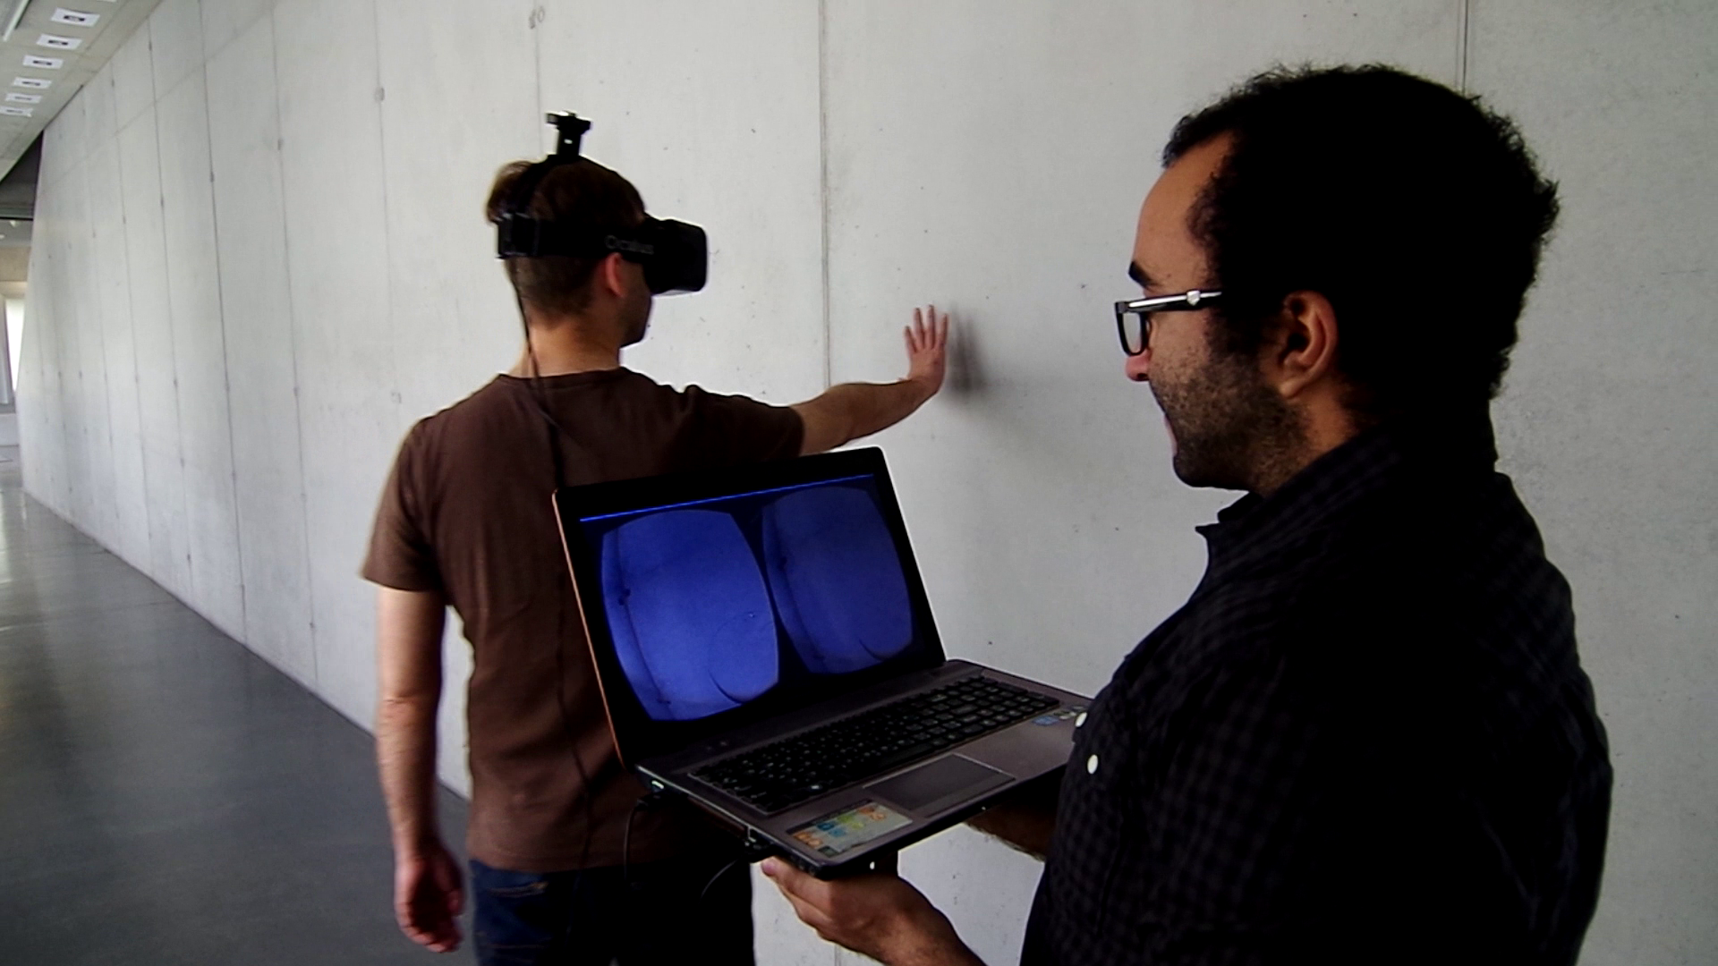
The end

