Slide 1
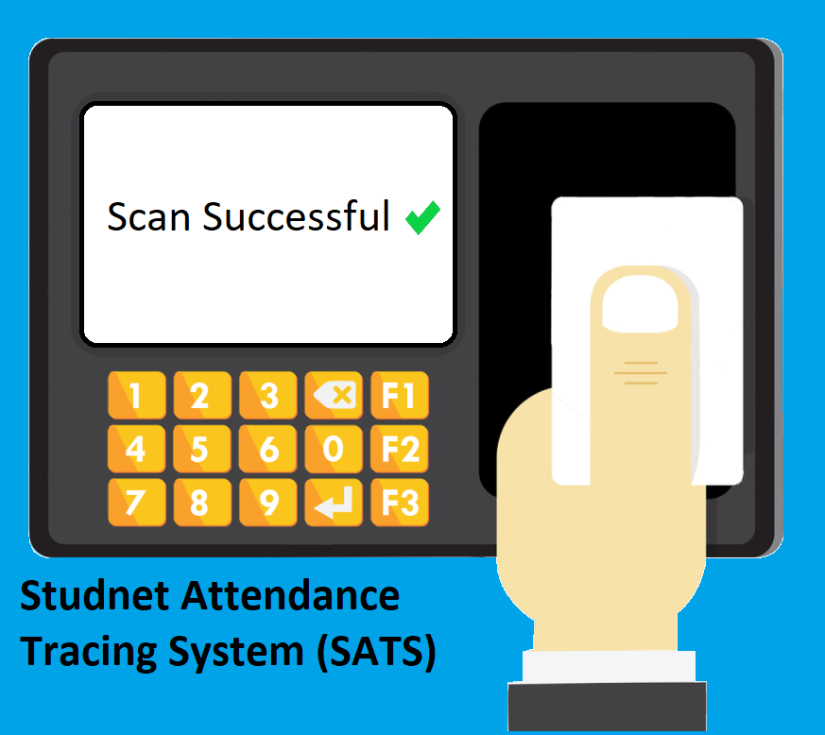
Student Attendance Tracking System (SATS)

Slide 2

Coordinator Hashem Bajabaa
Team Members
Skills : Java developer & Team Management
Member Abdulilah Alqasem
Skills : Java developer
Member Mohammad Zouman
Skills : Java developer
Member Abdulaziz Aldukhaiel
Skills : Java developer
Member Saleh Sawab
Skills : Java developer

Slide 3



Slides Content
Introduction To SATS
1
SATS Requirements
2
SATS Design
3
SATS Results
4
Team Contributions
5
Future Work And Conclusion
6

Slide 4



What is SATS ?
SATS is a system that organizes and improves the process of attendance tracking and monitoring in universities

Slide 5
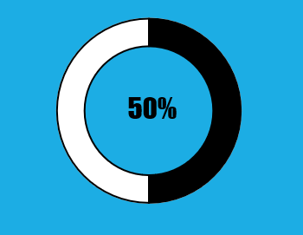


Motive
Assume that it takes 3 minutes to take attendance in the traditional way, and the semester is 16 weeks long that is 80 days excluding weekends, and every day you have 2 courses, then in one day it takes 6 minutes just for taking attendance, in the whole semester that is 80 days 480 minutes have been wasted just for taking attendance.
In SATS assuming that it takes 1 minute for the professor to start the system, then for the whole semester that is 80 days 240 minutes have been wasted just for taking attendance.
The percentage of saved time using SATS

Slide 6



Main Goals
Decreasing the time taken for attendance therefore increasing the time for teaching
Eliminating the chances of attending another student instead of the other
Taking the responsibility of the professors to students so they have full responsibility over their attendance

Slide 7

Why SATS is Important ?
Reducing the time taken form the lecture for attendance

Slide 8






Computer process input data from scanner
SATS Components
Excel file store and view data
Scanner scans badges and sends the data to the computer
Student badge used for the scan reader

Slide 9
Slides Content
Introduction To SATS
1
SATS Requirements
2
SATS Design
3
SATS Results
4
Team Contributions
5
Future Work And Conclusion
6

Slide 10



Database storing student's information First name, Last name and student ID.
SATS Functional Requirements
Compare and check when the scanner scan’s a badge the system checks the ID of the badge in the database.
Excel file compares the data from the scanning device with database, after it goes under a process, finally save it.

Slide 11


SATS Non-Functional Requirement
Database with good capacity to store all student's information.

Slide 12
Slides Content
Introduction To SATS
1
SATS Requirements
2
SATS Design
3
SATS Results
4
Team Contributions
5
Future Work And Conclusion
6

Slide 13
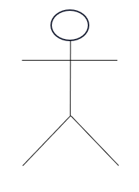

Start the system
Access student data
Use Case Diagram
It’s a representation of user interaction with the system in SATS.
View data
Professor
Professor can stop the system as optional
Scan badge
Student

Slide 14

Activity Diagram
Shows the activities involved when the system start scanning in SATS.

Slide 15

Start check(String ID)
Flowchart
ResultSet q=stmtatment.executeQuery(“SELECT id FROM student”);
False
q.next()
Shows the details of the checkByID(String id) method that manipulate the database.
True
DBid==ID
False
True
Return True
Return False

Slide 16
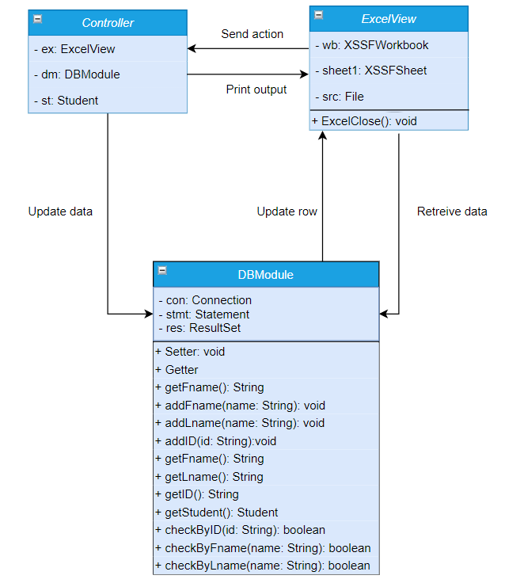

SATS Architectural Pattern
MVS pattern implementation

Slide 17
Slides Content
Introduction To SATS
1
SATS Requirements
2
SATS Design
3
SATS Results
4
Team Contributions
5
Future Work And Conclusion
6

Slide 18
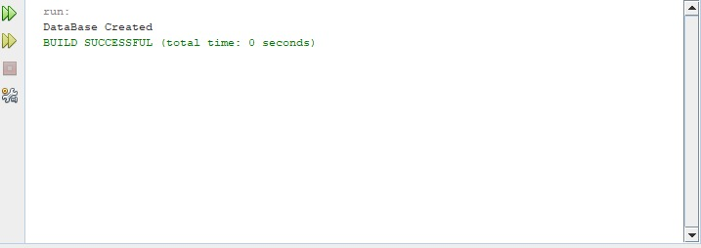
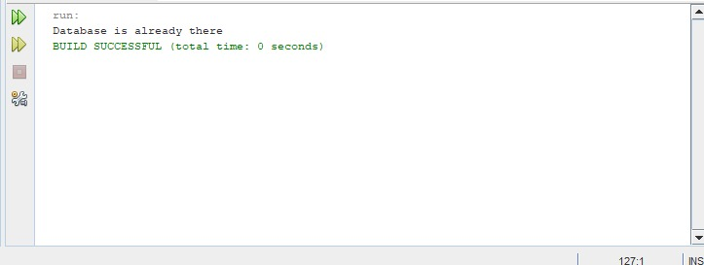
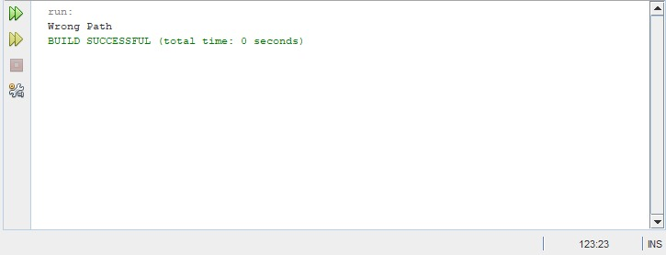
Public void created(String Path)
Results
Database Path
jdbc:sqlite:info.db
Functional Requirement Database
Database Path
jdbc:sqlite:info.db
Database Path
Jdbc:sqlitfe:ignfo.d

Slide 19
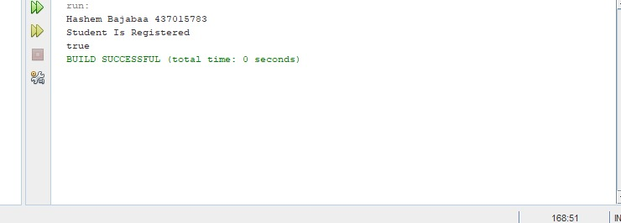
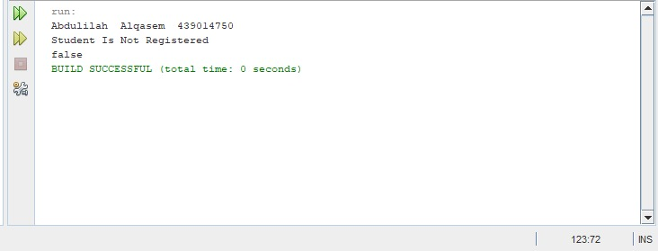
Public Boolean checkStudent(String id, String fname, String lname)
Results
437015783, Hashem, Bajabaa
First Input From Scan Reader
Functional Requirement Compare and check
Second Input From Scan Reader
439014750, Abdulialh, Alqasem

Slide 20
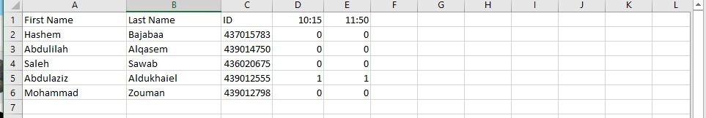
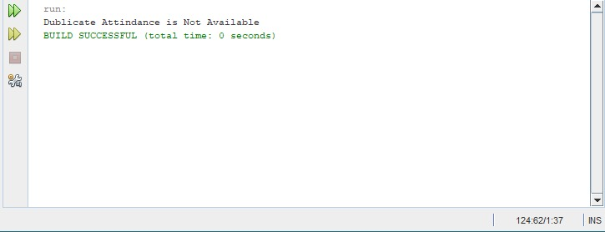
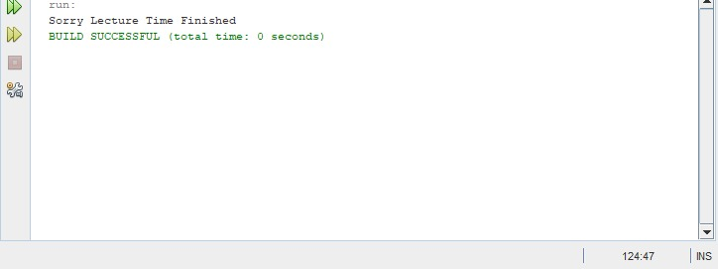
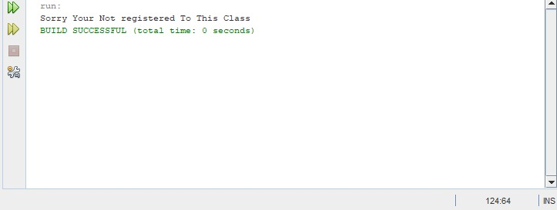
Public void attendByID(string id, Time scanningTime)
Results
First Input: 439012555, 10:15
Second Input: 439012555, 10:16
Functional Requirement
Excel file
Third Input: 436020675, 12:00
Fourth Input: 439012454, 10:20

Slide 21
Slides Content
Introduction To SATS
1
SATS Requirements
2
SATS Design
3
SATS Results
4
Team Contributions
5
Future Work And Conclusion
6

Slide 22
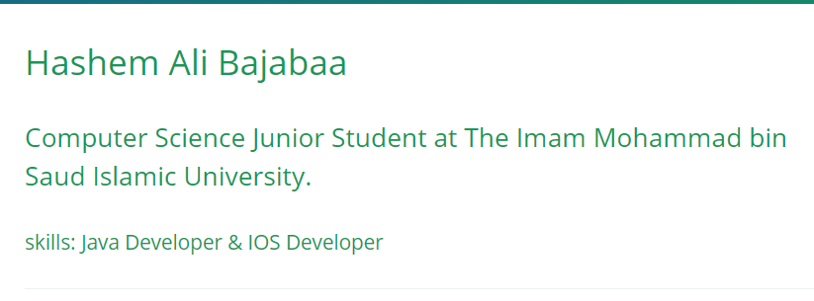
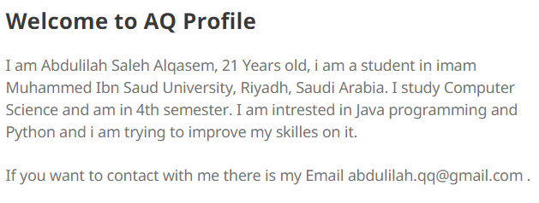

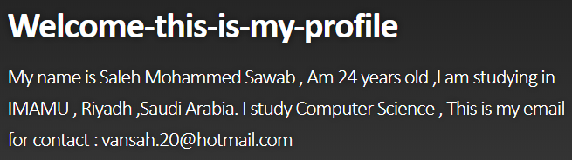
GitHub Pages

Slide 23
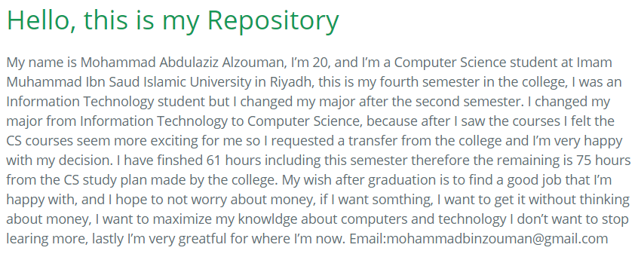
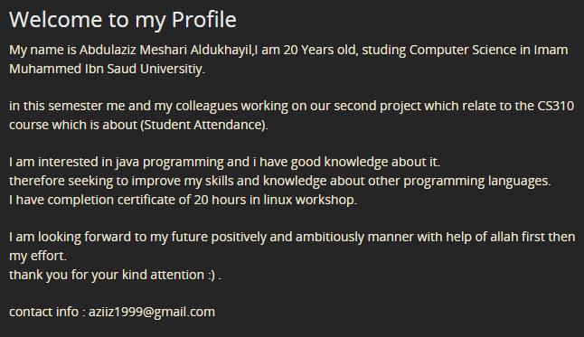
GitHub Pages

Slide 24

Team Contributions
#0
Introduction
Project Overview
Project Organization
Management Process
#1
Introduction
General Description
Specific Requirements
Conclusion
#2
Introduction
System Architecture
High Level And Low-Level Design
Conclusion
#3
Introduction
Requirements
Hashem Bajabaa
Abdulaziz Aldukhaiel
Abdulilah Alqasem
Mohammad Zouman
Saleh Sawab
Design
Results

Slide 25
Slides Content
Introduction To SATS
1
SATS Requirements
2
SATS Design
3
SATS Results
4
Team Contributions
5
Future Work And Conclusion
6

Slide 26



Upgrading the scan reader from connecting to the computer over a USB cable to a
Wi-Fi connection
Future Work
Upgrading the scan reader from connecting to the computer over a USB cable to a
Wi-Fi connection.
SATS currently use a type of database that is accessed only from one computer, upgrading the database over servers to cover all classrooms in the university.
Make the system independent without using excel software and create our own software to attend and track students.

Slide 27

Conclusion
SATS aims to make professors concentrate on just teaching and educating students not to waste the limited valuable time of lectures, and make the students have full responsibility over their attendance.

Slide 28


