Slide 1
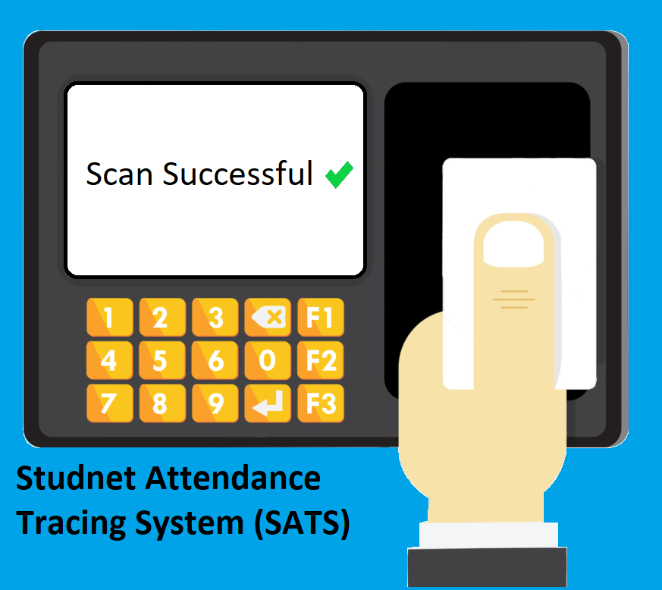

Slide 2

Leader Hashem Bajabaa
Team Members
Skills : Java developer & IOS deveolper
Member Abdulilah Alqasem
Skills : Java developer
Member Mohammad Zouman
Skills : Java developer
Member Abdulaziz Aldukhaiel
Skills : Java developer
Member Saleh Sawab
Skills : Java developer

Slide 3



Slides Content
Introduction To SATS
1
Introduction To SATS
2
Introduction To SATS
3
Introduction To SATS
4
Introduction To SATS
5
Introduction To SATS
6

Slide 4



What is SATS ?
SATS is a system that organizes and improves the process of attendance tracking and monitoring in universities

Slide 5
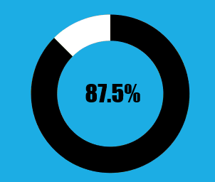


Motive
Assume that it takes 8 minutes to take attendance in the traditional way, and the semester is 16 weeks long that is 80 days excluding weekends, and every day you have 3 courses, then in one day it takes 24 minutes just for taking attendance, in the whole semester that is 80 days 1920 minutes have been wasted just for taking attendance.
In SATS assuming that it takes 1 minute for the professor to start the system, then for the whole semester that is 80 days 240 minutes have been wasted just for taking attendance.
The percentage of saved time using SATS

