Slide 1
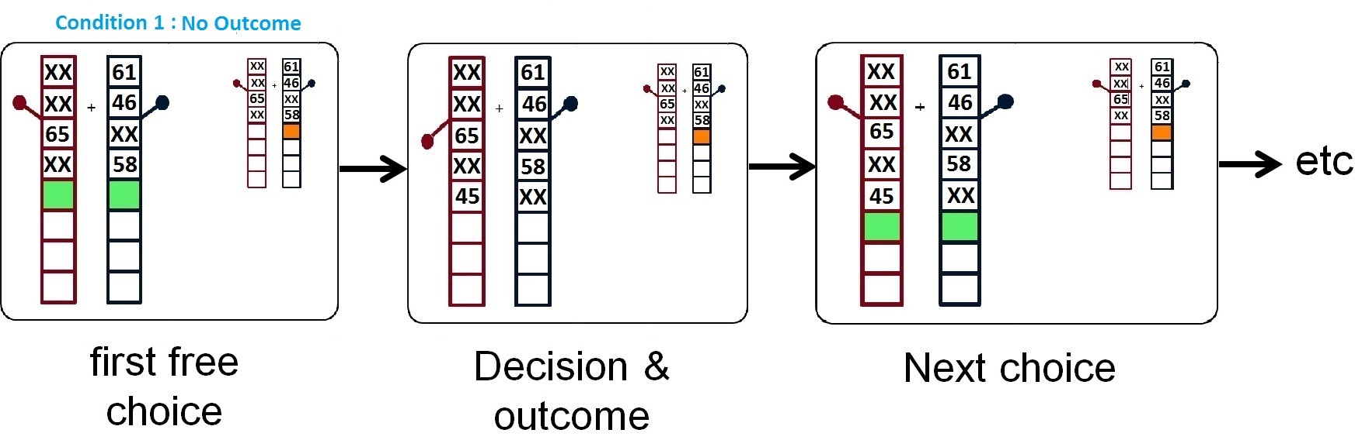
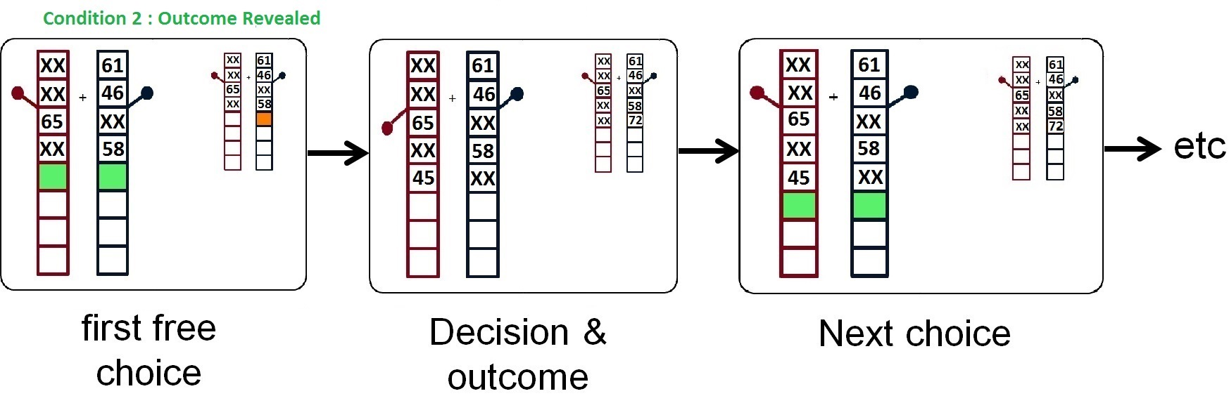
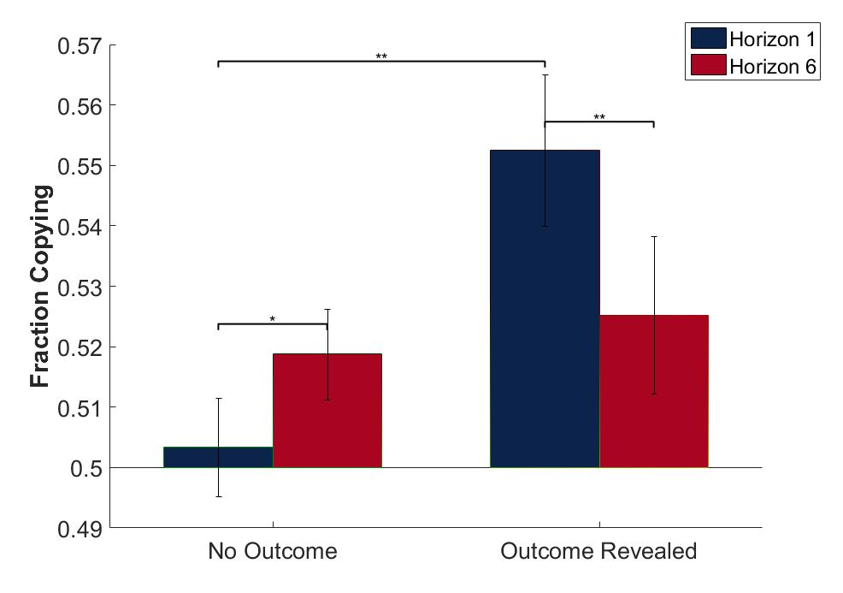
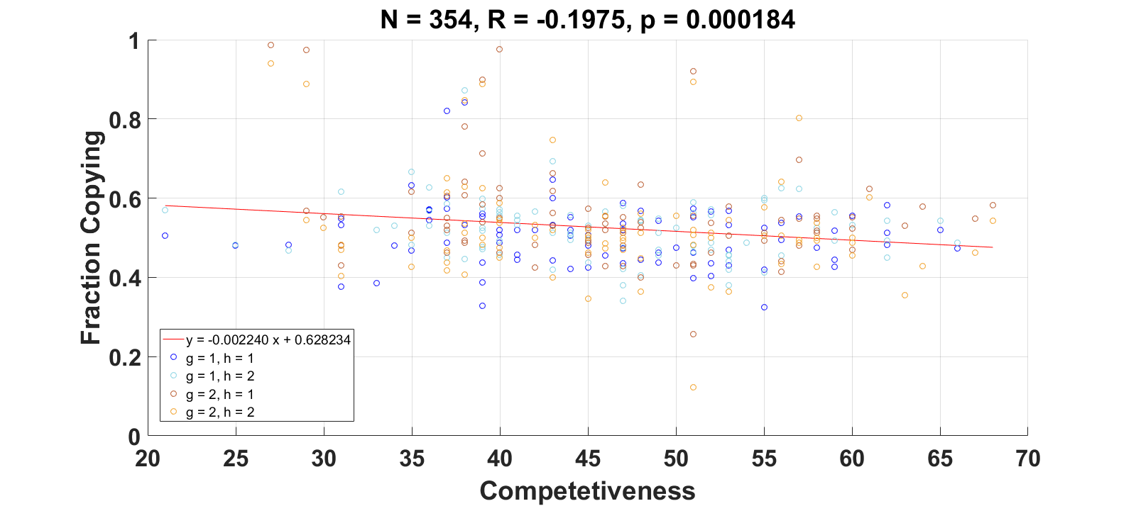
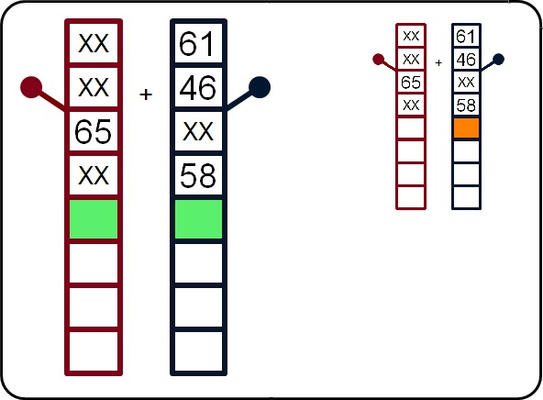
The social influence on explore-exploit decisions
Hashem Sadeghiyeh, Siyu Wang, and Robert C. Wilson
Summary
Condition 1: No Outcome (N=94)
The explore-exploit dilemma:
explore to gain information?
exploit for immediate reward?
What other people do can help with the decision in two different ways
1. I can copy them, if I’m too lazy to make the decision for myself
2. I can do something different from them, to diversify the experience of the group
Hypothesis: balance between copying and diversifying will depend on whether I will ultimately see the outcome of their action
If I won’t see their outcome copying will be favored
If I will see their outcome, diversifying will be favored
When the other person’s outcome would remain hidden, subjects copied the other person more in long horizon than short one (more herding) that may reflect the fact that making the right choice is harder in long horizon.
Condition 2: Outcome Revealed (N=92)
When the other person’s outcome would be revealed, subjects copied the other person less in long horizon than short one (more diversification) which means that subjects preferred to get more information by choosing the opposite option when there were future opportunities to use them.
Task
Original Horizon Task:
Choose between two slot machines to maximize reward
Rewards come from Gaussian distributions with unknown means
p(r | m_{i})
XX
61
Results
Focus on first choice.
XX
+
46
The more competitive you are, the less likely you are to copy others
Before first choice, participants see four example trials. Precisely controls what they know
65
XX
XX
58
Social Horizon Task:
Social information about actions of another person presented on the right
Social information only given on first free-choice trial

