Slide 3
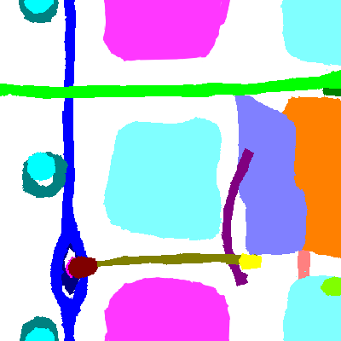
1-BVG 2-AVG
3-GC 4-MCC
5-SPL 6-OFT1
7-OFT2 8-BVS1
9-BVS2 10-BVS3
11-AVC1 12-AVC2
13-PEO 14-SVPL
15-SVPR 16-ALVR
17-LSV 18-RSV

Slide 4
1-Bulbo-Ventricular Groove (BVG)
2-Atrio-Ventricular Groove (AVG)
3-Groove Channel (GC)
4-Meso-Cardium Connection (MCC)
5-SPL forming connection (SPL)
6-OutFlow Tract cushions (OFT1)
7-OutFlow Tract poles (OFT2)
8-Bulbo-Ventricular Septum Ring (BVS1)
9-Bulbo-Ventricular Septum Region (BVS2)
10-Bulbo-Ventricular Septum (BVS3)
11-Atira-Ventricular Canal Ring (AVC1)
12-Atira-Ventricular Canal Cushion (AVC2)
13-Pro-Epicardial Organ (PEO)
14-Sinous Venosous Pole Left (SVPL)
15-Sinous Venosous Pole Right (SVPR)
16-Atria Left Venosous Ring (ALVR)
17-Left Side of Ventricle (LSV)
18-Right Side of Ventricle (RSV)

Slide 5
1-Bulbo-Ventricular Groove (BVG)
2-Atrio-Ventricular Groove (AVG)
3-Groove Channel (GC)
4-Meso-Cardium Connection (MCC)
5-SPL forming connection (SPL)
6-OutFlow Tract cushions (OFT1)
7-OutFlow Tract poles (OFT2)
8-Bulbo-Ventricular Septum Ring (BVS1)
9-Bulbo-Ventricular Septum Region (BVS2)
10-Bulbo-Ventricular Septum (BVS3)
11-Atira-Ventricular Canal Ring (AVC1)
12-Atira-Ventricular Canal Cushion (AVC2)
13-Pro-Epicardial Organ (PEO)
14-Sinous Venosous Pole Left (SVPL)
15-Sinous Venosous Pole Right (SVPR)
16-Atria Left Venosous Ring (ALVR)
17-Left Side of Ventricle (LSV)
18-Right Side of Ventricle (RSV)
1
2
3
4
5
6
7
8
9
10
11
12
13
14
15
16
17
18

Slide 6
Stage10
1-Bulbo-Ventricular Groove (BVG)
2-Atrio-Ventricular Groove (AVG)
3-Groove Channel (GC)
4-Meso-Cardium Connection (MCC)
5-SPL forming connection (SPL)
6-OutFlow Tract cushions (OFT1)
7-OutFlow Tract poles (OFT2)
8-Bulbo-Ventricular Septum Ring (BVS1)
9-Bulbo-Ventricular Septum Region (BVS2)
10-Bulbo-Ventricular Septum (BVS3)
11-Atira-Ventricular Canal Ring (AVC1)
12-Atira-Ventricular Canal Cushion (AVC2)
13-Pro-Epicardial Organ (PEO)
14-Sinus Venosus Left Pole (SVLP)
15-Sinus Venosus Right Pole (SVRP)
16-Atria Left Venosus Ring (ALVR)
17-Left Side of Ventricle (LSV)
18-Right Side of Ventricle (RSV)
OFT1
OFT2
RSV
SVRP
MCC
PEO
OFT1
SVLP
LSV
AVC2
OFT2
BVS1
AVC1
BVS3
GC
BVG
AVG
ALVR
BVS2
SPL
OFT2
RSV
SVRP
OFT1
1
2
3
4
5
6
7
8
9
10
11
12
13
14
15
16
17
18

Slide 7
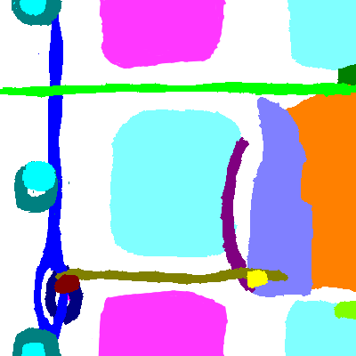
Stage11
1-Bulbo-Ventricular Groove (BVG)
2-Atrio-Ventricular Groove (AVG)
3-Groove Channel (GC)
4-Meso-Cardium Connection (MCC)
5-SPL forming connection (SPL)
6-OutFlow Tract cushions (OFT1)
7-OutFlow Tract poles (OFT2)
8-Bulbo-Ventricular Septum Ring (BVS1)
9-Bulbo-Ventricular Septum Region (BVS2)
10-Bulbo-Ventricular Septum (BVS3)
11-Atira-Ventricular Canal Ring (AVC1)
12-Atira-Ventricular Canal Cushion (AVC2)
13-Pro-Epicardial Organ (PEO)
14-Sinus Venosus Left Pole (SVLP)
15-Sinus Venosus Right Pole (SVRP)
16-Atria Left Venosus Ring (ALVR)
17-Left Side of Ventricle (LSV)
18-Right Side of Ventricle (RSV)
OFT1
OFT2
RSV
SVRP
PEO
MCC
BVS1
SVLP
OFT1
LSV
AVC2
OFT2
AVC1
GC
BVS3
BVG
AVG
ALVR
BVS2
SPL
OFT2
RSV
SVRP
OFT1
1
2
3
4
5
6
7
8
9
10
11
12
13
14
15
16
17
18

Slide 8
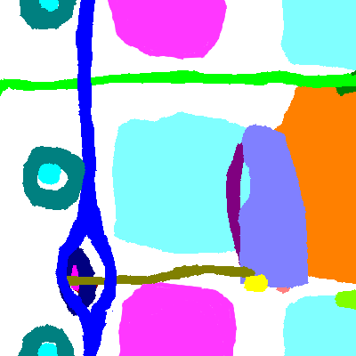
Stage12
1-Bulbo-Ventricular Groove (BVG)
2-Atrio-Ventricular Groove (AVG)
3-Groove Channel (GC)
4-Meso-Cardium Connection (MCC)
5-SPL forming connection (SPL)
6-OutFlow Tract cushions (OFT1)
7-OutFlow Tract poles (OFT2)
8-Bulbo-Ventricular Septum Ring (BVS1)
9-Bulbo-Ventricular Septum Region (BVS2)
10-Bulbo-Ventricular Septum (BVS3)
11-Atira-Ventricular Canal Ring (AVC1)
12-Atira-Ventricular Canal Cushion (AVC2)
13-Pro-Epicardial Organ (PEO)
14-Sinus Venosus Left Pole (SVLP)
15-Sinus Venosus Right Pole (SVRP)
16-Atria Left Venosus Ring (ALVR)
17-Left Side of Ventricle (LSV)
18-Right Side of Ventricle (RSV)
OFT1
OFT2
RSV
SVRP
MCC
PEO
BVS1
OFT1
SVLP
LSV
AVC2
OFT2
AVC1
BVG
BVS3
GC
AVG
BVS2
ALVR
SPL
OFT2
RSV
OFT1
SVRP
1
2
3
4
5
6
7
8
9
10
11
12
13
14
15
16
17
18

Slide 9
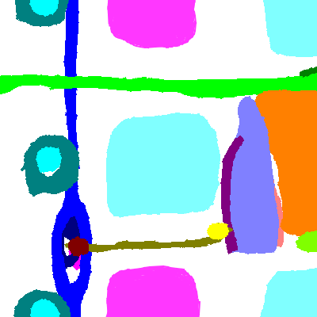
Stage13
1-Bulbo-Ventricular Groove (BVG)
2-Atrio-Ventricular Groove (AVG)
3-Groove Channel (GC)
4-Meso-Cardium Connection (MCC)
5-SPL forming connection (SPL)
6-OutFlow Tract cushions (OFT1)
7-OutFlow Tract poles (OFT2)
8-Bulbo-Ventricular Septum Ring (BVS1)
9-Bulbo-Ventricular Septum Region (BVS2)
10-Bulbo-Ventricular Septum (BVS3)
11-Atira-Ventricular Canal Ring (AVC1)
12-Atira-Ventricular Canal Cushion (AVC2)
13-Pro-Epicardial Organ (PEO)
14-Sinus Venosus Left Pole (SVLP)
15-Sinus Venosus Right Pole (SVRP)
16-Atria Left Venosus Ring (ALVR)
17-Left Side of Ventricle (LSV)
18-Right Side of Ventricle (RSV)
OFT1
SVRP
RSV
OFT2
BVS1
PEO
MCC
SVLP
OFT1
LSV
AVC2
OFT2
AVC1
ALVR
AVG
GC
BVS3
BVG
SPL
BVS2
OFT2
RSV
OFT1
SVRP
1
2
3
4
5
6
7
8
9
10
11
12
13
14
15
16
17
18

Slide 10
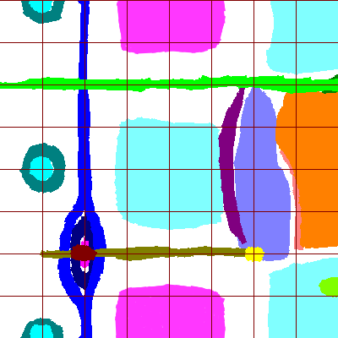
Stage14
1-Bulbo-Ventricular Groove (BVG)
2-Atrio-Ventricular Groove (AVG)
3-Groove Channel (GC)
4-Meso-Cardium Connection (MCC)
5-SPL forming connection (SPL)
6-OutFlow Tract cushions (OFT1)
7-OutFlow Tract poles (OFT2)
8-Bulbo-Ventricular Septum Ring (BVS1)
9-Bulbo-Ventricular Septum Region (BVS2)
10-Bulbo-Ventricular Septum (BVS3)
11-Atira-Ventricular Canal Ring (AVC1)
12-Atira-Ventricular Canal Cushion (AVC2)
13-Pro-Epicardial Organ (PEO)
14-Sinus Venosus Left Pole (SVLP)
15-Sinus Venosus Right Pole (SVRP)
16-Atria Left Venosus Ring (ALVR)
17-Left Side of Ventricle (LSV)
18-Right Side of Ventricle (RSV)
OFT1
OFT2
RSV
SVRP
BVS1
PEO
MCC
AVC1
SVLP
OFT1
LSV
AVC2
OFT2
GC
ALVR
BVS3
BVS2
BVG
AVG
SPL
OFT2
RSV
SVRP
OFT1
1
2
3
4
5
6
7
8
9
10
11
12
13
14
15
16
17
18

