Slide 1
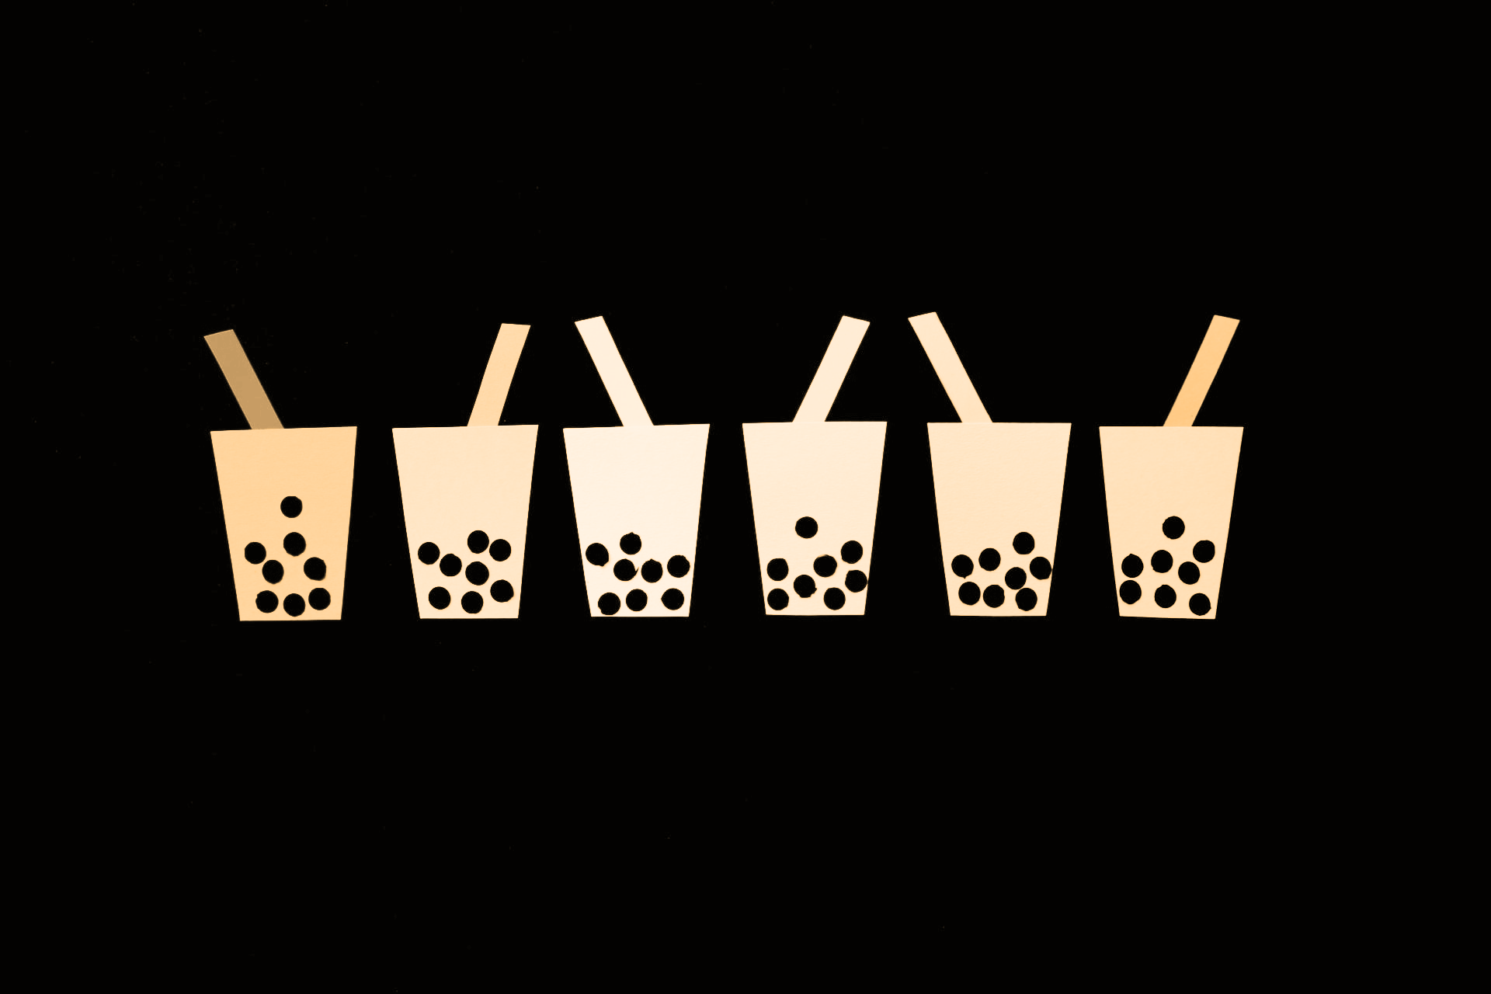
Best Bubble Tea in Toronto
By: H. Javed
Date: Feb 18, 2020

Slide 2
Problem Statement - Best Bubble Tea In Toronto
API Documentation
API Requests
Pandas DataFrame
Results
Challenge 3
Challenge 2

Slide 3
Results - Bubble Tea
Yelp
FourSquare
Name | Review Count | User Ratings
The Alley | 197 | 4.5
Tiger Sugar | 131 | 4
Tika Tea House | 93 | 3.5
Kung Fu Tea on Spadina | 82 | 4
Baroness | 40 | 4.5
Yi Fang Taiwan Fruit Tea | 37 | 4
Tea Land | 35 | 3.5
YGO Lab | 30 | 4.5
The Krys Milktea Bar | 10 | 4
Cuppa Tea | 10 | 3
Name | Review Count | User Ratings
Tsaa Tea Shop | 39 | 7.3
Chatime | N/A | N/A
Cuppa Tea | N/A | N/A
Chatime | N/A | N/A
Chatime | N/A | N/A
Chatime | N/A | N/A
For the Win Cafe | 15 | 8.4
Chatime | N/A | N/A
Chatime | N/A | N/A

Slide 4
Results - Sushi
Tag - “Japanese”
Tag - “Sushi”
Name | Review Count | User Ratings
Millie Creperie | 363 | 4
Touhenboku Ramen Restaurant | 295 | 3.5
Kasa Moto | 233 | 3.5
Film Cafe by Eative | 143 | 3.5
Gushi Japanese Street Food | 106 | 4
Uncle Tetsu's Japanese Cheesecake | 53 | 3.5
Name | Review Count | User Ratings
Kasa Moto | 233 | 3.5
Rolltation | 215 | 4
Poke Eats | 129 | 4

Slide 5
Yelp - Outstanding Winner
5000 free calls/ month
Significantly better quality data
Ease of use
Foursquare had better API documentation

Slide 6
More Time:
Questions?
Explore creating database in SQLite

