Slide 1
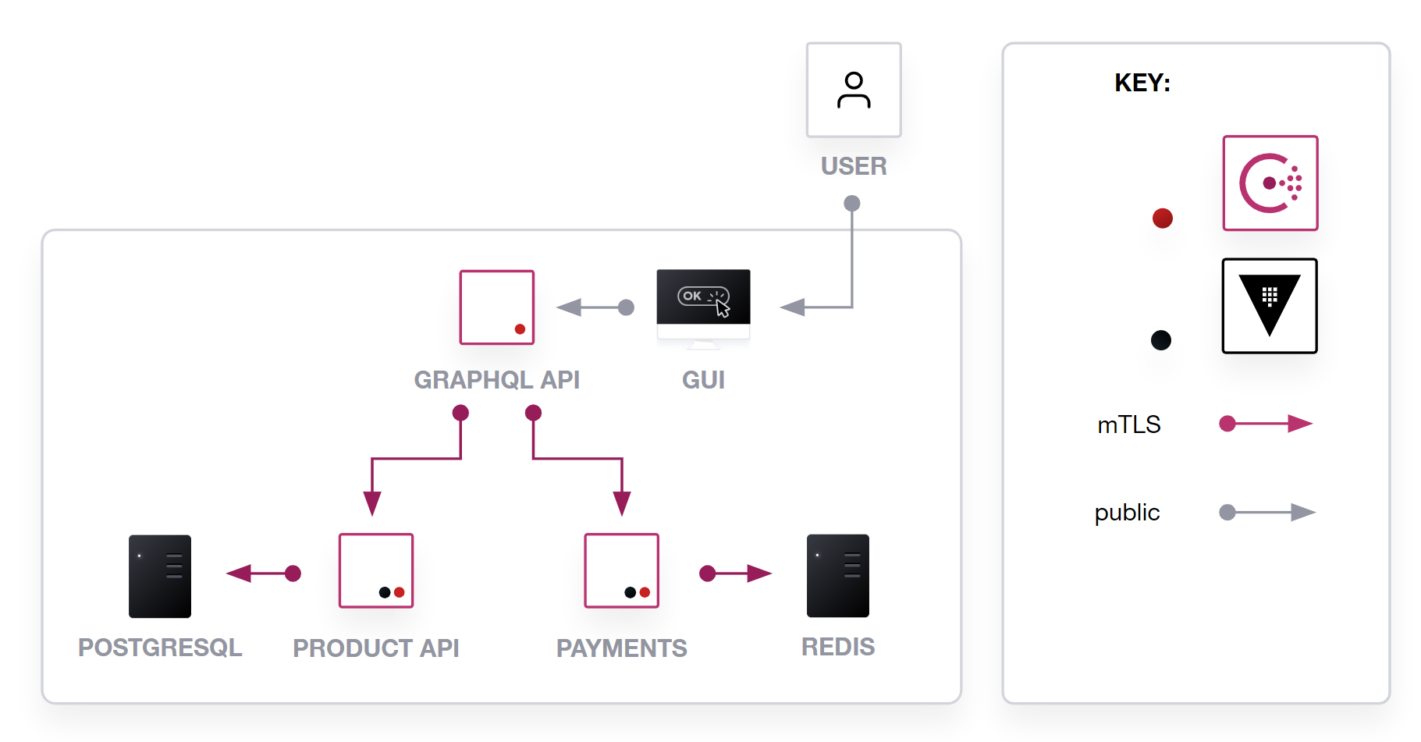
PUBLIC API
FRONTEND

Slide 2
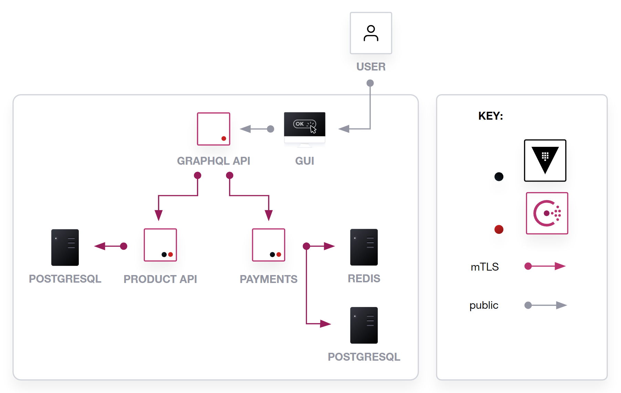
PUBLIC API
FRONTEND

