Slide 1
W601 Antipinch Window Regulator Testing Sequence on EOL
Mohan Ranga
Synedyne Systems
04-01-2021

Slide 2
W601 Antipinch Window Regulator Testing Sequence on EOL
Max. 2 Seconds
Max. 15 Seconds
Stall duration Max. 0.5 Seconds
Bring to Shipping position
Pre-Sequence Automated Flashing
(This feature shall be selectable by software)
Carrier plate reached TDC by UP command
Post-Sequence Automated Flashing
(This feature shall be selectable by software)
Max. 4 Seconds
Speed, Running Current, Stall Current
Pinch Force
Max. 5 Seconds
Speed, Running Current, Stall Current
Max. 4 Seconds
Pinching
Max. 2 Seconds
DUT
Tagging
Max. 3 Seconds
Antipinch Reversal
Stall duration Max. 0.5 Seconds
Stall duration Max. 0.5 Seconds
Reversal Distance
Max. 15 Seconds
Wreg is mounted and load is engaged
Carrier plate reached BDC by DOWN command
Wreg load is dis-engaged
<Measurements to be done>

Slide 3
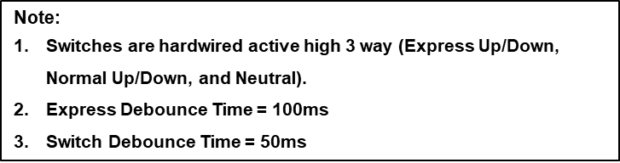
Antipinch Window Regulator Switch Control Logic (Flow Chart)
W601 Switch Logic | Additional Details
Up Operation Switch Logic Down Operation Switch Logic
Manual Up
> Express_Debounce_Time
Function | Type of Signal | Debounce Time | Voltage for Sense(Switch Voltage)
Express Roll Up | Hardwired Active High Signal (3-Way Switch) | ≥ Switch_Debounce_Time & ≤ Express_Debounce_Time | >8V
Express Roll Down | Hardwired Active High Signal (3-Way Switch) | ≥ Switch_Debounce_Time & ≤ Express_Debounce_Time | >8V
Normal Roll Up | Hardwired Active High Signal (3-Way Switch) | > Express_Debounce_Time | >8V
Normal Roll Down | Hardwired Active High Signal (3-Way Switch) | > Express_Debounce_Time | >8V
Manual Up
Up Switch Signal
> 8 V – Switch ON
Express Up
< 1.2 V – Switch OFF
Up Switch Signal (Express Up)
≥ Switch_Debounce_Time & ≤ Express_Debounce_Time
> 8 V – Switch ON
< 1.2 V – Switch OFF
Down Switch Signal
> 8 V – Switch ON
< 1.2 V – Switch OFF
Description | Default Value | Resolution | Range
Switch_Debounce_Time | 50 ms | 10ms | 1-500ms
Express_Debounce_Time | 100ms | 10ms | 1-5000ms
Manual Down
> Express_Debounce_Time
Manual Down
Down Switch Signal
> 8 V – Switch ON
Express Down
< 1.2 V – Switch OFF
Down Switch Signal (Express Down)
≥ Switch_Debounce_Time & ≤ Express_Debounce_Time
> 8 V – Switch ON
< 1.2 V – Switch OFF
Up Switch Signal
> 8 V – Switch ON
< 1.2 V – Switch OFF

Slide 4
Antipinch Window Regulator Switch Control Logic (Clarification questions)
Any initialization
Any inching movement
Any deinitialization
How can we differentiate express up and normal up & for the down command as well.
For the ant pinch up which command should we give.

Slide 5
Switch Debounce Time
Express Debounce Time
> Express Debounce Time
Manual Up
Manual Up
> 8 V – Switch ON
Up Switch Signal
< 1.2 V – Switch OFF
Express Up
Up Switch Signal (Express Up)
> 8 V – Switch ON
≥ Switch _ De-bounce _ Time
≤ Express _ De-bounce _ Time
< 1.2 V – Switch OFF
> 8 V – Switch ON
Down Switch Signal
< 1.2 V – Switch OFF

