Slide 1

1929- PY1B
[Customer Name]
25th November, 2020

Slide 2
Contents
Ant pinch control strategy
Medtronic's video for ventilator basics
Medtronic's clinician manual overview
Requirement documentation
Alarm screen-141

Slide 3
EOL program modification for PY1B SW5.2.0 testing sequence
Cycle Time Sequence
Trigger{Down(H),Up(H)--- Down(L)+Up(L) }
Automatic current cut off
Load cell measurement
Switch based De-Initialization
TDC
Pinch Force Measurement
Inching Movements(Manual UP)
Shipping Position
?
?
Auto Down
Manual Down
Manual UP
Delay
Auto UP
?
BDC
Dead Weight Loading
Delay
Dead Weight Release and Factory Mode Verification
Delay
Trigger{Up(H) ,Down(H), --- Down(L)+Up(L) }

Slide 4
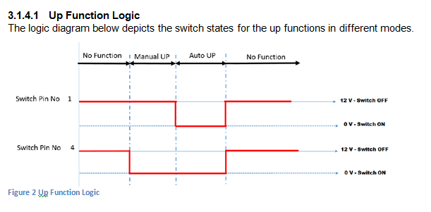
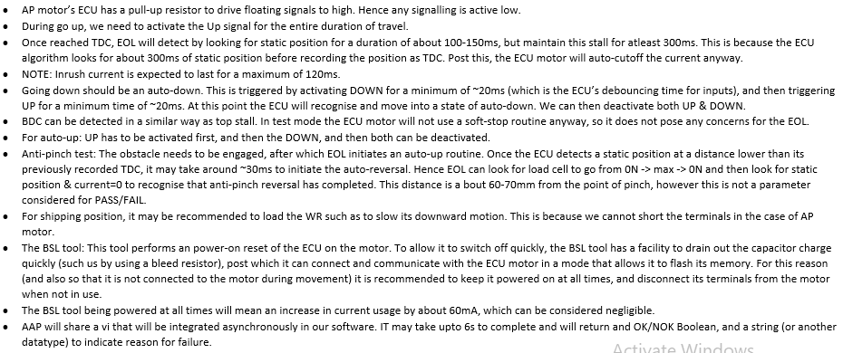
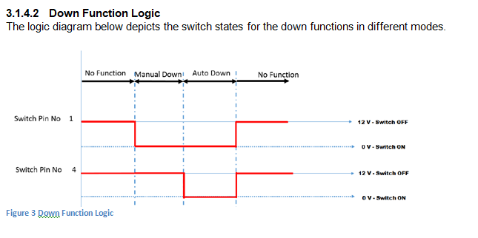
BSL flash and initialization details
DOWN pin
UP pin
DOWN pin
UP pin

Slide 5
Cycle Time Sequence for the standard WR
Load cell measurement
Delay
TDC
Go up (Loaded)
Shipping Position
Shipping posiition
Homing
BDC
Delay
Delay

Slide 6
Test sequence
Load dn
Load up

Slide 7
Test sequence

Slide 8
Test sequence

Slide 9
Test sequence

Slide 10
Test sequence

Slide 11
Test sequence

Slide 12
Test sequence

Slide 13
Test sequence

Slide 14
Test sequence

Slide 15
Test sequence

Slide 16
Test sequence

Slide 17
Shipping position

Slide 18
Shipping position
SP

Slide 19
Shipping position
SP

Slide 20
Test sequence

Slide 21
Test sequence

Slide 22
Test sequence

Slide 23
Test sequence

Slide 24
Test sequence

Slide 25
Test sequence

Slide 26
After Cycle Time Sequence 68Sec
Process Steps | Time Duration
Part loading + Connect the wiring harness + Start button | 13
Carrier plate moves from Shipping position to BDC and Dead Weight Loading | 5
Inching Movement from BDC to TDC and Calibration Cycle from TDC to BDC | 8
From BDC to Pinch force position, from pinch force position to BDC | 6
Move Up to TDC and perform Switch Based De-Initialization and Move to BDC | 6
Factory Mode Verification (Interlock) | 15
Dead Weight Release and moving from BDC to shipping position | 5
Remove wiring harness from motor, take out window regulator from fixture and place it to stand | 10
Total

Slide 27
Testing SequencE
After EOL check is complete, following steps have to be followed in order to de-initialize:
1. Take the carrier plate to the top and stall. 1 Sec
2. Once stalled in the top, give 10 manual up commands. 2 Sec
3. Followed by 10 automatic up commands. 2 Sec
4. The carrier plate will move down a short distance as an acknowledgement to the de-initialization command. 2 Sec
Note:
1. The gap between consecutive commands shall be within 30-50 ms.
2. The duration to complete the de-initialization shall be under 3 seconds.

Slide 28
BSL flash and initialization details
DOWN pin
UP pin
DOWN pin
UP pin

Slide 29
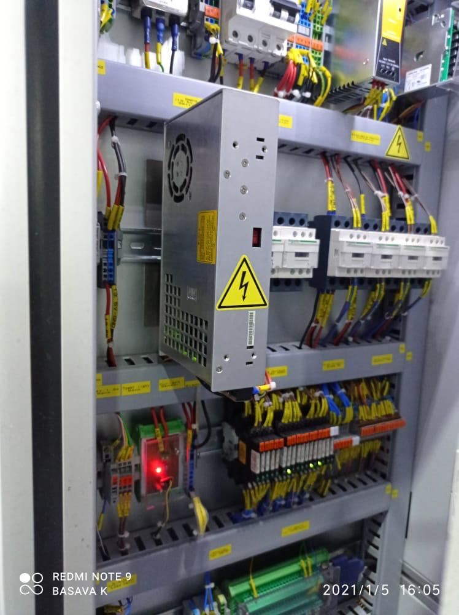
Installation diagram
IPC
24V
USB
13.5V
BSL
ECU
1
2
3
4
A2
A2
+
-
+
-
L
DO35,17
i/p
o/p
UP, DN releays
DOs

Slide 30
Installation diagram
IPC
24V
USB
13.5V
BSL
ECU
1
2
3
4
A2
: Mount the relays
Make space in the din rale
Mount the relays in the appropriate order
+
-
+
-
L
i/p
o/p
DOs

Slide 31
Installation diagram
IPC
24V
USB
13.5V
BSL
ECU
1
2
3
4
A2
: Mount the relays
Make space in the din rale
Mount the relays in the appropriate order
+
-
+
-
L
D releays
i/p
o/p
UPreleays
DOs

Slide 32
Installation diagram
IPC
24V
USB
13.5V
BSL
ECU
1
2
3
4
A2
: Stick the 4 TBs
Make space in the din rale
Mount the TBs in the appropriate color
+
-
+
-
L
D releays
i/p
o/p
UPreleays
DOs

Slide 33
Installation diagram
IPC
24V
USB
13.5V
BSL
ECU
1
2
3
4
A2
: Stick the BSL tool
Confirm the location
Cut the double side tap
Mark the location
Stick it
+
-
+
-
L
D releays
i/p
o/p
UPreleays
DOs

Slide 34
Installation diagram
IPC
24V
USB
13.5V
BSL
ECU
1
2
3
4
A2
: Contactor 2_1L1 - ECU_1L1
Choose the wire dimeter =
Confirm the wire path in cable tray
Confirm the length of the cable
Cut the cable accordingly
Confirm the second pin of 1L1 is already used or not
Confirm if we want to use twin leg
Luging and crimping
Wiring
+
-
+
-
L
D releays
i/p
o/p
UPreleays
DOs

Slide 35
Installation diagram
IPC
24V
USB
13.5V
BSL
ECU
1
2
3
4
A2
: Contactor 2_3L2 - ECU_3L2
Choose the wire dimeter =
Confirm the wire path in cable tray
Confirm the length of the cable
Cut the cable accordingly
Confirm the second pin of 3L2 is already used or not
Confirm if we want to use twin leg
Luging and crimping
Wiring
+
-
+
-
L
D releays
i/p
o/p
UPreleays
DOs

Slide 36
Installation diagram
IPC
24V
USB
13.5V
BSL
ECU
1
2
3
4
A2
: Connection ECU_1L1 - BSL _1L1
Choose the wire dimeter =
Confirm the wire path in cable tray
Confirm the length of the cable
Cut the cable accordingly
Confirm the second pin of ECU_1L1 is already used or not
Confirm if we want to use twin leg
Luging and crimping
Wiring
+
-
+
-
L
D releays
i/p
o/p
UPreleays
DOs

Slide 37
Installation diagram
IPC
24V
USB
13.5V
BSL
ECU
1
2
3
4
A2
: Connection ECU_3L2 - BSL_3L2
Choose the wire dimeter =
Confirm the wire path in cable tray
Confirm the length of the cable
Cut the cable accordingly
Confirm the second pin of ECU_3L2 is already used or not
Confirm if we want to use twin leg
Luging and crimping
Wiring
+
-
+
-
L
D releays
i/p
o/p
UPreleays
DOs

Slide 38
Installation diagram
IPC
24V
USB
13.5V
BSL
ECU
1
2
3
4
A2
A2
:24 GND – BSL_A2, ECU_A2
Confirm the wire path in cable tray
Confirm the length of the cable
Confirm the short cable length
Cut the cable accordingly
Luging and crimping
Wiring
+
-
+
-
L
D releays
i/p
o/p
UPreleays
DOs

Slide 39
Installation diagram
IPC
24V
USB
13.5V
BSL
ECU
1
2
3
4
A2
A2
:24 volts – BSL_21NC
Confirm the wire path in cable tray
Confirm the length of the cable
Cut the cable accordingly
Luging and crimping
Wiring
+
-
+
-
L
D releays
i/p
o/p
UPreleays
DOs

Slide 40
Installation diagram
IPC
24V
USB
13.5V
BSL
ECU
1
2
3
4
A2
A2
:Dio18- BSLA1
Confirm the wire path in cable tray
Confirm the length of the cable
Cut the cable accordingly
Luging and crimping
Wiring
+
-
+
-
L
D releays
i/p
o/p
UPreleays
DOs

Slide 41
Installation diagram
IPC
24V
USB
13.5V
BSL
ECU
1
2
3
4
A2
A2
:ECU2T1- TB +ve, ECU4T2- TB -ve,
Confirm the wire path in cable tray
Confirm the length of the cables
Cut the cables accordingly
Put masking tap to make it bunch
Luging and crimping
Wiring in the correct order
+
-
+
-
L
D releays
i/p
o/p
UPreleays
DOs

Slide 42
Installation diagram
IPC
24V
USB
13.5V
BSL
ECU
1
2
3
4
A2
A2
:BSL2T1- BSL tool +ve, BSL4T2- BSL tool -ve,
Confirm the wire path in cable tray
Confirm the length of the cables
Cut the cables accordingly
Put masking tap to make it bunch
Luging and crimping
Wiring in the correct order
+
-
+
-
L
D releays
i/p
o/p
UPreleays
DOs

Slide 43
Installation diagram
IPC
24V
USB
13.5V
BSL
ECU
1
2
3
4
A2
A2
:BSL out put- +TB, -TB, Lin
Confirm the wire path in cable tray
Confirm the length of the cable
Cut the cables accordingly
Put masking tap to make it bunch
Luging and crimping
Wiring in the correct order
+
-
+
-
L
D releays
i/p
o/p
UPreleays
DOs

Slide 44
Installation diagram
IPC
24V
USB
13.5V
BSL
ECU
1
2
3
4
A2
A2
:DO17-DN Relay A1
Choose the wire dimeter =
Confirm the wire path in cable tray
Confirm the length of the cable
Cut the cables accordingly
Luging and crimping
Wiring
+
-
+
-
L
D releays
DO35,17
i/p
o/p
UPreleays
DOs

Slide 45
Installation diagram
IPC
24V
USB
13.5V
BSL
ECU
1
2
3
4
A2
A2
:DO35-UP Relay A1
Choose the wire dimeter =
Confirm the wire path in cable tray
Confirm the length of the cable
Cut the cables accordingly
Luging and crimping
Wiring
+
-
+
-
L
D releays
DO35,17
i/p
o/p
UPreleays
DOs

Slide 46
Installation diagram
IPC
24V
USB
13.5V
BSL
ECU
1
2
3
4
A2
A2
:24V GND-UP Relay A2 short with DN relay A2
Choose the wire dimeter =
Confirm the wire path in cable tray
Confirm the length of the cable
Confirm the shorting cable length
Cut the cables accordingly
Luging and crimping
Wiring
+
-
+
-
L
DO35,17
i/p
o/p
UP, DN releays
DOs

Slide 47
Installation diagram
IPC
24V
USB
13.5V
BSL
ECU
1
2
3
4
A2
A2
:13.5V-UP Relay 11 short with DN relay 11
Choose the wire dimeter =
Confirm the wire path in cable tray
Confirm the length of the cable
Confirm the shorting cable length
Cut the cables accordingly
Luging and crimping
Wiring
+
-
+
-
L
DO35,17
i/p
o/p
UP, DN releays
DOs

Slide 48
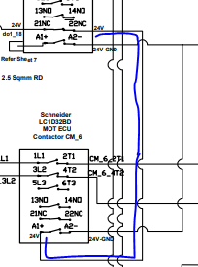
Installation diagram
IPC
24V
USB
13.5V
BSL
ECU
1
2
3
4
A2
A2
:BSL_22NC-ECU_A1
Choose the wire dimeter =
Confirm the wire path in cable tray
Confirm the length of the cable
Cut the cable accordingly
Luging and crimping
Wiring
+
-
+
-
L
DO35,17
i/p
o/p
UP, DN releays
DOs

Slide 49
Installation diagram
IPC
24V
USB
13.5V
BSL
ECU
1
2
3
4
A2
A2
:Ant pinch cable and BSL USB cable
Confirm the routing path
Wiring
+
-
+
-
L
DO35,17
i/p
o/p
UP, DN releays
DOs

Slide 51
Contents
Electronics study for the project
Station identification
Medtronic's clinician manual overview
Requirement documentation

Slide 52
I2c communication
Station 1 : Coin singling
Station 2 :
Station 3 :
Station 4 :

Slide 53
Contents
Electronics study for the project
Medtronic's video for ventilator basics
Medtronic's clinician manual overview
Requirement documentation

